Slide 1
Open Educational Resources (OER) in Practice: Campus OER/Zero-Textbook-Cost (ZTC) Program Spotlights from Across the Spectrum
This work is licensed under a Creative Commons Attribution 4.0 International License.
Notes:
The Open Washington Open Attribution Builder is a handy tool for creating your attributions, if you’d like to indicate how your work should be attributed or if you are using resources that require attribution. https://www.openwa.org/attrib-builder/ Including how your presentation is licensed on your title slide is an effective way of making this clear. OERI resources are most commonly licensed CC BY, allowing others to use and modify them – but requiring that they be properly attributed.

Slide 2
Welcome!
On behalf of the ASCCC OERI, we are pleased to have you here with us for “Open Educational Resources (OER) in Practice: Campus OER/Zero-Textbook-Cost (ZTC) Program Spotlights from Across the Spectrum”
If you are not already muted, please mute yourself upon arrival.
Please note that you are encouraged to use the Zoom “chat” feature for questions and comments.
You’re invited to introduce yourself in the chat – please provide your name, college, discipline/role
This event will be recorded. Archives of all ASCCC OERI events are available at asccc-oeri.org > Webinars and Events

Slide 3
Description
Join us for a candid and practical monthly webinar series that illustrates how colleges are building, adapting, and sustaining their OER and ZTC programs. Rather than focusing solely on “best practices,” this series will explore actual practices and program building. Each session will feature 2-4 colleges sharing how their OER/ZTC efforts are structured.

Slide 4
Overview
Description
Who is here today
Formal recorded presentations about each program
Open unrecorded Q & A
Notes:
An Overview slide should be included that is an outline of the presentation.

Slide 5
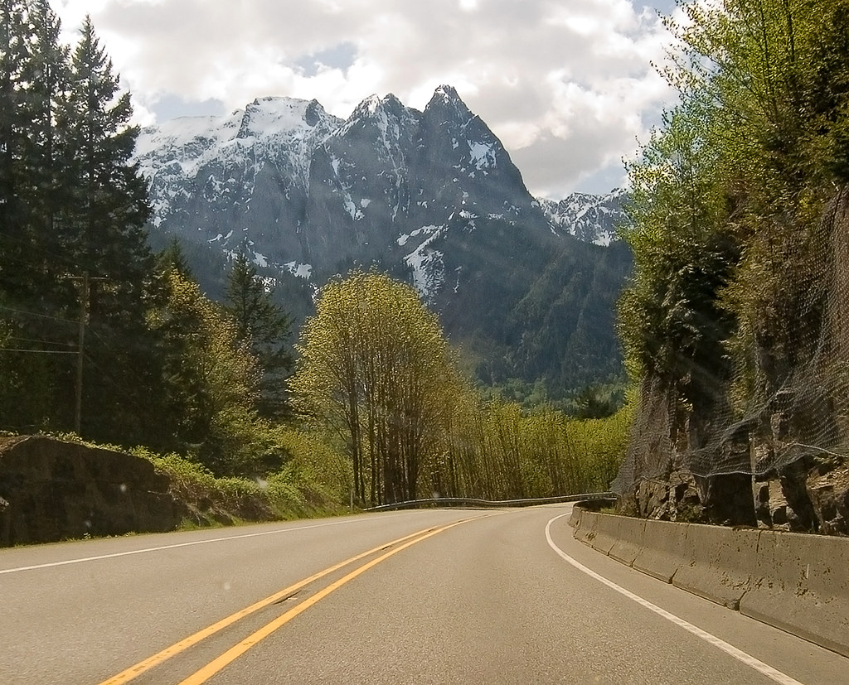
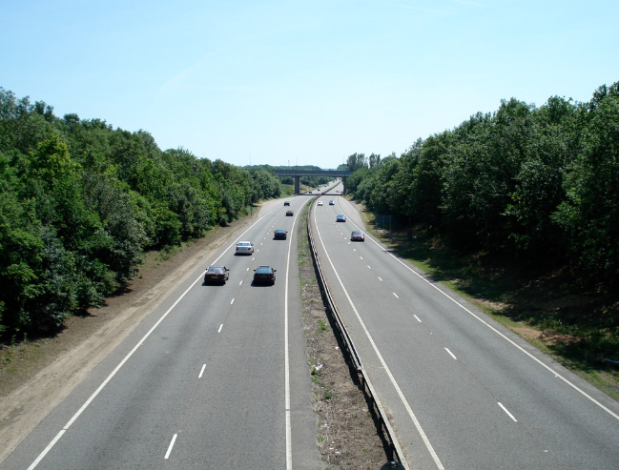
Description:
“All Roads Lead to Rome”
Every college approaches OER differently
All have the same goal: Reducing barriers for students
Webinar series goal: a practical look at the logistical “how-to” behind different models and dive into what colleges have found effective in their unique contexts.
"Mountain road" by pfly is licensed under CC BY-SA 2.0 | "Road" by amardilo is licensed under CC BY 2.0..
Notes:
A description of the presentation is included in the slide deck so that the purpose of the slide deck is established – and to inform anyone viewing the presentation as to what was planned.

Slide 6

Presenters
Kevin Smith, OERI Area C Regional Lead, OERL, Rio Hondo College
Mandy Kronbeck, OERL and OER Coordinator, East Los Angeles College
Maria Betancourt, OER Co-coordinator, East Los Angeles College
Caroline Hallam, OERL and OER & Eresources Librarian, Glendale Community College
Photo by Siora Photography on Unsplash
Notes:
Presenters can be included following the description or the overview. Where images are used, they should include an attribution (Photo by…) and appropriate alternative text should be used (or the image marked decorative).

Slide 7
Who is here today
Rio Hondo College | East LA College | Glendale Community College
9.6 % ZTC 14 current ZTC pathways (3 AA-T, 4 General Studies AA, 3 AA, 4 CoA ZTC pathways) 10,000 ish FTES Single College District Fun fact: Before Diners, Drive-Ins and Dives, Rio Hondo was described as the college around the 3Ds: The dump, the dairy, and the dead. | 24% ZTC (500+ sections in Fall 2025) 12 current ZTC pathways (5 AATs, 3 skills certificates, and 4 NC certificates of completion) Working on 15 more pathways via state grants 7000 FTES (28,000 headcount) Largest of a 9 college District Fun fact: ELAC was featured in Netflix’s Last Chance U | 20% ZTC ZTC pathways: Sociology, Geography, Philosophy, and Social Work and Human Services AA-Ts; working on Math and Economics AA-Ts 14,000 FTES Single College District Fun fact: Dan Harmon’s show Community was inspired by his experiences at Glendale (Glendale News-Press)

Slide 8
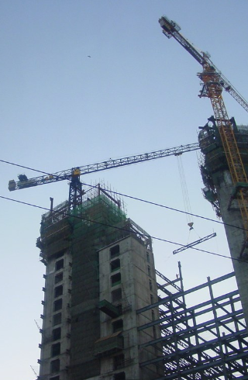
What to Expect
Structures
Processes
Goals:
  Sustainability
  Outcomes
Unrecorded: Q and A
"Construction buildings" by kalmyket is licensed under CC BY-SA 2.0.
Notes:
Structures
“How you built it”, committee, taskforce, Academic Senate, Coordinator roles and breakdowns, reassign time, unpaid labor? program review integration, tenure process integration, college plans etc.
Processes
“How is it working in real practice?” Projects funded, Other money? Standardization for equitable pay across campus? Faculty recruitment? SOPs? Pre and Post approval processes? Accountability measures?
Sustainability
“How do you keep it going strong?” flags during implementation, adjustments needed, student involvement, GE funding secured, full time person to do the ongoing work,
Outcomes
“What has worked and what would you do differently?
Dream Time: Wish List
If another round of funding, what would you do? What new programs would you tackle? What more do you need (XB-12 guidance? ZTC Tracking and Mapping Automated system, an ROI calculator)

Slide 9
Rio Hondo: Structures and Processes
Structures
  Standing OER committee: Committee of the Academic Senate
    Definitely a plus for sustainability
  Three leads: OER Committee Chair, OER Liaison, ZTC Lead
  No official program
  Part of Program Review process
    Another plus for sustainability
Processes
  ZTC money is used with intentionality
  Tiered structures for payments
  ZTC Lead presents recommendations to OER committee

Slide 10
Rio Hondo Goals: What’re we working on
Need to engage the Board of Trustees
Integrate it into campus processes
  Planning documents
  Distance Ed: POCR
  Curriculum: OER option on course updates
  Outreach/Marketing: ZTC pathways don’t even appear on the website
  Getting accurate data (XB12)
  Guided Pathways: Mappings to include ZTC
  Scheduling: How to ensure no backsliding with scheduling for ZTC pathways

Slide 11

Structures
Institutional Support
  Dean who supports OER and ZTC grant
  2 OER coordinators, supported by state ZTC grant
  Librarians who are strong OER advocates and eBook experts
  ZTC program endorsed by the college’s Academic Senate; supportive AS President
  Research Team: student surveys and ZTC/LTC Dashboard
  ZTC goal included in current Student Equity Plan and Strategic Educational Plan
Professional Development
  OER Community of Practice
  Teaching and Learning Series Workshops
Notes:
Maria

Slide 12
ZTC Grant Process: Pathways
Strategies for Participation:
Outreach, outreach, outreach!
Academic Senate
Administration
Opening Day
Department meetings
Implementation Grant (Summer 2023)
Anthropology AAT
Geology AST
Acceleration (Fall 2023)
Geography AAT
Environmental Science AST
Business Administration AS
English AAT
Cloud Computing Certificate of Achievement
Gerontology (CFES) Certificate of Achievement
Museum Studies Certificate of Achievement
Site Supervisor (CFES) Certificate of Achievement
Acceleration II (Fall 2024)
Data Analytics Certificate of Achievement
$320k allocation (Spring 2025)
Social and Behavioral Sciences Associate degree in Spanish (LOTE)
Legal Support Professional Certificate of Achievement
Notes:
Maria

Slide 13
ZTC Conversion Process
Phase 1: Preparatory Workshops & Reflections
ASCCC OERI: OER Basics
ASCCC OERI: Accessibility Basics
Reflection
Phase 2C: Peer Review
Peer review is completed by a selected discipline specific colleague.
Reviewer completes a peer review reflection.
Authors edit their created work and publish it.
Phase 2A: Resource Review & Reflections
OER resource reviews
Conversion Reflection
Conversion Timeline
Phase 3A: Canvas
Complete Course Evaluation Checklist (based on CVC-OEI and other high-quality course rubrics).
Course shared on Canvas Commons.
Phase 2B: Syllabus and created or adapted work
Training webinar in OER publishing platform
Adapted or created work (i.e. chapters, quizzes, presentations, and/or lessons)
Syllabus with OER integrated and 3 assignments that utilize the materials
Phase 4: Final Presentation and Reflection
Present at Opening Day 2026 OR for department.
Submit final reflection

Slide 14
Goals: What we’re working on
Continue learning about AI and OER integration so that we can spread the wealth to faculty
Continue building relationship with ASU and working with students to promote student voices about impacts of ZTC
Widen and continue outreach to Student Services to promote ZTC for students such as:
  DSPS
  EOPS
  Welcome Center
  Counseling
Continue to collaborate with other LACCD colleges for more district support
Continue to work with folks at the ASCCC-OERI and colleagues at colleges across the state

Slide 15
Glendale: Structures and Processes
Structures/Resources
  OER Librarian (me!) hired in 2019
    Subject librarians assist with book searches
  Standing Committee: Academic Senate OER Committee
    Last year, we reformed the committee to include one member from each academic division (highly recommended!)
    Meet four times a year
  OER & ZTC Guide
  Textbook Affordability Cohort & PD sessions

Slide 16
Glendale: Structures and Processes
Processes
  Targeting ZTC degrees selected with Division Chairs
  ZTC Funding Application for broadening pathways
    ZTC funding requests reviewed and approved by OER Committee
  XB12 codes submitted by faculty to their Divisions when accepting class assignments
  OER/ZTC activities reported in Library Services Program Review

Slide 17
Glendale Goals: What’re we working on
People power
  Training part-time librarian(s) to support OER search work
  Hiring paid ZTC co-lead in 2026
Training and Professional Development
  Self-paced instruction
  Improvement of OER & ZTC Guide
Publicizing ZTC Pathways
  Website
  Adding to Program Mapper
Sustainability
  Ensuring ZTC pathways are maintained
Institutionalization
  OER options considered for CORs
  Continued inclusion in Institutional Strategic Plan
Report on student ZTC awareness/enrollment for Michelson OER Spark Grant

Slide 18

Q&A
Not recorded
Be honest, transparent
Safe and Brave Space
No judgment
"That is the Question" by cogdogblog is licensed under CC BY 2.0.
Notes:
Presenters can be included following the description or the overview. Where images are used, they should include an attribution (Photo by…) and appropriate alternative text should be used (or the image marked decorative).

Slide 19

Lightning Round Robin!
(time dependent)
What do you wish you’d done differently and what would you do again?
What do you see as your colleges greatest challenge?
What are you hoping for?
"Lightning" by snowpeak is licensed under CC BY 2.0.

Slide 20

Resources and Notes
Kevin: ksmith@riohondo.edu
Mandy: Concofme@elac.edu
Maria: Betancme@elac.edu
Caroline: challam@glendale.edu
Google Form: Tell us what we can compile to share with you
Notes:
https://forms.gle/ZmkHggr8KSArFC5M7

