Slide 1
Welcome Activity
Welcome!
Please put your name and your college in the chat.
As we wait for people to join the zoom, please complete the first three questions on this padlet:
  AI Tools and Usage in Biology

Slide 2
Teaching with AI: Practical Tools for Biology Instructors
Nov 14, 2025
This work is licensed under a Creative Commons Attribution 4.0 International License.
Notes:
Ying

Slide 3
Welcome!
On behalf of the ASCCC OERI, we are pleased to have you here with us for “Teaching with AI: Practical Tools for Biology Instructors”
If you are not already muted, please mute yourself upon arrival.
Please note that you are encouraged to use the Zoom “chat” feature for questions and comments.
You’re invited to introduce yourself in the chat – please provide your name, college, discipline/role
This event will be recorded. Archives of all ASCCC OERI events are available at asccc-oeri.org > Webinars and Events
Notes:
Ying

Slide 4
Description
As artificial intelligence rapidly expands into education, biology instructors have new opportunities to create engaging, accessible, and cost-free resources for their students. This session introduces practical AI tools that help faculty enhance teaching and learning in biology courses, with a special focus on open educational resources (OER). Participants will explore how AI can generate visuals, customize examples, and develop instructional materials that support complex biological concepts.
Notes:
Ying

Slide 5

Presenters
Ying Liu, ASCCC OERI Biology Lead
  Biology, University of Southampton
Liz Encarnacion, ASCCC OERI AI Lead
  Communication Studies, Chaffey College
Photo by Siora Photography on Unsplash
Notes:
Both

Slide 6
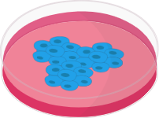
Overview
AI and Biology Education
LibreText Conductor and Microbiology Case Studies
Prompt Engineering and Notebook LM Demo
AI-Powered Pedagogy Applications & UDL
Image Creation Tools
Integrating AI into Workflow
Responsible AI Use
Open Discussion
Notes:
Liz

Slide 7
Objectives / Takeways
At the end of the session, you will be able to
Identify AI tools for generating visuals and instructional content
Apply AI for customizing examples and improving accessibility
Integrate AI ethically and openly into biology teaching workflow
Notes:
Liz

Slide 8
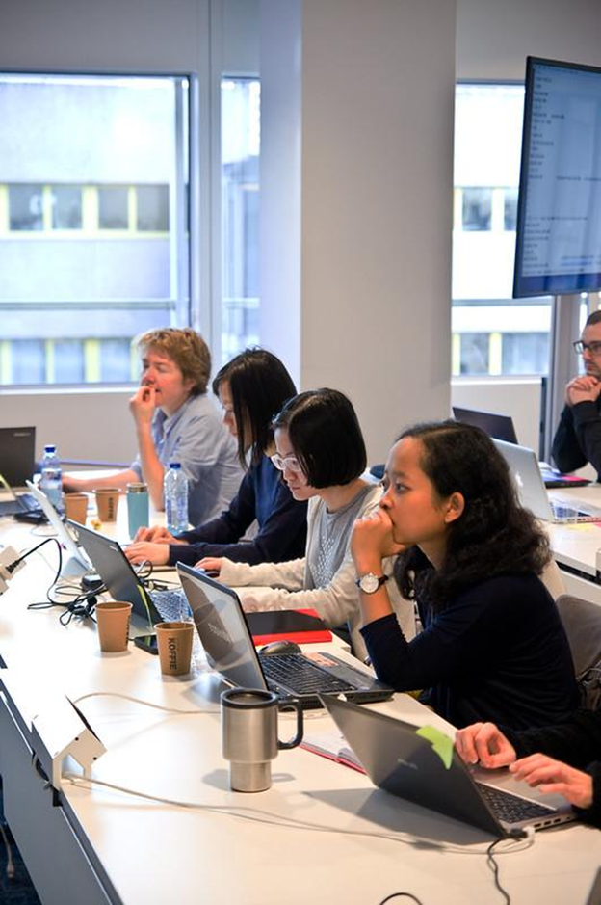
AI Impacts on Biology Education
Accelerated / enhanced content creation
Curriculum innovation
Support for UDL and accessibility
Data-informed teaching
Notes:
Ying

Slide 9
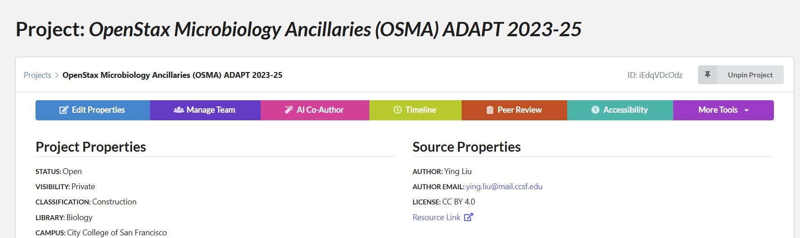
LibreTexts Conductor AI Co-Author
LibreTexts Conductor | Projects | Project View
Generate summary, alt text, and tags
Introduction to Microbiology (Liu et al.) - Biology LibreTexts
Notes:
Ying

Slide 10
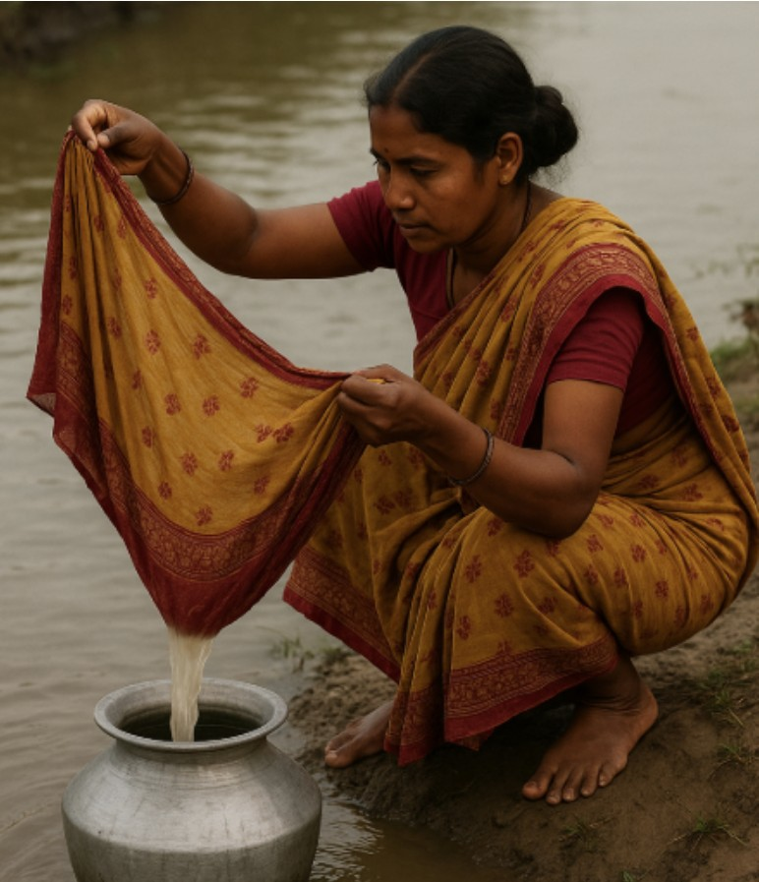
Microbiology Case Studies
Cholera Biofilm
Create question banks
  Feed ChatGPT a paragraph
  Generate a list of questions with feedback
Create images
  Create an image of a woman in Bangladesh filtering water with sari cloth
Notes:
Ying

Slide 11
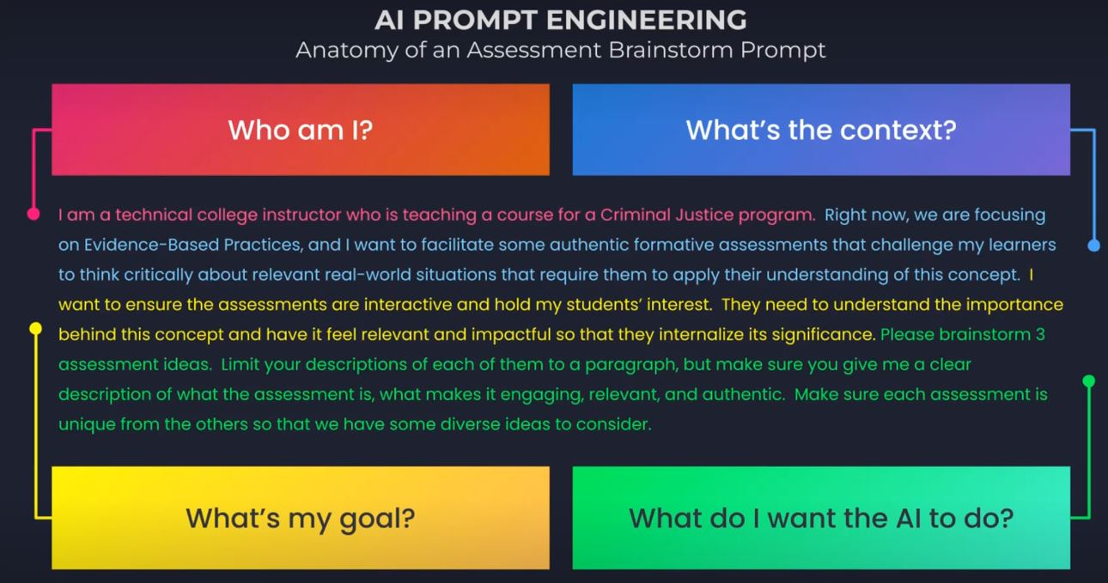
Prompt Engineering
Prompt Engineering
Notes:
Liz

Slide 12
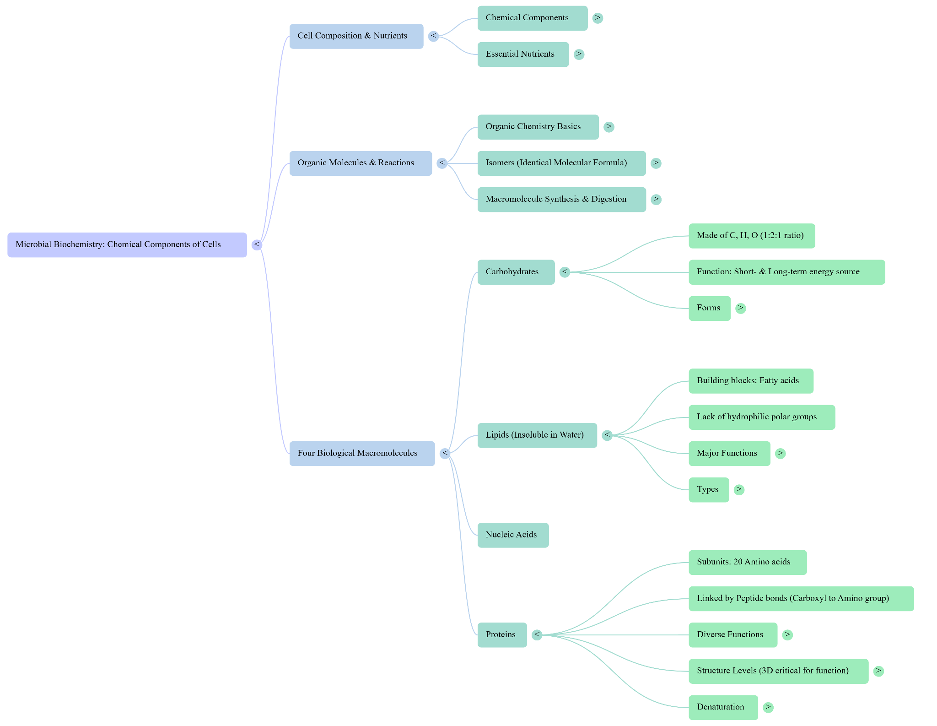
Notebook LM Demo
Microbiology: History, Scope, and Classification - NotebookLM
Audio overview
Video overview
Mind map
Flashcard
Quiz
Notes:
Ying

Slide 13
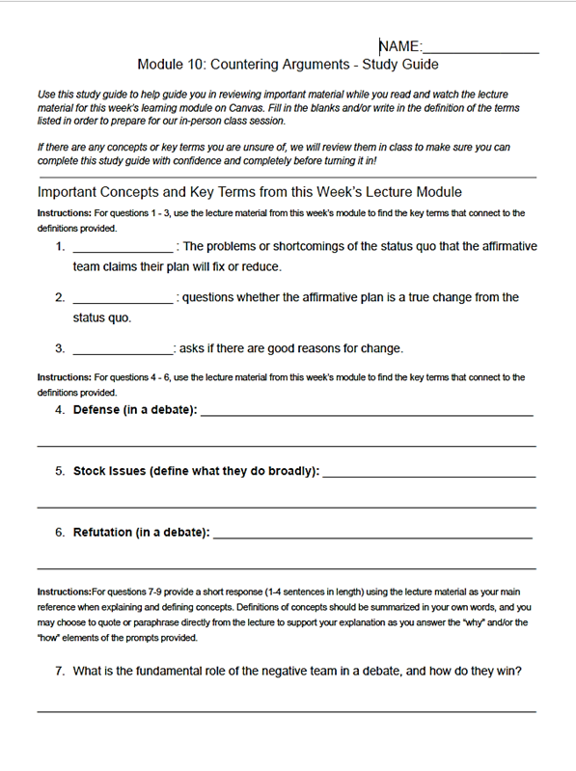
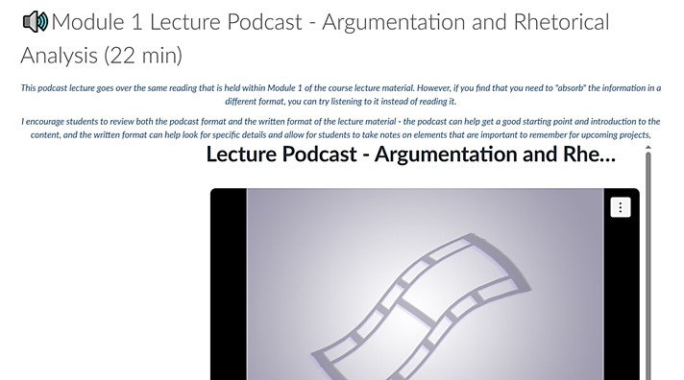
Notebook LM Demo (Cont.)
Study Guide Assignments
Instructor Briefing Doc
Podcast Lecture
Notes:
Liz

Slide 14
AI-Powered Pedagogy Applications (Publications)
Students using ChatGPT to Integrate Machine Learning into Biology Courses
Using AI to Prepare STEM Students for Real World Interactions with Interview Subjects
Bridges data science and biology
Explores complex datasets
Applies computation methods
Fosters interdisciplinary skills
Developed for Science of Aging
Provides repeatable practice
Shows improvements in confidence
Adaptable across contexts
Generative AI platform in undergraduate microbiology lab teaching for designing RNA drugs
Used in virology lab courses
Provides in silico lab experience
Introduces computational design
Applies AI-driven methodology
Notes:
Liz
AI tools can be integrated into biology curriculum, bridging disciplinary gaps and offering hands-on experiences with cutting-edge technologies.
These applications bridge traditional disciplinary gaps, offering hands-on experience with cutting-edge technologies.

Slide 15
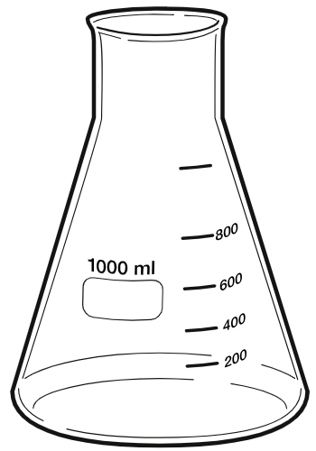
AI and Universal Design for Learning (UDL)
Opportunities for open-pedagogy approaches for students and instructors
Offers multi-modal tools for learning (such as the ones shown today) which reduces barriers and increases student access to information
Assists instructors and students with adaptive technology to promote accessibility within the classroom
Notes:
Liz - add to this slide

Slide 16
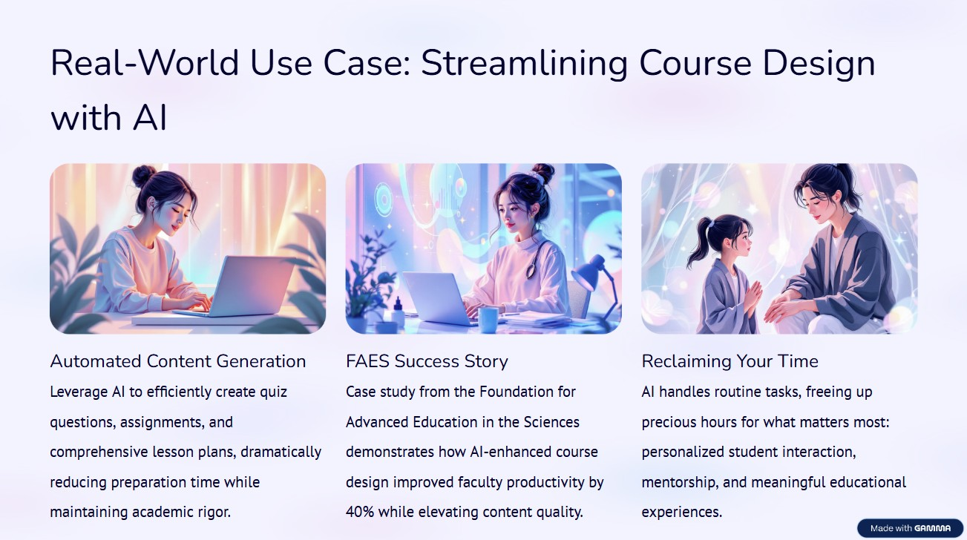
Slide Generation by Gamma
Notes:
Ying (Liz might chime in)

Slide 17
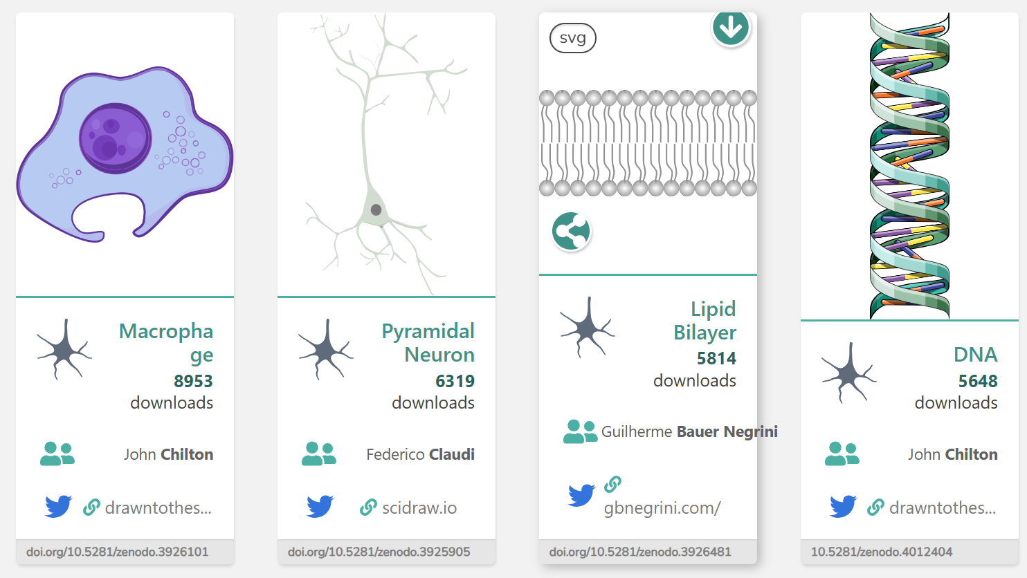
Visualizing Biology with AI
SciDraw
CC-BY
Creates professional scientific illustrations with a simple interface
Specialized templates for biological diagrams and models
Open license allows for free use in educational materials
Notes:
Liz
AI-powered tools are revolutionizing the creation of scientific illustrations, offering both accessibility and accuracy. These platforms enable instructors to produce professional-grade diagrams and figures with open licensing options.
These tools support the development of Open Educational Resources (OER), enhancing the visual component of biology instruction.

Slide 18
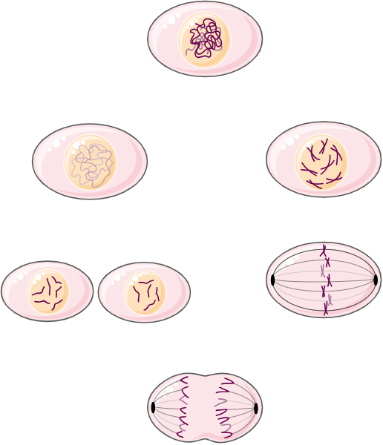
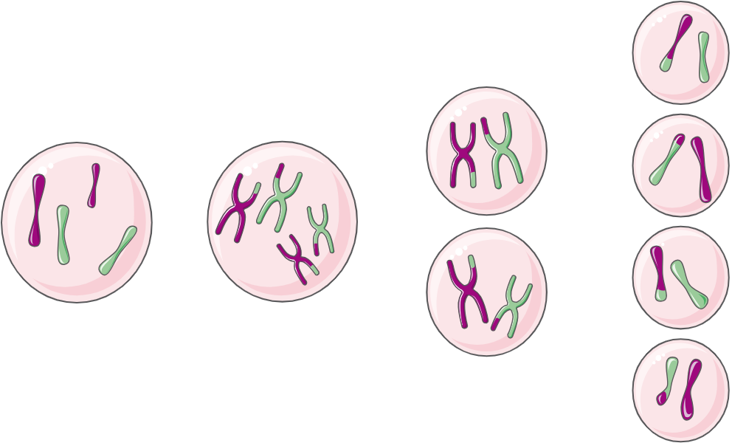
Visualizing Biology with AI (Cont.)
BioIcons
CC-BY
AI-powered biological illustration with focus on molecular structures
Detailed cellular and molecular visualization capabilities
Open license allows for free use in educational materials
meiosis icon by Servier https://smart.servier.com/ is licensed under CC-BY 3.0 Unported https://creativecommons.org/licenses/by/3.0/
Mitosis icon by Servier https://smart.servier.com/ is licensed under CC-BY 3.0 Unported https://creativecommons.org/licenses/by/3.0/
Notes:
Liz - break up slide and add images
AI-powered tools are revolutionizing the creation of scientific illustrations, offering both accessibility and accuracy. These platforms enable instructors to produce professional-grade diagrams and figures with open licensing options.
These tools support the development of Open Educational Resources (OER), enhancing the visual component of biology instruction.

Slide 19
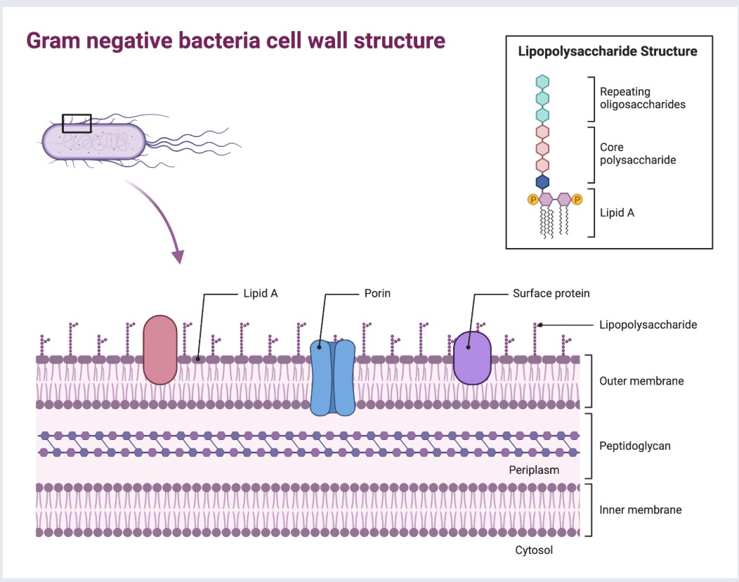
Visualizing Biology with AI (Cont. 2)
BioRender
CC-BY
Most scientifically accurate software for life sciences
Comprehensive templates for cells, antibodies, and laboratory equipment
Free version available for educational purposes
Gram Negative Bacteria Cell Wall Structure
Notes:
Ying
AI-powered tools are revolutionizing the creation of scientific illustrations, offering both accessibility and accuracy. These platforms enable instructors to produce professional-grade diagrams and figures with open licensing options.
These tools support the development of Open Educational Resources (OER), enhancing the visual component of biology instruction.

Slide 20

Enhancing Research & Data Skills
AI tools can significantly boost students' research capabilities and data literacy in biology education.
Consensus AI
Wolfram Alpha
Purpose: Academic paper analysis
Purpose: Data processing & visualization
Summarizes key findings and identifies consensus/divergence
Accesses 220M+ peer-reviewed papers
Helps evaluate research evidence
Performs complex calculations
Creates insightful plots
Models biological phenomena
Notes:
Liz
These tools develop critical research skills while providing computational support for biology students.

Slide 21
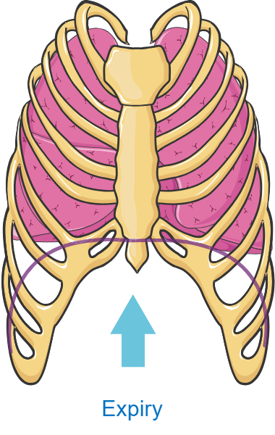
Responsible AI Use: Considerations
Accuracy & hallucinations in AI generators leading to false or misleading content
Monitor licensing and copyright (AI-generated images and CC-BY)
Student use: transparency and citation
FERPA/data privacy if tools use student data
Notes:
Liz

Slide 22
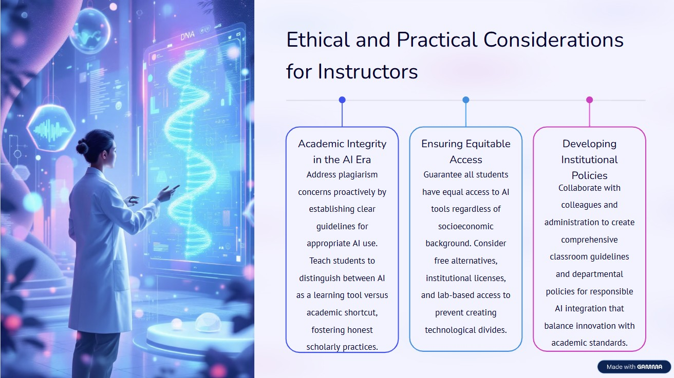
Ethical and Practical Considerations for Instructors
Notes:
Liz

Slide 23
Resources and Notes
AI-Powered Visual Tools
BioRender – Create life science figures and posters: https://biorender.com
SciDraw – Open-source biological illustrations: https://scidraw.io
Bioicons – AI molecular visualization tool: Bioicons - high quality science illustrations
Research & Learning Enhancement
NotebookLM – Google’s personalized research assistant: https://notebooklm.google
Consensus AI – Summarize findings from peer-reviewed papers: https://consensus.app
Wolfram Alpha – Data processing and visualization: https://www.wolframalpha.com
Notes:
Ying add resources

Slide 24
Resources and Notes (Cont.)
AI Pedagogy & OER
ASCCC OERI Webinars and Events: https://asccc-oeri.org/webinars-and-events/
LibreTexts AI Co-Author – Generate summaries, alt text, and metadata: https://libretexts.org
LibreTexts Biology Libraries: https://libretexts.org
Creative Commons Licenses: https://creativecommons.org/licenses/by/4.0/
Connect
ASCCC OERI Biology Lead: Ying Liu (ying.liu@soton.ac.uk)
ASCCC OERI AI Lead: Elizabeth Encarnacion (elizabeth.encarnacion@chaffey.edu)
Email: info@asccc-oeri.org
Notes:
Ying add resources

Slide 25
Open Discussion
What AI tools are you using? What do you use them for? What are your hesitancies?
Please complete the last questions on this padlet:
AI Tools and Usage in Biology
Notes:
Ying add resources

