Slide 1
Open Educational Resources (OER) in Practice: Campus OER/Zero-Textbook-Cost (ZTC) Program Spotlights from Across the Spectrum
December, 3rd 2025
This work is licensed under a Creative Commons Attribution 4.0 International License.
Notes:
The Open Washington Open Attribution Builder is a handy tool for creating your attributions, if you’d like to indicate how your work should be attributed or if you are using resources that require attribution. https://www.openwa.org/attrib-builder/ Including how your presentation is licensed on your title slide is an effective way of making this clear. OERI resources are most commonly licensed CC BY, allowing others to use and modify them – but requiring that they be properly attributed.

Slide 2
Welcome!
On behalf of the ASCCC OERI, we are pleased to have you here with us for “Open Educational Resources (OER) in Practice: Campus OER/Zero-Textbook-Cost (ZTC) Program Spotlights from Across the Spectrum”
If you are not already muted, please mute yourself upon arrival.
Please note that you are encouraged to use the Zoom “chat” feature for questions and comments.
You’re invited to introduce yourself in the chat – please provide your name, college, discipline/role
This event will be recorded. Archives of all ASCCC OERI events are available at asccc-oeri.org > Webinars and Events

Slide 3
Description
Join us for a candid and practical monthly webinar series that illustrates how colleges are building, adapting, and sustaining their OER and ZTC programs. Rather than focusing solely on “best practices,” this series will explore actual practices and program building. Each session will feature 2-4 colleges sharing how their OER/ZTC efforts are structured.

Slide 4
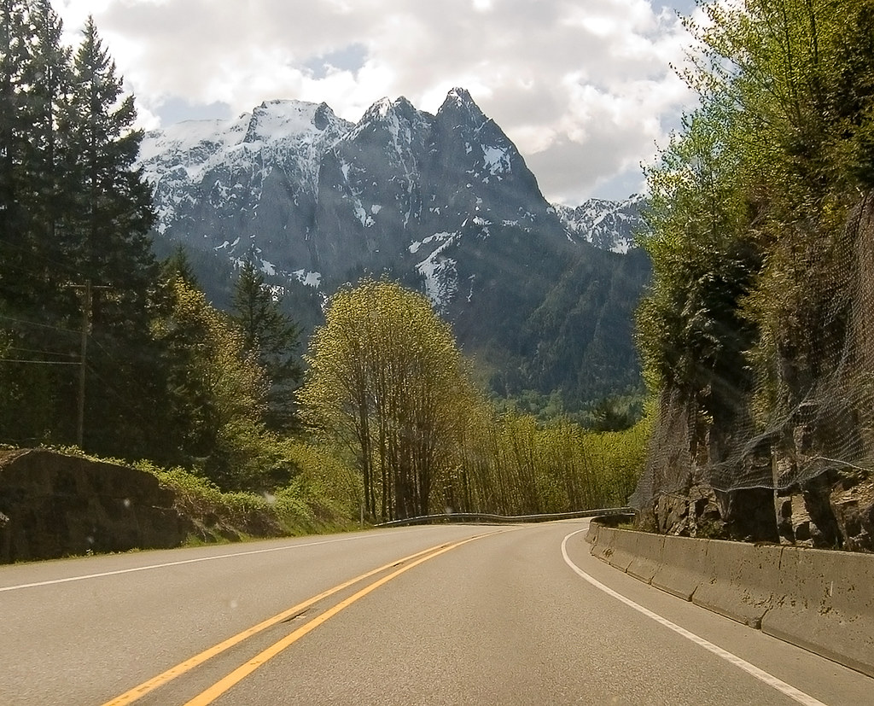
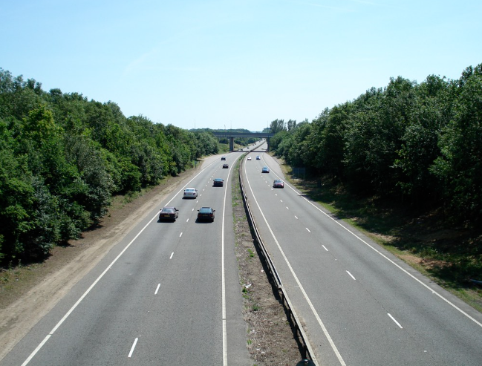
Description:
“All Roads Lead to Rome”
Every college approaches OER & ZTC differently
All have the same goal: Reducing barriers for students
Webinar series goal: a practical look at the logistical “how-to” behind different models and dive into what colleges have found effective in their unique contexts.
"Mountain road" by pfly is licensed under CC BY-SA 2.0 | "Road" by amardilo is licensed under CC BY 2.0..
Notes:
A description of the presentation is included in the slide deck so that the purpose of the slide deck is established – and to inform anyone viewing the presentation as to what was planned.

Slide 5
Overview
Presenters
Unique approaches to OER and ZTC:
Berkeley City College (Jenny)
Mendocino College (Gabrielle Visco)
Diablo Valley College (Amanda Choi)
Gavilan College (Deborah Gustlin)
Notes:
An Overview slide should be included that is an outline of the presentation.

Slide 6

Presenters
Jenny Yap: Librarian and ZTC Co-Coordinator, Berkeley City College
Gabrielle Visco: Librarian and ZTC Coordinator, Mendocino College
Amanda Choi: Librarian, Diablo Valley College
Deborah Gavilan: Art History Faculty, Gavilan College
Photo by Siora Photography on Unsplash
Notes:
Presenters can be included following the description or the overview. Where images are used, they should include an attribution (Photo by…) and appropriate alternative text should be used (or the image marked decorative).

Slide 7
College Profiles
Berkeley City College | Gavilan College | Diablo Valley College | Mendocino College
40% ZTC in Fall 2025 (55% of sections reported) 18 current ZTC pathways (16 AA-Ts, 1 AA, CalGetc pathway) 3,900 FTES Multi-college district (4 but will be 3 soon!) Fun fact: BCC was once called Vista College and classes were held all over Berkeley like in the basement of Ross Dress for Less | 6% ZTC (Fall 2025) 4 current ZTC pathways (3 AATs, 1 skills certificates) Art History, Studio Arts, Anthropology, Wastewater Management 2400 FTES (7,000 headcount) Small college District Fun fact: We are The Little Engine That Could… | Percentage of ZTC sections at your college: 40% How many ZTC pathways you have (certificates/AAs/AATs): 6 11,590 FTES Multi-college District Fun fact: river otters sometimes swim through the drainage pipes at our Pleasant Hill Campus and into the campus pond | 48% ZTC (FA 25) 4 Current ZTC Pathways 1,199 FTES (FA25) Rural College Fun fact: MC achieves highest percentage of Native American student in the CCC system.

Slide 8
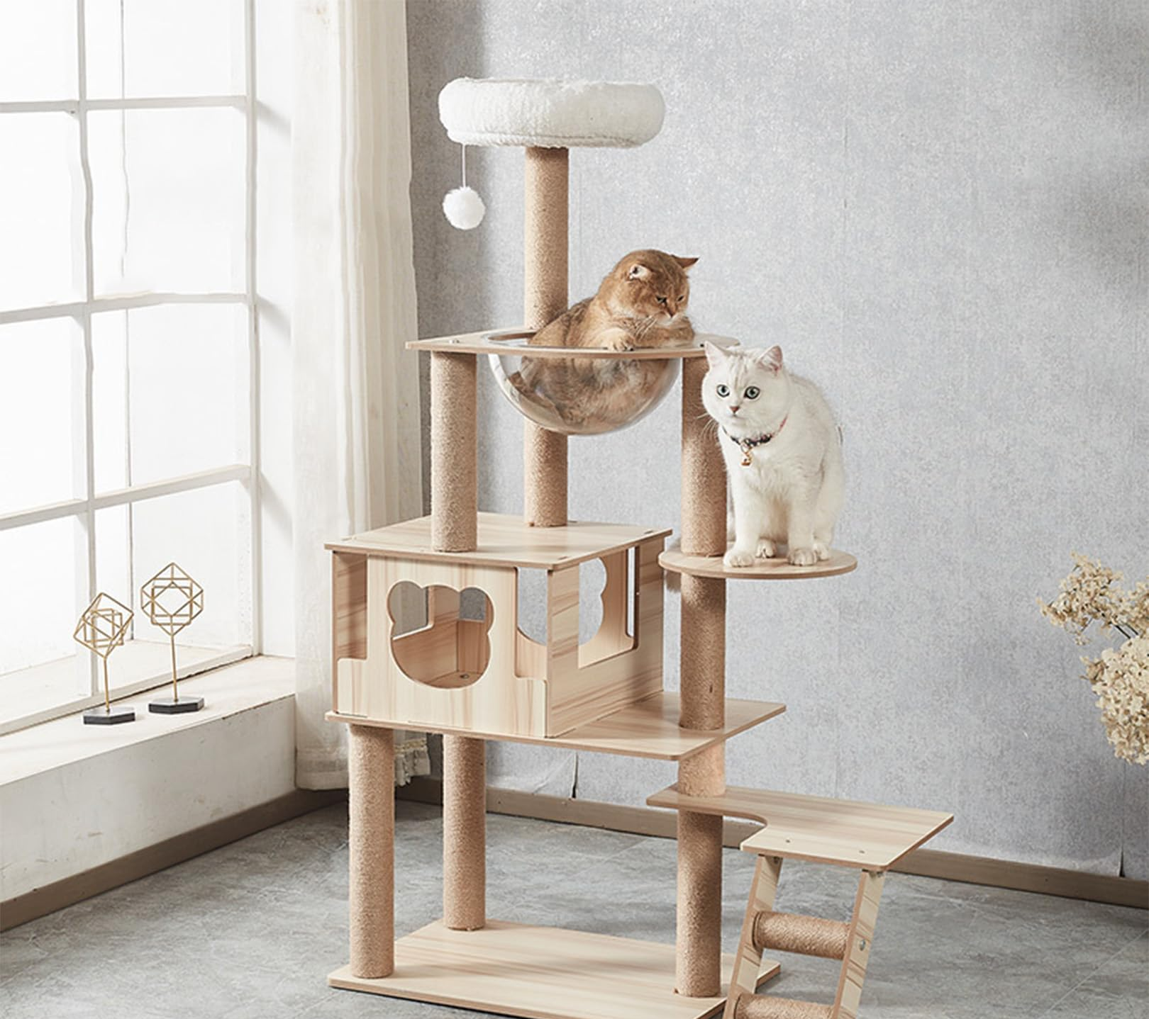

Berkeley City College: Structures and support
Support For Us
Affordable Educational Materials Committee (subcommittee of the Senate)
0.6 coordinator(s) for ZTC grant
VPI and staff
Referenced in Educational Masterplan
How We Use Funds
Stipends and release time
Grant coordinators and staff
Materials: lab manuals, library materials, class sets

Slide 9


Berkeley City College: points of pride & pain points
Pride
18 pathways! Plus more certs and AAs on the way
Conversion for unwilling faculty
Science department
Partnerships with POCR and TLC
Senate Resolution
Pain
Math
Resistance to change: Business, CIS
Sustainability
XB12 reporting

Slide 10
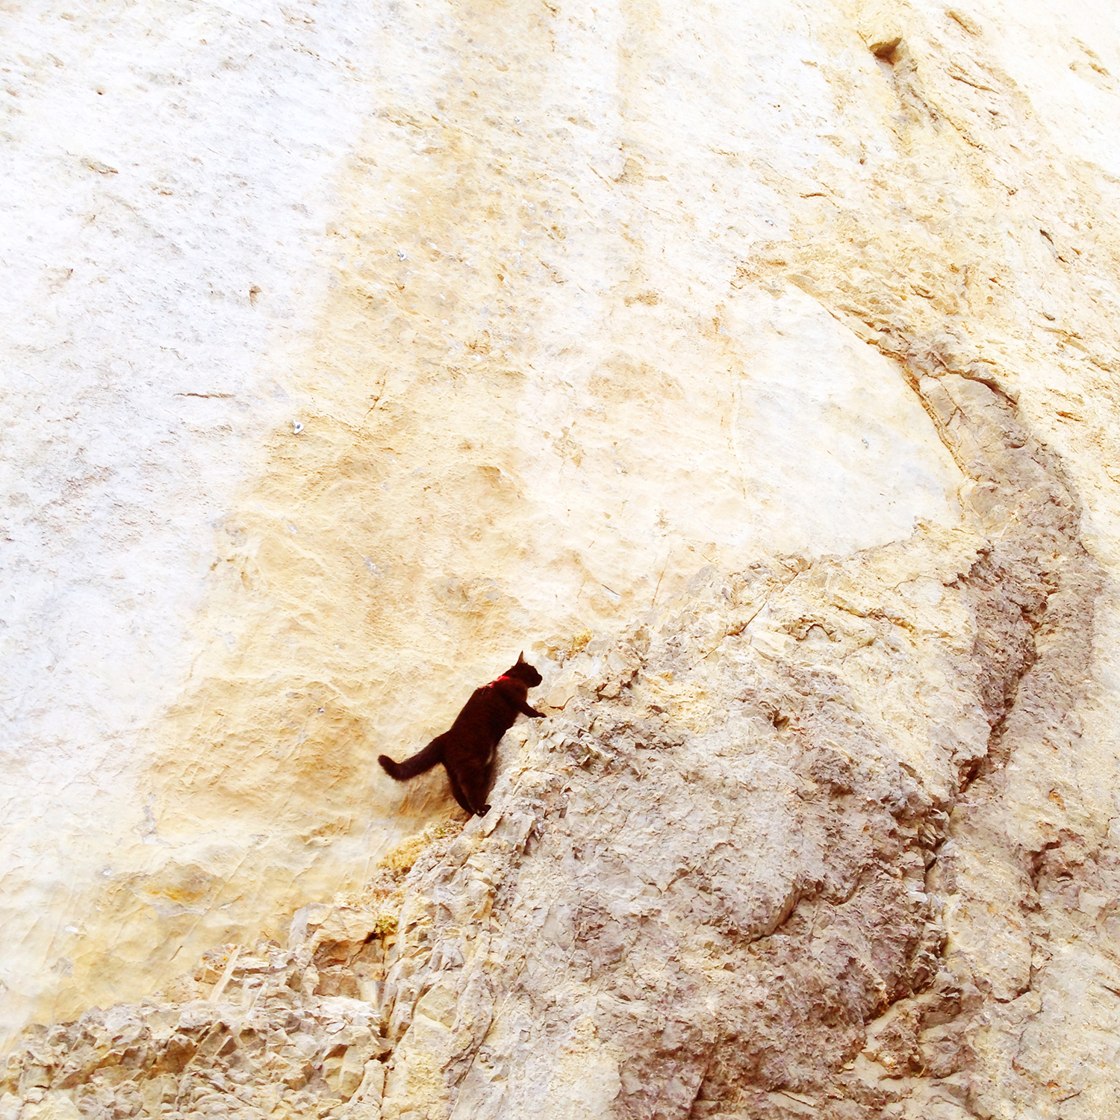
Berkeley City College: how we’re approaching sustainability beyond ZTC funding
Faculty who received funding agreed to maintain ZTC
AEM committee
Advocating through Student Equity and Achievement
Partnerships with POCR, TLC, and other initiatives
Librarians integrated in ZTC work
We need more!

Slide 11

Mendocino College: Structures and support
Support for us
OER Cadre team (not a part of Academic Senate)
Dean of Instruction- on OER Cadre & ZTC Grant Manager
Resolution passed by Academic Senate for LTC designation
FT Textbook Affordability Librarian (categorically funded)
How we use funds
Stipends and release time
Professional development
Library materials (eBooks)

Slide 12


Mendocino College: points of pride & pain points
Pride
ESL department Head, Melissa Fornari, has started authoring OER even though we are not able to pay her with ZTC grant money.
Pain
Work within silos
Lack of institutional buy-in
Sustainability
XB12

Slide 13

Mendocino College: how we’re approaching sustainability beyond ZTC funding
The hope is the faculty who have attended trainings and have adopted OER will continue to do so.
The Library has somewhat absorbed many responsibilities with ZTC, but cannot absorb full responsibilities after funds have ended.
We have been able to use Lottery funds for class sets.

Slide 14
Diablo Valley College: Structures and support
Support:
OER@DVC = Academic Senate workgroup coordinated by the library
.8 ZTC Grant coordination; .2 OER District Grant coordination
4CD Districtwide OER Council (DOERC)
Administrative support at college & district level
In Student Equity Plan; hopefully in new Educational Strategic Plan
How We Use Funds:
OAS and release time
Grant coordinators & OER librarian
Accessibility support: Accessibility specialist & CIDI Labs
ChatGPT Subscriptions
Professional Development
Materials: Lab manuals, library materials, course materials

Slide 15
Diablo Valley College: points of pride & pain points
Pride
Culture Change
40% ZTC in FA25
Successes with high impact courses in Bio and Chem
Pain
Sustainability of the work
Overcoming false or outdated assumptions about OER
Disciplines that require all faculty to use the same textbook
Math . . .
ZTC course marking process has been flawed
48% of students districtwide don’t know how to find ZTC course

Slide 16
Diablo Valley College: how we’re approaching sustainability beyond ZTC funding
No ongoing funding identified yet; Library has historically led ZTC/OER work and will continue to do so
Leadership in ZTC Pathways have agreed to maintain ZTC status of key courses
OER@DVC workgroup and DOERC will continue
Asynchronous, self-paced PD training course will remain available
4CD materials repository to help with discovery and adoption
Staying creative and scrappy!

Slide 17
Gavilan College: Structures and support
What structures (committees, re-assign time, coordination) do you have at your college to support ZTC efforts?
The first 1.5 years were spent on release time, totaling $9,000, without developing ZTC committees or a plan. I arrived in Spring 2025, assembled a team, and we created a plan, executed it, and secured funding for 38 projects by April 15, 2025. The ZTC project manager gets 40% release time, but that involves complete grant execution. Admin approves everything we submit for payment. I negotiated a monthly stipend of $1500 to $2000 for the other three members of the ZTC committee. We also have a Canvas course with all the information and a space for faculty to submit monthly content or chapters.
Is there administrative support, planning documents that reference ZTC/OER, Administrative or Board procedures, that are in support of ZTC/OER?
No
How do you use ZTC funds to support OER and ZTC?
We have designated $340,000 to cover projects supporting the 4 new ZTC pathways. The rest is spent on support. We have a 44% burden of faculty salaries.

Slide 18
Gavilan College: points of pride & pain points
What parts of your OER/ZTC work are you proud of at your college?
Our ZTC team played a key role in revitalizing Gavilan College’s OER efforts, saving a $520K ZTC grant by creating 4 pathways and funding 32 projects in just 3 months. As a long-time OER advocate, I mentor faculty, establish sustainable structures, and promote collaboration. Equity-focused OER initiatives break down barriers for historically underserved students, who make up the majority of the college’s population. Our advocacy has transformed campus culture to value and implement open education. We are the little engine that could.
What has been difficult/unclear/challenging at your college?
At the institutional level, ambiguities still exist—such as inconsistent understanding of ZTC definitions, the role of Inclusive Access, and how ZTC fits into administrative or board procedures. Keeping accurate ZTC labels in the schedule, coordinating across departments, and securing ongoing funding beyond the grant cycle also present challenges.
Our biggest challenge is the lack of support from our administration. Our ZTC has been created by faculty, led by faculty, and OER Content delivered by faculty. We work in a silo and are very efficient and get things accomplished.

Slide 19
Gavilan College: how we’re approaching sustainability beyond ZTC funding
How will your college maintain ZTC degrees after the ZTC funding runs out?
We are working on integrating ZTC and OER into long-term institutional frameworks to ensure the work persists beyond grant funding. Our strategy emphasizes embedding ZTC within existing governance, planning, and instructional support systems rather than treating it as a separate project. The Academic Senate, Guided Pathways teams, and the Equity Committee have all incorporated ZTC and burden-free instructional materials into their ongoing priorities. We have recommended to the Deans that they include ZTC funding in their PIPR cycles.
Will ZTC/OER be absorbed into another area? Receive ongoing funding? Does it need funding?
Ultimately, sustainability at Gavilan depends on a cultural shift. By integrating ZTC into curriculum design, scheduling, student communication, and equity initiatives, we ensure that ZTC degrees become a standard part of our operations, not just a temporary, grant-funded project. Faculty leadership, administrative backing, and a focus on accessible, equitable opportunities will keep this work moving forward well beyond the end of the initial funding.
Hopefully the state of California will process another ZTC grant cycle with more funding next year.

Slide 20

Q&A
Not recorded
Be honest, transparent
Safe and Brave Space
No judgment
"That is the Question" by cogdogblog is licensed under CC BY 2.0.
Notes:
Presenters can be included following the description or the overview. Where images are used, they should include an attribution (Photo by…) and appropriate alternative text should be used (or the image marked decorative).

Slide 21

Lightning Round Robin!
(time dependent)
What do you wish you’d done differently and what would you do again?
What do you see as your colleges greatest challenge?
What are you hoping for?
"Lightning" by snowpeak is licensed under CC BY 2.0.

