Slide 1
Creating Engaging Video Supplements for OER Textbooks
A Practical Workflow Using AI Tools
Kim Martin, M.A.
Early Childhood Education Faculty
Copper Mountain College
January 22, 2026

Slide 2
About Me
Kim Martin
M.A. in Early Childhood Education
Tenured ECE Faculty, Copper Mountain College
Former Distance Education Coordinator (3 years)
Teaching primarily online courses

Slide 3
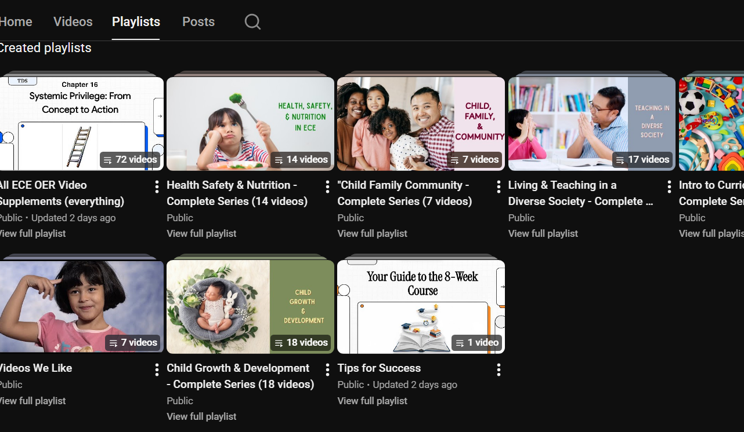
What I've Created
Video Supplement Series for ECE OER Textbooks
Child Growth & Development (18 videos)
Health, Safety & Nutrition (14 videos)
Child, Family, Community (7 videos)
…also Living/Teaching in Diverse Society and Intro to Curriculum…more to come!
All freely available on YouTube

Slide 4
The Challenge: The OER Gap
The Pros:
Free textbooks for students
Customizable content
No expensive editions
The Cons:
Limited supplementary materials
No videos, study guides, or multimedia
Extra work for instructors

Slide 5
Why 5-7 Minute Videos?
• Matches student attention spans
• Reduces cognitive load
• Easy to review multiple times
• Fits into busy schedules
• Mobile-friendly format
Research shows: Students stop watching after 6-7 minutes

Slide 6
My Workflow: A 5-Step Process
1. Go to OER textbook
2. Open a chapter & save as PDF
3. Upload PDF to Notebook LM
4. Generate video overview
5. Review, refine, caption, publish
Time per video: 30-45 minutes

Slide 7
Live Demonstration
Let's See It In Action
I'll show you:
• How to upload content to Notebook LM
• How to generate a video overview
• What the output looks like
• How I evaluate quality

Slide 8
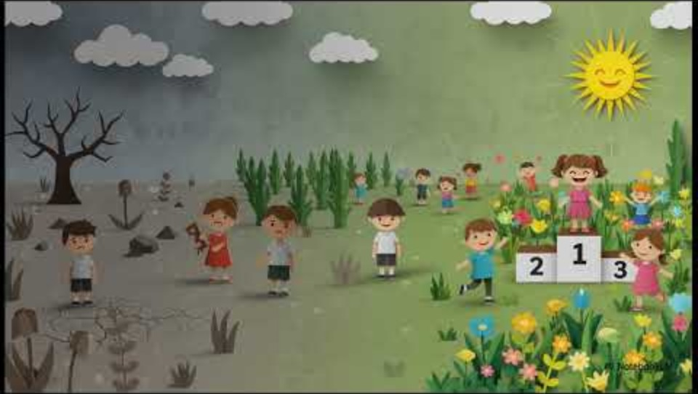
Example Video
CFC Part III: A Closer Look at Parenting
OR
Visit: https://www.youtube.com/@OERTeaching

Slide 9
Lessons Learned (After 72 Videos)
5-7 minutes is the sweet spot
Simple design > fancy production
Consistency helps students
Frees instructor time for personalized feedback
Students actually watch them

Slide 10
What to Watch Out For
You must verify accuracy
Some chapters work better than others
AI voice isn't for everyone
Initial learning curve
Bottom line: You're still the quality control

Slide 11
My Review Process
Listen to entire video before CAPTION & publishing
Check key terms and emphasis
Ensure pacing matches content
Add references in description
Test with a student when possible

Slide 12

Questions & Discussion
Questions? Ideas? Concerns?
I'd love to hear your thoughts.

Slide 13
Thank You!
YouTube Channel: OER Teaching
OER Teaching (YouTube link)
Email: kmartin@cmccd.edu
All videos are freely available for use in your courses.
Let's keep the conversation going!

