Slide 1


Welcome!
On behalf of the ASCCC OERI, we are pleased to have you here for “Everything You Ever Wanted to Know About Being an Open Educational Resources Initiative (OERI) Discipline Lead but Were Afraid to Ask (AKA OERI Discipline Lead Information Session)”
If you are not already muted, please mute yourself upon arrival. As this is set up as a meeting, we will be able to have an actual discussion – but we need all those who are not speaking to be muted.
You are also encouraged to use the “chat” feature.
This event will be recorded and available to you on the OERI website (asccc-oeri.org).

Slide 2
Everything You Ever Wanted to Know About Being an Open Educational Resources Initiative (OERI) Discipline Lead but Were Afraid to Ask (AKA OERI Discipline Lead Information Session)
Revised January 29, 2026. OERI Discipline Lead Webinar, February 2, 2026, 1:30 pm – 2:30 pm
This work is licensed under a Creative Commons Attribution 4.0 International License.
Attribute this slide deck as: "OERI Discipline Lead Webinar (26S)" by ASCCC OERI is licensed under CC BY 4.0.

Slide 3
Event Description
Discipline Leads are a critical component of the OERI ecosystem in serving as a resource for their colleagues and curating the OERI’s collection for their discipline. The OERI welcomes applicants from all disciplines and does not require prior experience with OER. Join this webinar to learn about the role and, hopefully, be persuaded to apply.

Slide 4
Your Presenters
Michelle Pilati
  Project Director, ASCCC OERI
  Psychology, Rio Hondo College

Slide 5
Overview
A Discipline Note
Introduction to the OERI
The Role of the Discipline Lead
Discipline Lead Expectations – Spring 2026
Questions

Slide 6
A Discipline Note
Disciplines vary – in many ways.
Adopting OER varies in complexity across disciplines and across courses within a discipline.
Consequently, the OERI needs discipline experts to inform its work – and it strives to work with those discipline experts in a way that respects differences while meeting the needs of the OERI and the field.

Slide 7
Introduction to the OERI
The Open Educational Resources Initiative is a project of the Academic Senate for California Community colleges.
It was initially established with funds from the legislature that were appropriated in 2018.
In the near future, the OERI will be funded with Zero Textbook Cost (ZTC) Degree Grant Program funds.
This change allows to OERI to continue its work, with an explicit expectation that it will update resources to ensure that sustainability of the system’s ZTC work.

Slide 8
ASCCC OERI
A 5-year project to implement OER systemwide by coordinating state level activities to increase OER availability and supporting local OER implementation.
At the end of the initial project period, the structure and accomplishments of the OERI would be evaluated and future funding needs identified.
Notes:
Slides from 2020. 6 million was expected to last 5 years. We hit the 5-year mark a few years ago.

Slide 9

OERI Structure
Notes:
We’re creating a web…

Slide 10
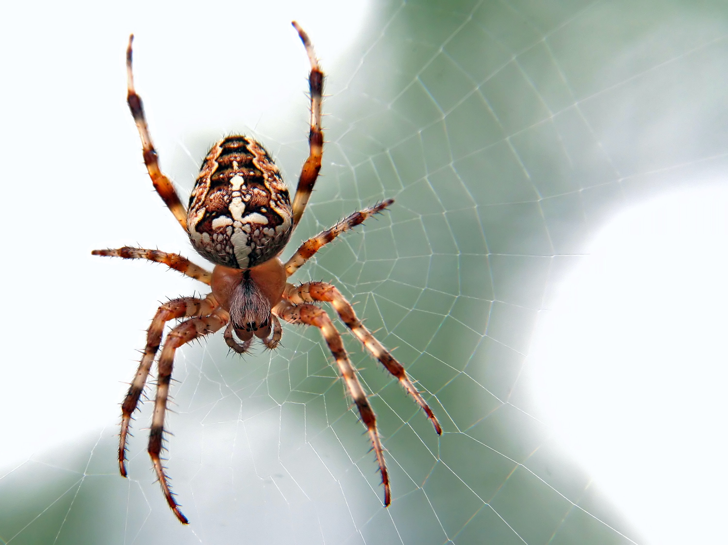
OERI Project Director
Michelle Pilati
  Psychology, Rio Hondo
Photo by Ed van duijn on Unsplash
Notes:
We’re creating a web…

Slide 11
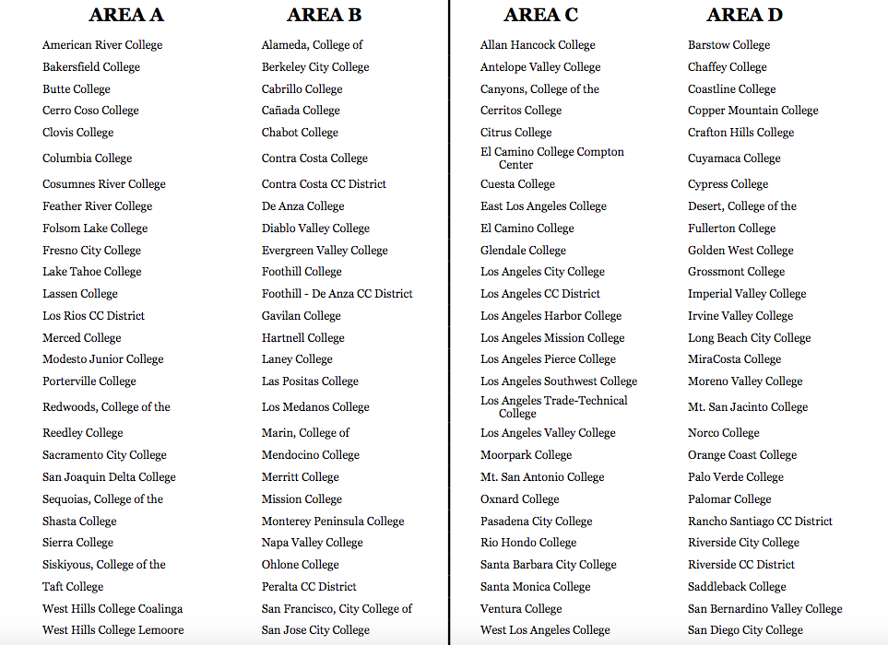
ASCCC Regions
Notes:
ASCCC divides the colleges into regions – that don’t fit nicely on a slide…

Slide 12
ASCCC Regions (cont.)
Area A – Sacramento, Central Valley
Area B – Bay Area
Area C – Los Angeles Region
Area D – Orange and San Diego Counties
Notes:
Here’s roughly what the regions consist of…

Slide 13
OERI Structure - 2020
Regional Leads
  Discipline Leads
  OER Liaisons
Project Support
  Project Monitors
  Accessibility Support
Notes:
Discipline leads – Now recruiting – discipline leads needed for history, political science, psychology – and more. Specifics on role to be developed.

Slide 14
OERI Structure - 2026
Project Director
  Michelle Pilati – Psychology, Rio Hondo
OERI Project Facilitators
  Shagun Kaur - Communication Studies, De Anza
  Suzanne Wakim - Biology, Butte
Regional Leads
  Amanda Taintor (Area A)
    Early Childhood Education, Reedley
  Cristina Moon (Area B)
    Spanish, Chabot
  Kevin Smith (Area C)
    Psychology, Rio Hondo
  Rachel Fleming(Area D)
    Library, Irvine Valley
Notes:
*New (sort of!)

Slide 15
OERI Leads
Accessibility
  Suzanne Wakim – Biology, Butte
Artificial Intelligence
  Elizabeth (Liz) Encarnacion – Communication Studies, Chaffey
Communication
  Julie Bruno – Communication Studies, Sierra
Distance Education
  Jim Julius - Distance Education, MiraCosta
IDEA Framework Lead
  Tiffany Lanoix – Sociology, West Los Angeles

Slide 16
Discipline Lead (DL) Co-Coordinators
Lara Braff (established leads)
  Anthropology, Grossmont College
  lara.braff@gcccd.edu
Jennifer Paris (new and newer leads)
  Early Childhood Education, College of the Canyons
  jennifer.paris@canyons.edu

Slide 17

OERI’s Goal?
Increase the use of open educational resources in lieu of commercial texts by all reasonable means available.
Photo by Markus Winkler on Unsplash

Slide 18
Increase OER Use By…
Increasing awareness
Increasing the availability of high-quality OER
Making the adoption of OER easier
Supporting you to help your faculty join us…

Slide 19
Background
Discipline Lead role introduced at the start of the initiative
Goals
  Identify resources likely to be of interest to CCC faculty
  Identify ”holes”
  Serve as a discipline resource
  Initiate OER discipline-based community

Slide 20
Approach
Discipline Leads given access to Canvas
Encouraged to organize resources by C-ID
Little guidance provided
Results?

Slide 21

Continued
Photo by GoaShape on Unsplash

Slide 22
Discipline Lead Role (Fall 2020)
We want to support you – not micromanage
Step 1
  Identify resources likely to be of interest to CCC faculty
  How?

Slide 23
Identifying Resources
Survey data (if available)
  All information we have for you – and all your work product – will be stored in a Google folder
  Organized by C-ID, if appropriate
Repositories
  https://asccc-oeri.org/finding-oer-to-use-in-your-courses/
  Cool4Ed – California use
    http://www.cool4ed.org/course-showcase
  LibreTexts – Imports resources from other sites
    Libretexts.org

Slide 24
Discipline Lead Role (Fall 2020) cont
Step 1
  Identify resources likely to be of interest to CCC faculty
Step 2
  Determine if a discipline survey is needed
  Prioritize resource needs
Step 3
  Your recommendation for how we should proceed with your discipline

Slide 25
Discipline Lead Role - Limits
You are not being asked to do anything other than identify – and share - existing resources
If you were asked to play a role in resource development, that would be an “ask” beyond your role as Discipline Lead.
Because of accessibility and ease-of-access issues, we moved away from Canvas for resource sharing – and have streamlined the resource update process.

Slide 26
Discipline Lead Role (Spring 2021)
Conduct a webinar show-casing available OER
Identify an approach to conduct outreach to the discipline
Serve as a point-person for the discipline
Update identified resource list, as needed

Slide 27
Discipline Lead Role (2025 - 2026)
Goals
Canvas for Onboarding
Term stipend increased to $600
New DLs who have not taken the OERI’s courses are encouraged to do so – and will receive a stipend upon completion

Slide 28
New Complexities – And Opportunities
Common Course Numbering
Cal-GETC
New C-ID descriptors and new Transfer Model Curricula
LibreTexts
AI and IDEA
New disciplines

Slide 29
New/new DLs (working with Jennifer)
Discipline | Faculty
Administration of Justice | George Cartwright
Astronomy | Rachel Mastrapa
Biology | Luke Blacquiere
Medical Assisting | Carissa Rosensteel
Music | Benjamin Makino
Sociology | Patricia Lara
Spanish | Alejandro Lee
Theatre Arts | Ian Wallace
Water and Wastewater Technology | Catherine Ames
Engineering | Patricia Foley
Humanities | Matthew Goldstein
Native American Studies | David Alvarez
Nutrition | Priya Venkatesan

Slide 30
Experienced DLs (working with Lara)
Accounting | Aleksandra Uchlik
ADAPT/H5P | Cristina Moon
Agriculture Business | Jacob Vazquez
American Sign Language (ASL) | Sara Stallard
Anthropology | Lara Braff
Art/Art History | Cerise Myers
Biotechnology | Christopher Smith
Business | Cornelius Brown
Chemistry | Benny Ng
Child Development (CD) | Amanda Taintor
Communication Studies | Elizabeth (Liz) Encarnacion
Early Childhood Education | Amanda Taintor
Education | Maureen Powers
English | Karen Crozer
Credit and Noncredit English as a Second Language (ESL) | Heather Maclean
Geography/Physical Sciences | Scott Crosier
Geology | Randal (Randy) Reed
Hospitality Management | Albert Yu
Information Technology and Information Systems | Angela Thomas
Journalism | Erin Hiro
Kinesiology | Laurie Runk
Math | Larry Green
MyOpenMath (MOM)/Math | Larry Green
MyOpenMath (MOM)/Non-Math | Emilie Hein
Philosophy | Noah Levin
Physics | Emilie Hein
Political Science | Dino Bozonelos
Psychology | Bakhtawar (Bucky) Bhadha

Slide 31
Recruiting DLs for….

Slide 32
New/Newer DL Expectations (Spring, 2026)
Complete or Review the DL Canvas Course
Check-in with Jennifer
ASCCC Listservs
  Sign up for the OERI listserv and your discipline list serv and on the ASCCC website. for the OERI and your discipline (you only need to do this once; if you are already signed up, it will notify you). These are one-way and do not have heavy use, so they will not overwhelm your inbox.
Read the Monthly DL Newsletter

Slide 33
General Expectations
Serve as a Helpful Point-of-Contact
Host a Webinar or Conversation
Unique Outreach (Varies by Term)
Build a New Curated Collection // Maintaining and Updating Existing Curated Collections

Slide 34
Documenting Completion of Expectations
By Friday, May 1st, submissions of all five of the following are due for stipend approval. Spring 2026
  New/Newer DLs Plans Survey
  Date of Check-in with Coordinator
  Date of Webinar/Conversation
  Curated Discipline Collection Checklist
  Spring 2026 New/Newer DLs Reflection Survey
  Please submit to Module 7 (DL Onboarding course)
  Contact Jennifer Paris if you have questions: jennifer.paris@canyons.edu

Slide 35
Experienced DLs Expectations (Spring 2026)
Check-in with DL Coordinator (Lara Braff)
Goal-setting assignment
Communication plan
Serve as point-of-contact for discipline
Host webinar/conversation
Update curated collection
DL course reflection/feedback survey
*All tasks and submission process can be found in Module 8 (DL Onboarding Course)
Questions? Contact: Lara Braff, lara.braff@gcccd.edu

Slide 36

Next Steps?
Photo by Andrew Itaga on Unsplash

Slide 37

Thanks!
Photo by Thgusstavo Santana from Pexels

