Slide 1
Measuring Effort and Analytics with The Forge
February 20, 2026
This work is licensed under a Creative Commons Attribution 4.0 International License.

Slide 2
Welcome!
On behalf of the ASCCC OERI, we are pleased to have you here with us for “Measuring Effort and Analytics with The Forge”
If you are not already muted, please mute yourself upon arrival.
Please note that you are encouraged to use the Zoom “chat” feature for questions and comments.
You’re invited to introduce yourself in the chat – please provide your name, college, discipline/role
This event will be recorded. Archives of all ASCCC OERI events are available at asccc-oeri.org > Webinars and Events

Slide 3
Description
In the Artificial Intelligence (AI) era, educators are increasingly challenged by writing assignments and the need to distinguish between student-generated work and AI-leveraged content. The Forge offers a solution by shifting the focus from the final product to the writing process itself.
This webinar will explore how instructors across various disciplines - from composition, world languages, and linguistics to chemistry and statistics - can use analytic maps to gain deeper insights into how students construct their work and visualize the writing process.
With The Forge’s new integration with the LibreTexts ADAPT homework system, students can access The Forge with a single click while providing instructors with analytical tracking and rubric abilities, aligning with equitable grading practices such as mastery grading, contract-based grading, and ungrading by empowering students to show their critical thinking and revision history.

Slide 4

Presenters
Sarah Harmon, OER/ZTC Program Manager
Linguistics, Cañada College
Delmar Larsen, PhD., Founder and Director of the Libretext platform
Chemistry, University of California, Davis
Liz Encarnacion (they/she), AI Lead ASCCC OERI
Communication Studies, Chaffey College
Photo by Tim Mossholder on Unsplash

Slide 5
Overview
Introduction: Redefining Success in the AI Era
The Shift from Product to Process
Instructor View (Writer)
Technical Deep Dive: How The Forge Captures Effort
Analytics: EssayMaps
The ADAPT Integration Bridge
Interdisciplinary Use Cases
The Importance of Peer Review
Canada College Example
Human Validation Questions - The Forge as an Agentic AI Mitigation Tool
Concluding Thoughts & Q&A

Slide 6
Redefining Success in the AI Era: The Shift from Product to Process
How can assessments be less focused on the outcome (the grade) and more grounded in the process of learning?
Metacognitive exercises are process-based grading systems that reward reflection to deepen learning
Metacognitive exercises require students to make the thinking process more important than the final outfit. Key strategies include process documentation, outlining, brainstorming, and engaging in the “why’s”
Foster revision and multiple attempts
By allowing students to revise and resubmit work without penalty, the focus shifts from meeting deadlines to learning from mistakes. This encourages students to analyze feedback and refine their understanding to improve their work
Increase Formative over Summative Assessments
Emphasizing low-stakes drafts, peer reviews, and scaffolded assignments builds on-going active learning, as oppose to fewer high stakes summative assignments that can be easily outsourced.

Slide 7
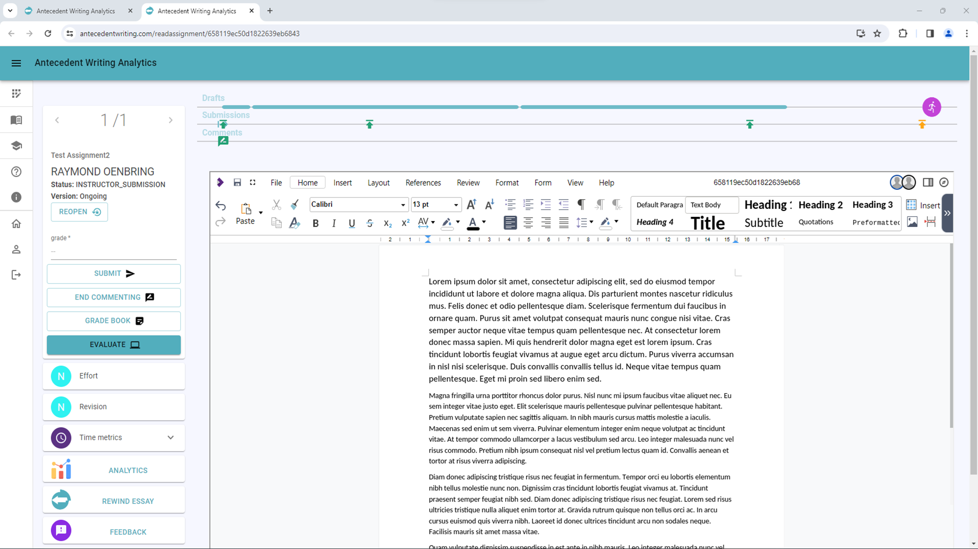
Instructor View (Writer)

Slide 8
Technical Deep Dive: How The Forge Captures Effort
Logging and Visualizing
Processing students “time on task” as well as complete edit history
Allows instructors to see student’s methodology and approach to writing and how the document has evolved across drafts and sessions of writing.
Proving specialized analytics and visualizations to discern patterns in behavior
Rewind and animation tools allow instructors to watch the writing process frame by frame.
Heat maps showcase color-coded grids to exemplify if effort was made in short bursts of writing, last-minute efforts, or longer sustained sessions to process complex information and/or build creative flow.
Word change and revision graphs display revision patterns which showcase steady development in structure, argument development, clarity of message, and comprehension.

Slide 9
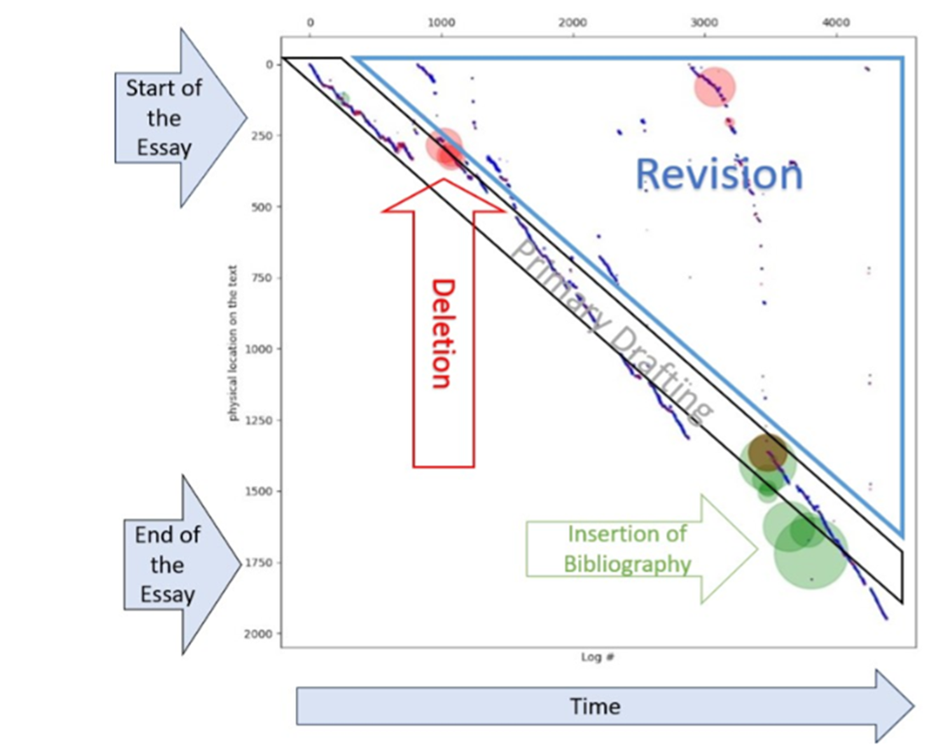
Analytics: EssayMaps
Content written at start of project is on the left of EssayMap
Content written on the top of project is on the top of EssayMap
Content that is pasted is indicated by green circles
Content that is cut is indicated by red circles

Slide 10
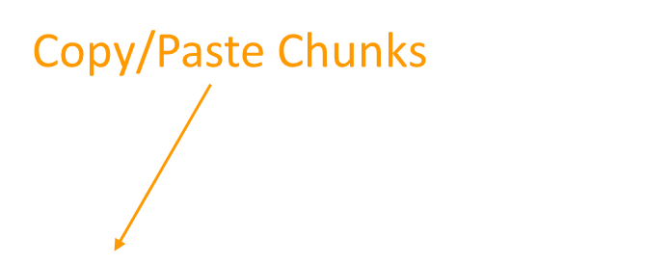
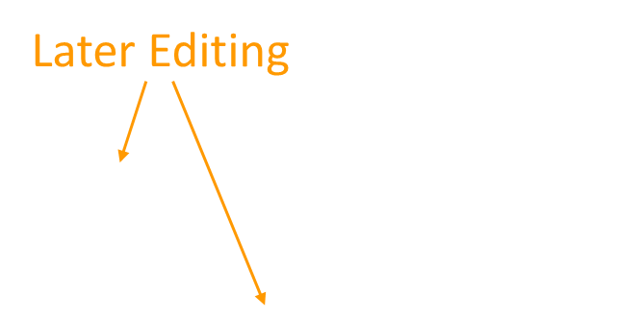
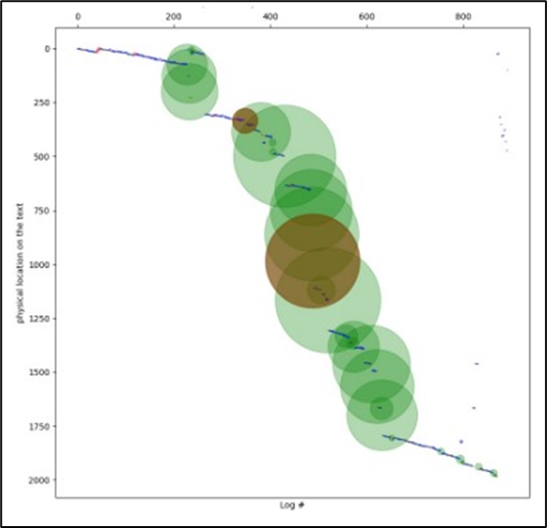
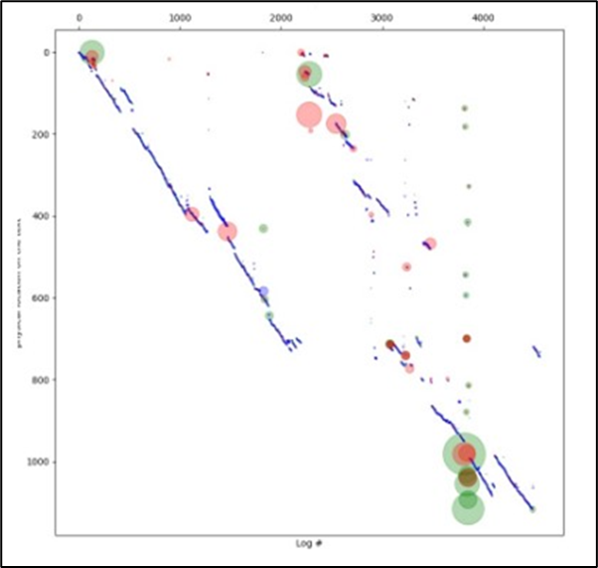
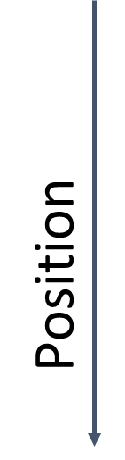
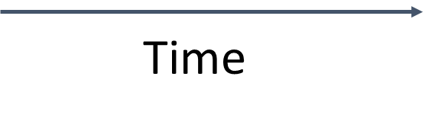
Analytics: EssayMaps (Cont.)

Slide 11
Technical Deep Dive: How The Forge Captures Effort (Cont.)
Process and Integrity
Aggregating metrics into an indicator of effort to provide a “score” instructors can review and consider in rubric evaluations.
Instructors can define these thresholds and to what degree they wish to use these analytics within their course grading practices.
A separate revision score focuses on the depth and frequency of revisions, which help instructors distinguish the iterative process versus the linear process of writing.
Instructors can see when large “drop ins” of pasted text are added which can signal additional evaluations may be necessary to verify the authenticity of the students’ voice in their writing.

Slide 12
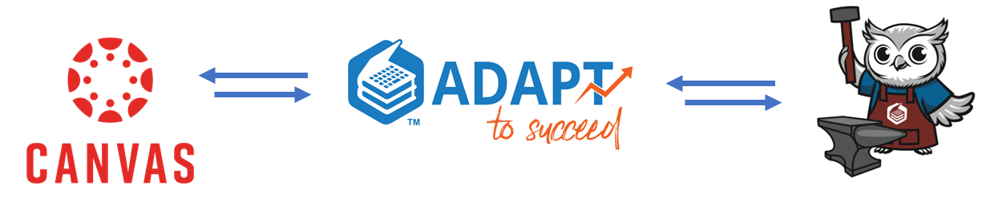
The ADAPT Integration Bridge
The Forge tracks process while ADAPT tracks item level performance.
Integrating both allows instructors to use ADAPT’s engagement and accuracy data in tandem with The Forge’s effort and revision scores to understand unique student experiences where additional problem practice or higher emphasis on drafting and revision may be necessary.

Slide 13
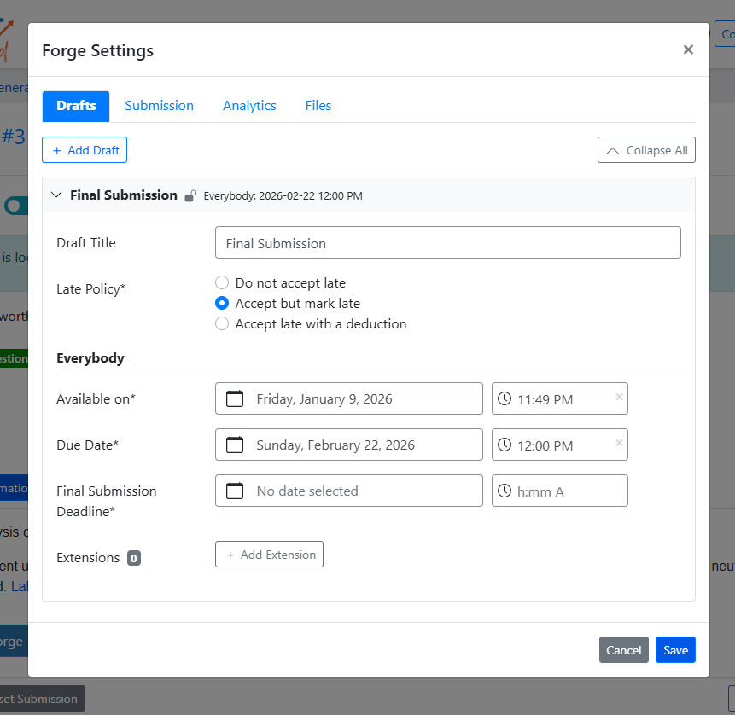
The ADAPT Integration Bridge (Cont.)
Instructors can pair a Forge assignment with the ADAPT advanced grading elements, which then integrates back into Canvas LMS.
For students, this translates to an ease of user interface and consistency in assignment location within the Canvas LMS.

Slide 14
Interdisciplinary Use Cases
Currently The Forge is being used in:
Humanities & Social Sciences
Quantitative, Professional,
& Applied Fields
Communication, Media, & Visual Disciplines
STEM Disciplines
The Forge supports long-form and data-rich assignments where students are required to:
Work on staged drafting and editing skills
Peer Review
Utilize spreadsheets, slide decks, and drawing tools
Co-create open pedagogy assignments that can be published directly through LibreText

Slide 15
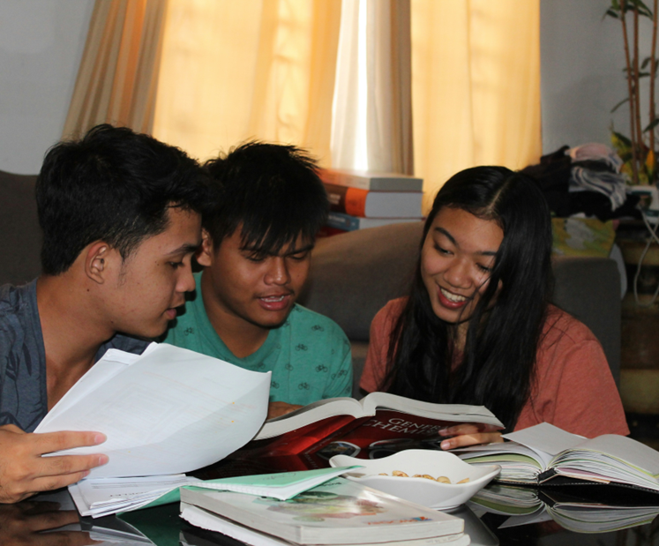
The Importance of Peer Review
Peer engagement theory posits that students learn and develop more effectively through interactions and collaborations with their peers, rather than in isolation.
Active Learning
Improved Understanding
Enhanced Communication Skills
Constructive Feedback
Critical Thinking
Revision and Improvement
Photo by Lanelle Ladero on Unsplash

Slide 16
Cañada College ENGL/LING 200 Fall 2025 Usage
Term project drafts for the paper using different documents for each draft with templates
Used to use Turn-It-In, but wanted to move away from that
Wanted to have students showcase the effort that they’re putting into their project
Wanted to know what students were copy/pasting versus writing and editing
Not looking to use AI ‘detectors’ 😡
Pre-ADAPT integration as a way to test it out and give input to developers

Slide 17
ENGL/LING 200 Fall 2025 End of Semester Survey Comments
Students said:
Forge times out quickly. It makes me reload.
The lag issues are frustrating.
Editing is a hassle; we can’t find the tools.
Google Docs and Microsoft Word can convey the same information about revisions that Forge does, and they work better.
Forge doesn’t work well in my browser.
My response:
Yes, I’ve noticed that, too. That’s on purpose, as it’s tracking your activity in the doc.
Yes, I’ve noticed lag. It’s not too bad— but it’s more obvious than GD/MW.
No, it’s the same layout as Word. It has all the same tools that GD/MW has. No excuse!
Nope! Forge lets me see your work in 30s intervals, shows me what you copied/wrote/edited, the amount of time you did this. GD/MW’s revision histories aren’t always accurate (esp. GD). I can’t control templates in GD/MW that I can with Forge.
The only browser that has issues is Safari (which is standard across tech).
Note: These comments were before the updates to the Forge and its integration into ADAPT.

Slide 18
ENGL/LING 200 Fall 2026: Ideas to Consider
Definitely keep using The Forge for the drafts of the term project
Will have students use the same document throughout
Considering using for weekly problem sets (using a template)
With improved infrastructure, many of the issues students reported in Fall 2025 are remediated or mitigated.
Explainer videos coming

Slide 19
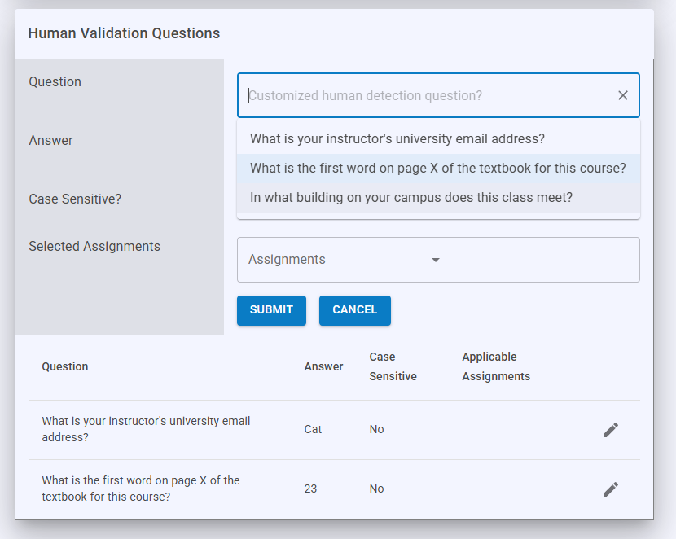
Human Validation Questions - The Forge as an Agentic AI Mitigation Tool
Agentic AI is a concern for many instructors where traditional assignments can be completed with minimal human cognition, allowing students to outsource not only drafting but also planning, research, and revision to automated systems.
Agentic systems can interpret prompts, break down tasks into component steps, search for relevant sources, adapt to rubrics, and iteratively refine output—often producing work that appears thoughtful and polished.
This raises questions about authorship, academic integrity, and, more fundamentally, whether submitted work reflects genuine learning.

Slide 20
Concluding Thoughts
Because students know that their revision and effort through the process of the assignment and not just the product of the assignment will be measured and evaluated, they are more likely (required) to implement aspects of critical thinkers rather than passive AI users.
This brings us back towards the metacognitive goals within both formative and summative assessments we discussed at the beginning of the presentation.
Instructors can design The Forge to allow or situate AI use strategically within the student’s workflow and use the analytic data to review if students moved beyond the AI assistance into deeper cognitive reflection.
Transparency in the process of how and where instructors are reviewing student created content and under what elements aligns with equity-minded pedagogical practices and brings the student into the experience as well.

Slide 21

Discussion, Questions, and Other Considerations
Photo by Madison Oren on Unsplash

