Slide 1
Introduction to ZTC Leadership
Revised February 11, 2026. OERI and ZTC TAP presentation, February 11, 2026, 12:00 pm – 1:30 pm. This work is licensed under a Creative Commons Attribution 4.0 International License.
Attribute this slide deck as: ”Intro to ZTC Leadership" by ASCCC OERI and ZTC TAP is licensed under CC BY 4.0.

Slide 2
Session Description
This training is for individuals who have recently assumed a leadership role with their college’s Zero Textbook Cost (ZTC) Degree Program grants, designed to quickly get you up-to-speed on OER and ZTC basics. This webinar is intended to ensure that faculty leads/coordinators, deans, directors, and others in management roles related to their college’s ZTC efforts have the knowledge and resources needed to be successful. Are you responsible for ZTC grant reporting and tracking but not sure how to spell OER and ZTC? This session is for you! - Topics will include OER and ZTC basics, including open licensing; making the case with faculty; and creating a local ZTC support team and workflow.

Slide 3
Presenters
James Glapa-Grossklag
Technical Assistance Provider (TAP), ZTC Degree Grant Program
Dean, College of the Canyons
Michelle Pilati
Project Director, ASCCC OERI
Psychology, Rio Hondo College
Notes:
Carrie - Find out who is in the room and who uses OER; disciplines?

Slide 4
Overview
Introductions
What is ZTC?
OER – What and why?
Reporting and Tracking
What do you need beyond $520,000?
Questions and Answers

Slide 5



ZTC Grant and Ed Code
Zero Textbook Cost (ZTC) Degrees
… community college associate degrees or career technical education certificates earned entirely by completing courses that eliminate conventional textbook costs by using alternative instructional materials and methodologies, including open educational resources ...
CA Education Code Section 78052(a)

Slide 6
ZTC Degree Grant Program
ZTC Degree Grant Program
AB 1602 / Ed Code 78050 - 78052 became effective July 27, 2021
$115 million investment to develop ZTC pathways across California community colleges system
Roll-Out Phases of ZTC Program
Planning Grant of $20K to 115 colleges in June 2022
Implementation Grant of $180K to 115 colleges in March 2023
Planning and Implementation Grants subsequently combined as Implementation Grant of $200k
Acceleration Grant of $21M to 84 colleges by December 2023
27 subject-matter Collaboration Cohorts facilitated by ASCCC OERI
Acceleration II, OER Expansion, and Impact Grants by December 2024 for $6M
ZTC 2025 Allocation of $320k in Feb 2025, to 115 college in flexible funds to backfill underfunded prior-awarded ZTC pathways or to develop new ZTC pathways, for $36.8M

Slide 7
ZTC Degree Grant Eligibility
Develop and implement one or more of the following program pathways:
An existing associate degree or career technical education certificate program, prioritizing existing associate degrees for transfer.
A new associate degree or career technical education certificate program that meets one of the following conditions:
Has a high value in the regional market.
Meets an emerging regional business industry need.
Has high textbook costs.
Maximum of $200k per program

Slide 8
Non-Duplication
The chancellor’s office shall ensure that a grant does not result in the development or implementation of duplicate degrees for a subject matter to avoid duplication of effort and ensure the development and implementation of the greatest number of degrees for the benefit of the greatest number of students.

Slide 9
Reporting
NOVA – Chancellor’s Office platform for grants
Colleges determine their contacts in NOVA
Program Plan – describe what you propose to do
Some colleges are past due in submitting program plans to describe how they will use the 2025 ZTC Allocation of $320k
Fiscal Report – inform what you did
Some colleges are past due in submitting reports about how they used the ZTC Implementation Grant of $200k
For reporting questions, contact ztctap@canyons.edu
For NOVA issues, contact ztc@cccco.edu

Slide 10
ZTC Pathways - Direct and Indirect
$115M investment
115 colleges funded with at least $520,000
680+ programs funded
410+ indirect programs identified
1100 total programs in development

Slide 11
What a ZTC Pathway Is - and Isn’t
A sequence of courses that lead to a credential
The credential is an ADT, AA/AS, or CTE CoA
Available to students in a consistent and predictable manner
Announced to students in the schedule of classes
Not every single section of a course
Not impinging on academic freedom of faculty

Slide 12
Determining a ZTC Pathway
What courses does a student need to complete the credential?
For an ADT, AA/AS, major courses and GE courses
Engage your counseling faculty, program advisors, and curriculum chairs

Slide 13

Identifying a ZTC Pathway
CCCs and CSUs are required by law to identify ZTC sections in their schedules of classes
Check your schedule

Slide 14

ZTC Technical Assistance

Slide 15
ZTC Monthly Office Hours
OER Librarian Office Hours
Discuss eBook licensing, reserve copies of ZTC/OER texts, Alma-D, cataloging OER, library roles on OER/ZTC teams, and more.
Open Licensing Office Hours
How do you license materials? How do you re-mix materials?
What about AI?!
Meet with your college committee, project teams, etc
Open Publishing Office Hours
Content Development and Storytelling
Strategies for Collaboration and Managing Publishing Teams
Enhancing your OER: Photos, Media, Illustrations
Publishing and Marketing your OER

Slide 16

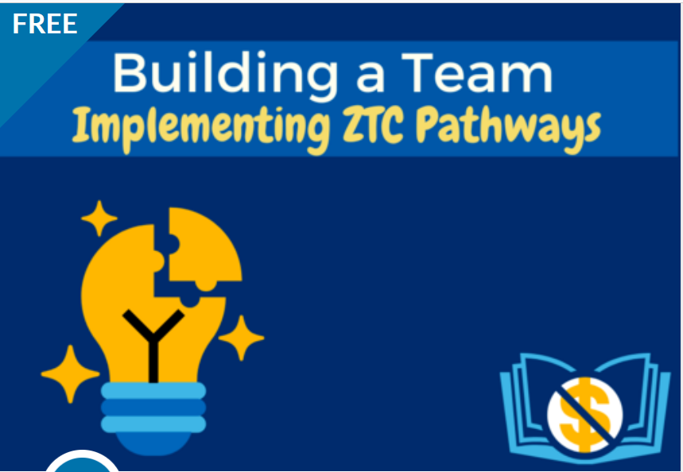



ZTC Courses via @ONE
In Canvas Commons search for #ZTCPD

Slide 17
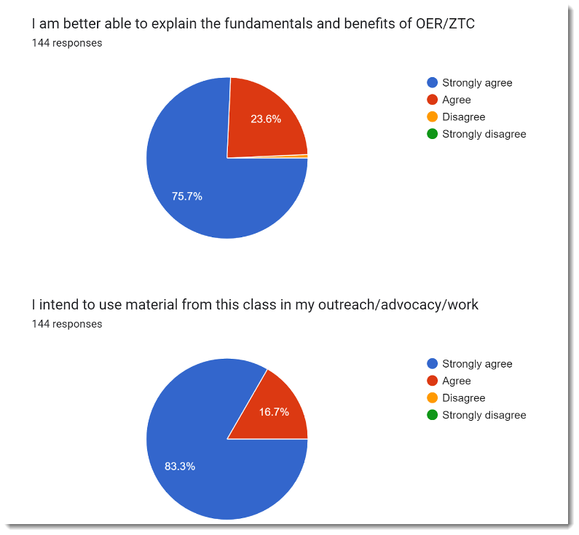
I intend to use material from this class in my outreach/advocacy
I am better able to explain the fundamentals and benefits of OER/ZTC
Data from evaluations,
all courses
Blue = Strongly Agree
Red = Agree
Notes:
Chloe

Slide 18
Chancellor’s Office ZTC email list
ZTC email list is the primary means of disseminating information about the ZTC Degree Grant Program
Send a subscribe request to ztc@cccco.edu

Slide 19

CCC OER Repository
LibreTexts of UC Davis selected as OER Repository for CCCs
Watch for trainings beginning soon

Slide 20
ASCCC and ZTC
Zero Means Zero Textbook Cost; Fall 2021; Resolution Number 3.05
The ASCCC:
recognizes OER as the preferred and most sustainable mechanism for eliminating course costs but acknowledge that instances will arise in which eliminating costs is not possible;
asserts that while OER can reduce or eliminate instructional materials and textbook costs, resources should be dedicated to convening discipline faculty to determine the most sustainable mechanisms for reducing the costs of course resources; and
encourage the use of approaches that significantly reduce course resource costs such that course sections with a low-cost can obtain zero-textbook-cost status by virtue of the cost being absorbed by the college, district, or the state.

Slide 21
What are Open Educational Resources?
“OER are teaching, learning, and research resources that reside in the public domain or are released under an intellectual property license that permits their free use and repurposing by others”
-- Hewlett Foundation

Slide 22
Examples of OER
Textbooks
Test banks
Homework Systems
Lab Manuals
Writing Exercises
Classroom Activities
Video/Audio Resources
Images
Interactive Exercises

Slide 23
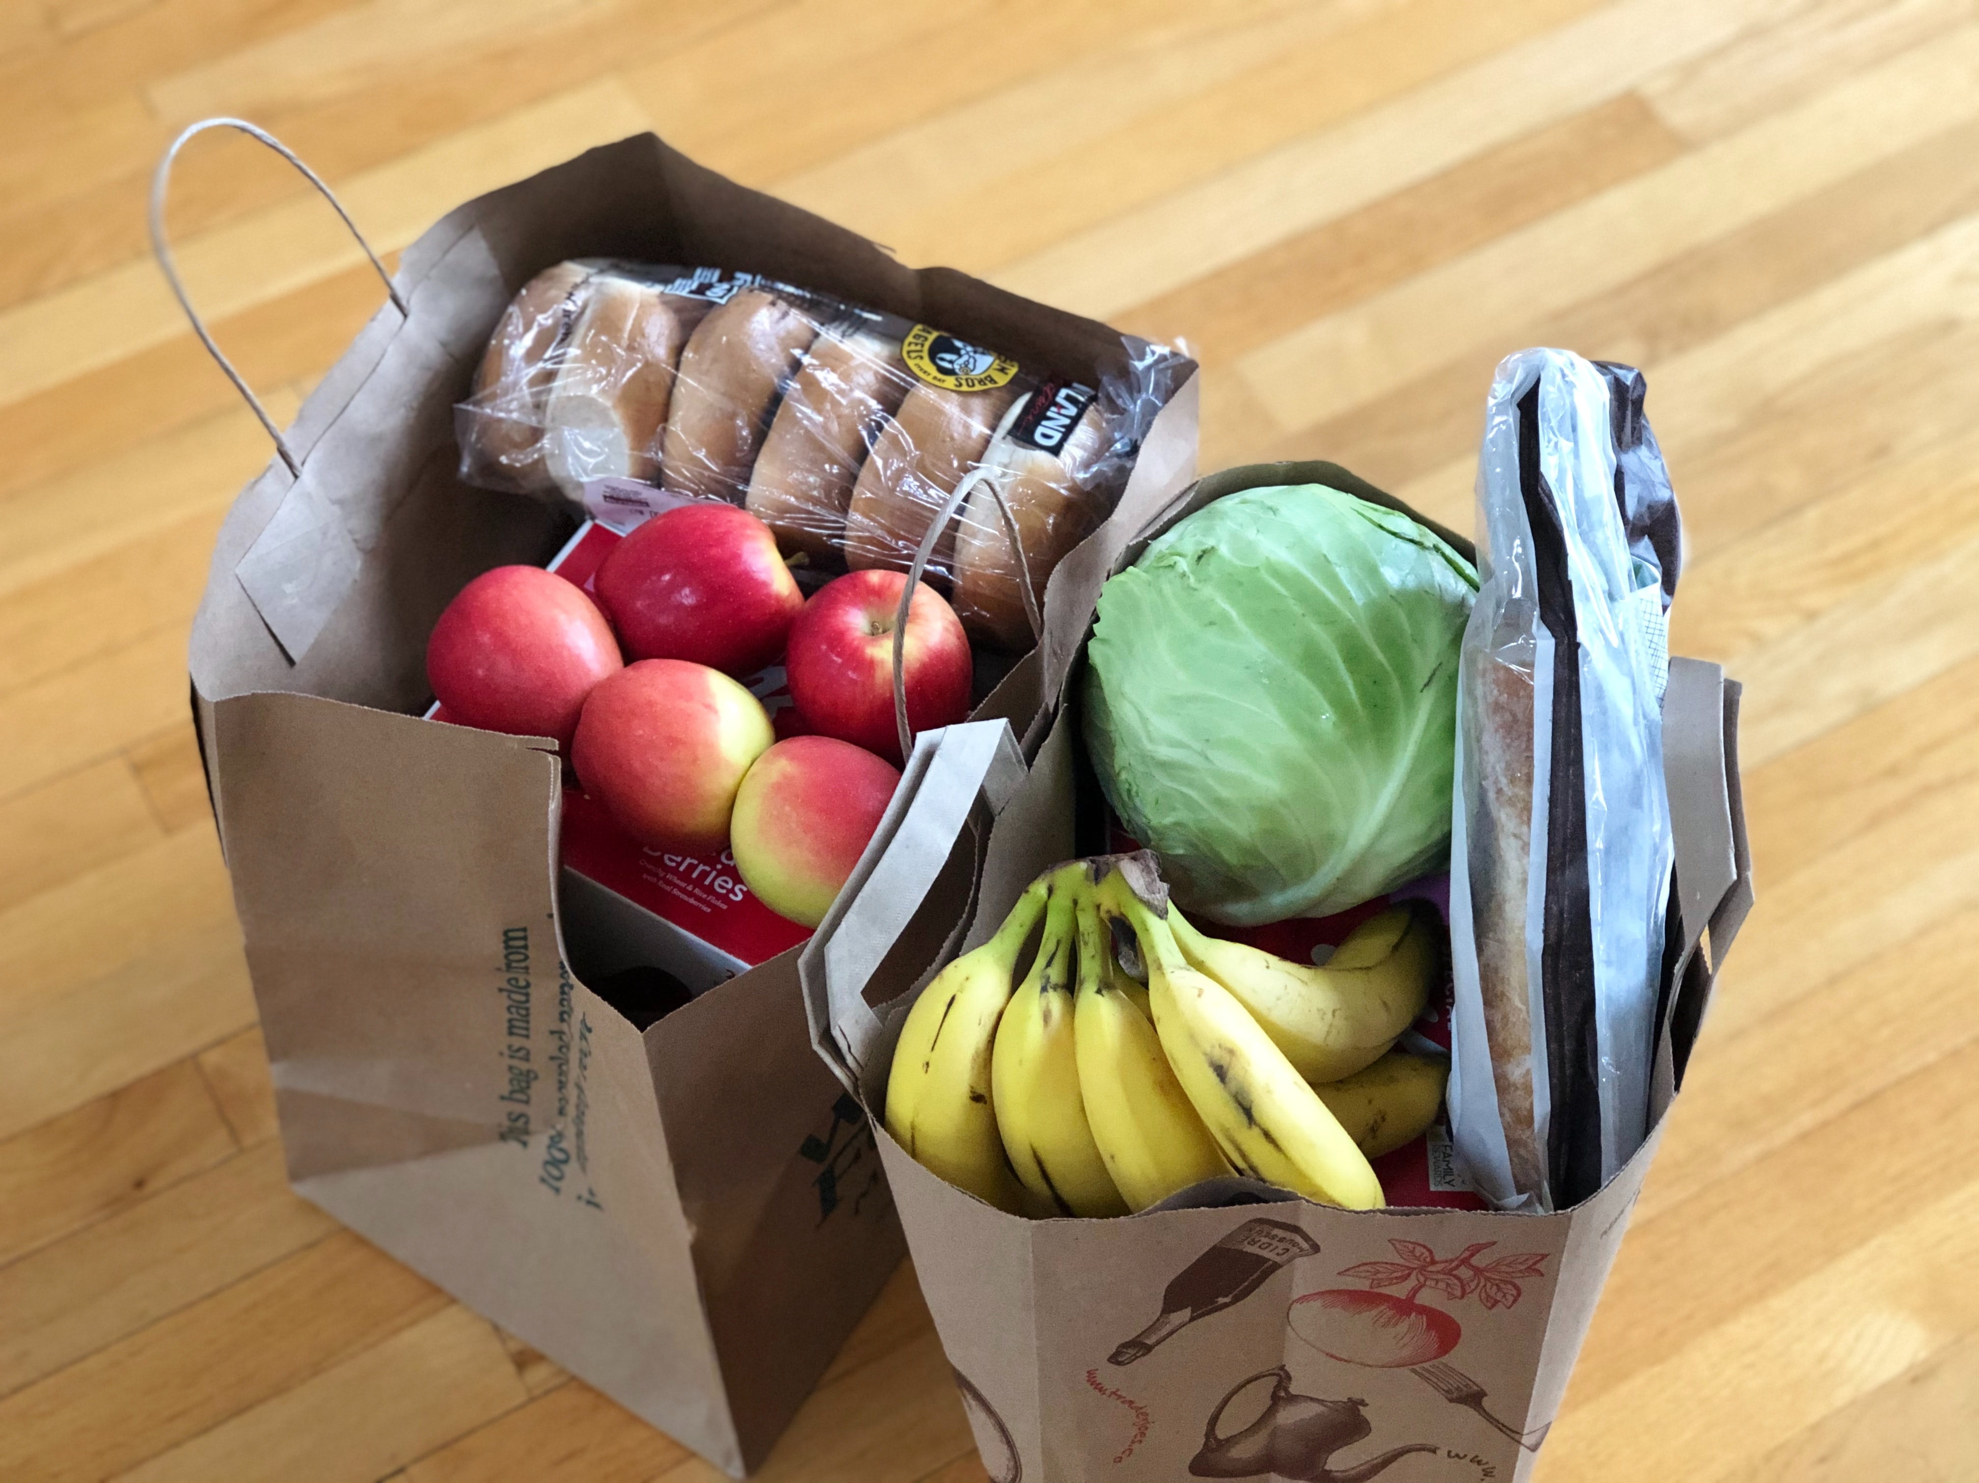
Why OER? For Students…
Textbook costs
Ensures access to resources is equitable
Enables all students to have materials on first day of class
Photo by Maria Lin Kim on Unsplash

Slide 24
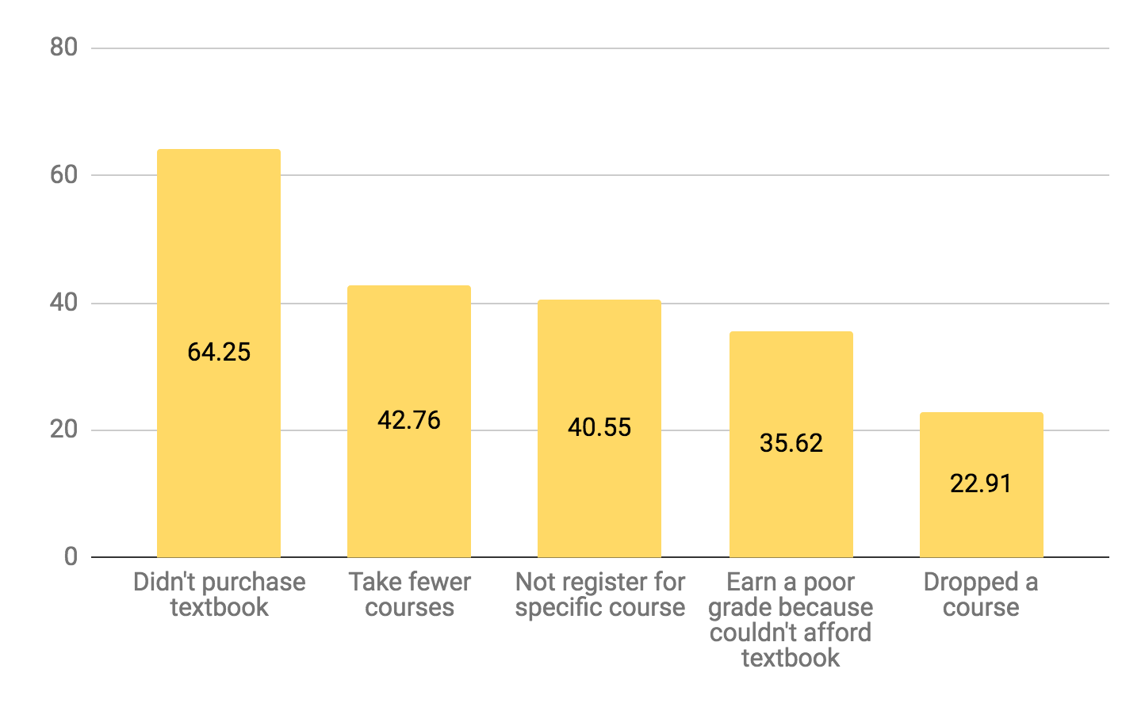
How have textbook costs impacted you?
Source: 2018 Student Textbook and Course Materials Survey Executive Summary

Slide 25
Free is Good, But Open is Even Better
When OER are truly “open”, they can be modified to meet the learning needs of students.
Faculty can teach the course the way they want to teach it—for example: reorder content, address bias, update research, enhance accessibility.
Faculty can collaborate with colleagues – and students (“open” pedagogy).
OER free faculty from the structures imposed by commercial texts.

Slide 26
ASCCC OERI
Established to implement OER systemwide by coordinating state level activities to increase OER availability and support local OER implementation.
Ensuring the sustainability of the ZTC Degree Program by updating commonly adopted resources.
Notes:
Michelle

Slide 27

OERI’s Primary Goal?
Increase the use of open educational resources in lieu of commercial texts by all reasonable means available.
Photo by Markus Winkler on Unsplash
Notes:
Michelle

Slide 28
Increase OER Use By…
Increasing awareness and availability
Improving access to high-quality OER
Making the adoption of OER easier
Supporting local OER advocates
Facilitating the development of OER
Promoting the development of discipline OER communities
Notes:
Michelle

Slide 29
OERI and ZTC
Supporting the ZTC Program is well-aligned with everything the OERI has been doing.
And the OERI has been demonstrating what collaboration can do.
And the OERI is well-prepared to support local efforts.
What has the OERI been doing?

Slide 30
Curated Collections (tinyurl.com/ZTC4CCCs)
Searchable ASCCC OERI OER by C-ID Collection
Collaboration Cohort Reported OER Usage by C-ID
OER by Discipline
OER by California State University General Education
OER by the California General Education Transfer Curriculum (Cal-GETC)
OER by Transfer Model Curriculum
ASCCC OERI – Identified Gaps in OER Availability

Slide 31
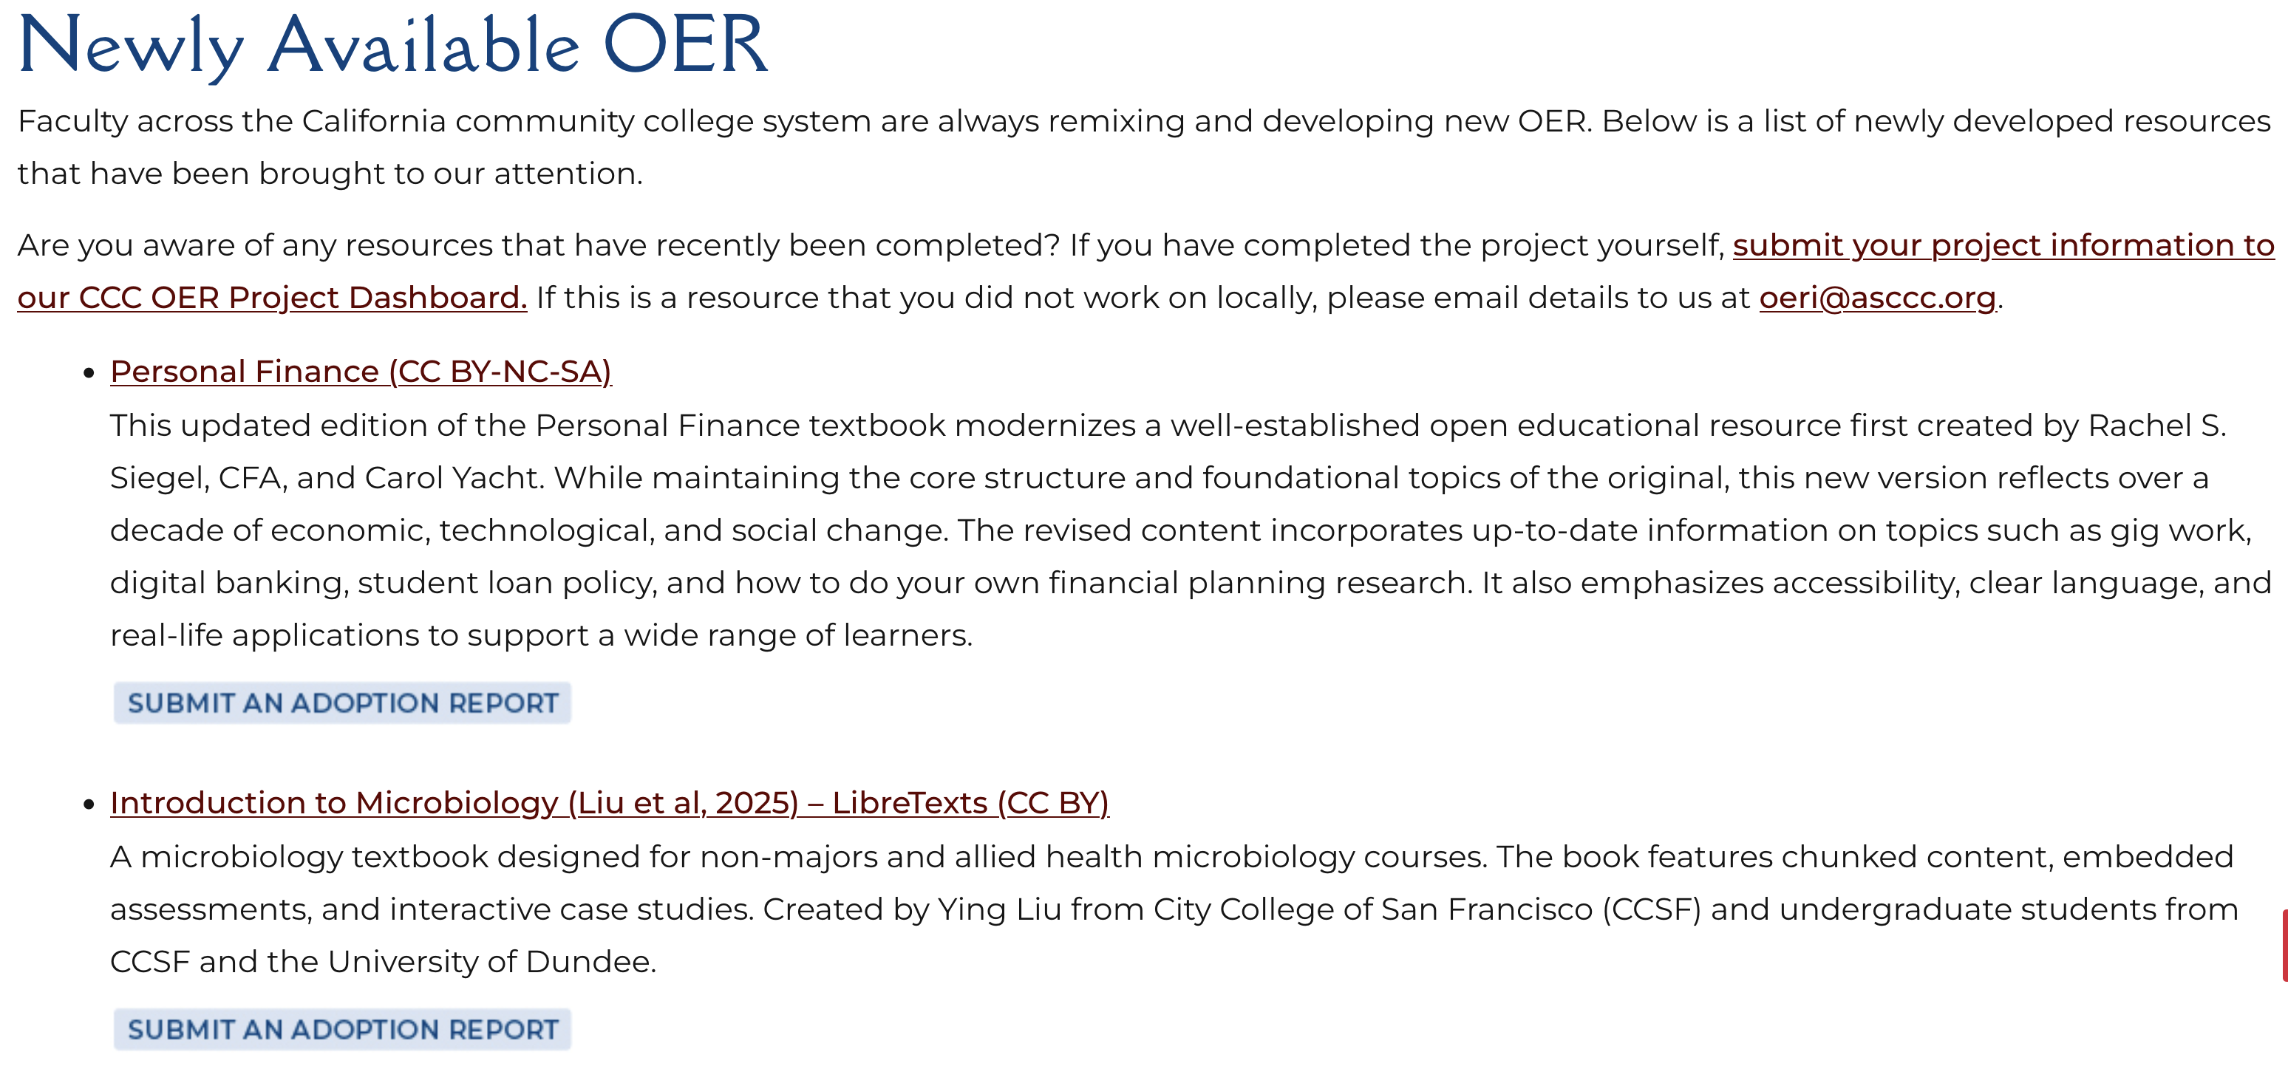
Tracking OER Development and Adoption
Notes:
https://asccc-oeri.org/newly-available-oer/

Slide 32
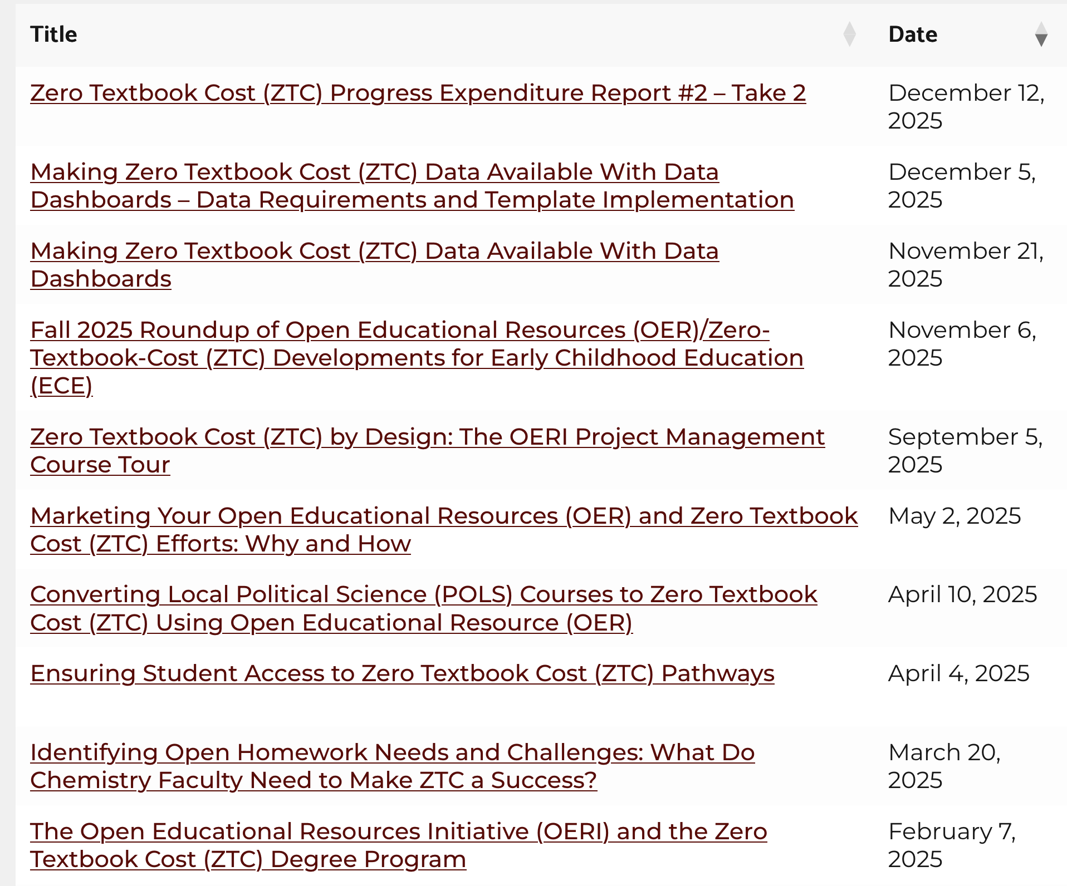
Extensive Collection of Archived Webinars
Notes:
https://asccc-oeri.org/webinars-and-events/

Slide 33
Upcoming Webinars
Measuring Effort and Analytics with The Forge
Friday, February 20, 2026 from 10:30 am – 11:30 am
In the Artificial Intelligence (AI) era, educators are increasingly challenged by writing assignments and the need to distinguish between student-generated work and AI-leveraged content. The Forge offers a solution by shifting the focus from the final product to the writing process itself. This webinar will explore how instructors across various disciplines – from composition, world languages, and linguistics to chemistry and statistics – can use analytic maps to gain deeper insights into how students construct their work and visualize the writing process. With The Forge’s new integration with the LibreTexts ADAPT homework system, students can access The Forge with a single click while providing instructors with analytical tracking and rubric abilities, aligning with equitable grading practices such as mastery grading, contract-based grading, and ungrading by empowering students to show their critical thinking and revision history.
Finding the Human Connection in a Digital World: Using Discuss-It to Build Community, Promote Critical Thinking, and Shift the Focus of Assessment
Friday, March 6, 2026 10:30 am – 11:30 am
In an age of automation, how do you ensure that student work remains a reflection of genuine learning? Join us to learn about Discuss-It, an openly-licensed tool within the LibreTexts platform. Discuss-It transforms discussions into interactive, multimedia exchanges through audio, video, and text. Learn how integrating voice and video responses can boost engagement, build community, and bring human presence back to your courses regardless of your discipline.

Slide 34
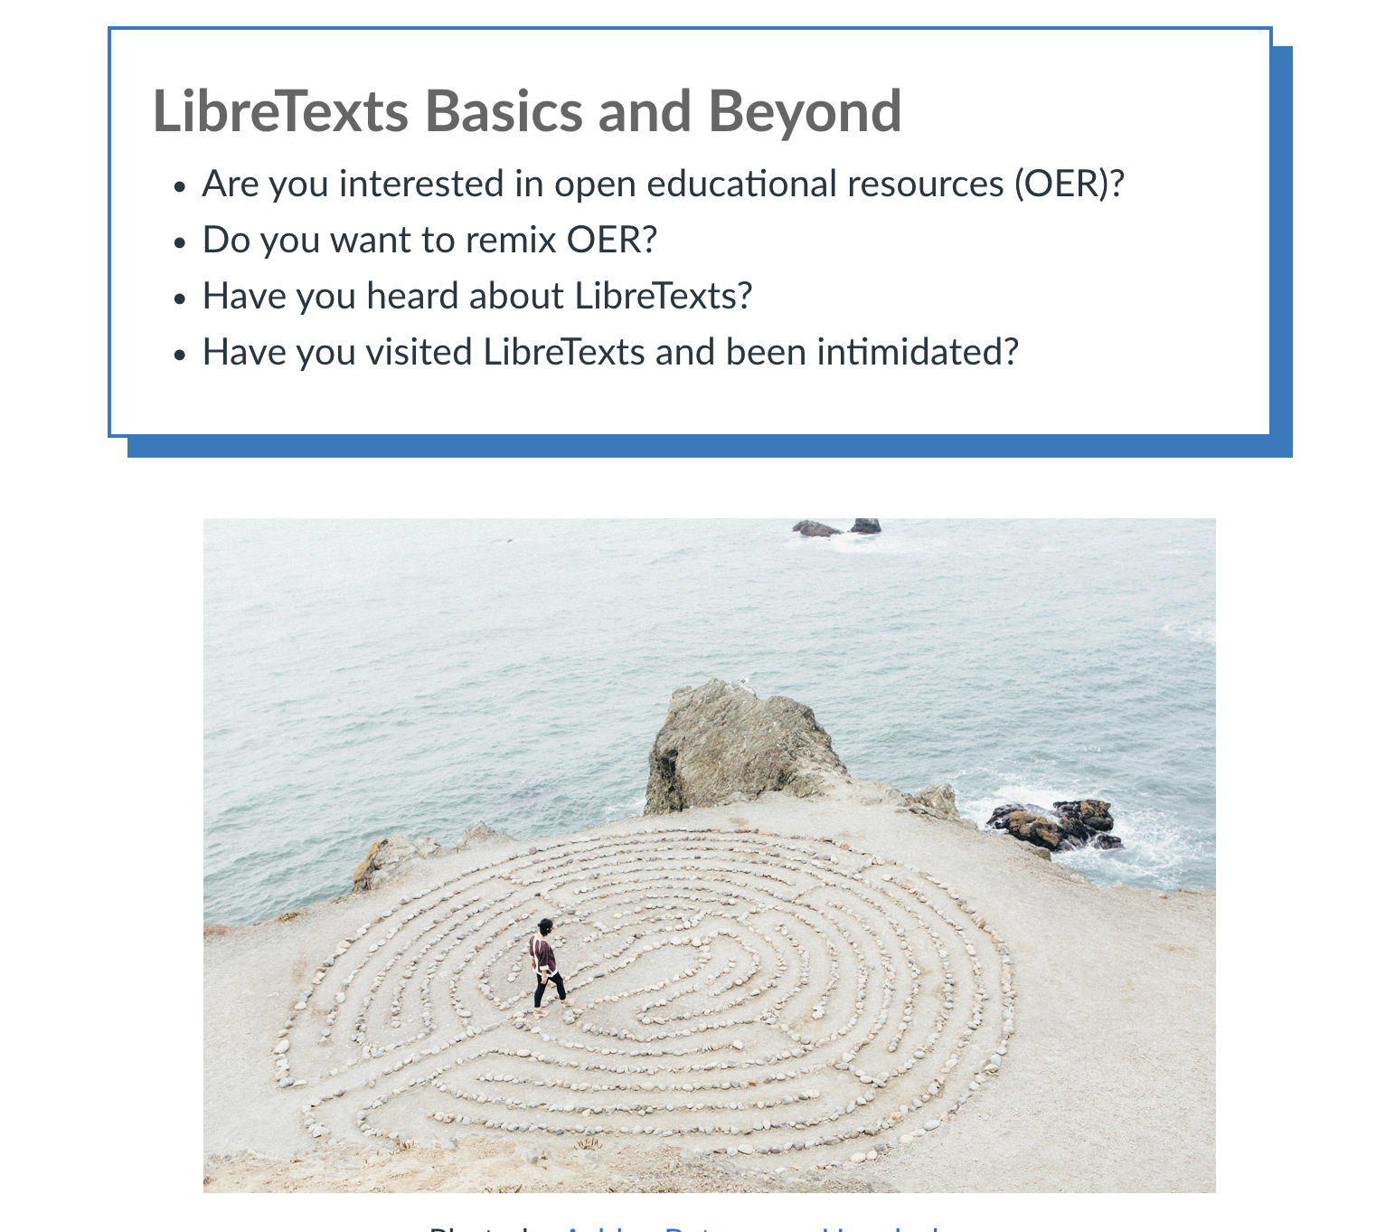
Courses
Accessibility Basics
OER Basics
OER Project Management
LibreTexts Basics and Beyond (new)
LibreTexts ADAPT (coming soon)

Slide 35
OERI Resources
OERI Website
asccc-oeri.org
OERI General E-Mail
oeri@asccc.org
ASCCC listservs (OERI and disciplines)
https://www.asccc.org/sign-our-newsletters
OER and ZTC
tinyurl.com/OER4ZTC

Slide 36
Reporting and Tracking
NOVA
COOL4Ed
XB12

Slide 37
XB12 and No-Cost Marking
XB12 – Section-level data element that indicates whether a course section is no-cost, low-cost (if locally established), or has a cost that is greater than low-cost.
How a course became no-cost must also be reported.

Slide 38
XB12 Codes
A. Section has no associated course material
C. Section has course material costs none of which are passed on to students
*D. Section has low course material costs (as defined locally)
E. Section uses only no-cost, OER course material
F. Section uses only no-cost digital course material that does not meet OER guidelines
G. Section uses a mix of no-cost OER and other cost bearing resources, but no costs are passed to the student
Y. Section does not meet no-cost or low-cost course material criteria
Notes:
* This is likely to change.

Slide 39
Contact Us
oeri@asccc.org
ztctap@canyons.edu

