Slide 1

Why Open Educational Resources (OER) Marketing Matters (and How to Start)
Creating or curating OER is only part of the work of a local OER lead — helping others find and understand OER is just as important. This webinar introduces the importance of marketing OER on campus and how it supports awareness, buy-in, and sustainability.

Slide 2

The Hidden Challenge Beyond Creating OER
Creation is Half the Battle
Discovery Drives Impact
Awareness Fuels Sustainability
Developing or curating high-quality OER requires significant effort, expertise, and time—but it's only the beginning of the journey.
Without intentional marketing, even the best OER often remain underused and unknown by those who need them most.
Building awareness and securing buy-in are critical for long-term program success and institutional impact.

Slide 3
The Stakes: Why Marketing OER is Essential
The challenge of OER adoption isn't just about availability—it's about awareness. Without strategic outreach and marketing, even well-funded OER programs risk invisibility and stagnation on campus.
Faculty and students alike face barriers to discovering and understanding OER, creating a critical gap between resources and the communities they're designed to serve.

Slide 4

If you build it, will they come?
The answer is often no—without intentional marketing and outreach.

Slide 5

What is OER Marketing? More Than Just Branding
Creating Exchanges
OER marketing is about creating exchanges that satisfy both individual and institutional goals. It's not just logos and taglines—it's about connecting people to valuable resources through clear, consistent messaging.
Connecting to OER
Aligning Goals
Effective marketing builds ongoing awareness over time, not just a single announcement. It creates sustained engagement and long-term buy-in across your campus community.
Building Awareness

Slide 6

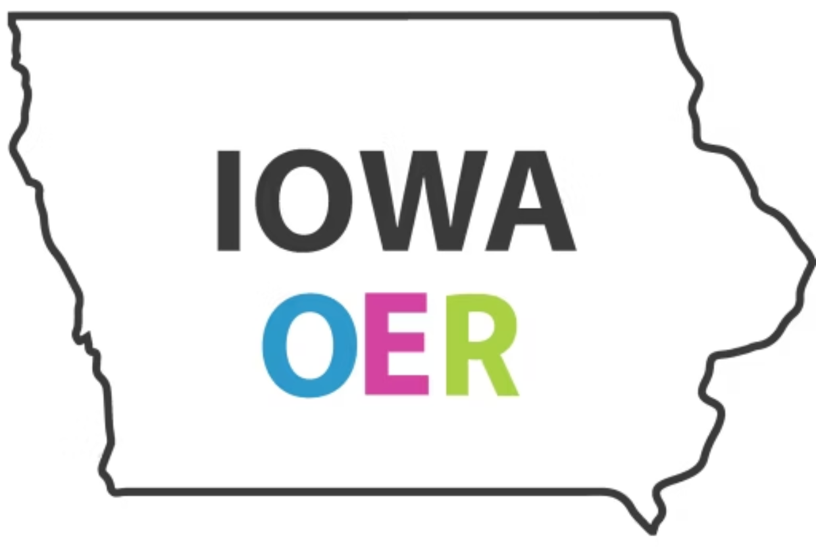
Building a Strong OER Brand Identity
Simplicity Creates Recognition
Simple, clear, and consistent branding builds recognition across all touchpoints. A memorable visual identity helps OER stand out in a crowded campus environment.
Case Study: Iowa OER
The Iowa OER logo uses the state outline and neutral colors to create unity across diverse institutions while maintaining local flexibility and institutional pride.
Iowa OER – Iowa OER is working to make higher education more affordable for students in Iowa by advocating for the use of open educational resources.
Align and Approve
Work within your institutional branding guidelines but always seek approval from marketing departments to avoid conflicts and ensure campus-wide consistency.

Slide 7

Crafting Your OER Message: Know Your Audience
Faculty Concerns
Faculty may be skeptical about quality and often unaware of benefits beyond cost savings. Address pedagogical flexibility, customization, and research-backed quality evidence.
Student Awareness
Students are often unaware of OER or confused about the difference between OER and simply "free resources." Clear, student-centered messaging is essential.
Tailored Messaging
Address awareness gaps, quality perceptions, and relevance for each audience. One message doesn't fit all stakeholders.

Slide 8

Marketing OER to Faculty: Building Trust Through Evidence and Relationships
Quality, Success, and Equity Data
Professional Development Opportunities
Focus on quality data, success data, and equity data that demonstrate OER's impact on student learning and access.
Highlight available PD resources such as the OERI Canvas courses, Libretexts, and Adapt course shells that support faculty adoption.
Celebrate and Recognize
Strategic Outreach
Focus on the celebration of adopters, adapters, and share general adoption numbers for the campus to build momentum.
Senate outreach, division and department level outreach to reach faculty where they already gather and make decisions.
The Power of 1:1 Relationships
Marketing to faculty can also be entirely about 1:1 relationships—personal conversations often drive adoption more than mass campaigns.

Slide 9

Marketing OER to Students: Cost Savings and Clear Pathways
Focus on Cost Savings
How to Find ZTC Courses and Degree Pathways
Students are most motivated by the financial impact—emphasize the direct cost savings and affordability benefits of OER materials.
Provide clear, accessible information about how to find Zero Textbook Cost (ZTC) courses and complete degree pathways that eliminate textbook expenses.
ZTC/LTC Distinctions Matter More
Involve Student Leadership
Students care less about OER as a concept and more about ZTC/LTC (Low Textbook Cost) distinctions—use language that resonates with their priorities.
Engage Associated Students and other student groups as partners in spreading awareness and advocating for OER adoption across campus.

Slide 10



Evidence-Based Messaging: The Power of Data
Equal or Better Quality
Significant Student Savings
Improved Outcomes
Studies consistently show OER materials equal or exceed the quality of traditional textbooks, with rigorous peer review processes.
Average textbook costs reach $1,200 per year. OER eliminates this barrier, making education more accessible and equitable.
Research demonstrates that OER adoption correlates with improved student success, retention rates, and deeper engagement with course material.

Slide 11
Practical Marketing Strategies for OER Leads
01
Start Where You Are
Leverage Existing Events
You don't need a massive budget or marketing team. Strategic, focused efforts with existing campus infrastructure can create significant impact.
Piggyback on campus events like Teaching & Learning Week, Open Education Week, and faculty development days to maximize reach without starting from scratch.
02
Create a Central Hub
Develop an OER webpage featuring clear benefits, real examples, success stories, and step-by-step how-to guides for adoption.
03
Targeted Workshops
Organize presentations and hands-on workshops tailored to specific groups—discipline-based faculty, adjuncts, or student leaders.

Slide 12




Low-Resource Marketing Tactics That Work
Social Media Stories
Strategic Partnerships
Visual Communication
Use existing campus social media channels to share faculty testimonials, student success stories, and quick OER facts that build awareness organically.
Collaborate with libraries, student government, faculty senates, and curriculum committees to amplify your message and share resources.
Develop simple, shareable infographics and one-pagers explaining OER benefits that faculty and staff can easily distribute.

Slide 13

Building Community and Recognition
Create Belonging
Establish a community of practice where OER champions can share strategies, troubleshoot challenges, and build collective momentum. Regular meetups create sustained engagement.
Celebrate Champions
Develop awards or competitive grants recognizing OER adopters and creators. Public recognition motivates participation and signals institutional commitment.
Showcase Impact
Host annual or semester events highlighting OER success stories. These gatherings foster relationships and create visible proof of program value.

Slide 14
CHAPTER 3
Getting Started — Your First Steps
Map Key Stakeholders
Craft Your Elevator Pitch
Identify champions, influencers, and decision-makers across campus. Tailor your outreach strategy to match their specific interests and concerns.
Assess Your Landscape
Develop a clear, concise 30-second explanation of OER benefits that you can adapt for different audiences—faculty, administrators, and students.
Conduct surveys or informal conversations to understand current awareness levels and attitudes about OER on your campus. Know where you're starting from.

Slide 15
Tools and Resources to Support Your Marketing
ASCCC OERI Marketing Toolkit
Ready-made templates, brochures, and digital assets to promote OER initiatives on your campus.
Open Education Week Resources
Access annual campaign materials, event ideas, and promotional content for global OER advocacy.
You don't have to create everything from scratch. The open education community has developed extensive resources you can adapt and customize for your campus context.
From presentation slides to data visualizations, leverage existing high-quality materials to accelerate your marketing efforts and maintain consistency with broader OER messaging.
OER Impact Data
Utilize statistics and infographics from organizations like SPARC or Babson to demonstrate OER benefits.
Campus OER Toolkit
Customizable presentation slides and handouts designed for faculty, administrators, and student outreach.

Slide 16




Overcoming Common Barriers
Quality Concerns
Clarify Misconceptions
Time Management
Address faculty skepticism with peer reviews, adoption testimonials, and research demonstrating equal or superior learning outcomes with OER materials.
Educate campus communities about the difference between "free" resources and true OER with revision and remix rights that enable pedagogical customization.
Focus on high-impact, repeatable activities rather than one-off events. Build systems and templates that can be reused semester after semester.

Slide 17

Marketing OER is the Key to Lasting Impact
Transform Hidden Gems
Marketing transforms OER from hidden resources into campus-wide assets that faculty actively seek out and students clearly understand.
Build Sustainable Programs
Strategic messaging creates awareness, secures buy-in from leadership, and ensures long-term sustainability for your OER initiatives.
Start Small, Stay Consistent
Begin with one or two focused strategies, maintain consistent communication, and watch your OER community grow organically over time.
Champion and Connect
Your role as an OER lead extends beyond creation—you are a champion, connector, and catalyst for educational change on your campus.

