Slide 1
Fresh and Easy?
Authentic Assessment for the Communication Studies OER Classroom in the Age of AI
Communication Studies Discipline Lead Webinar, March 4, 2026 2 PM
This powerpoint was created by Liz Encarnacion and is licensed under a Creative Commons Attribution 4.0 International License.)

Slide 2
Welcome!
On behalf of the ASCCC OERI, we are pleased to have you here with us for the Communication Studies Discipline Lead Webinar
If you are not already muted, please mute yourself upon arrival.
Please note that you are encouraged to use the Zoom “chat” feature for questions and comments.
You’re invited to introduce yourself in the chat – please provide your name, college, discipline/role
This event will be recorded. Archives of all ASCCC OERI events are available at asccc-oeri.org > Webinars and Events

Slide 3
Description
The current surge of generative and agentic AI can mean having to shift gears constantly as an instructor.
No matter the course and no matter the AI policy, this session will help support you in your OER classroom to find low-lift ways to refresh content, revise assessments, and identify boundaries or policies that align with your educational philosophy without having to overhaul your entire course.
Notes:
A description of the presentation is included in the slide deck so that the purpose of the slide deck is established – and to inform anyone viewing the presentation as to what was planned.

Slide 4

Presenters
Liz Encarnacion (they/she), ASCCC OERI Communication Studies Discipline Lead
Communication Studies, Chaffey College
Photo by Tim Mossholder on Unsplash
Notes:
Presenters can be included following the description or the overview. Where images are used, they should include an attribution (Photo by…) and appropriate alternative text should be used (or the image marked decorative).

Slide 5
Overview
Humans vs. Robots
Recognize where Communication Studies stands in relation to AI within education.
Refresh Assessment with OER
Discover practical ways to update assignments using the flexibility of open educational resources.
AI Boundaries and Policies
Explore a spectrum of instructor and student centered approaches for setting clear, trust-building AI expectations.
Create An Easy Refresh Plan
Utilize concrete skills and methods to practice on a current assessment or rubric.
Notes:
We'll move through four focused segments designed to build on each other — from understanding the landscape to walking away with an actionable plan.

Slide 6
AI Is Changing (Almost) Everything
Technological changes to education are inevitable, but the framework that guides learning does not have to.
Teaching critical thinking, how to apply expertise, ways to utilize personal experience and professional judgement to support problem solving will continue to be prioritized in human connection and social capital.
Resilient
Authentic
Adaptable
Notes:
The rise of generative AI — from ChatGPT to Copilot to increasingly autonomous agentic tools — has fundamentally reshaped how content is created and how students approach writing, research, and even speech preparation.
For instructors, the pressure to adapt can feel relentless. But the goal isn't constant course overhauls. Instead, we should aim for assignments that are resilient, authentic, and adaptable

Slide 7
The Human versus the Robot
Critical Thinking
Evaluating evidence, questioning assumptions, and constructing reasoned arguments remain distinctly human competencies.
Interpersonal Awareness
Reading nonverbal cues, navigating conflict, and building empathy require lived relational experience.
Rhetorical Strategy
Crafting persuasive messages that resonate with specific audiences demands contextual judgment AI cannot replicate.
Audience Adaptation
Adjusting communication in real-time based on audience feedback is an emotionally intelligent skill.
Notes:
Communication Studies sits at a unique intersection. Our discipline prizes skills that are deeply human — and that's both our challenge and our advantage in the age of AI.
Chat Prompt - Which skill in Communication Studies do you think AI can authentically replicate?

Slide 8
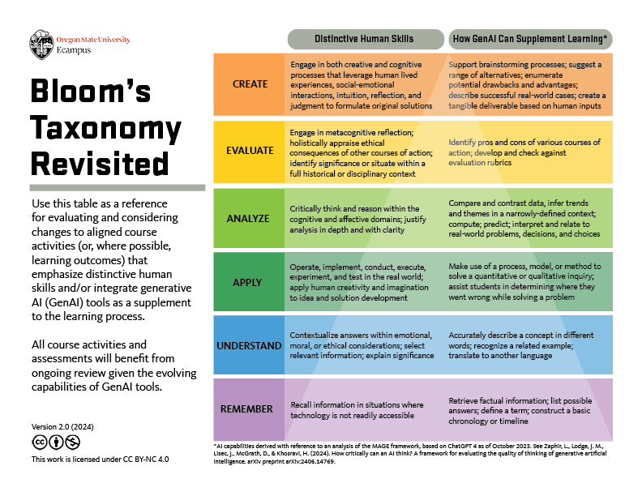
Authentic Assessments
Notes:
Authentic assessments are naturally more resistant to AI shortcuts. When we design assignments that invite context, personal perspective, and transfer skills, we create learning experiences that AI-generated text simply can't fake. And because OER gives us the freedom to revise and remix at will, we can continuously refresh our materials — no publisher timelines, no cost barriers, no permission hoops.
Authenticity - Grounds work in real contexts and lived experience
Process - Emphasizes drafting, reflection, and iteration over polished products
Reflection - Asks students to connect learning to personal growth and identity

Slide 9
Leverage What You Already Have
The Communication Studies OER “world” already offers strong foundational content that's ready for adaptation. None of us need to be starting from scratch when we can remix with intention.
Public Speaking (C-ID COMM-110)
Speech outlines are highly adaptable for contemporary issues and context.
Scaffolding speech drafting process into smaller assignments builds on the theory of metacognitive exercise and process-based grading systems.
Notes:
Metacognitive exercises are process-based grading systems that reward reflection to deepen learning
Metacognitive exercises require students to make the thinking process more important than the final outfit. Key strategies include process documentation, outlining, brainstorming, and engaging in the “why’s”
Foster revision and multiple attempts
By allowing students to revise and resubmit work without penalty, the focus shifts from meeting deadlines to learning from mistakes. This encourages students to analyze feedback and refine their understanding to improve their work
Increase Formative over Summative Assessments
Emphasizing low-stakes drafts, peer reviews, and scaffolded assignments builds on-going active learning, as oppose to fewer high stakes summative assignments that can be easily outsourced.

Slide 10
Leverage What You Already Have (Cont.)
Interpersonal Communication (C-ID COMM 130)
Self-assessments are ideal for reflective practice
Higher-levels of application based learning opportunities as opposed to recall and memorization strategies.
Small Group Communication (C-ID COMM 140)
Focus on real groups doing real work
Perfect for open pedagogy principles to become reality!
Focus on local, dynamic, or “class-specific” content
Layer process, product, and reflection opportunities throughout the group engagement sessions in order to build individual accountability while fostering team dynamics.
Process can include recorded meetings, process logs, revision/decision paths that make it harder to unethically include AI use
Notes:
Require local, dynamic, or “class‑specific” content Use prompts that reference:
Your college context, current campus issues, or class‑generated data
In‑class activities, case studies, or discussions Generic AI can’t easily “know” your classroom history.
Build in structured, evidence-based reflection After group work, students must:
Connect experiences to specific theories/concepts
Cite course OER chapters
Reference specific group moments (quotes, decisions, conflicts) AI can’t convincingly fabricate detailed lived experiences over time.

Slide 11
Authenticity Checks for
A Quick Reset
These three authenticity checks offer simple, strategic ways to make any assessment more authentic:
Person. Connect to student experience, identity, or community.
Process. Include visible stages. Process-oriented work reveals learning in motion.
Product. Encourage diverse formats (video, audio, live presentations). Multimodal work is harder to outsource to AI.

Slide 12
Communicating Your AI Expectations
Build Transparency and Trust!
Syllabi & Rubrics
Incorporate AI policy language directly into your syllabus, your homepage, welcome week module and assignment rubrics.
Equal Expectation Setting
Disclose if you as the instructor will be using AI through presentation building, AI detection software, plagiarism checkers, etc. Set the same expectations for students as you do yourself to model positive and ethical behaviors in the profession.
Collaborative Revision
OER makes it possible for faculty and students to collaboratively revise policies and share best practices for each classroom. Setting boundaries and expectations together helps to bring students into the norm setting experience to deepen the ground rules framing and context.
Notes:
Clear communication about AI expectations builds trust and reduces anxiety — for both you and your students

Slide 13
Plan Your Refresh
Reflection: What's one small change you can apply in your current courses or before next semester?
Step 1: Identify
One assignment that feels vulnerable to AI shortcuts or no longer engages students the way it use to.
Step 2: Revise
Using one authentic check: person, process, or product.
Step 3: Reinforce
Through a policy or reflection element that sets clear expectations.
Notes:
Choose one "stale" assessment — an assignment that feels vulnerable to AI shortcuts or no longer engages students the way it once did.
Apply one authentic check— Person, Process, or Product — to refresh the assignment with minimal effort and maximum impact.
Add a policy or reflection element: an AI use declaration, a self-assessment, or updated rubric language that sets clear expectations.

Slide 14
Resources and Notes
4 Steps to Design an AI-Resilient Learning Experience, MIT
Oregon State University ECampus - Bloom’s Taxonomy Revisted
Public Speaking (C-ID Comm 110) Canvas Shell of OER Resources
Metacognitive Study Strategies

Slide 15

Discussion, Questions, and Other Considerations
Photo by Madison Oren on Unsplash
Notes:
Liz

