Slide 1
ASCCC OERI OERL Webinar: Engaging Students: Surveys, Bookmarks, and Tools for OER Momentum at Your College!
Revised 2/28/2026
This work is licensed under a Creative Commons Attribution 4.0 International License.
Notes:
The Open Washington Open Attribution Builder is a handy tool for creating your attributions, if you’d like to indicate how your work should be attributed or if you are using resources that require attribution. https://www.openwa.org/attrib-builder/ Including how your presentation is licensed on your title slide is an effective way of making this clear. OERI resources are most commonly licensed CC BY, allowing others to use and modify them – but requiring that they be properly attributed.

Slide 2
Welcome!
On behalf of the ASCCC OERI, we are pleased to have you here with us for “Engaging Students: Surveys, Bookmarks, and Tools for OER Momentum at Your College!”
”
If you are not already muted, please mute yourself upon arrival.
Please note that you are encouraged to use the Zoom “chat” feature for questions and comments.
You’re invited to introduce yourself in the chat – please provide your name, college, discipline/role
This event will be recorded. Archives of all ASCCC OERI events are available at asccc-oeri.org > Webinars and Events

Slide 3

Engaging Students: Surveys, Bookmarks, and Tools for OER Momentum at Your College!
OERL Webinar; Monday, March 2, 2026 | 11:00 am – 12:00 pm
Creative Commons license (recommended - This work is licensed under a Creative Commons Attribution 4.0 International License.)
Fig. 1. "student engagement abstract" (prompt), DALL-E, OpenAI, 27 Feb. 2026, chat.openai.com. Copyright status: No copyright claimed (U.S.); AI-generated image.

Slide 4
Description
Students experience textbook costs and access barriers every day—yet many don’t know that ZTC and OER options even exist, and their perspectives sometimes go unheard. This webinar equips OER Liaisons with simple, ready-to-use tools to change that. Participants will learn how to engage students using a shared, IRB approved student-facing survey that can be deployed immediately with built in blurbs, and customizable bookmark templates designed to raise awareness, spark curiosity, and invite participation. The session shows how to engage students to build OER momentum across campus. With no complex research setup and no added workload, this session focuses on plug-and-play tools that help students feel seen while grounding OER efforts in authentic, campus-relevant student voice.
Notes:
A description of the presentation is included in the slide deck so that the purpose of the slide deck is established – and to inform anyone viewing the presentation as to what was planned.

Slide 5

Presenters
Rachel Fleming, ASCCC OERI Region D Lead
OER Librarian & ZTC Coordinator, Irvine Valley College
Cristina Moon, ASCCC OERI Region B Lead and ADAPT Lead
Spanish, Chabot College
Photo by Siora Photography on Unsplash

Slide 6
Overview
Why engage students
The Awareness Problem
Student voice with hesitant faculty or admin
Getting big names to show up
Tool 1: IVC Survey ready to go!
Tool 2: Bookmark templates!
Further tools to explore
Q&A

Slide 7

Why Engage Students?
Students live the problem: cost, access delays, and “day-one” barriers show up in real time
Awareness is the bottleneck: many students don’t know ZTC/OER exists even when they’re enrolled in it
Student voice accelerates buy-in: it helps hesitant faculty/admin move from “in theory” to “this is happening here”
Better messaging + better design: student feedback improves how we label, explain, and deliver ZTC pathways
Momentum is contagious: when students start asking for ZTC options, campus attention follows
Low lift, high impact: quick, plug-and-play tools (survey + bookmarks) gather insights without heavy research setup
Fig. 1. "student engagement abstract" (prompt), Adobe Firefly, 27 Feb. 2026, firefly.adobe.com. Copyright status: No copyright claimed (U.S.); AI-generated image.

Slide 8

The Awareness Problem
Most students don’t recognize the terms: “ZTC” and “OER” often mean nothing until we define them
ZTC can be invisible even when it exists: students enroll without realizing a course/degree is ZTC
Cost info isn’t consistently clear at the point of decision: students need clarity during search, plan, register
Students default to “textbooks are just expensive”: they don’t know there are alternatives or how to find them
Mixed signals create distrust: “free” claims can feel confusing if there are printing, access-code, or platform costs
Result: low demand + weak feedback loops: campuses struggle to scale ZTC because student voice isn’t captured
Fig. 1. "student interface cost abstract" (prompt), Adobe Firefly, 27 Feb. 2026, firefly.adobe.com. Copyright status: No copyright claimed (U.S.); AI-generated image.

Slide 9
Student voice with hesitant faculty or admin
Student questions shift the conversation from “optional initiative” to “current student need”
Academic freedom stays intact — students aren’t overriding faculty; they’re sharing lived impact
Real-time feedback is persuasive: one authentic student moment can do what emails and reports can’t
Student voice reduces defensiveness: it reframes OER as service, not a critique of teaching choices
Creates a clear pathway to action: questions → curiosity → “okay, how do I switch?”
Your role: make the connection by giving students simple language + a place to direct questions
Fig. 1. "student engagement abstract" (prompt), DALL-E, OpenAI, 27 Feb. 2026, chat.openai.com. Copyright status: No copyright claimed (U.S.); AI-generated image.

Slide 10

Credibility & Clout: Getting Big Names & Faces to show up to Events with OER and ZTC visible and celebrated!
Visibility matters: leadership presence signals “this is real, supported, and worth joining”
Make it easy to say yes: short time ask, clear role, clear photo moment, clear talking point
Give them what they already want: a positive student-centered story + a photo for campus comms/social
Design the “photo-proof” moment: branded slide/sign, bookmark display, student quote board, “ZTC Saves $$” prop
Use students as the centerpiece: a quick student thank-you or 30-second quote makes it authentic
Follow-up amplifies momentum: post-event photos + a link/QR (“Find ZTC classes”) keeps OER visible after the event
Fig. 1. "campus leadership engagement abstract" (prompt), DALL-E, OpenAI, 27 Feb. 2026, chat.openai.com. Copyright status: No copyright claimed (U.S.); AI-generated image.

Slide 11


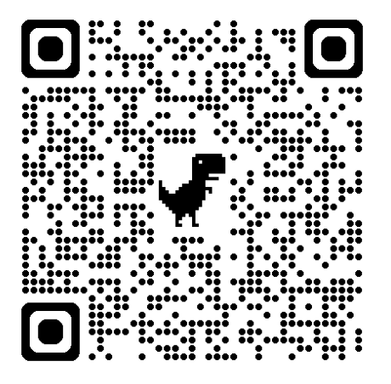
Tool 1: Survey from IVC ready to deploy!
Ready to go, live right now!
Brings student voice to the ZTC conversation
Any college that participates will receive access to all the de-identified dataset
Ready to go blurbs: https://asccc-oeri.org/ztc-degree-feasibility-study-student-survey-sharing-request/

Slide 12
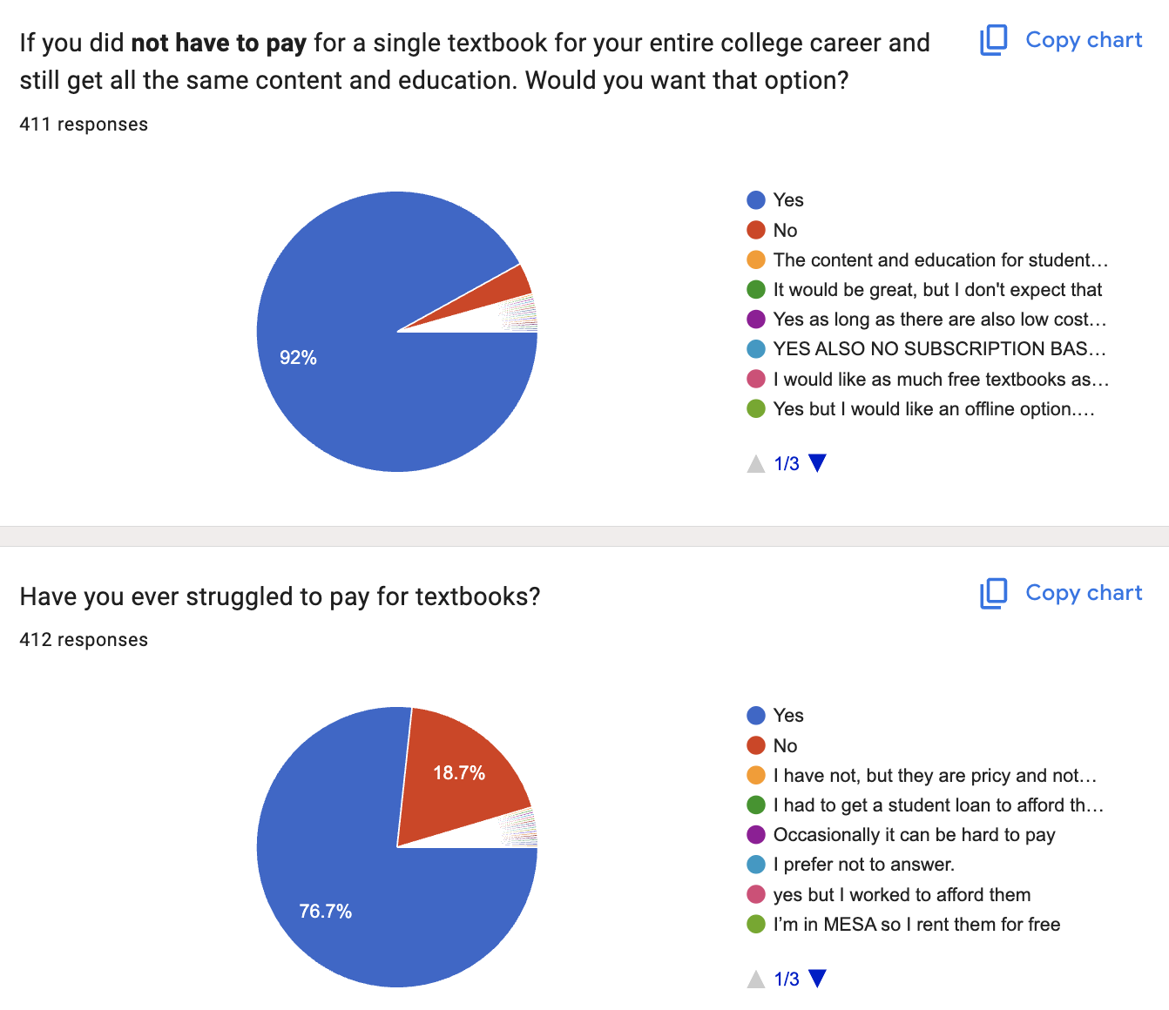
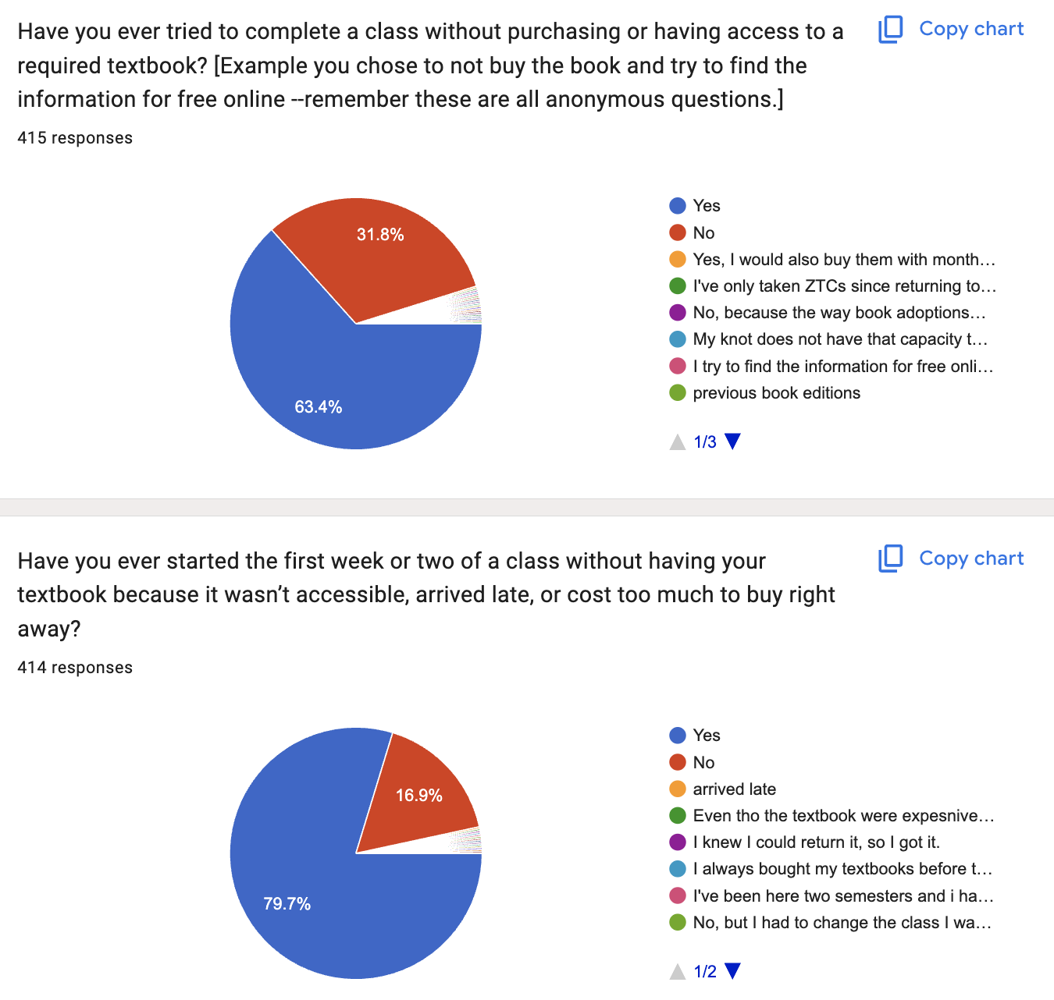
LIVE DATA: Insightful Information Behaviors and Needs From Our Students!
Screenshots of Data: ZTC Degree Feasibility Study by IVC Library,, licensed under CC BY-NC-SA 4.0. Screenshot taken 27 Feb. 2026. Survey live until May 2026.

Slide 13
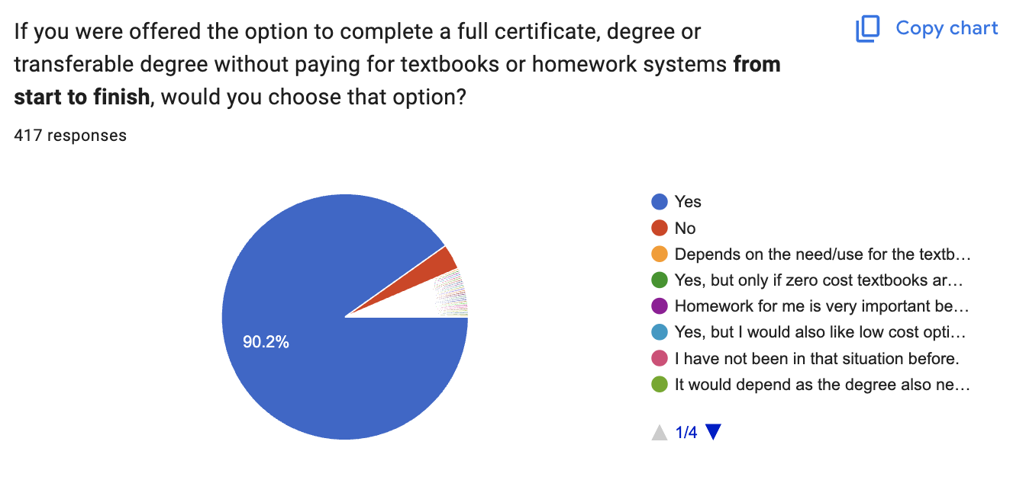
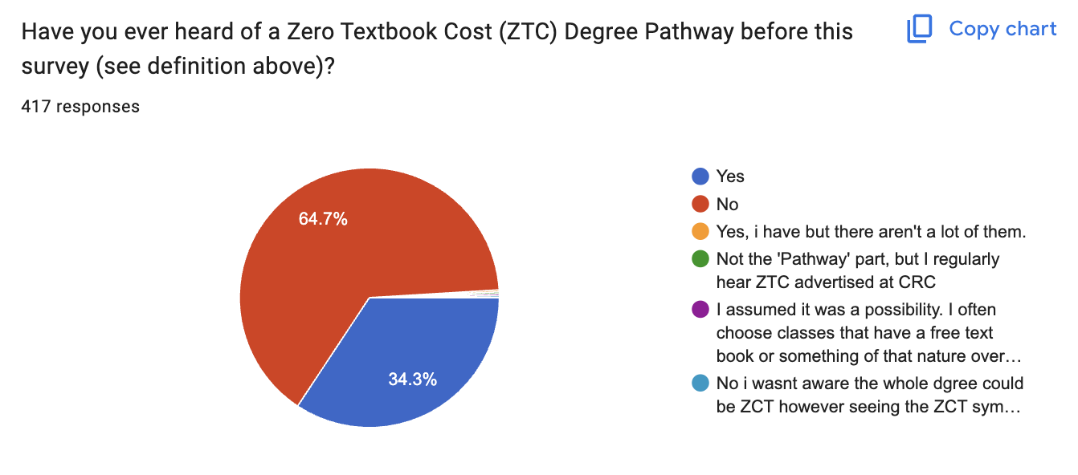
Students don’t know but they would like it if they did!
Screenshots of Data: ZTC Degree Feasibility Study by IVC Library,, licensed under CC BY-NC-SA 4.0. Screenshot taken 27 Feb. 2026. Survey live until May 2026.

Slide 14
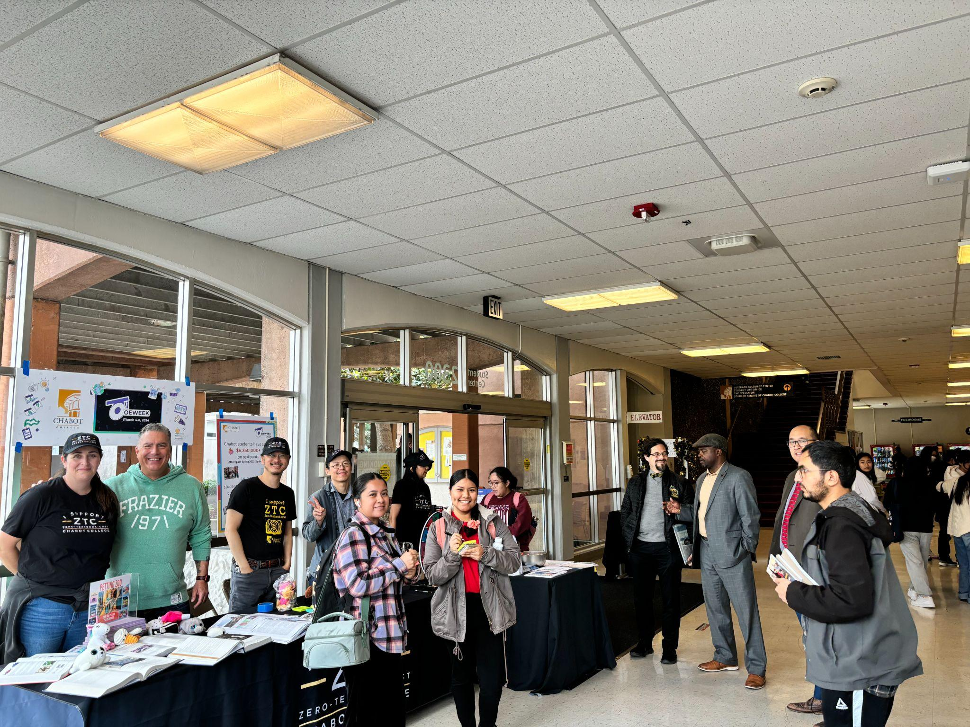
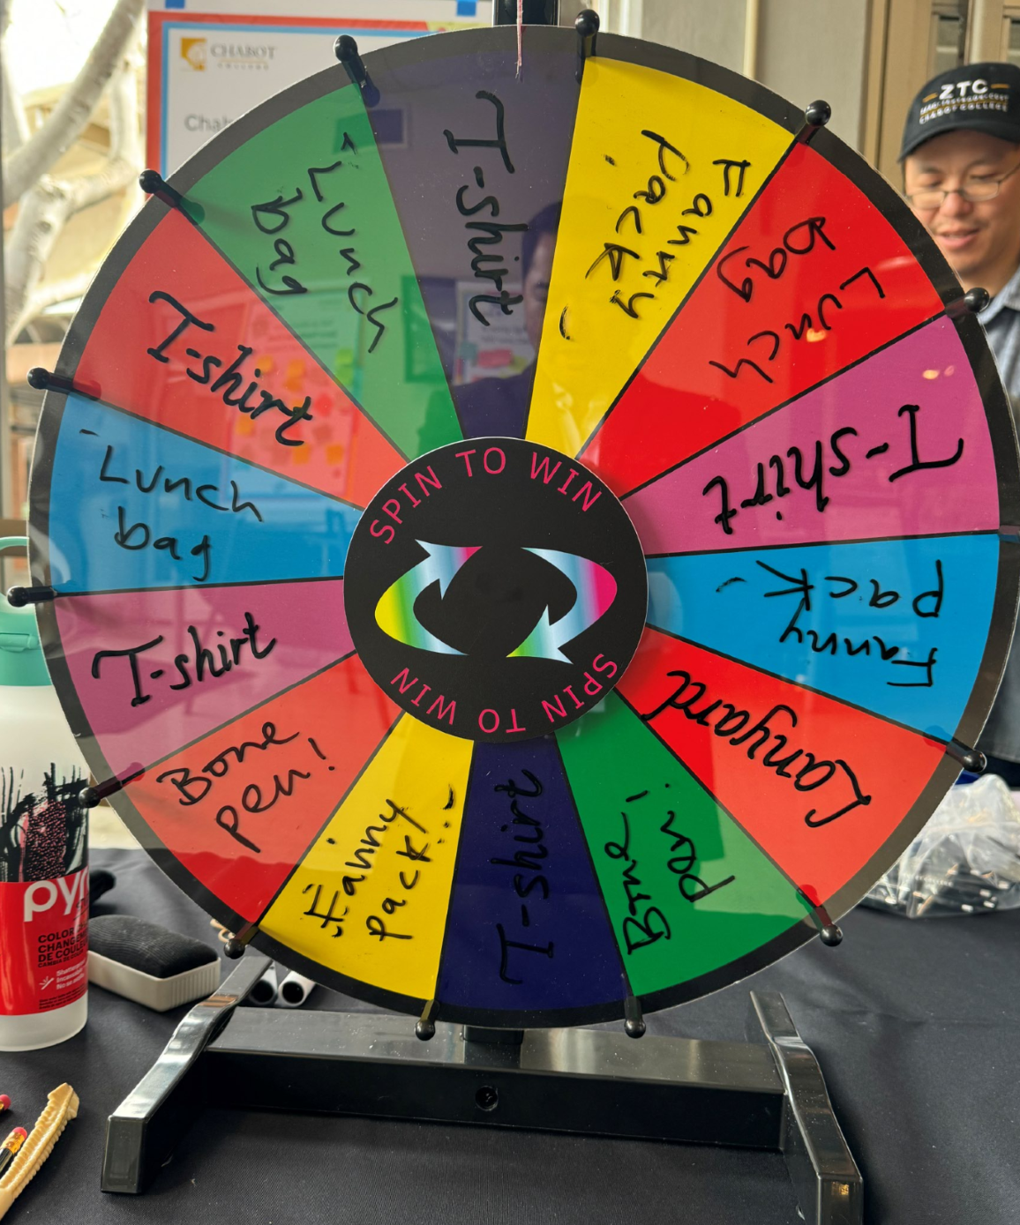
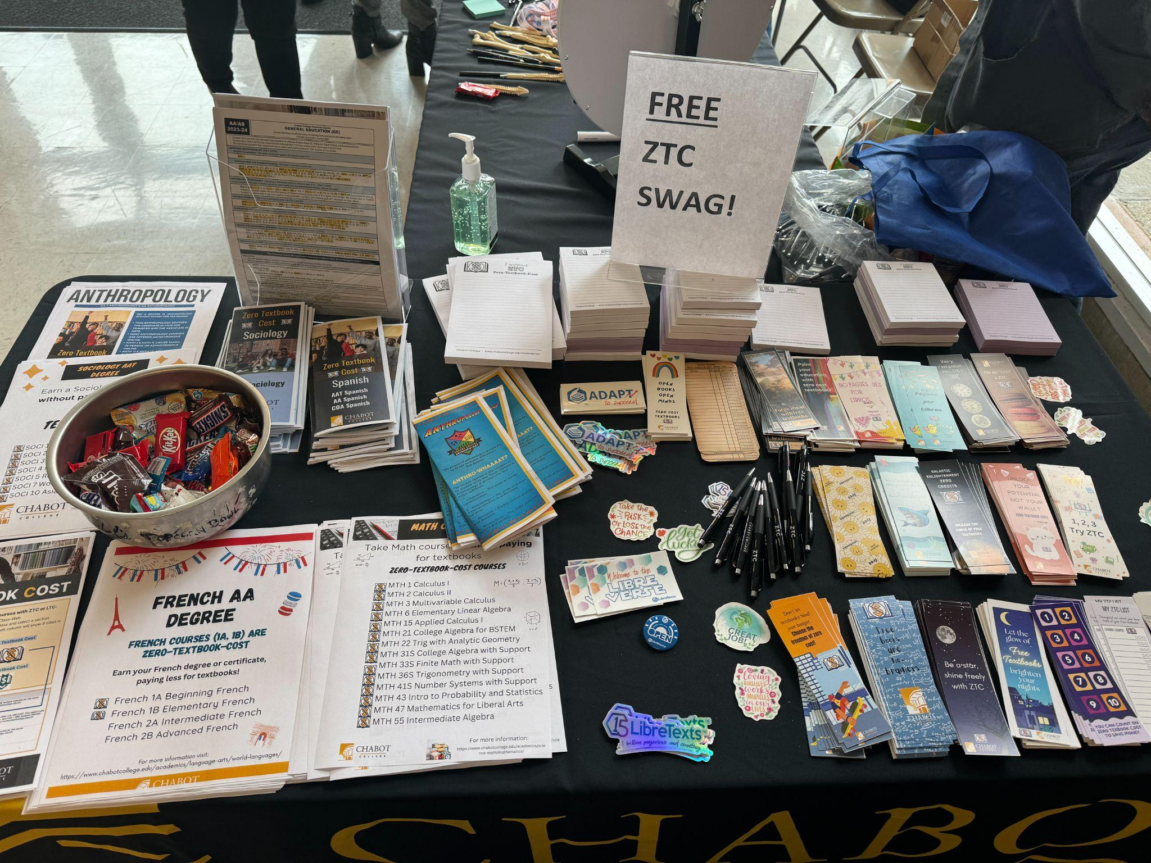
Celebrate OEWeek with a ZTC Fair

Slide 15
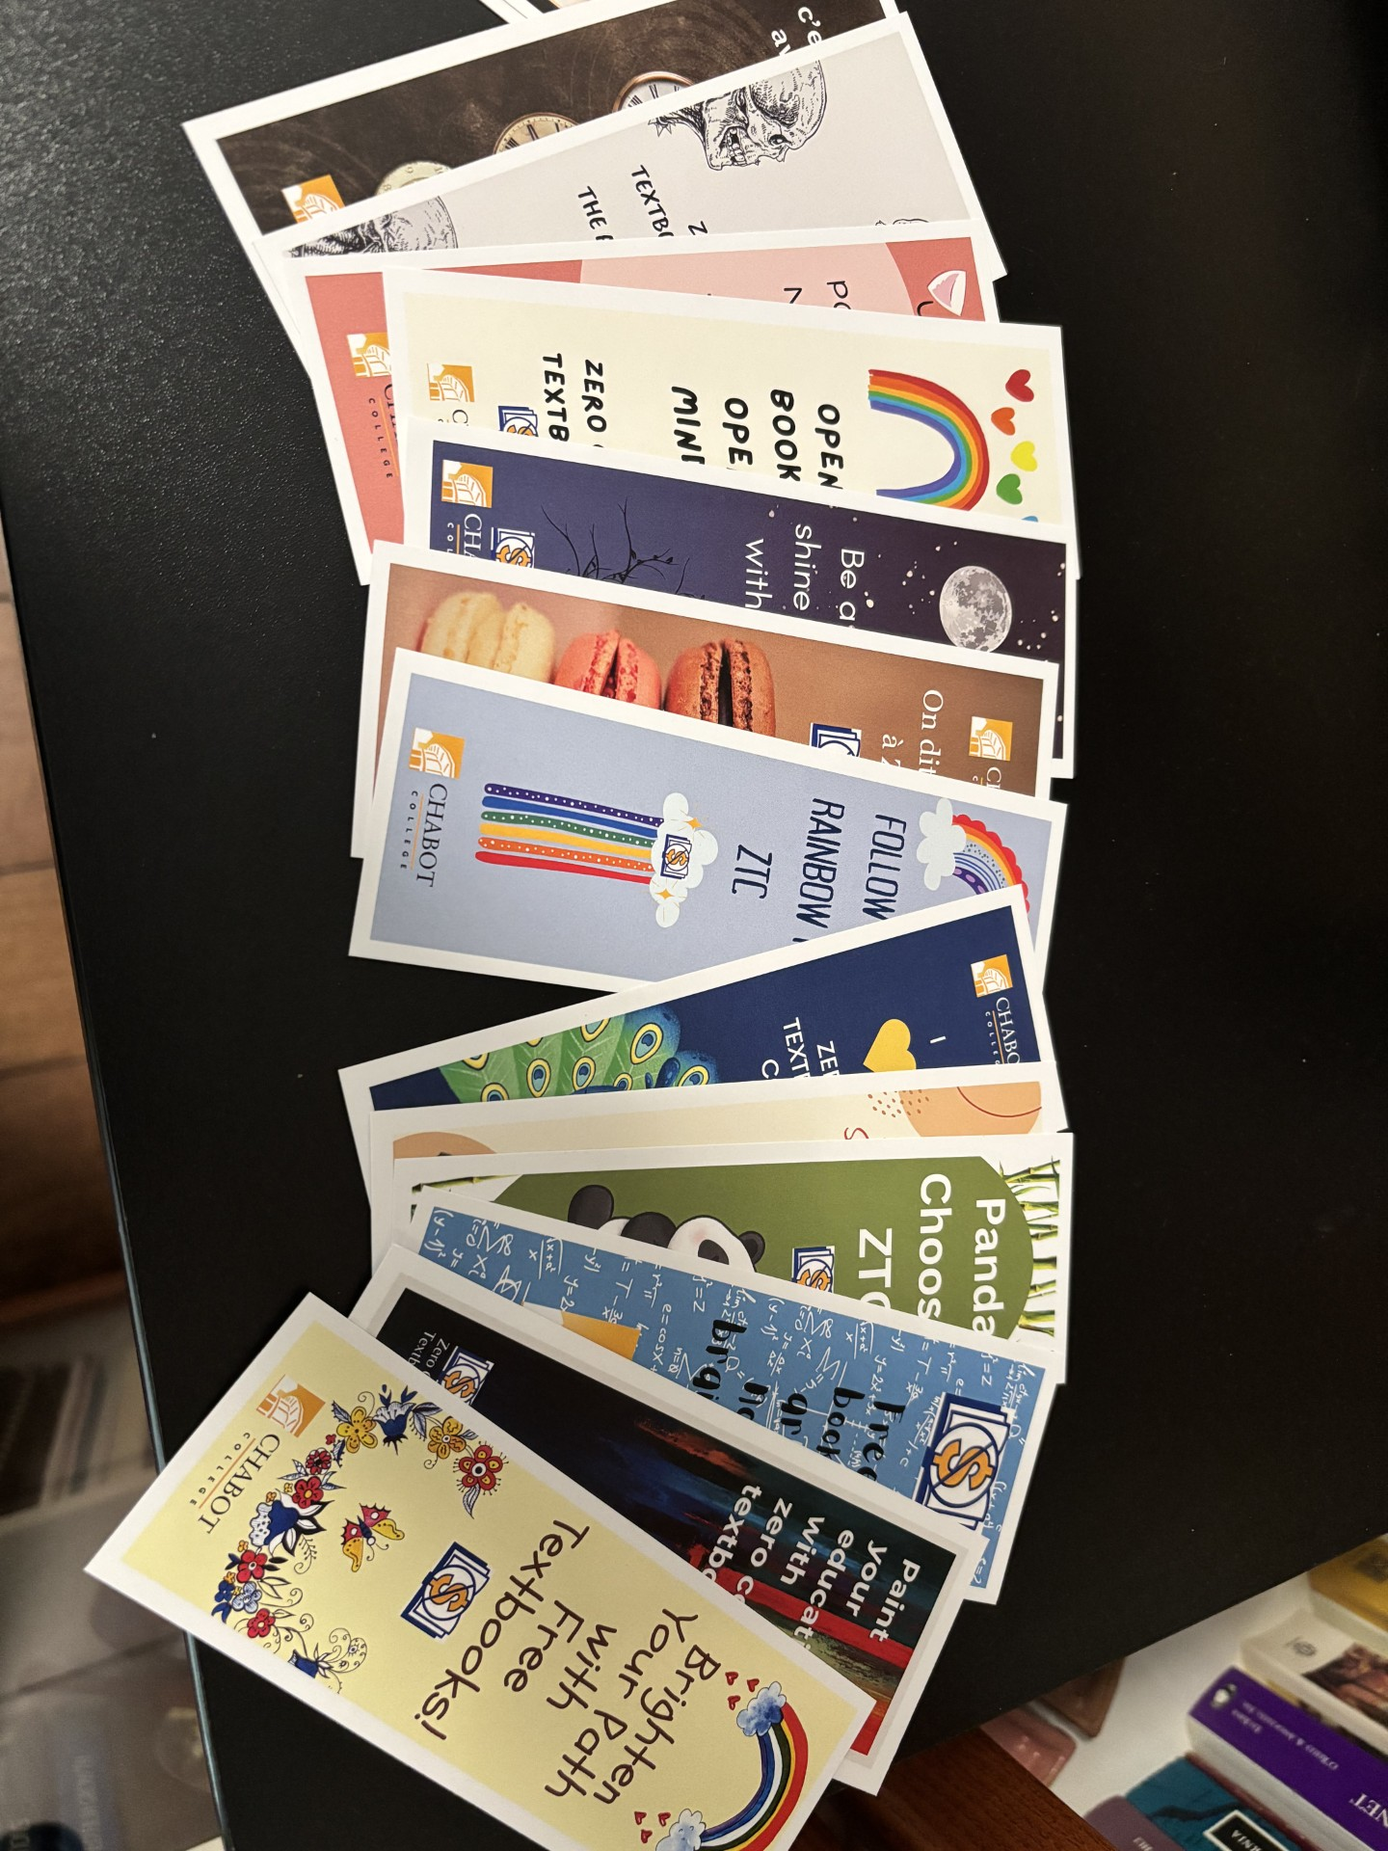

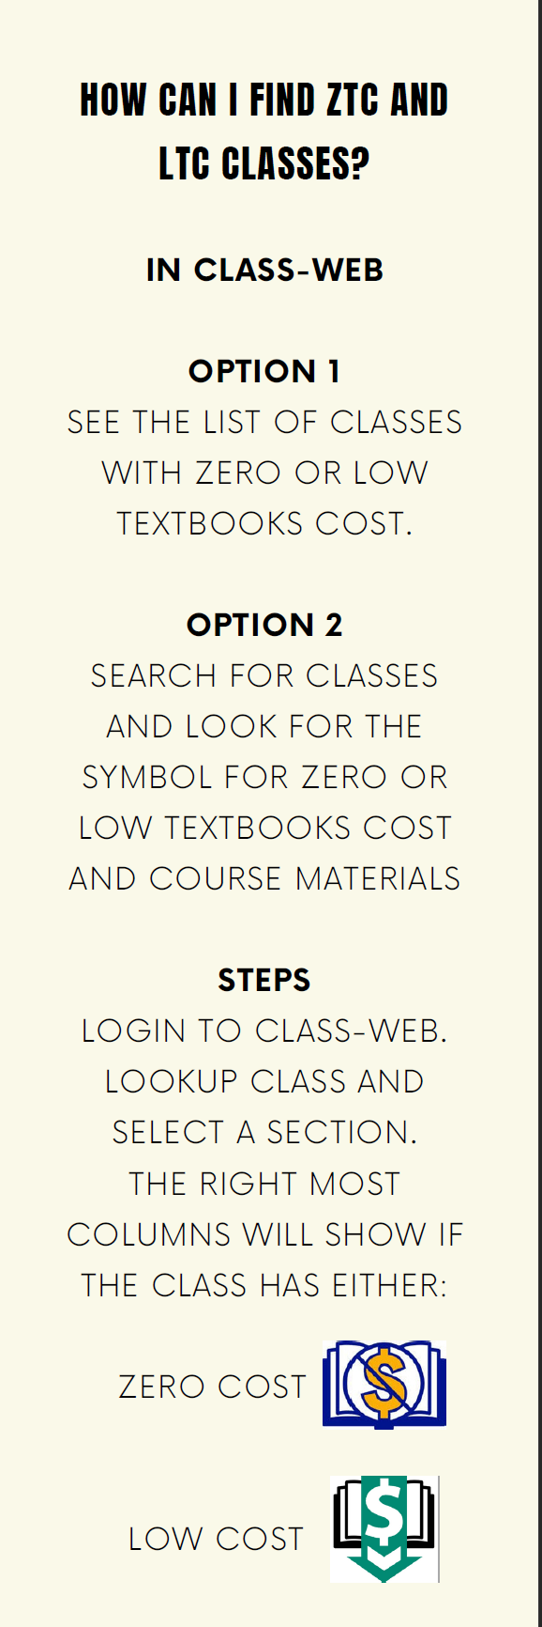
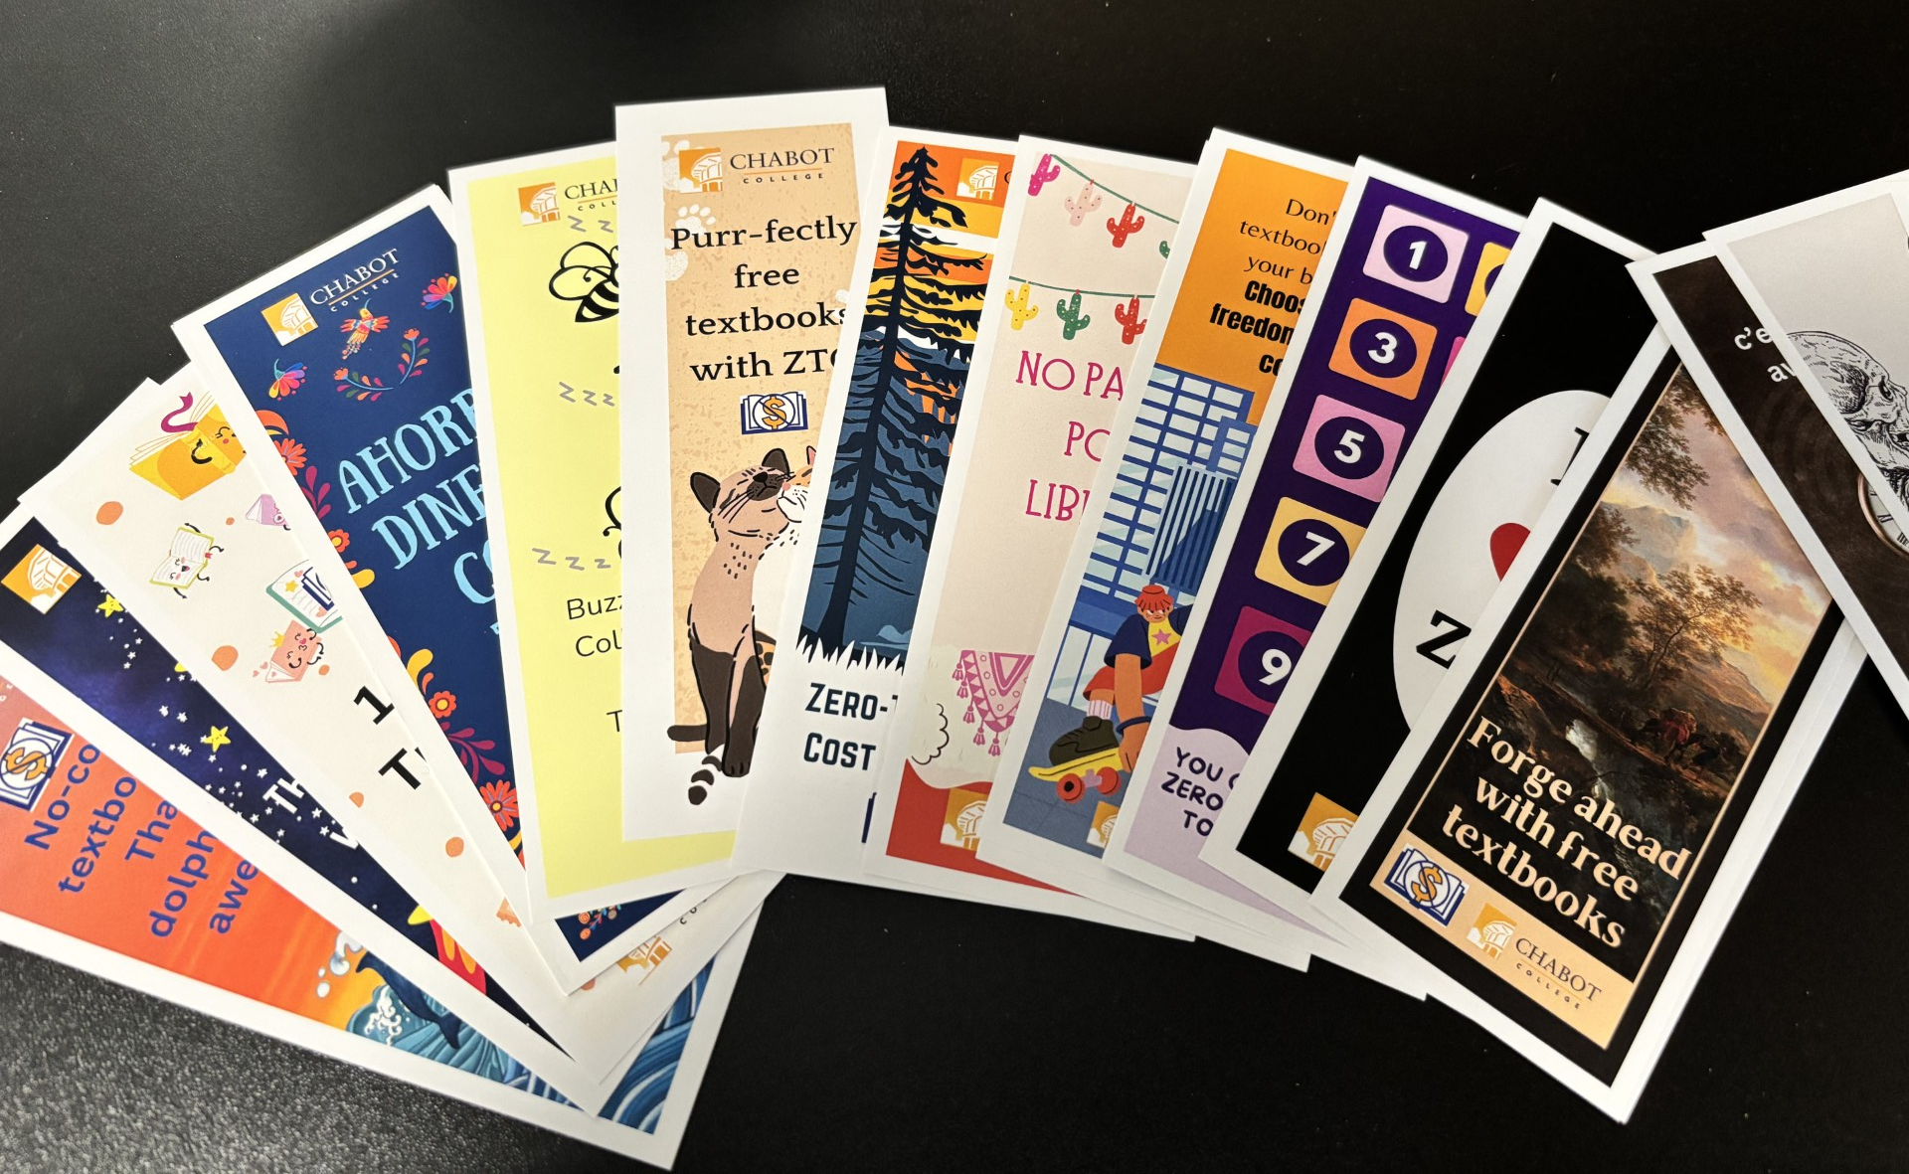
Tool 2: ZTC Bookmarks and bookmark templates ready to go!

Slide 16
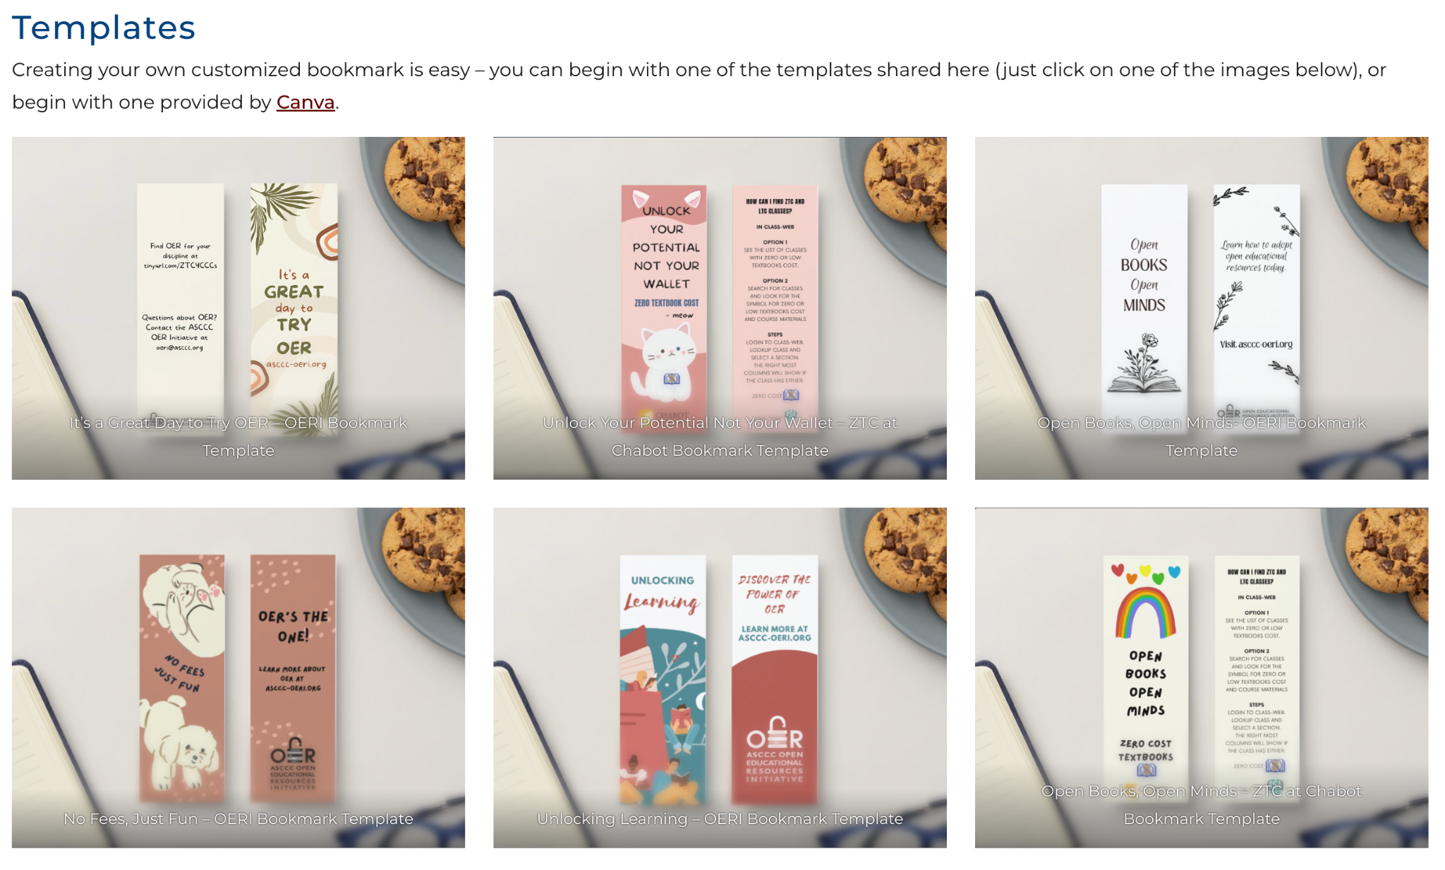
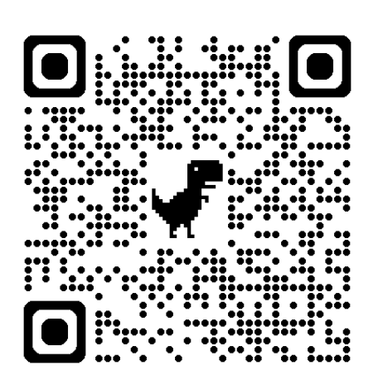
Tool 2: ZTC Bookmark templates in Canva ready to go!

Slide 17
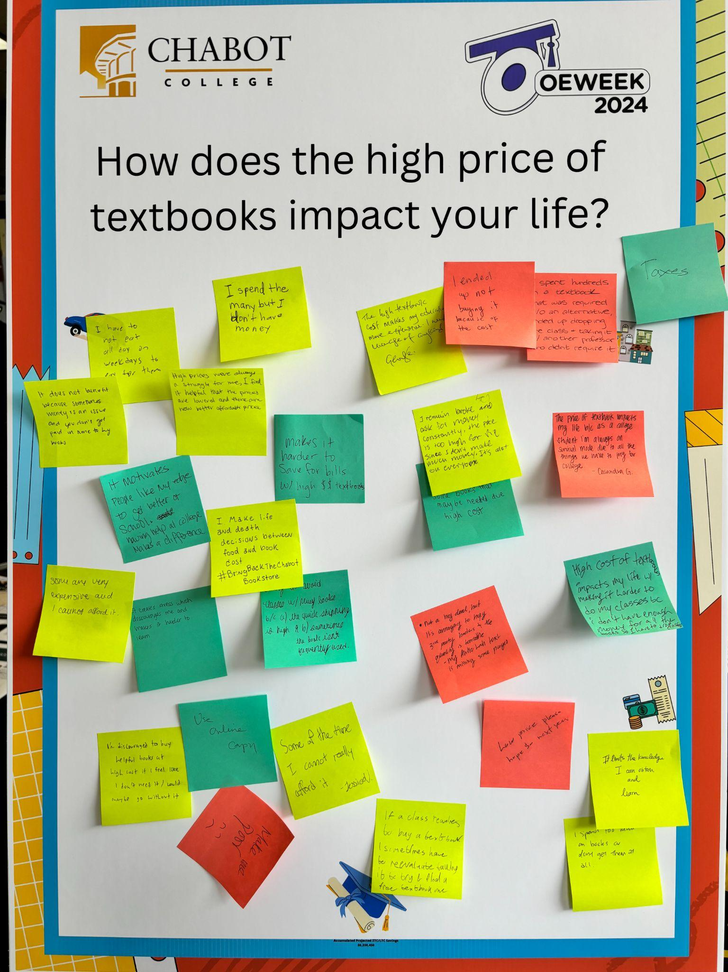
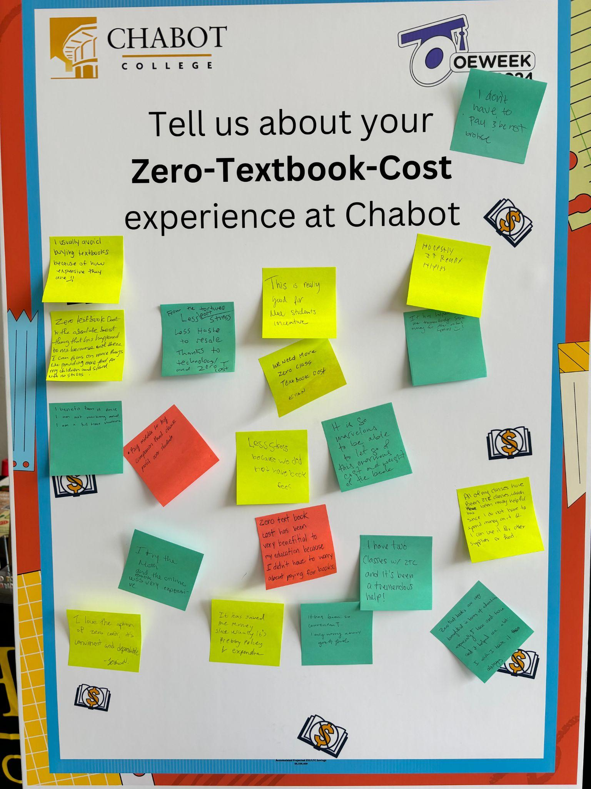
Tool 3: ZTC Wall

Slide 18
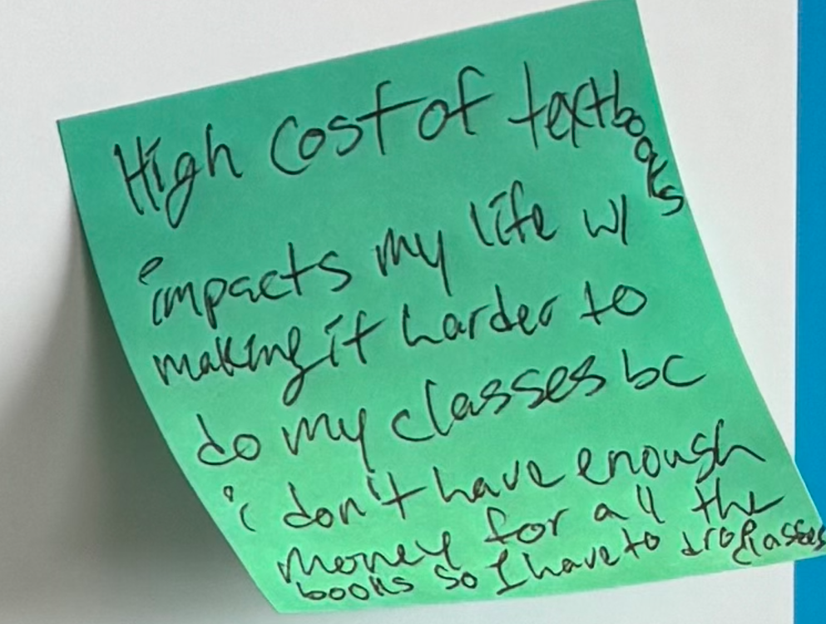
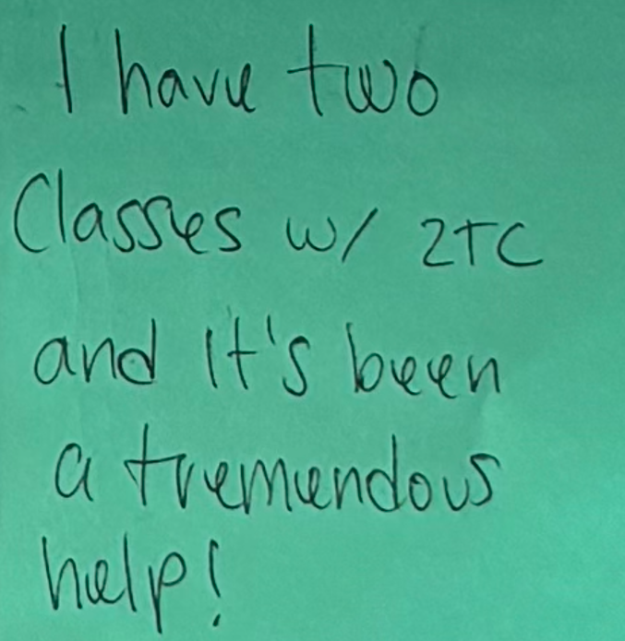
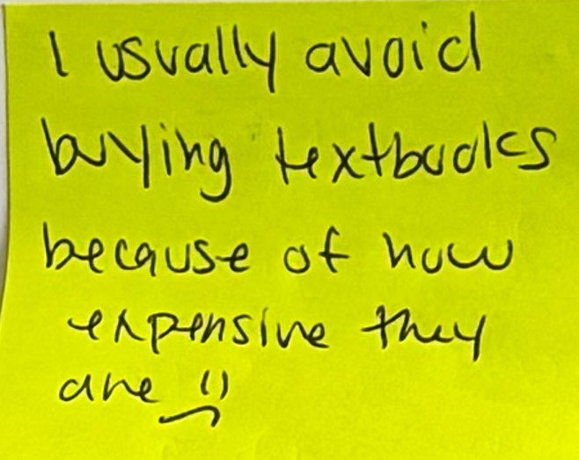
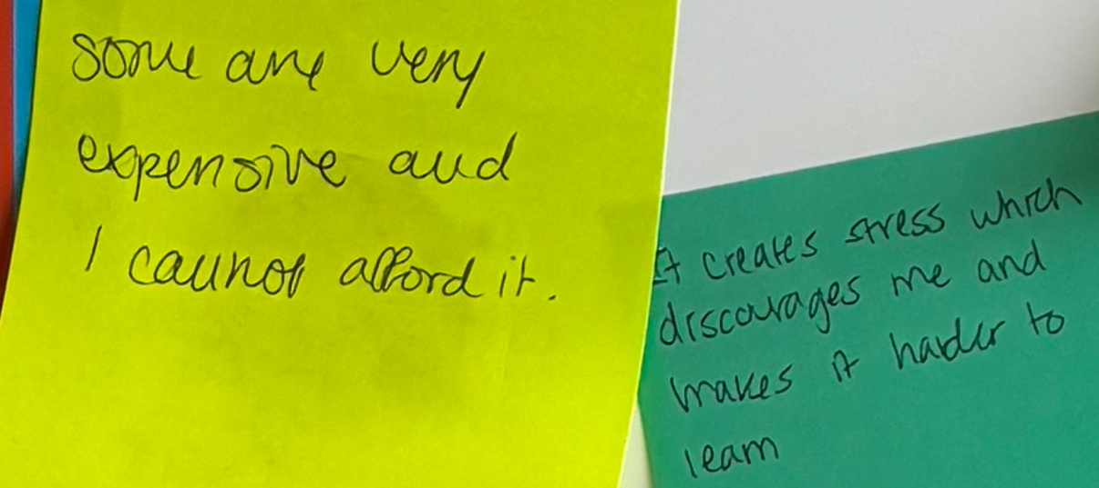
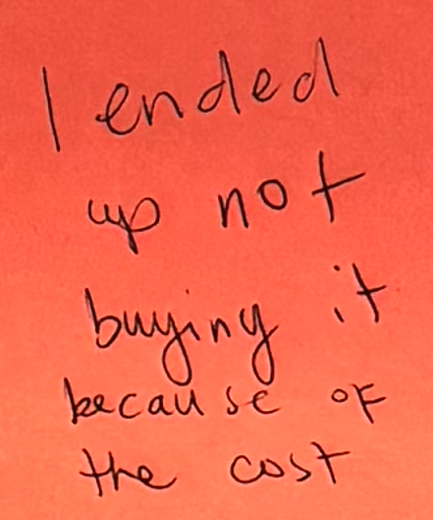
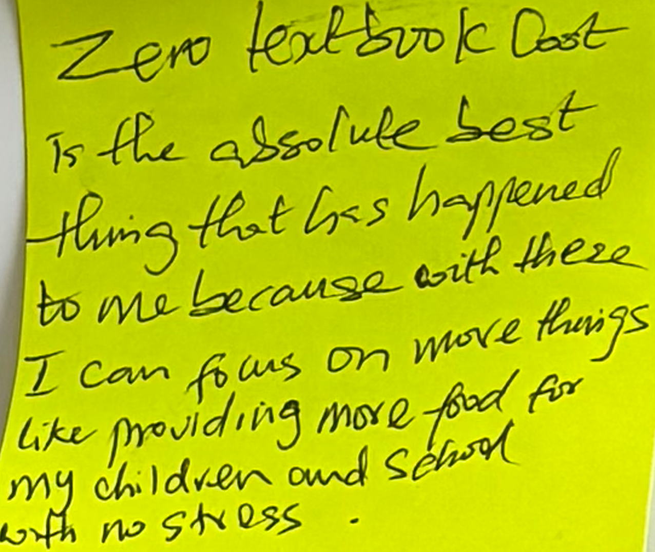
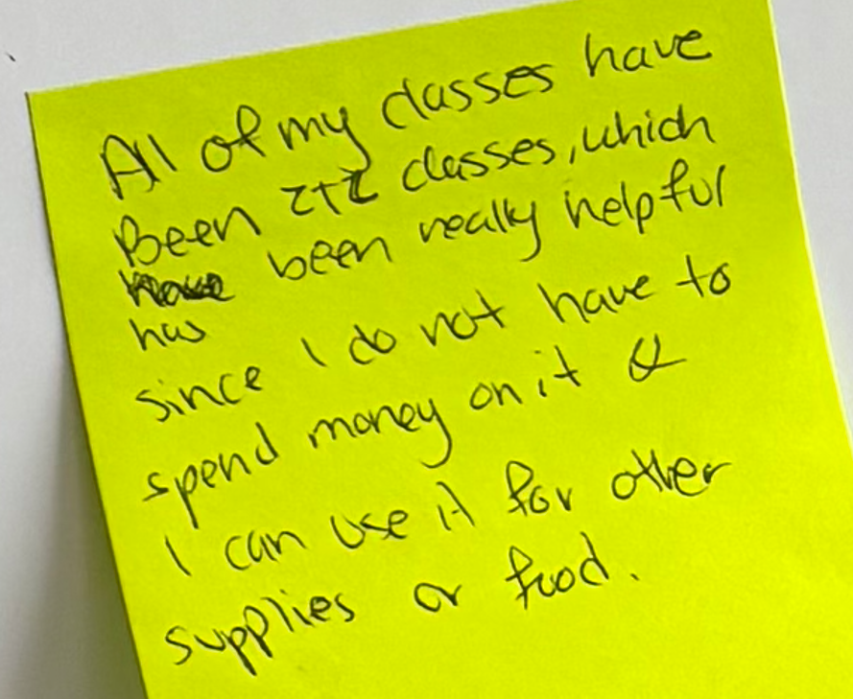
What students are saying about textbooks

Slide 19
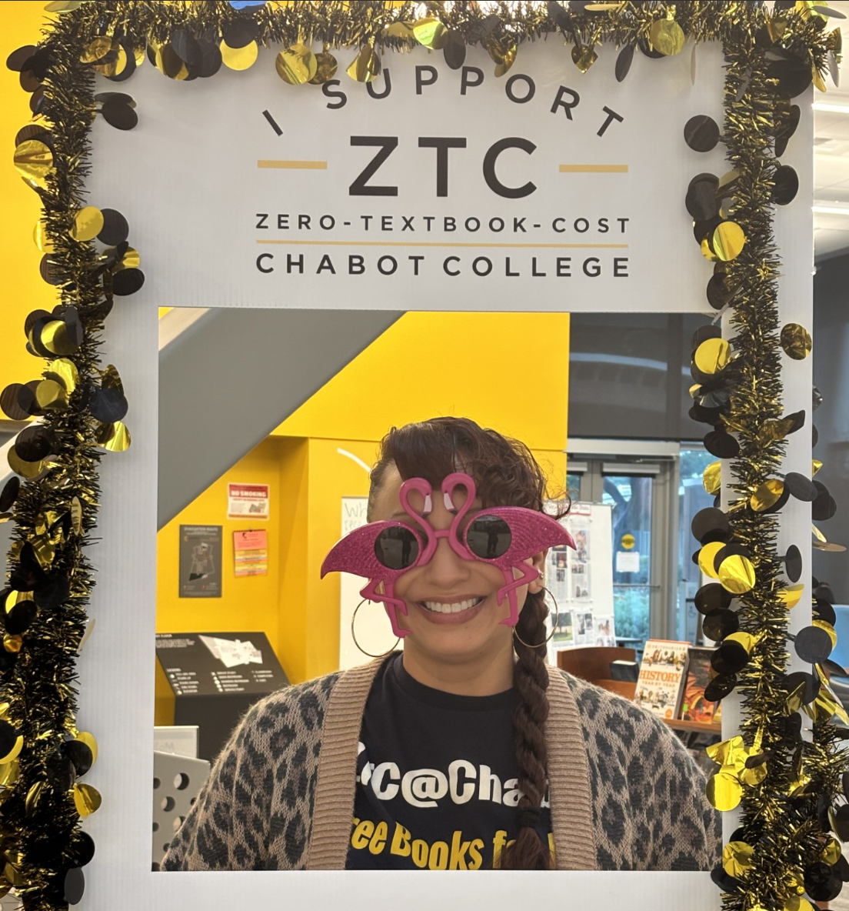
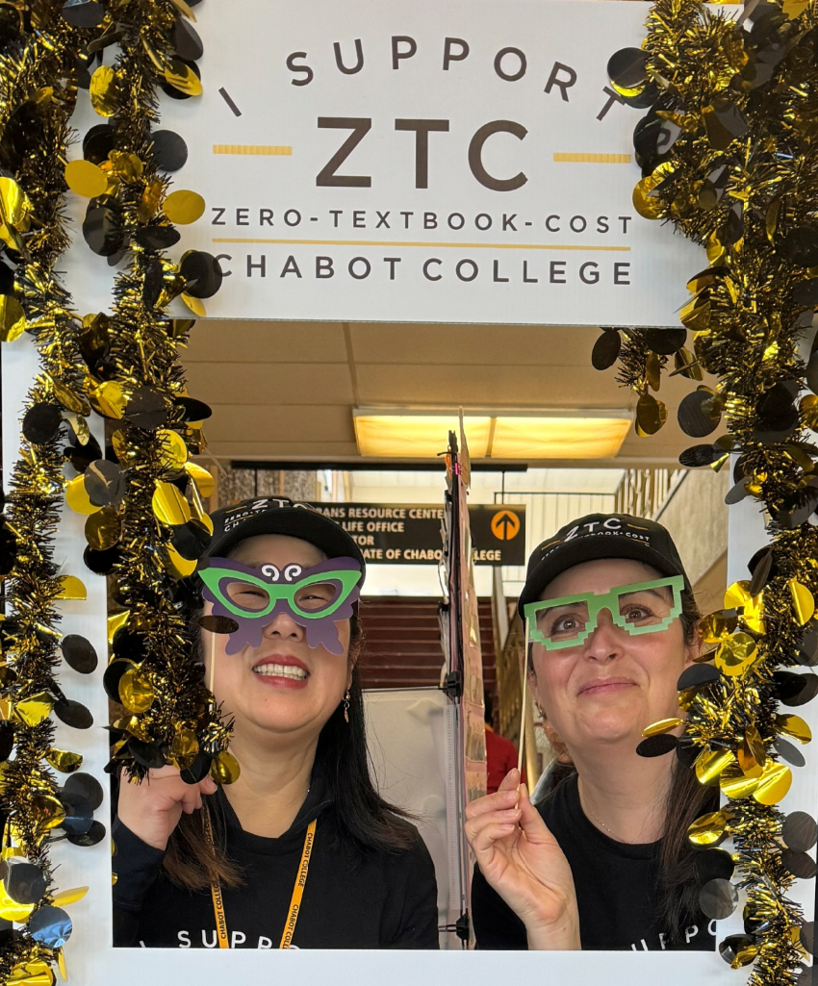
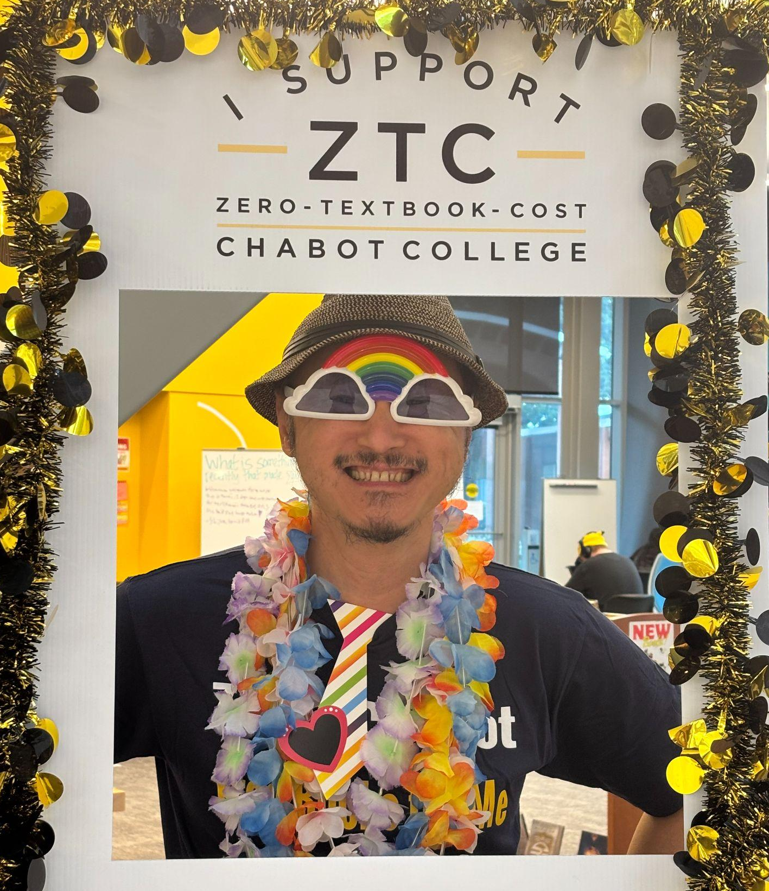
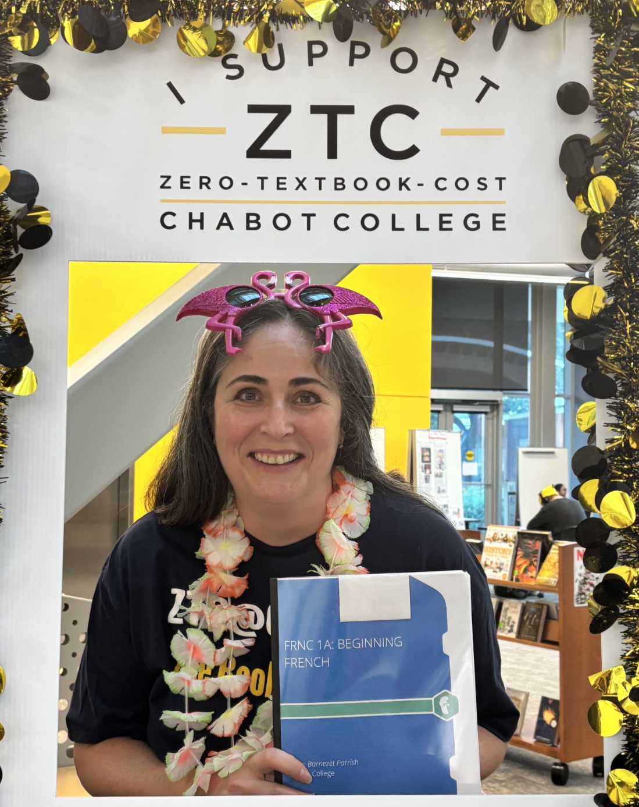
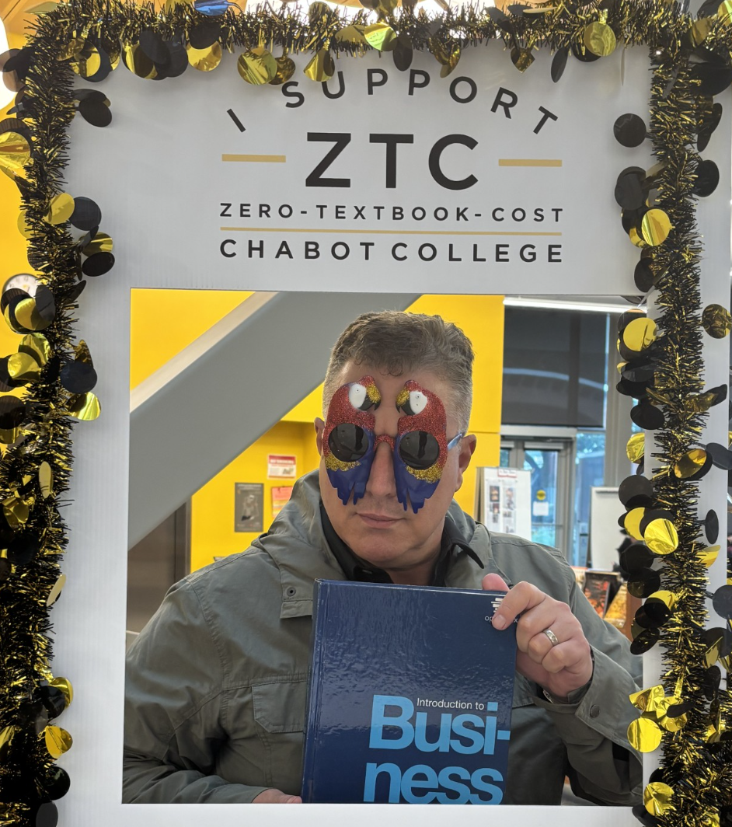
Tool 4: ZTC Photo Booth

Slide 20
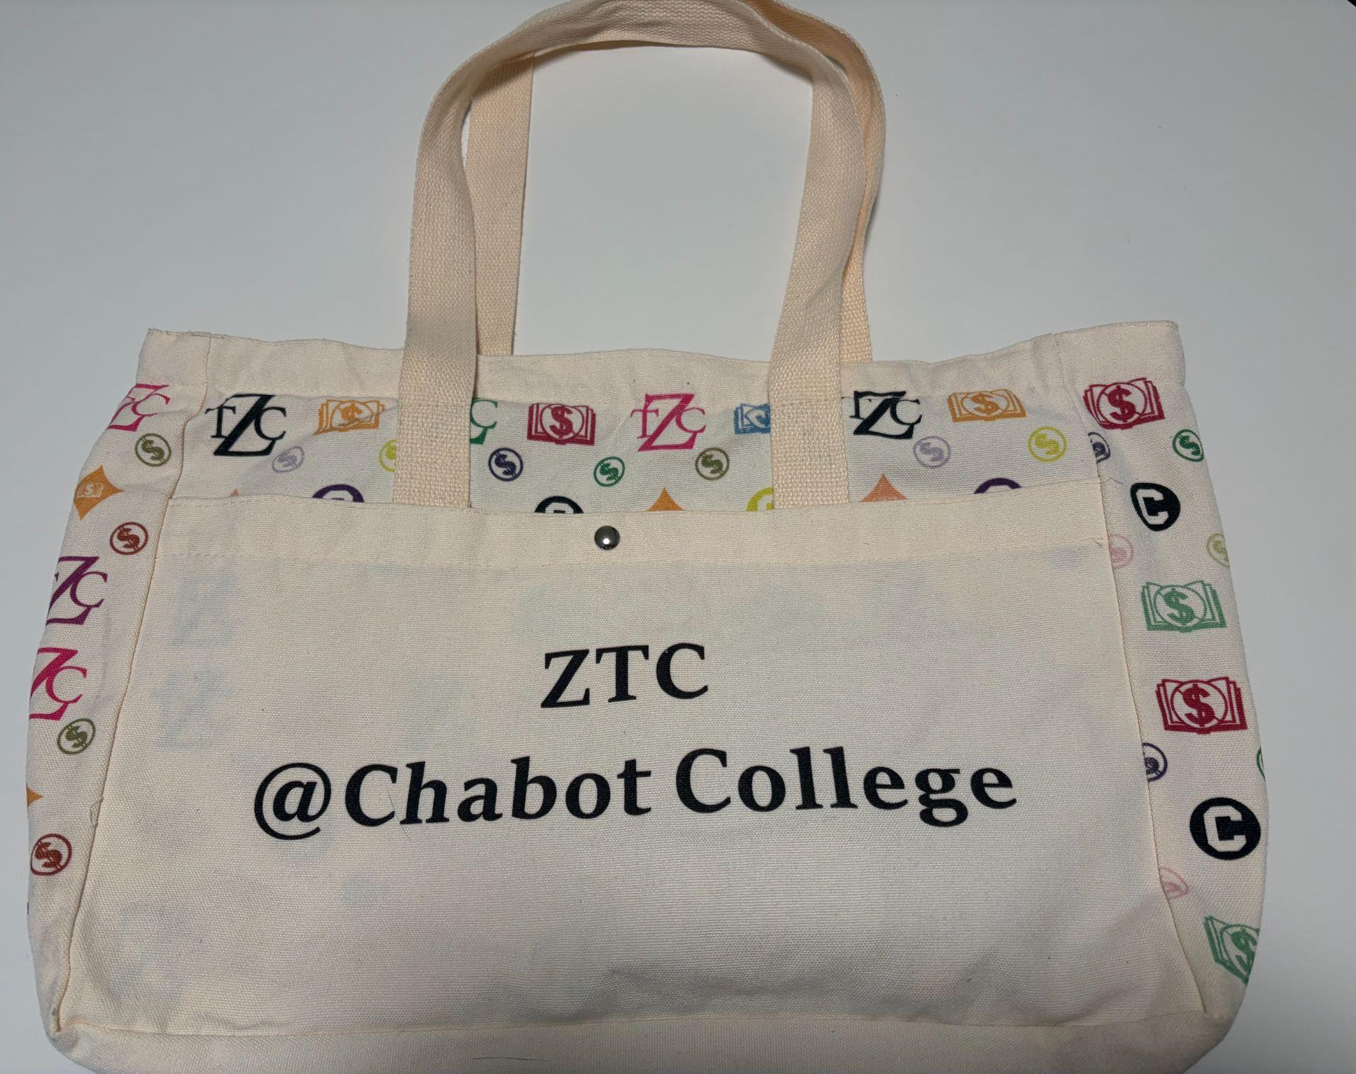
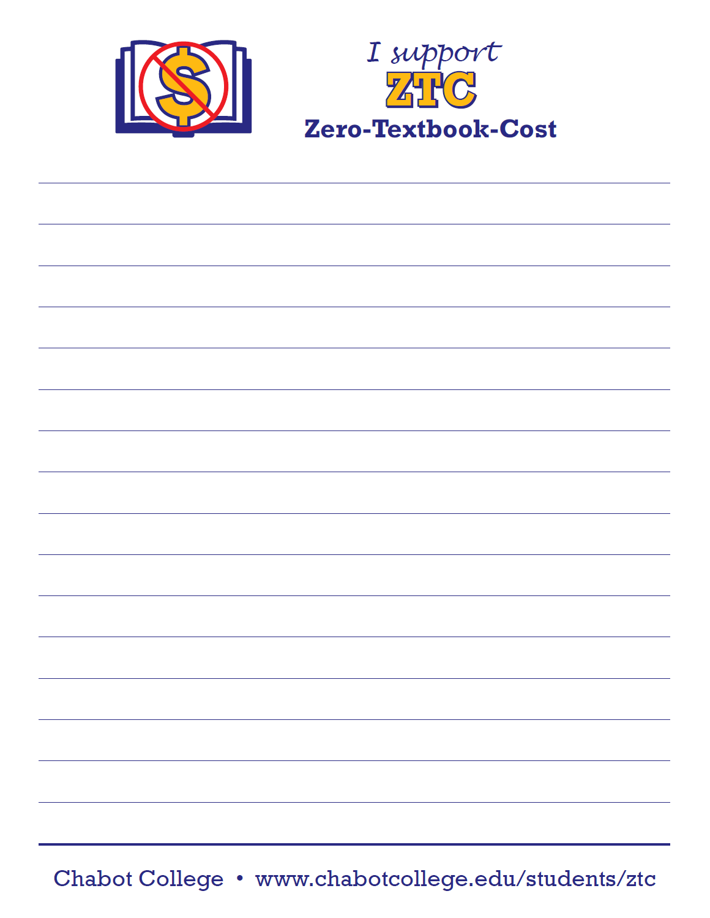
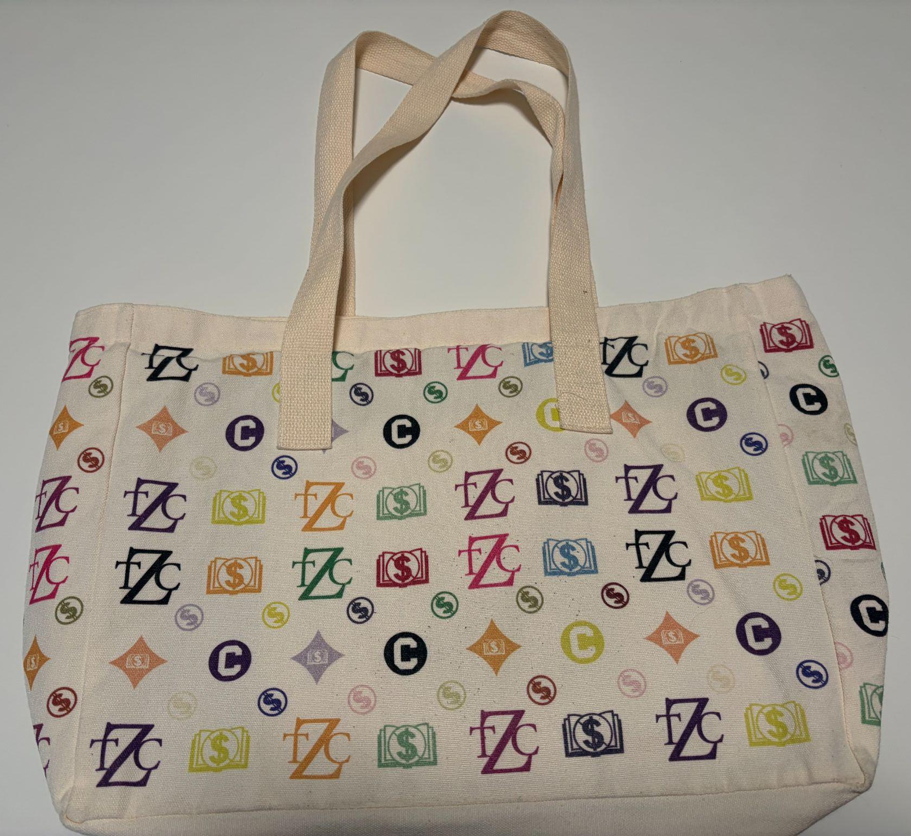
Swag Ideas:
ZTC Tote Bags and Notepads

Slide 21
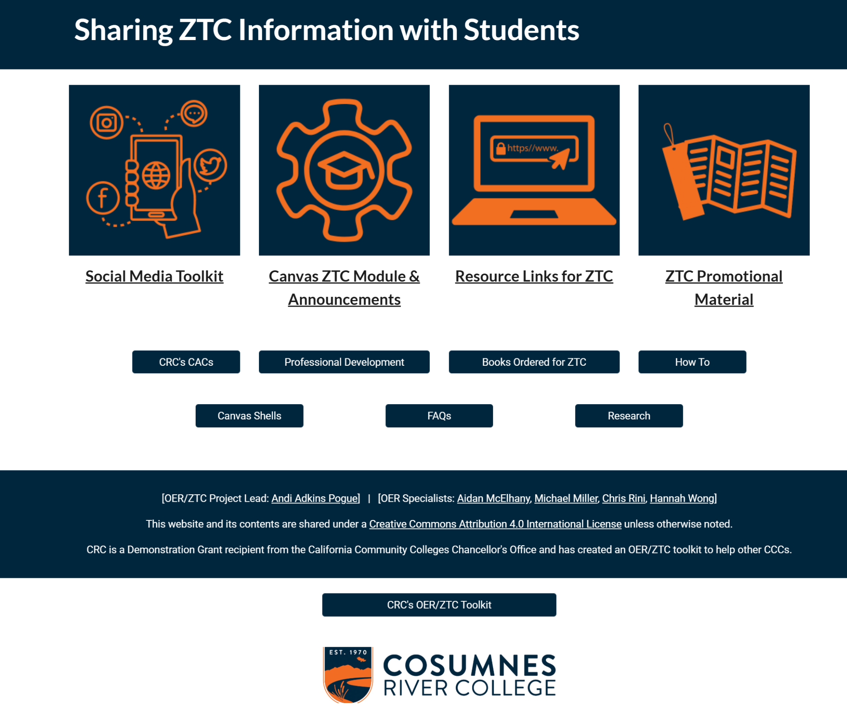
Cosumnes River College Toolkit
Notes:
https://sites.google.com/apps.losrios.edu/crc-ztc/how-to/share-ztc-info?authuser=0

Slide 22
Tool 5: Further Tools to Explore
Textbook hero awards for faculty or departments and let students nominate!
Micro-polls in a classroom with QR codes and single slide with 1-2 questions
Sticker/whiteboard voting in the library/fair “textbook costs impacted me this term YES/NO/SOMETIMES”
Photobooths
“Tell us your textbook story” Postcard prompt- 1 question, drop it at the desk (anonymous option).
Provide a syllabus blurb swap for faculty to explain their ZTC/OER sections how to find the books.
Local focus groups
Canvas announcements
Partner with
Student Government
Counseling/Ed Plan touchpoints
EOPS/DSPS/Promise/PUENTE
Notes:
https://sites.google.com/apps.losrios.edu/crc-oer-ztc-toolkit/home/student-outreach?authuser=0

Slide 23
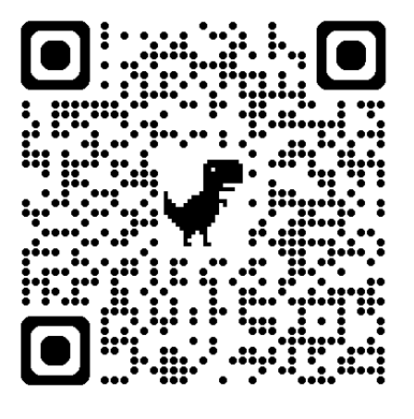
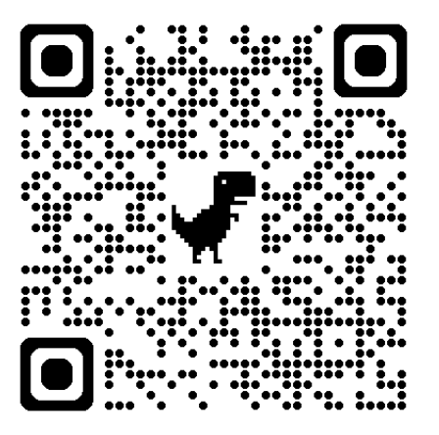
Resources and Notes
survey and blurbs | bookmark templates
Marketing OER & Examples Document
Notes:
https://asccc-oeri.org/ztc-degree-feasibility-study-student-survey-sharing-request/
https://asccc-oeri.org/marketing-oer-and-ztc-bookmark-templates/
https://docs.google.com/document/d/10SxjxEvTLZZhuPZS9hGatmV7rgFMSSg7M1rH-GWRzCU/edit?tab=t.0

Slide 24
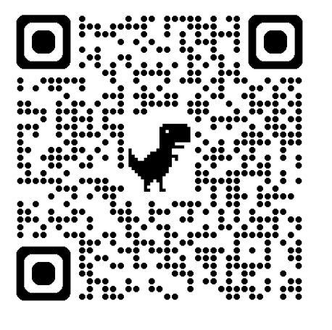
ASCCC OERI
Resources for Engaging Students
OER and Students (toolkits, resolutions, student surveys)

Slide 25
What’s Next?
Pathways to Zero: Partnering with Counselors to Promote the Visibility of Zero Textbook Cost (ZTC) and Open Educational Resources (OER)
Monday, March 16, 2026 from 10:00 am – 11:00 am Counselors are key influencers in how students discover courses, build schedules, and understand degree pathways. This session explores how to collaborate with counseling teams to increase the visibility of ZTC programs, highlight OER-designated sections, and embed cost transparency into guided pathways conversations. Going beyond just marketing, we’ll examine how OER messaging can support equity goals, student completion, onboarding processes, and institutional enrollment strategies. Register for Pathways to Zero

Slide 26
Thank you!
Feel free to email:
rfleming@ivc.edu
cmoon@chabotcollege.edu
OERL Webinar; Thursday, March 2, 2026 | 11:00 am – 12:00 pm
This work is licensed under a Creative Commons Attribution 4.0 International License.

