Slide 1
Finding the Human Connection in a Digital World: Using Discuss-It to Build Community, Promote Critical Thinking, and Shift the Focus of Assessment
This slide last updated March 6, 2026; ASCCC OERI Friday Forum, March 6, 2026, 10:30 am - 11:30 am
This work is licensed under a Creative Commons Attribution 4.0 International License. Attribute this slide deck as: “Finding the Human Connection in a Digital World: Using Discuss-It to Build Community, Promote Critical Thinking, and Shift the Focus of Assessment” by ASCCC OERI is licensed under CC BY 4.0.

Slide 2
Event Description
In an age of automation, how do you ensure that student work remains a reflection of genuine learning? Join us to learn about Discuss-It, an openly-licensed tool within the LibreTexts platform. Discuss-It transforms discussions into interactive, multimedia exchanges through audio, video, and text. Learn how integrating voice and video responses can boost engagement, build community, and bring human presence back to your courses regardless of your discipline.
Notes:
Discuss-It demonstrations site - https://adapt.libretexts.org/students/assignments/94618/init-formative

Slide 3
Presenters
Cristina Moon
Chabot College (Spanish)
OERI Area B Regional Lead, ADAPT Lead
Michelle Pilati
Río Hondo College (Psychology)
OERI Project Director

Slide 4
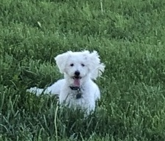
Overview
Revisiting Assignments in the Age of AI
Rethinking Discussion
LibreTexts and ADAPT
Discuss-It
Getting Started
Sophie in the Grass, by M. Pilati, CC BY

Slide 5
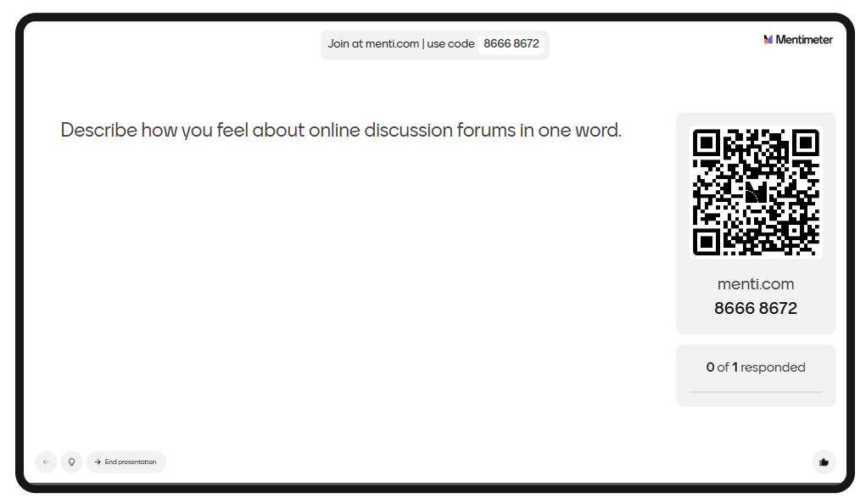
A question for you…
Notes:
menti.com 5137 8579

Slide 6
What if..
…. discussions could be completely different - and not only do what discussions were always supposed to do - but also help you address current challenges.

Slide 7
Revisiting Assignments in the
Age of AI
Ensure that in an age of automation, student work remains a reflection of genuine learning:
Building community and social presence through collaboration.
Promoting critical thinking and reflection.
Shifting from grading the product to valuing the human process.
Notes:
MP

Slide 8
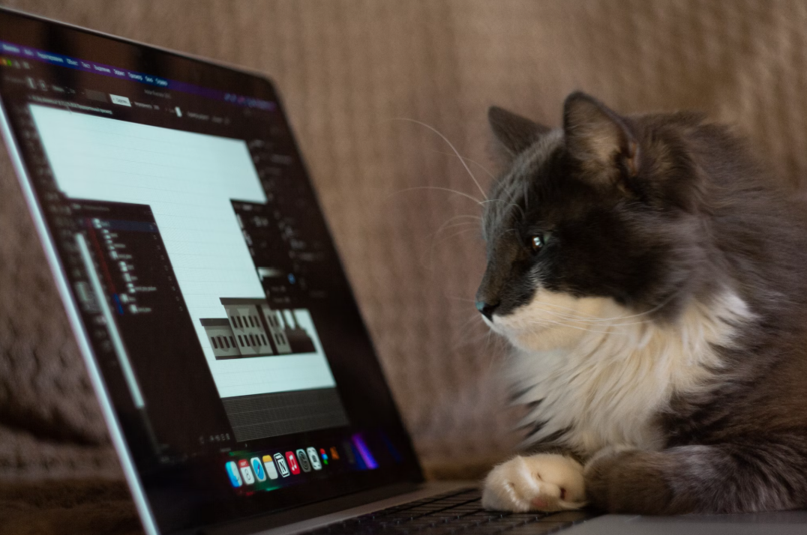
Traditional Discussion Assignments
Text only
Allow for limited engagement
Typically do not inspire creativity or facilitate collaboration
Commonly viewed as a chore by students
Challenge faculty to establish regular and substantive interaction (RSI)
Photo by Anton Kraev on Unsplash
Notes:
WICHE overview of RSI - https://wcet.wiche.edu/policy/regular-and-substantive-interaction/ For the purposes of determining institutional eligibility for federal financial aid, Congress created a delineation between the definitions of “distance education” and “correspondence education.” This resulted from a consumer protection concern, as students in the 1990’s experienced financial aid fraud related to correspondence education. Additionally, there was interest in assuring aid eligibility for those taking distance education courses, as that modality was growing.
Institutions offering more than 50 percent of their total course offerings via correspondence or enrolling more than 50 percent of their students in correspondence courses are not eligible to participate in Title IV financial aid programs. Even if the institution is eligible, students enrolled in correspondence programs are limited to a half-time federal Pell Grant award.

Slide 9

A Discussion Assignment Could
Provide a space for students to demonstrate learning
Reflect speaking and listening practice
Allow for interaction in multiple modalities
Bring authentic interaction and engagement
Build confidence
Develop communication skills
Facilitate collaboration
Photo by Joe Caione on Unsplash

Slide 10

Challenges of Online
Asynchronous Discussions
One-dimensional (text-only) responses can limit expression
Uploading recorded files can be challenging and difficult to find in a course management system (CMS)
Engagement is typically low - students reply only to fulfill a requirement
Superficial responses or lack of true peer interaction
Increased use of AI tools (e.g., ChatGPT) for responses
Photo by Our Life in Pixels on Unsplash

Slide 11
What if you could…
allow students to reply to prompts with audio, video, and/or text.
use multimedia for your prompts.
make discussion a truly human experience.
grade an audio submission by reading a transcript of what the student posted.
establish completion/participation criteria allowing students to track their own progress and assignment completion.
initiating threads
required responses
e.g., initiate one thread and respond twice
specify minimum word requirements for text and minimum time requirements for audio and video responses.

Slide 12
What is LibreTexts?
An OER everything platform that simplifies OER adaptation and remixing
Allows for on-demand printing
Simplifies OER integration into a course management system
Provides access to available openly-licensed homework resources
Offers its own homework system, ADAPT
Notes:
CM

Slide 13
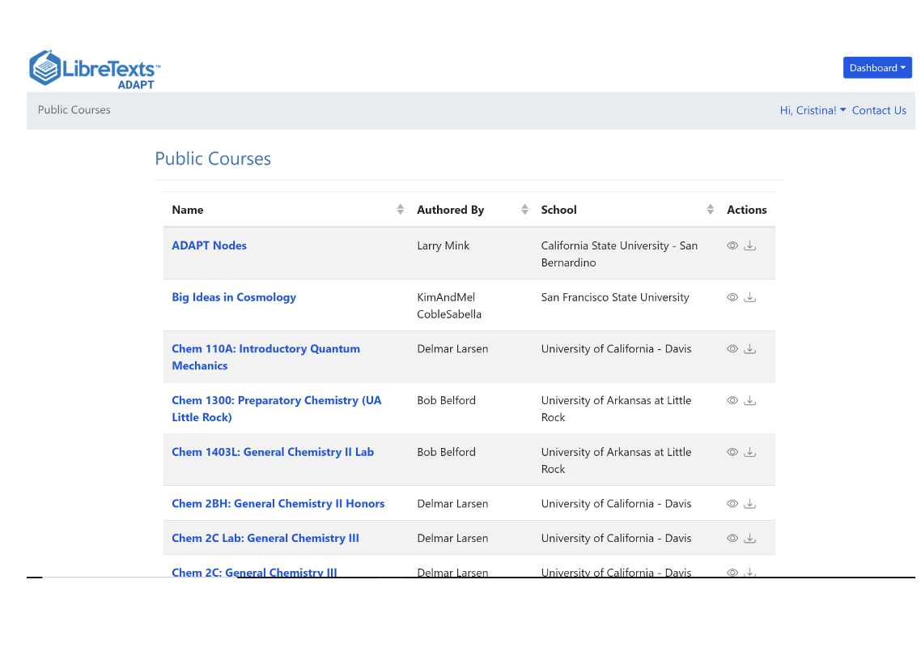
What is ADAPT?
ADAPT is a comprehensive online assessment/homework infrastructure that provides faculty the ability to include auto-graded and non-auto-graded activities from different platforms such as H5P, MyOpenMath, WeBWork, and its own native ADAPT questions.
ADAPT can be integrated into an course management system with full grade integration or it could be run independently.

Slide 14
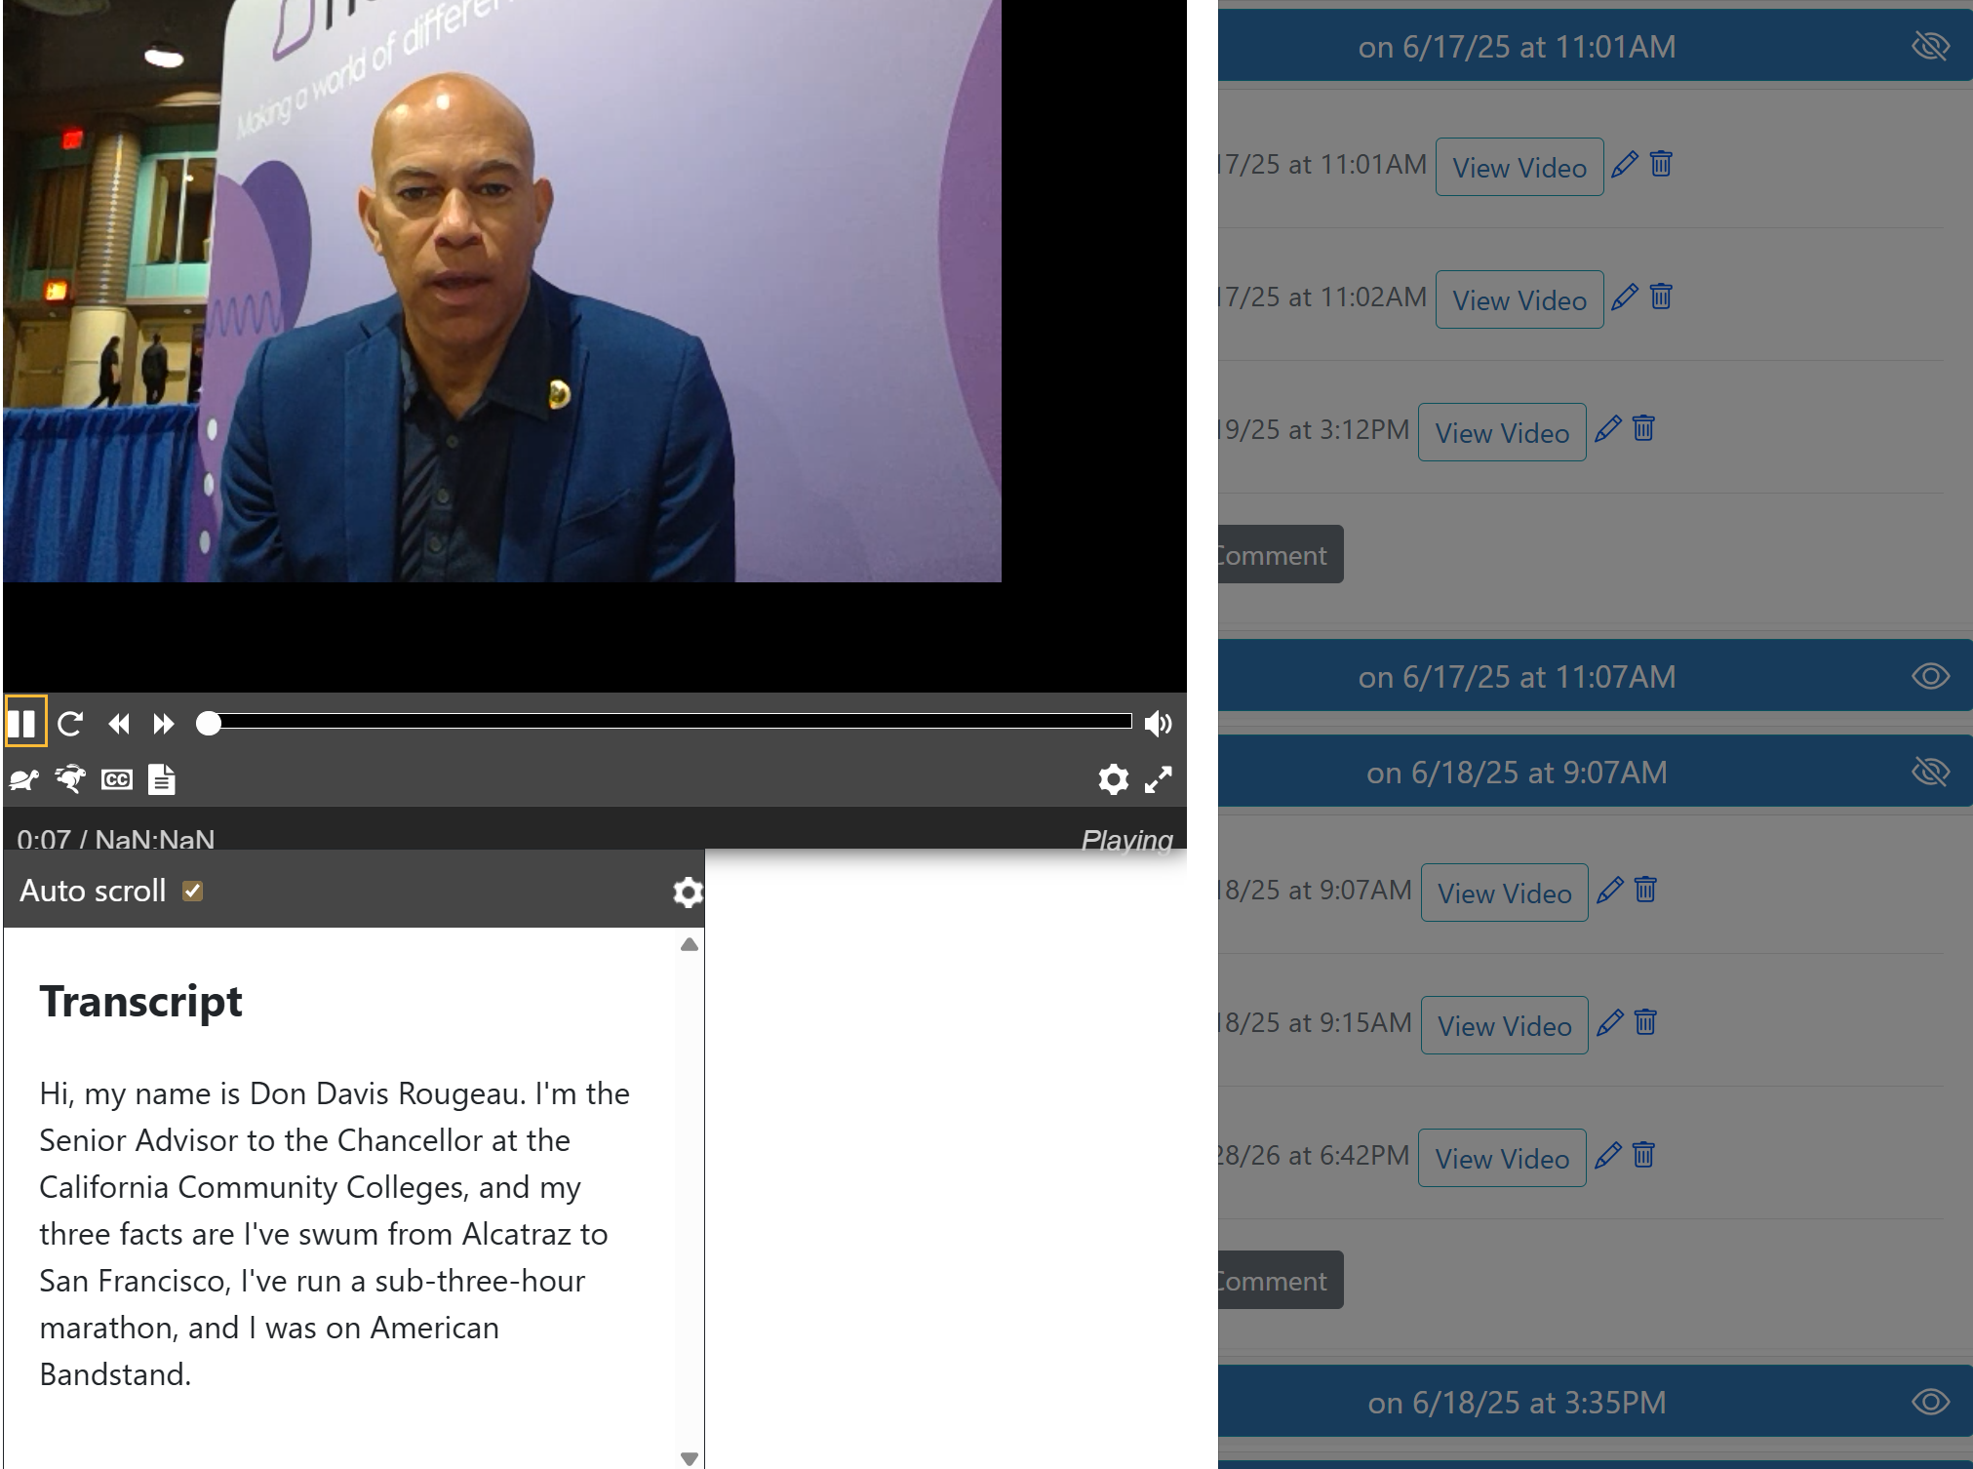
What is Discuss-It?
A specialized question type within the LibreTexts ADAPT platform ideal for addressing the regular and substantive interaction (RSI).
Features:
Ability to post video, audio, or text responses.
Auto-captioning and transcription with high accuracy using Whisper AI for multiple languages.
Easy cloning (or copying) of all public questions.
CMS integration: LTI-compliant, offering automatic gradebook syncing.
Rubric for grading.
Notes:
CM

Slide 15

Discuss-It Demo Site
Notes:
https://adapt.libretexts.org/students/assignments/94618/init-formative

Slide 16
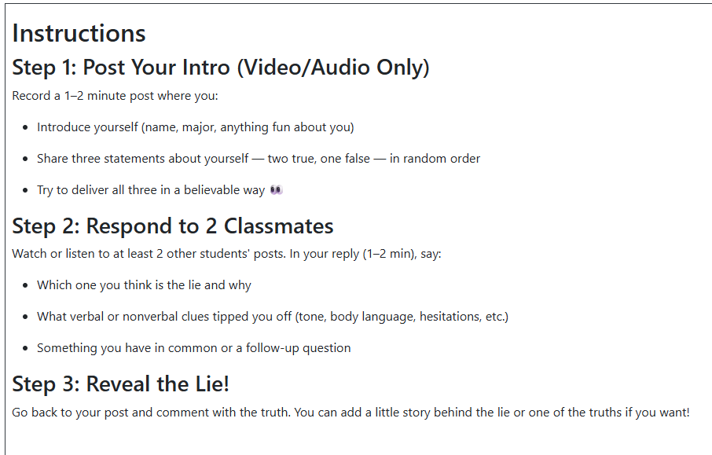
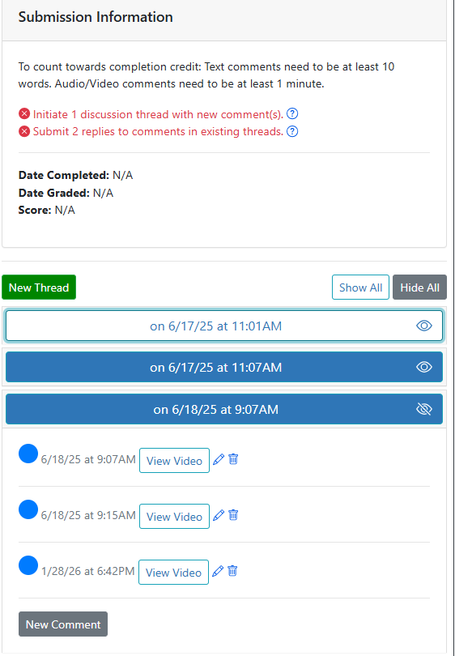
Icebreaker Activity Example 1:
Two Truths and One Lie
Notes:
CM

Slide 17
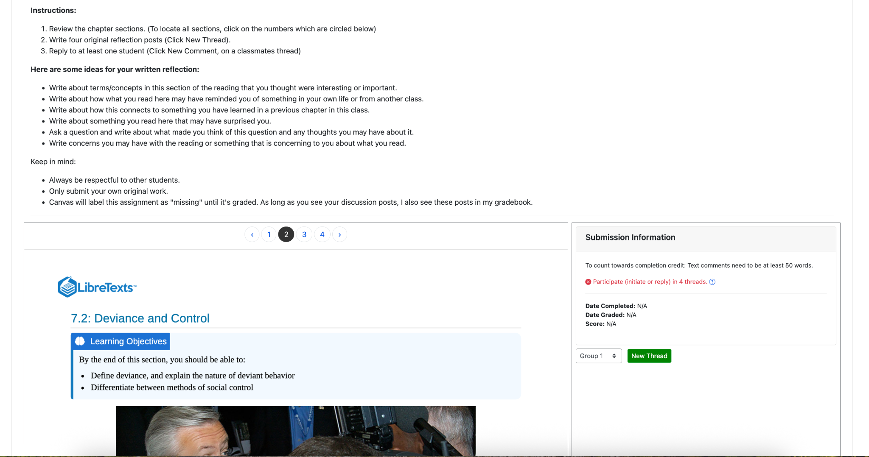
Sociology Example 1:
Chapter Reflection

Slide 18
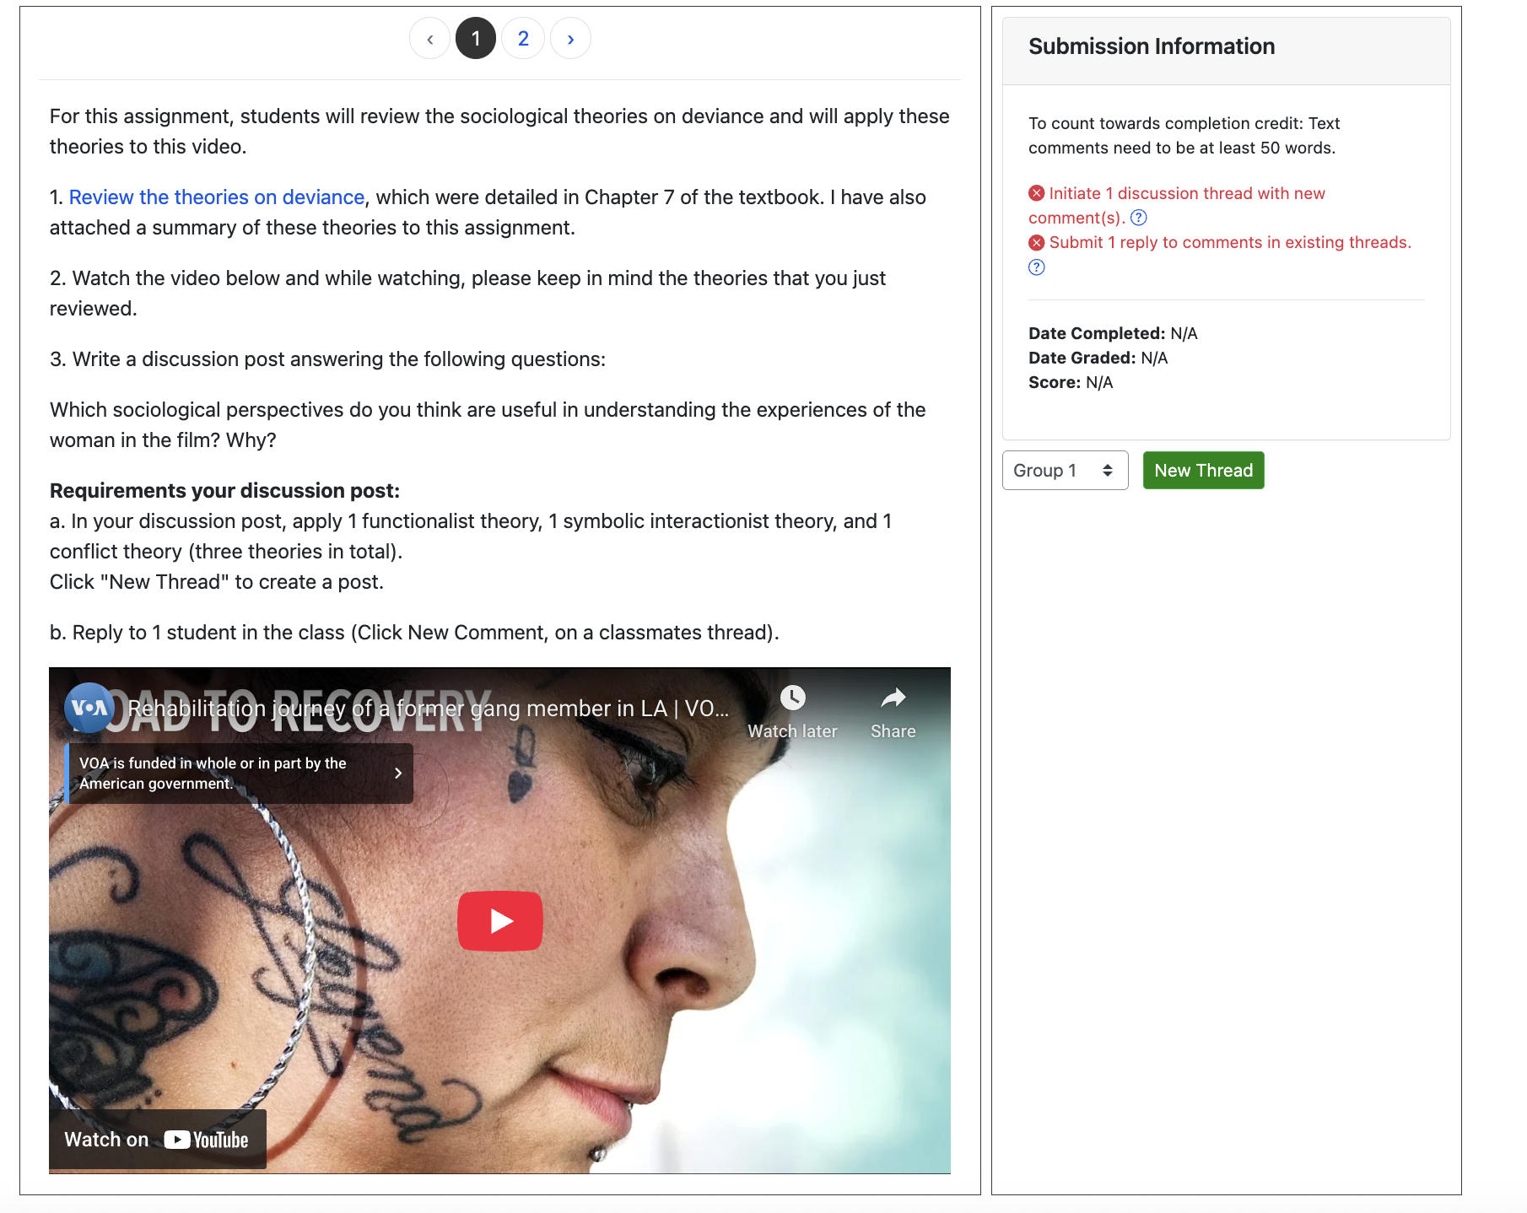
Sociology Example 2: Applying Course Concepts
Students apply theories to a video and reply

Slide 19
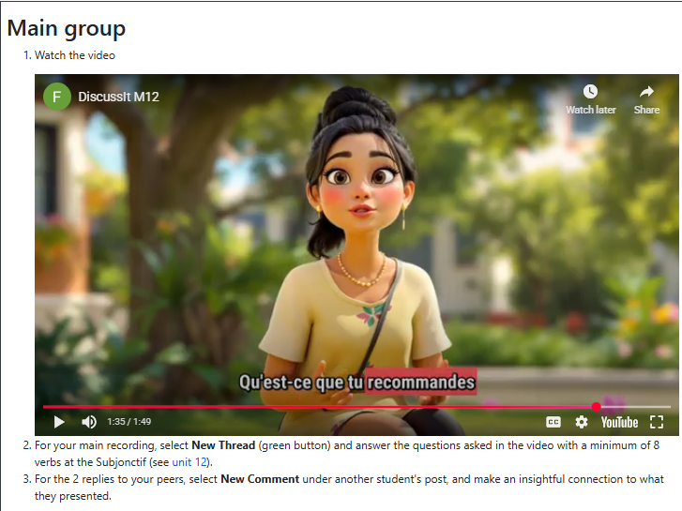
French Example: Rethinking written discussion assignments
Canvas written discussion used to have an example and a set of questions to help students write their own paragraph. There was a grammar requirement (i.e. minimum of 8 adverbs). Students responded to other students too.
Revised assignment The example is now presented in the video (created by HeyGen, hosted on YouTube) and the questions students must answer are presented at the end of the video. The grammar components are still required (i.e. minimum of 8 adverbs with hyperlink to unit covered). Students still need to respond to peers with a meaningful connection to what was said.

Slide 20
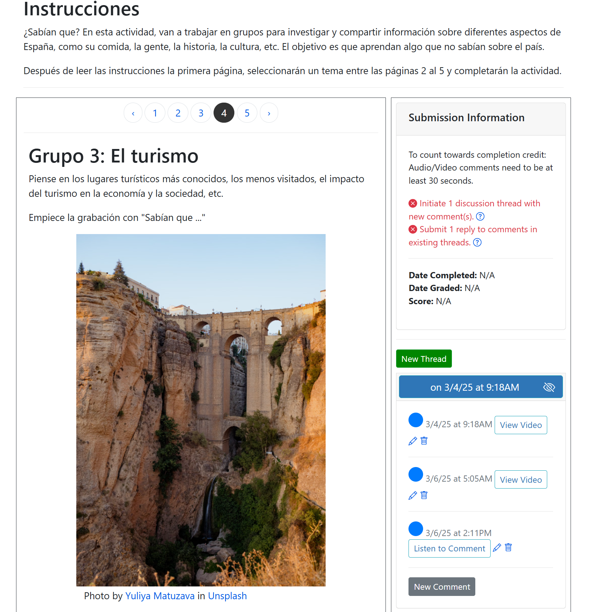
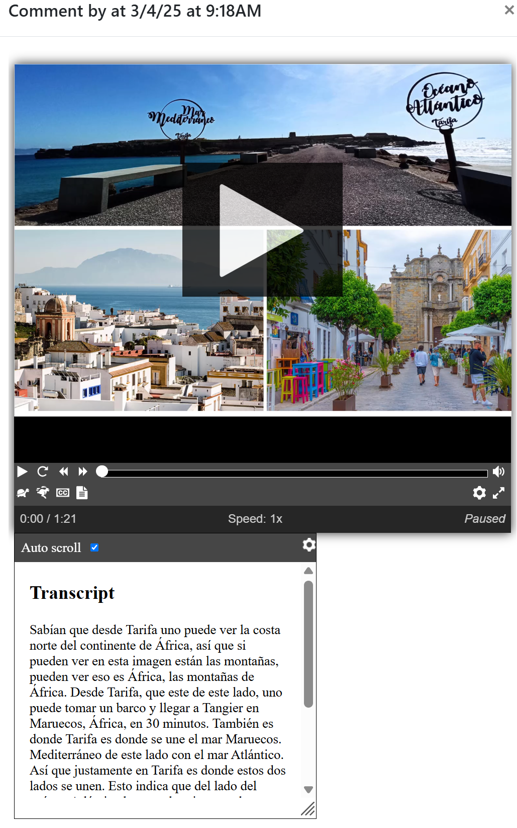
Spanish Example:
Did you know?

Slide 21
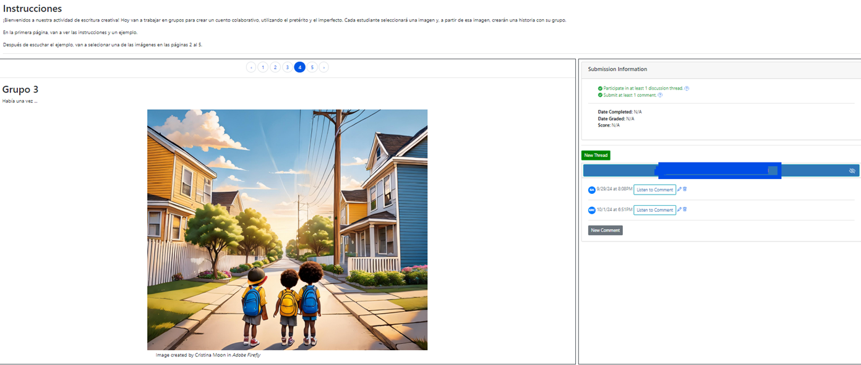
Spanish Example 2: Chain Story
Students choose an image to narrate a story started by a peer.

Slide 22
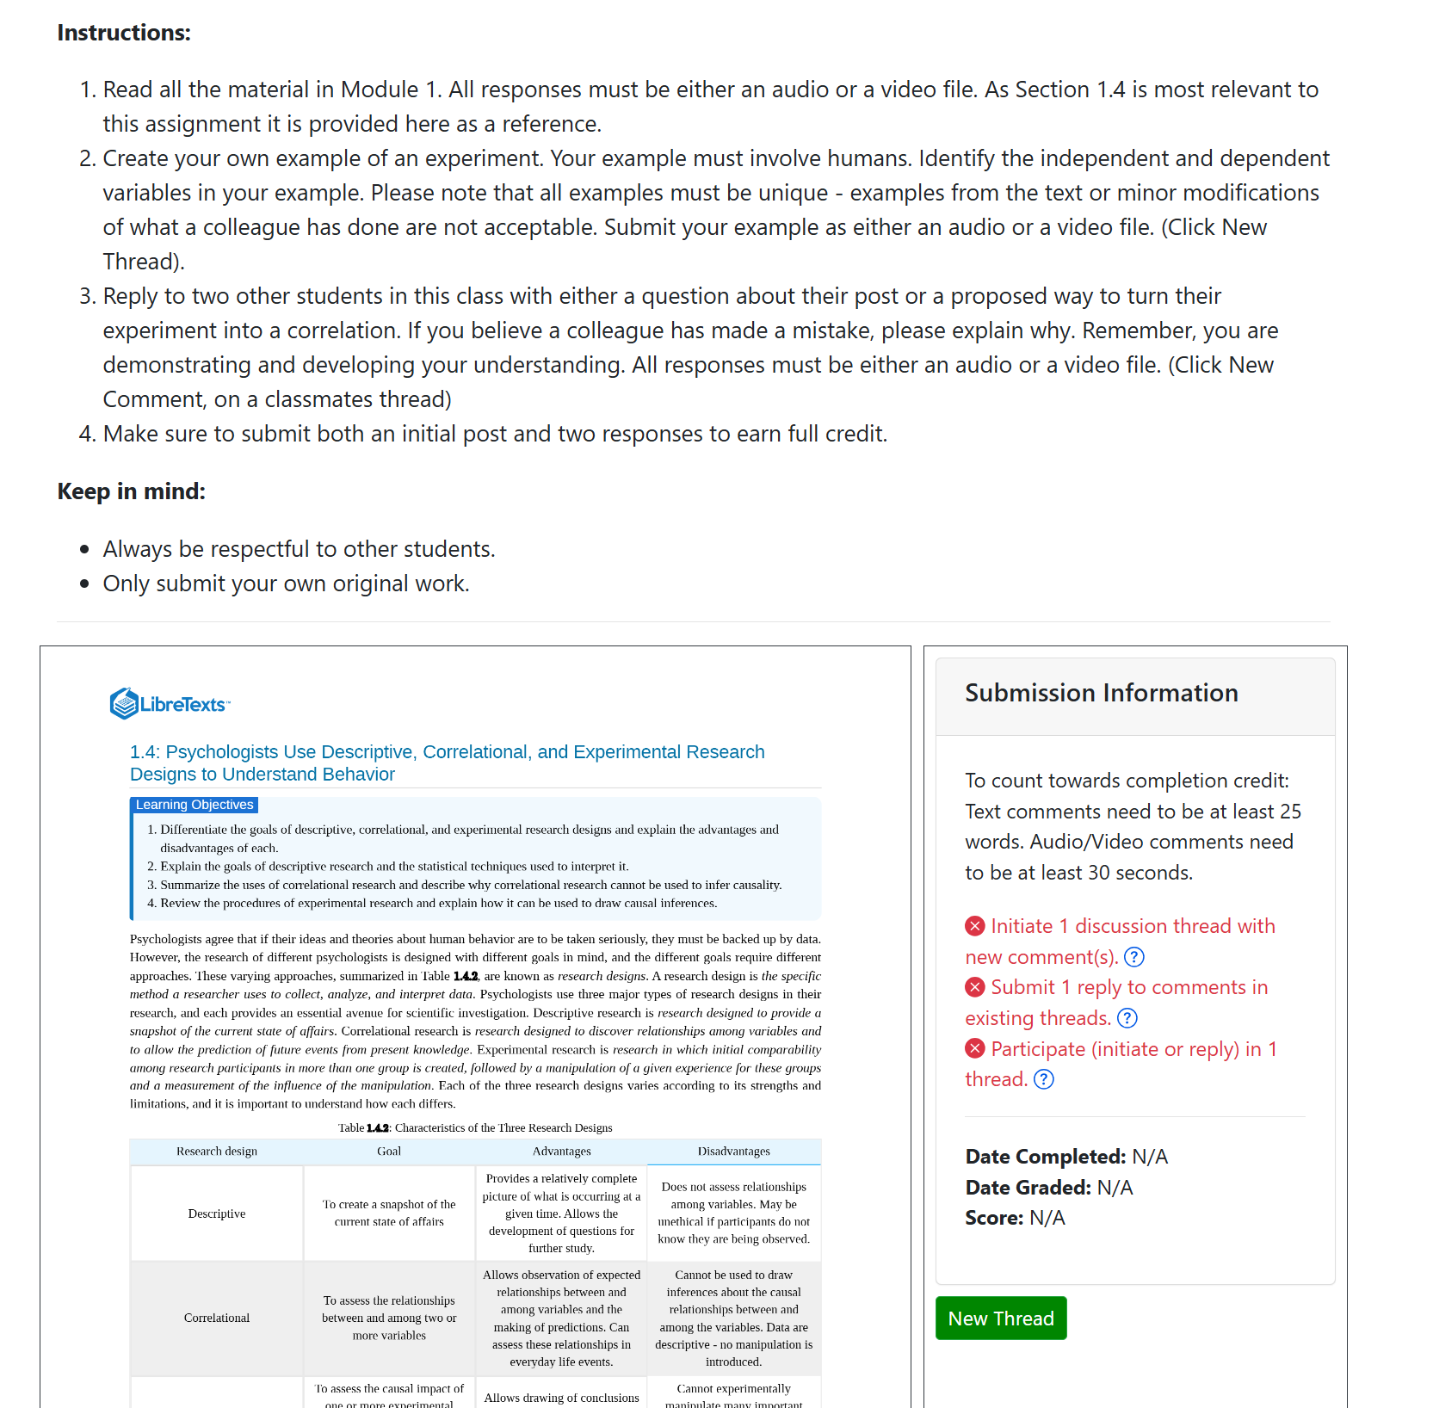
Intro Psych Example

Slide 23
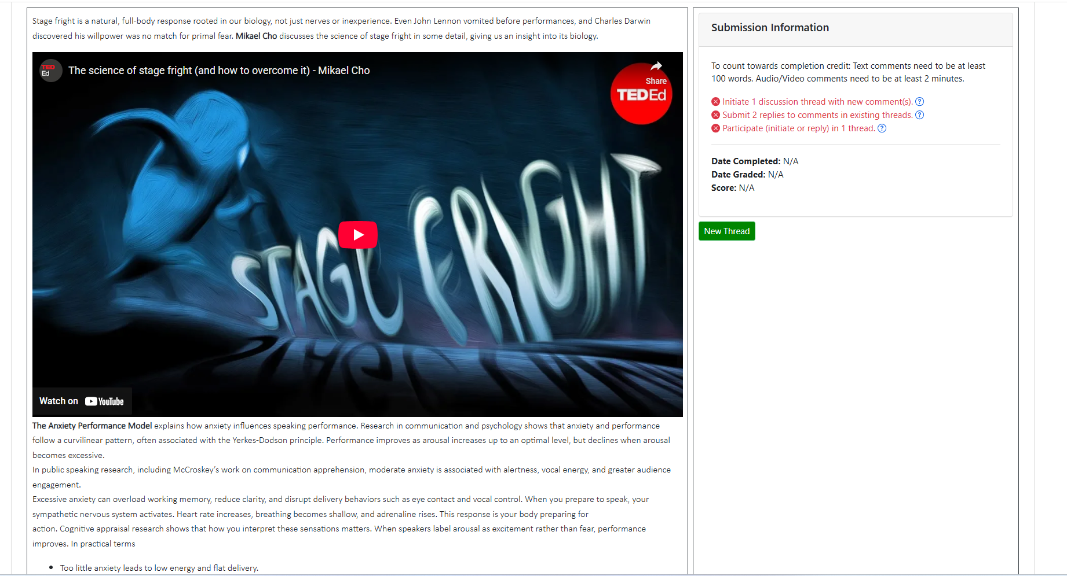
Comm Studies Example
Notes:
Builds low stakes practice before major graded speeches.
Reduces speech anxiety through repeated exposure.
Enables visible assessment of delivery and audience adaptation.
Strengthens peer feedback and evaluative listening.
Free, accessible platform with accurate auto captioning for ADA compliance
Integrated time stamps and rubric tools to streamline grading… coming soon.

Slide 24
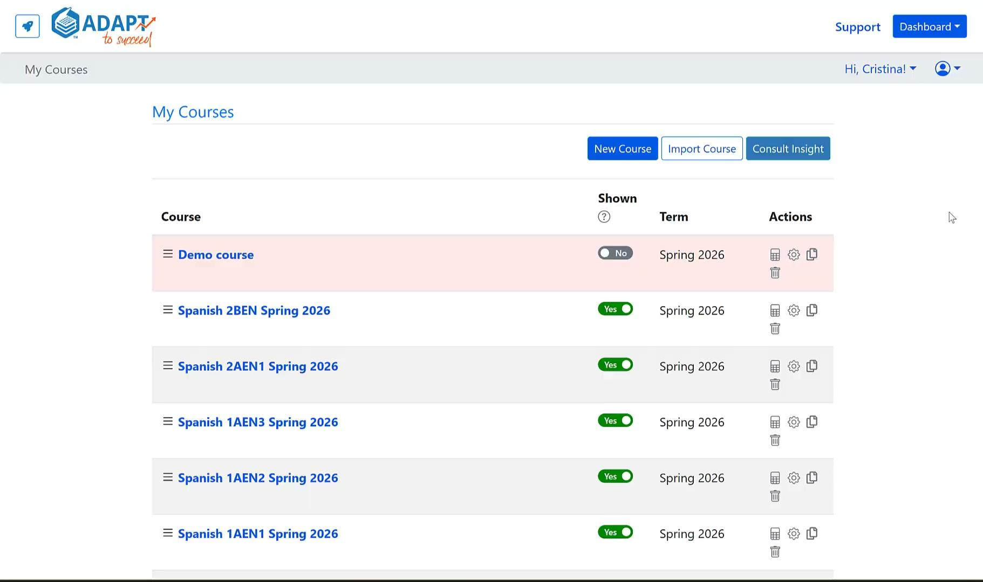
Integration of
ADAPT in LMS (Canvas)

Slide 25

Do you want to get started today?
Here we go….
Photo by Jamie Street on Unsplash

Slide 26
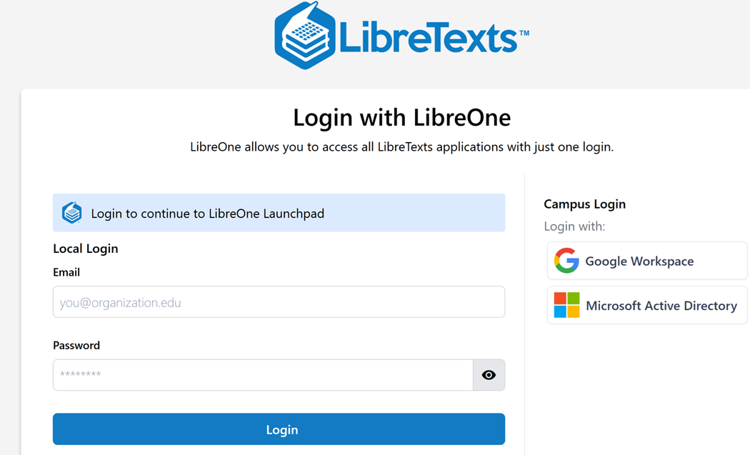
Create a Free LibreOne Account
LibreOne link (https://one.libretexts.org/)
Once you have the account, start with “Consult Insight” for training videos and instructions.
Notes:
https://one.libretexts.org/

Slide 27
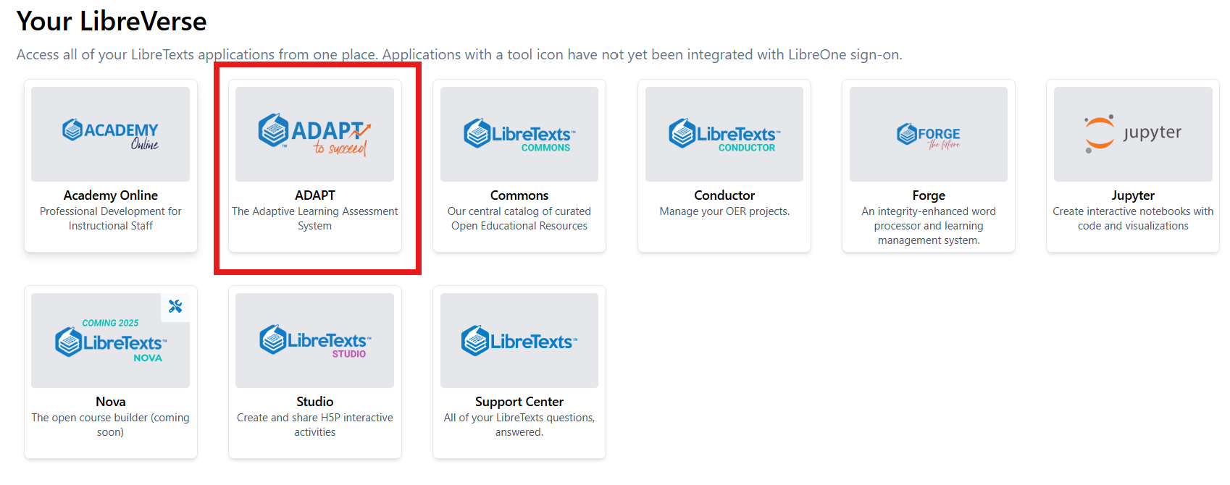
Finding ADAPT on the Launchpad
https://one.libretexts.org/

Slide 28
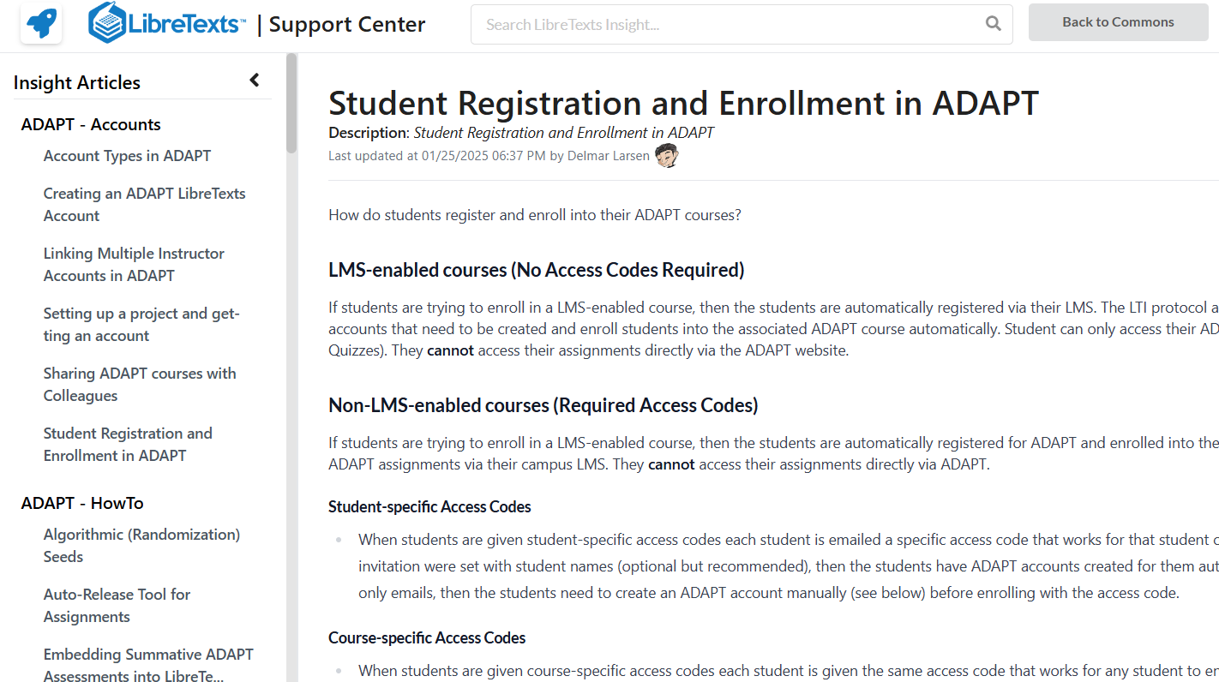
Assistance: The Insight Knowledge Base
https://commons.libretexts.org/insight
Notes:
https://commons.libretexts.org/insight

Slide 29
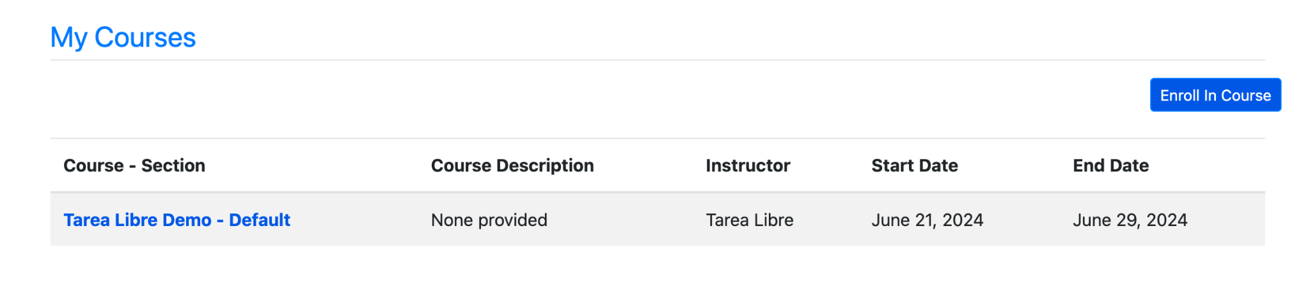
ADAPT Structure
Course
ADAPT demonstration site is an assignment within the Tarea Libre Demo course
Assignment
Assignments are found within courses
Questions
Questions are found within an assignment and can consist of any question/prompt/activity types within ADAPT

Slide 30
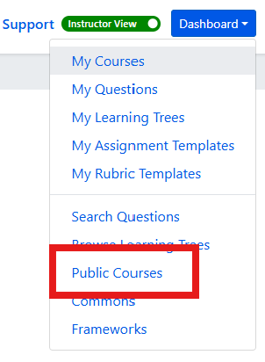
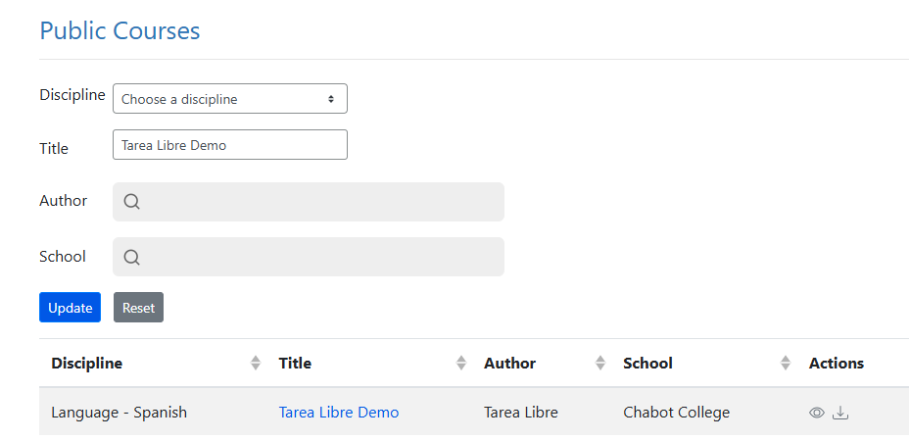
ADAPT Quick Start - Import Demo Course and Clone Discuss-It activities
First go to the ADAPT Dashboard, select Public Courses.
Next under Title, type Tarea Libre Demo and then select the import (down arrow).
Notes:
Maybe make this two slides?

Slide 31
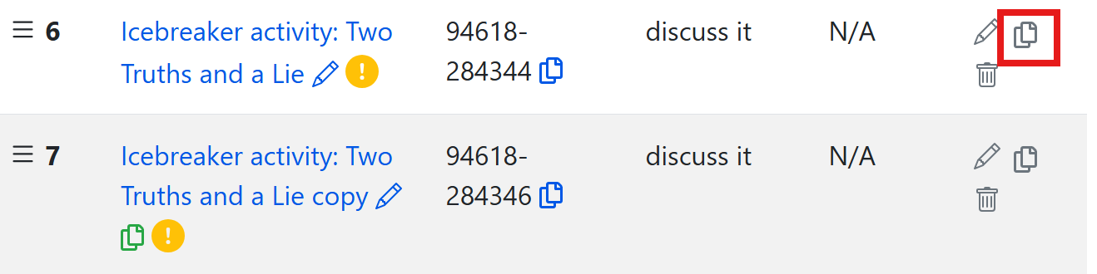
Clone to Customize
Once you clone (or copy) an activity, you will be able to customize it.

Slide 32
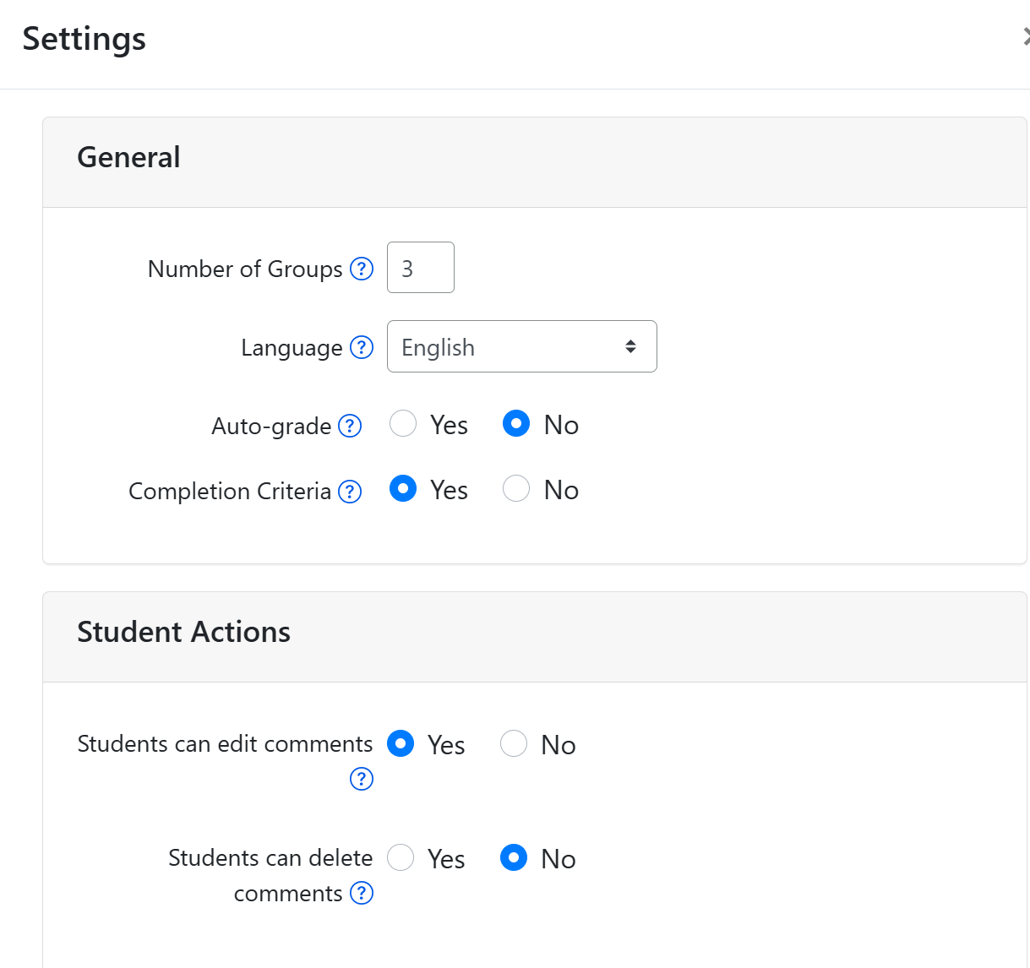
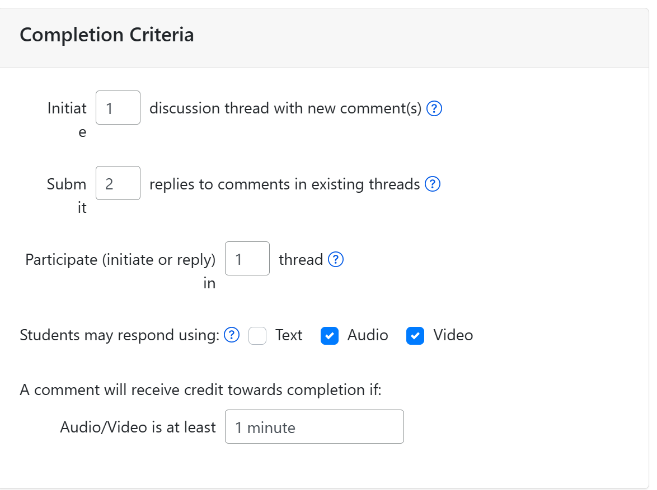
Discuss-It Assignment Settings

Slide 33
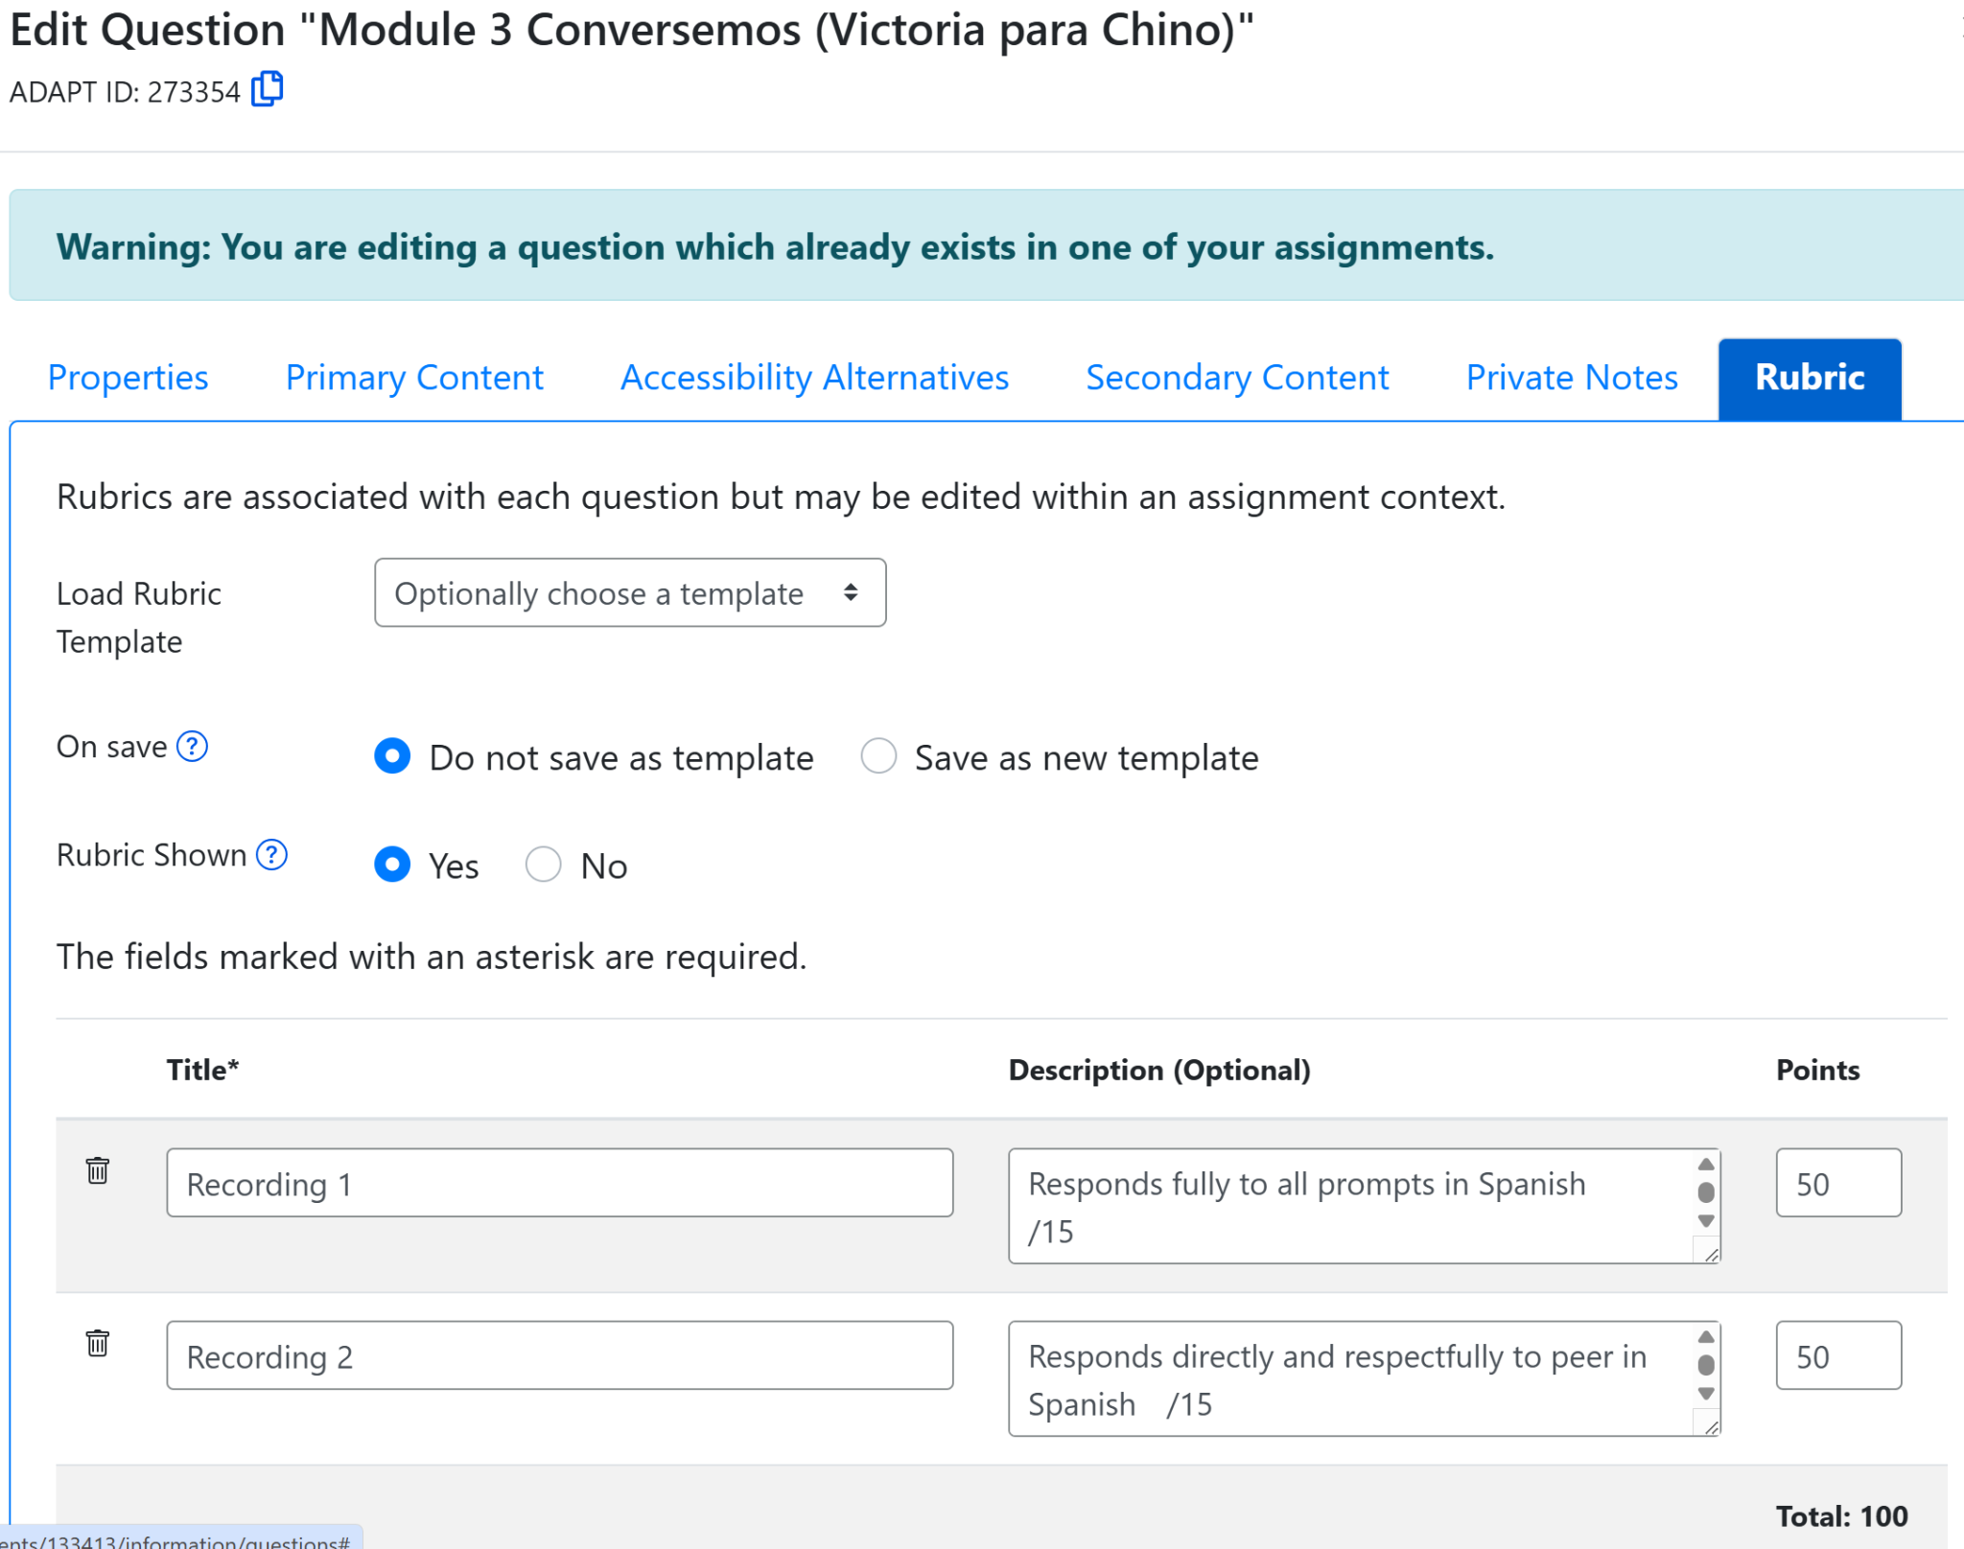
Grading with a Rubric
New rubric feature provides enhanced open-ended grading to a fixed set of pre-existing criteria.
Rubric can be added to any question with open-ended components.
Rubric can be connected to the question (“Question Rubric”) or to assignment (“Assignment Rubric”) that will override the Question Rubric.

Slide 34
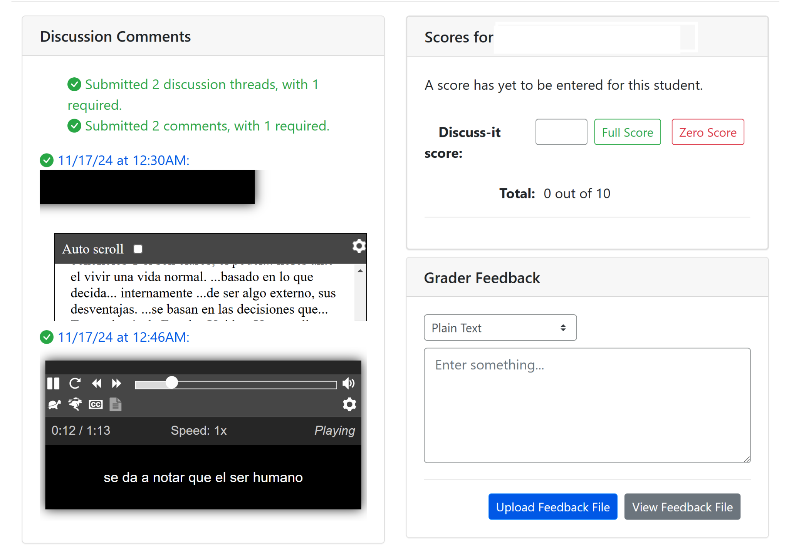
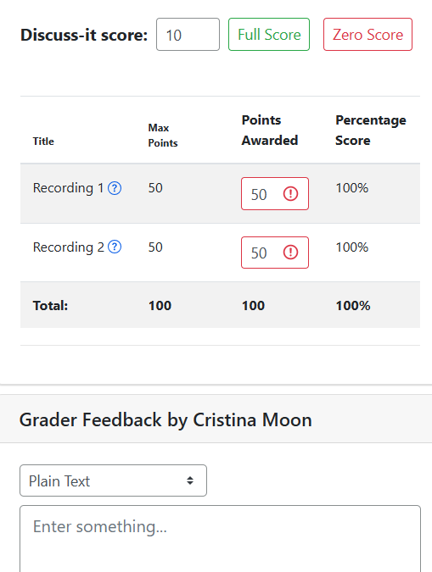
Easy Grading of Discuss-It Questions

Slide 35
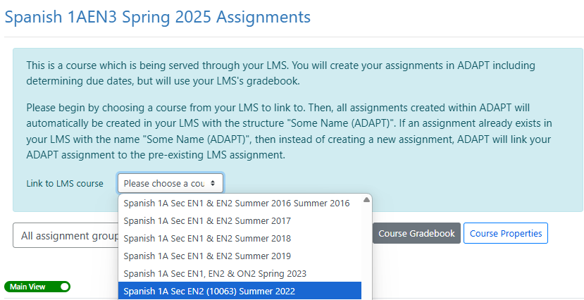
Option 1
Linking Canvas Course to ADAPT Course via API
The API link to Canvas will automatically create individual Canvas assignments and gradebook entries.
Notes:
More info on API: https://docs.google.com/document/d/1ItwdvFXi6fqy-OilptSjTaxGZ7LeCPEZMDQtYElBsQg/edit?tab=t.0#heading=h.1f9oybosc2xn

Slide 36
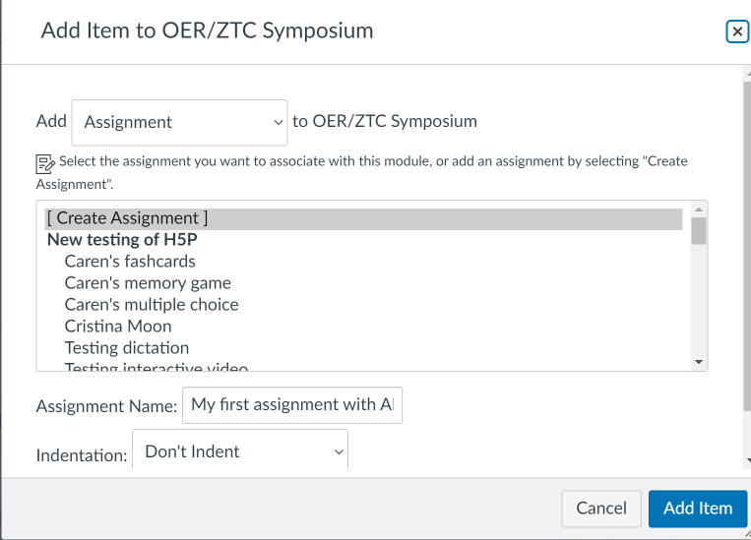
Option 2
How to link ADAPT in Canvas via LTI
Create an assignment in Canvas
Notes:
1:25

Slide 37
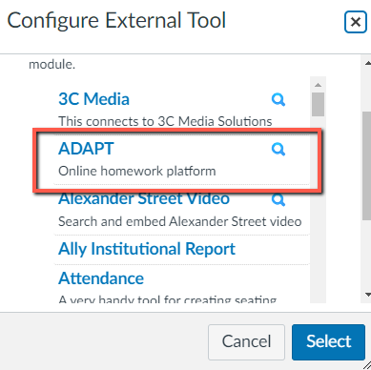
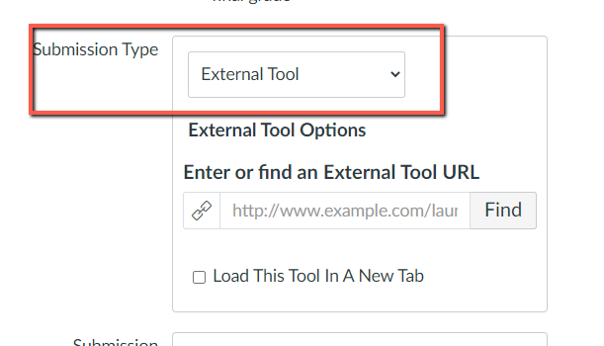
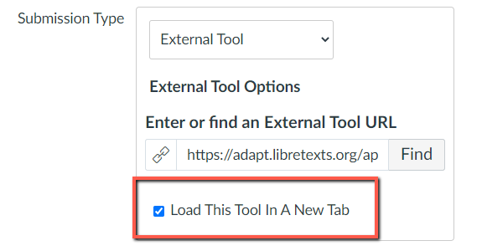
Select ADAPT in External Tool

Slide 38
ASCCC OERI
Archived Webinars
Title | Date | Tags
ADAPT Level 4 – Question Banks and ADAPT Canvas Integration | July 7, 2025 | ADAPT, ADAPT Series, Homework, LibreOne, LibreStudio, LibreTexts ADAPT
ADAPT Level 3 – Fostering Oral Interaction with ADAPT’s Discuss-It Question Type | June 30, 2025 | ADAPT, ADAPT Series, Homework Systems, LibreOne, LibreTexts ADAPT
ADAPT Level 2 – Creating in ADAPT | June 20, 2025 | ADAPT, ADAPT Series, Homework Systems, LibreOne, LibreTexts ADAPT
ADAPT Level 1 – Accessing ADAPT and Finding Existing Assessments | June 13, 2025 | ADAPT, LibreTexts, LibreTexts ADAPT
Introduction to Editing Pages in LibreTexts | June 10, 2025 | LibreOne, LibreTexts
Introduction to the LibreTexts Remixer | June 9, 2025 | LibreTexts, LibreTexts Basics, LibreTexts Conductor
LibreTexts’ ADAPT Homework Platform and the new Discuss-It | April 16, 2025 | ADAPT, Canvas, Discipline Webinar, Discuss-It, LibreTexts, LibreTexts ADAPT
Introduction to Remixing in LibreTexts Workshop | June 4, 2024 | LibreOne, LibreTexts, Remixing
Spanish Open Educational Resources (OER) Homework Hackathon 2: Let’s have fun with ADAPT | May 10, 2024 | ADAPT, Discipline Webinar, LibreTexts ADAPT, Spanish
Notes:
SK

Slide 39

LibreTexts Support and Training
Visit the LibreTexts Academy for more professional development services.
General Introduction to ADAPT
LibreTexts Workshop Recordings
LibreTexts (https://libretexts.org)
Office hours (TTh 9:00-10:00 am)
Notes:
SK

Slide 40
Learn More About Discuss-It
At the ASCCC AI Academy
At the Online Teaching Conference
Sign Up for the OERI Listserv

Slide 41
More Information
ASCCC OERI Website (asccc-oeri.org)
Resources
Webinars and Events
LibreTexts (https://libretexts.org)
Office hours (TTh 9:00-10:00 am)

Slide 42

Thanks!
Photo by Thgusstavo Santana from Pexels

