Slide 1
Welcome!
On behalf of the ASCCC OERI we are pleased to have you here for “ADAPT Hackathon Training.”
If you are not already muted, please mute yourself upon arrival.
As this is set up as a meeting, we will be able to have an actual discussion – but we need all those who are not speaking to be muted.You are also encouraged to use the “chat” feature.
This event will be recorded and available to you on the OERI website (asccc-oeri.org).
In order to participate fully, you need to have a LibreTexts instructor account.
Log into LibreOne (https://one.libretexts.org/)

Slide 2
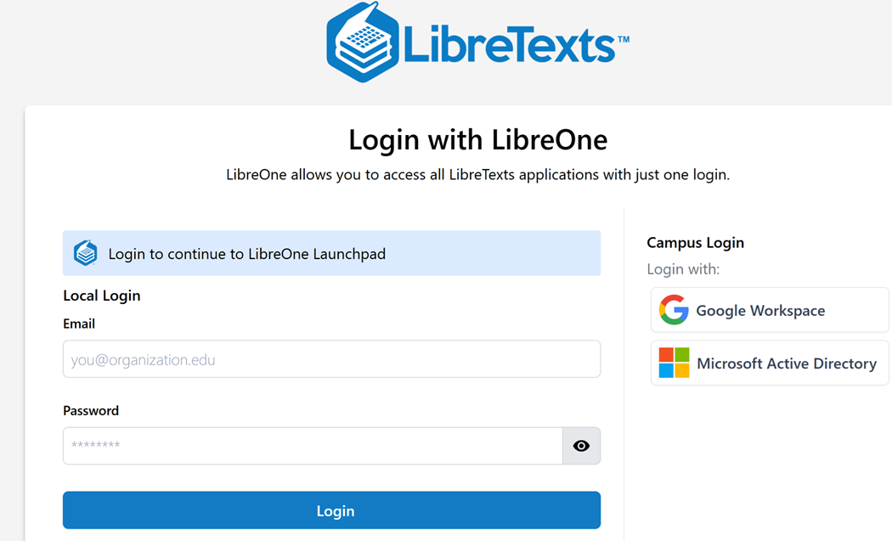
Create an Account and
Log Into LibreOne
LibreOne link (https://one.libretexts.org/)
Once you have the account, start with “Consult Insight” for training videos and instructions.
Notes:
https://one.libretexts.org/

Slide 3
ADAPT Hackathon Training
This presentation last modified April 3, 2026.
This work is licensed under a Creative Commons Attribution 4.0 International License.
Attribute this slide deck as: “ADAPT Hackathon Training” by ASCCC OERI is licensed under CC BY 4.0.

Slide 4
Event Description
Are you interested in developing openly licensed assessments for your discipline? Have you heard about Discuss-It and The Forge? Would you like to learn how to quickly develop new questions in the ADAPT homework system? Join us for this inaugural hackathon training as we prepare to build out assessments for a variety of disciplines.

Slide 5
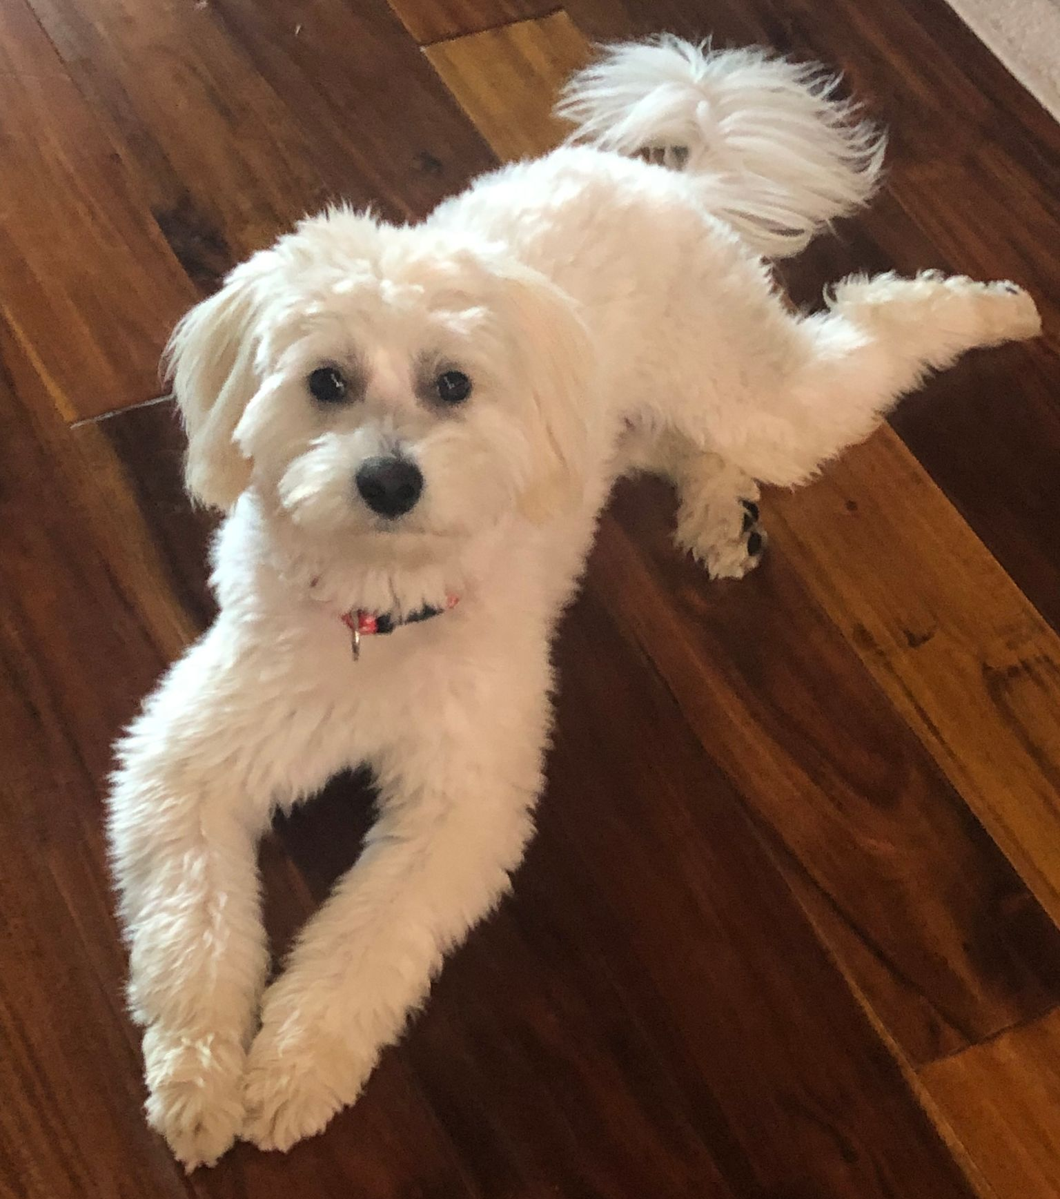
Presenters
Cristina Moon, Spanish, Chabot College
  OERI Region B Lead
  OERI ADAPT Lead
Michelle Pilati, Psychology, Rio Hondo College
  OERI Project Director

Slide 6
Overview
What is ADAPT?
Why ADAPT?
Accessing ADAPT
ADAPT Non-Native Questions
ADAPT Native Questions
Cloning ADAPT Questions

Slide 7
Today’s Goal
Learn how to use “cloning” to quickly create ADAPT questions.
Beginner Level
  Select choice
  Highlight text
  Matching
Intermediate Level
  Flashcard
Advanced Level
  Discuss-It
  The Forge

Slide 8
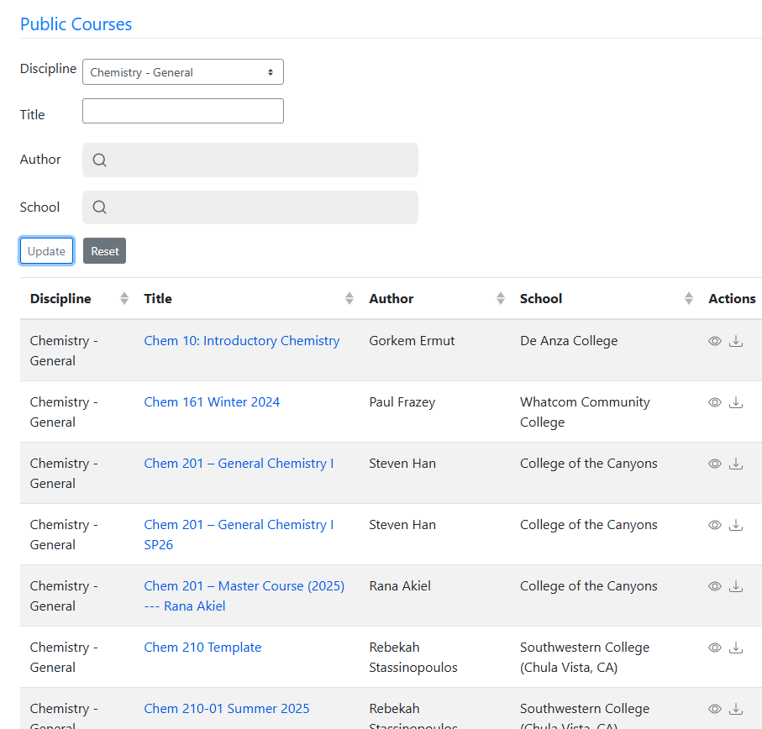
What is ADAPT?
ADAPT is a comprehensive online assessment/homework infrastructure that provides faculty the ability to include auto-graded and non-auto-graded activities from different platforms such as H5P, MyOpenMath, WeBWork, and its own native ADAPT questions.
ADAPT can be integrated into Canvas or it can be run independently.

Slide 9
Why ADAPT?
Allows for the creation of a wide array of questions and activities.
Implement independently - or integrate into Canvas.
The development of new question types - and enhancements to existing ones - is ongoing.

Slide 10
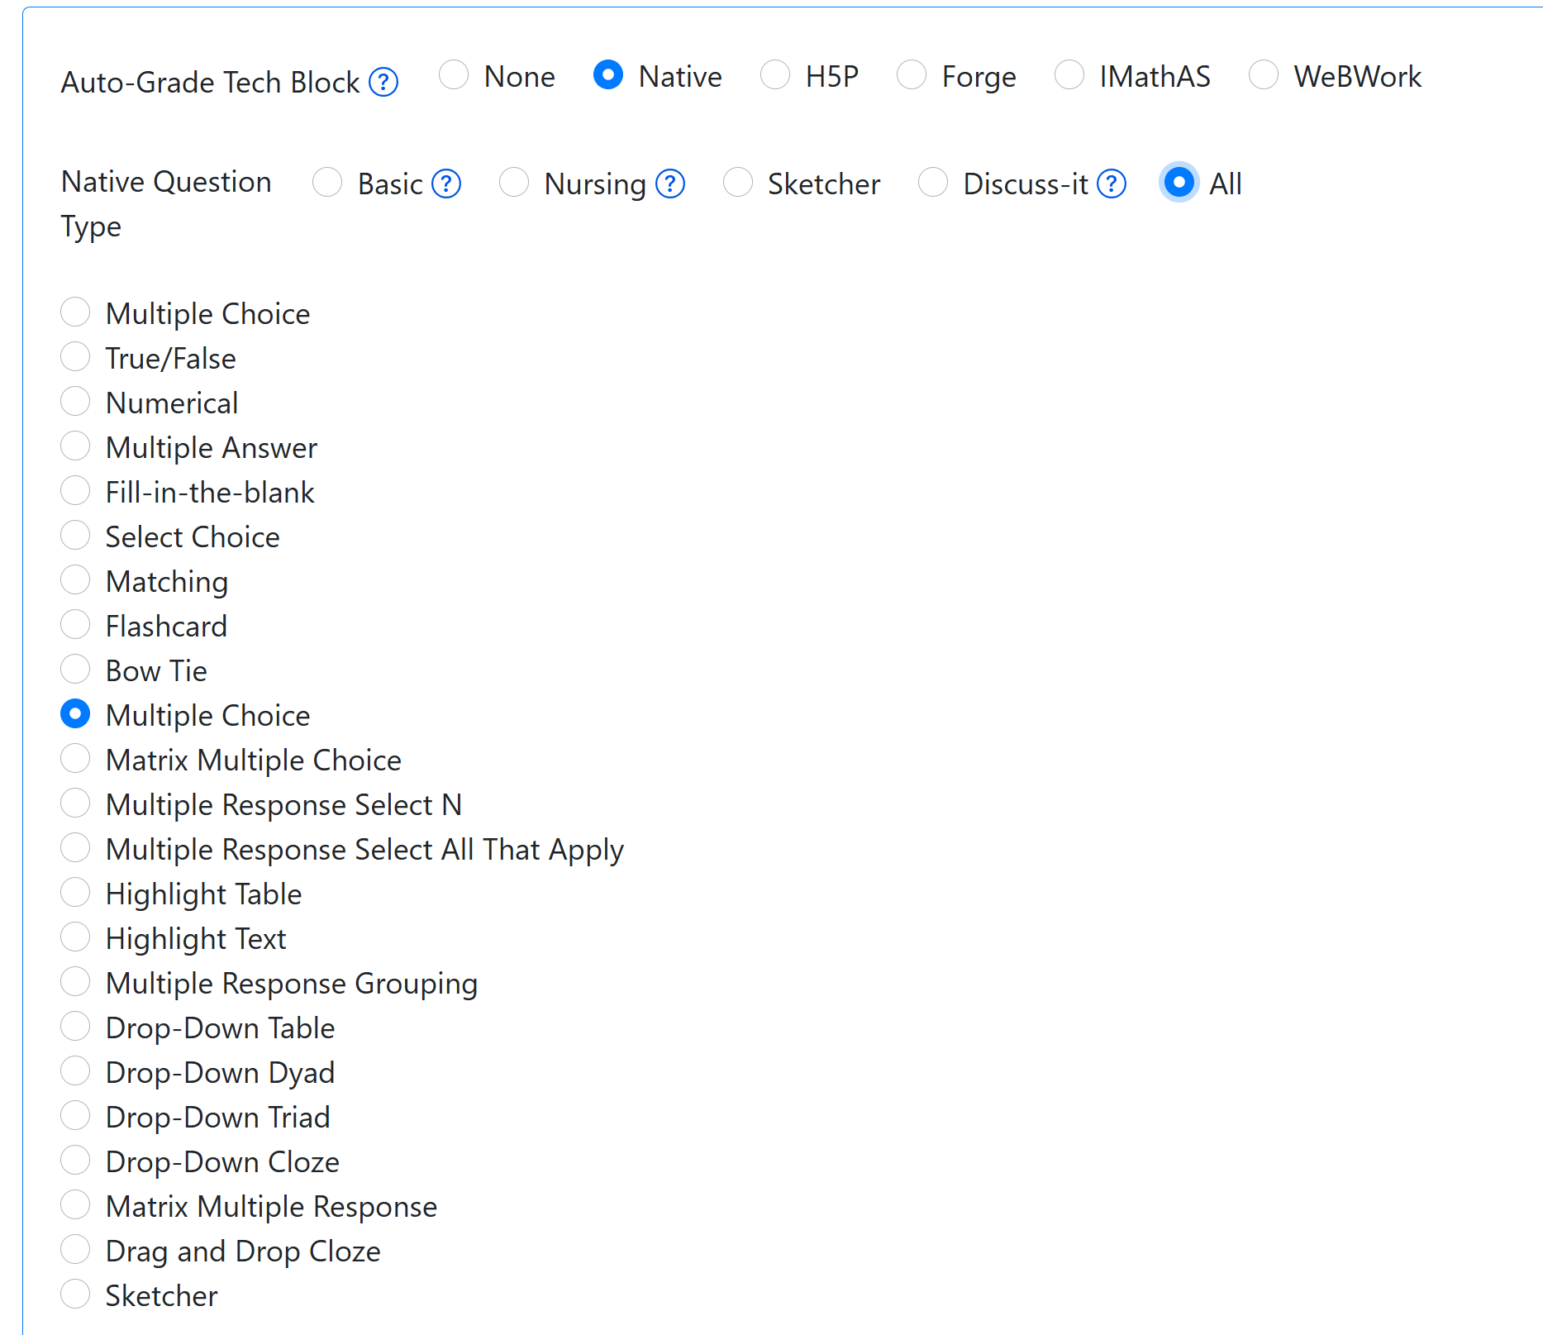
Beyond the Canvas QTL
Question Types

Slide 11
Preview of New - and Newer - Question Types
Discuss-It
The Forge
Flashcards
Accounting (in development)

Slide 12
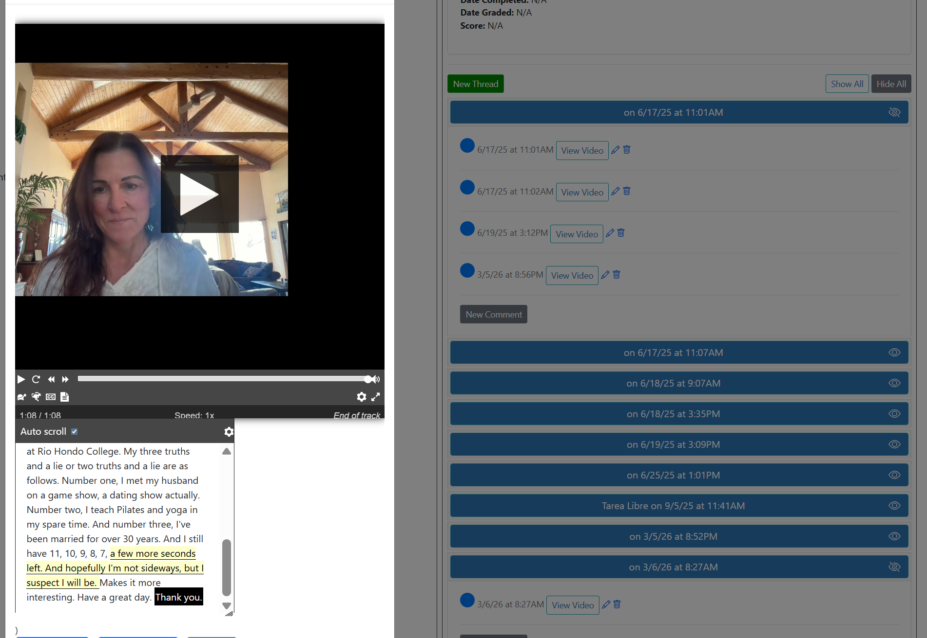
What is Discuss-It?
A specialized question type within the LibreTexts ADAPT platform ideal for addressing the regular and substantive interaction (RSI).
Features:
Ability to post video, audio, or text responses (warning if copy/paste occurs)
Auto-captioning and transcription with high accuracy using Whisper AI for multiple languages.
Easy cloning (or copying) of all public questions.
Canvas integration with automatic gradebook syncing.
Rubric for grading.
Notes:
CM

Slide 13

Discuss-It Demo Site
tinyurl.com/LTADAPT
Notes:
https://adapt.libretexts.org/students/assignments/94618/init-formative

Slide 14
What is the Forge?
A platform designed to support writing
What It Does
Shifts from product to process
Builds authentic learning and academic integrity
Centers student voice and development over compliance
Privacy by Design
No student data sold
No external AI database submissions
Self-hosted and GDPR-compliant options

Slide 15
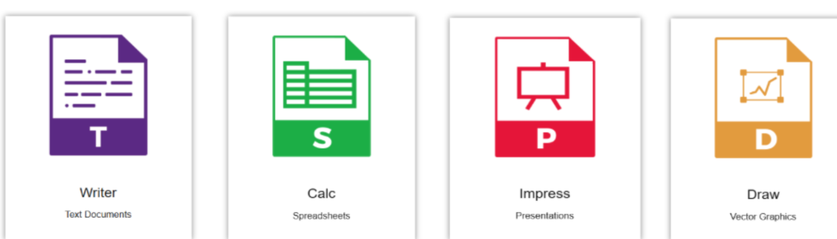
The Forge Tools
Within Forge, instructors can assign individualized, editable documents using four tools:
Writer for word processing
Calc for spreadsheets
Impress for presentations
Draw for vector graphics
Notes:
DL

Slide 16
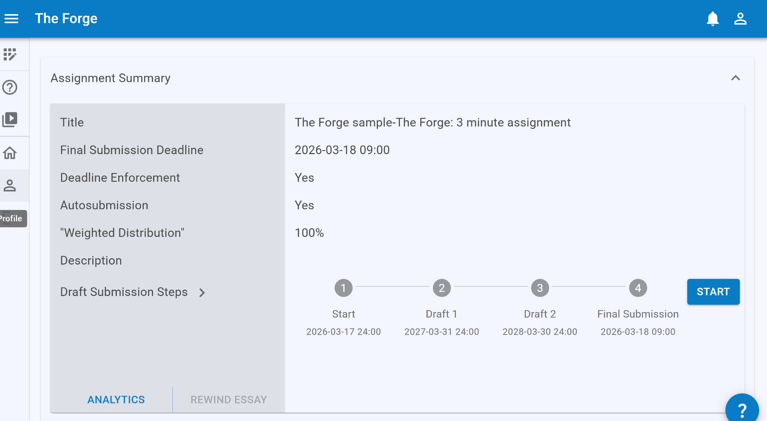
Student View

Slide 17
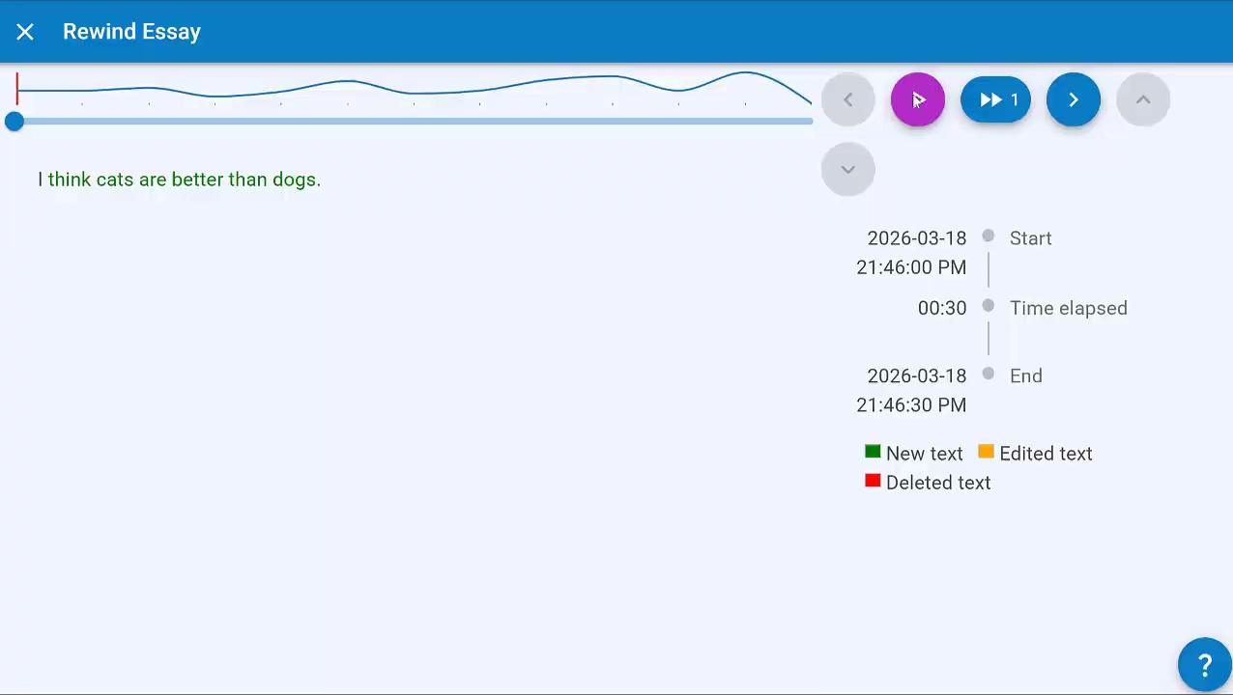
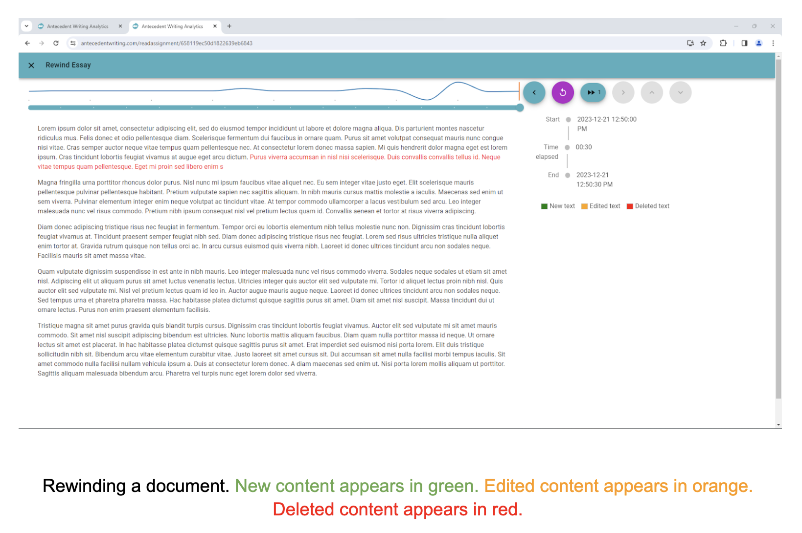
Analytics: “Rewinding” Documents
Notes:
CM
The Rewind feature provides the instructor with an animation showing how the assignment was written, offering instructors with a finer-scale view of the student’s writing process. If instructors wish to advance the frame, they can click on the forward button. Instructors can click repeatedly on the forward button to move quickly through the animation. By default, the rewind shows the state of the assignment every 30 seconds when the student is writing.

Slide 18
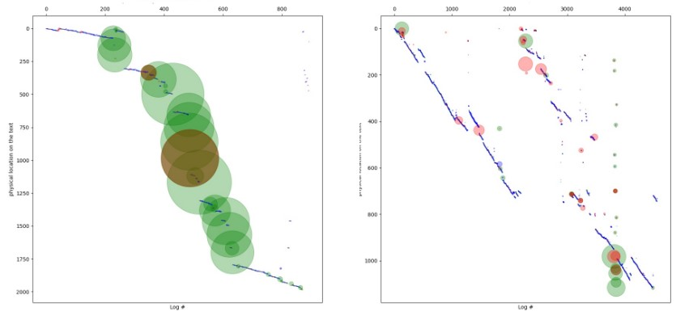
Forge: Long-form writing Analytics & Assessment
Copy/Paste Chunks
Later Editing
Word Count
Time

Slide 19
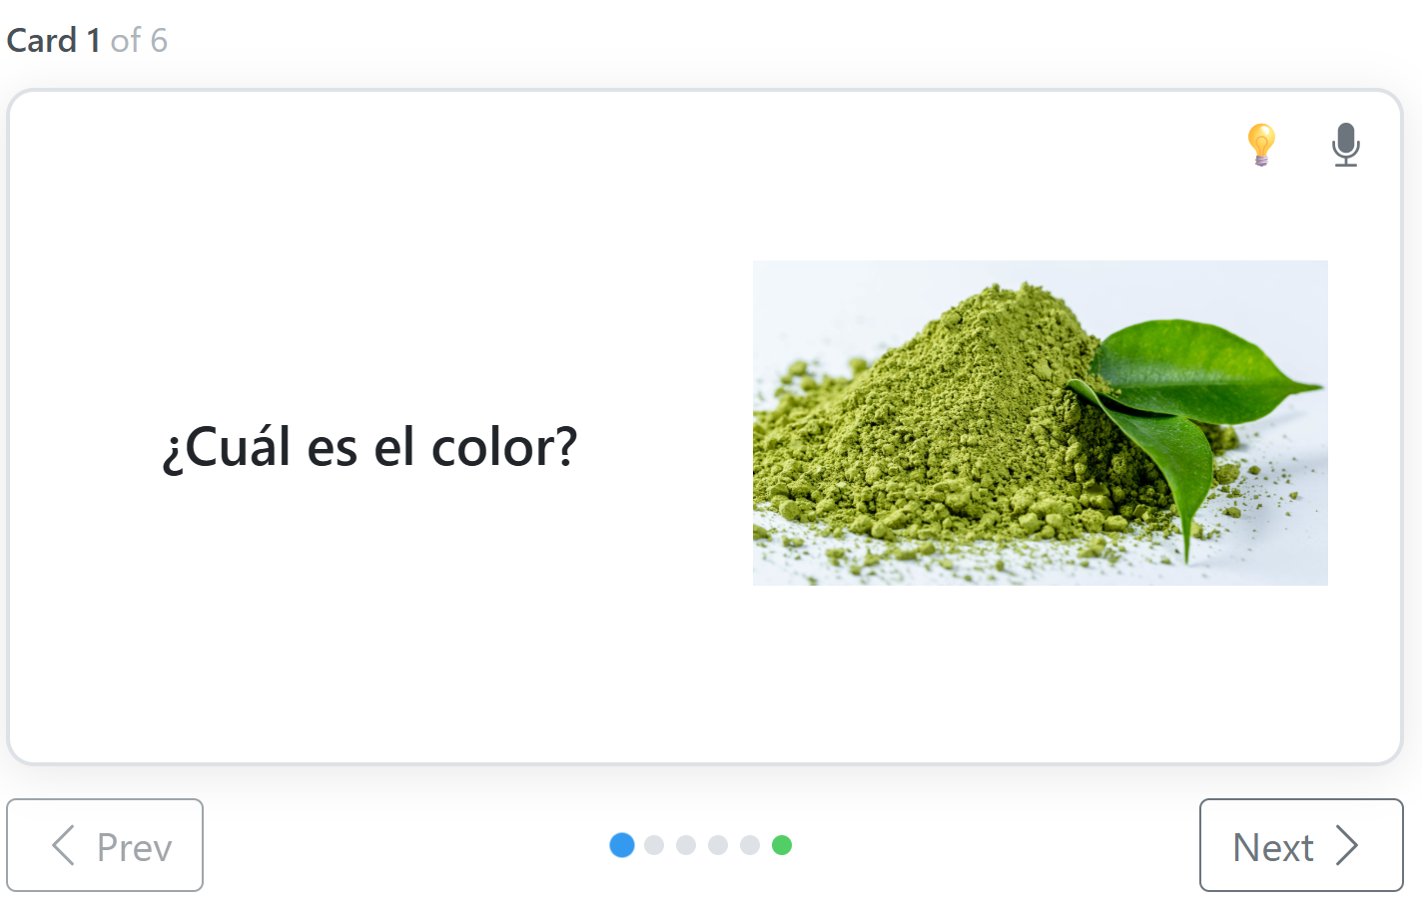
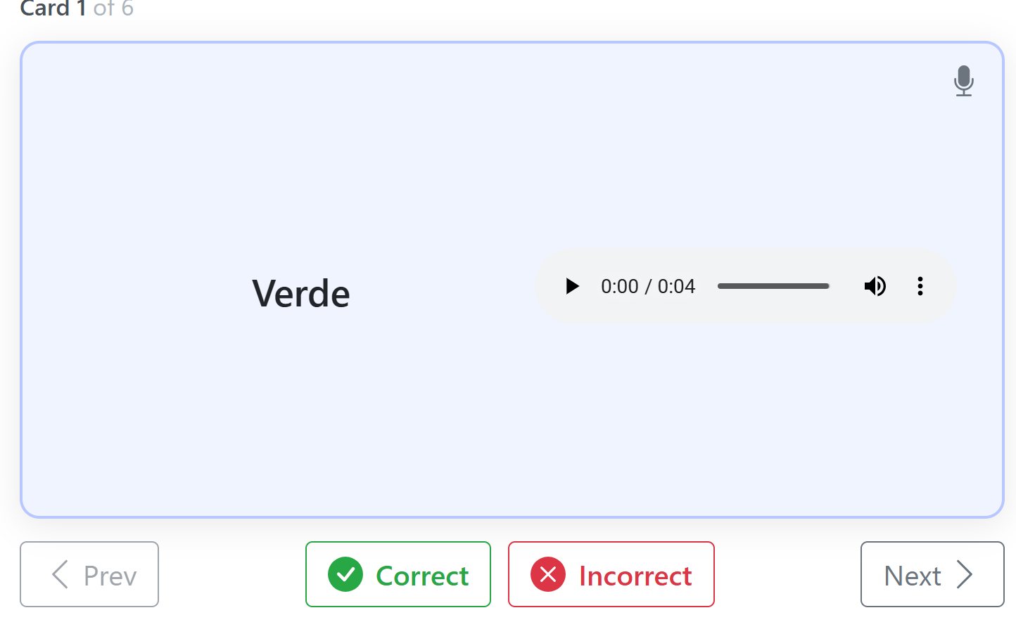
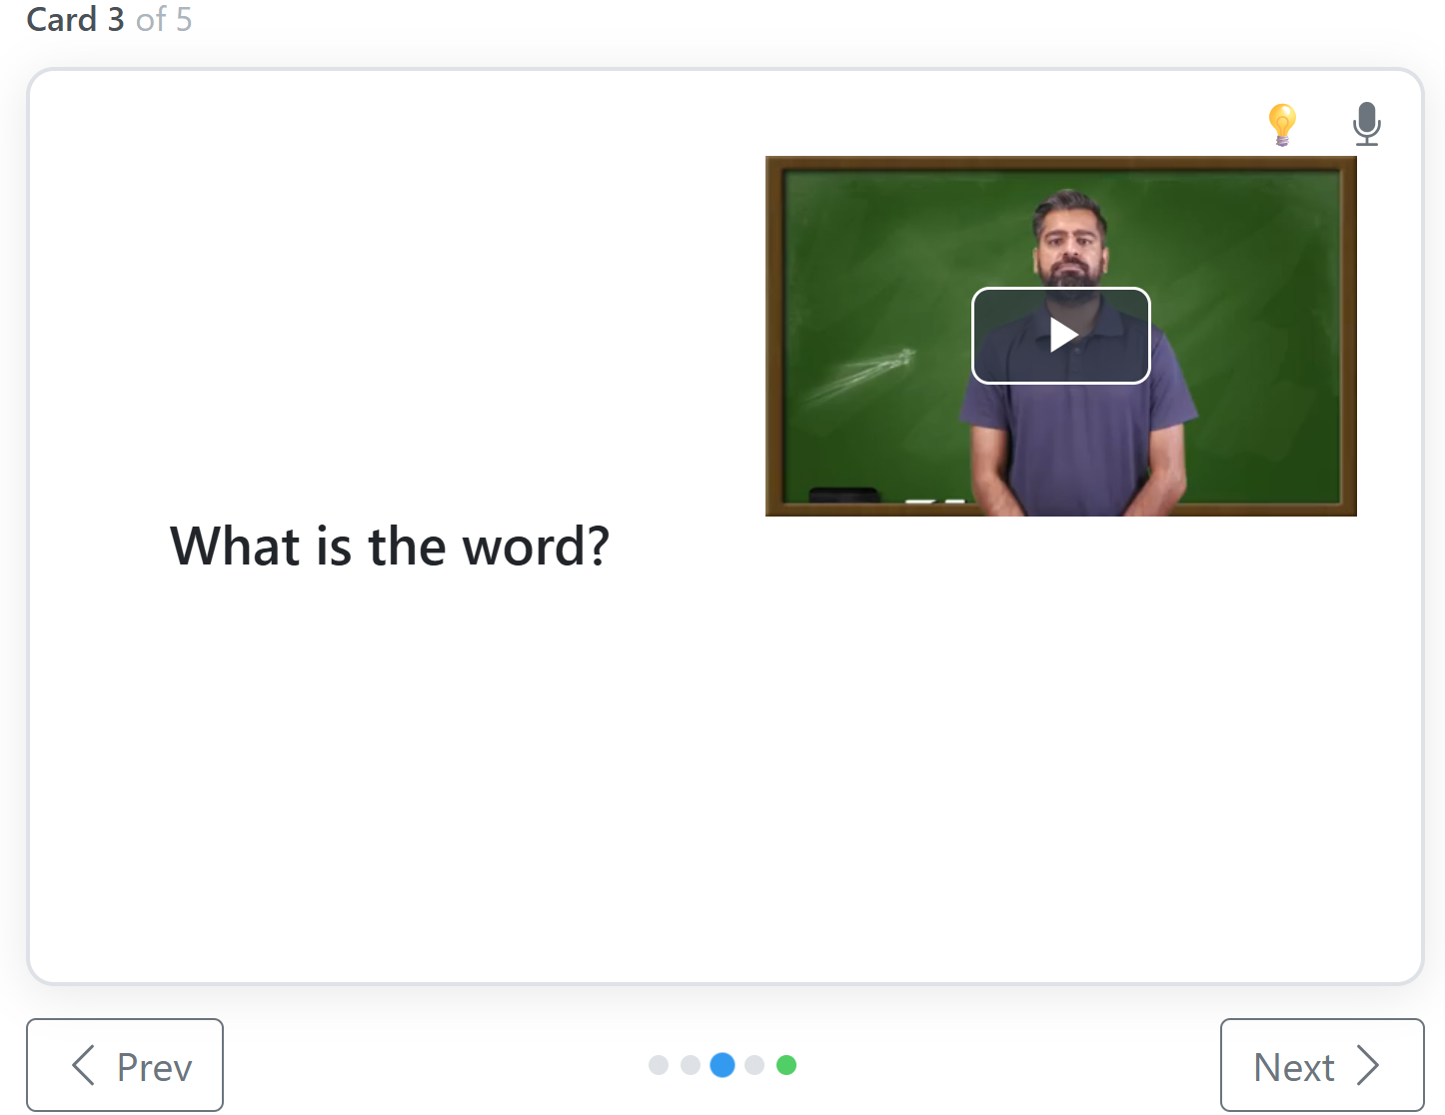
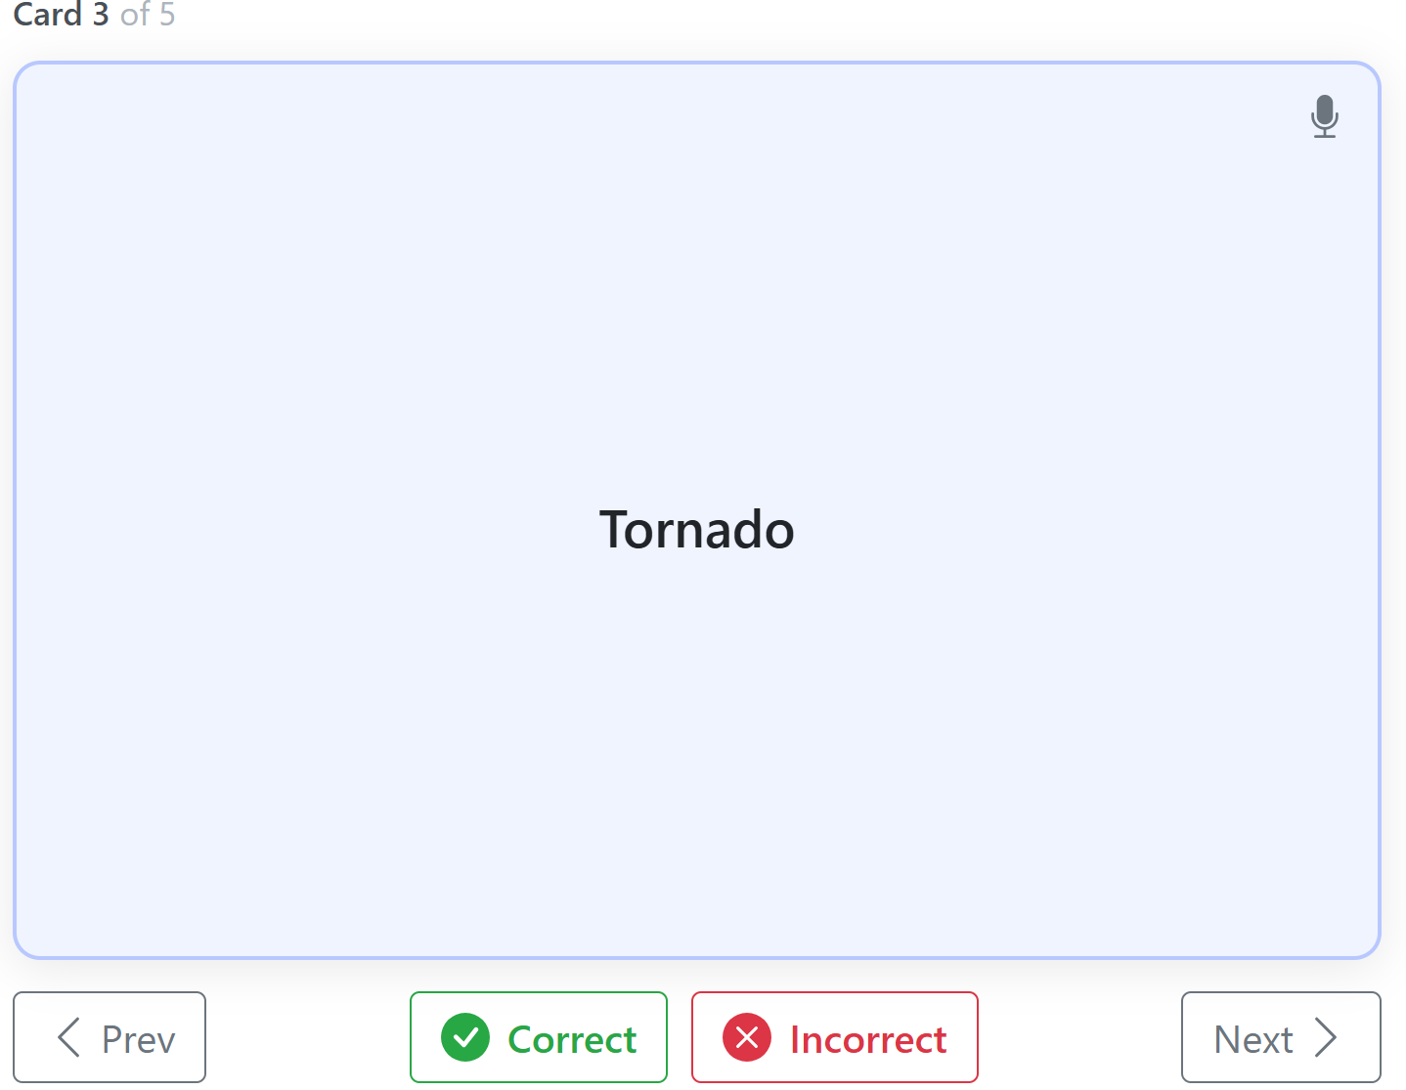
Flashcards - Text, Images, Audio, Video

Slide 20

Let’s Start the Hackathon
Photo by Jamie Street on Unsplash

Slide 21
Agenda for the Hackathon
Import the OERI ADAPT Demo Course.
Go over cloning and editing with Select Choice and Flashcard examples.
Breakout Rooms: Practice in small groups.
Go over resources and what is to come.

Slide 22
Log into LibreOne
LibreOne link (https://one.libretexts.org/)
Once you have the account, start with “Consult Insight” for training videos and instructions.
Notes:
https://one.libretexts.org/

Slide 23
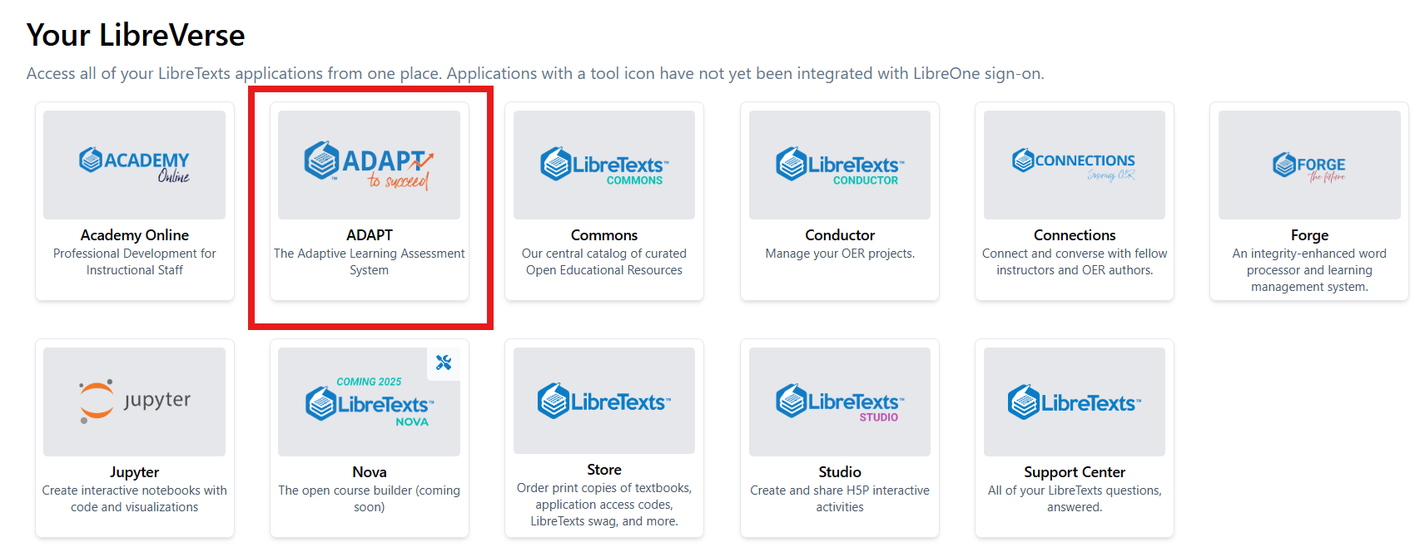
Finding ADAPTT

Slide 24
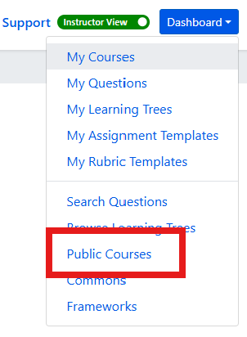
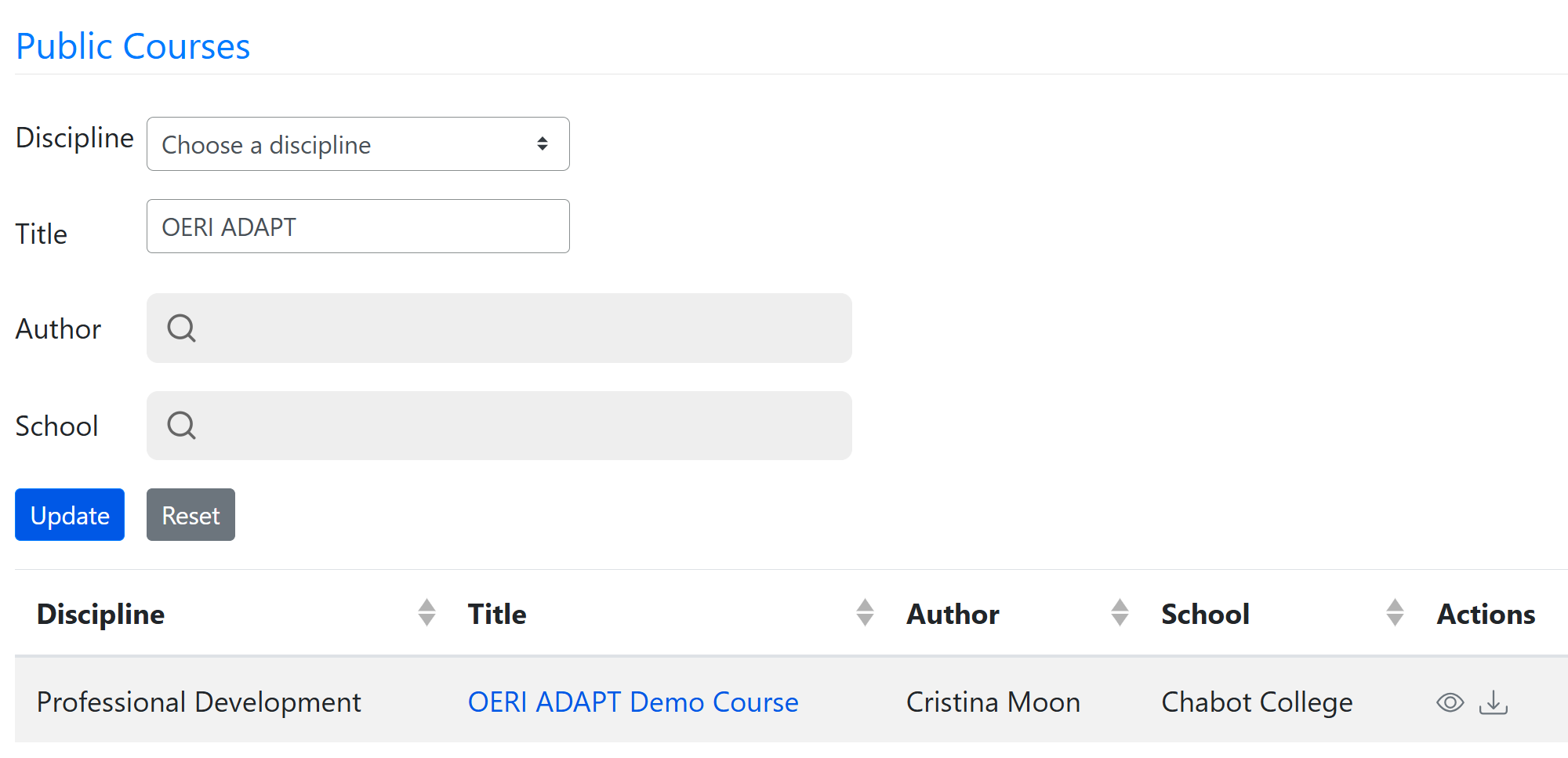
Import OERI ADAPT Demo Course
First, find the Dashboard and select Public Courses.
Next, under Title, type OERI ADAPT Demo Course and then select the import (down arrow).

Slide 25
Importing a Public Course - Step-by-Step
Log into LibreTexts.
Navigate to ADAPT.
If you are logged in as an Instructor, your Dashboard will be in the upper right of your screen no matter where in ADAPT you are.
Select “Public Courses.”
Leave the “Discipline” field as it as and then enter “OERI ADAPT” or “OERI ADAPT Demo” in the “Title” field.
Select “Update.”
You should now have the OERI ADAPT Demo Course available for you to import into your courses.
Select the down arrow under actions (on the far right) to import the course.

Slide 26
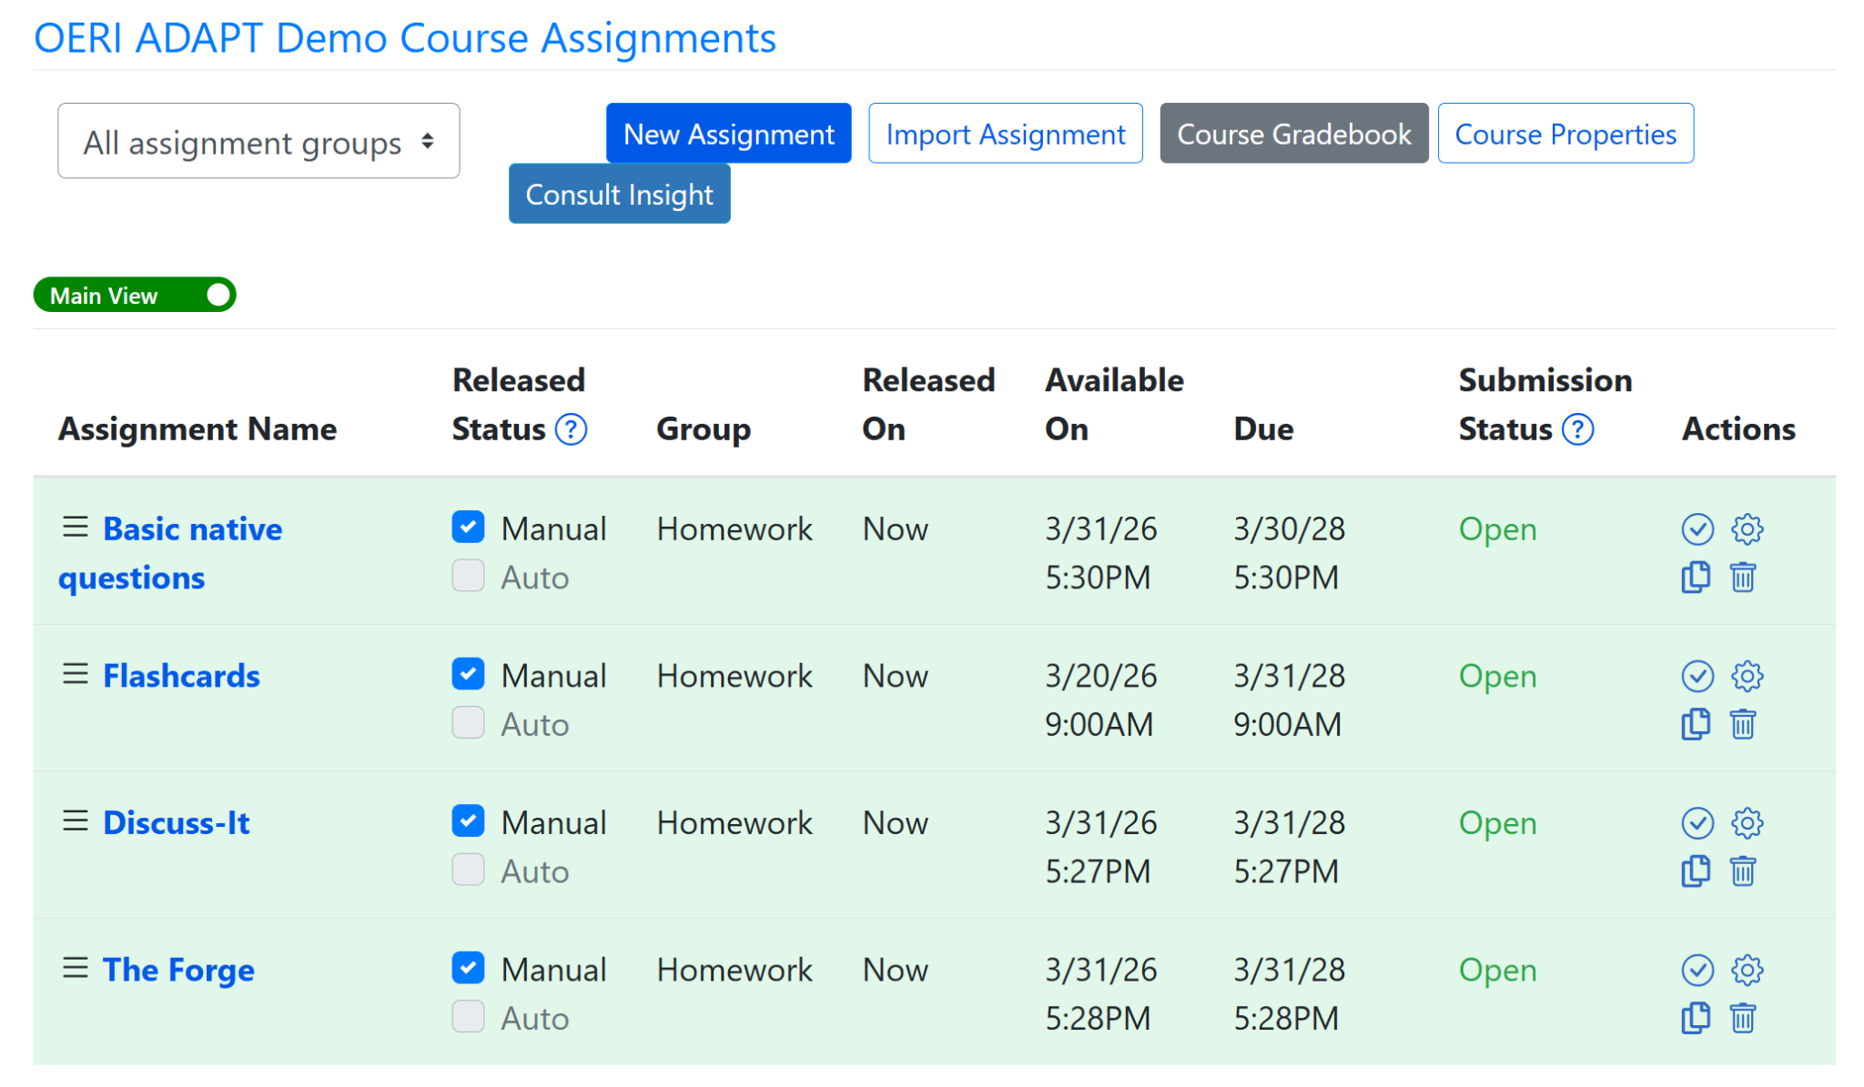
OERI ADAPT Demo Course Assignments
Notes:
Within the demo course, you will see 4 assignments - each contains examples of the question or activity type specified in its title.

Slide 27
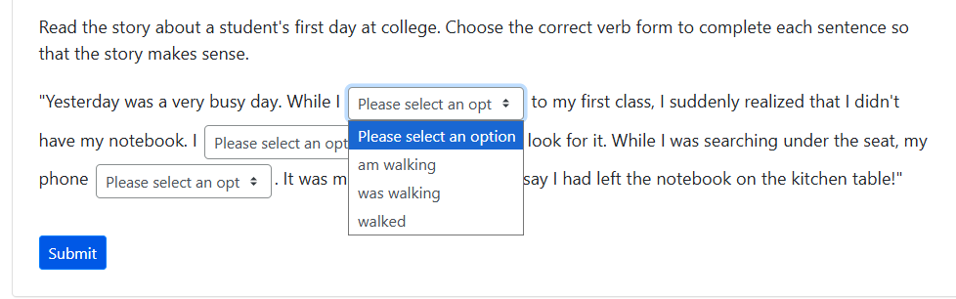
Select Choice Question

Slide 28
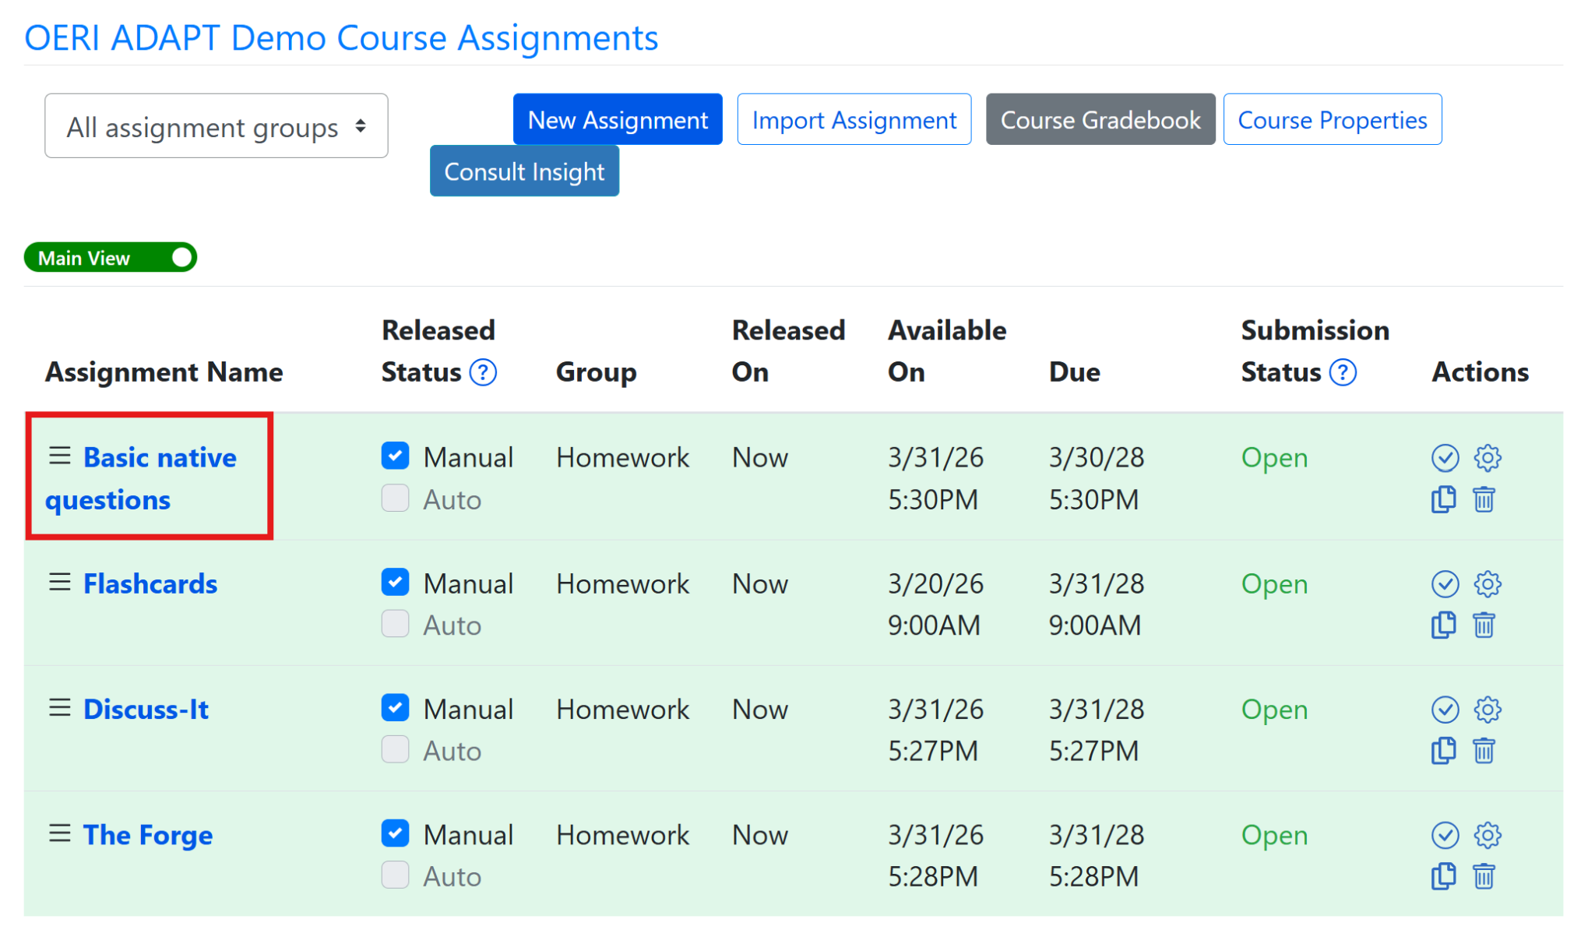
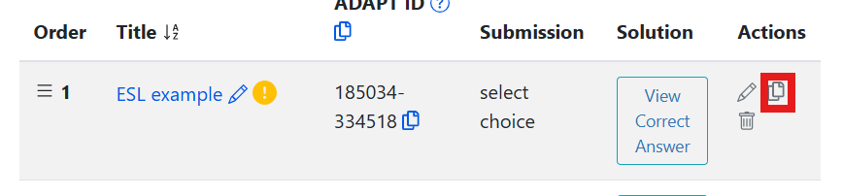
Clone (Copy) an ADAPT Question
Choose the ESL example to clone. Select the clone icon under the Actions heading.
Your cloned question will be at the bottom of the page in your Basic native questions assignment.

Slide 29
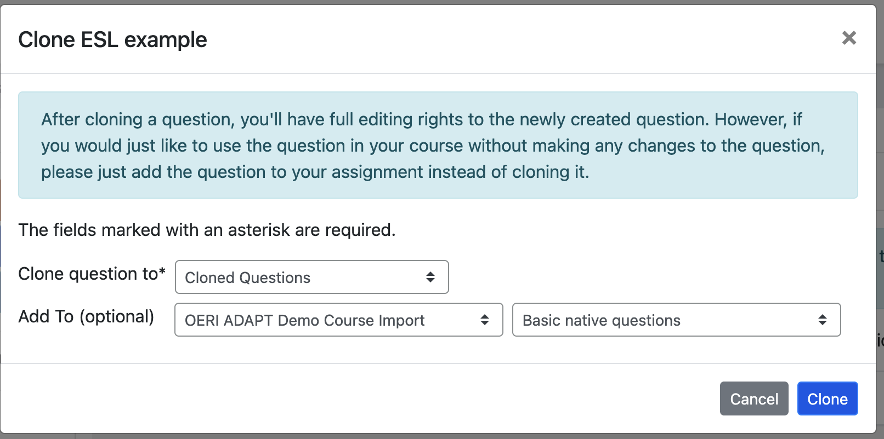
After Cloning

Slide 30
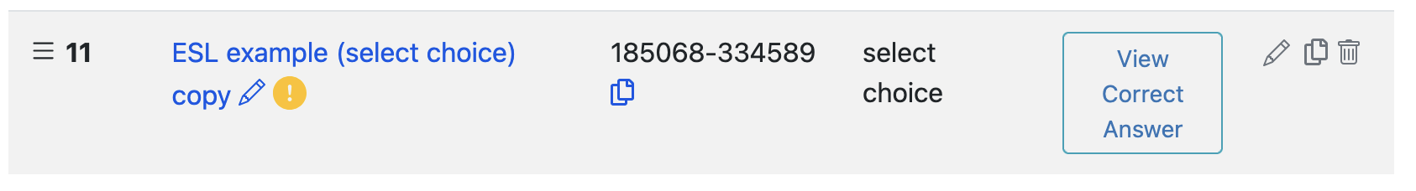
To Access Your Copy, Select Its Title
You can modify the title of your question by selecting the pencil icon at the end of the title either before or after accessing all elements of your copy.
Upon accessing your question for editing, you will make edits in just two sections:
  Properties
  Primary Content

Slide 31
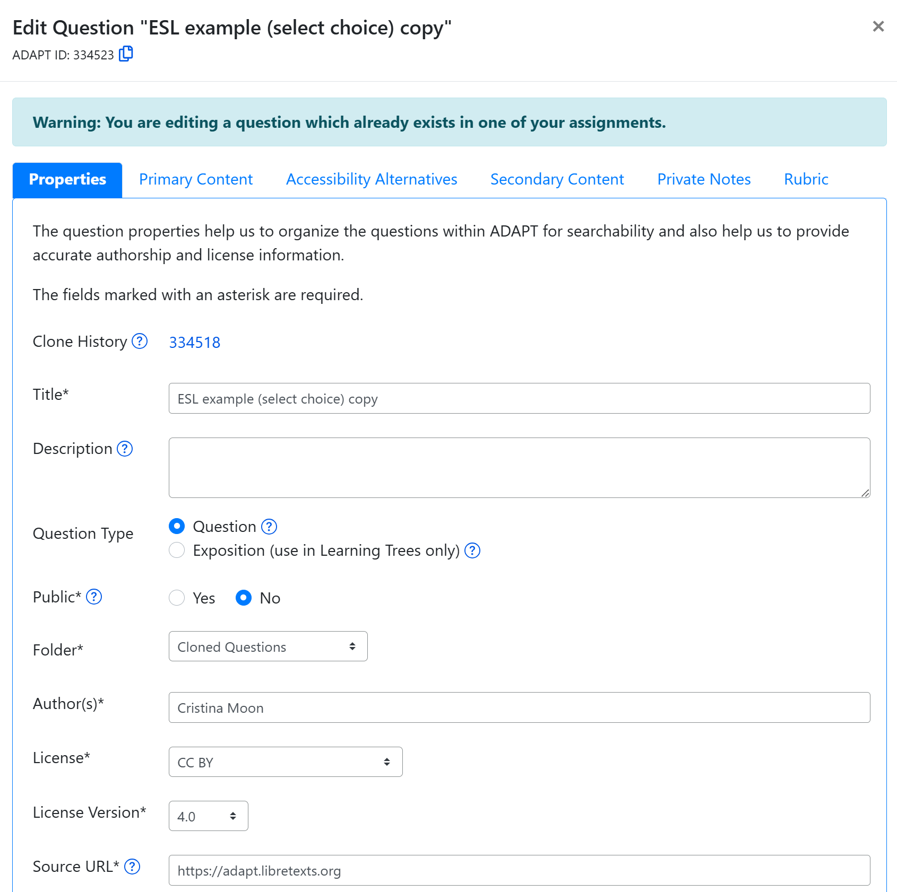
Properties: Edit the Properties of Your Select Choice Question
Notes:
Edit Properties and Primary Content. 1. Change the title. 2. Add a description, if desired. 3. Don’t change Question Type. 4. Public - yes or no. 5. Automatically goes to Cloned Questions folder - but you can change this. 6. Change author to yourself. 7. Modify license if needed.

Slide 32
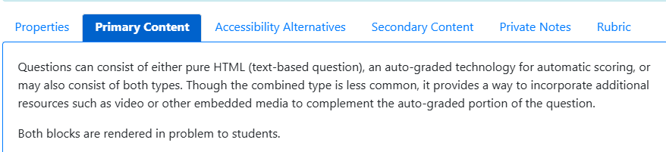
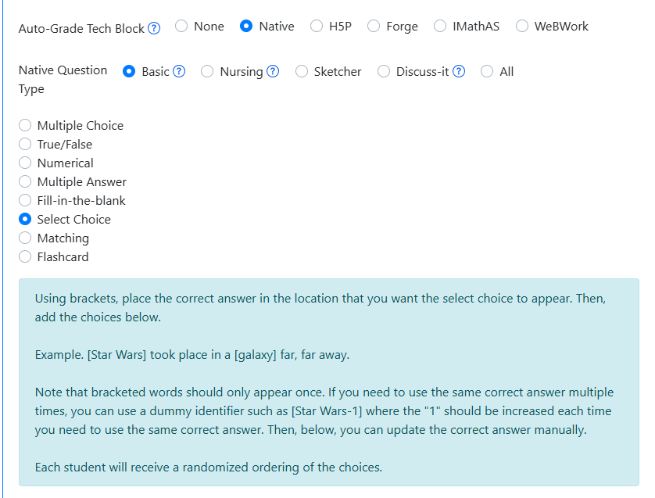
Primary Content: Instructions for Creating a Select Choice Question
Notes:
Under Primary Content choose Native > Select Choice

Slide 33
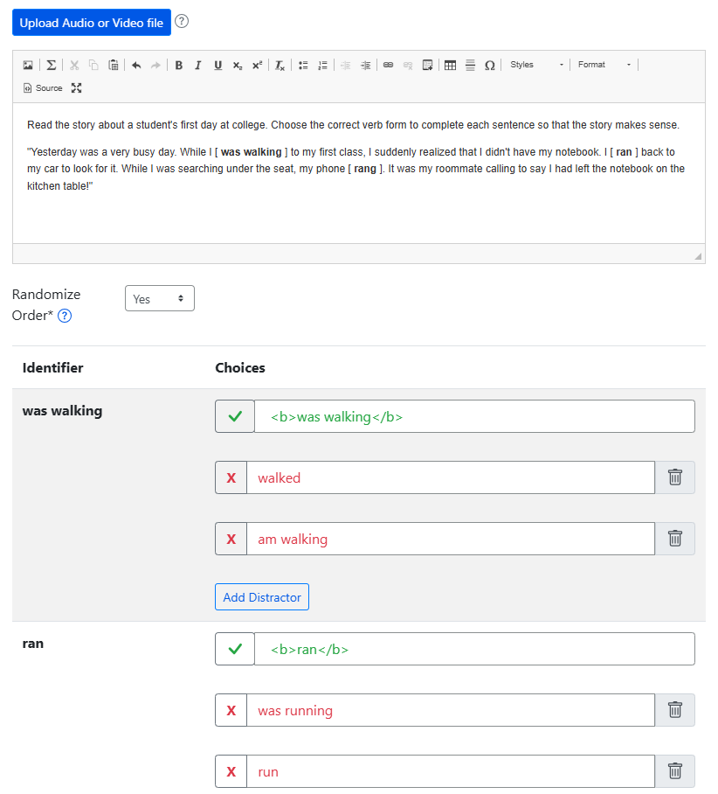
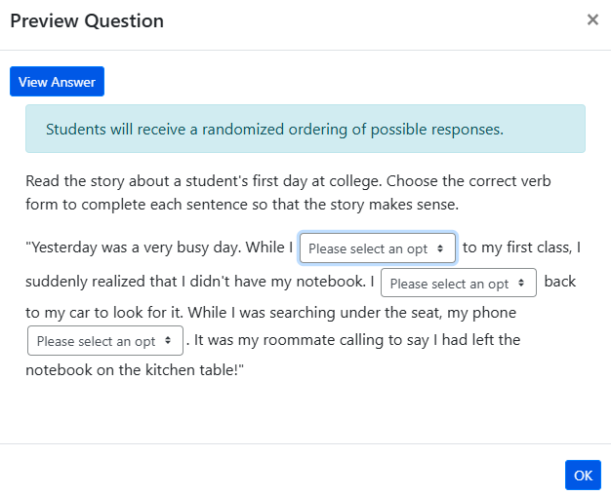
Modify Select Choice Primary Content and Question Preview

Slide 34
Editing/Creating a Select Choice Question
Instructions (available in the bottom half of the Primary Content screen):
  Using brackets [ ], place the correct answer in the location that you want the select choice to appear.
  Then, add the choices below.
Begin by pasting in the content you want to use to create your Select Choice question.
During synaptic transmission, an action potential in a neuron – the presynaptic neuron – causes a neurotransmitter to be released into a tiny gap called the synaptic cleft between two neurons. The neurotransmitter diffuses across the synaptic cleft and binds to receptors on the neuron receiving the signal – the postsynaptic neuron, which produces a change in the postsynaptic cell. Looking into this process in more detail, we can split the processes of synaptic transmission into a number of separate steps (Figure 3.27):
Then add in your brackets. [correct answer]
And add in the choices.

Slide 35
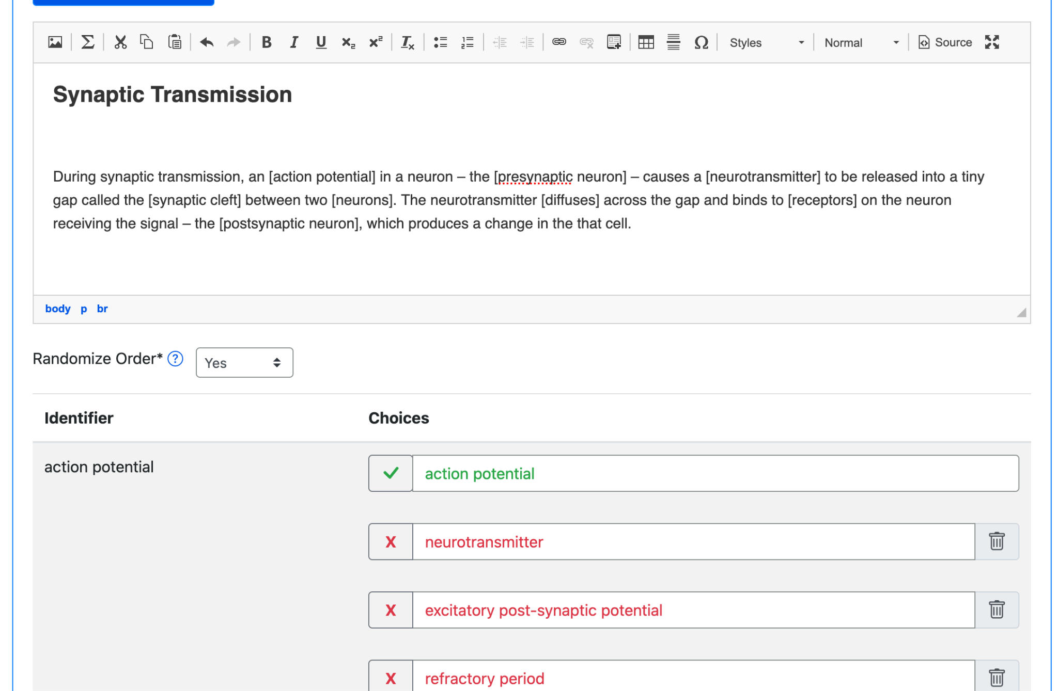
Formatted Select Choice Question

Slide 36
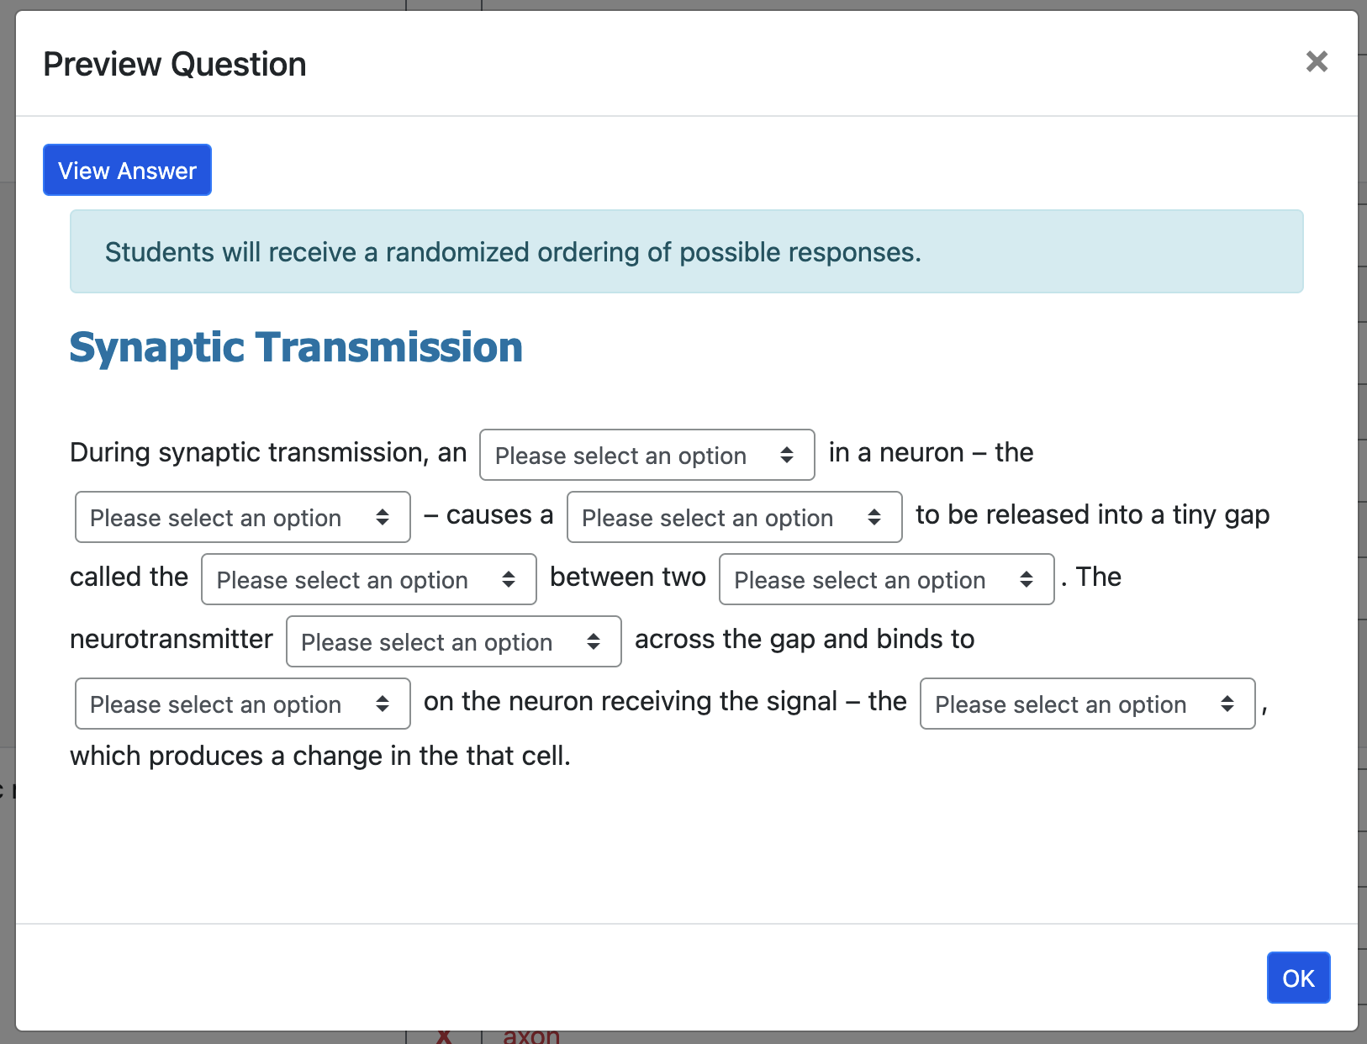
New Select Choice Question

Slide 37
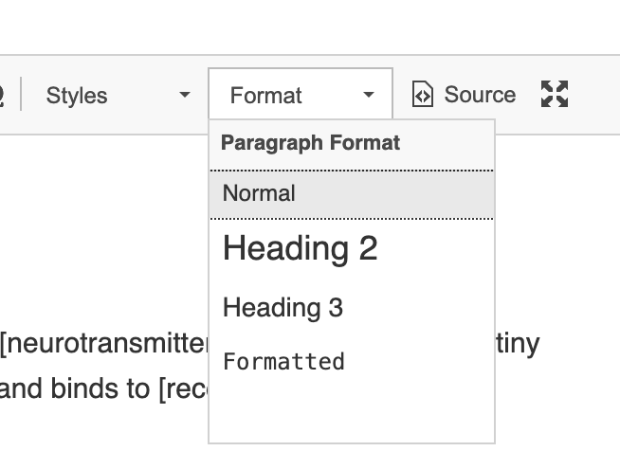
Notes
You will be prompted to explain your changes. You don’t have to explain yourself.
If you have issues with the formatting of your question, you can remove or add headers by selecting “Format” or, if you are really fancy, select “Source” and modify the HTML.

Slide 38
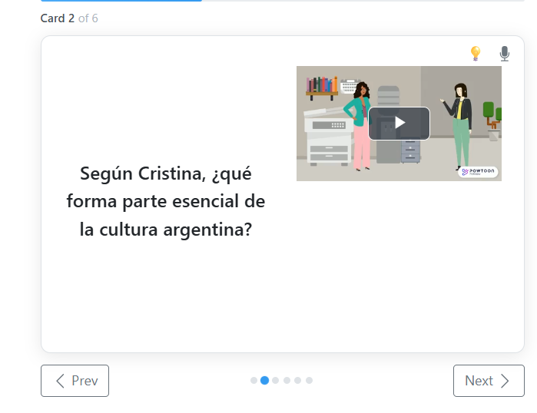
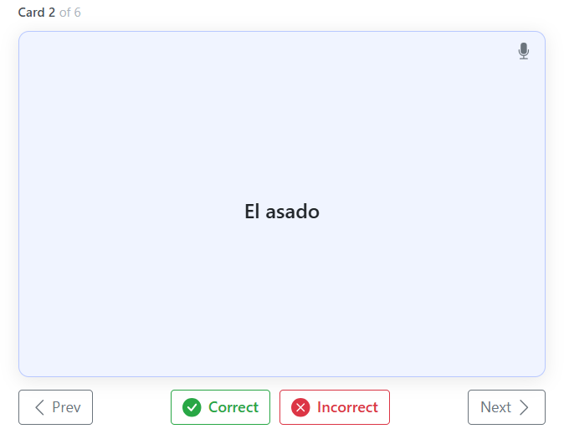
Flashcard Question

Slide 39
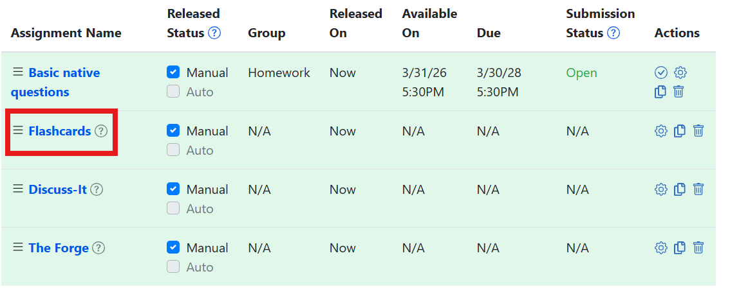
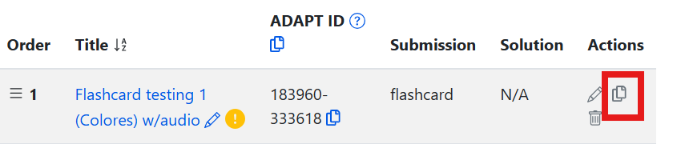
Clone a Flashcard
Return to your imported demo course.
Navigate to the Flashcards assignment.
Clone the Flashcard of your choice.

Slide 40
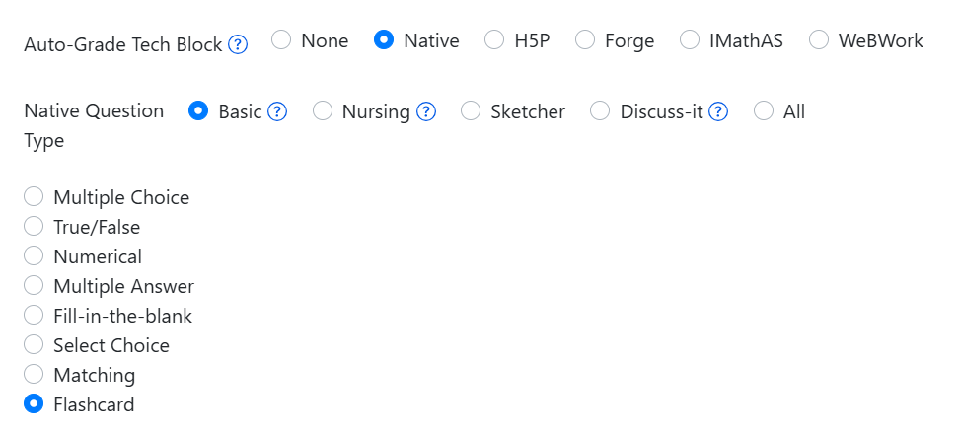
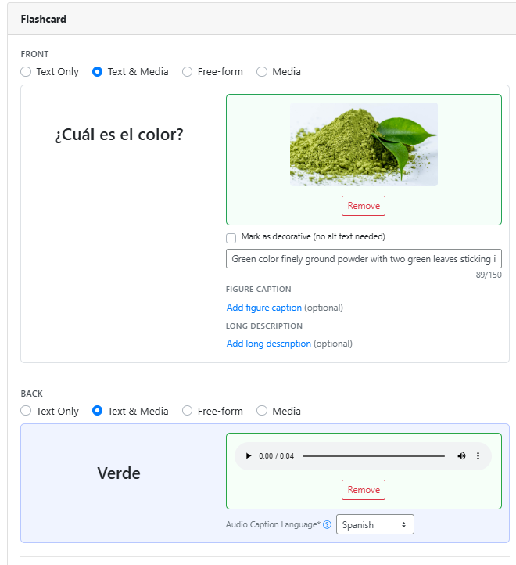
Flashcard Primary Content and Preview
Preview

Slide 41
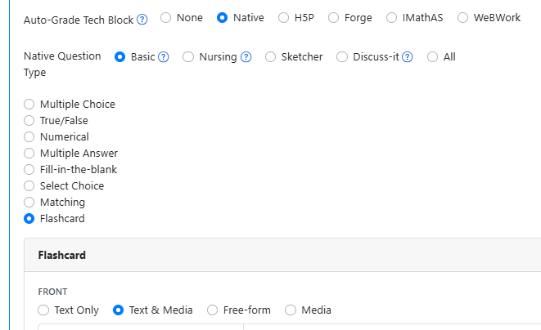
Primary Content: Instructions for Creating a Flashcard

Slide 42
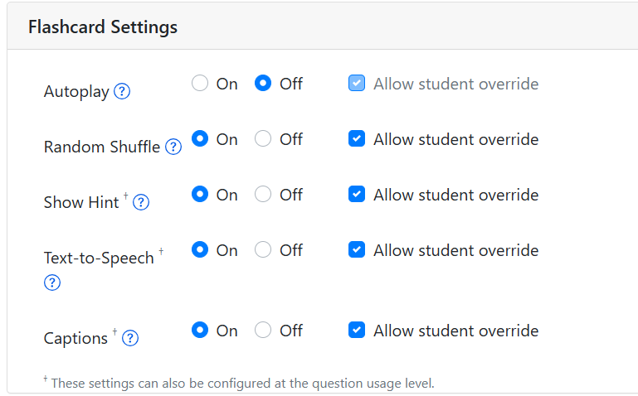
Go to Assignment Properties to find Flashcard Settings
Confirm that all the settings are correct for the Flashcard assignment that you just created.
Check:
autoplay
random shuffle
show hit
text to speech
captions

Slide 43
Editing/Creating a Flashcard Question
Questions can consist of either pure HTML (text-based question), an auto-graded technology for automatic scoring, or may also consist of both types. Though the combined type is less common, it provides a way to incorporate additional resources such as video or other embedded media to complement the auto-graded portion of the question.
  Both blocks are rendered in problem to students.
Front and Back options
  Text only
  Text and media
  Free-form
  Media
Hint (optional)

Slide 44
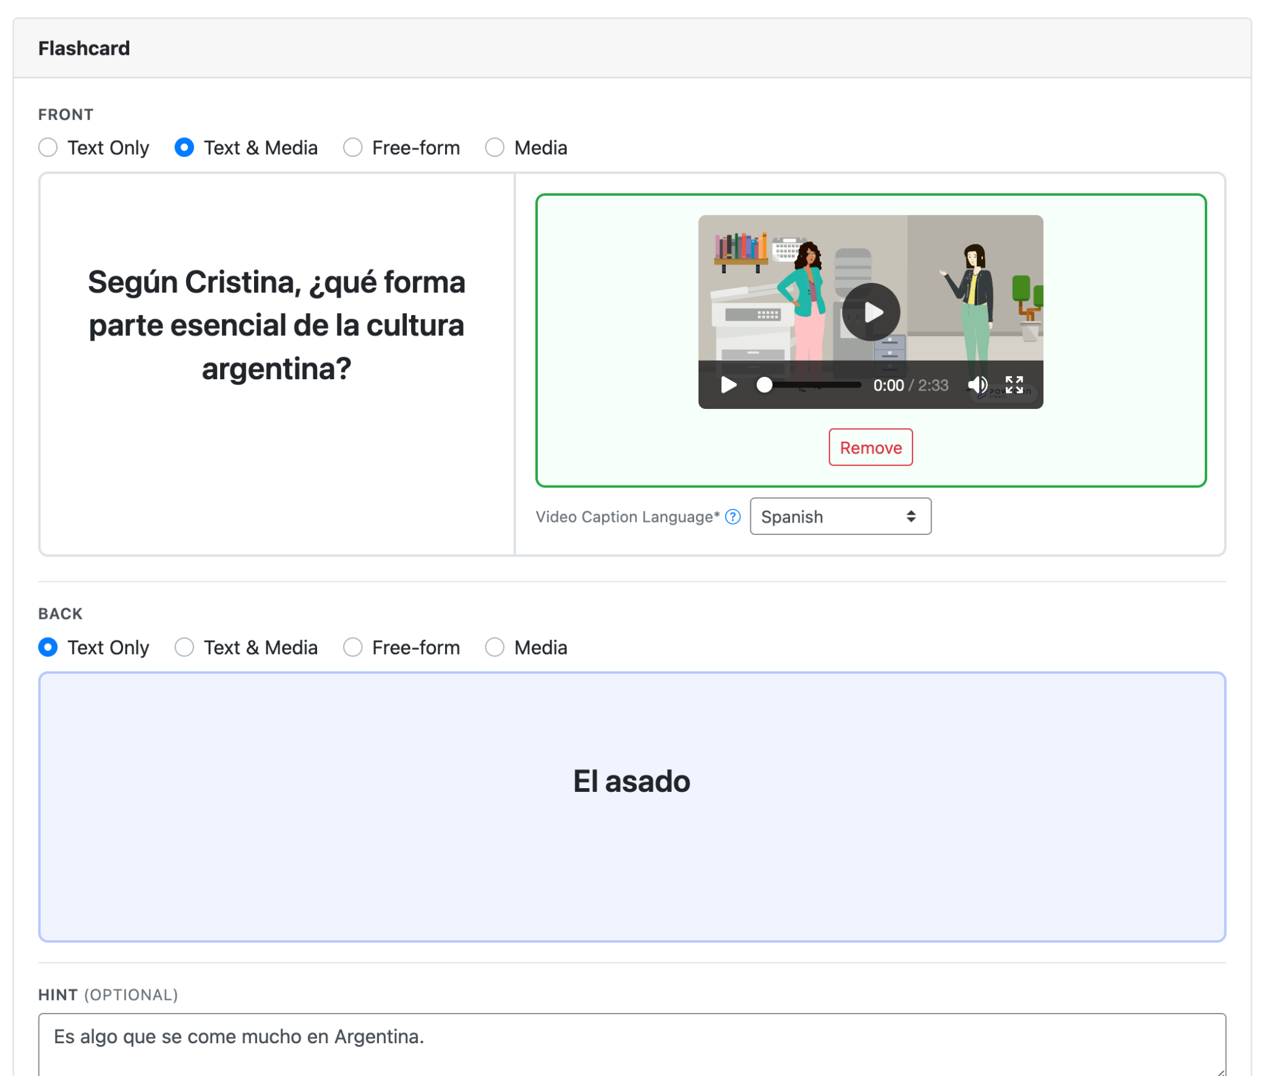
Flashcard - Spanish Example

Slide 45

Flashcard - New Example

Slide 46
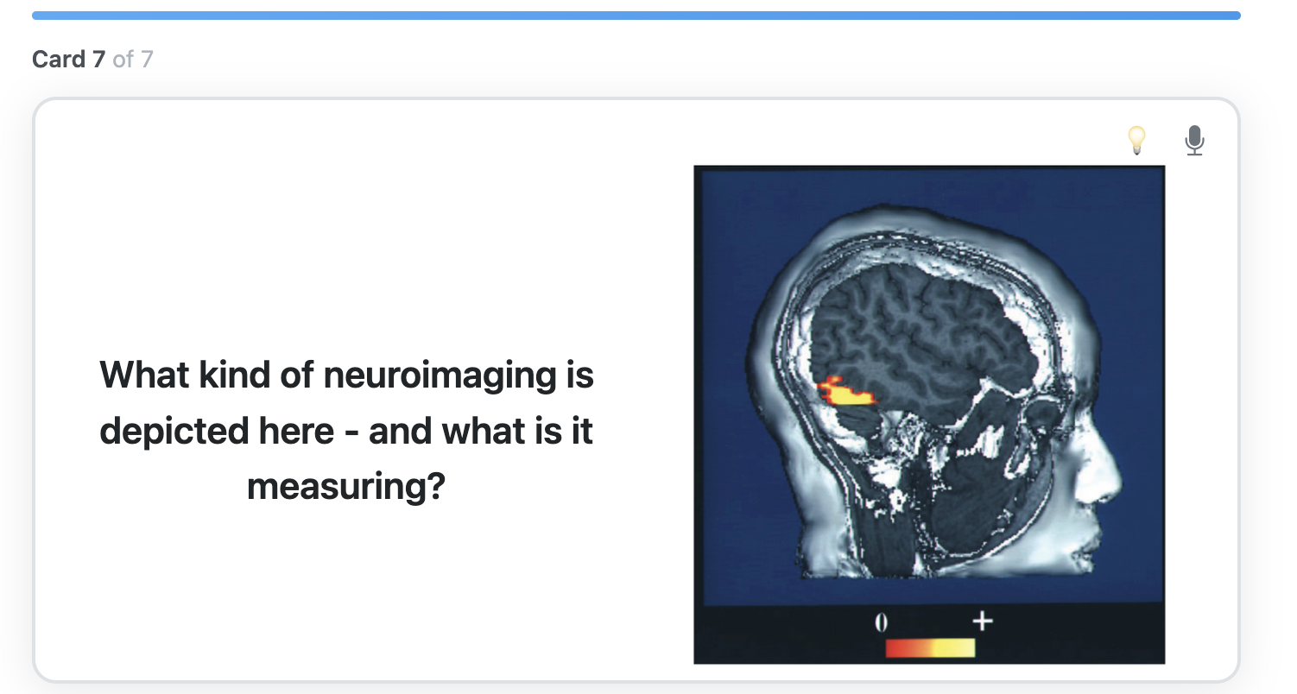
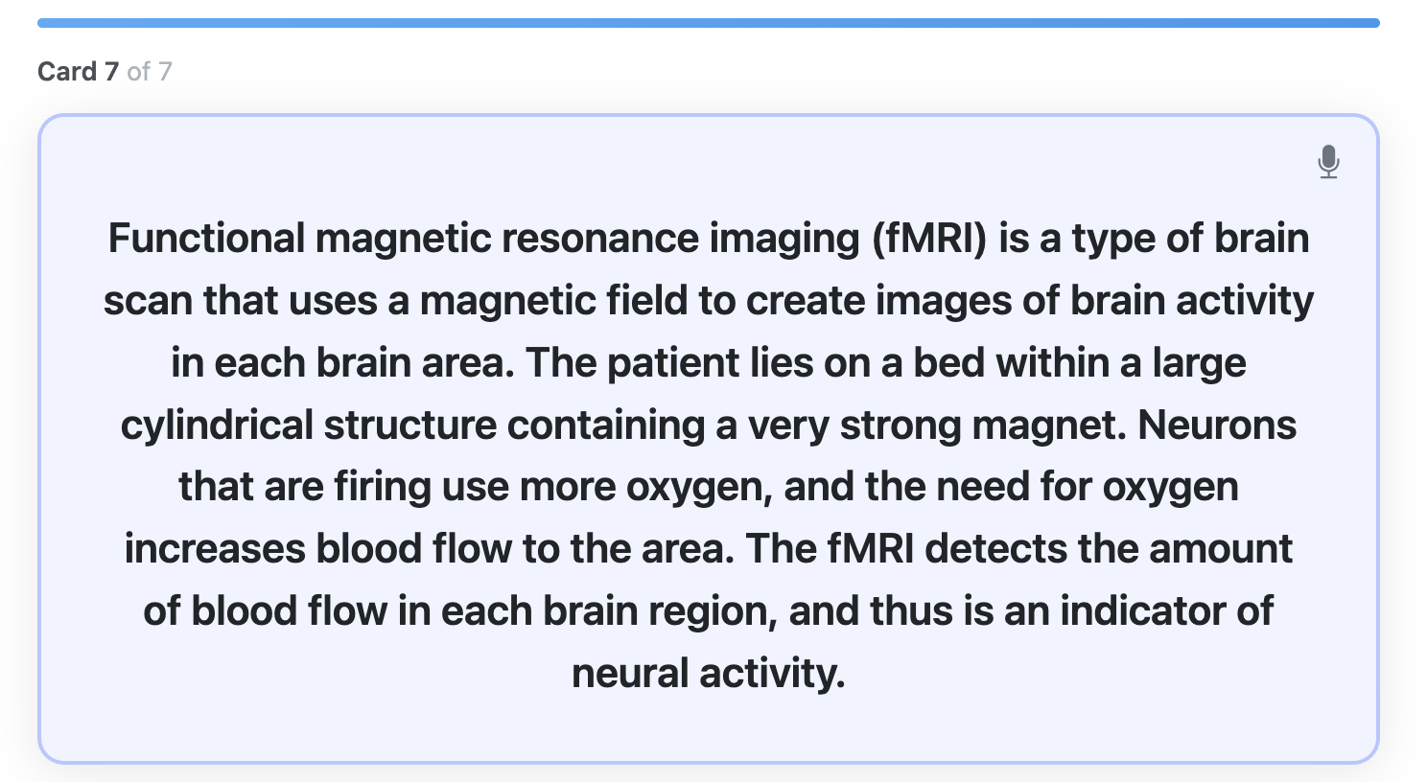
Flash Card - New Example - Preview
Notes:
S

Slide 47
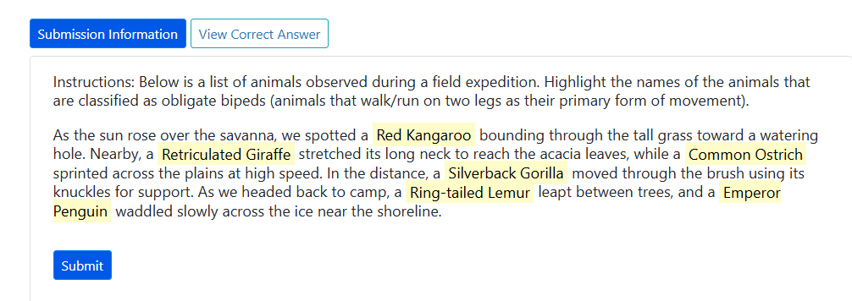
Highlight Text Question

Slide 48
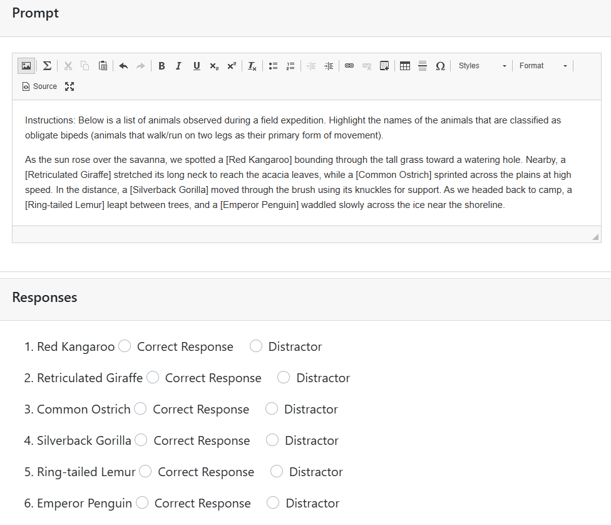
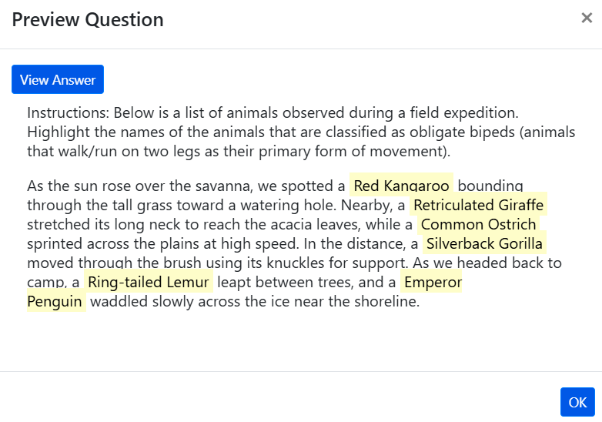
Highlight Text Primary Content and Question Preview

Slide 49
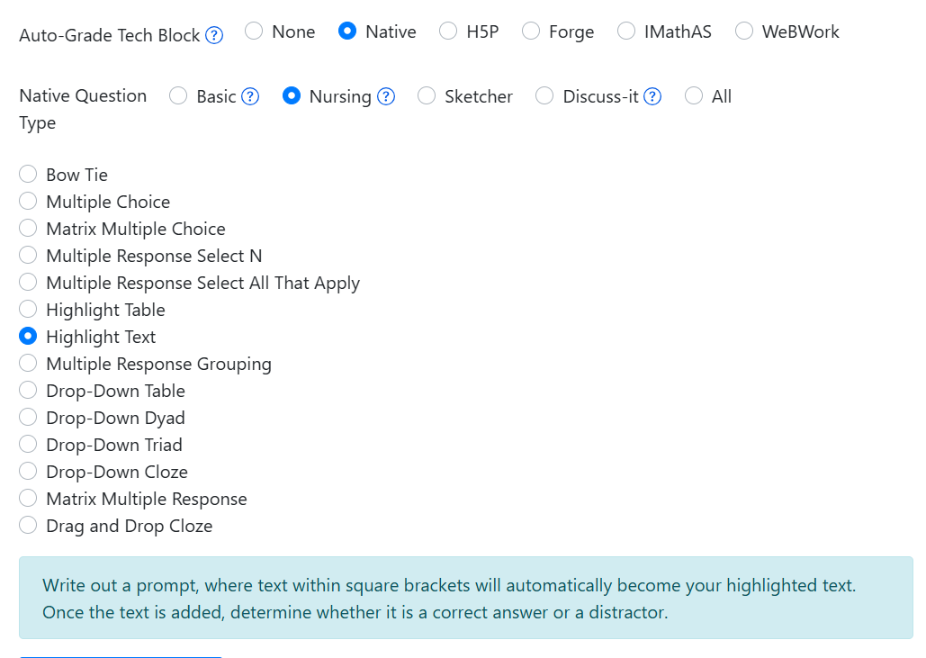
Instructions for Creating a Highlight Text Question

Slide 50
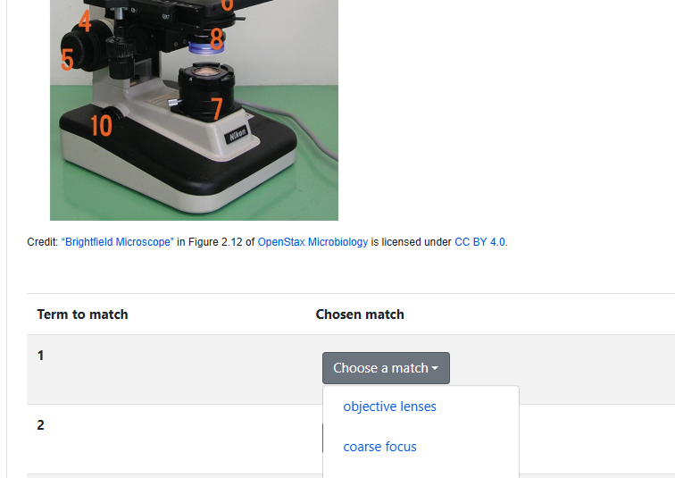
Matching Question

Slide 51
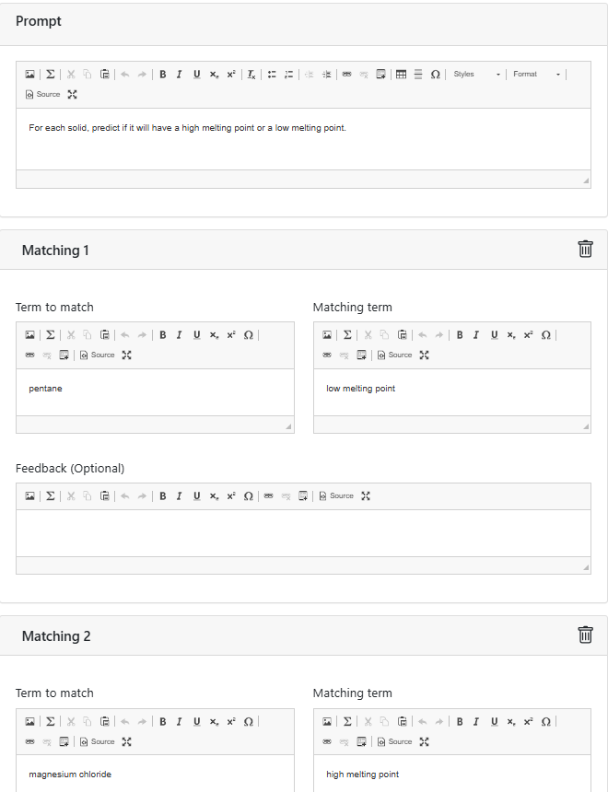
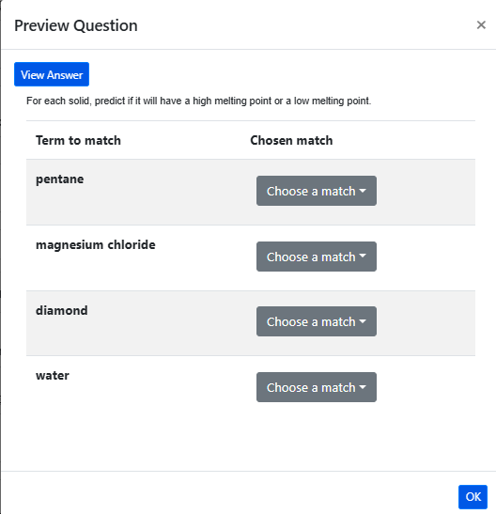
Matching Primary Content and Question Preview

Slide 52
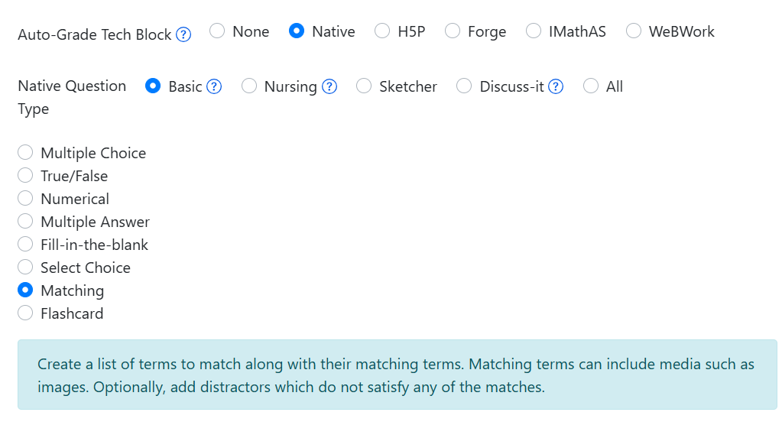
Instructions for Creating a Matching Question

Slide 53

Fill in the blank Question

Slide 54


Fill in the blank Primary Content and Question Preview

Slide 55

Instructions for Creating a Fill in the blank Question

Slide 56
Looking for more Resources?

Slide 57

Assistance: The Insight Knowledge Base
Notes:
SK

Slide 58

LibreTexts Support
Visit the LibreTexts Academy for more professional development services.
General Introduction to ADAPT
LibreTexts Workshop Recordings
LibreTexts (https://libretexts.org)
Office hours (TTh 9:00-10:00 am)
Notes:
SK

Slide 59
Upcoming LibreTexts and ADAPT in-person Trainings
Regional Trainings:
Register for Saturday, April 25, 8:30 am – 3:30 pm
OERI Regional at Cañada College
Register for Saturday, May 2, 8:30 am – 3:30 pm
OERI Regional at Saddleback College
Register for Friday, August 14, 8:30 am – 3:30 pm
OERI Regional at Allan Hancock
Online Teaching Conference:
Tuesday, June 23, 9:00 am-12:00 pm
Notes:
MP

Slide 60
ASCCC OERI Webinars
Title | Date | Tags
Measuring Effort and Analytics with The Forge | February 20, 2026 | ADAPT, AI, Artificial Intelligence, LibreTexts, LibreTexts ADAPT, The Forge
Beyond the Discussion Board: Reimagining Online Conversations with Discuss-It | November 12, 2025 | ADAPT, Discuss-It, LibreTexts, LibreTexts ADAPT
Re-examine ADAPT to Create Chemistry Problems | October 30, 2025 | Chemistry, Discipline Webinar
ADAPT Level 4 – Question Banks and ADAPT Canvas Integration | July 7, 2025 | ADAPT, ADAPT Series, Homework, LibreOne, LibreStudio, LibreTexts ADAPT
ADAPT Level 3 – Fostering Oral Interaction with ADAPT’s Discuss-It Question Type | June 30, 2025 | ADAPT, ADAPT Series, Homework Systems, LibreOne, LibreTexts ADAPT
ADAPT Level 2 – Creating in ADAPT | June 20, 2025 | ADAPT, ADAPT Series, Homework Systems, LibreOne, LibreTexts ADAPT
ADAPT Level 1 – Accessing ADAPT and Finding Existing Assessments | June 13, 2025 | ADAPT, LibreTexts, LibreTexts ADAPT
LibreTexts’ ADAPT Homework Platform and the new Discuss-It | April 16, 2025 | ADAPT, Canvas, Discipline Webinar, Discuss-It, LibreTexts, LibreTexts ADAPT
Addressing the Homework Needs of Economics: Adaptive Homework Assignments and Graphing Technology | March 18, 2025 | Discipline Webinar, Economics, Homework Systems
Notes:
SK

Slide 61
More Information
ASCCC OERI Website (asccc-oeri.org)
  Resources
  Webinars and Events
Notes:
SK

Slide 62
And to Contact Us…
General OERI E-Mail:
oeri@asccc.org
Find everyone’s email at: https://asccc-oeri.org/about-us/

Slide 63

Thanks!
Photo by Thgusstavo Santana from Pexels

