Slide 1
Welcome!
On behalf of the ASCCC OERI, we are pleased to have you here with us for OERI Webinar: Adopting Open Educational Resources (OER): Practical Strategies for Implementation in Your Course
If you are not already muted, please mute yourself upon arrival.
Please note that you are encouraged to use the Zoom “chat” feature for questions and comments.
You’re invited to introduce yourself in the chat – please provide your name, college, discipline/role
This event will be recorded. Archives of all ASCCC OERI events are available at asccc-oeri.org > Webinars and Events

Slide 2
Adopting Open Educational Resources (OER): Practical Strategies for Implementation in Your Course
Webinar: Wednesday Apr 1, 2026. 3:30pm – 4:30pm (Pacific Time - Los Angeles).
Creative Commons license (recommended - This work is licensed under a Creative Commons Attribution 4.0 International License.)

Slide 3

Presenters
Aleksandra Uchlik, ASCCC OERI Accounting Lead
Accounting, GWC
ASCCC OERI Coordinator
Photo by Siora Photography on Unsplash

Slide 4
Description
This session introduces faculty to the practical process of adopting Open Educational Resources (OER). Participants will learn about the benefits of OER for equity, cost savings, student success, and course sustainability. The presentation includes a demonstration of how to adopt an OpenStax textbook, an overview of ready-to-import Canvas course materials and assignments, and strategies for aligning OER with course learning outcomes. The session concludes with a discussion of implementation practices, accessibility considerations, and continuous course improvement.

Slide 5
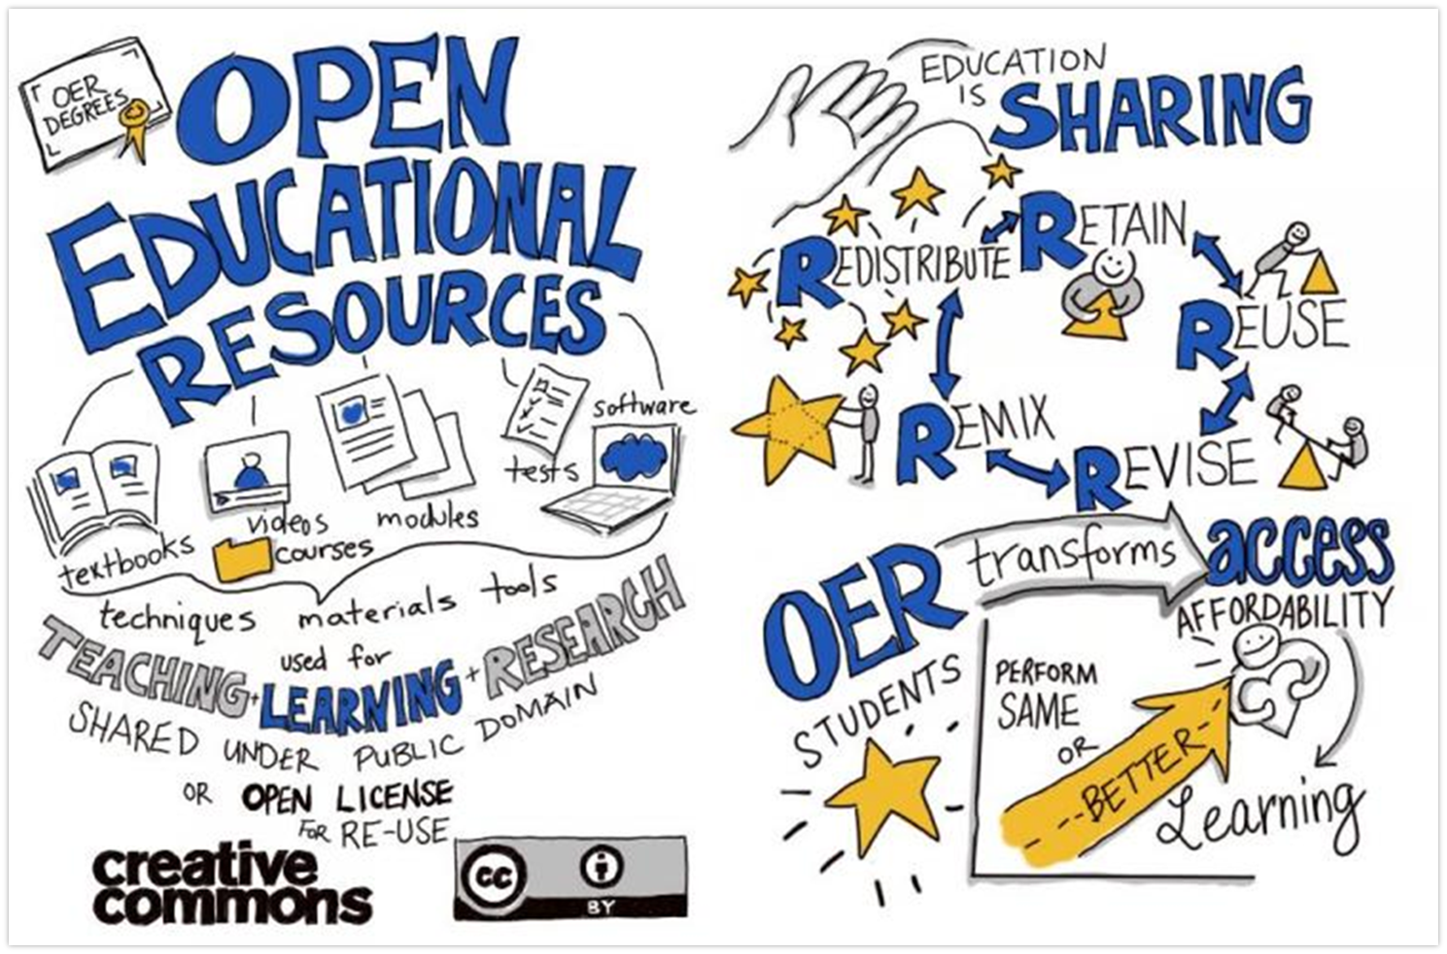
What is OER?
OER is Sharing by Giulia Forsythe is in the public domain

Slide 6
Places to Find OER
Open Textbook Collections
OpenStax
Open Textbook Library
LibreTexts
Open SUNY Textbooks
BC Campus Open Education
OER Repositories
OER Commons
MERLOT
SkillsCommons
CCCOER
OER Search Tools
OASIS
Mason OER Metafinder (MOM)
State & System Initiatives
California Open Online Library for Education (COOL4ED)
Open Oregon Educational Resources

Slide 7
Example: Adopting an OpenStax Textbook in Canvas
Step 1: Select an OpenStax Textbook
Review available textbooks by discipline
Confirm alignment with course learning outcomes
Step 2: Access Instructor Resources
Download the textbook (PDF, web, or LMS formats)
Review instructor materials such as slides, test banks, and assignments
Step 3: Import Content into Canvas
Use Canvas Commons or OpenStax course cartridges
Import modules, readings, and assessments
Step 4: Customize for Your Course
Align readings with course schedule
Modify assignments and discussions
Add instructor-created content if needed
Include an outline of the presentation here

Slide 8
Resources and Notes
Financial Accounting (C-ID ACCT 110)
· Principles of Accounting Volume 1 Financial Accounting (OpenStax) (CC BY-NC-SA)
Attributions
"Searching in OER Repositories - Use the Tools!"Links to an external site. Links to an external site.by Jen Klaudinyi is licensed under CC BY 4.0Links to an external site.
This page was adapted from the ASCCC OERI — OER Basics Canvas Course, found on Canvas Commons, created by Suzanne Wakim for the ASCCC OERI, and licensed under a Creative Commons Attribution 4.0 International License.

