Slide 1

Calculus with AI Support for Learning
Larry Green, Lake Tahoe Community College

Slide 2

Our New World
Calculus students Don’t read the textbook
They require basic math help along the way
They just ask ChatGPT to do their homework
They copy and paste the AI response without learning
100% score on homework and 20% on exams

Slide 3

What Can We Do About It?
Don’t pretend that AI will just go away.
It is not our students’ fault that they are not prepared for calculus.
We need to do our best to adapt to the new world.

Slide 4
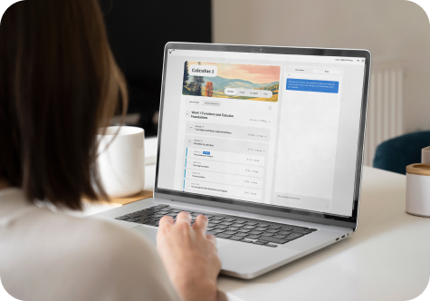
Learnvia
Starts with a step by step very short guided video.
Students answer quick questions part way through.
Then they have step by step questions to answer.
Hints are provided
There is an AI assistant that focuses on the particular question they are working on.
Some of the questions ask the students to explain their reasoning, and AI grades it.
Gates Foundation funded, so ZTC

Slide 5

Feedback
At every step there is a feedback button
The Learnvia Support team is quick on getting things fixed
Students are asked to take surveys
Students and faculty can be part of a paid group

Slide 6

Playtime

Slide 7
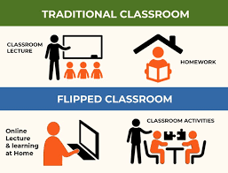
Flipped Classroom Approach
Students required to go through Learnvia before class
Class begins with a quick quiz
Application Video
Then short recap by the instructor
Group work with handout.
Students present their solutions on the board.
Interactive Online Activities

Slide 8
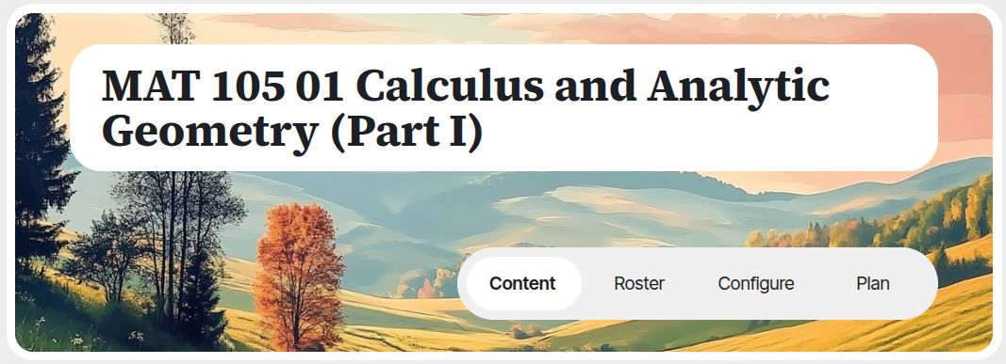
How to Get it in Your Class
Get an Evaluation Copy
Have your IT LTI it into Canvas
Configure
Plan
Content

Slide 9
How to Guide
Step -by-step walkthrough on how to use Learnvia
Link

Slide 10

Questions???

