Slide 1
Accessibility: Complex Images and Alt Text
Developed March 10, 2026, by Suzanne Wakim and Shagun Kaur
This work is licensed under a Creative Commons Attribution 4.0 International License.
Notes:
The Open Washington Open Attribution Builder is a handy tool for creating your attributions, if you’d like to indicate how your work should be attributed or if you are using resources that require attribution. https://www.openwa.org/attrib-builder/ Including how your presentation is licensed on your title slide is an effective way of making this clear. OERI resources are most commonly licensed CC BY, allowing others to use and modify them – but requiring that they be properly attributed.

Slide 2
Welcome!
On behalf of the ASCCC OERI, we are pleased to have you here with us for “Accessibility: Complex Images and Alt Text.”
If you are not already muted, please mute yourself upon arrival.
Please note that you are encouraged to use the Zoom “chat” feature for questions and comments.
You’re invited to introduce yourself in the chat – please provide your name, college, discipline/role
This event will be recorded. Archives of all ASCCC OERI events are available at asccc-oeri.org > Webinars and Events

Slide 3
Description
Writing alternative text (alt text) for simple images is one thing, but what about dense charts, layered maps, complex infographics, scientific diagrams, or multi-panel visuals? This webinar dives into practical strategies for describing highly detailed images clearly, accurately, and in alignment with accessibility standards. Bring your image challenges to add some flavor to the discussion.
Notes:
A description of the presentation is included in the slide deck so that the purpose of the slide deck is established – and to inform anyone viewing the presentation as to what was planned.

Slide 4
Presenters
Suzanne Wakim, ASCCC OERI Project Facilitator and Accessibility Lead
Distance Education /Accessibility Butte College
Shagun Kaur, ASCCC OERI Project Facilitator
Communication Studies, De Anza College
Notes:
Presenters can be included following the description or the overview. Where images are used, they should include an attribution (Photo by…) and appropriate alternative text should be used (or the image marked decorative).

Slide 5

Overview
Alt text basics
Complex Images
Other types of images
Notes:
An Overview slide should be included that is an outline of the presentation.

Slide 6
Writing Alt Text - The Basics
Should not be the file name
Should not begin with “image of” or similar. Only identify the type of image being used if it is relevant (e.g., painting, screenshot).
Text in the image should be avoided, but must be identified if present
The decorative tag is only for images that serve no function other than “eye candy.”
Should be short (less than ~120 characters)
Be descriptive – all relevant information should be available in the alt text.

Slide 7
Alt Text vs. Captions
Alt Text (Alternative Text): What screen readers read aloud to describe an image for someone who cannot see it.
Invisible to most users
Focuses on what the image shows
Helps users understand the essential visual information
Should be brief, objective, and descriptive
Caption: Visible text under the image that explains why the image matters.
Visible to everyone
Connects the image to learning goals or the surrounding text
Adds context, interpretation, or meaning

Slide 8

Alt Text Describes. Captions Explain
Diverse Collaboration by Vitaly Gariev on Unsplash
Alt text: A diverse group of six college students gathered around a laptop in a classroom, collaborating and smiling.
Caption: Students collaborating around a laptop illustrate how knowledge is socially constructed through interaction, dialogue, and diverse perspectives.

Slide 9
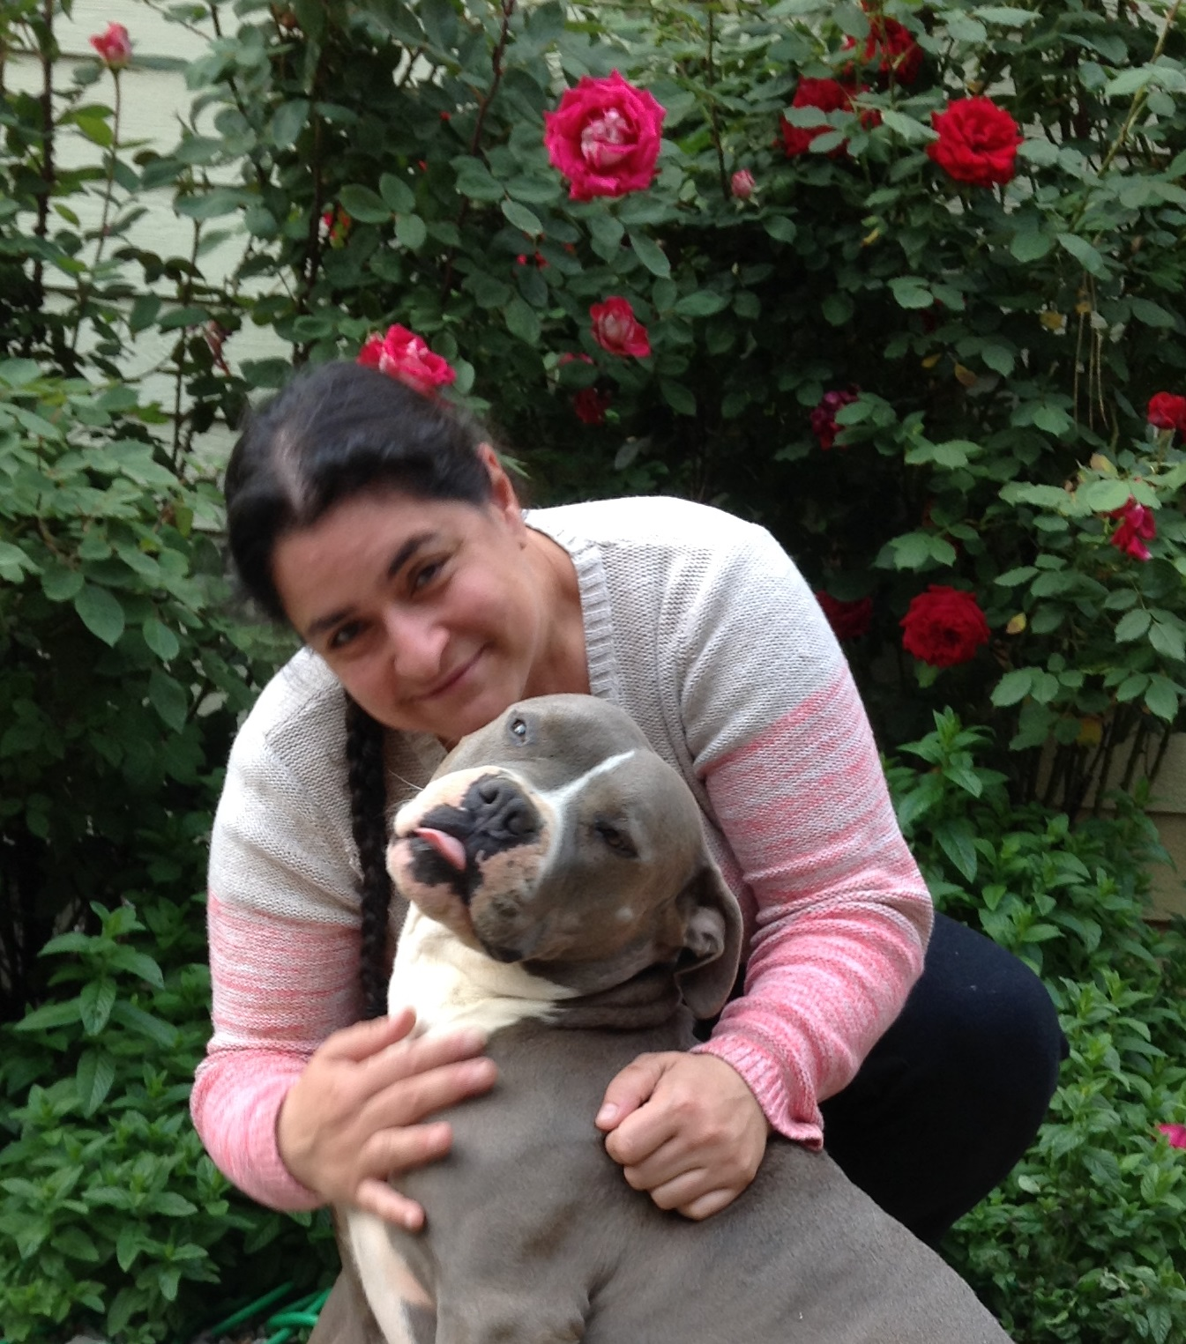
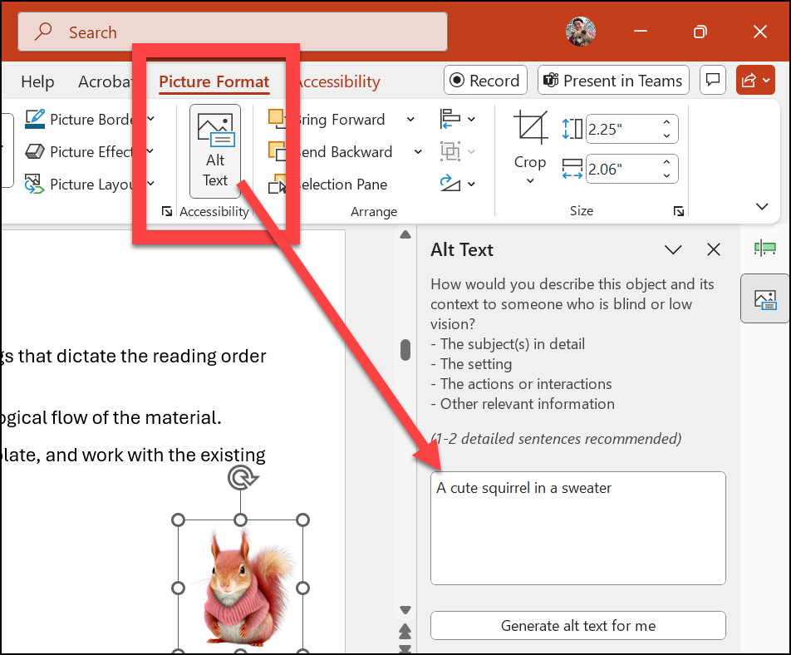
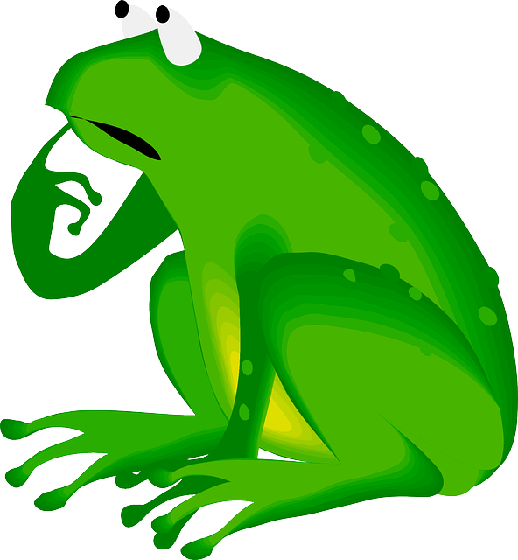
Is it Decorative?
Notes:
Type Y in chat if decorative, N if it needs alt text
Existential question - if an image does not have a purpose, why is it there?
My image - can focus on mood rather than technical description (e.g. - with a welcoming smile)
Mood is important (not alt text but video on captions demonstrates importance of tone)
https://www.youtube.com/watch?v=tfe479qL8hg

Slide 10
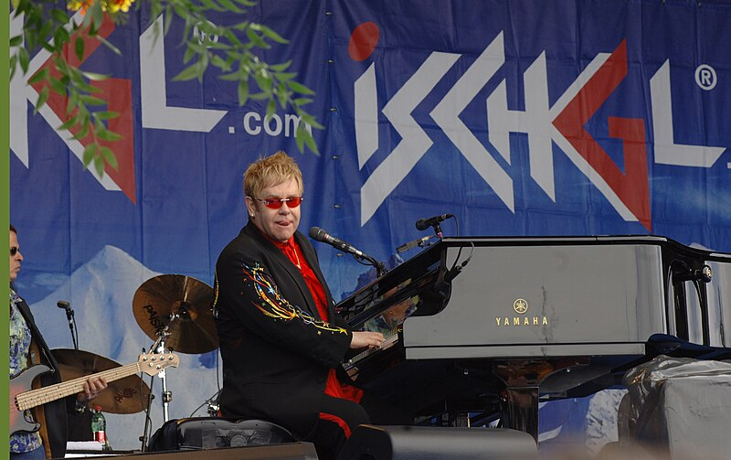
Writing Alt Text: Context Matters
AI-generated alt text:
A person playing a piano
Visualize the image
What would be good alt text?
Alt text must be set by the content creator because only they know the purpose
Elton John by Bunny is in the Public Domain
Notes:
Music Context: Elton John performing at a grand piano on an outdoor stage with band instruments and a festival banner behind him.
Fashion Class: Elton John performs at a piano wearing a black jacket with colorful embroidered sleeves and red tinted sunglasses.

Slide 11

Context: Setting Tone and Mood
Scenario: This photo of the teacher is on the welcome page of their online class.
Alt text: name
In chat: What are good alt text options?
Cultural Context: Woman smiling as colored powder is thrown during Holi, a Hindu festival celebrating spring, renewal, and community.

Slide 12
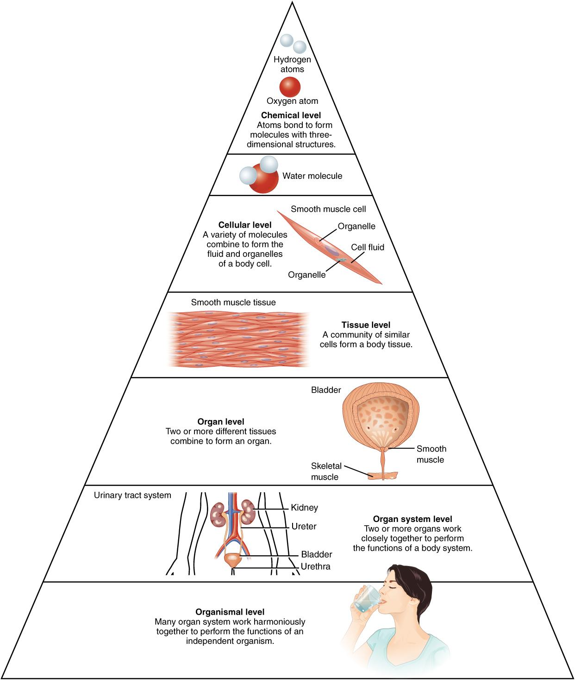
Complex Images
Explained in the caption or surrounding text
Or verbally in a video
Alt text should identify where the image is explained
Avoid linking out to external descriptions unless necessary
Universal Design for Learning (UDL). All students benefit if we describe this image
Good Example: Anatomy Book
Anatomy Textbook licensed CC BY
Notes:
Authors created a section with the information from this image
UDL Guidelines

Slide 13
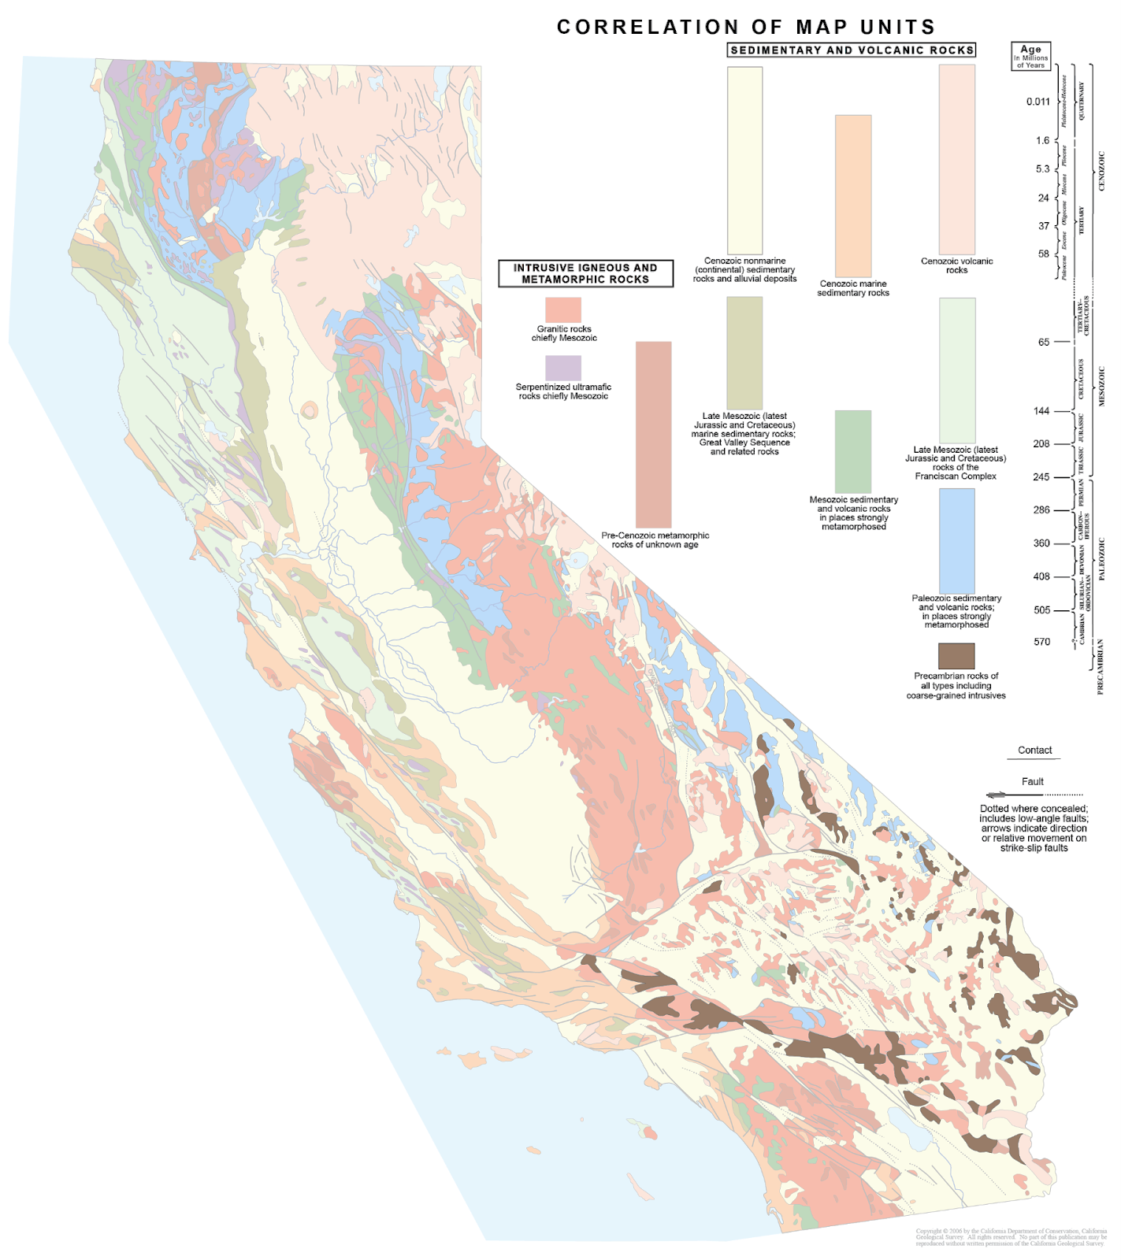
Focus on Pedagogical Value
What is the purpose of the image? What are students meant to learn from it?
Consider both UDL and screen readers
Good Example
Geology Book

Slide 14
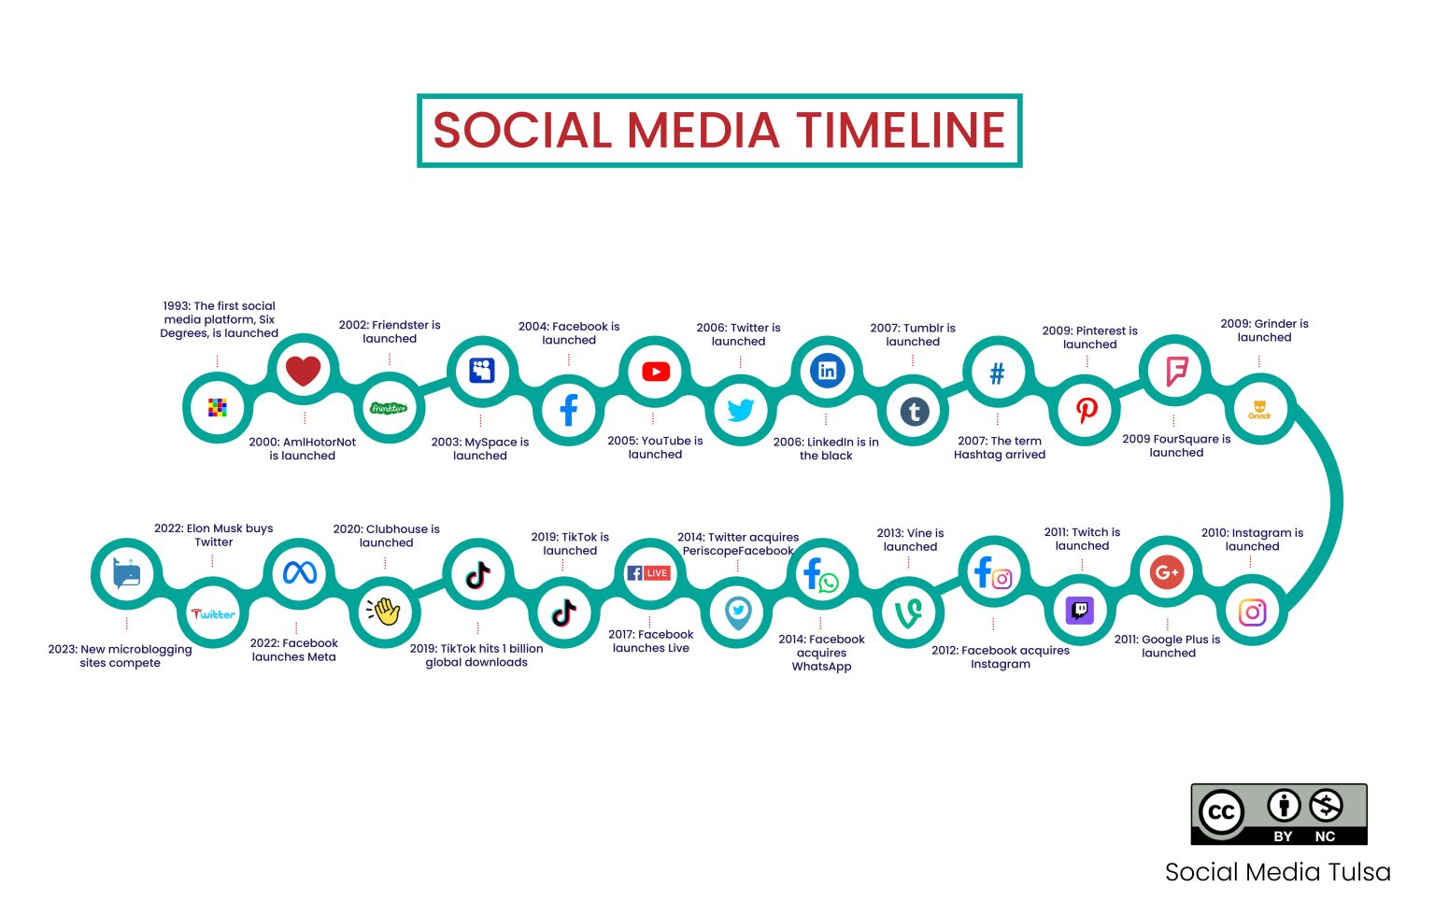
Infographics
Notes:
Do we need ALL of this? Can we present it in a different way? UDL again
Image source: https://open.library.okstate.edu/introtosocialmedia/chapter/social-media-marketing-a-brief-history/

Slide 15
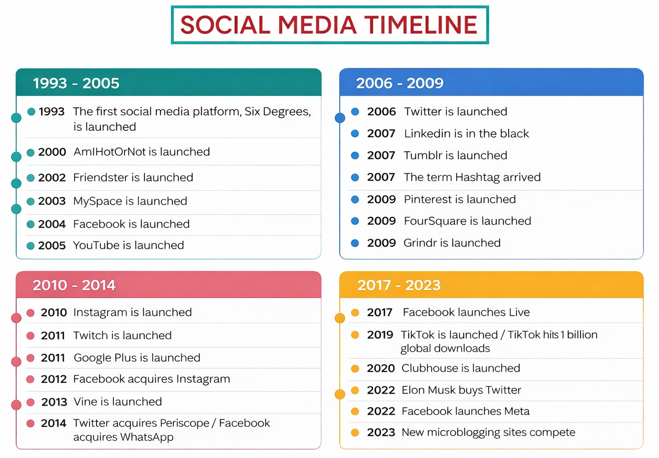
Alternatives
Year | Event
1993 | The first social media platform, Six Degrees, is launched
2000 | AmIHotOrNot is launched
2002 | Friendster is launched
2003 | MySpace is launched
2004 | Facebook is launched
2005 | YouTube is launched
2006 | Twitter is launched
2006 | LinkedIn is in the black
2007 | Tumblr is launched
2007 | The term Hashtag arrived
2009 | Pinterest is launched
2009 | FourSquare is launched
2009 | Grindr is launched
2010 | Instagram is launched
2011 | Twitch is launched
2011 | Google Plus is launched
2012 | Facebook acquires Instagram
2013 | Vine is launched
2014 | Twitter acquires Periscope
2014 | Facebook acquires WhatsApp
2017 | Facebook launches Live
2019 | TikTok is launched
2019 | TikTok hits 1 billion global downloads
2020 | Clubhouse is launched
2022 | Elon Musk buys Twitter
2022 | Facebook launches Meta
2023 | New microblogging sites compete
Notes:
https://teachonline.asu.edu/image-accessibility-generator/
Prompt adapted from Purdue University (for complex images): “You are a university-level instructor working to ensure images in your Open Educational Resource on [California Geology] conform to WCAG 2.1 Web Content Accessibility Guidelines at Level AA. You need to accommodate for blindness, low vision, and/or color blindness to ensure equal accessibility of course content to all students. You will be provided with an image and must return a succinct title, alternate text (alt text), and a long description. The alt text should be no more than 120 characters and should briefly describe the meaning conveyed by the image in the context of the course material. The detailed description may be one or more paragraphs and must describe the image in great detail. The detailed description should be easily scannable and use headings, paragraph breaks, and lists as appropriate.”

Slide 16
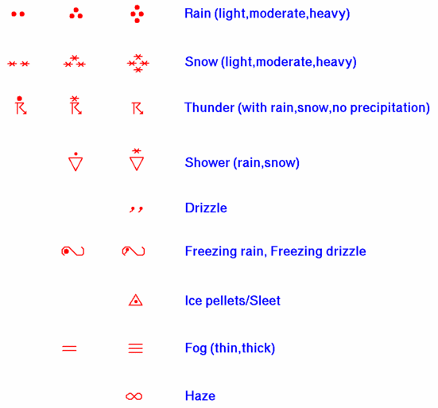
Inclusion by Design: Meteorology
Symbols | Meaning
One, two, or three solid dots in a column | Rain (light, moderate, heavy)
One, two, or three asterisks in a column | Snow (light, moderate, heavy)
A lightning bolt with a dot or asterisk | Thunderstorm (with rain, snow, or no precipitation)
An inverted triangle with a dot or asterisk | Shower (rain or snow)
Two short apostrophe-like marks | Drizzle
Curved lines resembling the number 2 | Freezing rain or freezing drizzle
Triangle with a dot | Ice pellets or sleet
Two or three stacked horizontal bars | Fog (thin or thick)
Infinity symbol | Haze
Figure 1.2.3: The NOAA convention showing precipitation type and intensity on a station model. Table 1.2.3 presents a condensed version of the salient features from Figure 1.2.3 in tabular form. (Public Domain; Station Model via NOAA/NWS)

Slide 17
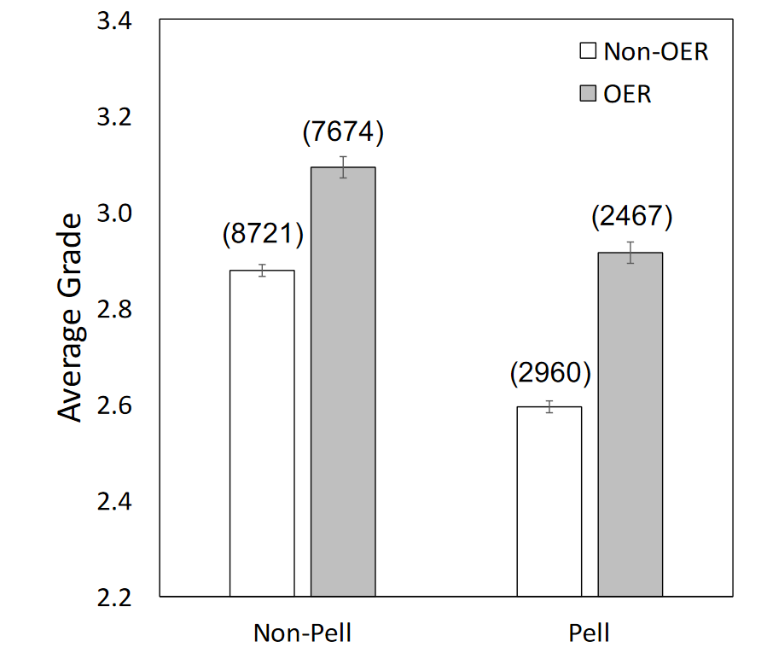
Graphs
Describe a summary of the graph in the caption or surrounding text (UDL focus)
Add a table with the data
On the same page or a separate page for complex graphs
Notes:
Caption is that students did better with OER and larger effect for Pell students than non-Pell
If complex graph, maybe link to external
Graph from research study

Slide 18
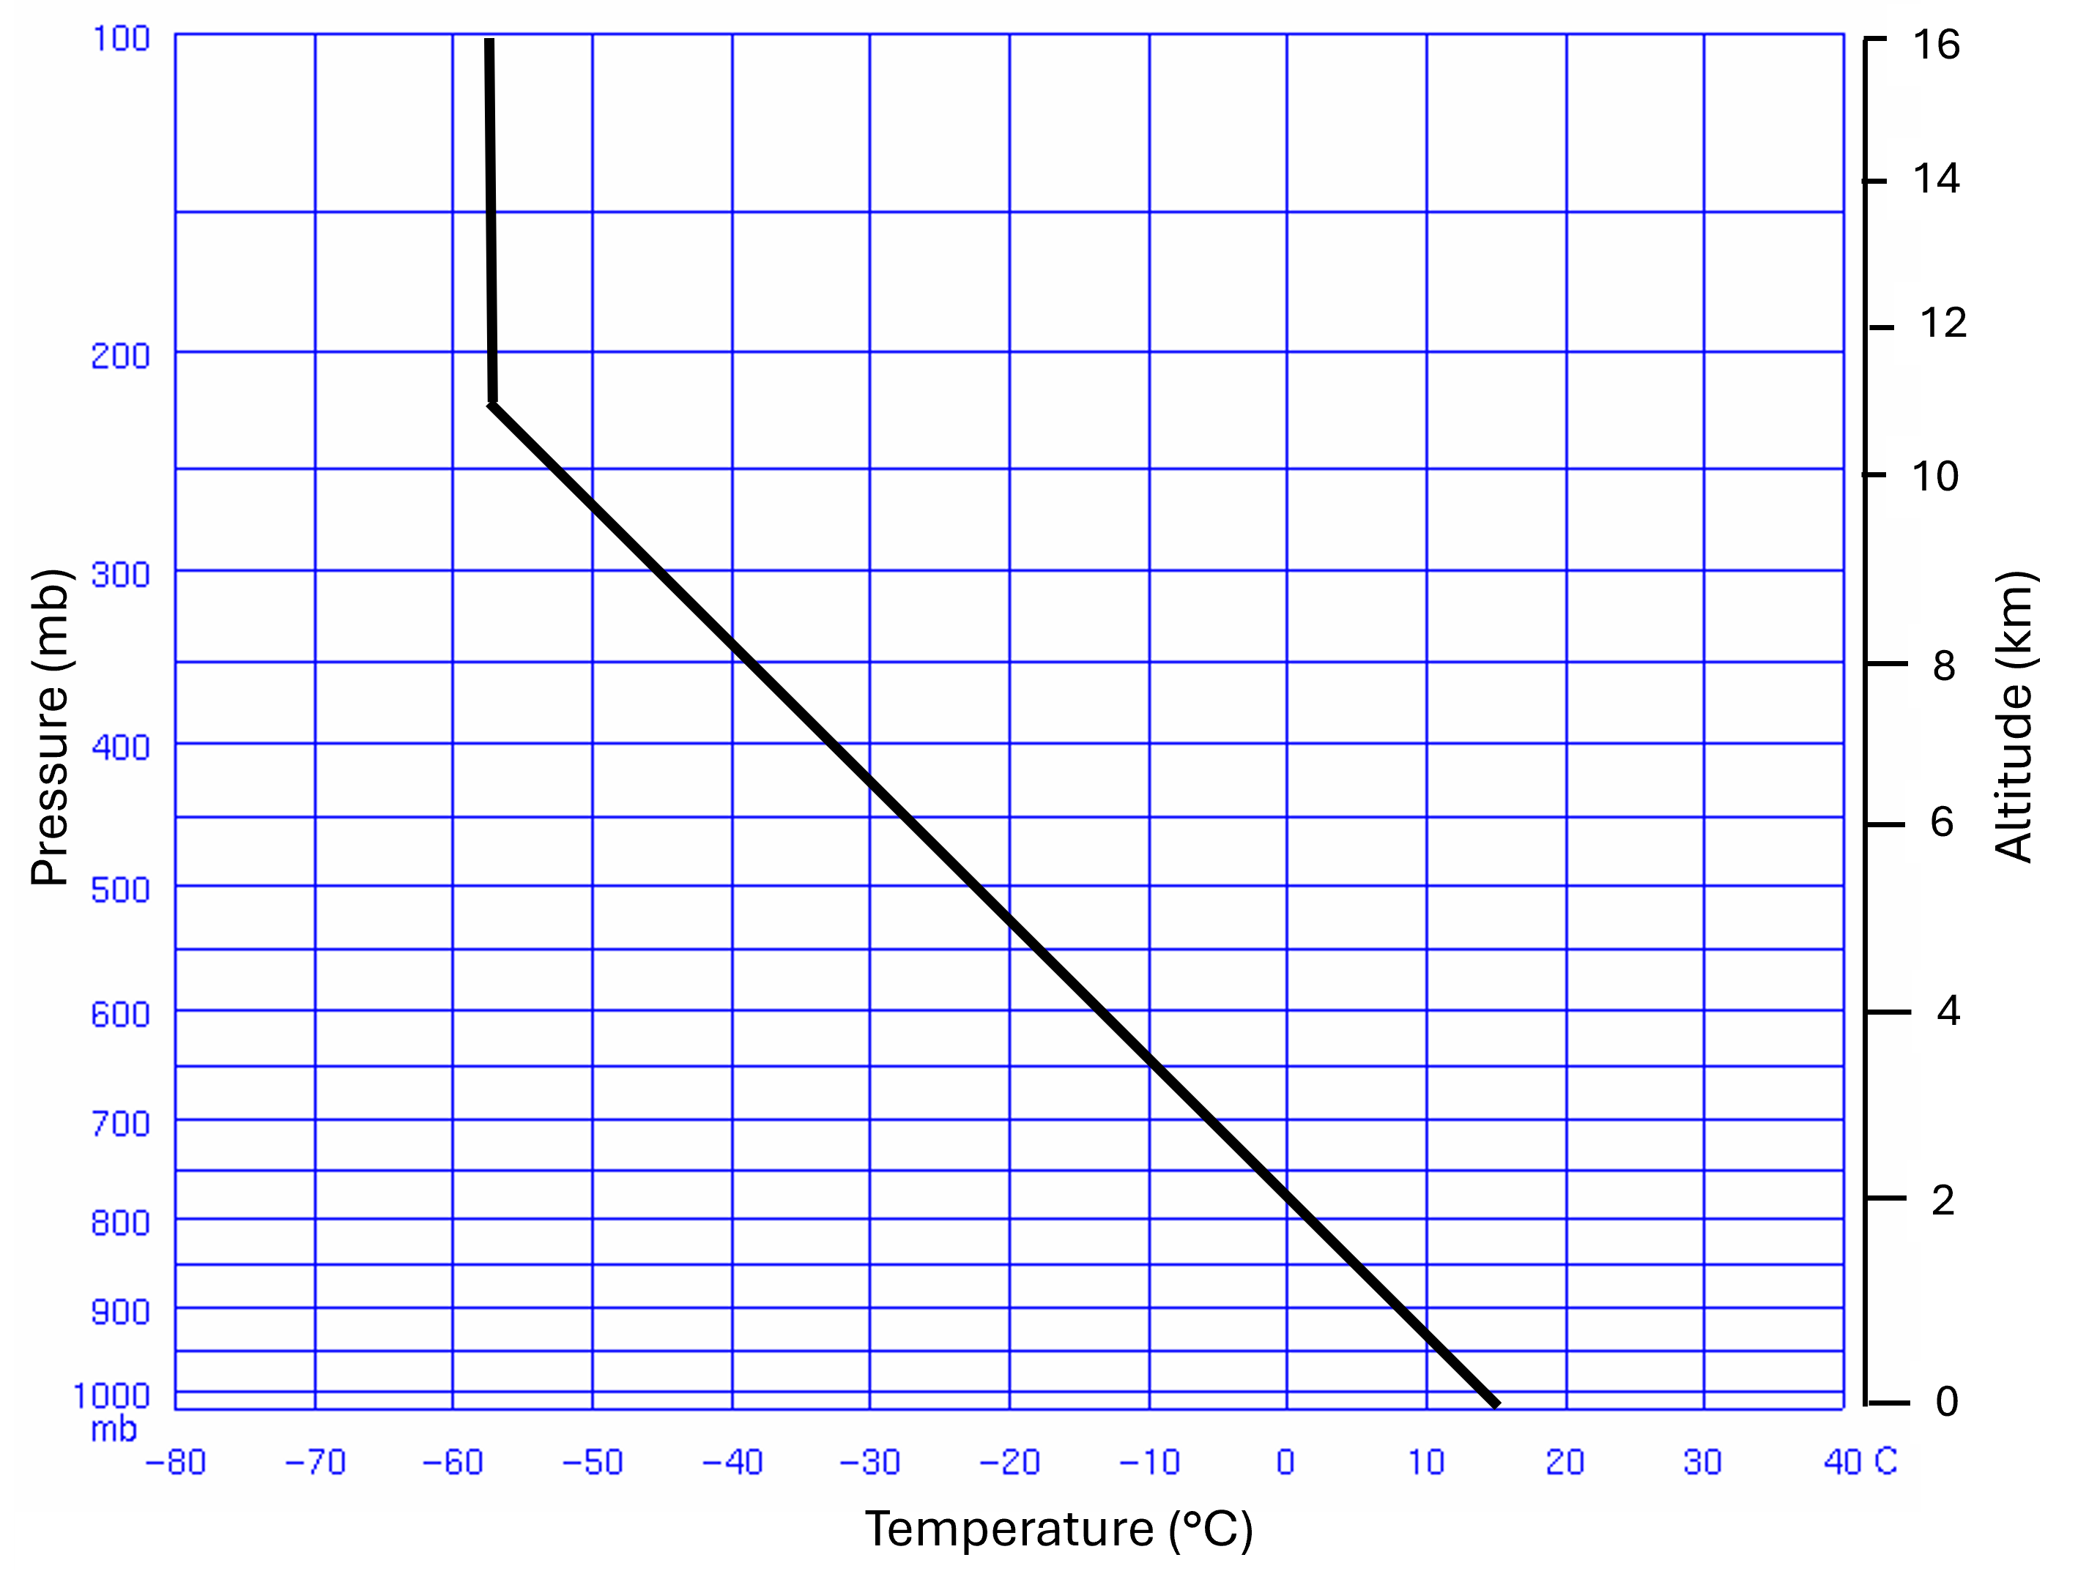
Complex Graphs
The U.S. Standard Atmosphere
Congratulations! You created a Stüve diagram plot of the temperature profile over Tampa Bay, FL. But how do we know whether the upper-air temperature over Tampa Bay is warmer or cooler than that of the rest of the U.S.? To compare radiosonde observations with the “average” atmospheric conditions, the U.S. Standard Atmosphere was developed. The U.S. Standard Atmosphere is a simple model of how the pressure, temperature, density, and viscosity of Earth's atmosphere vary over a wide range of altitudes or elevations. The lower portion of the US Standard Atmosphere has only three points: a surface temperature of +16 °C, -56.5 °C at 11 km, and -56.5 °C at 16 km. This data is shown in Figure 1.5.2 with the data recreated in Table 1.5.2 .
Pressure (mb) | Altitude (km) | Temperature (°C)
1000 | 0 | 15
900 | 1 | 8
800 | 2 | 1
700 | 3 | -6
600 | 4 | -13
500 | 6 | -22
400 | 7 | -33
300 | 9 | -45
250 | 10 | -52
200 | 11 | -56.5
175 | 12 | -56.5
150 | 13 | -56.5
125 | 14 | -56.5
100 | 16 | -56.5

Slide 19
Color for Meaning
Color should not be the sole means of communicating information

Slide 20
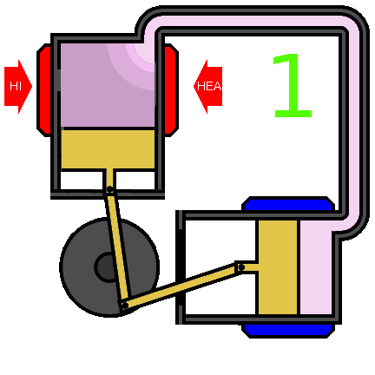
Animated Gifs
Can be distracting
Solutions
Add start/stop options
Limit the number of loops
Ezgif can limit loops
If showing steps, also include individual pictures for steps
Notes:
Image Source: https://commons.wikimedia.org/wiki/File:Atkinson_Opposed_Piston_Engine.gif

Slide 21

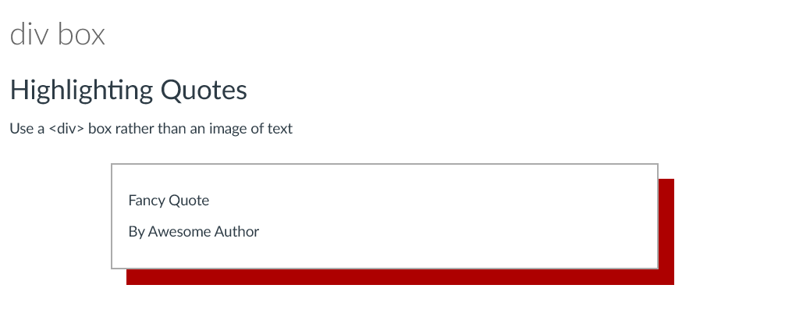
Avoid Images of Text
Zoom in to 200% to check readability
If there is text in the image, include the exact text in the alt text
Use a <div> box or other code to highlight text
New Direction in Chicanx and Latinx Studies

Slide 22
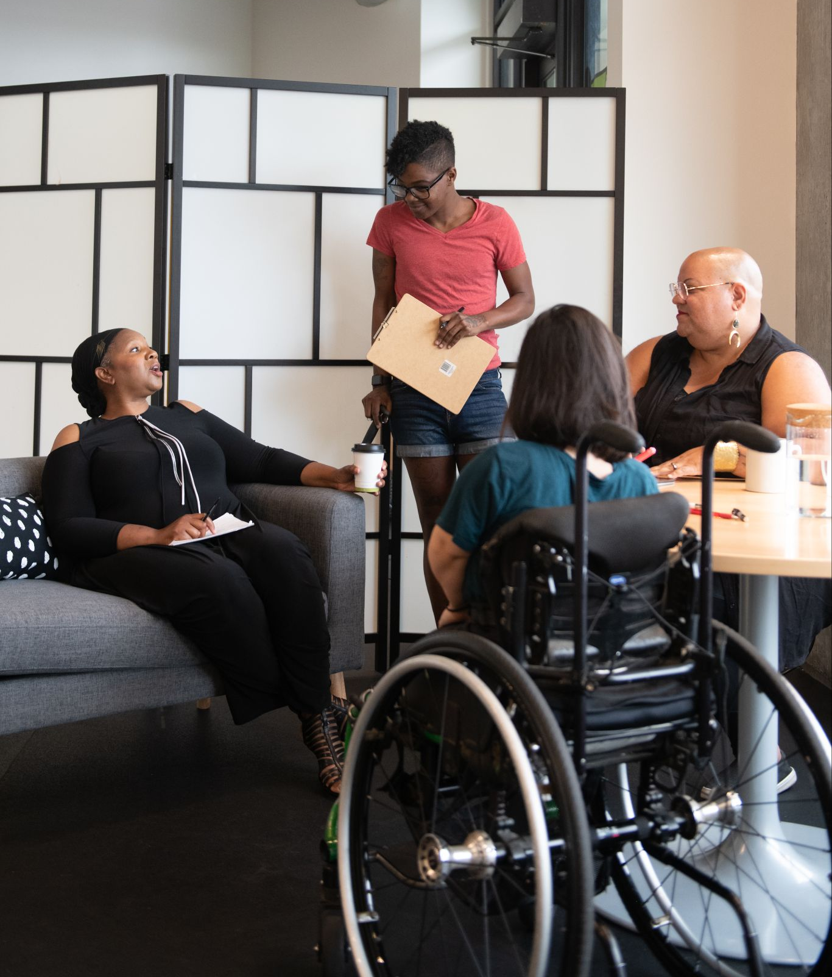
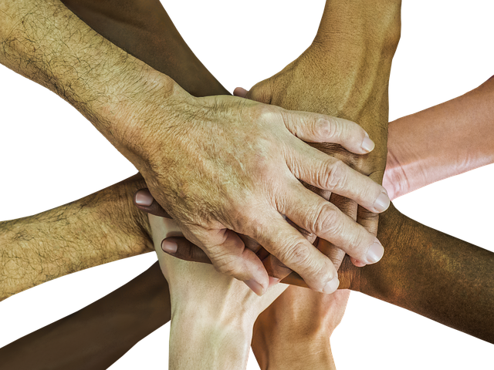
Demonstrating Inclusion
Representation in Alt Text
Identity and. Inclusion in Alt Text
Make Things Accessible
Good examples of Alt Text
Gender Spectrum Collection
Disabled and Here
Notes:
What would you use for alt text?
Meeting image from Disabled And Here project page. published under Creative Commons attribution licensing
Hands image from Pixabay

