Slide 1

Leading with Impact
Communicating the Value of Open Educational Resources (OER) to Governing Boards and Executive Leadership
ASCCC OERI WEBINAR

Slide 2
From Classroom to Boardroom
What We'll Cover Today
A strategic roadmap for earning lasting institutional support for OER.
01
02
Why Board Engagement Matters
Understanding the Board's Role
Sustainability starts at the top
Policies, priorities, and power
03
04
How Boards Receive Information
Where to Engage
Formal meetings, study sessions, and the Brown Act
Strategic entry points for OER advocates
05
06
What Resonates with Trustees
How to Present Effectively
Outcomes, equity, and constituent impact
Building the case and getting started

Slide 3
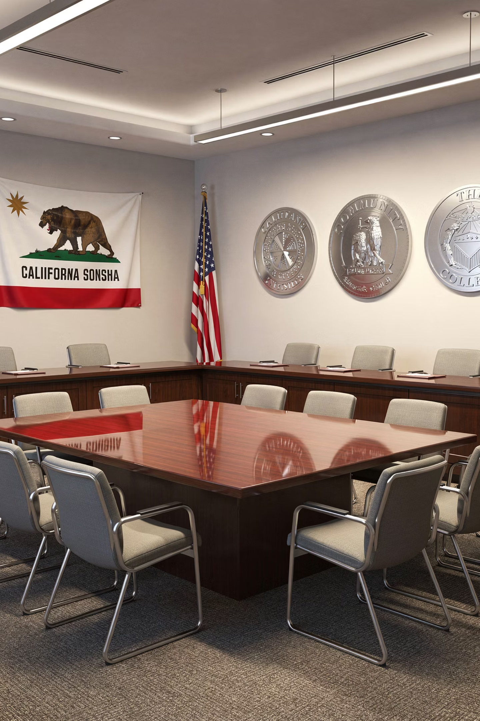
Why Board Engagement Matters for Sustainability
Setting the Stage
OER initiatives can thrive in individual classrooms — but without institutional alignment, they rarely scale. Board-level awareness transforms OER from a faculty project into a college priority.

Slide 4

A Reality Check: How Involved Is Your Board?
At many colleges, governing boards have had little to no exposure to Zero Textbook Cost (ZTC) or OER — even when programs are already well underway.
🔴 Risk
🟢 Opportunity
Without board awareness, OER programs lack policy protection, dedicated funding, and long-term champions at the institutional level.
Boards that understand OER impact become powerful advocates — in budget hearings, accreditation reviews, and community conversations.
At one California community college, the Board of Trustees heard about ZTC for the first time just three months ago — despite years of active implementation by faculty.
This gap is common. And it represents both a risk and an opportunity for OER leaders.

Slide 5
Understanding the Board of Trustees
Know your audience before you walk into the room.

Slide 6

What Is the Role of the Board of Trustees?
California Community College Boards of Trustees hold broad institutional authority. Understanding how they operate is essential for any effective advocacy strategy.
Board Policies (BPs)
Administrative Procedures (APs)
High-level governance directives set by trustees — the rules the institution must follow. BPs can formally embed OER and ZTC into institutional expectations.
Operational procedures implemented by administration to execute BPs. APs are where ZTC course marking and OER support practices live.
Budget & Strategic Planning
Trustees approve annual budgets and multi-year strategic plans. Aligning OER with institutional priorities puts it in the path of resource allocation.

Slide 7
How Boards Receive Information
Meeting them where they are — and working within the rules.

Slide 8
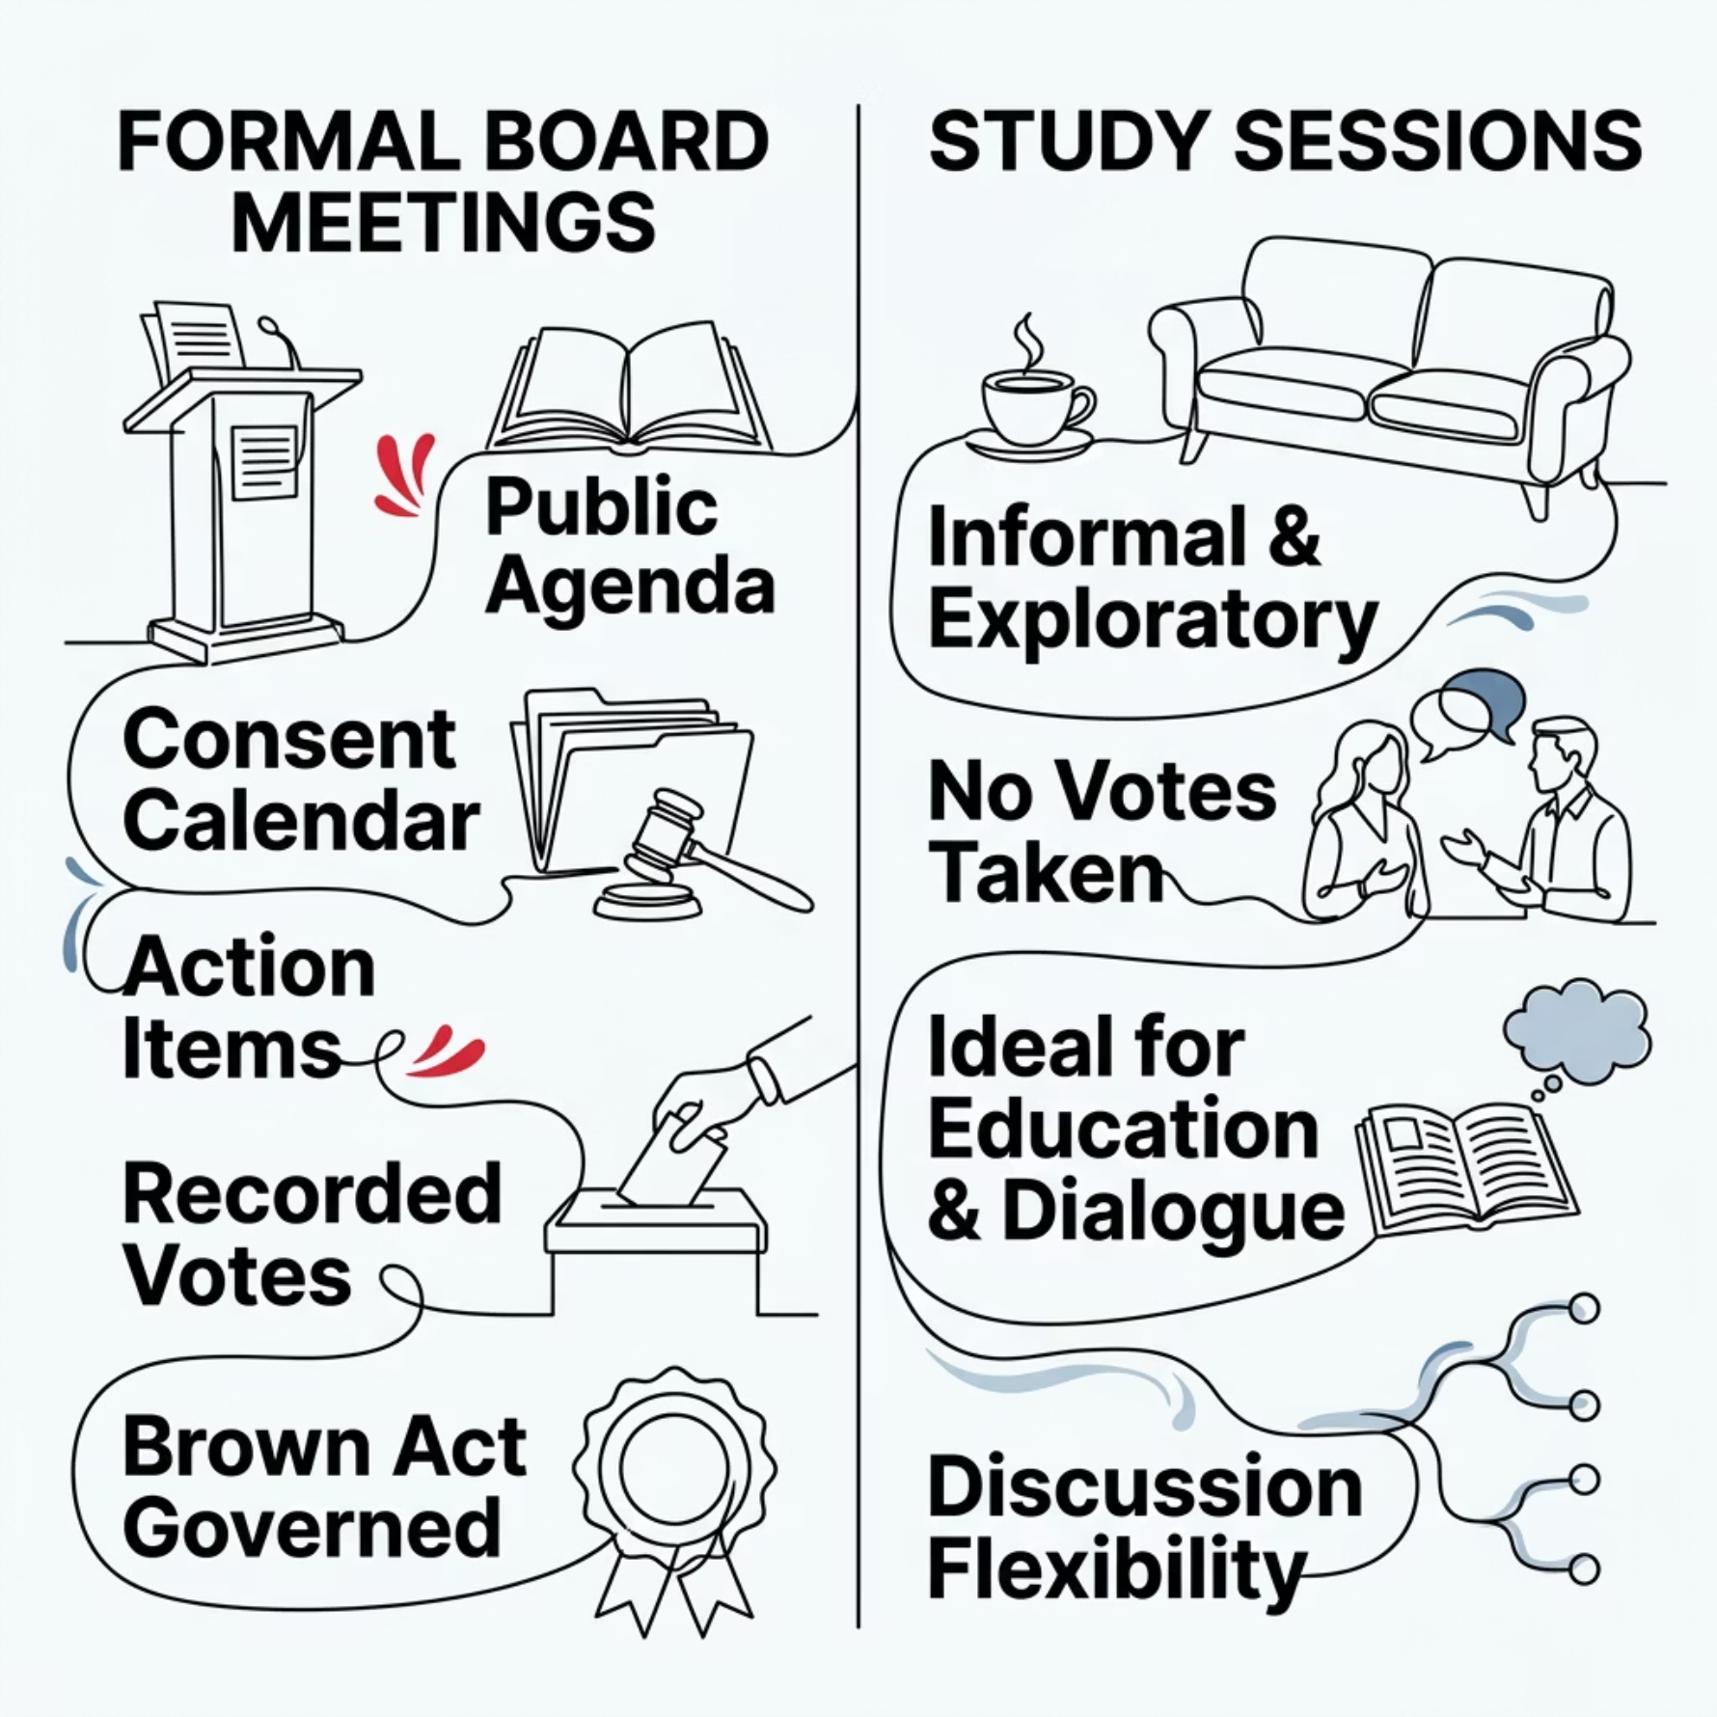

Navigating Board Information Channels
Know the Rules: The Brown Act
California's Ralph M. Brown Act governs open meeting requirements for public agencies, including community college boards. Key implications for OER advocates:
All board business must occur in publicly noticed meetings
Agenda items must be posted 72 hours in advance
Serial communications among a majority of trustees are prohibited
Study sessions offer more flexible dialogue within Brown Act bounds

Slide 9
Where to Engage Trustees
Strategic entry points for OER advocates across the institution.

Slide 10
Six Strategic Engagement Opportunities
Board Presentations
Study Sessions
Formal agenda items showcasing OER outcomes — student savings, equity gains, program growth.
Low-stakes, exploratory dialogue. Ideal for introducing ZTC concepts before requesting formal action.
Annual Reports
Policy Opportunities
Embed OER impact data in institutional reporting — cumulative savings, adoption rates, student reach.
Advocate for BP/AP language that mandates ZTC/LTC course marking and codifies OER support.
Initiative Discussions
Trustee Invitations
Connect OER to college-wide initiatives — Guided Pathways, Equity Plans, accreditation self-studies.
Invite trustees to OER showcases, faculty recognition events, and student success celebrations.

Slide 11
What Resonates with Trustees
Trustees are outcome-driven. Give them data they can take to their constituents.

Slide 12

Lead with Student Impact
Nothing moves a trustee faster than a clear, compelling story about student success. Connect OER directly to the outcomes they are accountable for.
Student Savings
Quantify cumulative cost savings. "$2.1 million saved by 14,000 students" is a headline trustees can repeat at community events.
Equity & Access
Show how ZTC sections reduce Day 1 barriers for low-income, first-generation, and underrepresented students.
Affordability & Accountability
Frame OER as responsible fiscal stewardship — delivering quality instruction while reducing student debt burden.
Guided Pathways Alignment
Link ZTC pathways to completion and transfer rates. OER can be the cost-free fuel for a student's entire academic journey.

Slide 13

Make It Visual — Make It Stick
Why Visuals Work for Boards
Trustees review dozens of agenda items per meeting. A well-designed infographic or single data point in large type cuts through the noise instantly.
Before: Text-heavy report
After: Visual-first framing
"OER adoption increased across 47 course sections serving approximately 1,400 students with estimated savings of $182,000."
$182,000 returned to students. 1,400 learners. 47 ZTC sections. One semester.

Slide 14

Don't Overlook Your Student Advocates
Two Powerful Voices Often Left Out
Student perspectives carry unique moral authority in boardrooms. Engage these advocates early and equip them with your data.
The Student Trustee
Associated Students
A voting or advisory member of the board who represents the student body. Brief them personally — they can champion ZTC from inside the governance structure.
Student government organizations can pass resolutions in support of ZTC, present at board meetings, and amplify the student savings narrative with lived experience.

Slide 15
How to Present Effectively
Building the right foundation before you enter the boardroom.

Slide 16

Laying the Groundwork: A Practical Approach
Build Data Story
Compile savings, equity, and success metrics
Secure Support
Present to Board
Brief VP, Senate President, or Superintendent
Request agenda item or include in report
Effective board engagement is rarely spontaneous. The most successful OER advocates build internal alignment before requesting formal board time — especially in single-college districts where access to the board is more direct.

Slide 17
Single-College Districts: A Closer Reach
Why Single-College Districts Have an Advantage
Practical First Steps
In a single-college district, the administration, the board, and the faculty operate in closer proximity. There are fewer bureaucratic layers between an OER lead and a trustee.
1
Get your VP Academic Affairs on board first
They control agenda access and can champion your item.
This means informal relationship-building — a hallway conversation, an invitation to a ZTC event, a mention in a superintendent's report — can open doors that formal channels might not.
2
Request a study session — not a formal vote
Lower stakes, more dialogue, and a chance to educate before you advocate.
3
Bring student voices and data together
A student testimonial paired with a savings figure is nearly impossible to dismiss.

Slide 18

Key Takeaways: Leading with Impact
1
Know Your Governance Structure
Understand BPs, APs, and how your board receives and acts on information.
2
Find Your Entry Point
Study sessions, annual reports, and trustee invitations are lower-barrier starting points than formal agenda items.
3
Speak in Outcomes
Savings numbers, equity data, and student stories are the currency of trustee attention.
4
Build Coalition First
Secure admin support, engage student advocates, and align OER with institutional strategic priorities before you present.

