Slide 1
So You are an Accessibility Person now
Developed March 17, 2026. Suzanne Wakim and Shagun Kaur
This work is licensed under a Creative Commons Attribution 4.0 International License.
Notes:
The Open Washington Open Attribution Builder is a handy tool for creating your attributions, if you’d like to indicate how your work should be attributed or if you are using resources that require attribution. https://www.openwa.org/attrib-builder/ Including how your presentation is licensed on your title slide is an effective way of making this clear. OERI resources are most commonly licensed CC BY, allowing others to use and modify them – but requiring that they be properly attributed.

Slide 2
Welcome!
On behalf of the ASCCC OERI, we are pleased to have you here with us for ““Accessibility Apps: So, You’re Suddenly Expected to be an Accessibility Expert”. If you are not already muted, please mute yourself upon arrival.
Please note that you are encouraged to use the Zoom “chat” feature for questions and comments.
You’re invited to introduce yourself in the chat – please provide your name, college, discipline/role
This event will be recorded. Archives of all ASCCC OERI events are available at asccc-oeri.org > Webinars and Events

Slide 3
Presenters
Suzanne Wakim, ASCCC OERI Project Facilitator and Accessibility Lead
  Distance Education /Accessibility Butte College
Shagun Kaur, ASCCC OERI Project Facilitator and LibreTexts Lead
  Communication Studies, De Anza College

Slide 4

Topics
Evaluating Websites and Online Books
  WAVE
  Accessibility Checklist
Notes:
Learn how to check websites, videos, and PDFs for accessibility. We will practice using the WAVE and Silktide Accessibility Checkers to evaluate external websites. We will also learn how to evaluate PDFs for accessibility and find accessible videos in YouTube.
Accessibility Checklist: https://asccc-oeri.org/oeri-accessibility-checklist/

Slide 5
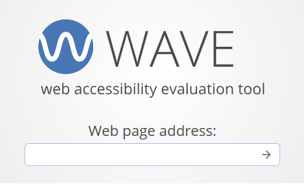
WAVE by WebAIM
WAVE
  https://wave.webaim.org/
Has browser extensions for Chrome, Firefox and Edge
  Works on any website

Slide 6
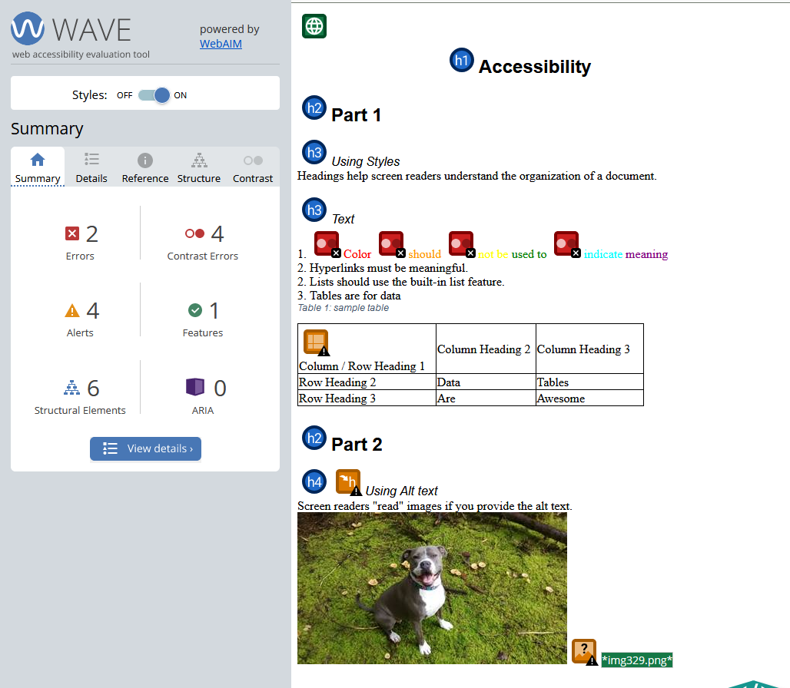
WAVE Results

Slide 7
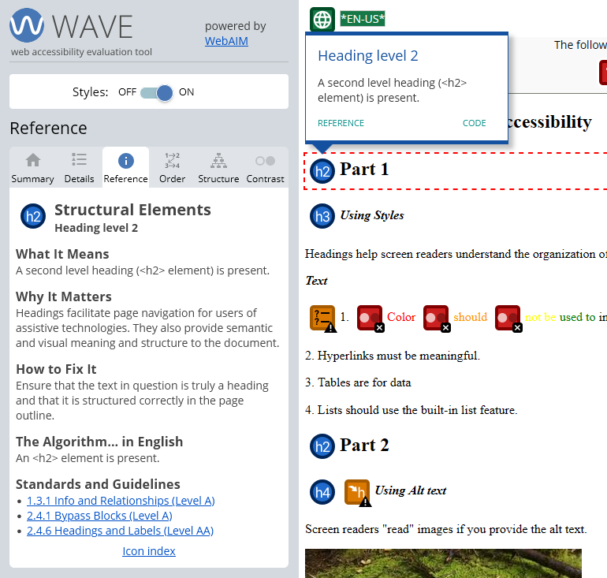
WAVE as a Learning Tool
Selecting anything on the page opens a window
“References” provides useful information

Slide 8
Headings Checklist
All headings are styled using the platform’s Heading styles.
Every page has a heading at the top, H1 or H2 depending on the platform.
If a page of content begins with a box the first H2 or H3 should be under the box.
The heading structure is consistent throughout the page, with no skipped levels.
Headings are substantially unique and are not repeated on a page.

Slide 9
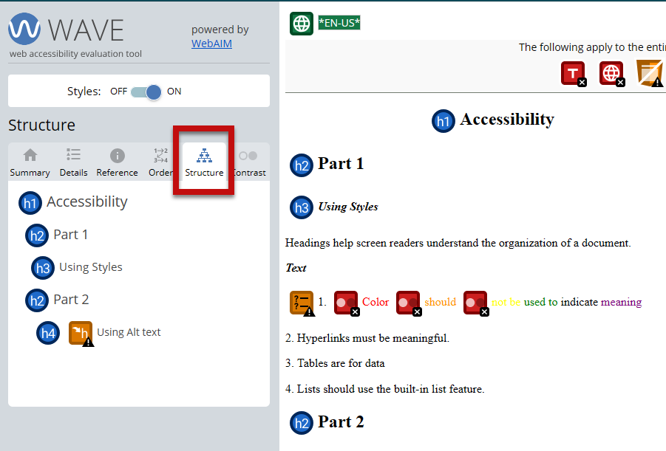
Headings in WAVE
Blue circles on page
In “Structure” tab

Slide 10
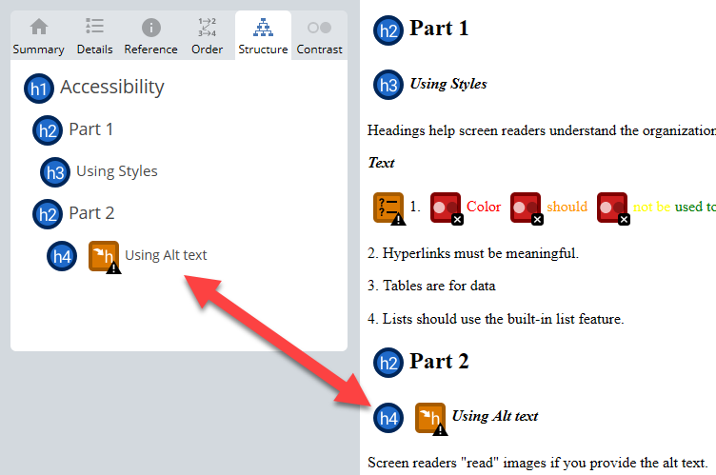
Skipped Headings

Slide 11
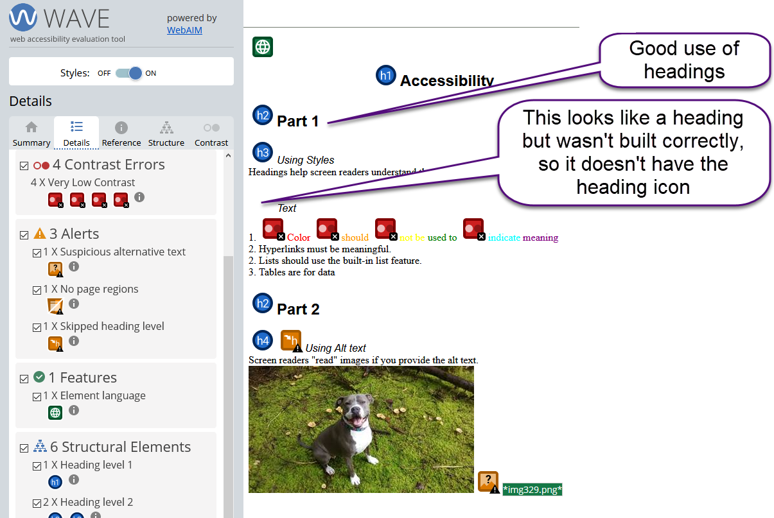
Missing Heading
Not identified as an error
Requires human check

Slide 12
Lists and Links Checklist
Lists
Links
All lists are styled properly, using the List option.
Numbered lists are only used for sequential or the numbering serves a communication purpose.
Headings are not formatted with the List feature.
Websites are linked to meaningful text, not URLs.
Terms such as “click here” do not appear in linked text.
Links are not repeated on the same page unless the repetition is employed for pedagogical purposes.

Slide 13
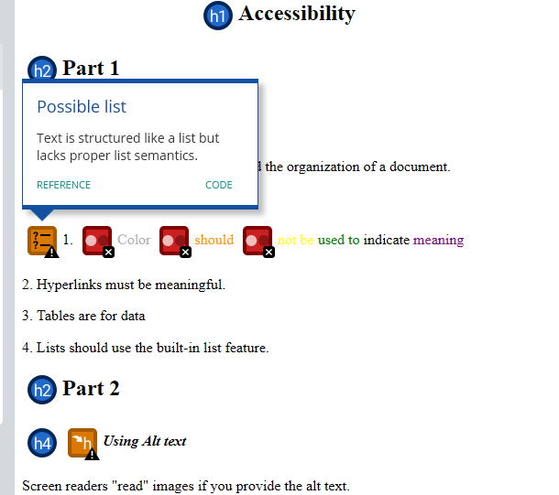
Lists
Identified as a warning

Slide 14
Images Checklist
All images have concise, descriptive alternative text (alt text).
Alt text does not repeat the figure caption and is no longer than 120 characters.
Alt text does not begin with “image of”, “picture of”, or other redundant language.
The alt text does not contain the image file name.
Complex figures are described or explained in the caption or surrounding text.
Any text that appears in an image is included in the figure caption or the alt text.
Every image has a caption.

Slide 15
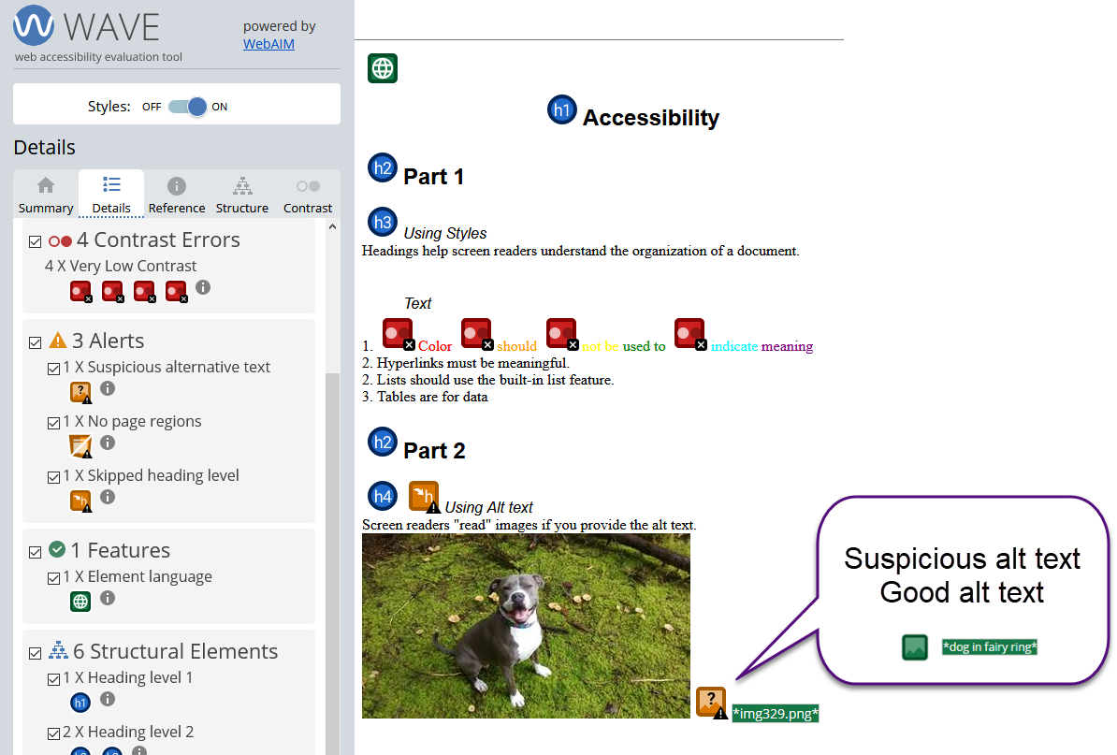
Alt Text in WAVE
Missing alt text: Error
Suspicious alt text: Warning
Useful for seeing all alt text on a page at once

Slide 16
Text Checklist
All capitals are only used for acronyms and abbreviations.
Bold formatting is used sparingly, such as for special terms or glossary terms.
Italics are used sparingly, for emphasis.
Text is not underlined (unless the platform’s style is to underline hyperlinks).
All text is legible. The font size must not be less than a 12-point font.
Overly decorative fonts are not used and the text color has sufficient contrast against the background.
Words are used rather than symbols.
Blank lines are not used for formatting purposes.

Slide 17
Color Contrast Checklist
  Text color has sufficient contrast against the background to meet WCAG requirements (minimum 4.5:1 for normal text and 3:1 for large text).
  Light gray or low-contrast text on light backgrounds is not used.
  Color is not the only method used to convey meaning or information.
  Text placed on images or colored backgrounds is checked for sufficient contrast.
  Buttons, links, and other interface elements meet contrast requirements.
  WAVE contrast errors and alerts are reviewed and resolved where applicable. Look for contrast alerts:
    🔴 “Contrast Error” – text fails WCAG contrast requirements
    🟡 “Contrast Alert” – possible issue that should be reviewed

Slide 18
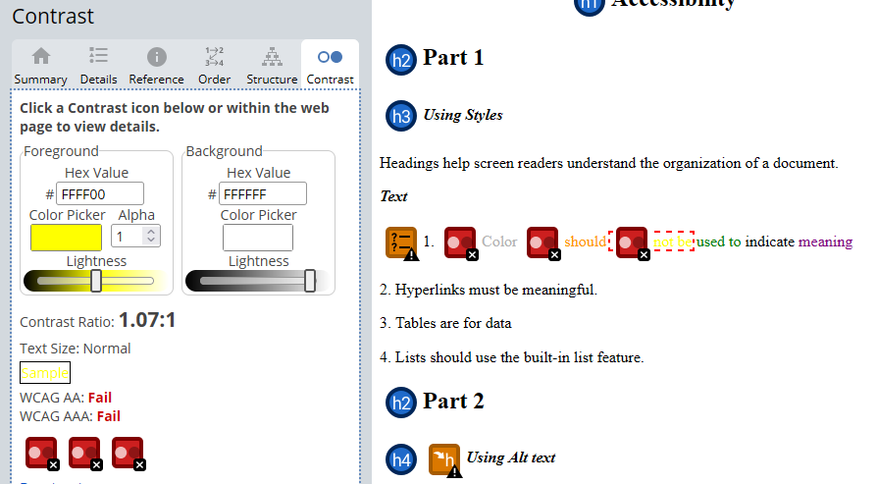
Color Contrast
Contrast tab
Word is highlighted
Use slider to find accessible color

Slide 19
Colorblindness Checklist
Color is not the only way meaning or information is communicated.
Color-coded information also includes text, labels, or icons.
Charts, graphs, and diagrams include labels or patterns, not just color.
Links and interactive elements can be identified without relying on color alone.
Problematic color combinations (such as red/green) are avoided or clearly distinguished.
  Example:
  Instead of showing status with only color (✔or ✖ ), include text labels or icons such as ✔(green) = “Complete” or ✖ (red) = “Error.”

Slide 20
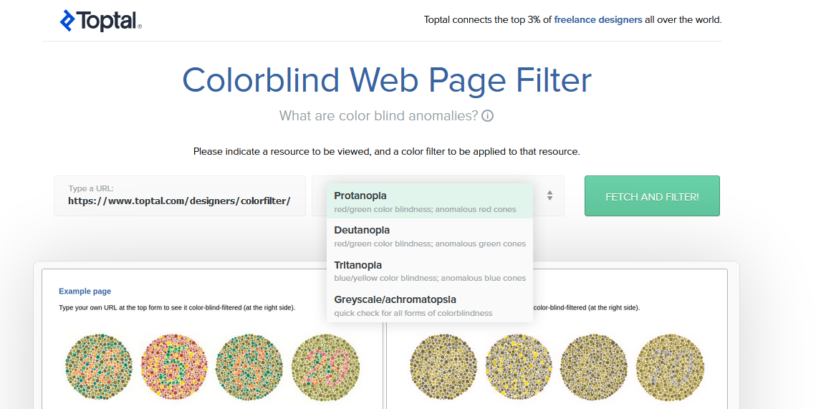
Color Blindness check
Toptal Colorblind Web Page Filter

Slide 21
Tables Checklist
All tables are produced using the platform’s Table features.
Each table has a caption.
Each table has properly formatted header rows and columns.
Any images provided within tables have descriptive alternate text.
Table cells do not include images for character symbols.

Slide 22
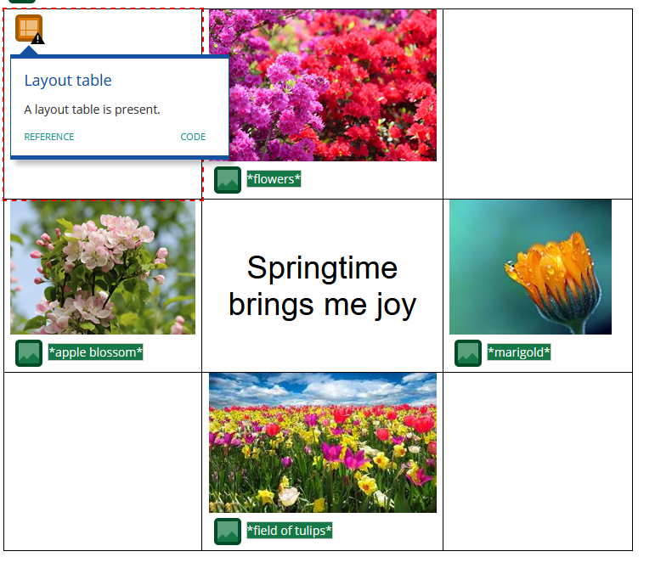
Layout Tables
Identified as warning

Slide 23
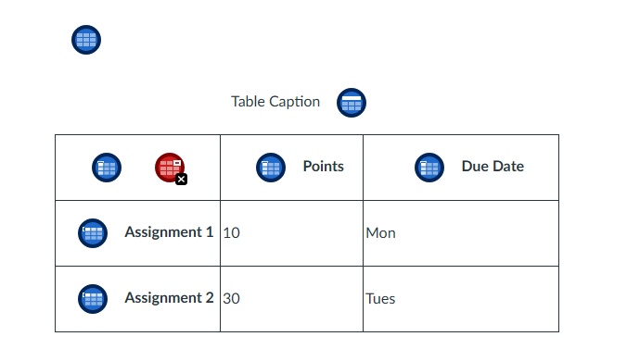
Table Features Identified
Data Table
Caption
Headings
Blank Cells (error)

Slide 24

Discussion

