Slide 1
Empowering Arabic Learning: A Guided Tour of Arabic OER
OER-DL Webinar; 05/07/2026, 2:00 pm – 3:00 pm
This work is licensed under a Creative Commons Attribution 4.0 International License.

Slide 2
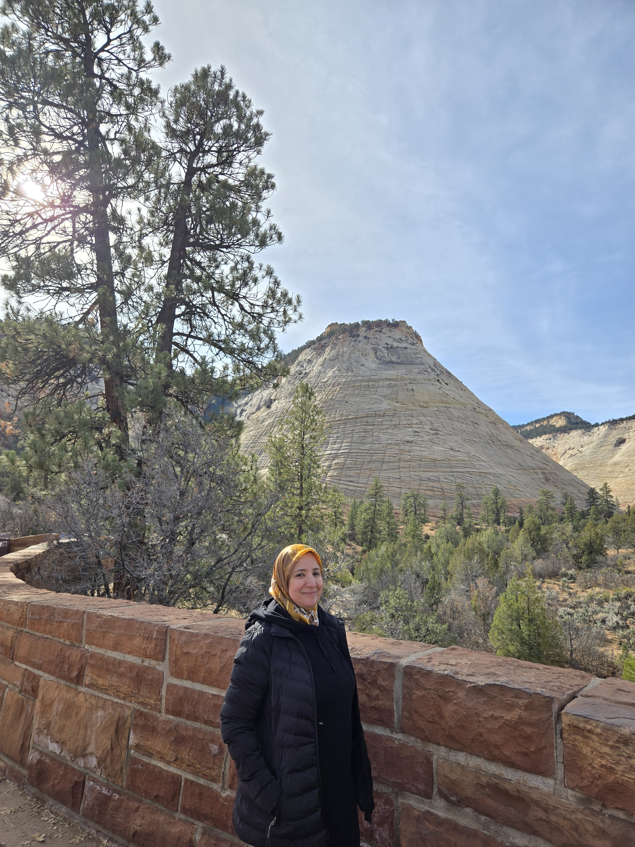

Presenter
Name: Hana Kassas
Arabic Language Educator
Cuyamaca Community College
Arabic OER Author and Creator
OERI Discipline Lead for Arabic
Dedicated to expanding access to Arabic language learning through Open Educational Resources.
Notes:
Presenters can be included following the description or the overview. Where images are used, they should include an attribution (Photo by…) and appropriate alternative text should be used (or the image marked decorative).

Slide 3

Overview
Introduction to the Arabic OER Collection:
How to find the Arabic Resources in LibreTexts
How to find the Arabic Resources in Canvas Commons
How to hind the Arabic Resources in CooL4Ed (California Open Online Library for Education)
A guided tour of specific introduction to the Arabic OER Collection
Introduction to Arabic I
Introduction to Arabic II
Arabic Level One
Arabic Level Two
Arabic Level Three
Coming soon Arabic Level Four

Slide 4
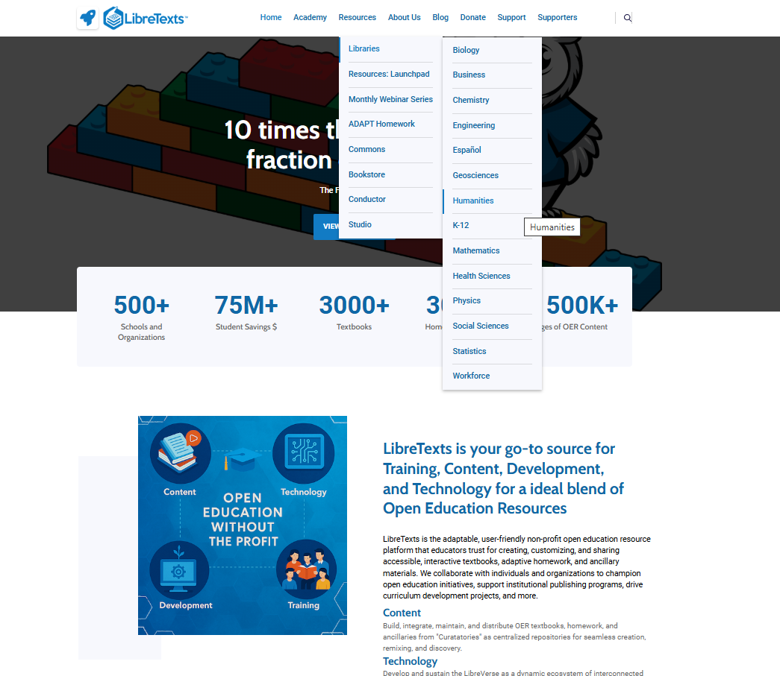
How to Find the Arabic Resources: Libre Texts
Go to LibreTexts.org
Hover over "Resources"
Select "Libraries" (a menu will appear)
Click on "Humanities"

Slide 5
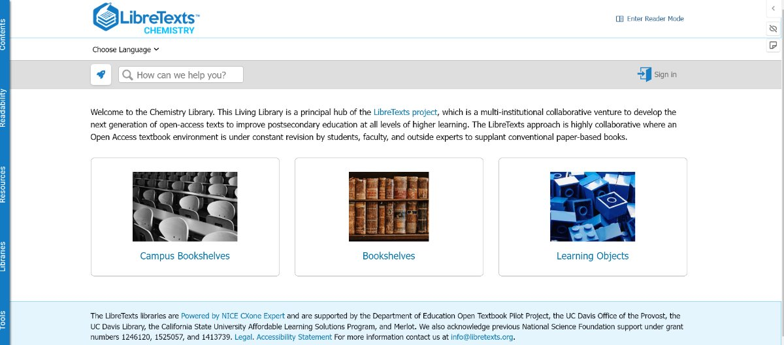
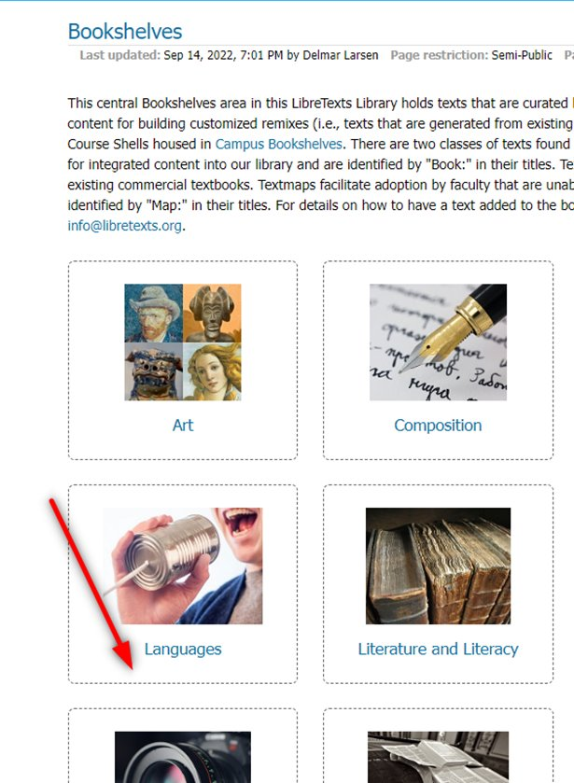
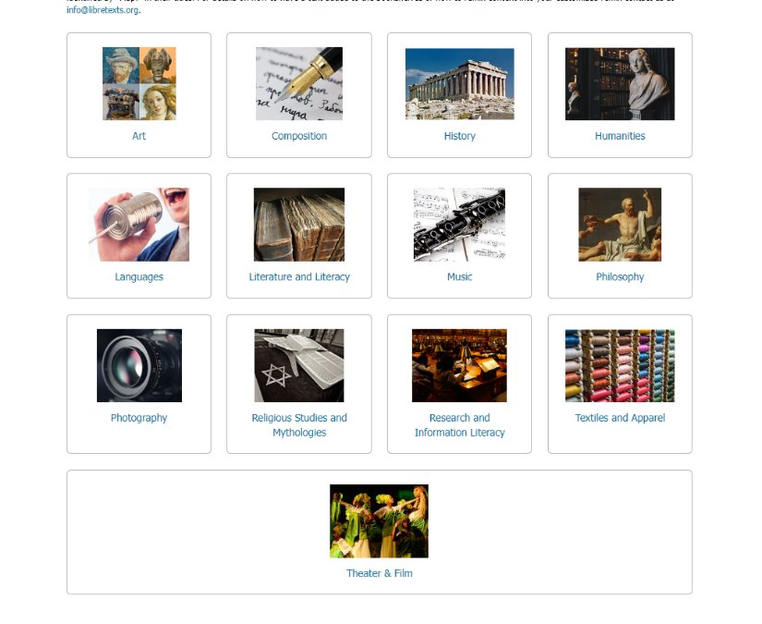
How to Find the Arabic Resources: Libre Texts
LibreTexts features subject libraries organized into three resource types:
Bookshelves
Learning Objects
Campus bookshelves
Click on "Bookshelves"
Use the subject filters (check the boxes)
Select "Languages"
Choose "العربية" (Arabic)

Slide 6
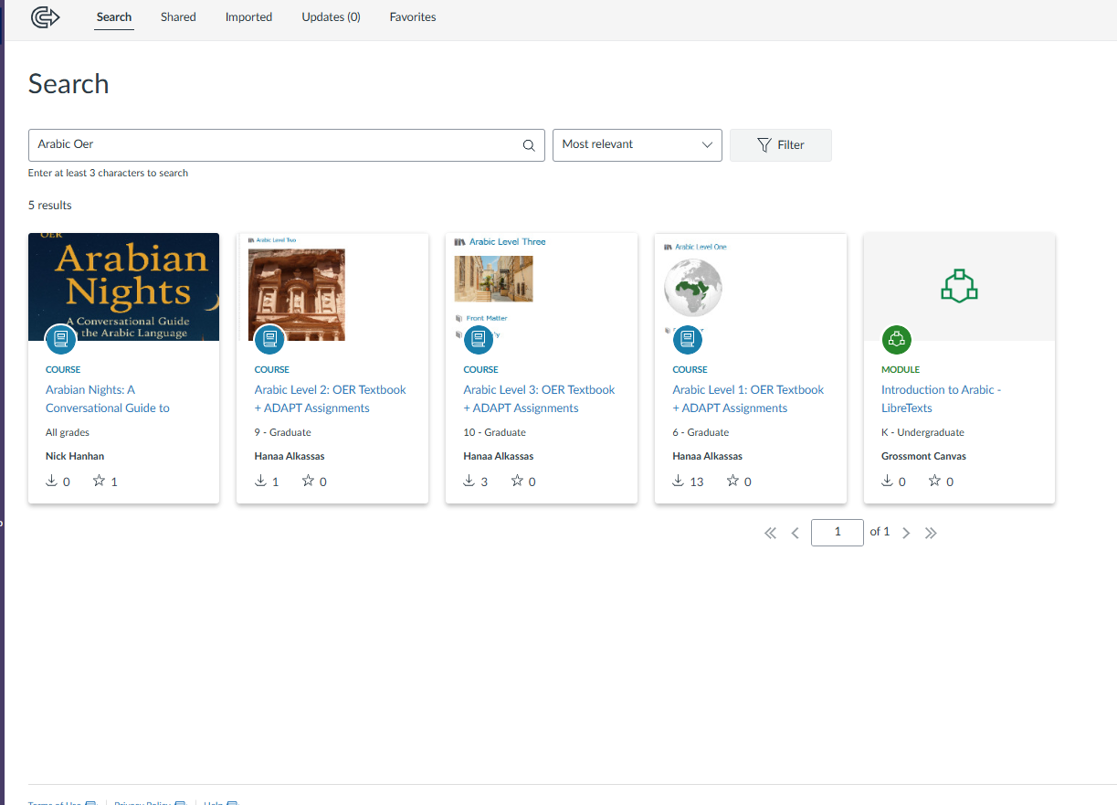
How to Find the Arabic Resources: Canvas Commons
Go to "Canvas Commons"
In the search box, type "Arabic OER", "Arabic", or "Arabic Level"
Look for the following Arabic Courses:
Arabic Level 1: OER Textbook + ADAPT Assignments Course
Arabic Level 2: OER Textbook + ADAPT Assignments Course
Arabic Level 3: OER Textbook + ADAPT Assignments Course
Introduction to Arabic - LibreTexts

Slide 7

How to Find the Arabic Resources: Cool4Ed
Go to Cool4Ed website
Type "Arabic" in the search box
Look for the Arabic Resources
The resources are labeled as ZTC Course and Resources
ZTC Course: Arabic Leve One at Cuyamaca College in Arabic
ZTC Course: Arabic Leve Three at Cuyamaca College in Arabic
ZTC Course: Arabic Leve Two at Cuyamaca College in Arabic
ZTC Resource: Arabic Level One in
ZTC Resource: Arabic Level Three in
ZTC Resource: Arabic Level Two in
These resources are the same in LibreTexts and Canvas Commons

Slide 8
A Guided tour of specific introduction to the Arabic OER Collection
Arabic OER Resources by Level.

Slide 9
Introduction to Arabic I
Introduction to Arabic (Kassas, et al., ASCCC OERI) (CC BY)
Overview of Arabic-speaking countries and language context
Introduction to the Arabic alphabet and writing system
Explanation of diacritics and vowel patterns
Basic linguistic concepts and grammatical terminology
Inclurdes 10 Thematic Units
The first resource in the series, completed in 2022
Developed by:
Hana Kassas, (project manager) Cuyamaca Community College
Rola Aoneh, Cuyamaca Community College
Maysaa Toma, San Diego City Community College
Dr. Layla Bahar Al-Aloom, Chevron Community College
Samira Murtada, San Bernardino Valley College

Slide 10
Arabic Level One
Arabic Level One (Kassas) (CC BY-NC-SA)
Overview of Arabic-speaking countries and cultural diversity within these countries
Beginner-level vocabulary and grammar presented in context
Activities that support listening, speaking, reading, and writing skills
Cultural notes related to the Arabic-speaking world
Structured lessons designed for introductory Arabic courses
Includes 12 Thematic Units
Added a dedicated assessment page at the end of each chapter to provide structured checkpoints for practice
Developed by:
Hana Kassas, (project manager) Cuyamaca Community College

Slide 11
Comparison: Introduction to Arabic I vs. Arabic Level 1
Introduction to Arabic I | Arabic Level One
Group of letters introduced in one section | Each letter introduced in its own section
Videos created to teach how to write the letters and audios to help pronunciation | More videos created to introduced letters and their shapes in words
Interactive Activities using H5P platforms | Integrated more structured and organized, step by step activities utilizing H5P and Adapt platforms
Uses YouTube videos (not Creative Commons) | Uses only Creative Commons licensed videos
Includes 10 chapters | Expands to 12 chapters
5 Chapters and 10 section in each chapter | Added a dedicated assessment page at the end of each chapter

Slide 12
Introduction to Arabic II
Introduction to Arabic II (Kassas, et al., ASCCC OERI) (CC BY-NC-SA)
Suitable as a core instructional or reference textbook
Structured lessons introducing vocabulary and grammar
Readings and explanations supporting language comprehension
Themes related to everyday life and student experiences
Includes 5 Thematic Units
Developed by:
Hana Kassas, (project manager) Cuyamaca Community College
Dr. Layla Bahar Al-Aloom, Chevron Community College
Samira Murtada, San Bernardino Valley College

Slide 13
Arabic Level Two
Arabic Level Two (Kassas) (CC BY-NC-SA)
Thematic lessons focused on everyday communication
Vocabulary and grammar development for second-semester learners
Numerous practice activities and exercises
Cultural readings related to daily life in the Arab world
Activities that support listening, speaking, reading, and writing skills
Offers a more carefully structured learning experience, with a greater number of targeted exercises and assessments, providing a more organized and comprehensive practice compared to Introduction to Arabic II.
Includes a Check Your Understanding' activity in each section, offering students more interactive learning opportunities to reflect and confirm their comprehension.
Developed by:
Hana Kassas, (project manager) Cuyamaca Community College

Slide 14
Arabic Level Three
Arabic Level Three (Kassas) (CC BY-NC-SA)
Theme-based lessons connected to real-life contexts
Built on the foundation of previous levels by integrating advanced linguistic structures
Expanded grammar topics and vocabulary development
Reading, writing, listening, and speaking activities
Cultural insights related to Arab societies and traditions and thematic cultural analysis
Integrated assessments and practice tasks within each chapter
Preparing learners for deeper academic and professional pursuits to be global citizens
Developed by:
Hana Kassas, (project manager) Cuyamaca Community College

Slide 15
Arabic Level One Canvas Shell
Arabic Level 1 Canvas Shell (Canvas Commons) (CC BY)
This Canvas course shell provides a complete online course structure for Arabic Level 1, aligned with the Arabic Level One OER textbook.
The course is organized into weekly modules that guide students through vocabulary, grammar, reading, listening, and speaking activities designed for beginner learners.
The course includes discussions, assignments, and interactive practice activities, many of which are connected to the ADAPT platform for automatically graded exercises and additional language practice.
The shell provides instructors with a ready-to-use framework that can be imported into Canvas and customized to fit different teaching formats, including online, hybrid, or face-to-face courses.

Slide 16
Arabic Level Two Canvas Shell
Arabic Level 2 Canvas Shell (Canvas Commons) (CC BY)
This Canvas course shell provides a structured online course framework for Arabic Level 2, aligned with the Arabic Level Two OER textbook.
The course is organized into modules that guide students through vocabulary development, grammar practice, reading passages, listening activities, and communicative speaking tasks.
The shell includes discussions, assignments, and interactive learning activities, many of which are linked to the ADAPT platform to provide students with additional practice and automatically graded exercises that reinforce course concepts.
These modules help students expand their ability to communicate about everyday topics such as family, school life, hobbies, and daily routines.
This course shell can be imported directly into Canvas and customized by instructors, providing a ready-to-use structure for teaching Arabic Level 2 in online, hybrid, or face-to-face learning environments.

Slide 17
Arabic Level Three Canvas Shell
Arabic Level 3 Canvas Shell (Canvas Commons) (CC BY) This Canvas course shell provides a structured online course framework for Arabic Level 3, aligned with the Arabic Level Three OER textbook.
The course is organized into modules that guide students through vocabulary development, advanced grammar topics, reading passages, listening activities, and communicative speaking tasks.
Each module integrates vocabulary, cultural content, grammar explanations, reading and writing activities, listening and speaking practice, and assessments, allowing students to strengthen their overall Arabic proficiency.
The shell also includes discussions, assignments, and interactive activities, many of which are connected to the ADAPT platform to provide students with additional practice and automatically graded exercises.
Instructors can import this course shell into Canvas and adapt it for use in online, hybrid, or face-to-face Arabic language courses.

Slide 18
Open Educational Resources and Arabic (ASCCC OERI)
The page Open Educational Resources and Arabic is part of the broader work of the ASCCC Open Educational Resources Initiative (OERI), which aims to expand access to high-quality, no-cost instructional materials for students.

