Slide 1
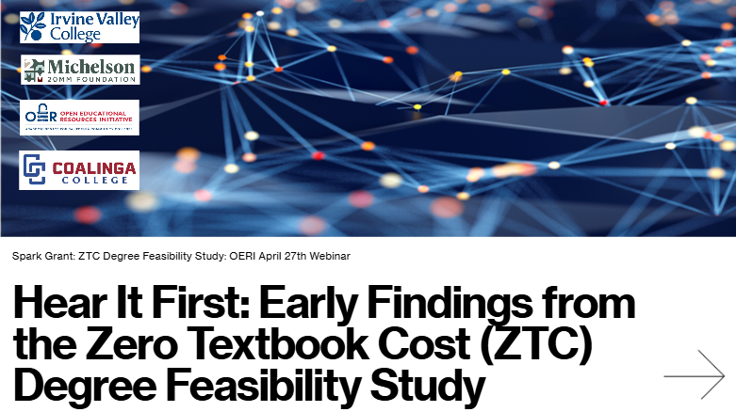
Hear It First: Early Findings from Zero Textbook Cost (ZTC) Degree Feasibility Study

Slide 2
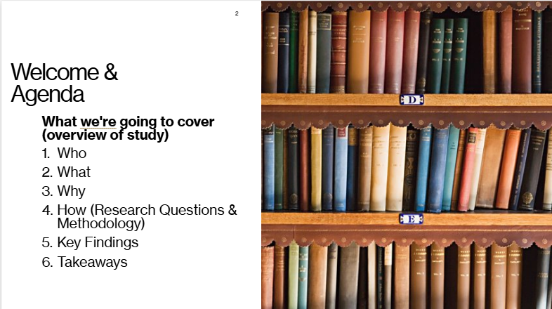
Welcome & Agenda

Slide 3
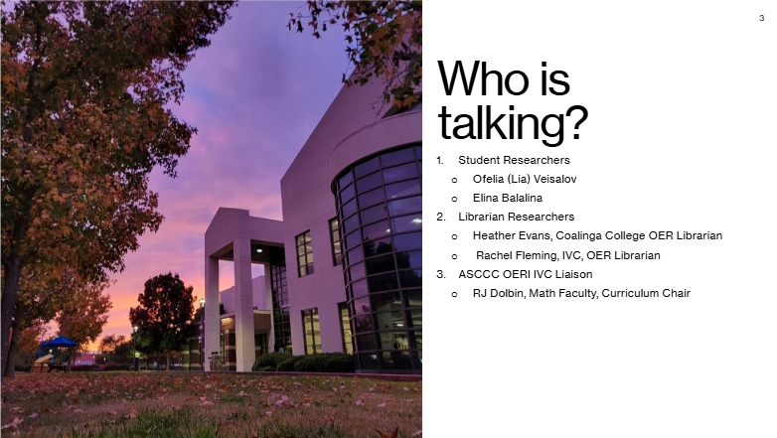
Who is talking?

Slide 4
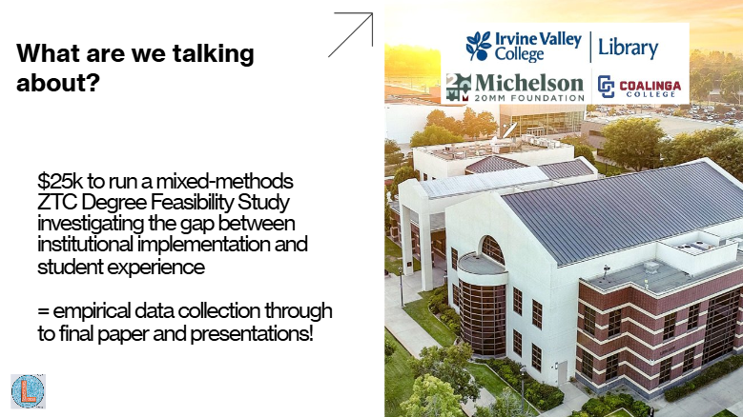
What are we talking about?

Slide 5

Start with the Findings

Slide 6
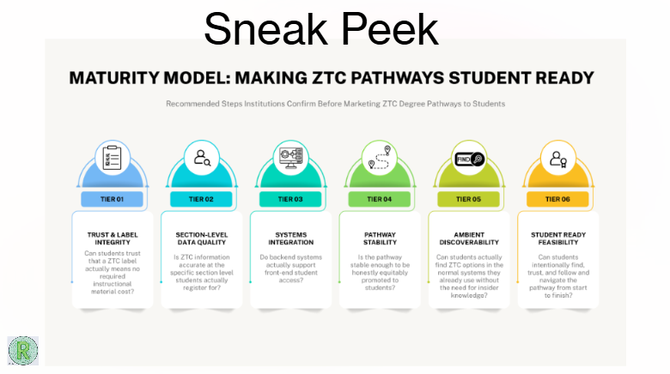
Sneak Peek Maturity Model: Making ZTC Pathways student ready

Slide 7
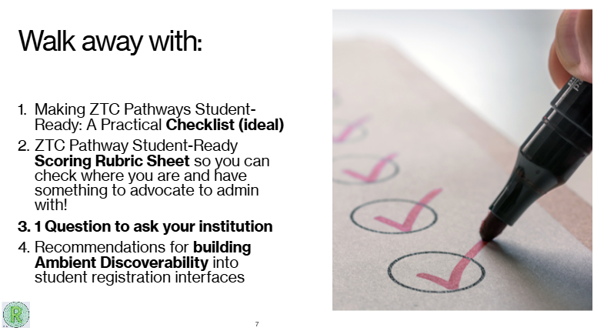
Walk away with:

Slide 8

Let’s drive into the research!

Slide 9
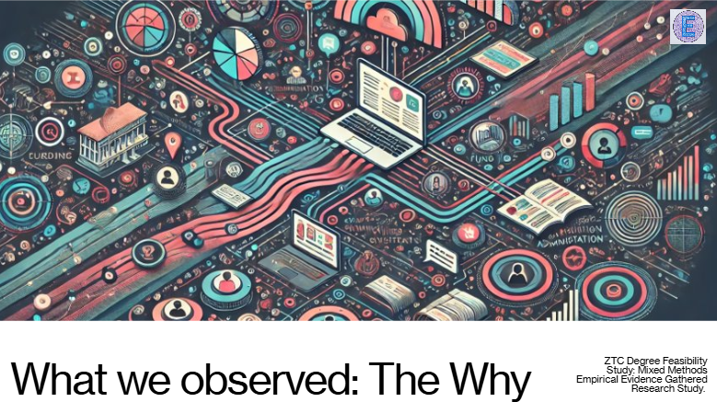
What we observed: The Why

Slide 10
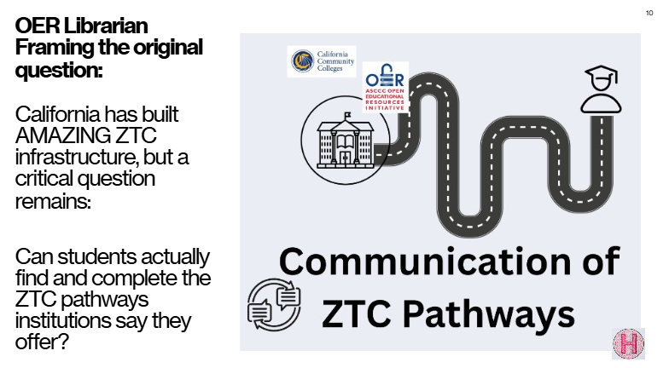
OER Librarian Framing the original question:

Slide 11
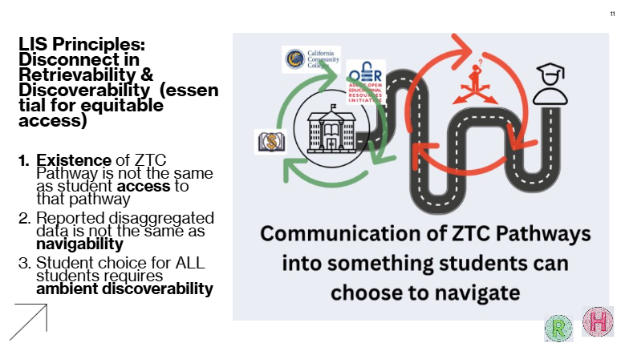
LIS Principles: Disconnect in Retrievability & Discoverability (essential for equitable access)

Slide 12
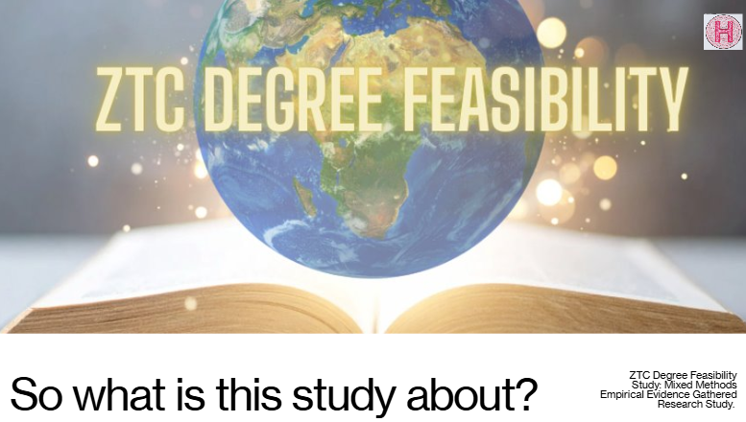
ZTC Degree Feasibility

Slide 13
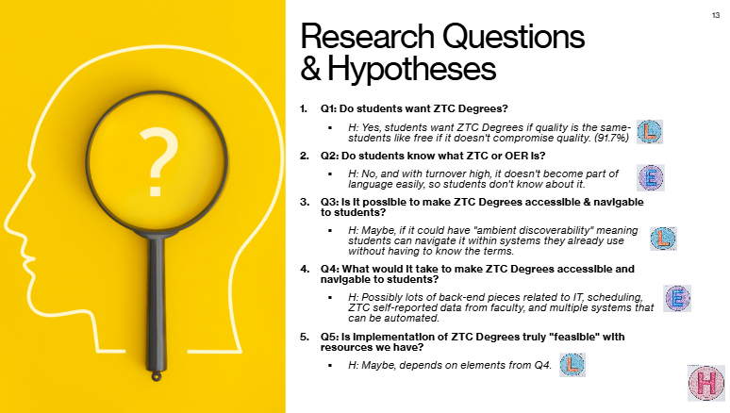
Research Questions and Hypotheses

Slide 14
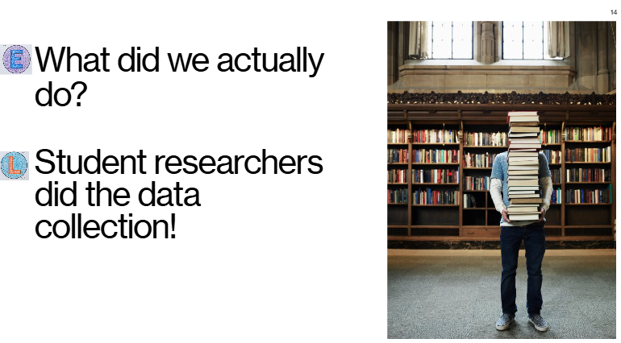
Question Slide

Slide 15
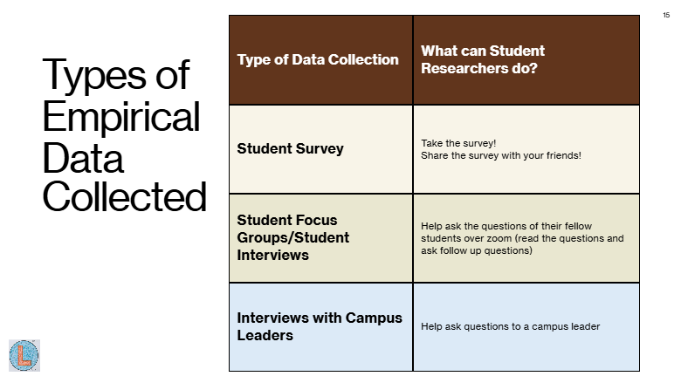
Types of Empirical Data Collected

Slide 16

Key Findings (Preliminary)

Slide 17
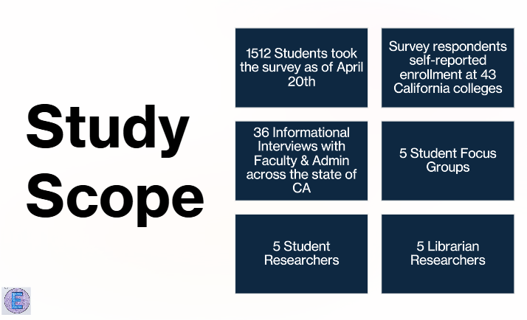
Study Scope

Slide 18
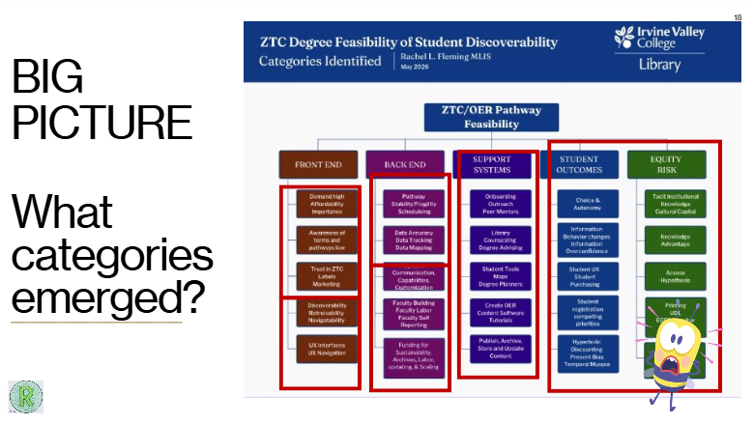
Big Picture: What categories emerged?

Slide 19
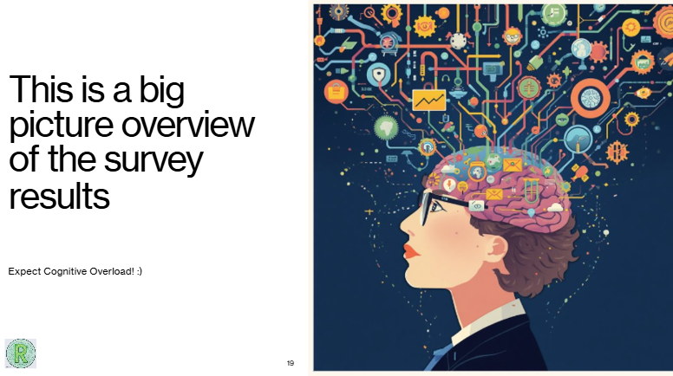
This is a big picture overview of the survey results

Slide 20
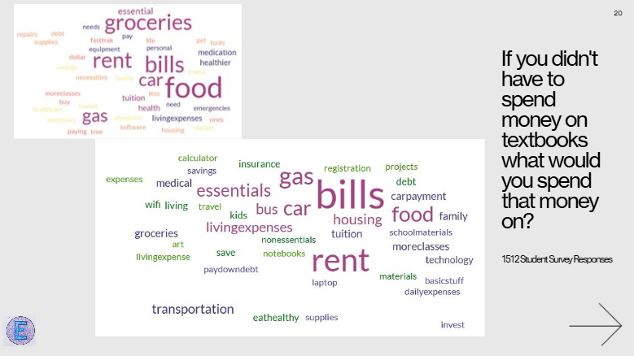
If you didn’t have to spend money on textbooks what would you spend that money on?

Slide 21
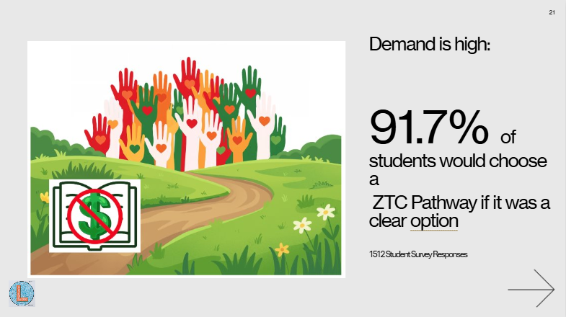
Demand is high:

Slide 22
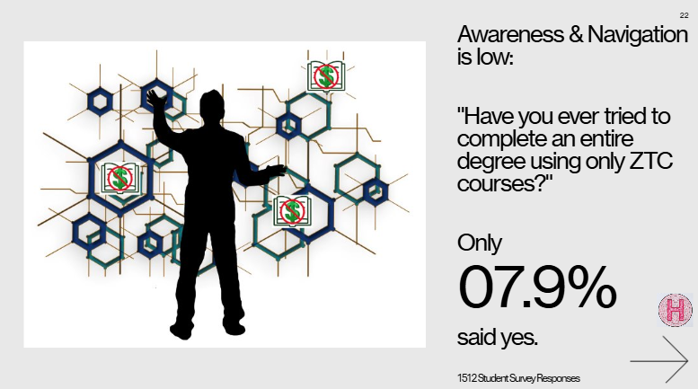
Awareness and Navigation is low:

Slide 23
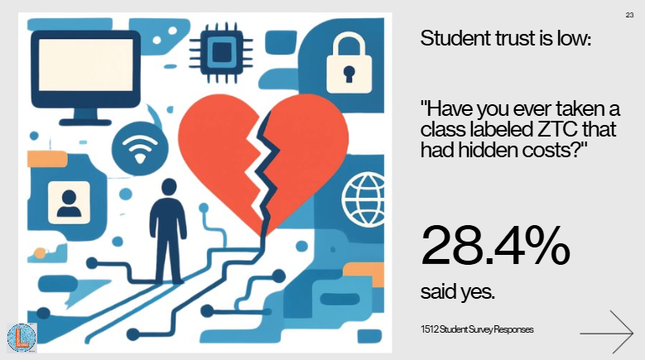
Student trust is low

Slide 24
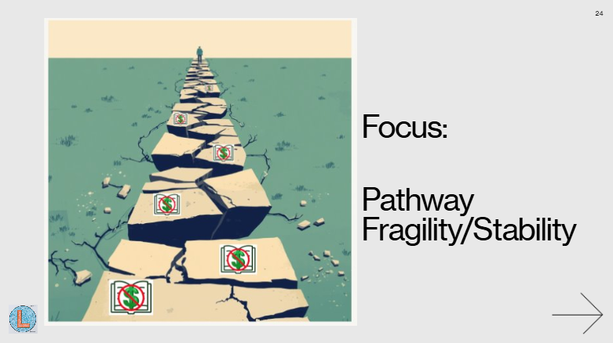
Focus: Pathway Fragility/Stability

Slide 25

Student Trust and Transparency

Slide 26
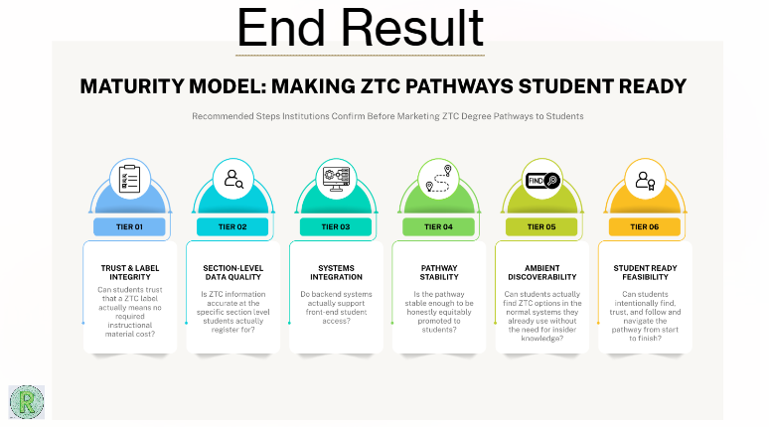
End Results

Slide 27
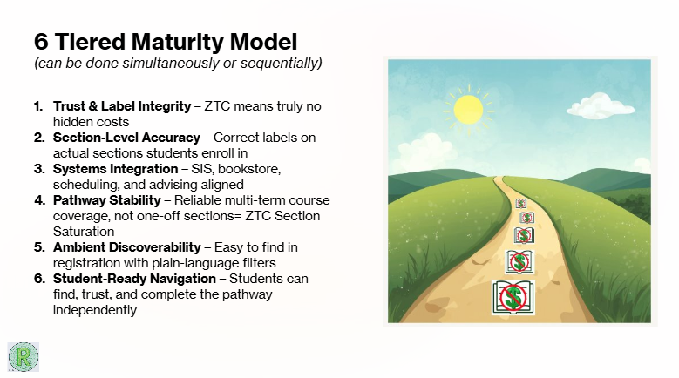
6 Tiered Maturity Model

Slide 28
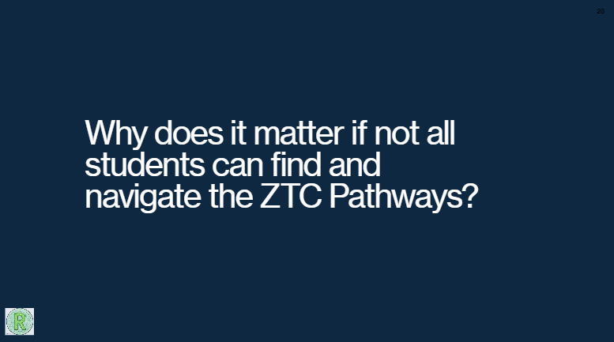
Why does it matter if not all students can find and navigate the ZTC pathways?

Slide 29

Equity Risk

Slide 30
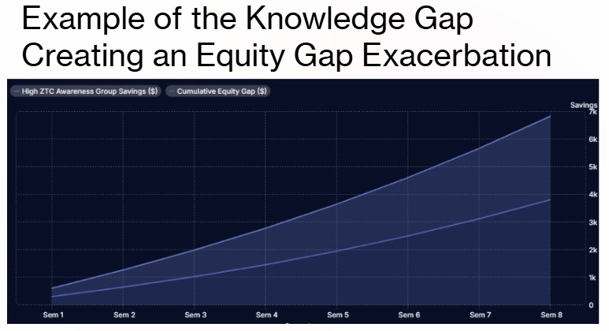
Example of the knowledge gap. Creating an equity gap exacerbation

Slide 31
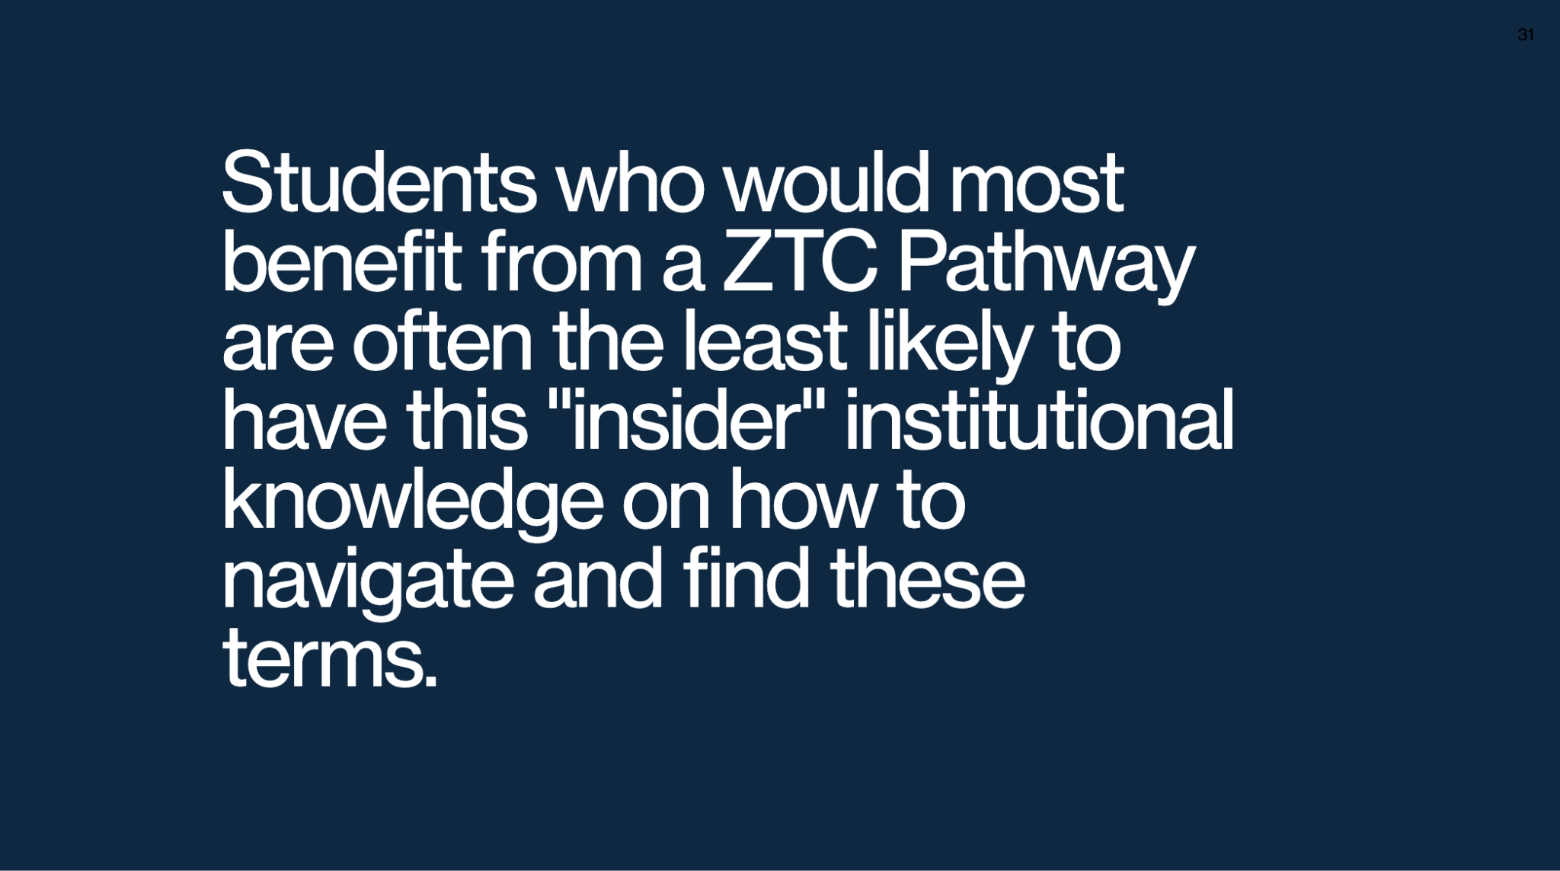
Student quote

Slide 32
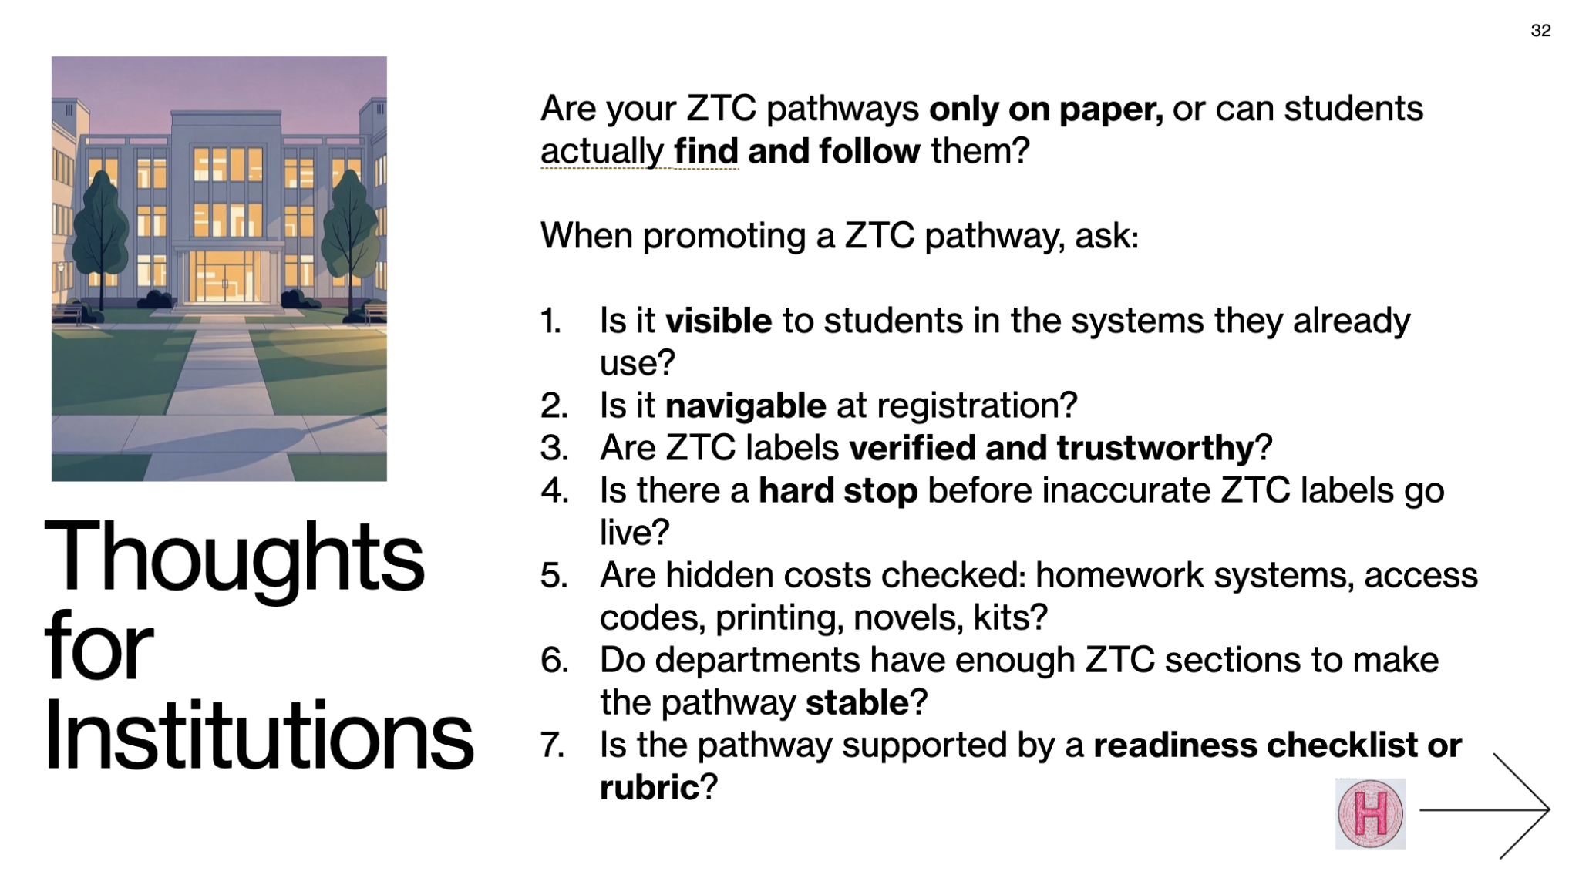
Thoughts for Institutions

Slide 33
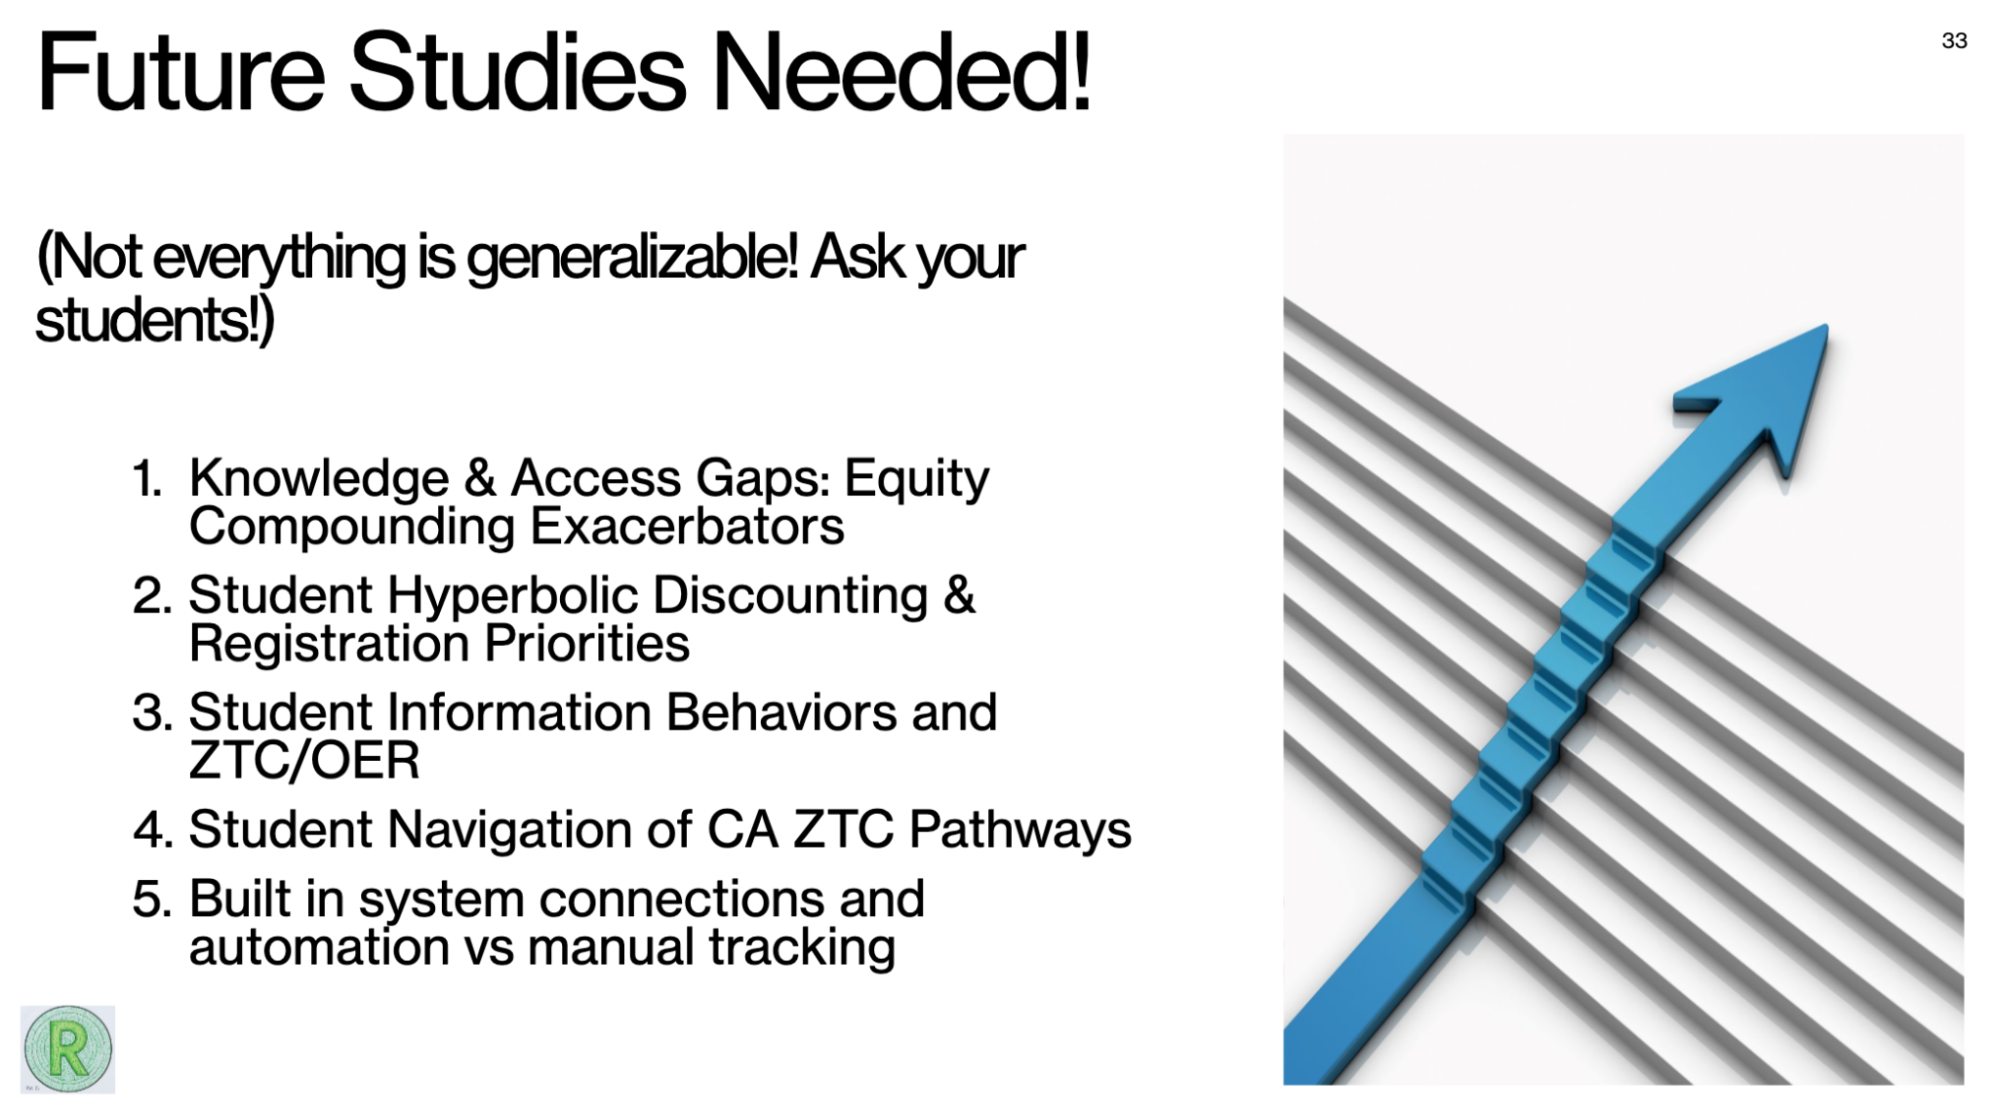
Future Studies Needed!

Slide 34
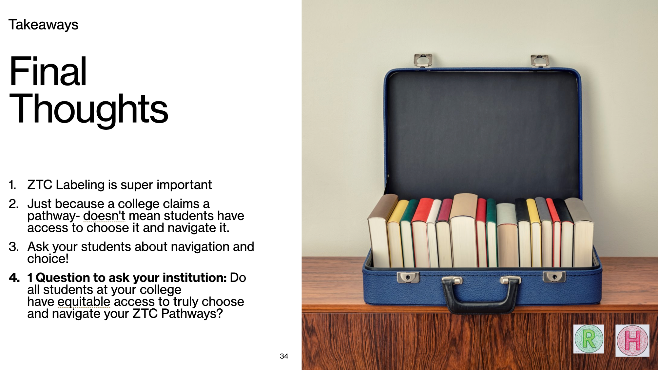
Takeaways: Final Thoughts

Slide 35
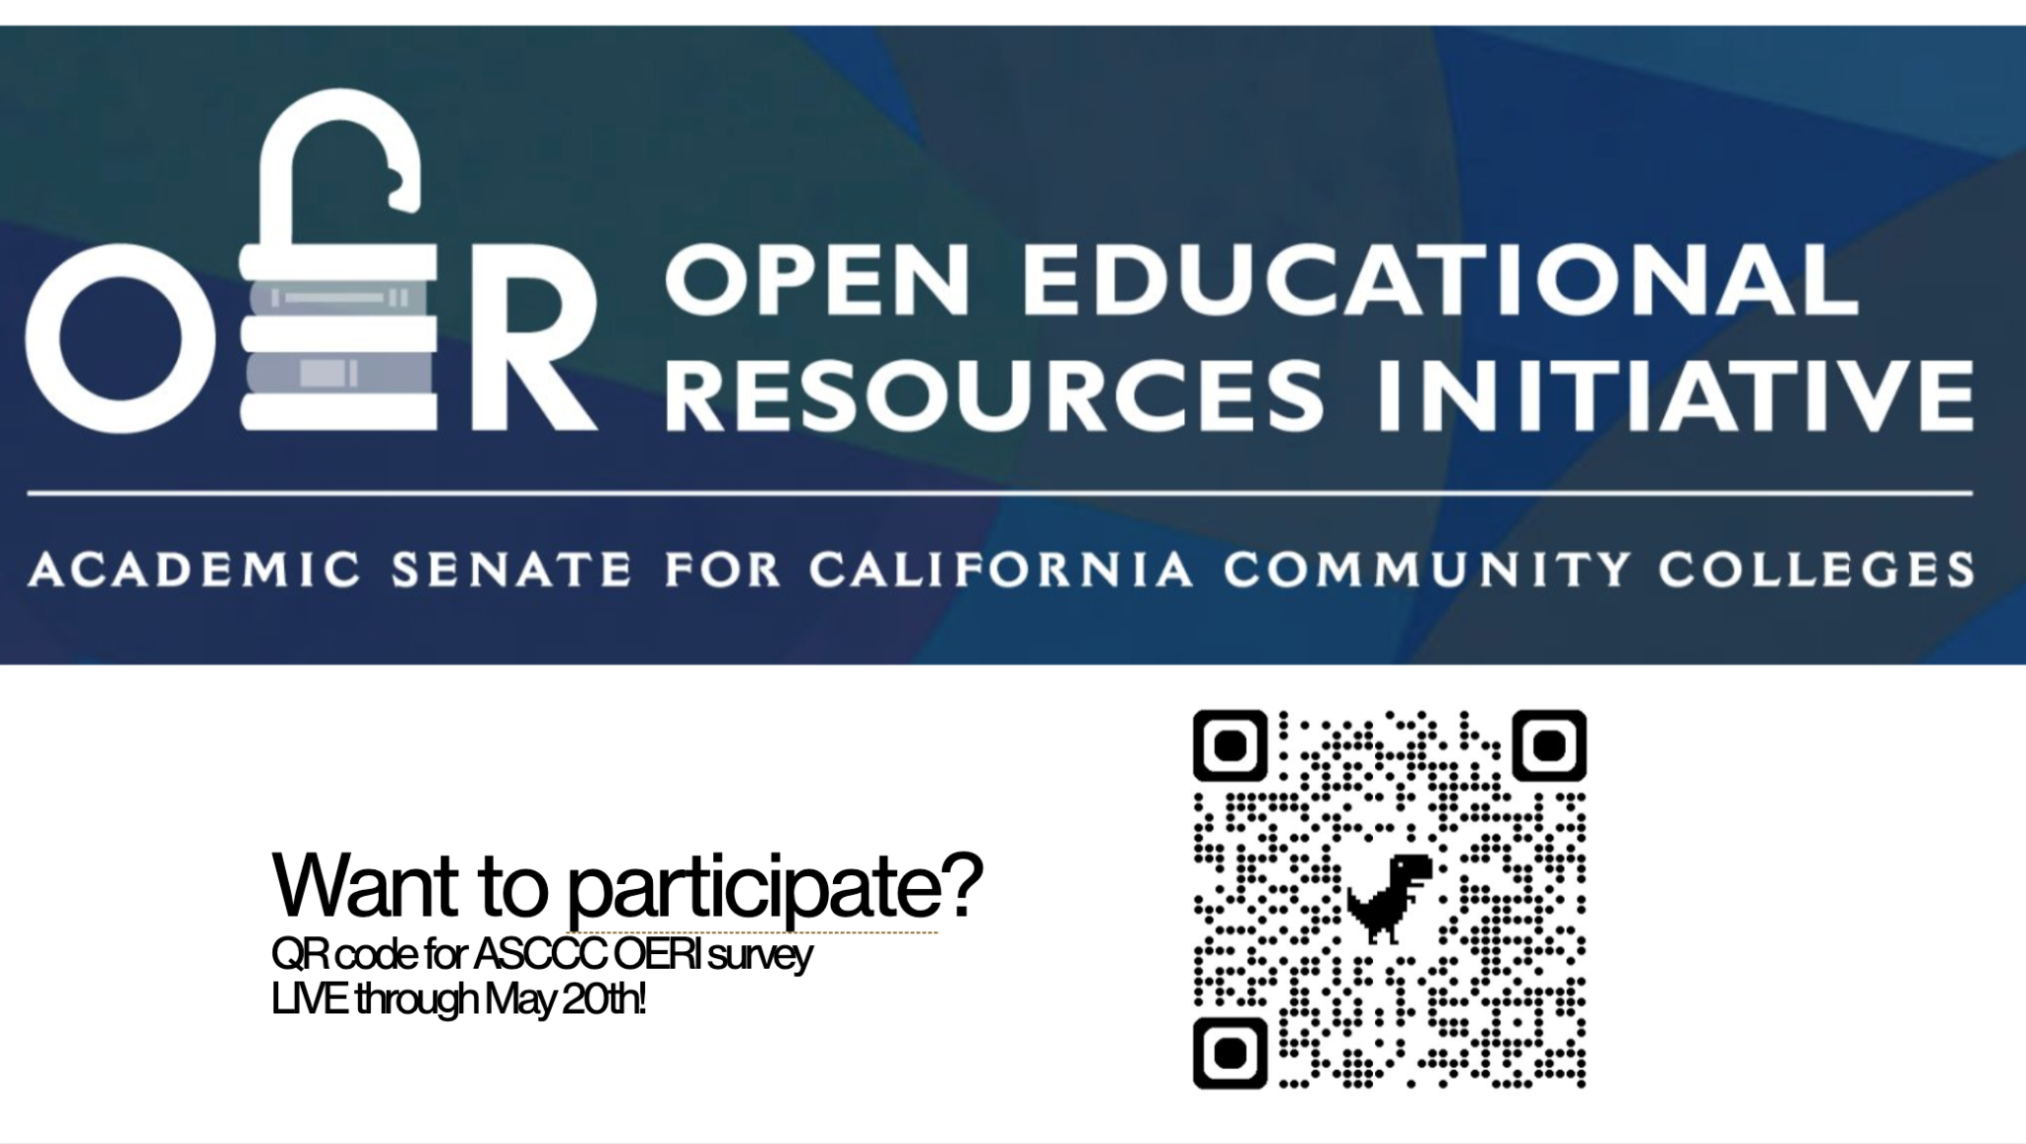
Want to participate?

Slide 36

Q&A and Sharing Maturity Model and Checklist

