Slide 1





Hear It First: Early Findings from the Zero Textbook Cost (ZTC) Degree Feasibility Study
Spark Grant: ZTC Degree Feasibility Study: OERI April 27th Webinar

Slide 2

Welcome & Agenda
What we're going to cover (overview of study)
Who
What
Why
How (Research Questions & Methodology)
Key Findings
Takeaways

Slide 3
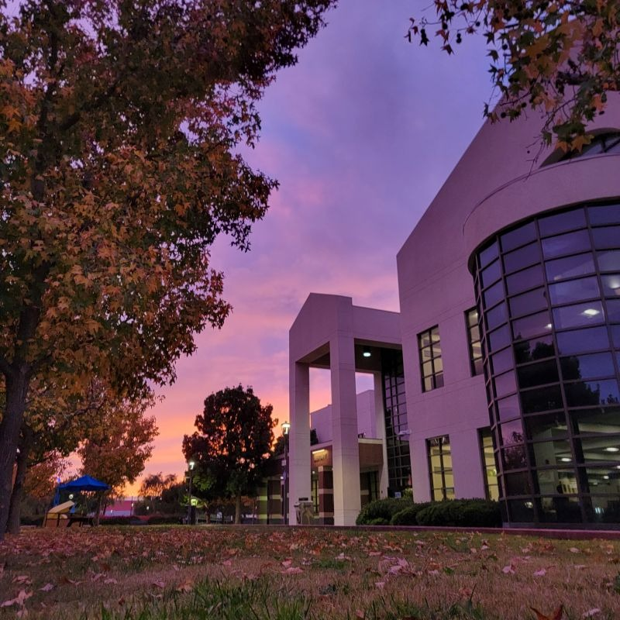
Who is talking?
Student Researchers
  Ofelia (Lia) Veisalov
  Elina Balalina
Librarian Researchers
  Heather Evans, Coalinga College OER Librarian
  Rachel Fleming, IVC, OER Librarian
ASCCC OERI IVC Liaison
  RJ Dolbin, Math Faculty, Curriculum Chair

Slide 4
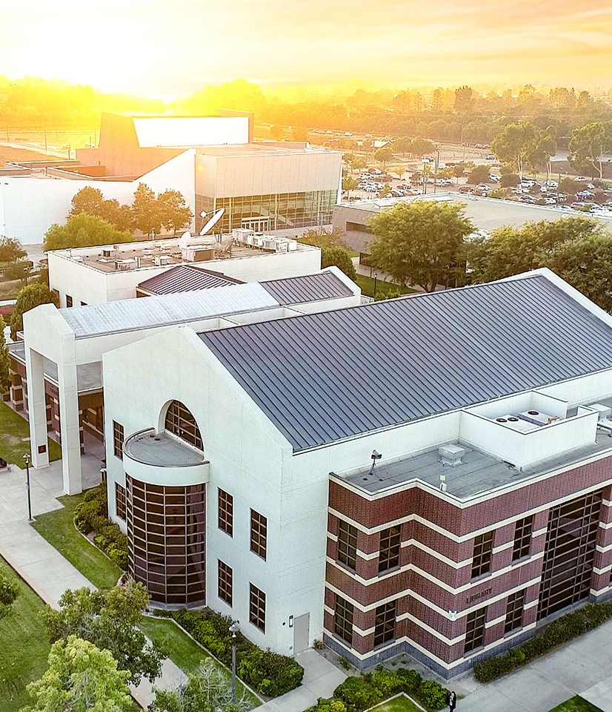

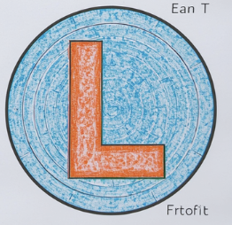
What are we talking about?
$25k to run a mixed-methods ZTC Degree Feasibility Study investigating the gap between institutional implementation and student experience
= empirical data collection through to final paper and presentations!

Slide 5

Start with the
Findings

Slide 6
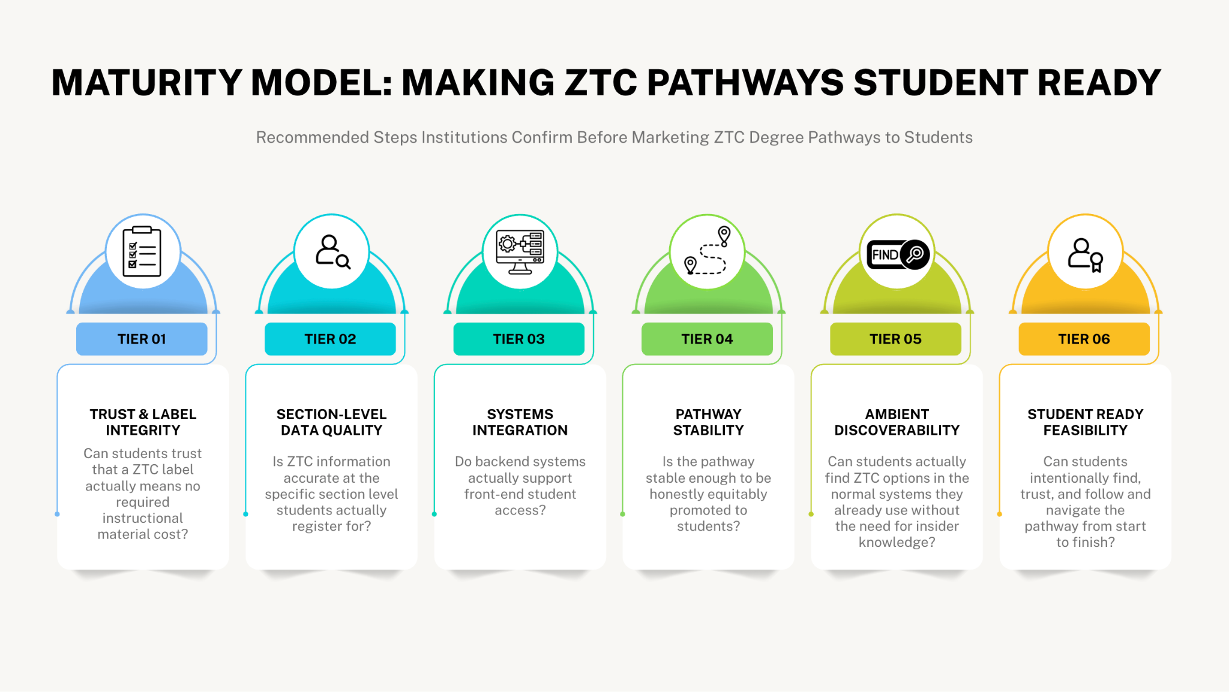

Sneak Peek

Slide 7

Walk away with:
Making ZTC Pathways Student-Ready: A Practical Checklist (ideal)
ZTC Pathway Student-Ready Scoring Rubric Sheet so you can check where you are and have something to advocate to admin with!
1 Question to ask your institution
Recommendations for building Ambient Discoverability into student registration interfaces

Slide 8



Let's dive into the research!
What?
Why?
How?
Lots of data!

Slide 9


What we observed: The Why
ZTC Degree Feasibility Study: Mixed Methods Empirical Evidence Gathered Research Study.

Slide 10
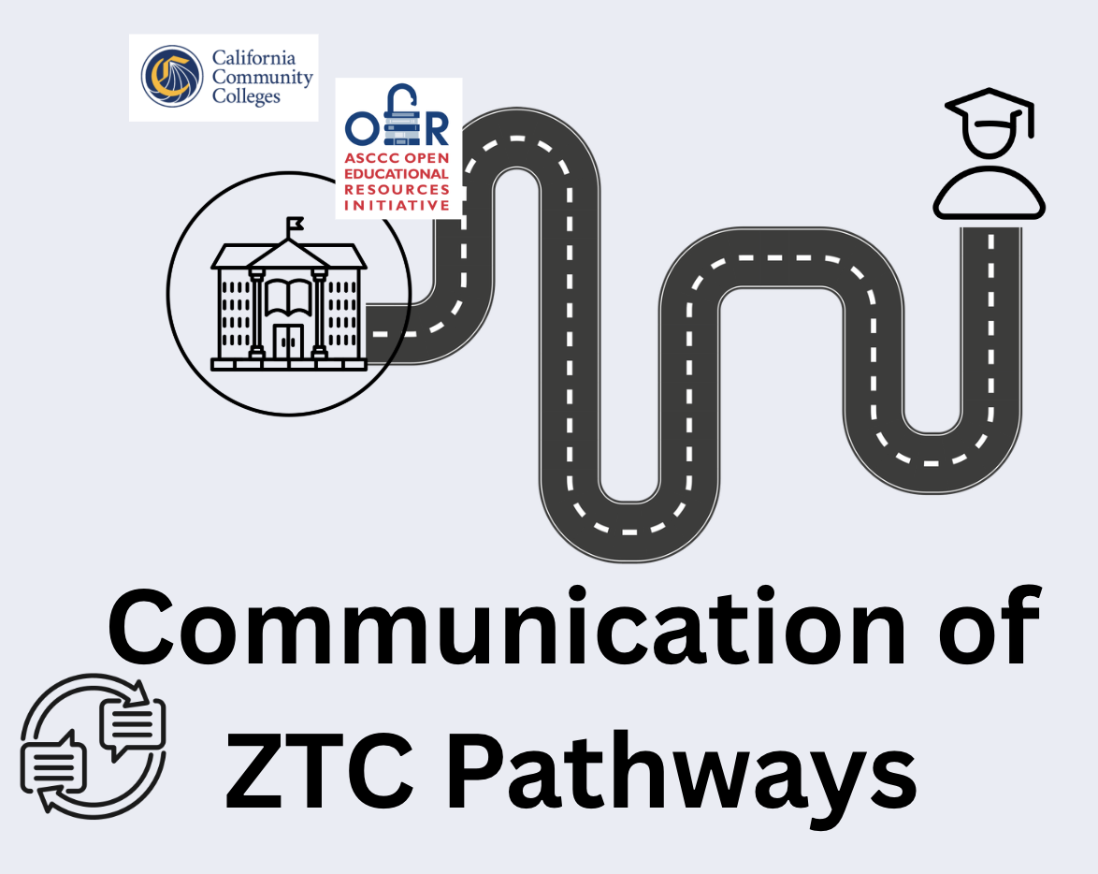

OER Librarian Framing the original question:
California has built AMAZING ZTC infrastructure, but a critical question remains:
Can students actually find and complete the ZTC pathways institutions say they offer?

Slide 11
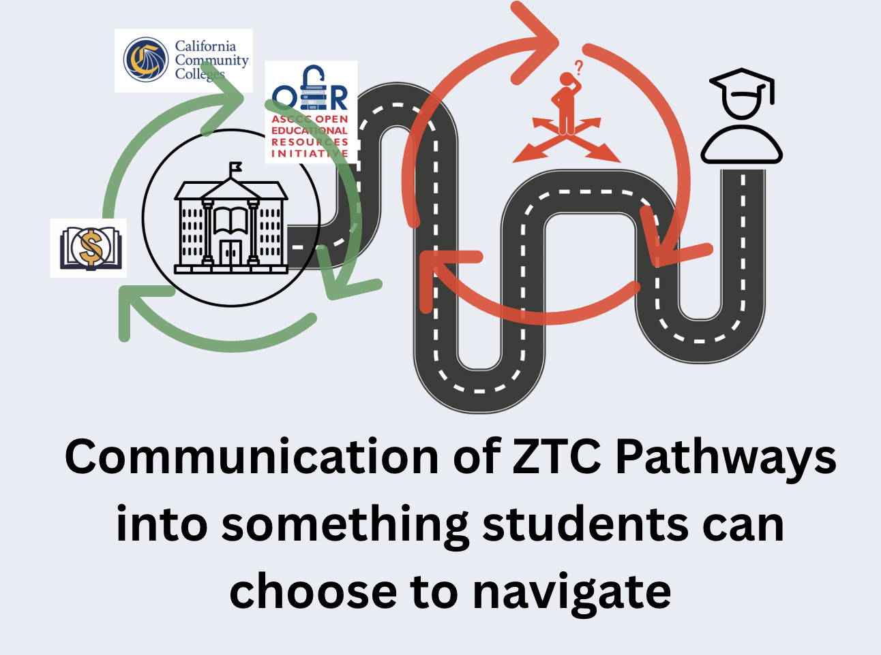

LIS Principles: Disconnect in Retrievability & Discoverability (essential for equitable access)
Existence of ZTC Pathway is not the same as student access to that pathway
Reported disaggregated data is not the same as navigability
Student choice for ALL students requires ambient discoverability

Slide 12

So what is this study about?
ZTC Degree Feasibility Study: Mixed Methods Empirical Evidence Gathered Research Study.

Slide 13

Research Questions & Hypotheses
Q1: Do students want ZTC Degrees?
    H: Yes, students want ZTC Degrees if quality is the same- students like free if it doesn't compromise quality. (91.7%)
Q2: Do students know what ZTC or OER is?
    H: No, and with turnover high, it doesn't become part of language easily, so students don't know about it.
Q3: Is it possible to make ZTC Degrees accessible & navigable to students?
    H: Maybe, if it could have "ambient discoverability" meaning students can navigate it within systems they already use without having to know the terms.
Q4: What would it take to make ZTC Degrees accessible and navigable to students?
    H: Possibly lots of back-end pieces related to IT, scheduling, ZTC self-reported data from faculty, and multiple systems that can be automated.
Q5: Is implementation of ZTC Degrees truly "feasible" with resources we have?
    H: Maybe, depends on elements from Q4.

Slide 14

What did we actually do?
Student researchers did the data collection!

Slide 15
Types of Empirical
Data
Collected
Type of Data Collection | What can Student Researchers do?
Student Survey | Take the survey! Share the survey with your friends!
Student Focus Groups/Student Interviews | Help ask the questions of their fellow students over zoom (read the questions and ask follow up questions)
Interviews with Campus Leaders | Help ask questions to a campus leader

Slide 16

Key Findings (Preliminary)
ZTC Degree Feasibility Study: Mixed Methods Empirical Evidence Gathered Research Study.

Slide 17
Study Scope
1512 Students took the survey as of April 20th
5 Student Focus Groups
5 Student Researchers
36 Informational Interviews with Faculty & Admin across the state of CA
5 Librarian Researchers
Survey respondents self-reported enrollment at 43 California colleges

Slide 18
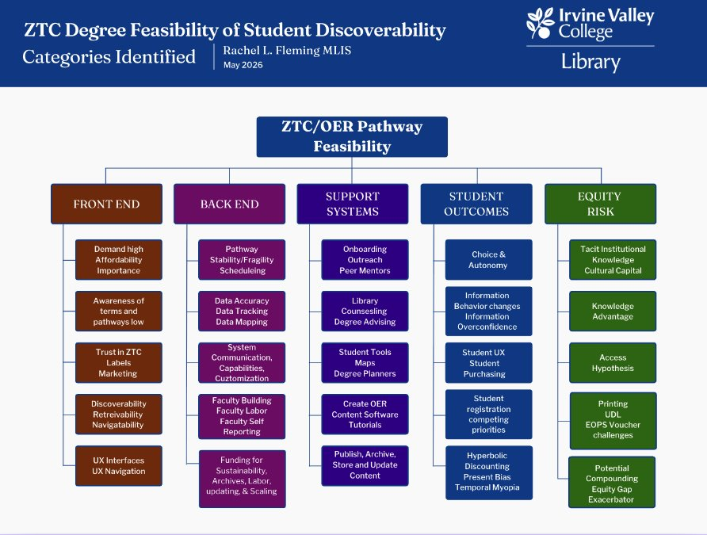

BIG PICTURE
What categories emerged?

Slide 19

This is a big picture overview of the survey results
Expect Cognitive Overload! :)

Slide 20
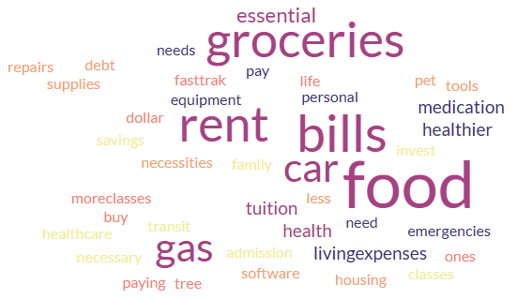
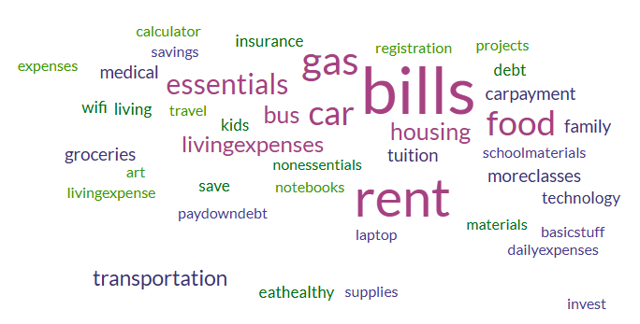
If you didn't have to spend money on textbooks what would you spend that money on?
1512 Student Survey Responses

Slide 21

Demand is high:
91.7% of students would choose a
ZTC Pathway if it was a clear option
1512 Student Survey Responses

Slide 22

Awareness & Navigation is low:
"Have you ever tried to complete an entire degree using only ZTC courses?"
Only
07.9%
said yes.
1512 Student Survey Responses

Slide 23

Student trust is low:
"Have you ever taken a class labeled ZTC that had hidden costs?"
28.4%
said yes.
1512 Student Survey Responses

Slide 24
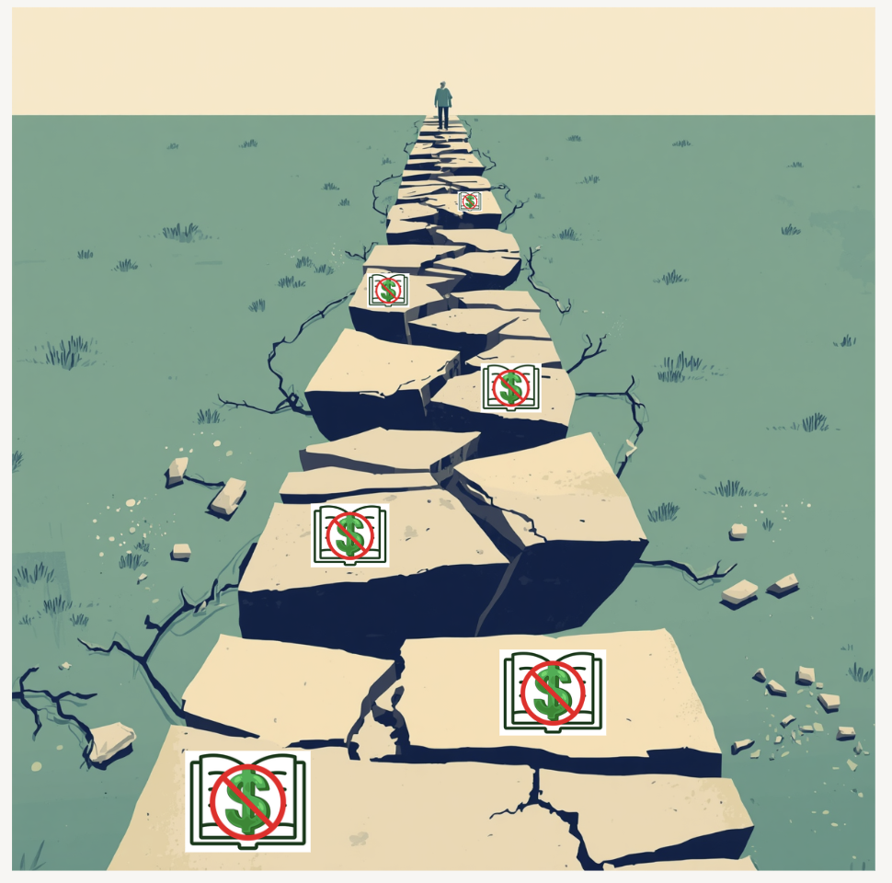
Focus:
Pathway Fragility/Stability

Slide 25

Student Trust
&
Transparency
How do we build stable, trustworthy, student-ready pathways?

Slide 26
End Result

Slide 27

6 Tiered Maturity Model
(can be done simultaneously or sequentially)
Trust & Label Integrity – ZTC means truly no hidden costs
Section-Level Accuracy – Correct labels on actual sections students enroll in
Systems Integration – SIS, bookstore, scheduling, and advising aligned
Pathway Stability – Reliable multi-term course coverage, not one-off sections= ZTC Section Saturation
Ambient Discoverability – Easy to find in registration with plain-language filters
Student-Ready Navigation – Students can find, trust, and complete the pathway independently

Slide 28
Why does it matter if not all students can find and navigate the ZTC Pathways?

Slide 29

Equity Risk
Who Gets to Benefit?
What happens when only students who already know how to “work the system” can find ZTC/OER courses?
Students with insider knowledge save money, plan better, and move ahead.
Students without that knowledge may never know the option exists.
That is not equitable access. That is selective access.

Slide 30
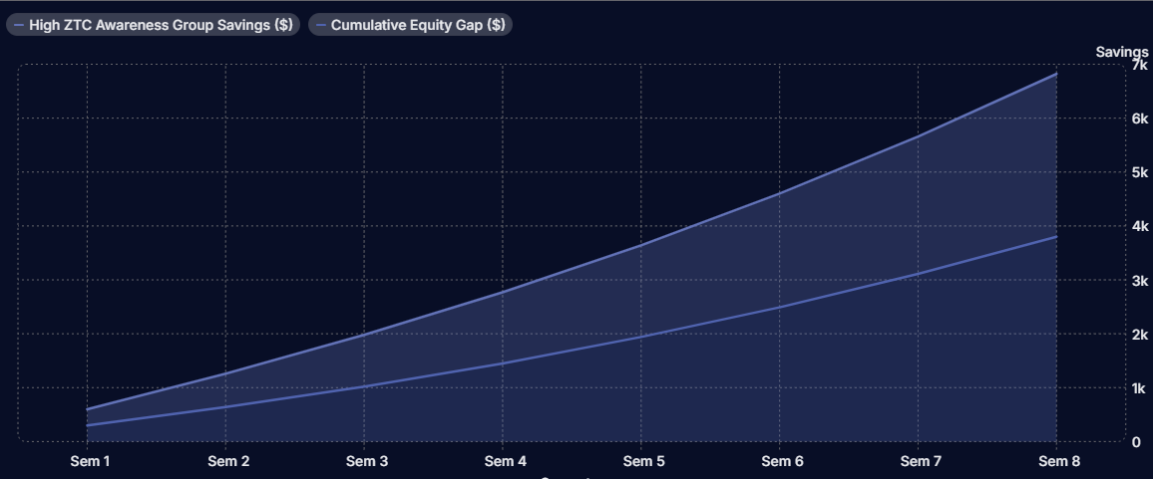
Example of the Knowledge Gap Creating an Equity Gap Exacerbation

Slide 31
Students who would most benefit from a ZTC Pathway are often the least likely to have this "insider" institutional knowledge on how to navigate and find these terms.

Slide 32

Thoughts for Institutions
Are your ZTC pathways only on paper, or can students actually find and follow them?
When promoting a ZTC pathway, ask:
Is it visible to students in the systems they already use?
Is it navigable at registration?
Are ZTC labels verified and trustworthy?
Is there a hard stop before inaccurate ZTC labels go live?
Are hidden costs checked: homework systems, access codes, printing, novels, kits?
Do departments have enough ZTC sections to make the pathway stable?
Is the pathway supported by a readiness checklist or rubric?
Notes:
Just because we have a ZTC Pathway in thedissaggreggated data doesn't mean students can navigateit.
We invite you to ask if a student can't discover andnavigate it, should our colleges be marketing them?
If a pathway is "fragile" or lacks ambient discoverability, thismeans only students with tacit institutional knowledge,cultural capital, or savvy will be able to find these classespotentially creating further equity gaps rather than closingthem.
Do you have a ZTC Label verification process?
Do you have a "hard stop" for ZTC labels with 100% facultyreporting?
Do you have stable department wide commitments to ZTCleading to consistent ZTC courses scheduled?
In Process: ZTC Pathway Readiness Checklist, and ZTCReadiness Rubric.

Slide 33

Future Studies Needed!
(Not everything is generalizable! Ask your students!)
Knowledge & Access Gaps: Equity Compounding Exacerbators
Student Hyperbolic Discounting & Registration Priorities
Student Information Behaviors and ZTC/OER
Student Navigation of CA ZTC Pathways
Built in system connections and automation vs manual tracking

Slide 34

Final Thoughts
ZTC Labeling is super important
Just because a college claims a pathway- doesn't mean students have access to choose it and navigate it.
Ask your students about navigation and choice!
1 Question to ask your institution: Do all students at your college have equitable access to truly choose and navigate your ZTC Pathways?
Takeaways

Slide 35


Want to participate?
QR code for ASCCC OERI survey
LIVE through May 20th!
Notes:
https://asccc-oeri.org/ztc-degree-feasibility-study-student-survey-sharing-request/

Slide 36

Q&A and Sharing Maturity Model & Checklist
Notes:
https://docs.google.com/document/d/1x9jLdwHz62NVIq8hkkzj82Y76pB7FBq5VAzgCNAp1no/edit?tab=t.w8gc41259sus#heading=h.34ktlqc7o4yb

