Slide 1
Enhancing Biology Instruction with Open Educational Resources (OER): Images, Illustrations, and Infographics
OERL Conversation; Monday, May 4, 2:00 pm – 3:00 pm
This work is licensed under a Creative Commons Attribution 4.0 International License.
Notes:
The Open Washington Open Attribution Builder is a handy tool for creating your attributions, if you’d like to indicate how your work should be attributed or if you are using resources that require attribution. https://www.openwa.org/attrib-builder/ Including how your presentation is licensed on your title slide is an effective way of making this clear. OERI resources are most commonly licensed CC BY, allowing others to use and modify them – but requiring that they be properly attributed.

Slide 2
Welcome!
On behalf of the ASCCC OERI, we are pleased to have you here with us.
If you are not already muted, please mute yourself upon arrival.
You’re invited to introduce yourself in the chat – please provide your name, college, discipline/role
Presenter: Luke Blacquiere, Allan Hancock College, ASCCC OERI Discipline Lead Biology

Slide 3
Description
Images, illustrations, and infographics are essential for helping students grasp complex biological processes and structures.
Many instructors who adopt Open Educational Resource (OER) textbooks find that available images, illustrations, and figures are often fewer in number and less detailed than those found in publisher-produced materials.
In this conversation, participants will explore strategies for enhancing their course materials with high-quality, openly licensed figures. We will examine platforms that provide openly licensed biology images, illustrations, and infographics.
Notes:
A description of the presentation is included in the slide deck so that the purpose of the slide deck is established – and to inform anyone viewing the presentation as to what was planned.

Slide 4
Overview
What is OER?
Why adopt OER?
After adopting an OER textbook, what next?
Search for openly licensed figures
Share ideas and strategies
Conclusion
Notes:
An Overview slide should be included that is an outline of the presentation.

Slide 5
What is OER?
OER stands for Open Educational Resources, which are teaching and learning materials that you may freely use and reuse at no cost, and without needing to ask permission.
OER includes a wide variety of teaching and learning materials including: textbooks in online and print formats, interactive learning activities, videos, etc.
ASCCC OERI — OER Basics by ASCCC OERI is licensed under a Creative Commons Attribution 4.0 International License.
Notes:
Although you do not need to ask for permission, there are requirements. We will look at specific requirements shortly.

Slide 6
What is OER? (2)
The terms "open educational resources" and "open content" describe any work that is licensed in a way that gives users permission to engage in the 5 R activities:
Retain: the right to download, duplicate, store, and manage content.
Reuse: the right to use the content in a wide range of ways
Revise: the right to adapt, adjust, modify, or alter the content
Remix: the right to combine the original or revised content with other material to create something new
Redistribute: the right to share copies of the original content, your revisions, or your remixes with others
ASCCC OERI — OER Basics by ASCCC OERI is licensed under a Creative Commons Attribution 4.0 International License.

Slide 7
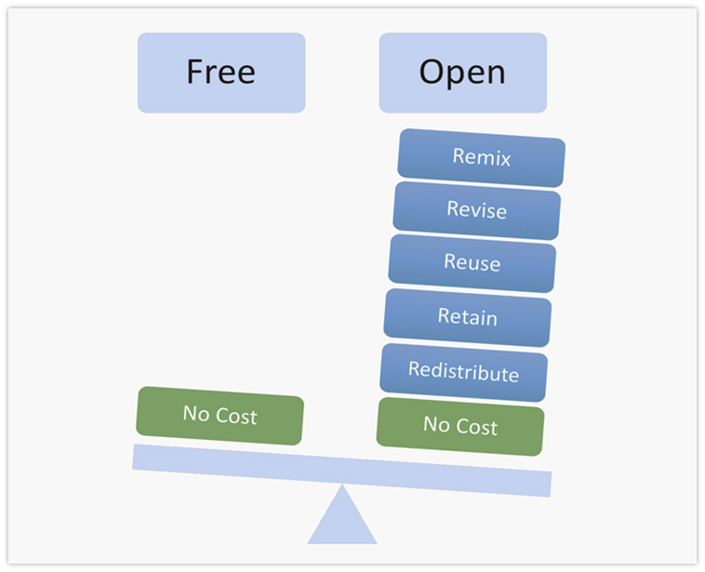
What is OER? (3)
Image by Designers for Learning: Gain Experience for Good, Jennifer Maddrell, Director licensed under CC BY-NC-SA
Notes:
Difference between free and open

Slide 8
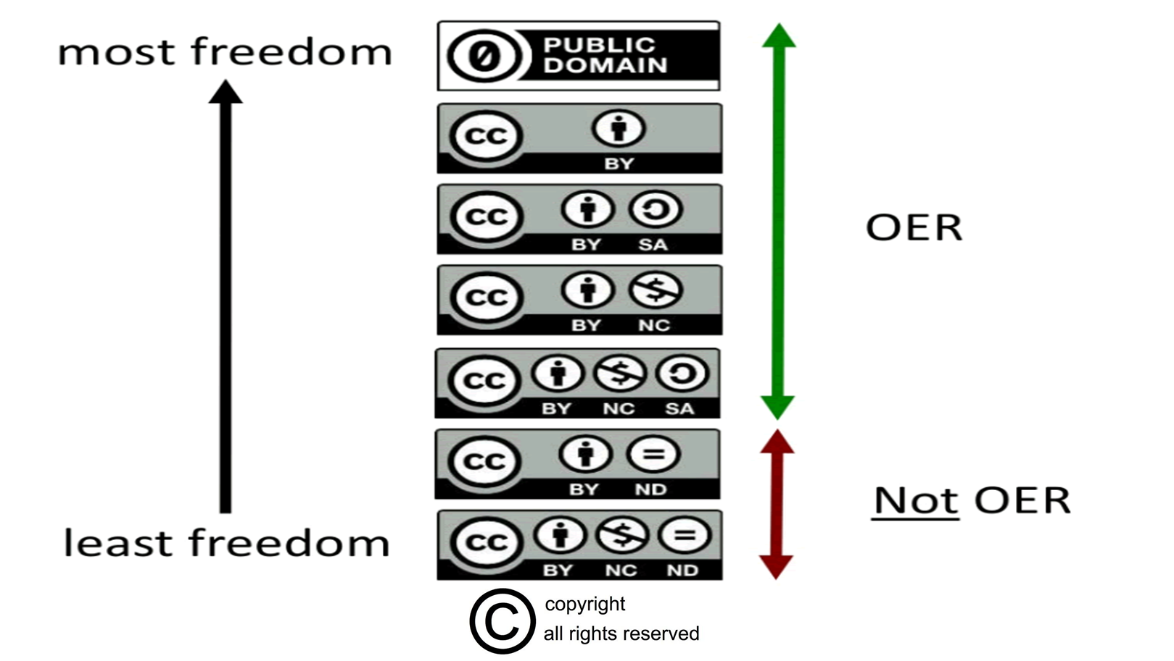
What is OER? (4)
OER Licenses
Creative Commons Licenses by Cable Green licensed under CC BY 4.0 and
All Rights Reserved Sign by All Ygraph.com licensed under CC BY 3.0
Notes:
Creative commons licenses are the most popular for Open Education Resources.
When everyone uses the same license system, it increases understanding of licenses in the OER community. It also make it easier. Similar to the use of the binomial nomenclature system
The final two categories are not considered OER because of the ND tag. ND = No Derivatives. This license does not give the right to revise or remix the work. These are two of the five R’s that are the bar for being Open.
Share your experience with Creative Commons licenses.

Slide 9
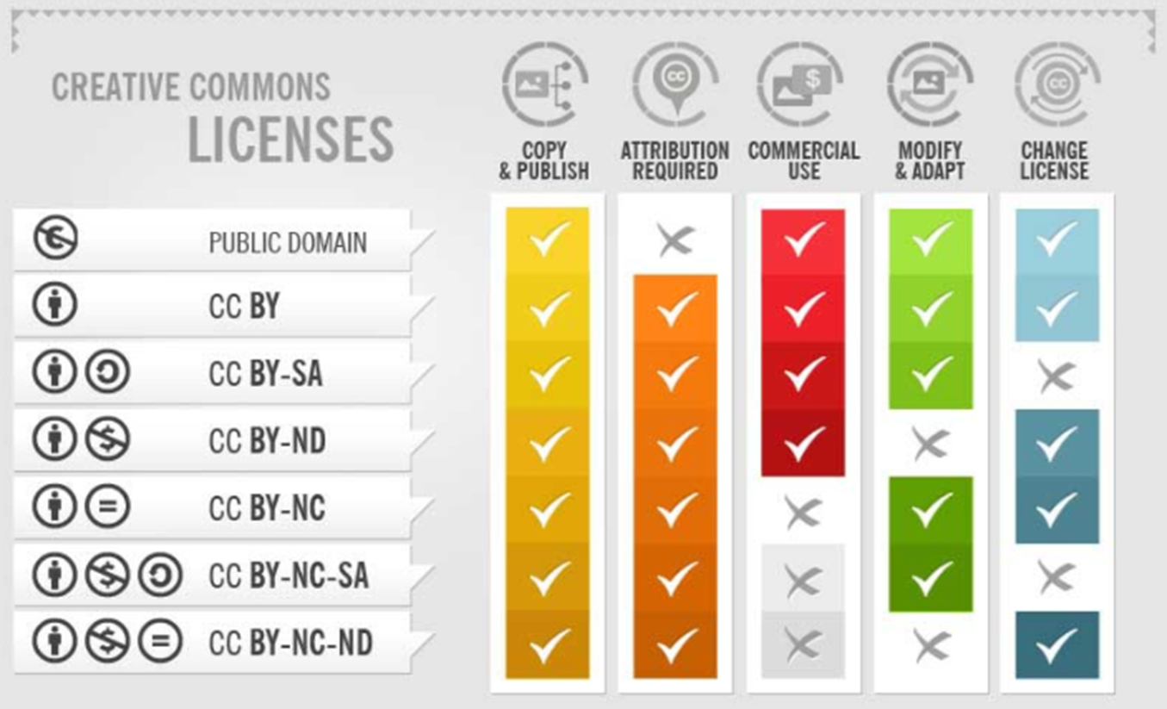
What is OER? (5)
Image is cropped from The Ultimate Guide by Fotor.com licensed CC BY-SA 3.0
Notes:
Both marked ND cannot be modified or adapted so they are not Open.
Copy and paste into chat: https://sarafhawkins.com/creative-commons-licenses-explained-plain-english/

Slide 10
Why OER?
Reasons to use OER.
Affordable — students save money
Flexible — redistribute and reuse content
Customizable — revise and remix
Up-to-date — add the latest research, events, information
Accessible — can be more accessible than print copies
Beneficial to all — knowledge can be freely and widely distributed around the world
Immediately available online — students don't have to wait to gain access to material
This is not a comprehensive list
Adapted from OER Commons & Open Education, licensed under a Creative Commons Attribution-NonCommercial-ShareAlike 4.0 License.
Notes:
Which of these are important to you?
Are there other reasons you use OER?

Slide 11
Why OER? (2)
The worldwide OER movement is rooted in the human right to access high-quality education.
Participation and co-creation are inherent to OER.
Opportunity to adapt content to make it specific to the community
What will education look like in the future?
Adapted from OER Commons & Open Education, licensed under a Creative Commons Attribution-NonCommercial-ShareAlike 4.0 License.
Notes:
OER offers opportunities for systemic change in teaching and learning content through engaging educators in new participatory processes and effective technologies for engaging with learning.
Participatory
Greater access

Slide 12
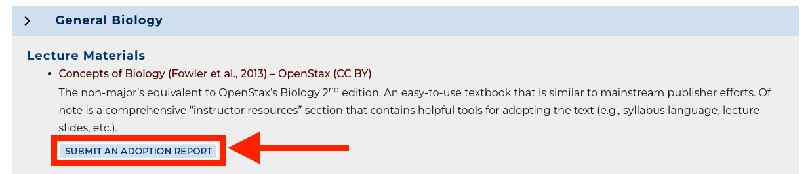
After adopting an OER textbook, what is next?
The ASCCC OERI Biology Discipline Curated Collection is a great resource when you are searching for a textbook or lab manual.
Please submit an adoption report:
When you do adopt and OER textbook or lab manual OR
If you have adopted a OER textbook or lab manual, and forgot to report it.
Example of how to submit and adoption report. from: https://asccc-oeri.org/open-educational-resources-and-biology/

Slide 13
After adopting an OER textbook, what is next? (2)
Many instructors who adopt OER textbooks find that available figures are often fewer in number and less detailed than those found in publisher-produced materials.
This leads us to the “What next?”
How to search for OER materials
Platforms that contain OER materials
What is the evaluation process for adopting OER materials
Notes:
Many instructors who adopt OER textbooks find that available figures are often fewer in number and less detailed than those found in publisher-produced materials.
What is your experience with OER textbook images, illustrations, and infographic?

Slide 14
Discussion
When selecting images, illustrations, and infographics, what is important to you? What is your selection criteria?
Do you have a “go to” place to find OER images, illustrations, and infographics?
What strategies have made your process of finding OER resources easier?

Slide 15
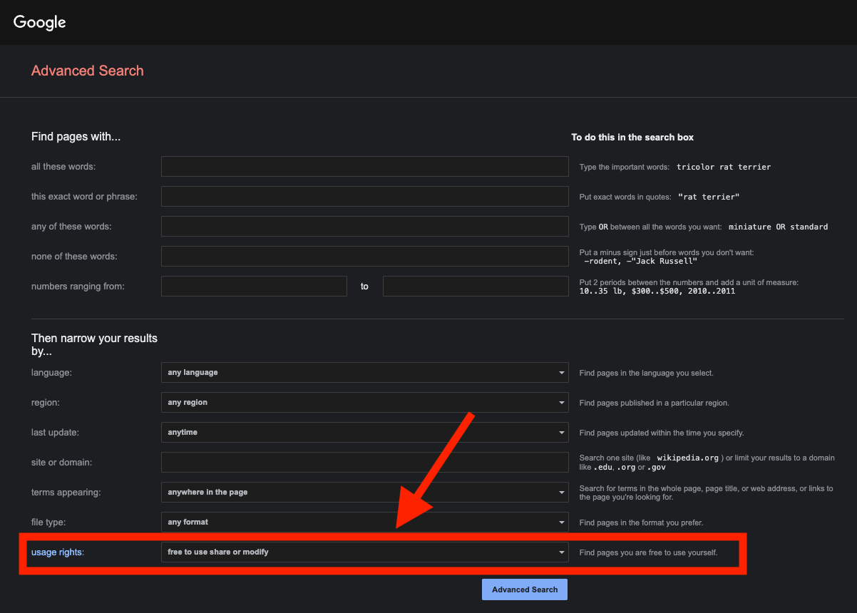
Google Advanced Search
Use Google for your search. Next, select Tools and then Advanced Search to access Google Advanced Search
Google Advanced Search has a field for usage rights allowing you to search for content specifically with open licenses
Screenshot by L. Blacquiere. Google Advanced Search. Captured on April 26, 2026.

Slide 16
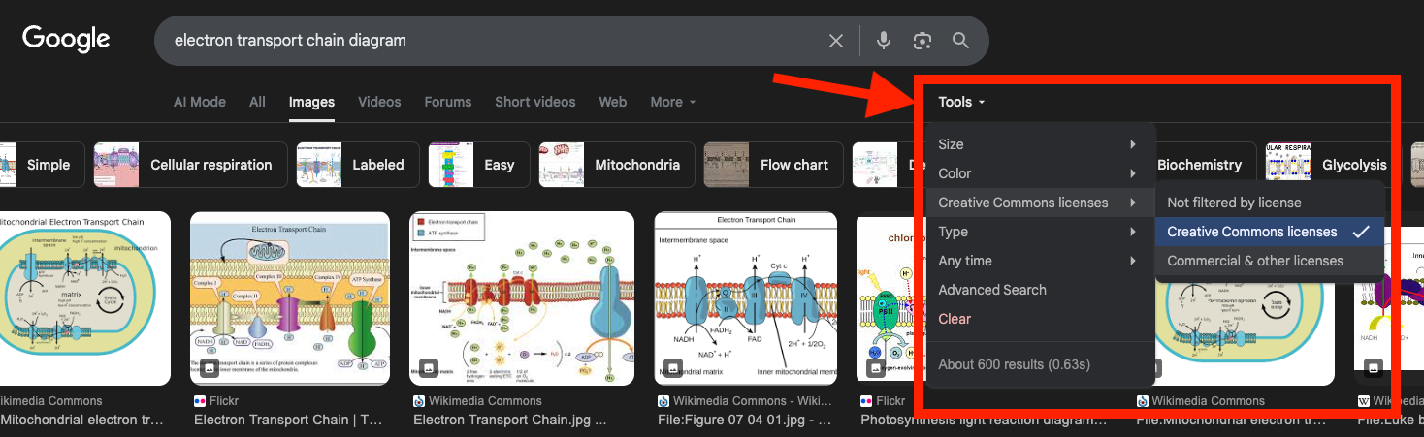
Google Images
To limit Google Image searches to openly licensed content use the Tools menu, select Usage rights and then Creative Commons licenses.
Screenshot by L. Blacquiere. Google Images search Tools menu. Captured on April 26, 2026.

Slide 17
Other Search Options
Image Search
Wikimedia Commons
Pixabay
Openverse
Flickr
Resource Search
OER Commons
Merlot
Check out Creative Commons OER resouces page for more search options

Slide 18
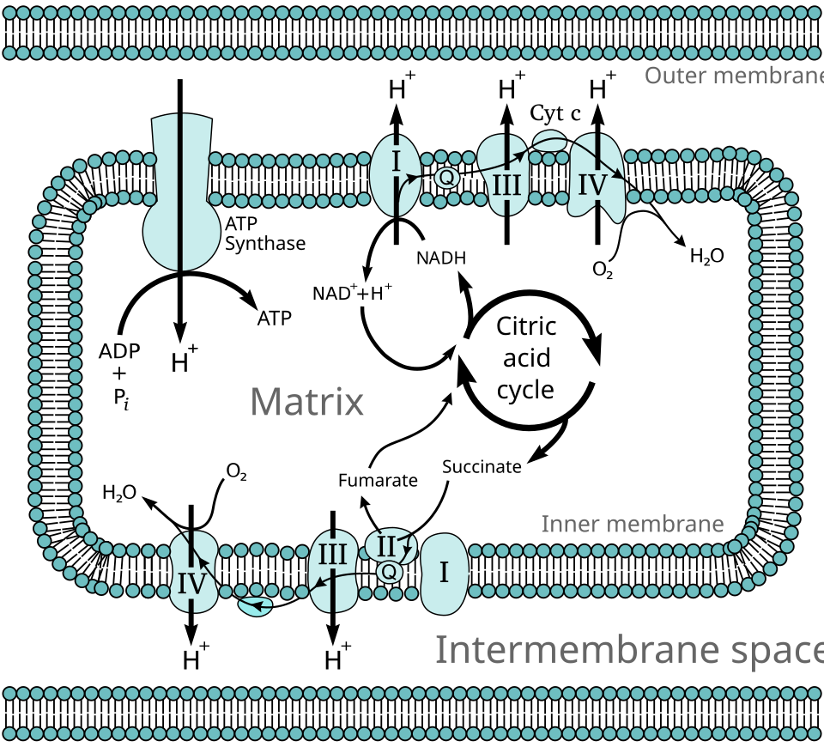
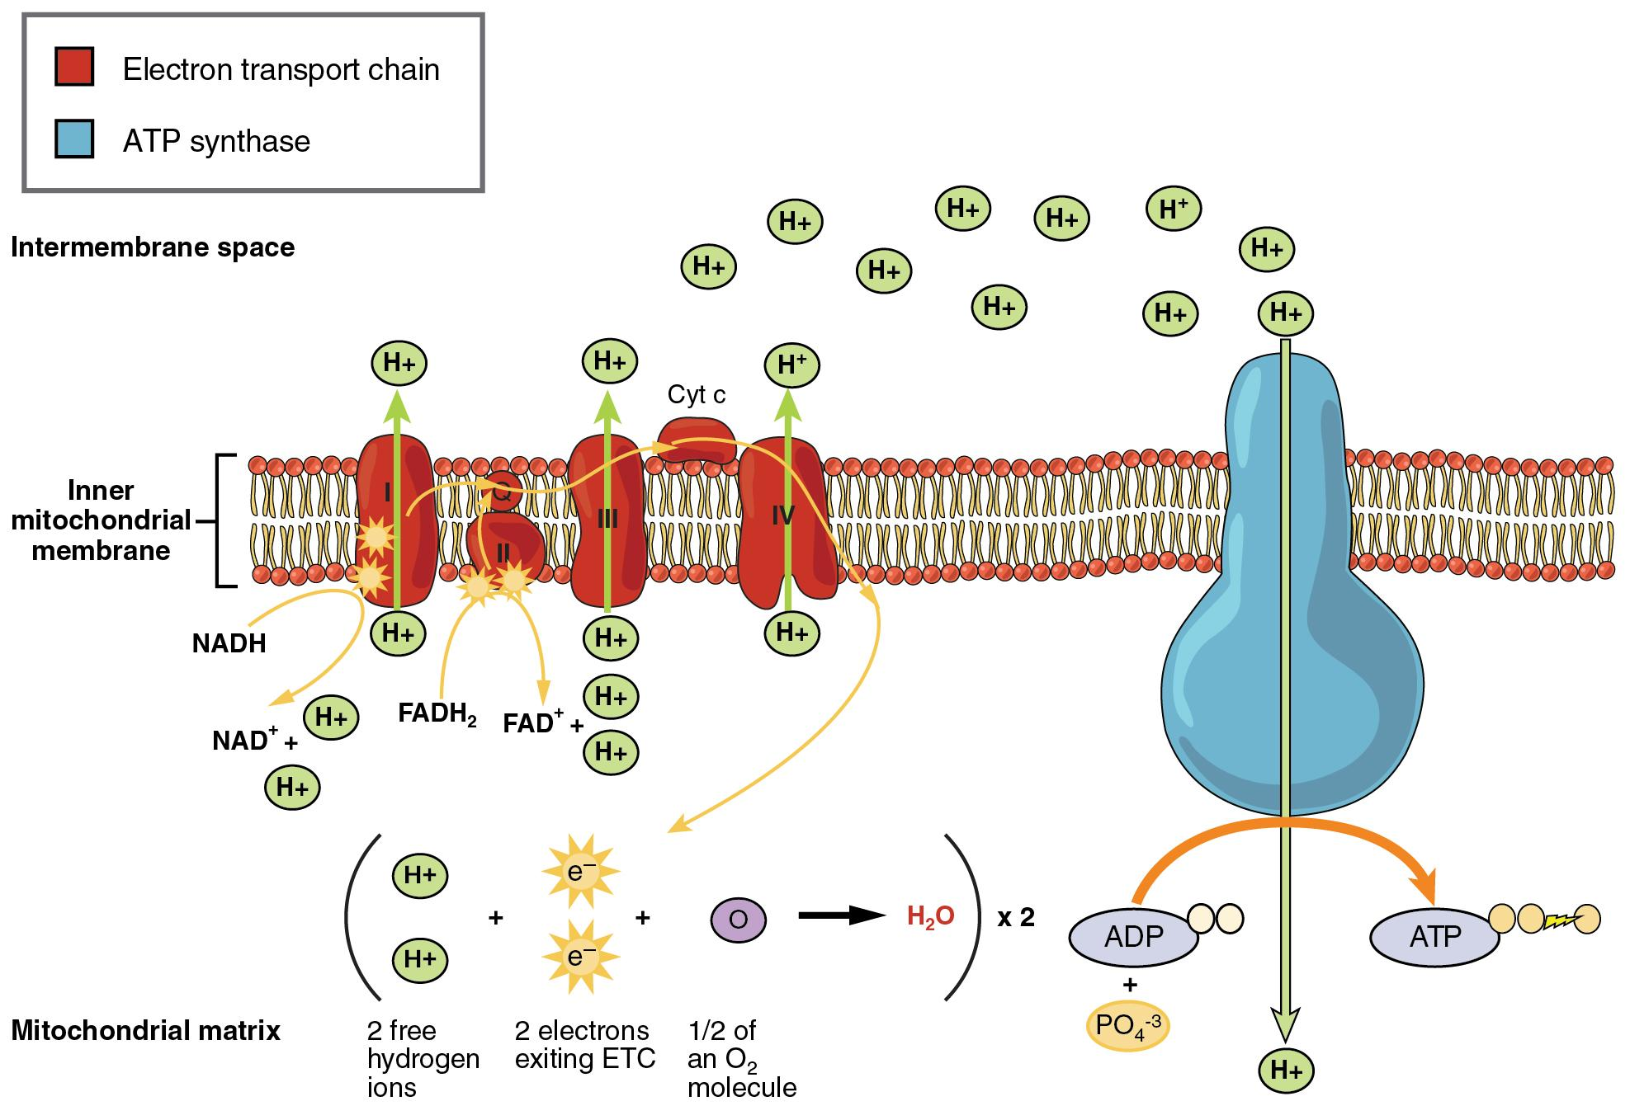
Google Image Search using the search term “electron transport chain”
"Mitochondrial electron transport chain" by Fvasconcellos is in the Public Domain, CC0
The Electron Transport Chain by OpenStax College, CC BY 3.0,

Slide 19
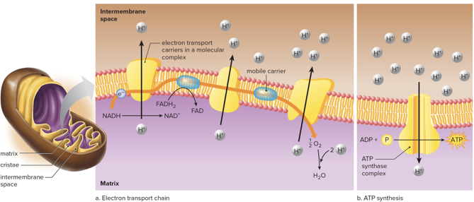
Electron transport chain infographic from a textbook publisher

Slide 20
Accessibility: Alt Text Options
Alt Text Generator in PowerPoint:
Diagram illustrating mitochondrial electron transport chain and ATP synthesis, showing proton movement across inner mitochondrial membrane. Key components include electron transport chain complexes in red, ATP synthase in blue, and labeled molecules like NADH, FADH2, ADP, ATP, and protons, highlighting energy conversion and water formation.
The Electron Transport Chain by OpenStax College, CC BY 3.0,
Alt Text Generator in PowerPoint:
Diagram of electron transport chain illustrating electron flow from NADH and FADH2 through complexes, pumping protons across the inner membrane into the intermembrane space, creating a proton gradient for ATP synthesis.
"Mitochondrial electron transport chain" by Fvasconcellos is in the Public Domain, CC0

Slide 21
Closing matter
OER adoption and development is new to our profession and speaking with other educators helps with growth and feeling supported.
I appreciate your participation in this conversation and I look forward to using what I have learned.
If you have further questions, my email is luke.blacquiere@hancockcollege.edu

