Slide 1
COOL4Ed: The Good, the Bad, and the Ugly
This presentation last modified May 8, 2026.
This work is licensed under a Creative Commons Attribution 4.0 International License.
Attribute this slide deck as: “COOL4Ed: The Good, the Bad and the Ugly” by ASCCC OERI is licensed under CC BY 4.0.

Slide 2
Event Description
As of April 15, 2026, over 110 submissions have been made to the COOL4Ed portal, the legislatively required place to share new open educational resources (OER) funded by the Zero Textbook Cost (ZTC) Degree Grant Program. An analysis of the initial submissions revealed the need for guidance related to how and what to submit to COOL4Ed, as well as the necessity of a place for the sharing of non-OER ZTC resources. The analysis also uncovered new OER that fill previously unmet needs, new ancillaries for commonly adopted OER, and effective practices that need to be incorporated into future COOL4Ed guidance. Join us to explore the good, the bad, and the ugly, discuss proposed guidance to address many of the issues, and to ask your COOL4Ed questions.

Slide 3
Presenters
Michelle Pilati, Psychology, Rio Hondo College
  OERI Project Director

Slide 4
Overview
About COOL4Ed
COOL4Ed Submissions
The Good
The Bad
The Ugly
Solutions

Slide 5
Why COOL4Ed?
ZTC legislation requires that OER created with ZTC funds be shared via COOL4Ed.
Modifications were made to COOL4Ed to address the needs of the colleges – and to, ideally, make adding to COOL4ED and finding resources easier.

Slide 6
Modifications to the ZTC Portal
Addition of a field to track:
  which resources were funded with ZTC funds.
  C-ID designations and Cal-GETC areas.
Both a non-CTE (Other) and a CTE (CTE) discipline category added.
Limited options for the types of resources that can be included as a means of promoting accessibility. PDF, for example, is not permitted.
Limited options for the types of licenses that can be selected.
The portal has been designed to allow resources that were developed through cross-college collaborations to be submitted by one college and also identified as a product of the other participating college or colleges.
A process for sharing OER that are only available to faculty users (e.g., assessments).

Slide 7
Other than new or adapted OER, what has been submitted?
OER adopted without modification (e.g., links to resources on the OpenStax website)
Library resources

Slide 8
Submissions to Date (137)
Canvas Resources – 76
  “Complete Courses” – 69
  Lab Manual – 1
  Module – 1
  Text - 5
LibreTexts – 30
  Text – 26
  Other - 4
Pressbooks – 1 (Health and Social Justice)
OER Commons – 8
College Website – 6
Other - 16

Slide 9
Important Submission Notes
Library resources have been removed.
COOL4Ed submissions are organized by course, not by resource. If a resource is used for more than one course, it will appear multiple times.
  Biotechnology (4)
  Music – Essential Theory Toolbox (Two resources X 4)
If multiple resources are used for one course, those resources should be submitted once – with the target course.
College websites and Canvas have been used to submit PDFs.
Notes:
Essential Theory and Musicianship Toolbox: Guide X 4
Essential Theory and Musicianship Toolbox: Documents X 4
Biotechnology X 4

Slide 10
The Good (Hopefully)
New OER texts for a variety of courses.
  ECE/CDEV
  English
  ESL
  HVAC
New ancillaries for commonly adopted OER texts.

Slide 11
The Bad
Canvas submissions often do not include sufficient information to quickly determine:
  what text, if any, is used.
  what ancillaries are provided.
Accessibility issues are often immediately evident.
The requirement to use CC BY appears to be commonly ignored.
Adoptions and minor adaptations commonly submitted.
Attributions are missing – or they are simply links (that may or may not work).

Slide 12
The Ugly
You may need an account with OpenStax to access the book.
Enrolling in the course XXX will provide full access to all materials or the content can be obtained directly from XXX. (link takes user to a site to buy the full text)
You do not need to purchase any textbooks for this class. We will be using free OER material, which I will provide links to as needed.

Slide 13
Adoptions and Minor Adaptations
Minor modifications of existing OER should generally not be added to COOL4Ed. If more than 30–50% of the content (by volume or pedagogical impact) is new, restructured, or substantially changed, it is reasonable to consider it a new resource rather than a minor adaptation.
OER that are adapted or remixed with minor changes should be reported to the OERI with an overview of the changes made. Such resources will be made available by the OERI and the OERI will report this information to the CCCCO.
Access the OER Project Update Submission Form
If a bulk upload process is desired and/or you are uncertain as to whether to include your OER in COOL4Ed or via the process referenced here, please contact the OERI for assistance (oeri@asccc.org).
Sharing a modified OER with the OERI will fulfill the reporting requirement for such resources.
Notes:
Submission form link - https://iris24742.softr.app/project-update

Slide 14
CCC Consortium Commons
Canvas – and Canvas Commons – are not secure environments.
If you submit to the California Community Colleges Consortium Commons – as opposed to the larger Commons, fewer people will have access to your resources.
If you are submitting anything that should not be available to all users, be sure to use this CCC Consortium Commons to limit access.

Slide 15
How to Share Ancillaries for LibreTexts
Ancillary materials (e.g., instructor resources, test banks) can be uploaded and managed within your Conductor project for the book.
Step 1: Navigate to Assets
  Open your Conductor project.
  Scroll to the bottom of the page to locate the Assets section.
Step 2: Create a Folder
  Select add a new folder.
Step 3: Upload Files
  Upload your ancillary files into the appropriate folder.
  Files can be added at any time and reorganized as needed.

Slide 16
LibreTexts Assets Access Options
All Conductor Users
Visible to anyone with a Conductor account.
Project Team Members
  Only visible to collaborators on your project.
  Best for materials still in development.
Verified Instructors
  Visible in Commons but only accessible to verified instructors.
  Recommended for most ancillaries.(Often indicated by a graduation cap icon.)

Slide 17
Attributions
Even the most open type of Creative Commons license (CC BY) requires attribution.
Washington Open Attribution Builder makes it easy to create an attribution. Creates your attribution as text and as HTML
"My Resource" by Me, CCCCO ZTC is licensed under CC BY 4.0

Slide 18
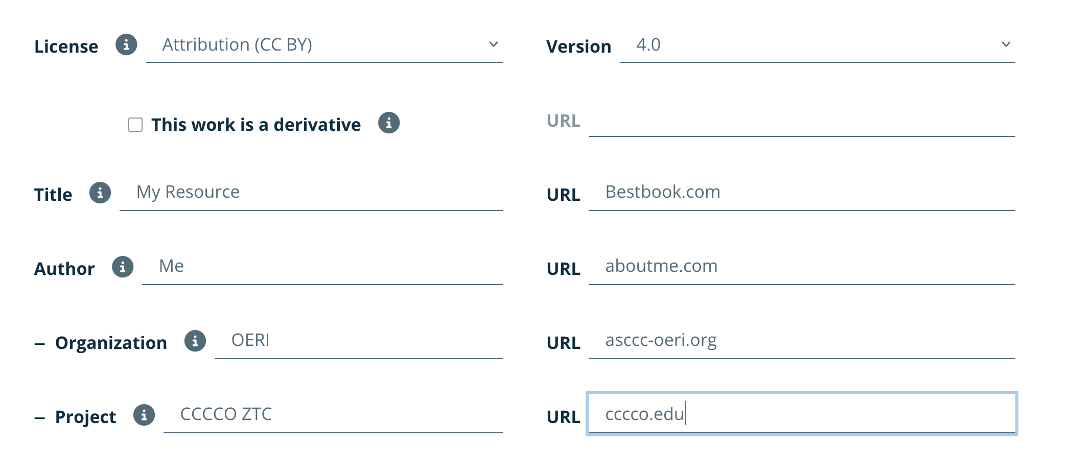
Washington Open Attribution Builder

