Slide 1
ASCCC OERI Presentation Template
Developed May 18, 2022
This work is licensed under a Creative Commons Attribution 4.0 International License.
Notes:
The Open Washington Open Attribution Builder is a handy tool for creating your attributions, if you’d like to indicate how your work should be attributed or if you are using resources that require attribution. https://www.openwa.org/attrib-builder/ Including how your presentation is licensed on your title slide is an effective way of making this clear. OERI resources are most commonly licensed CC BY, allowing others to use and modify them – but requiring that they be properly attributed.

Slide 2
Welcome!
On behalf of the ASCCC OERI, we are pleased to have you here with us for “Let’s Talk about Developing Journalism OER Resources for Publication Classes.”
If you are not already muted, please mute yourself upon arrival.
Please note that you are encouraged to use the Zoom “chat” feature for questions and comments.
You’re invited to introduce yourself in the chat – please provide your name, college, discipline/role
This event will be recorded. Archives of all ASCCC OERI events are available at asccc-oeri.org > Webinars and Events

Slide 3
Let’s Talk about Developing Journalism Open Educational Resources (OER) for Publication Classes
Presentation and Discussion, Wednesday, April 29, 2026 at 11 a.m.
Creative Commons license (recommended - This work is licensed under a Creative Commons Attribution 4.0 International License.)

Slide 4
Description
Your journalism program likely produces a publication, but do you have the necessary curriculum and educational resources to support it? And are those resources free to students? In this conversation, we will share a list of existing journalism OER and explore what resources we may need to create that are relevant, free, and accessible. Bring your suggestions and challenges and together we can find the answers.
Notes:
A description of the presentation is included in the slide deck so that the purpose of the slide deck is established – and to inform anyone viewing the presentation as to what was planned.

Slide 5
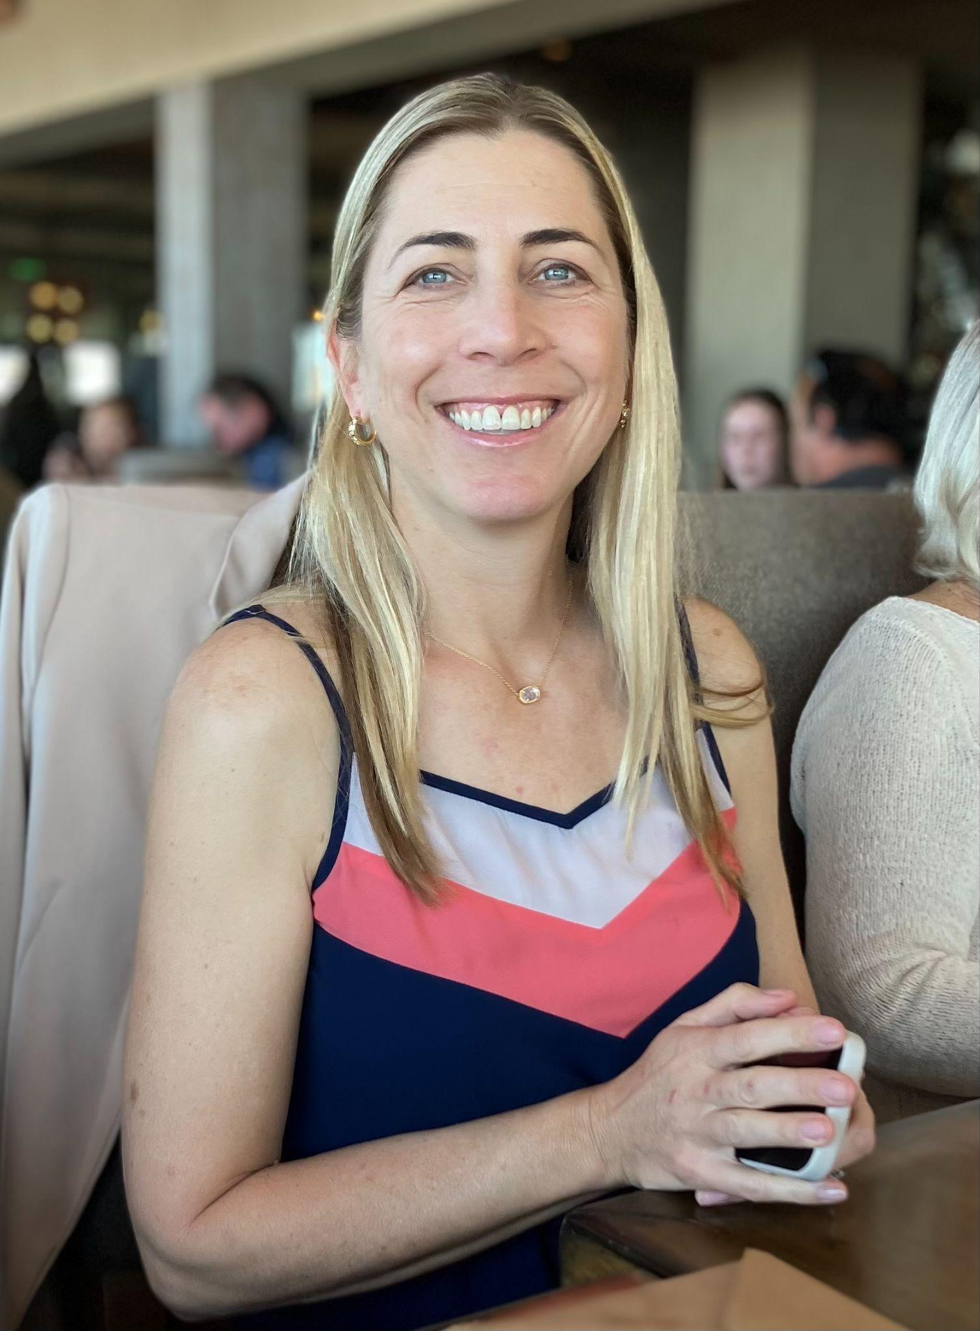
Presenter
Erin Hiro, ASCCC OERI Journalism Lead
Media Studies, Palomar College
20 years as a tenured professor
Earned recent second master’s degree in Instructional Design.
Courtesy Photo by Erin Hiro
Notes:
Presenters can be included following the description or the overview. Where images are used, they should include an attribution (Photo by…) and appropriate alternative text should be used (or the image marked decorative).

Slide 6
Overview
Review OER
Review of Journalism OER resources
OER Accessibility Tips
Review of Campus Publication Survey
Conversation on Campus Publication Needs and Plans
Conclusion
Notes:
An Overview slide should be included that is an outline of the presentation.

Slide 7
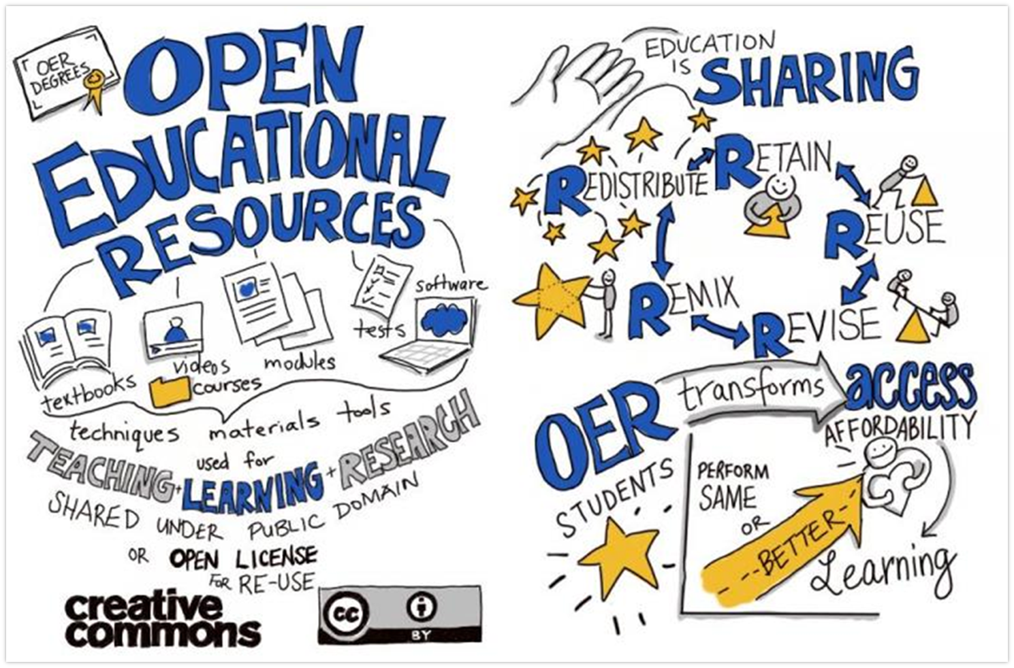
What is OER?
OER is Sharing by Giulia Forsythe is in the public domain

Slide 8
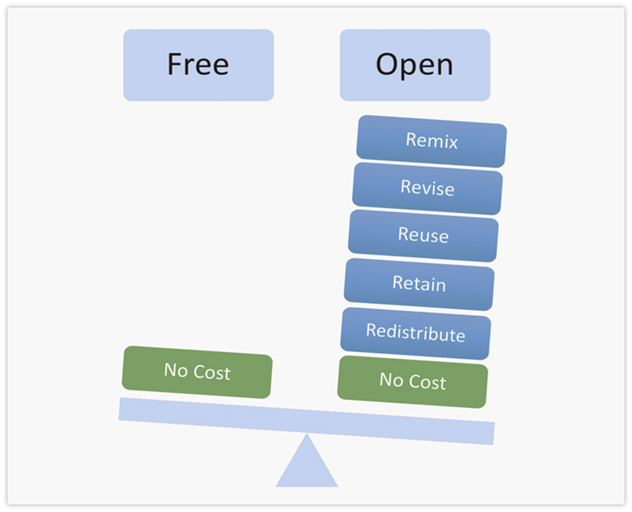

OER is More Than Just Free
Fair Use doesn’t make content magically okay to use
Image by GraphicMama-team available under the Pixabay license
Image by Designers for Learning: Gain Experience for Good, Jennifer Maddrell, Director licensed under CC BY-NC-SA

Slide 9
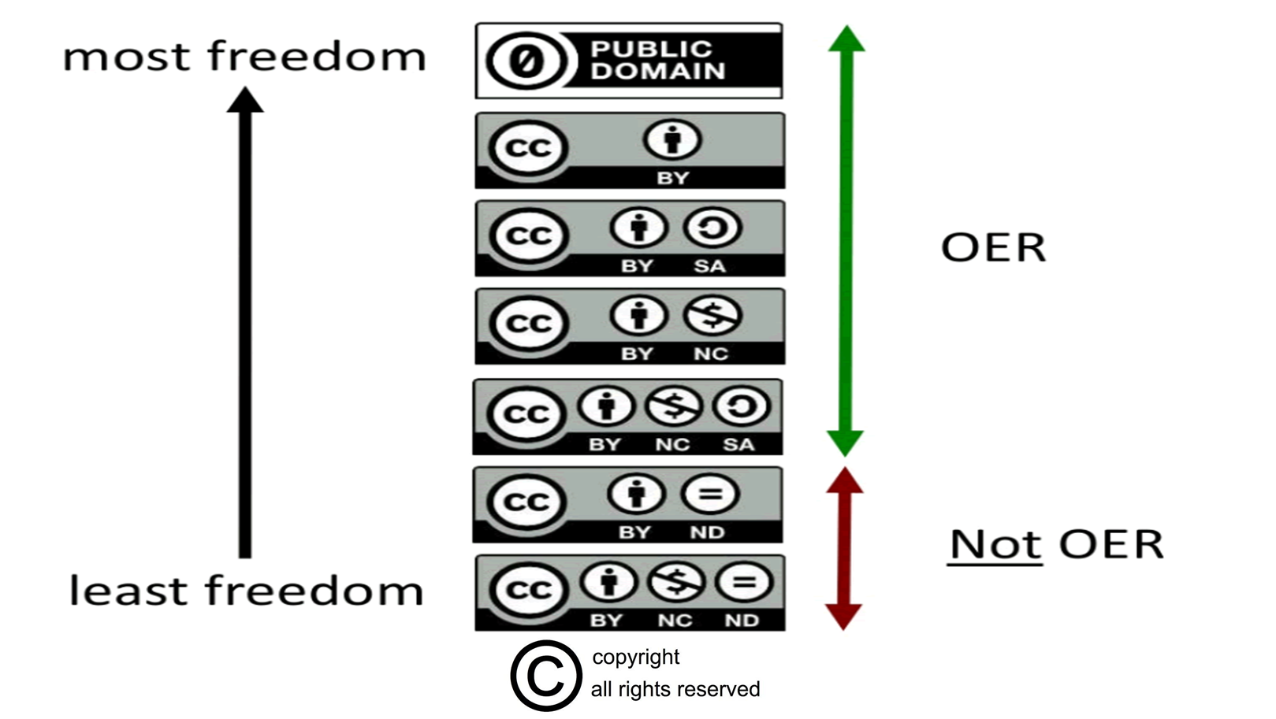
OER Licenses
Creative Commons Licenses by Cable Green licensed under CC BY 4.0 and
All Rights Reserved Sign by All Ygraph.com licensed under CC BY 3.0

Slide 10
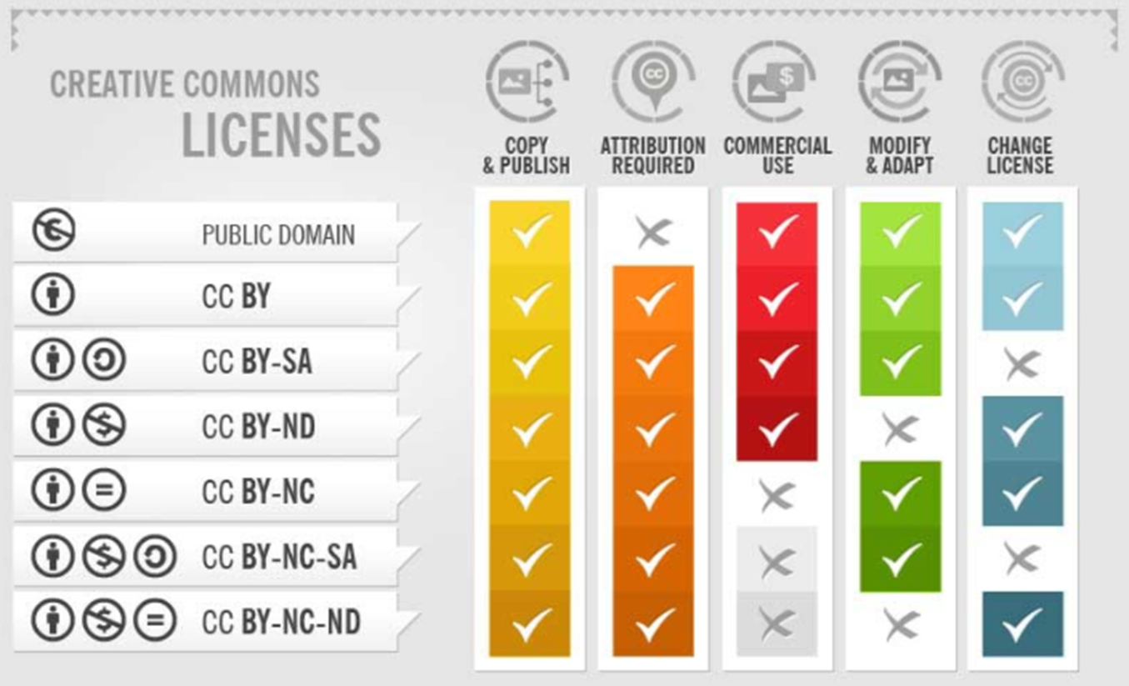
A Closer Look at the Licenses
Image is cropped from The Ultimate Guide by Fotor.com licensed CC BY-SA 3.0

Slide 11
Journalism OER Resources
You can find the most updated list at https://asccc-oeri.org/open-educational-resources-and-journalism/.
Please email ehiro@palomar.edu with suggestions or requests for Journalism OER Resources.

Slide 12
Journalism OER Resources (2)
Introduction to Mass Communications (C-ID JOUR 100)
Coming Soon: Full Canvas Class with Media textbook.
Introduction to Reporting and Newswriting (C-ID JOUR 110)
Updates to one textbook
Chapters on PR, Sports and Broadcast, fix video issues, accessibility
Accessibility challenges for another. Updated version expected in the Fall.
Multimedia Reporting (C-ID JOUR 120)
Adding small updates to OER Course.
Lower Division Student Media Practicum I (C-ID JOUR 130)
New resource - Canvas Class found in Canvas Commons

Slide 13
Journalism OER Resources (3)
Lower Division Student Media Practicum II (C-ID JOUR 131)
Focus of today’s discussion
Introduction to Public Relations (C-ID JOUR 150)
Great resources and more on the way
Introduction to Photojournalism (C-ID JOUR 160)
Course available on Canvas Commons
Introduction to Visual Communications (C-ID JOUR 170)
Need Graphics Design OER!
Intermediate Reporting/News Writing (C-ID JOUR 210)
Third class for most schools
Need public affairs reporting resources

Slide 14
OER Accessibility Tips
Links to news/other websites
If articles change every semester and are current events, they don’t have to be accessible as part of the just-in-time exception that information is shared too quickly to be made accessible.
It must be very current and not used for multiple semesters.
Put a statement in your syllabus and work with your DSPS office.
Newspaper archives
Often archives are PDFs inaccessible and cannot be used.
One approach may be to work with your library to make accessible copies over time. This shows that an effort to improve, which may help if there is an OCR (Office of Civil Rights) issue.
The syllabus statement for just-in-time articles can help.

Slide 15
OER Accessibility Tips (2)
Canvas Course limitations
Canvas shells are designed to be 100 percent accessible but can't be printed out like in a Libretext or Pressbook book.
State says this is a campus decision as both Canvas courses and online books have benefits and drawbacks. It is good to check with campus disabled resources group on their thoughts.
State suggestion: If possible, copy Canvas content for OER to online book format. The discussion prompts and assignments could be separate pages for instructors (like a teacher’s edition of the textbook).
Design textbooks on Issuu
PDFS must be addressed to quality for OER resources.
Check with campus for resources to support these changes.

Slide 16
Review of Campus Publication Survey
Survey Results of Campus Magazine Needs
Asked about current magazine resources, conditions and needs for the future
Findings
Five responded and only one had a stand-alone magazine class
The rest were combined with the newspaper class or no longer offered
Most had no required text but online resources such as www.asme.media
One used a textbook that costs $115.

Slide 17
Review of Campus Publication Survey (2)
Survey Results
Free textbook needs
Design
Production
Online writing style
Difference between magazine and newspaper writing
Mini-class of magazine resources to be merged with newspaper class
Quizzes on basic concepts
Theory behind magazine characteristics
Updated CORS to reflect technology changes
Other areas
Multimedia storytelling
Social media

Slide 18
Conversation on Campus Publication
Please answer the following questions in the chat:
Does your college produce a campus magazine.?

Slide 19
Conversation on Campus Publication (2)
Please answer the following questions in the chat:
Is the campus magazine course separate from the newspaper or combined?

Slide 20
Conversation on Campus Publication (3)
Please answer the following questions in the chat:
How much time in the semester is focused on learning about magazine creation and production?

Slide 21
Conversation on Campus Publication (4)
Please answer the following questions in the chat:
Are multimedia projects a part of the magazine learning? For example, a video linked to an online version of a magazine article?

Slide 22
Conversation on Campus Publication (5)
Now let’s have a conversation: Please feel free to use the chat or speak in the meeting.
What magazine resources have you created? Would you be willing to share?
What OER magazine resources need to be created?
Would an online, asynchronous format of learning resources help you so that advanced students could learn online while you are working with beginners in person?
What design resources to you have? What do you need?
How does multimedia play into magazine curriculum?

Slide 23
Needs and Plans
Needs
Video editing resources
Design resources
Magazine Writing resources
Campus Governance Resources
Community Reporting
Editing Resources
Magazine production and writing resources
Camera basics information
Plans
We will continue to update resources on the state website until the money runs out in December 2026.

Slide 24
Conclusion
Thank you for listening!
Please reach out to me with any questions!
Professor Erin Hiro
Palomar College
ehiro@palomar.edu or 760-744-1150 ext. 2450

