Slide 1
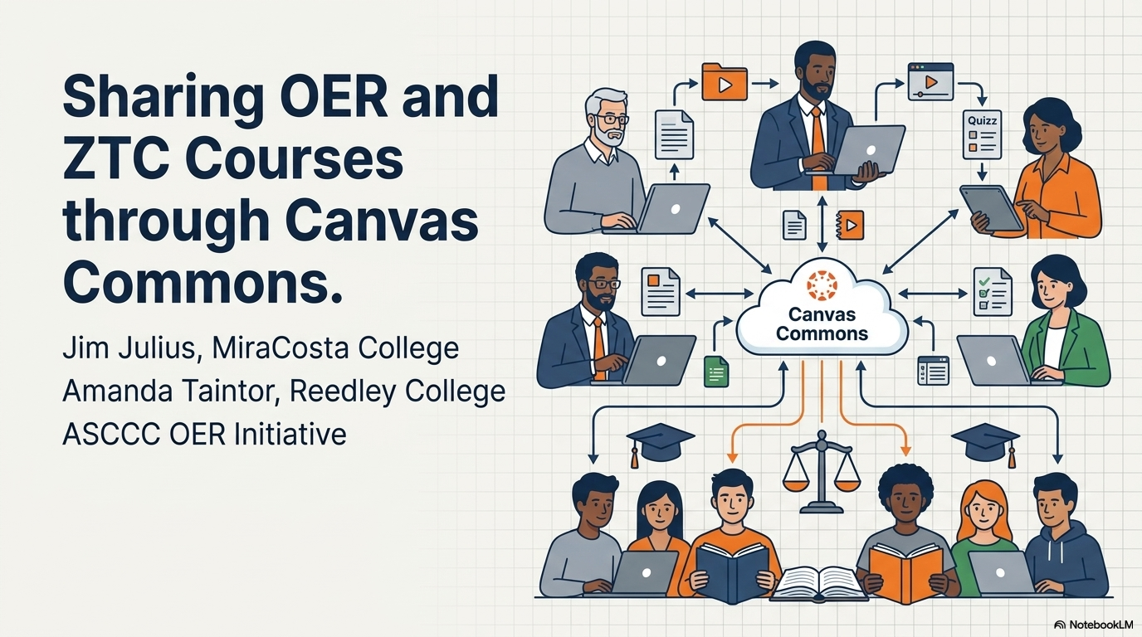
Sharing OER and ZTC Courses through Canvas Commons
Jim Julius, MiraCosta College Amanda Taintor, Reedley College ASCCC OER Initiative
Notes:
This deck created by NotebookLM based on content specified and created by Jim and Amanda. Feel free to reuse the slides/content under CC-BY 4.0 license.

Slide 2
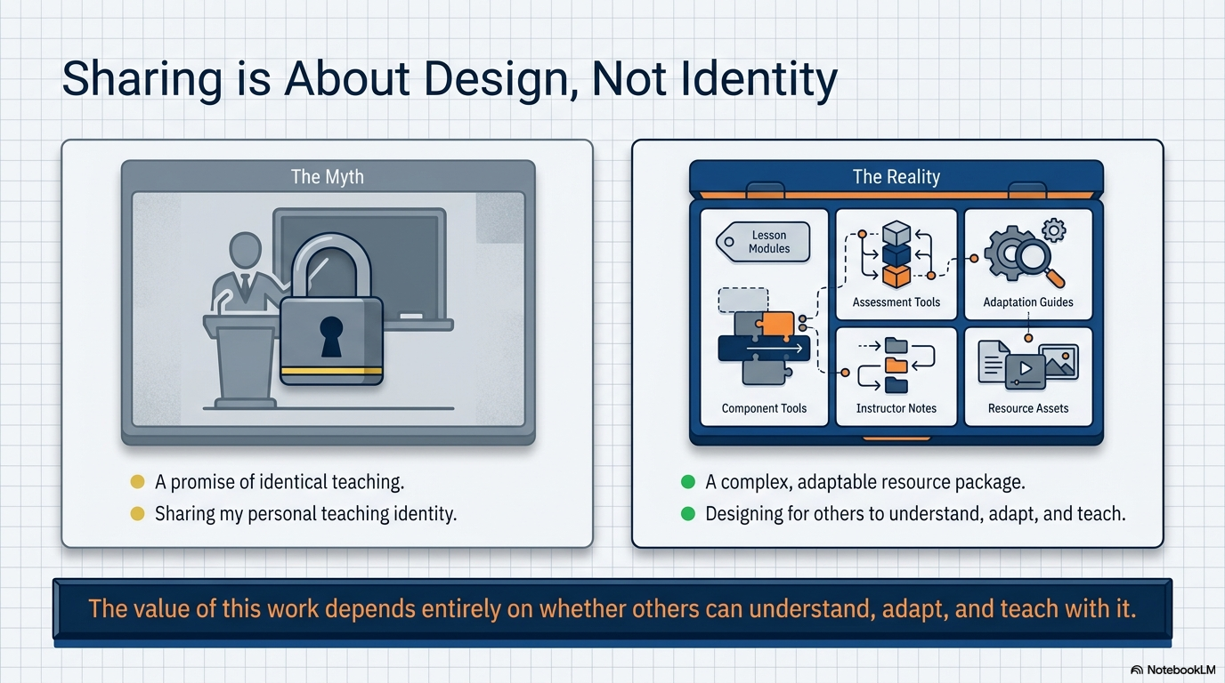
Sharing is About Design, Not Identity
The myth is a promise of identical teaching, or sharing my personal teaching identity. The reality is a complex, adaptable resource package, and designing for others to understand, adapt, and teach. The value of this work depends entirely on whether others can understand, adapt, and teach with it.

Slide 3
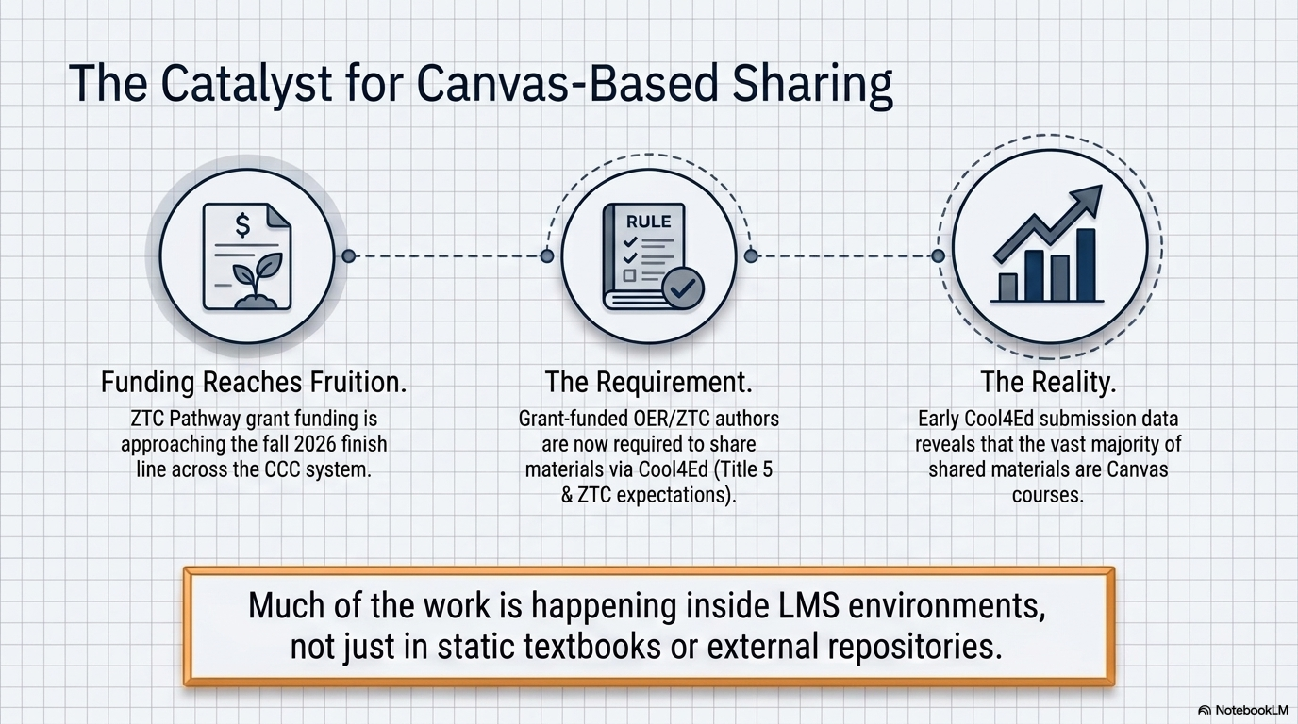
The Catalyst for Canvas-Based Sharing
Funding Reaches Fruition: ZTC Pathway grant funding is approaching the fall 2026 finish line across the CCC system. The Requirement: Grant-funded OER/ZTC authors are now required to share materials via Cool4Ed (Title 5 & ZTC expectations). The Reality: Early Cool4Ed submission data reveals that the vast majority of shared materials are Canvas courses. Much of the work is happening inside LMS environments, not just in static textbooks or external repositories.

Slide 4
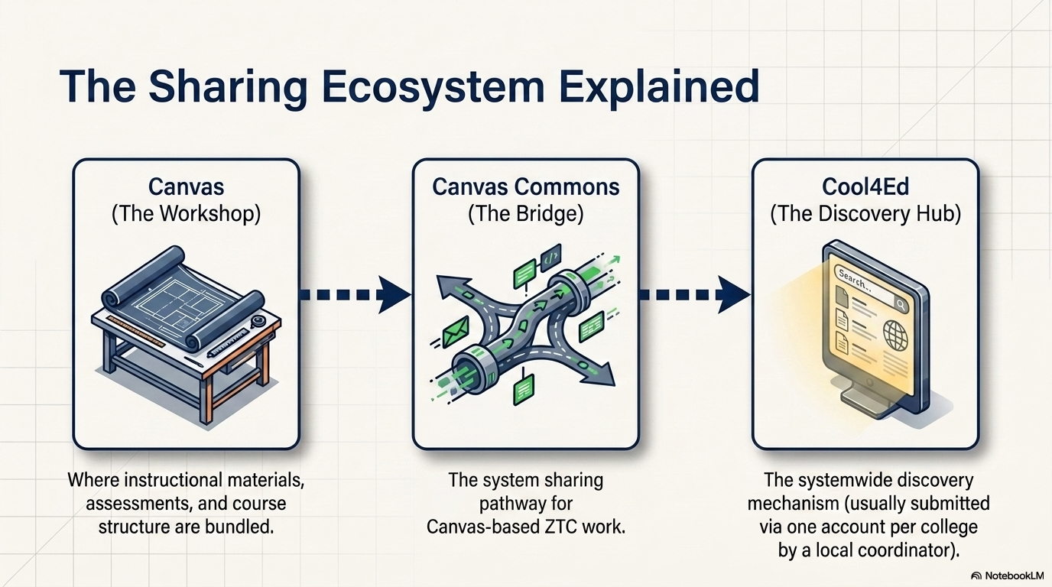
The Sharing Ecosystem Explained
Canvas is where instructional materials, assessments, and course structure are bundled. Canvas Commons is the system sharing pathway for Canvas-bassed ZTC work. Cool4Ed is the systemwide discovery mechanism (usually submitted via one account per college by a local coordinator).
Notes:
Remember that ZTC sharing through Canvas should be done in the Canvas Commons Consortium called “California Community Colleges,” providing a more secure and appropriate space for sharing ZTC-aligned resources. If your college does not currently have access to that Consortium enabled, please connect with your local Canvas administrator to request activation.

Slide 5
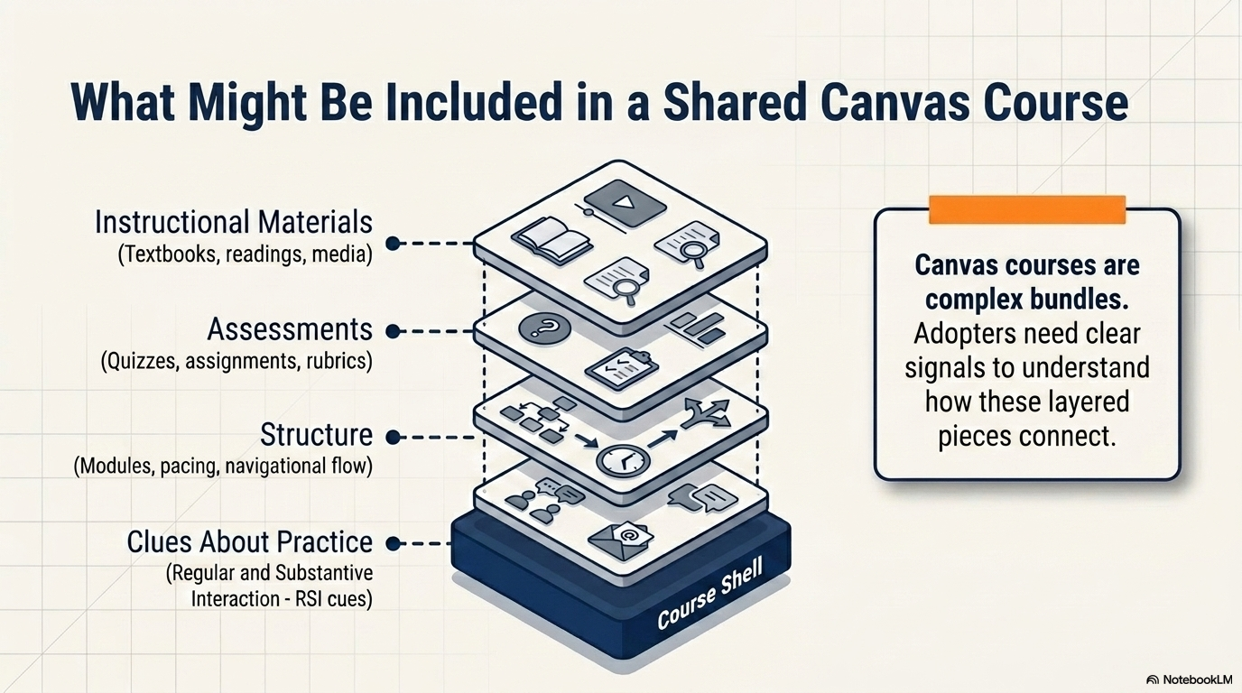
What Might Be Included in a Shared Canvas Course
Canvas courses are complex bundles. Adopters need clear signals to understand how these layered pieces connect.

Slide 6
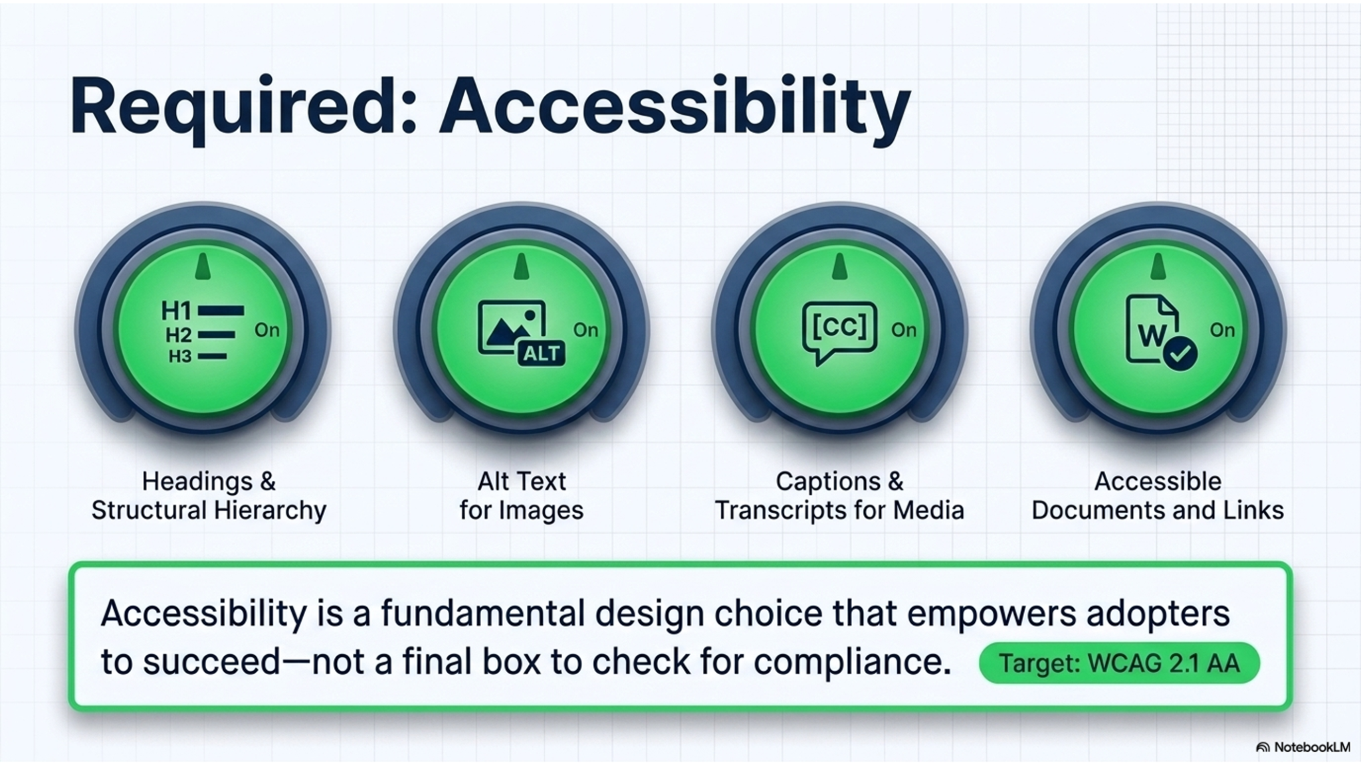
Required: Accessibility
Accessibility is a fundamental design choice that empowers adopters to succeed - not a final box to check for compliance. Target: WCAG 2.1 AA

Slide 7
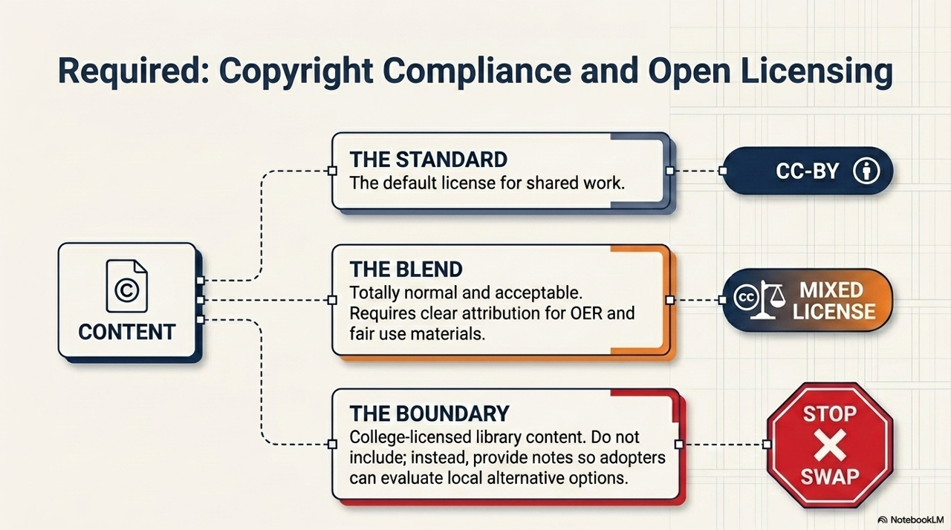
Required: Copyright Compliance & Open Licensing
Content may consistent of:
Standard - using the default CC-BY licensse
Blend - Totally normal and acceptable to have mixed licensing with clear attribution for OER and fair use materials.
Boundary - College-licensed library content. Do not include; instead, provide notes so adopters can evaluate local alternative options.

Slide 8
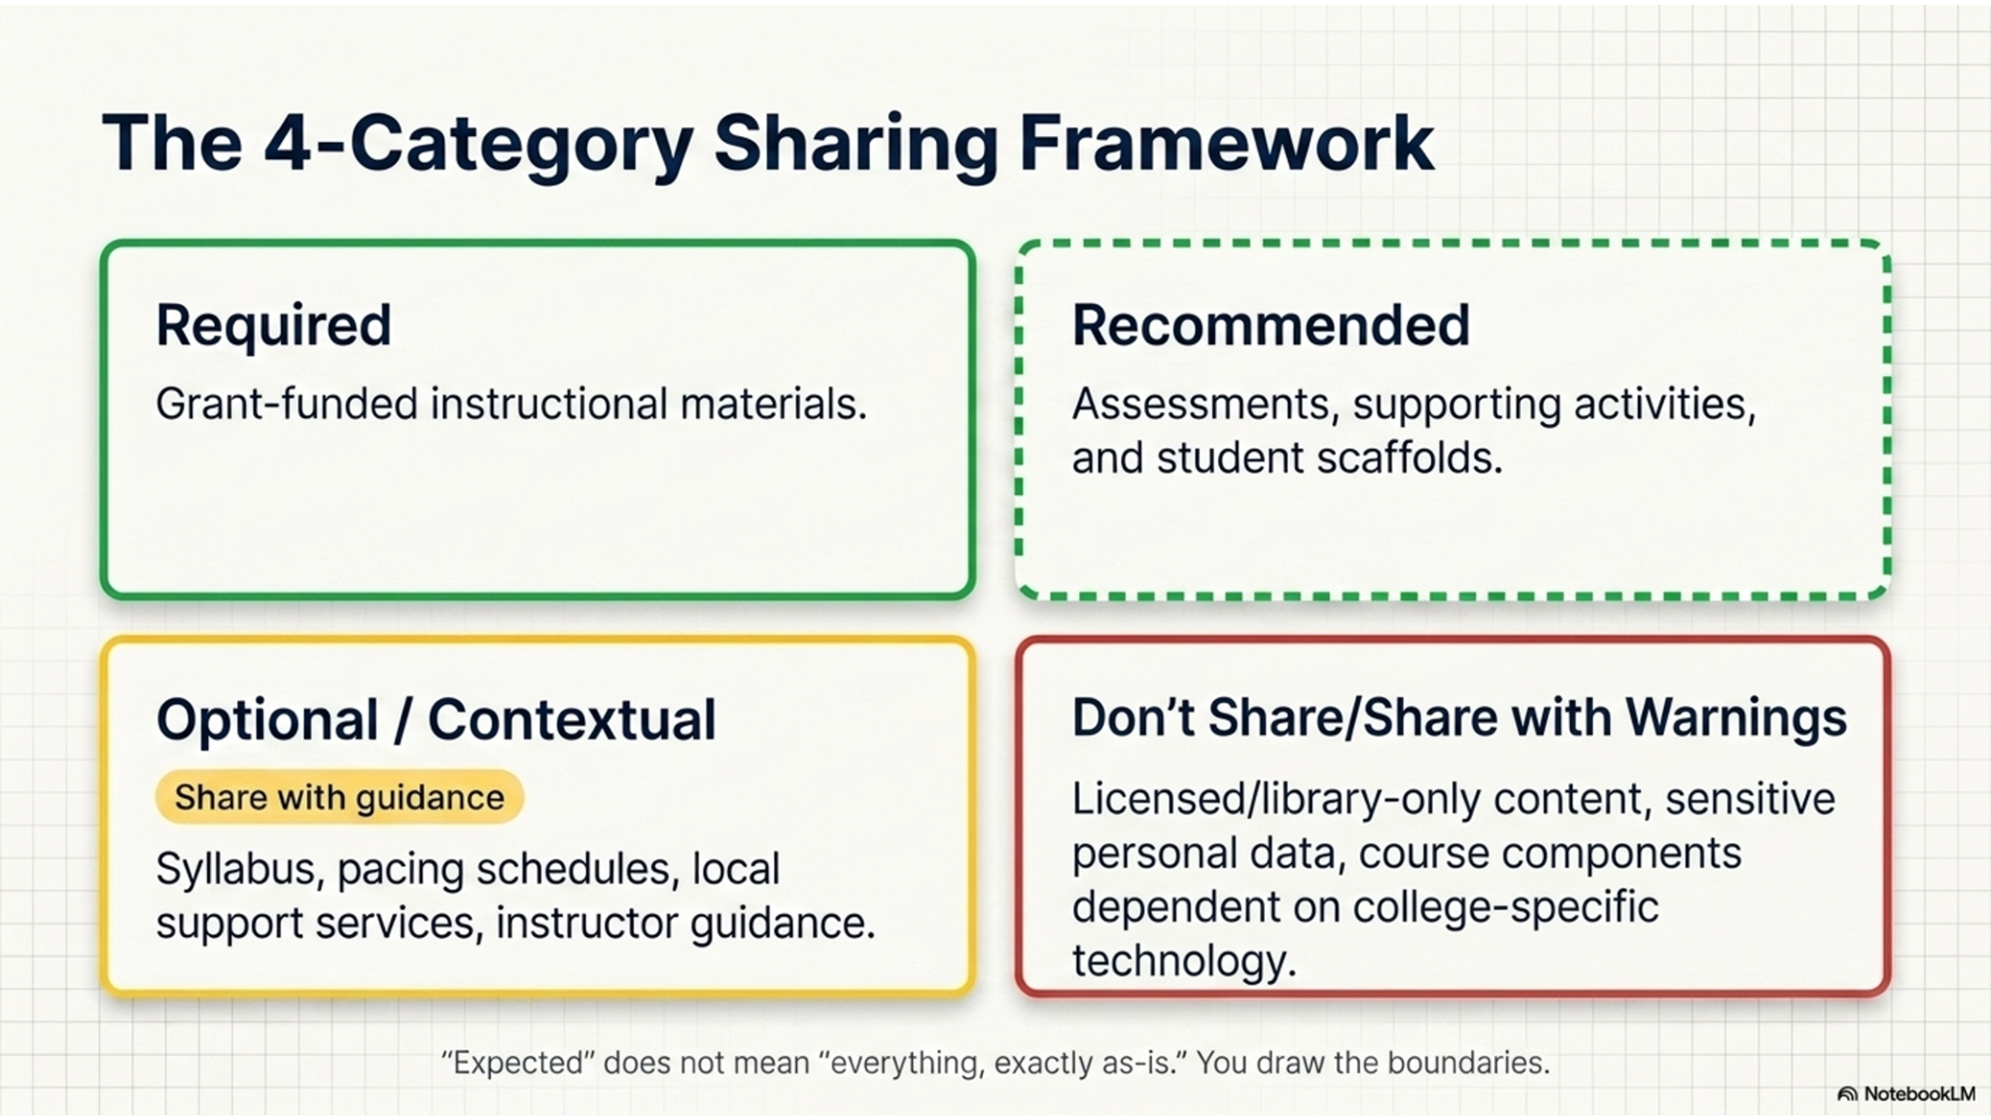
The 4-Category Sharing Framework
Required: Grant-funded instructional materials. Recommended: Assessments, supporting activities, and student scaffolds.
Optional/Contextual - share with guidance - Syllabus, pacing schedules, local support services, instructor guidance.
Don’t Share/Share with Warnings: Licensed/library-only content, sensitive personal data; course components dependent on college-specific technology.
“Expected” does not mean “everything, exactly as-is.” You draw the boundaries.

Slide 9
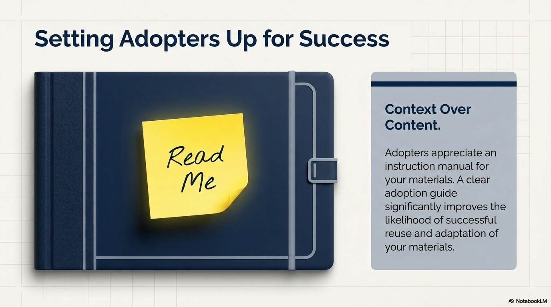
Setting Adopters Up for Success
Context over content - Adopters appreciate an instruction manual for your materials. A clear adoption guide significantly improves the likelihood of successful reuse and adaptation of your materials.

Slide 10
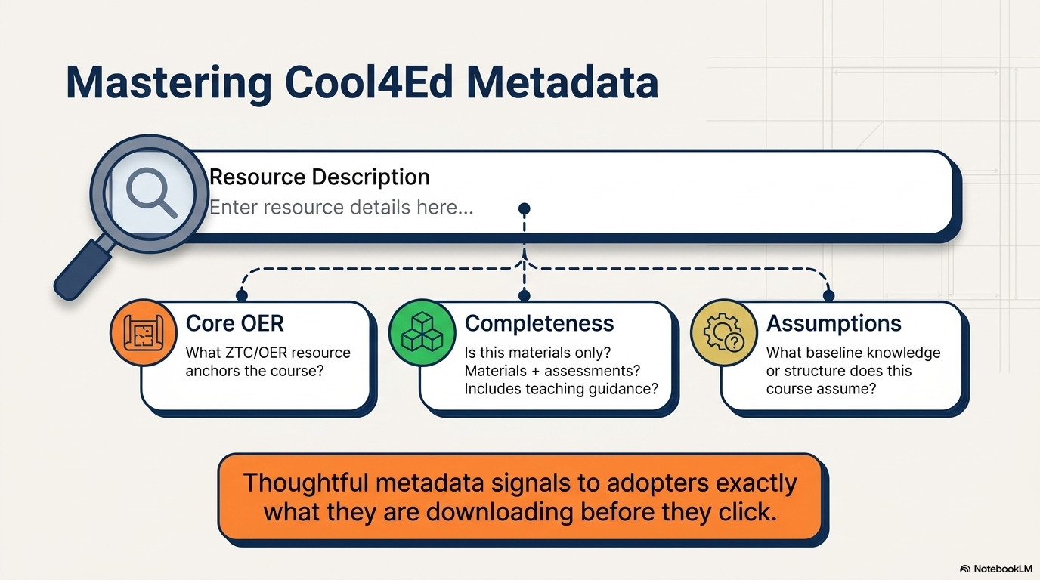
Mastering Cool4Ed Metadata
Cool4Ed Resource Description may include:
Core OER - What ZTC/OER resource anchors the course? Completeness - Is this materials only? Materials + assessments? Includes teaching guidance? and Assumptions - What baseline knowledge or structure does this course assume?
Thoughtful metadata signals to adopters exactly what they are downloading before they click.

Slide 11
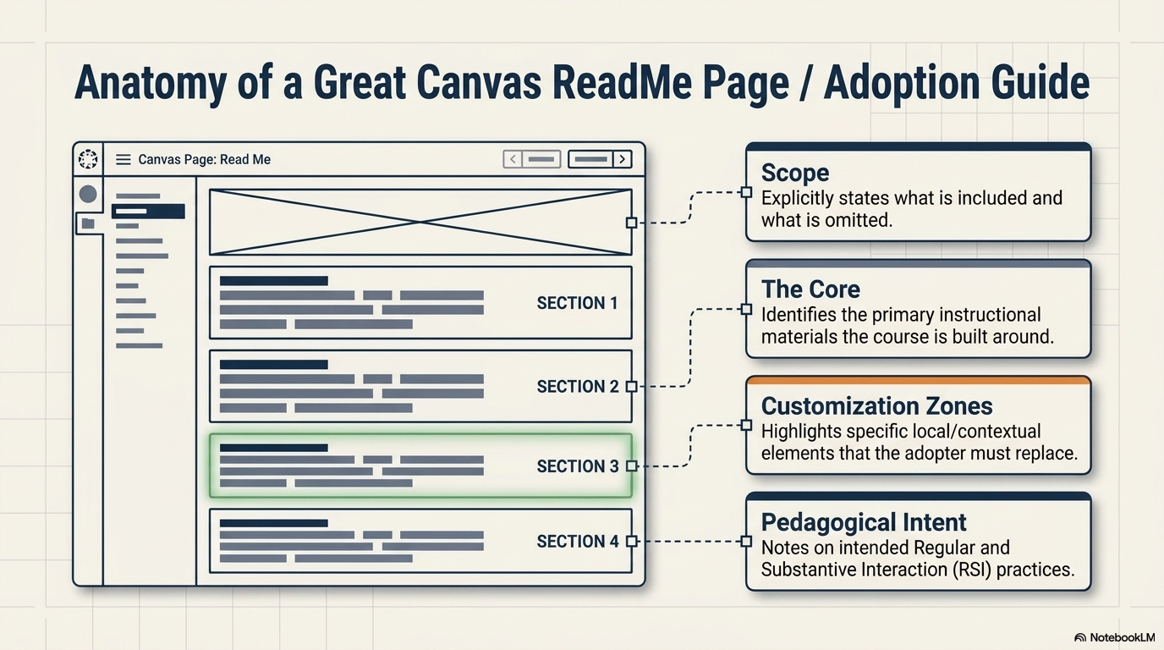
Anatomy of a Great Canvas ReadMe Page / Adoption Guide
Scope: Explicitly states what is included and what is omitted.
The Core: Identifies the primary instructional materials the course is built around.
Customization Zones: Highlights specific local/contextual elements that the adopter must replace.
Pedagogical Intent: Notes on intended Regular and Substantive Interaction (RSI) practices.

Slide 12
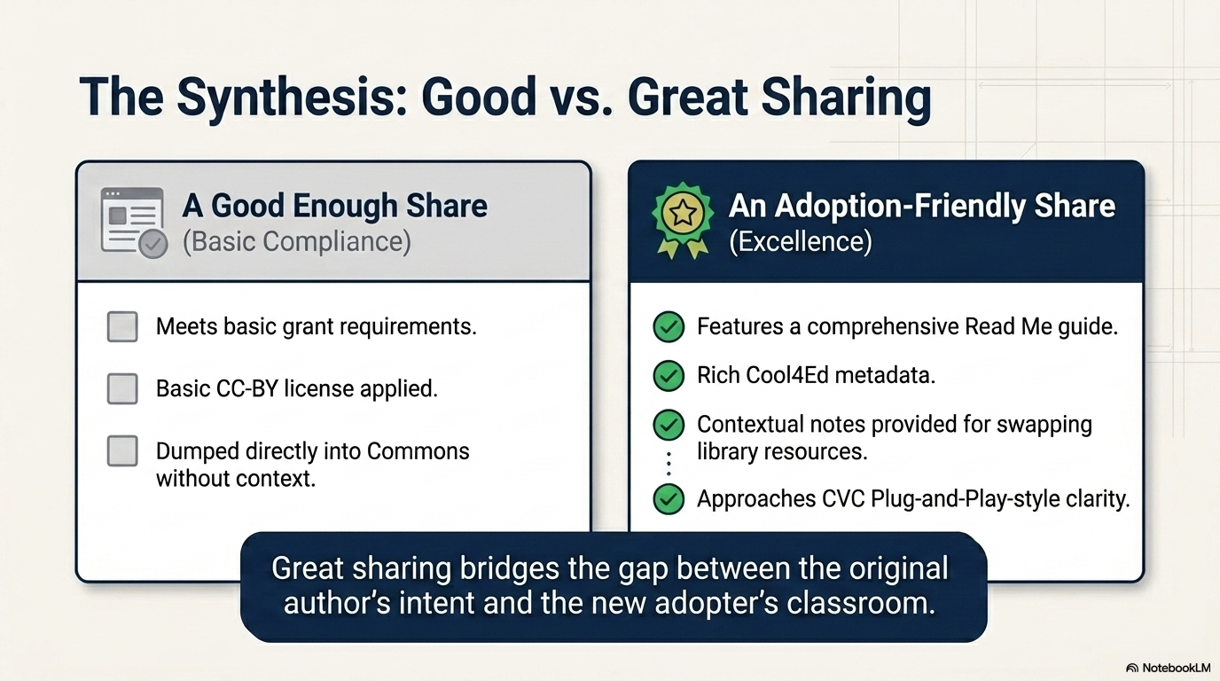
The Synthesis: Good vs. Great Sharing
Great sharing bridges the gap between the original author’s intent and the new adopter’s classroom
Adoption-friendly: Features a comprehensive Read Me guide; Rich Cool4Ed metadata; Contextual notes provided for swapping library resources; Approaches CVC Plug-and-Play-style clarity.
.
Good enough: Meets basic grant requirements, Basic CC-BY license applied, Dumped directly in to Commons without context.

Slide 13
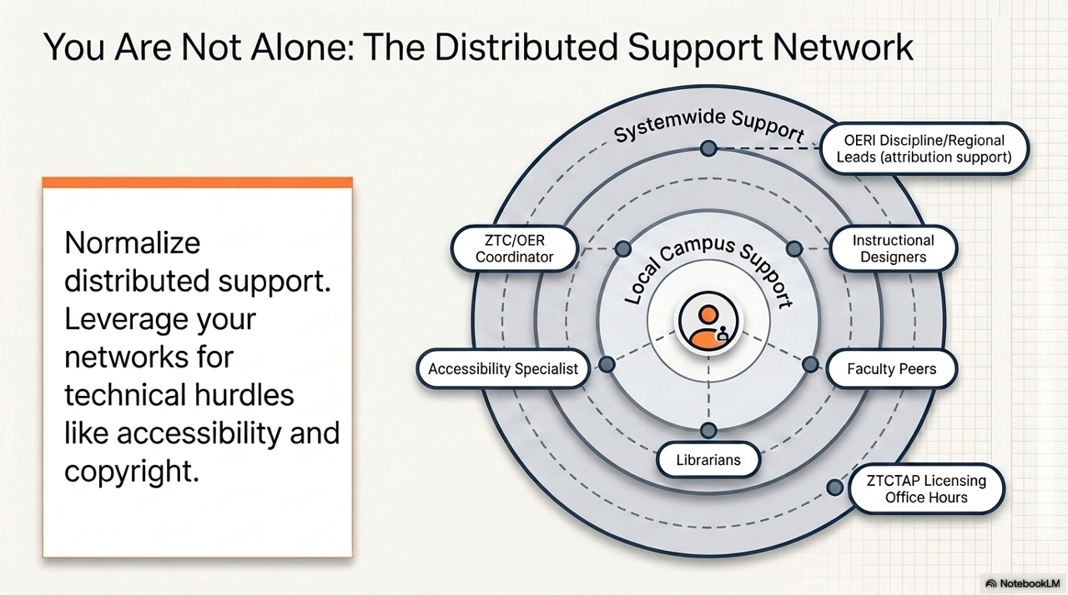
You Are Not Alone: The Distributed Support Network
Normalize distributed support. Leverage your networks for technical hurdles like accessibility and copyright.

Slide 14
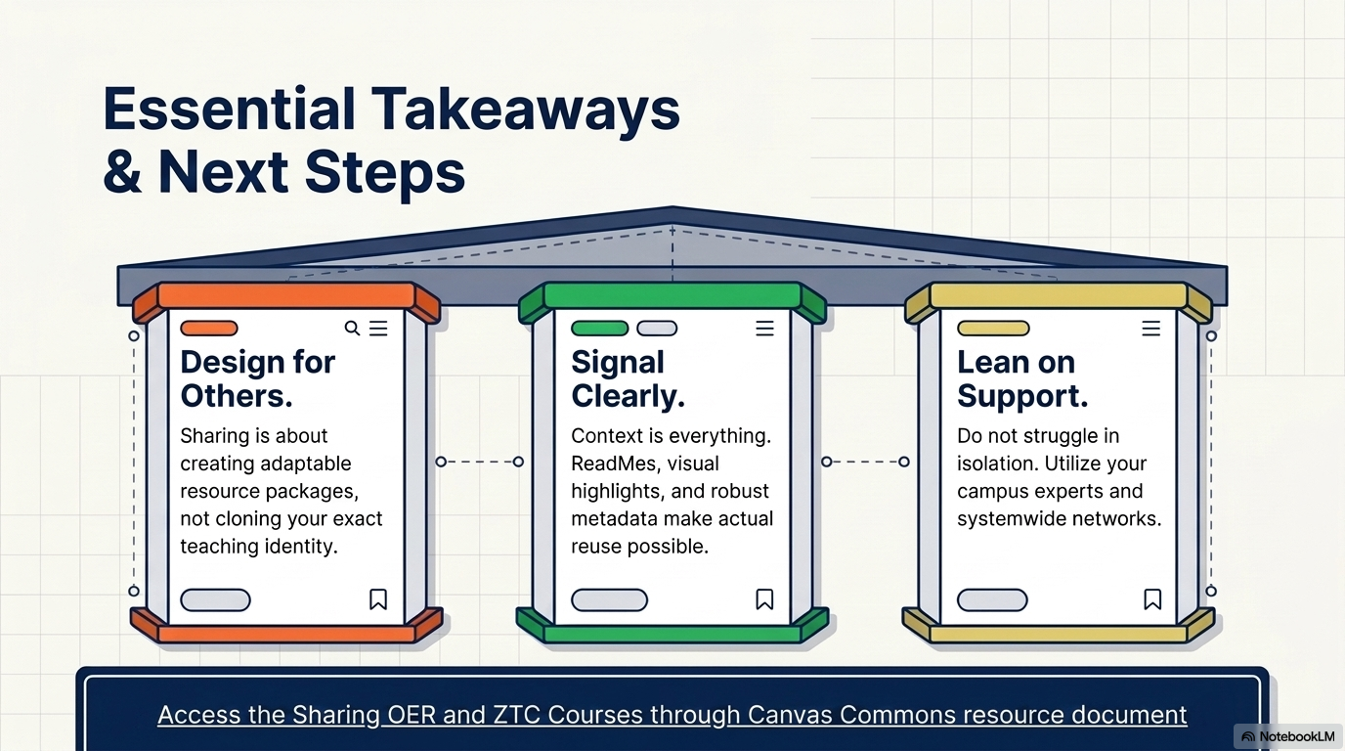
Essential Takeaways & Next Steps
Design for Others - Sharing is about creating adaptable resource packages, not cloning your exact teaching identity.
Signal Clearly - Context is everything - Readmes, visual highlights, and robust metadata make actual reuse possible.
Lean on Support - Do not struggle in isolation - utilize your campus experts and systemwide networks.
Access the Sharing OER and ZTC Courses through Canvas Commons resource document:
https://docs.google.com/document/d/1o2Sj30fguaaDt7ap-tuO66NfUikozoRPHu2A_YFMTxA/edit?tab=t.0

Slide 15
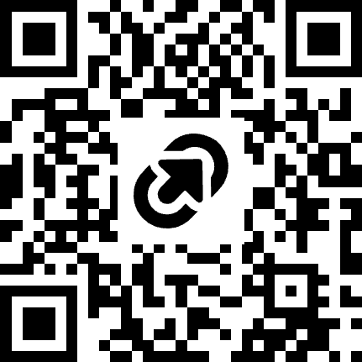
tinyurl.com/CCC-ZTC-Canvas

