Slide 1
Welcome!
On behalf of the ASCCC OERI, we are pleased to have you here with us for “Navigating ADAPT.”
If you are not already muted, please mute yourself upon arrival.
Please note that you are encouraged to use the Zoom “chat” feature for questions and comments.
You’re invited to introduce yourself in the chat – please provide your name, college, discipline/role
This event will be recorded. Archives of all ASCCC OERI events are available at asccc-oeri.org > Webinars and Events

Slide 2
Level 1: Navigating ADAPT
June 3rd, 2026. 9:00 am – 10:30 am
This work is licensed under a Creative Commons Attribution 4.0 International License.)

Slide 3

Presenters
Cristina Moon, ASCCC OERI ADAPT lead
  Spanish, Chabot College
Shagun Kaur, ASCCC OERI LibreTexts Lead
  Communication Studies, De Anza
Photo by Siora Photography on Unsplash
Notes:
Presenters can be included following the description or the overview. Where images are used, they should include an attribution (Photo by…) and appropriate alternative text should be used (or the image marked decorative).

Slide 4
Webinar Description
Ready to dive into ADAPT but not sure where to start? This opening session grounds you in the essentials of the LibreTexts adaptive homework platform, a comprehensive infrastructure that supports auto-graded and non-auto-graded activities from H5P, IMathAS, WeBWorK, and native ADAPT questions. We will navigate the vast repository of existing content, spanning thousands of individual questions, curated collections, and ready-to-use public courses, to find the right fit for your curriculum. You will also learn how ADAPT can be used as a standalone platform or integrated directly into an LMS like Canvas.

Slide 5

Overview
What is LibreTexts ADAPT
Navigating ADAPT
Searching for existing content
Importing content
Canvas Integration
Notes:
An Overview slide should be included that is an outline of the presentation.

Slide 6
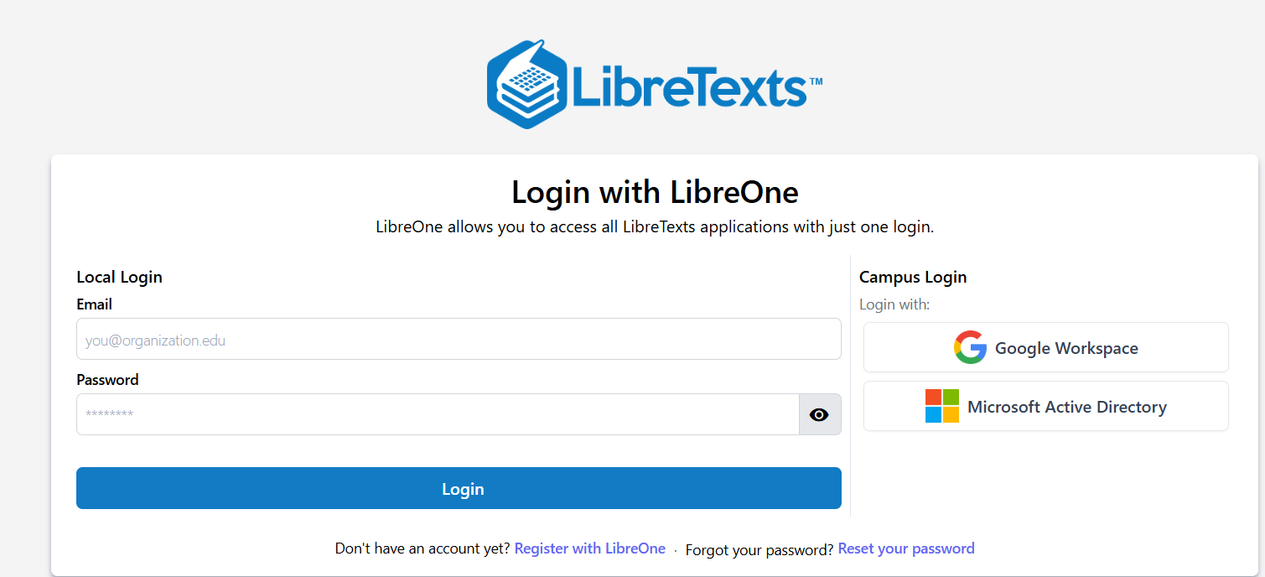
Registration for a LibreTexts Account
If you don't already have one, register for a LibreOne account.
Verify your Instructor status to unlock full LibreTexts functionality.

Slide 7
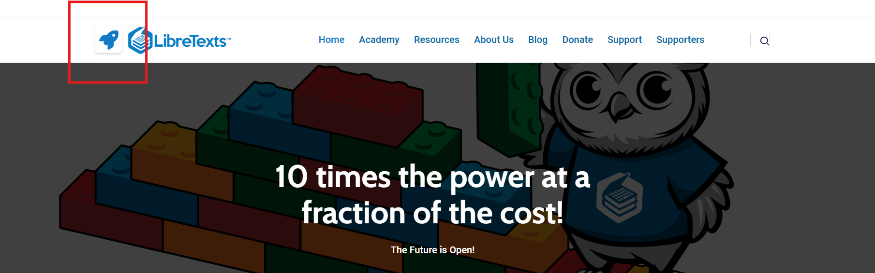
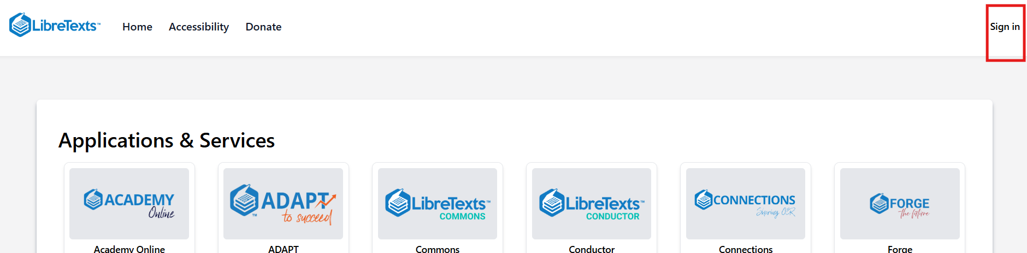
Logging in to your Account
Navigate to LibreTexts.org and click on the “rocket ship” icon
It will prompt you to sign in if you are not already logged in

Slide 8
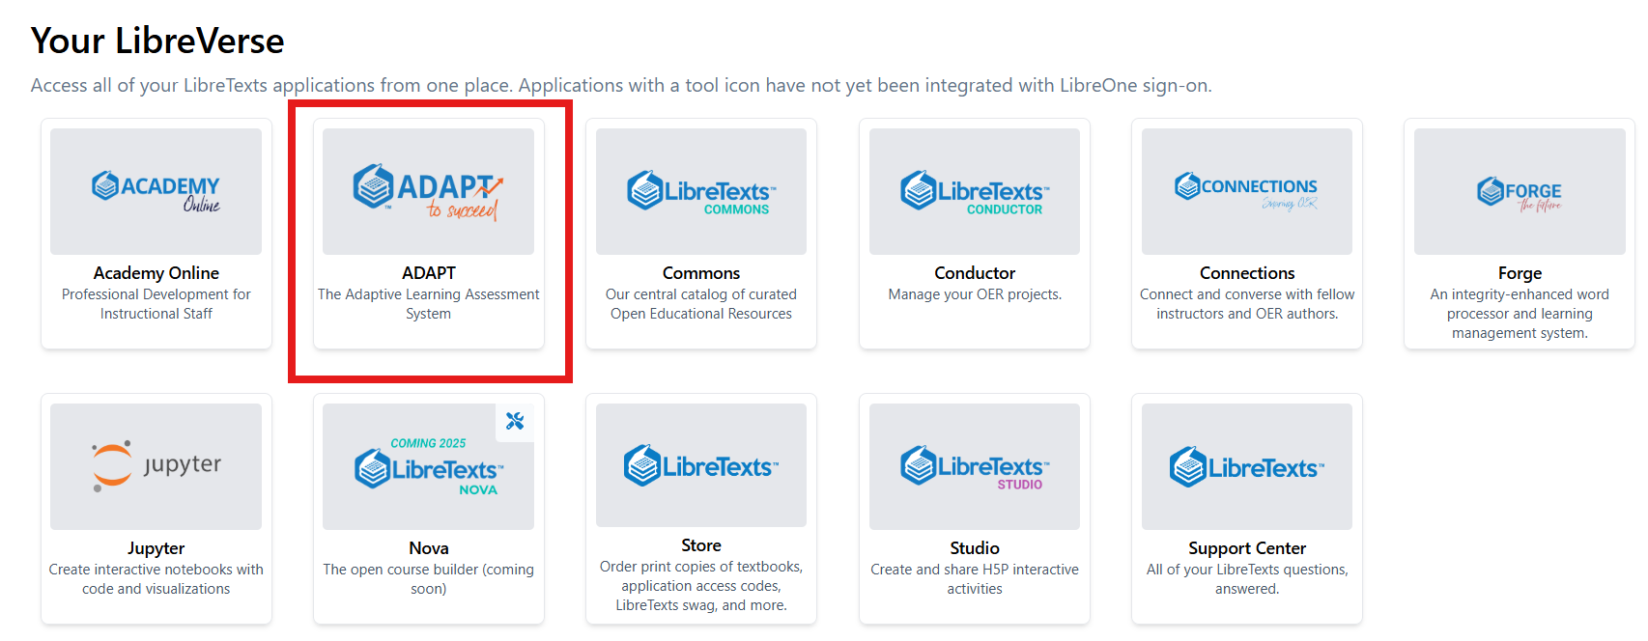
Find ADAPT

Slide 9
ADAPT: An Overview
ADAPT is the LibreTexts comprehensive assessment and homework platform with a library of more than 250,000 public questions.
Supports a wide variety of question types, including auto-graded and non-auto-graded activities from H5P, MyOpenMath, and WeBWorK, as well as accessible native question types such as Discuss-It, Forge, accounting, and flashcards.
Integrates with course management systems such as Canvas for automatic grade syncing, or can be used independently.
Free for California community colleges.

Slide 10
ADAPT as an OER Question Library
H5P: 28,000+ questions
WeBWork: 56,000+ questions
MOM/iMathAS: 73,000+ questions
Open-Ended: 72,000+ questions
ADAPT Native Technology: 100,000+ questions
  Basic QTI (Canvas-like): 46,000+ questions
  Nursing (NCLEX prep): 17,113+ questions
  Sketcher (molecular structures): 3391 questions
  Discuss-It (Threaded Audio/Visual): 556 questions

Slide 11
Why ADAPT?
Access and use public courses, collections, individual assignments, and questions.
Clone (copy) questions and edit.
Create new and accessible questions beyond the Canvas QTI question types.

Slide 12
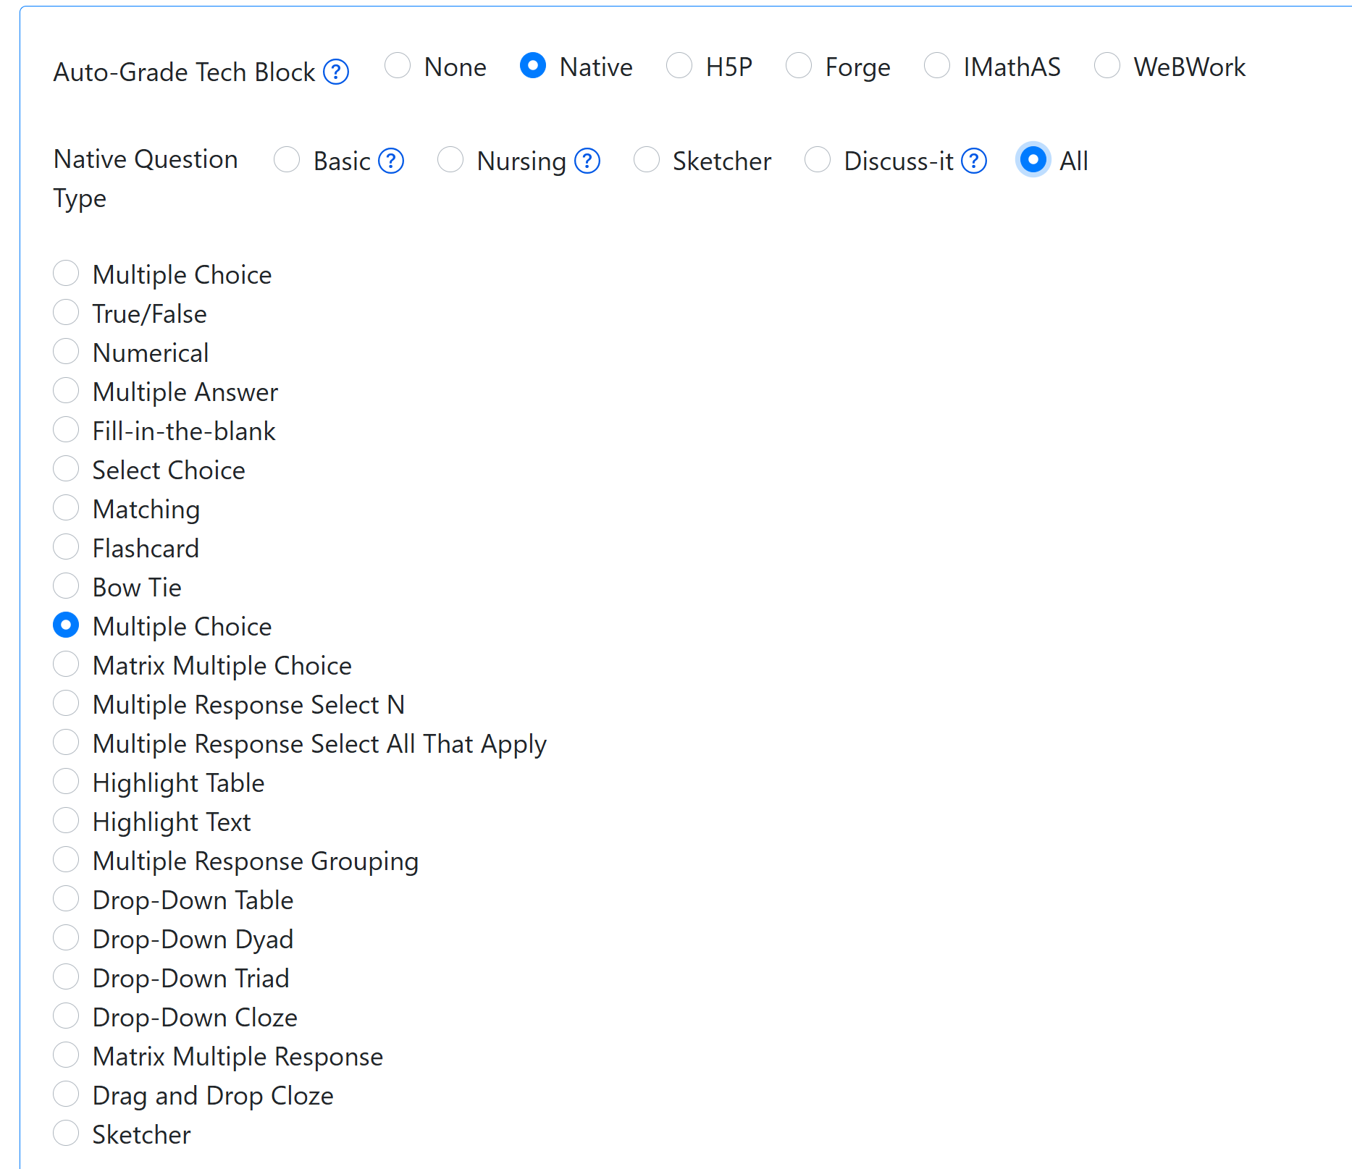
ADAPT Native Question Types

Slide 13
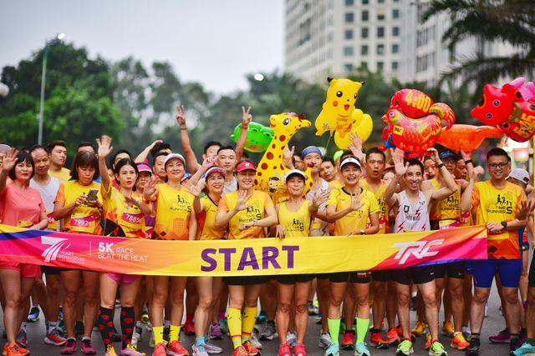
Are you Ready?
5k Marathon by Nguyen Ngoc Tien under Pexels license

Slide 14
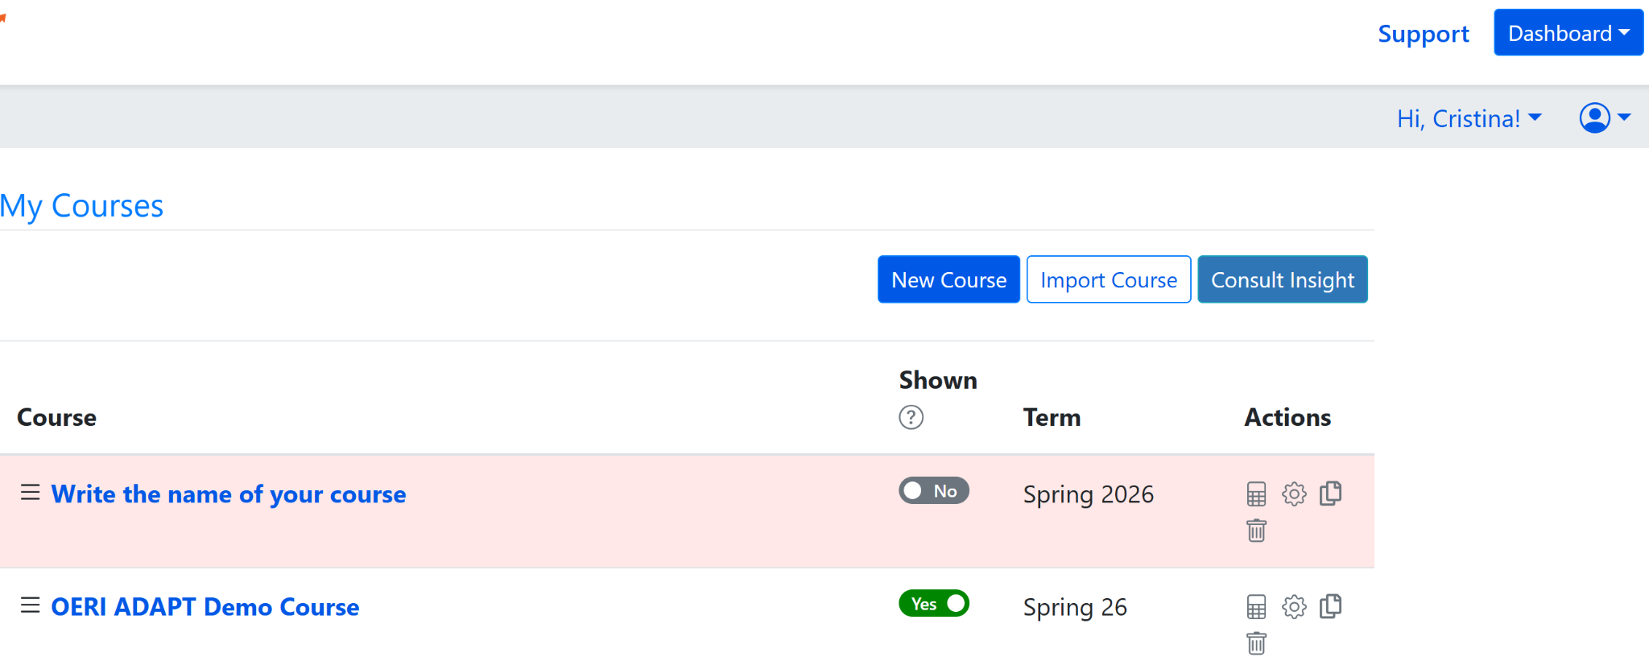
My Courses
Your landing page in ADAPT will be My Courses.
In this page, you will see:
Support, Dashboard
Hi, your name
New Course, Import Course, and Consult Insight.
Course, Shown, Term, Actions

Slide 15
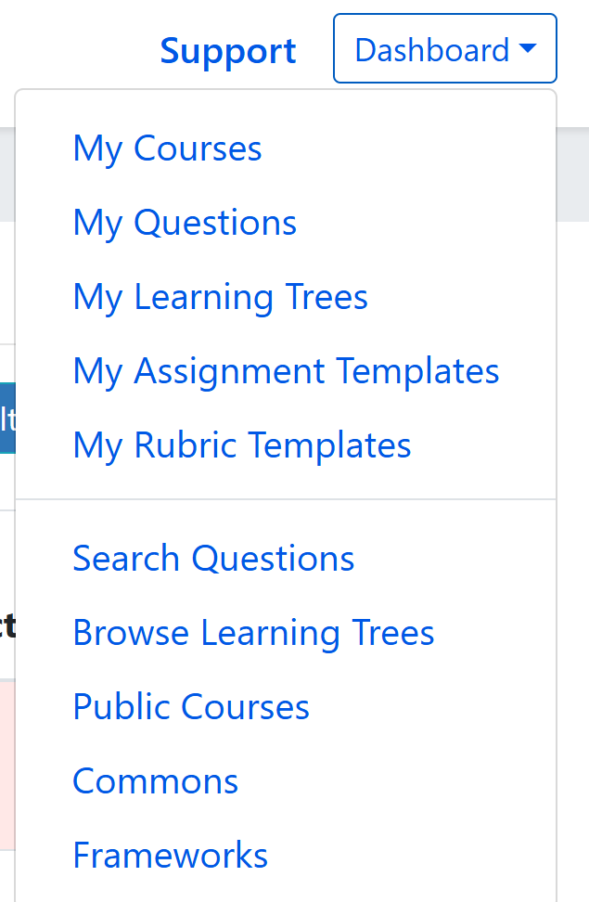
ADAPT Dashboard
Go to the Dashboard and explore:
Commons: Collections of assignments and questions usually linked to an OER.
Public Courses: Courses that other people have shared.

Slide 16

Time to Explore or Breathe
Sloth by Mancia Freddy is licensed CC0 1.0 Public Domain.

Slide 17
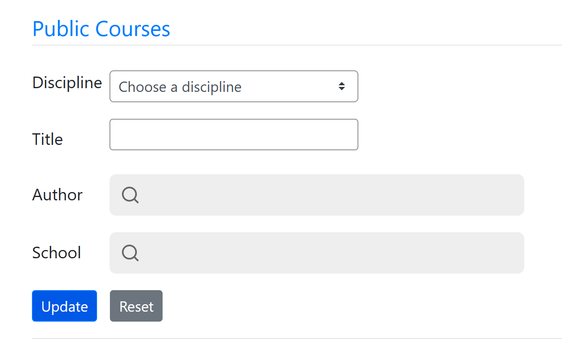
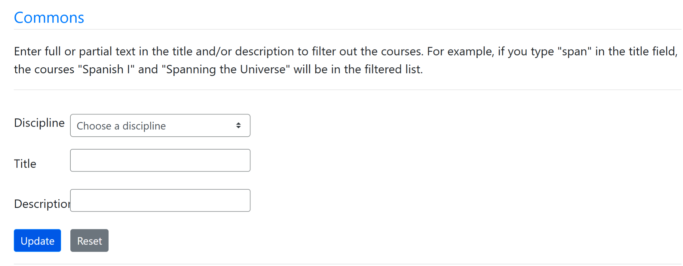
Searching Commons and Public Courses
Go to Public Courses or Commons and choose a discipline and find a course or collection that you would like to import to My Courses.

Slide 18
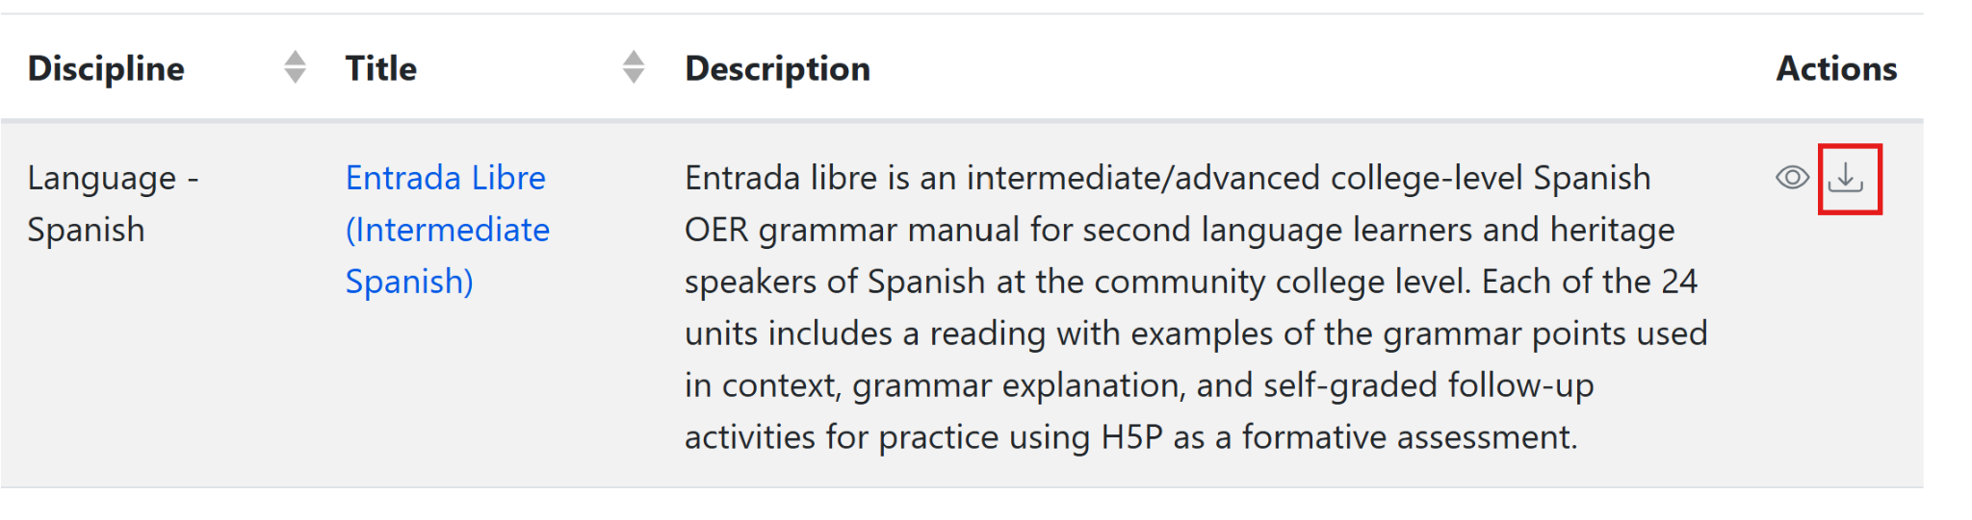
Importing to My Courses
If you select the title, you will be able to preview the assignments and questions.
Under Actions:
Eye icon gives you a quick view of the content.
Down arrow lets you import the resource to My Courses.

Slide 19
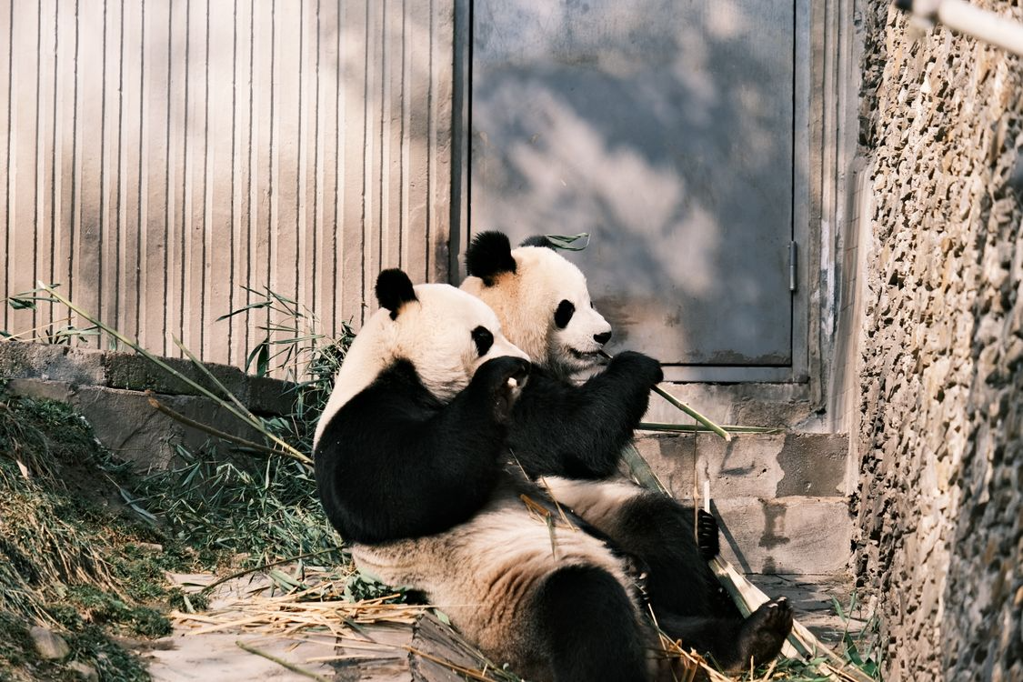
Time to Explore or Breathe
Two Pandas by Lily Lili under Pexels license

Slide 20
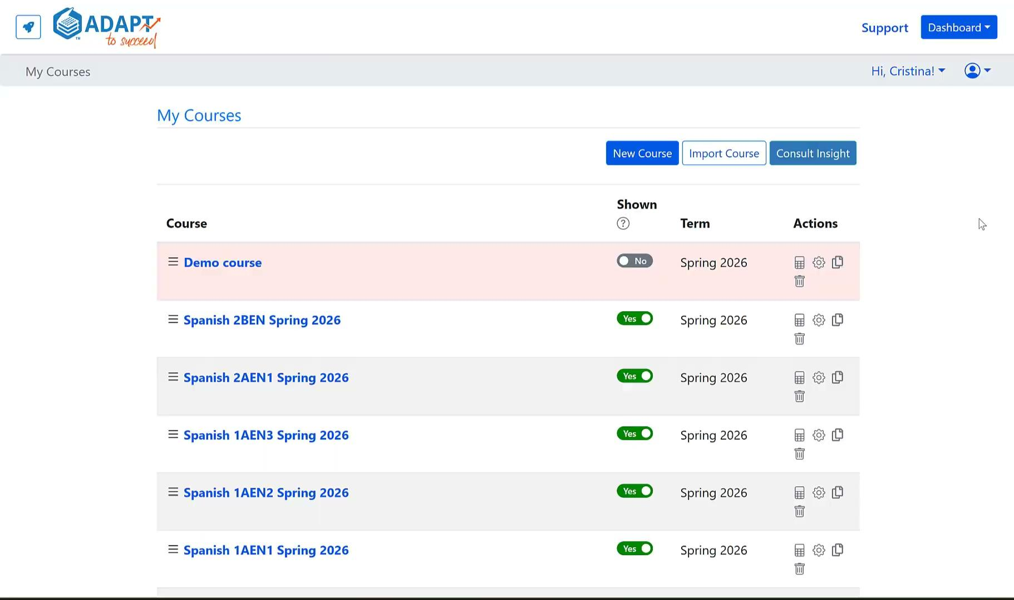
Easy Integration of ADAPT in Canvas
The API link to Canvas will automatically create individual Canvas assignments and gradebook entries.
Notes:
More info on API: https://docs.google.com/document/d/1ItwdvFXi6fqy-OilptSjTaxGZ7LeCPEZMDQtYElBsQg/edit?tab=t.0#heading=h.1f9oybosc2xn

Slide 21
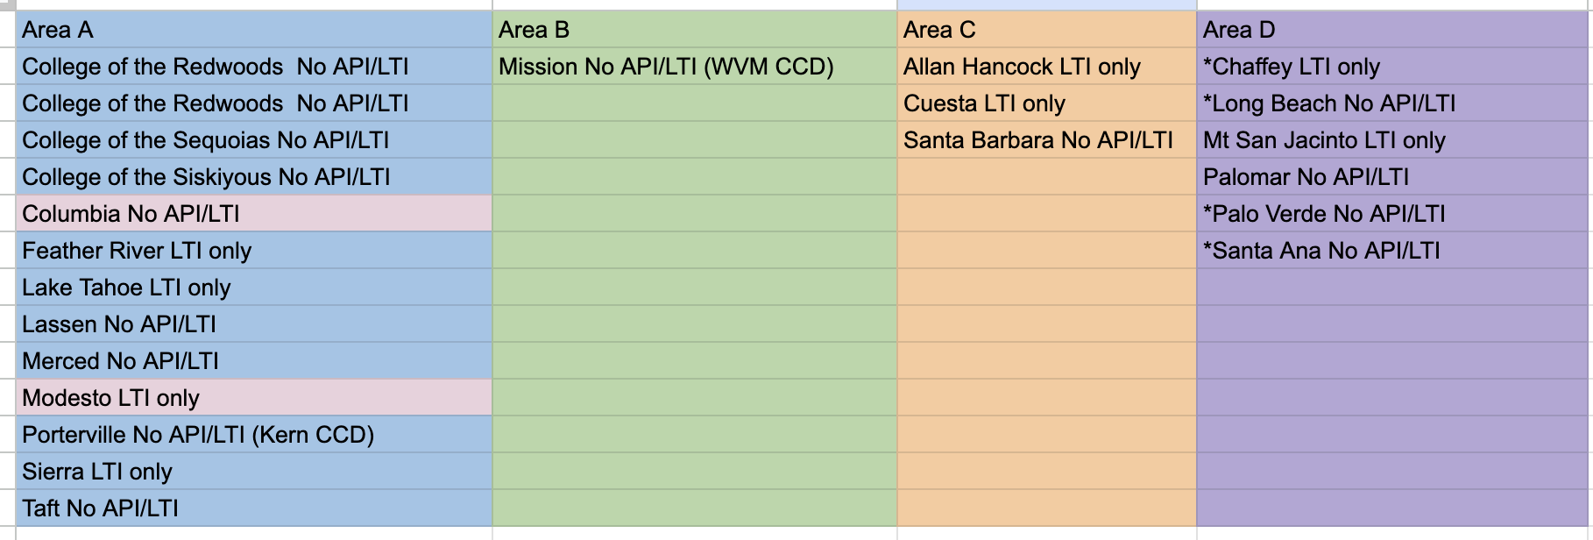
Is your college on this list?
Reach out to your Canvas Administrator.
You do not have the Canvas-ADAPT API/LTI
Please note that this list of colleges is accurate to the best of our knowledge.
If you find otherwise, please let the OERI know.

Slide 22
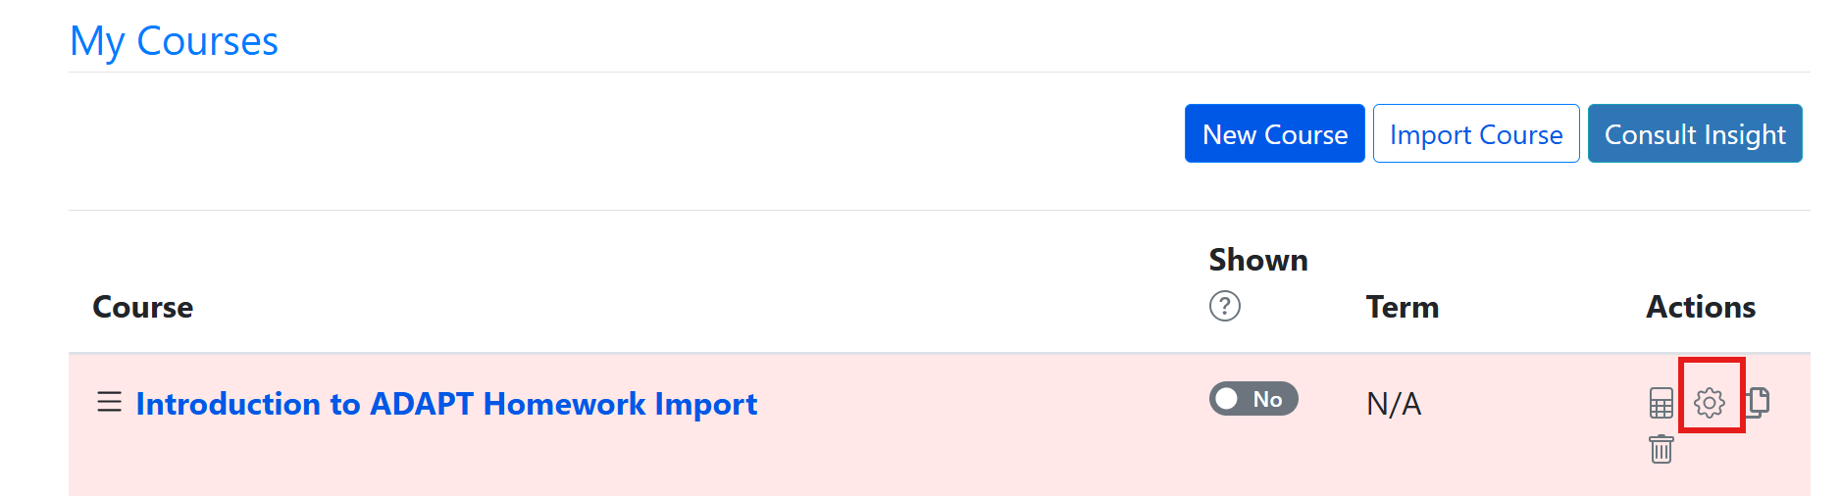
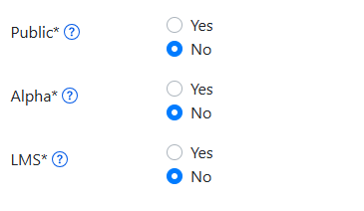
Linking ADAPT to your Canvas Course
Under Actions, go to Course Properties (the gear icon) and select Yes under LMS

Slide 23
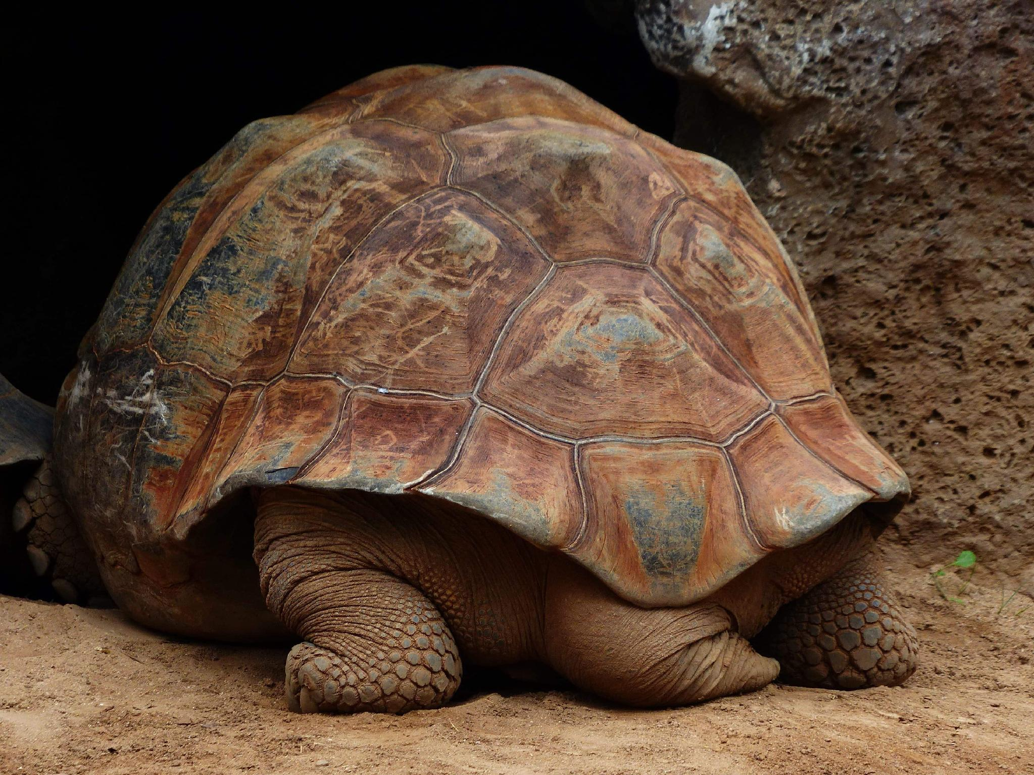
Time to Explore or Breathe
Tortoise is licensed CC0 1.0 Public Domain.

Slide 24
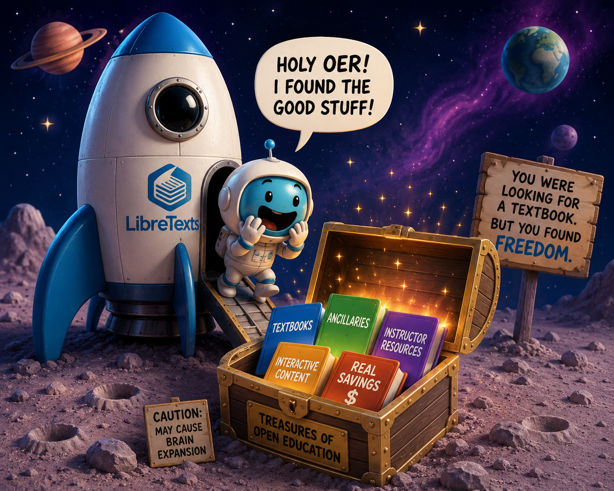
Did you Strike Gold?
LibreTexts Rocket Icon. Adapted for instructional use. Original icon from LibreTexts. CC0 1.0 Public Domain.

Slide 25
Next in the Series and Coming Up
ADAPT Level 2 | Cloning Native Basic Questions | Thursday, June 4, 12:00-1:30 pm
ADAPT Level 3 | Beyond the Final Draft: Process-Based Assessment with Forge | Tuesday, June 9, 9:00-10:30 am
ADAPT Level 4 | Collaborative Learning: Multimodal Engagement with Discuss-It | Thursday, June 11, 10:00-11:30 am
LibreTexts Level 2 | LibreTexts Remixer Lab: Create, Curate, Customize | Thursday, June 4, 9:00-10:30 am
LibreTexts Level 3 | Quick Start: Edit Pages in LibreTexts | Monday, June 8, 10:00-11:30 am
LibreTexts Level 4 | Designing with Media: Images and Video in LibreTexts | Wednesday, June 10, 10:30-12:00 pm

Slide 26

Contact Us
Holiday Hedgehog is licensed CC0 1.0 Public Domain
Cristina Moon –cmoon@chabotcollege.edu
Shagun Kaur – kaurshagun@fhda.edu
OERI Team - oeri@asccc.org

