Slide 1
Welcome!
On behalf of the ASCCC OERI, we are pleased to have you here with us for “LibreTexts Essentials: Navigation and Smart Search.”
If you are not already muted, please mute yourself upon arrival.
Please note that you are encouraged to use the Zoom “chat” feature for questions and comments.
You’re invited to introduce yourself in the chat – please provide your name, college, discipline/role
This event will be recorded. Archives of all ASCCC OERI events are available at asccc-oeri.org > Webinars and Events

Slide 2
Level 1: LibreTexts Essentials: Navigation and Smart Search
June 2nd, 2026. 9:00 am – 10:30 am
This work is licensed under a Creative Commons Attribution 4.0 International License.)

Slide 3

Presenters
Shagun Kaur, ASCCC OERI LibreTexts Lead
  Communication Studies, De Anza
Cristina Moon, ASCCC OERI ADAPT lead
  Spanish, Chabot College
Photo by Siora Photography on Unsplash
Notes:
Presenters can be included following the description or the overview. Where images are used, they should include an attribution (Photo by…) and appropriate alternative text should be used (or the image marked decorative).

Slide 4
Webinar Description
Find it fast, use it easily. This introductory, hands-on session covers navigation and smart search in LibreTexts, along with practical ways to bring materials into Canvas or assign them for direct online access. Designed to streamline your workflow while expanding equitable, low-cost course materials for students.

Slide 5

Overview
What is LibreTexts
LibreTexts Ecosystem
Conductor Overview
Searching the Commons and Libraries
Canvas Integration
Notes:
An Overview slide should be included that is an outline of the presentation.

Slide 6
Canvas Course: LibreTexts Basics and Beyond
This course is an adaptation created by Cristina Moon and Michelle Pilati. It is a revision of "Mastering Libretexts" created by Wendy Poling and is shared under a CC-BY-4.0 license
We will be covering Modules 1 and 2 today
Register for LibreTexts Basics and Beyond
If you have trouble registering, please contact the OERI oeri@asccc.org
Note: The ASCCC OERI LibreTexts Basics and Beyond course is also available on Canvas Commons for local use.

Slide 7
LibreTexts: An Overview
LibreTexts is an open educational resources (OER) platform for discovering, creating, curating, remixing, and sharing course materials.
What Can You Do with LibreTexts?
Access thousands of openly licensed textbooks and learning resources
Search, adopt, and curate content from across disciplines
Remix and customize materials to fit your course and students
Request additional OER resources to be added to the platform
Keep Canvas content synchronized with updates made in LibreTexts
Reduce textbook costs while expanding day-one access to learning materials

Slide 8

Registration for a LibreTexts Account
If you don't already have one, register for a LibreOne account.
Verify your Instructor status to unlock full LibreTexts functionality.

Slide 9


Logging in to your Account
Navigate to LibreTexts.org and click on the “rocket ship” icon
It will prompt you to sign in if you are not already logged in

Slide 10
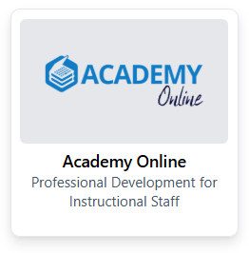
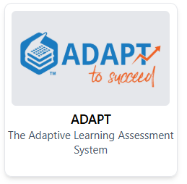
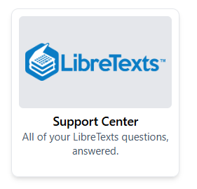

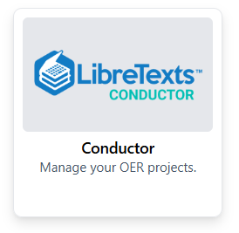
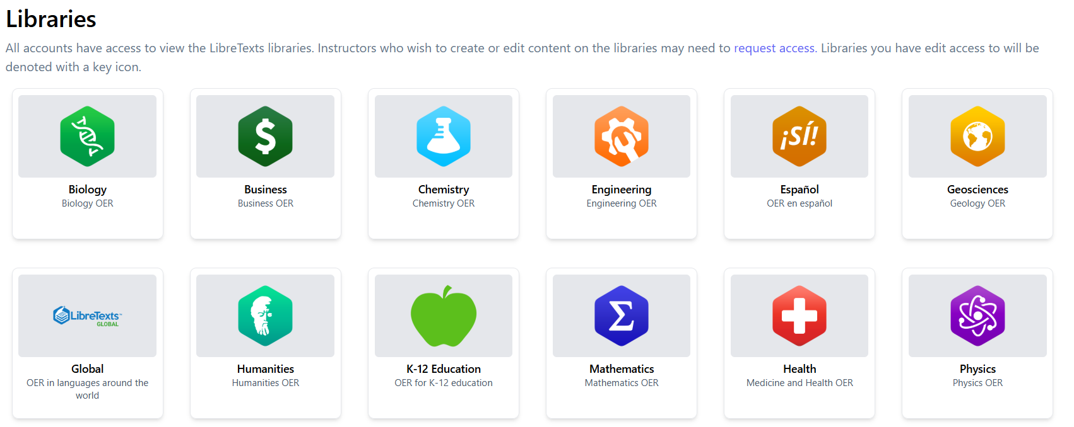
The LibreVerse: Tools and Libraries

Slide 11
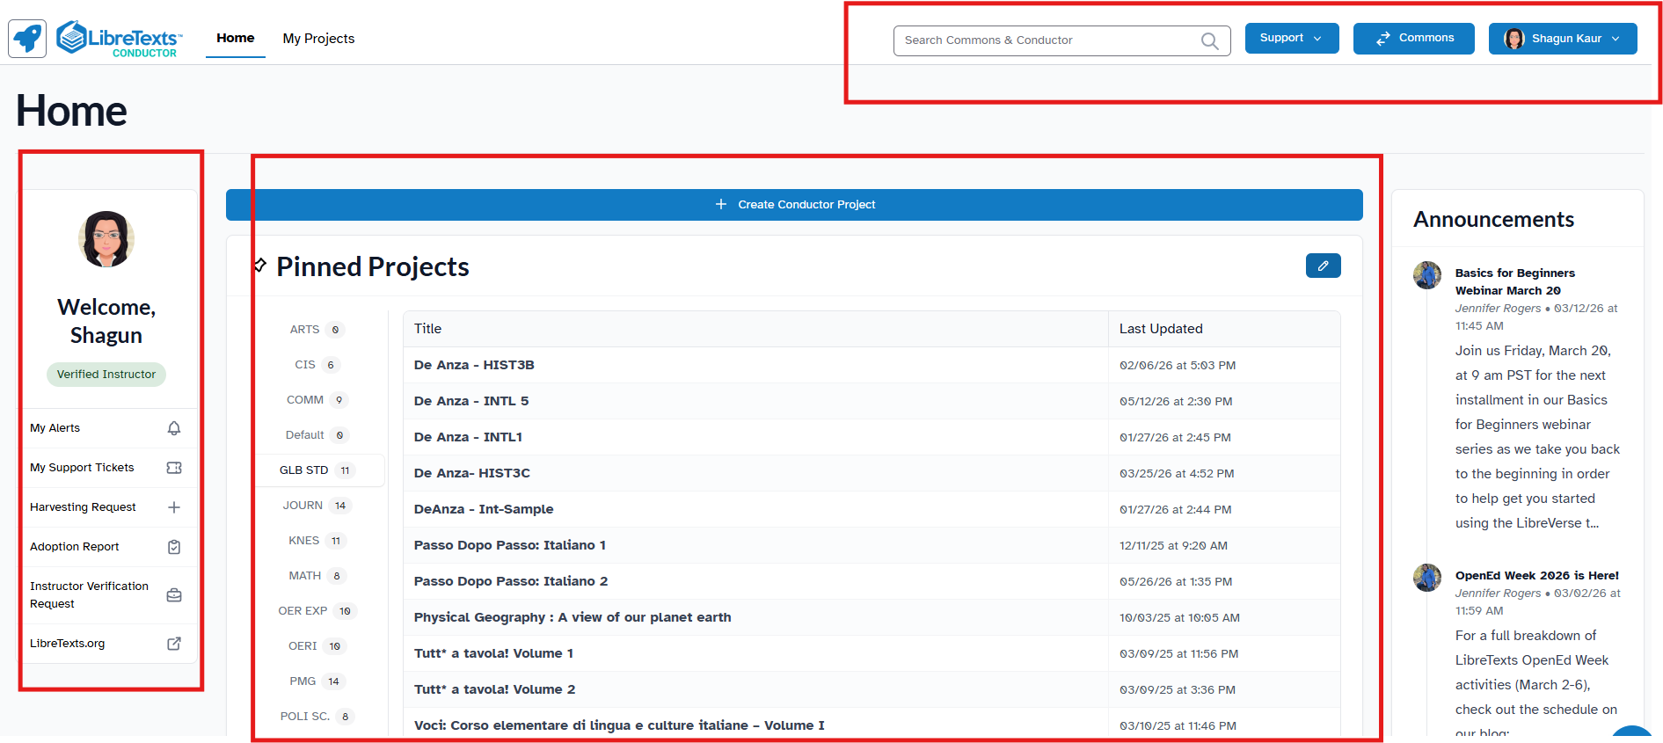
Conductor Dashboard
Navigation & Tools (Top Bar) - Access search, support resources, Commons, and account settings.
Project Workspace (Center) - Create, organize, and manage OER projects, folders, and recently updated content.
Account & Resources (Side Panels) - View instructor tools, requests, alerts, support options, and LibreTexts announcements.

Slide 12

Time to Explore or Breathe
Sloth by Mancia Freddy is licensed CC0 1.0 Public Domain.

Slide 13

Go Back to the Rocket Ship
LibreTexts Rocket Icon. Adapted for instructional use. Original icon from LibreTexts. CC0 1.0 Public Domain.

Slide 14
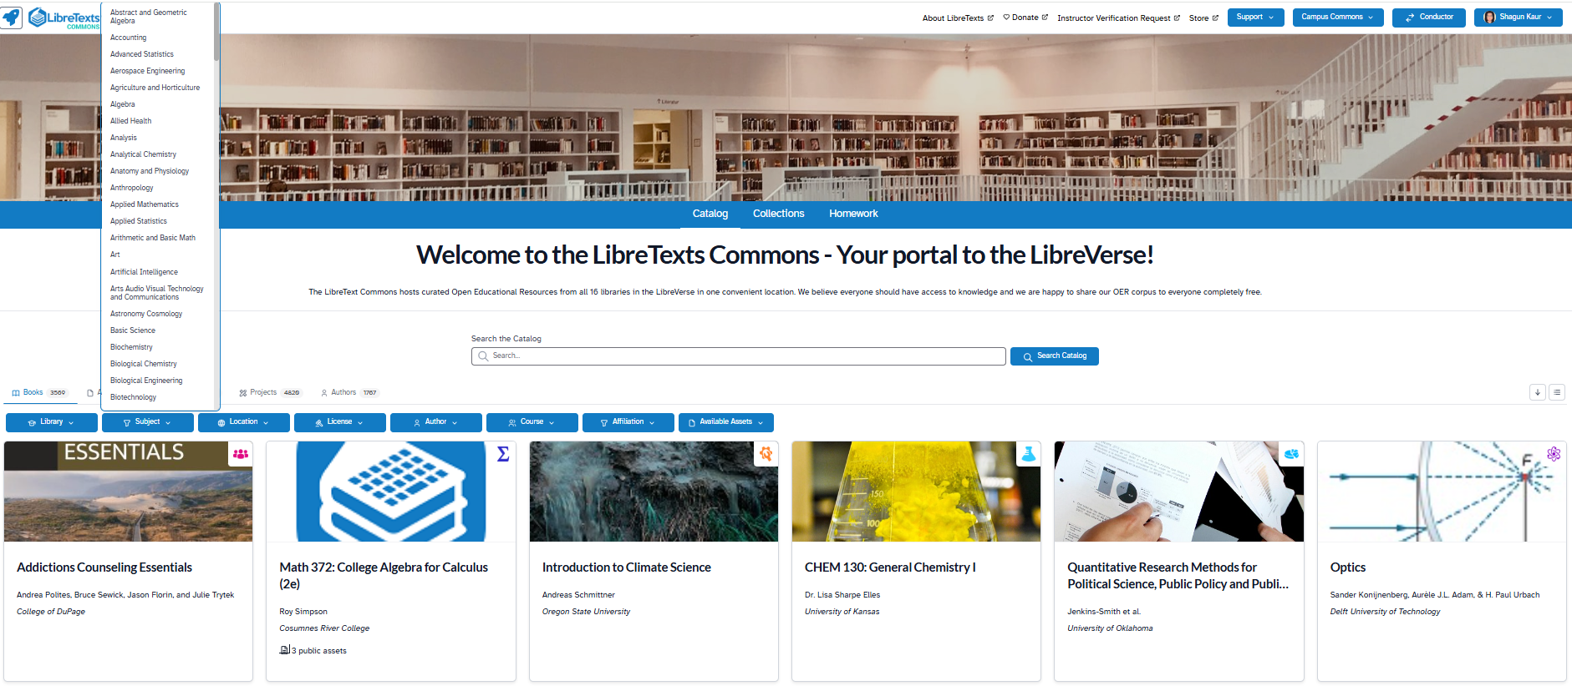
Searching the Commons

Slide 15
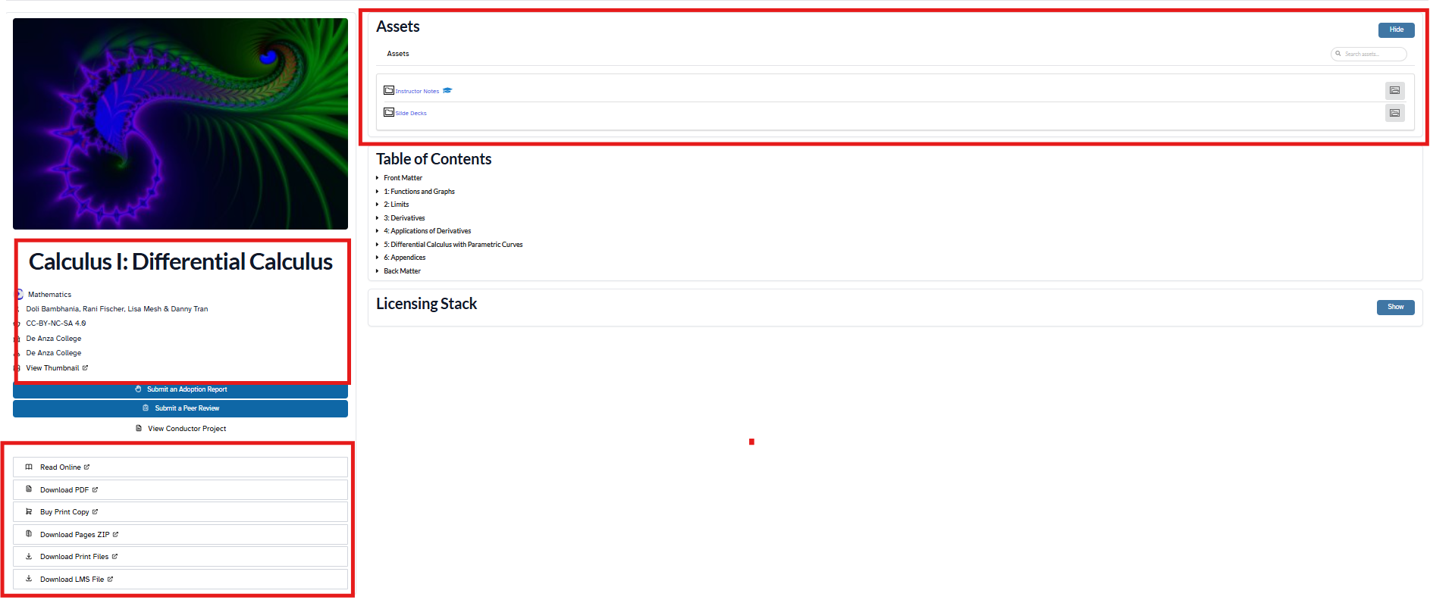
Accessing a Resource
Assets & Ancillaries - Access instructor resources, supplemental materials, and supporting files.
Resource Details - View authorship, institution, attribution, and licensing information.
Access Options - Read online or download the resource in multiple formats, including PDF and LMS packages.

Slide 16
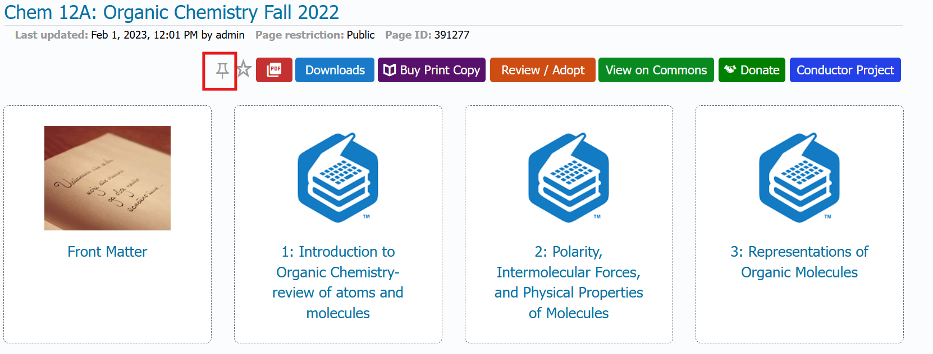
Pinning a Book
Click on “Read Online”
Sign in if prompted, and then click on the pin icon.
Star Notification – for the book or a page

Slide 17
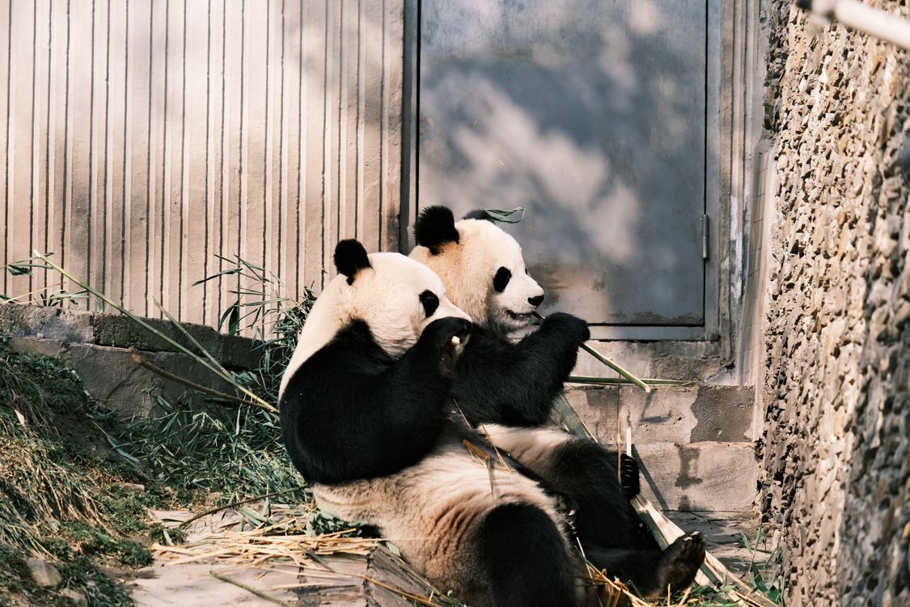
Time to Explore or Breathe
Two Pandas by Lily Lili under Pexels license

Slide 18

Go Back to the Rocket Ship
LibreTexts Rocket Icon. Adapted for instructional use. Original icon from LibreTexts. CC0 1.0 Public Domain.

Slide 19
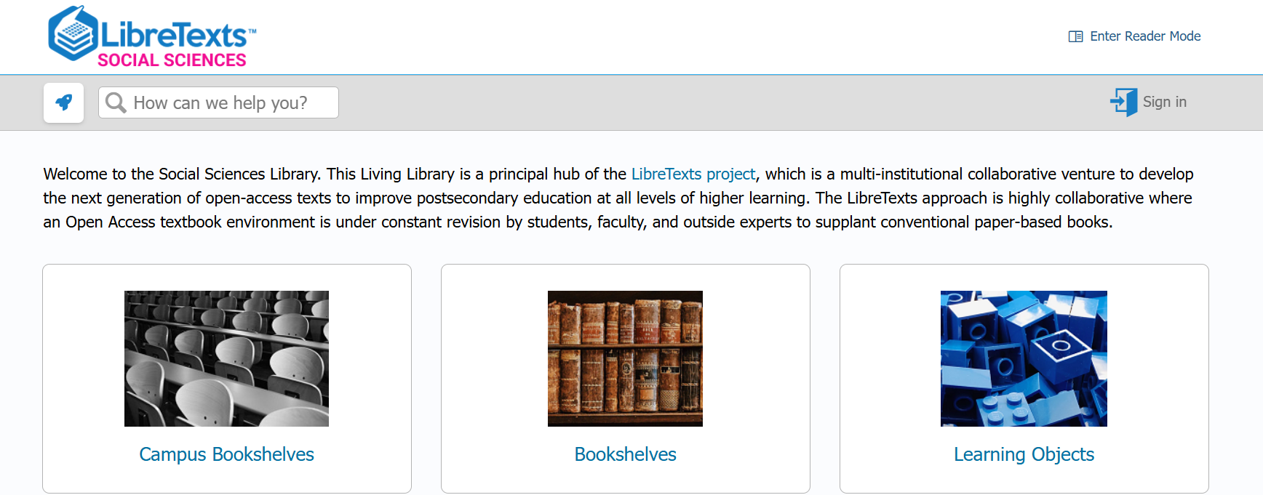
Navigating the Libraries

Slide 20
Bookshelves vs Campus Bookshelves
Bookshelves | Campus Bookshelves
"What's out there?" | "What's happening here?"
Discover OER from across the LibreTexts community. | Explore resources your/neighboring institution has adopted, adapted, or created.
Great for finding new textbooks and materials. | Great for finding campus-vetted resources.
Organized by discipline and subject area. | Organized around institutional collections and initiatives.
Shared by educators across colleges and universities. | Curated by a campus, district, or consortium.
Perfect when you're looking for ideas. | Perfect when you're ready to implement.

Slide 21

Time to Explore or Breathe
Tortoise is licensed CC0 1.0 Public Domain.

Slide 22
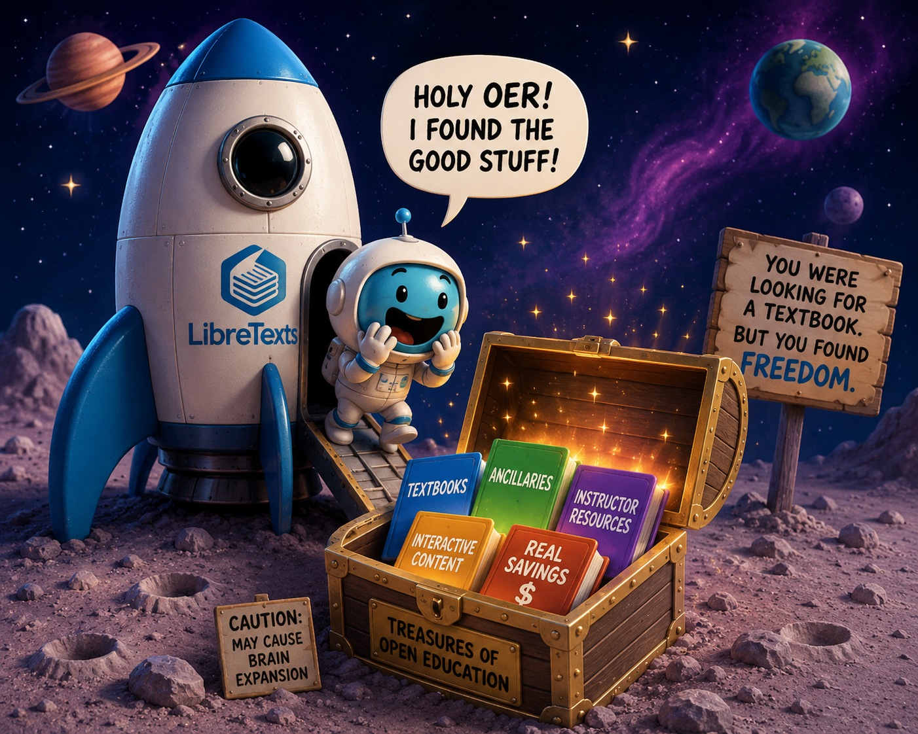
Did you Strike Gold?
LibreTexts Rocket Icon. Adapted for instructional use. Original icon from LibreTexts. CC0 1.0 Public Domain.

Slide 23
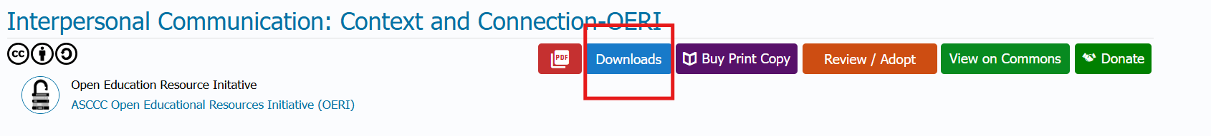
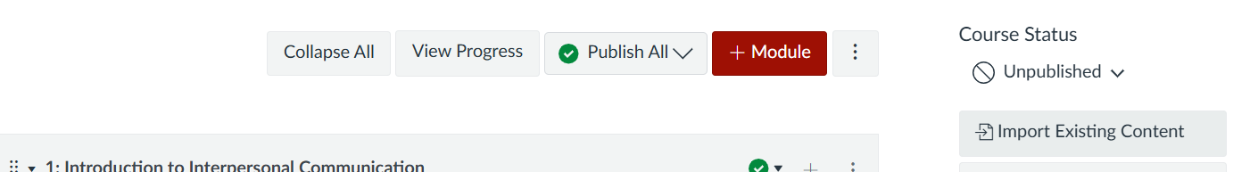
Downloading the LMS File
Once you find the content in LibreTexts you want, select the Downloads button and then “Import into LMS"
After the export is downloaded, you then enter your Canvas course to upload it. From the course homepage, select the “Import Existing Content” option from the menu on the right-hand side.

Slide 24
Integrating into Canvas
In your Canvas course, open Modules and select Import Existing Content.
From the Content Type menu, choose Common Cartridge 1.x Package.
Browse to and upload the LibreTexts package downloaded from the Downloads menu.
Select All Content to import the complete resource, or choose Specific Content if you want only selected materials.
Check Add to Import Queue to begin the import process.
Once the import is complete, review the imported modules, pages, assignments, and files.
Organize, edit, or publish the imported content as needed before making it available to students.
💡 Tip: Imported LibreTexts content becomes part of your Canvas course, allowing you to customize modules, add your own materials, and integrate OER directly into your course structure.

Slide 25
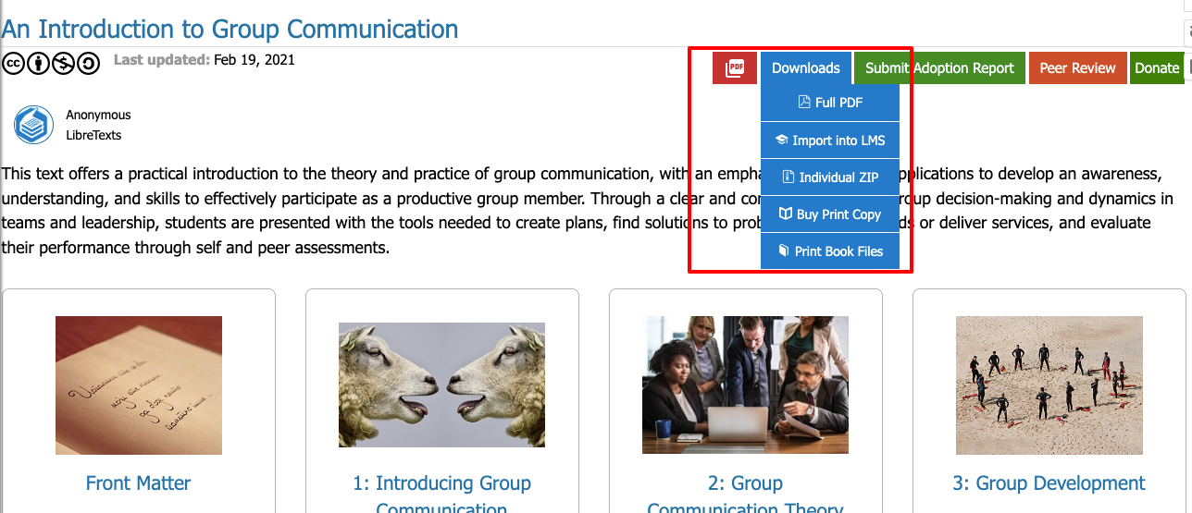
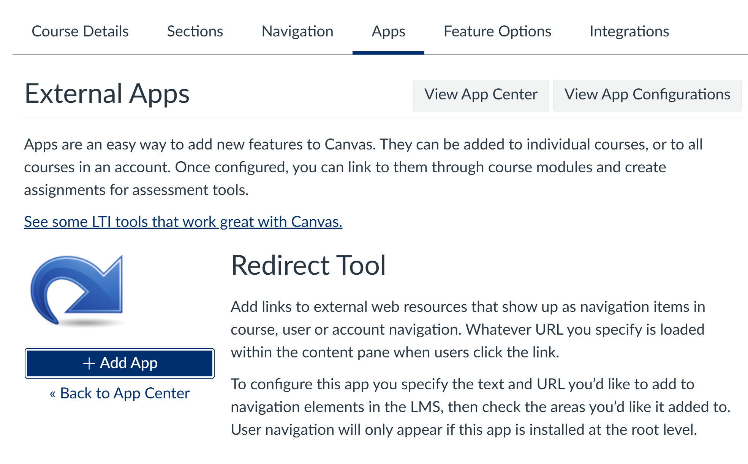
Alternatives
Direct Access to LibreTexts
Canvas Redirect Tool

Slide 26
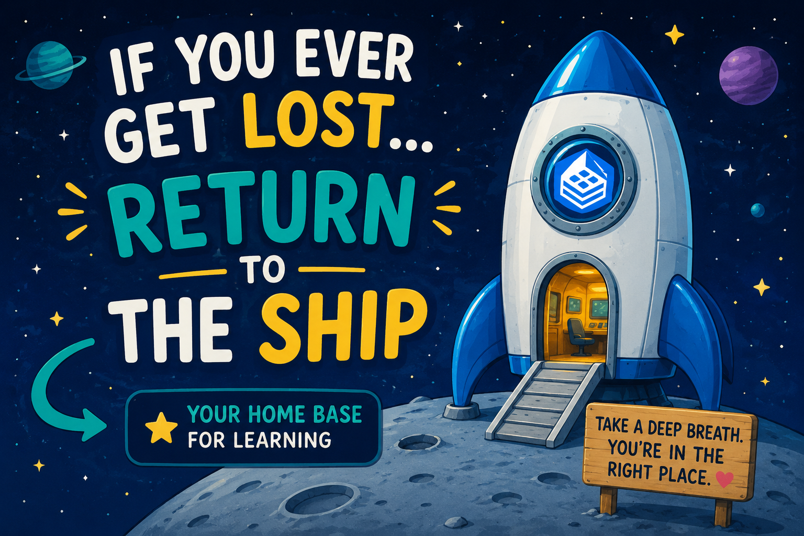
If you get lost: Return to the Ship
LibreTexts Rocket Icon. Adapted for instructional use. Original icon from LibreTexts. CC0 1.0 Public Domain.

Slide 27
Next in the Series and Coming Up
Level 1 | Accessing ADAPT and finding ADAPT questions | Wednesday, June 3, 9:00-10:30 am
Level 1 | LibreTexts Essentials: Navigation & Smart Search. | Tuesday, June 2, 9:00-10:30 am
Level 2 | LibreTexts Remixer Lab: Create, Curate, Customize. | Thursday, June 4, 9:00-10:30 am
Level 3 | Quick Start: Edit Pages in LibreTexts. | Monday, June 8, 10:00-11:30 am
Level 4 | Designing with Media: Images and Video in LibreTexts | Wednesday, June 10, 10:30-12:00 pm

Slide 28

Contact Us
Holiday Hedgehog is licensed CC0 1.0 Public Domain
Cristina Moon –cmoon@chabotcollege.edu
Shagun Kaur – kaurshagun@fhda.edu
OERI Team - oeri@asccc.org

