Slide 1
Welcome!
On behalf of the ASCCC OERI, we are pleased to have you here with us for “Cloning Native Basic Questions.”
If you are not already muted, please mute yourself upon arrival.
Please note that you are encouraged to use the Zoom “chat” feature for questions and comments.
You’re invited to introduce yourself in the chat – please provide your name, college, discipline/role
This event will be recorded. Archives of all ASCCC OERI events are available at asccc-oeri.org > Webinars and Events

Slide 2
Level 2: Cloning Native Basic Questions
June 4th, 2026. 12:00 pm – 1:30 pm
This work is licensed under a Creative Commons Attribution 4.0 International License.)

Slide 3

Presenters
Cristina Moon, ASCCC OERI ADAPT lead
  Spanish, Chabot College
Shagun Kaur, ASCCC OERI LibreTexts Lead
  Communication Studies, De Anza
Photo by Siora Photography on Unsplash
Notes:
Presenters can be included following the description or the overview. Where images are used, they should include an attribution (Photo by…) and appropriate alternative text should be used (or the image marked decorative).

Slide 4
Webinar Description
Now that you have explored ADAPT, it’s time to start building. This session focuses on the "cloning" process, allowing you to pull existing ADAPT questions into your own courses for full control. You will learn how to create and modify ADAPT native questions featuring various question types including fill-in-the-blank, multiple choice, select choice, highlight text, and matching as well as the new flashcard question type, all designed to be accessible and adaptable.

Slide 5

Registration for a LibreTexts Account
If you don't already have one, register for a LibreOne account.
Verify your Instructor status to unlock full LibreTexts functionality.

Slide 6


Logging in to your Account
Navigate to LibreTexts.org and click on the “rocket ship” icon
It will prompt you to sign in if you are not already logged in

Slide 7

Overview
Navigating ADAPT questions
Why Clone?
Import ADAPT Demo Course
Clone ADAPT Native Basic Questions
Add Questions to Assignment
Notes:
An Overview slide should be included that is an outline of the presentation.

Slide 8
ADAPT as an OER Question Library
H5P: 28,000+ questions
WeBWork: 56,000+ questions
MOM/iMathAS: 73,000+ questions
Open-Ended: 72,000+ questions
ADAPT Native Technology: 100,000+ questions
  Basic QTI (Canvas-like): 46,000+ questions
  Nursing (NCLEX prep): 17,113+ questions
  Sketcher (molecular structures): 3391 questions
  Discuss-It (Threaded Audio/Visual): 556 questions

Slide 9
Cloning Questions
You can any public question to your assignment, but only certain question types can be cloned.
Only ADAPT native questions, WeBWorK questions, Forge questions, and Learning Trees can be cloned.
For example, H5P questions cannot be cloned from ADAPT since they were not created in ADAPT. To edit an H5P question, you must find the activity in Studio and copy it and then bring it into ADAPT. For more information on how to copy H5P questions, see How to remix H5P
Cloning creates a copy of the question in your account that you can then edit.

Slide 10
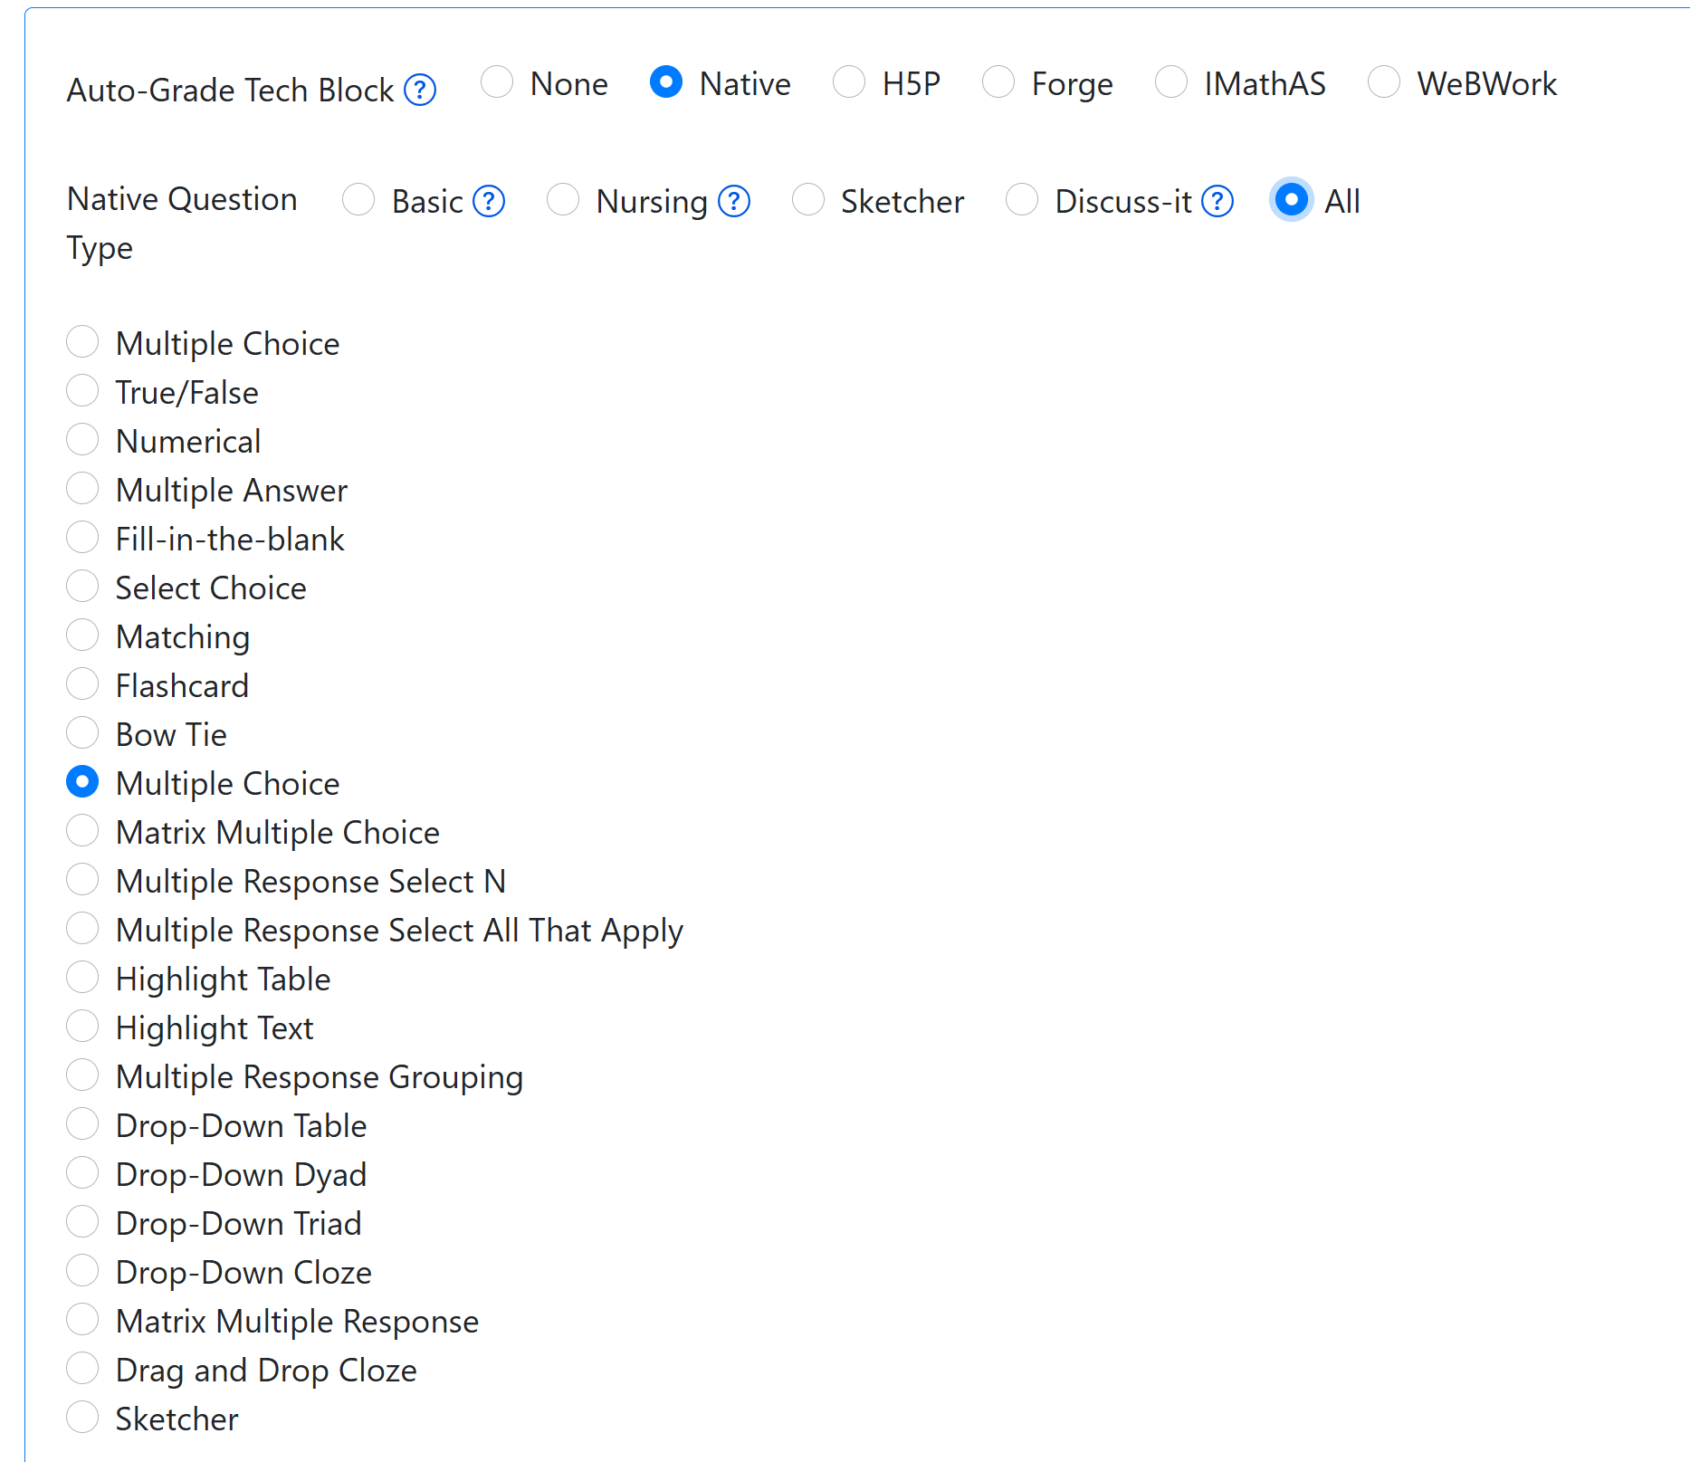
ADAPT Native Question Types

Slide 11
Why Clone a Question?

Slide 12
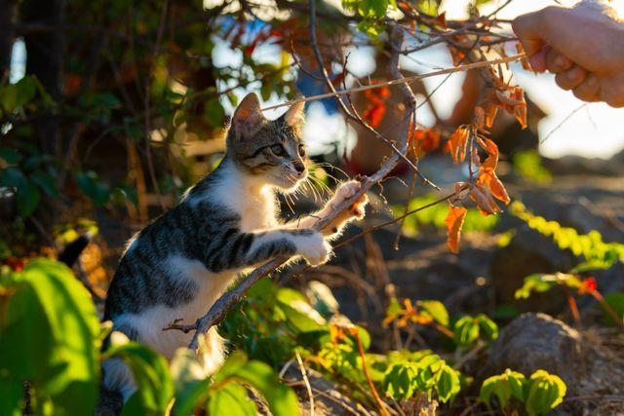
Ready to Play?
Playtime by Muhammed Sezer under Pexels license

Slide 13
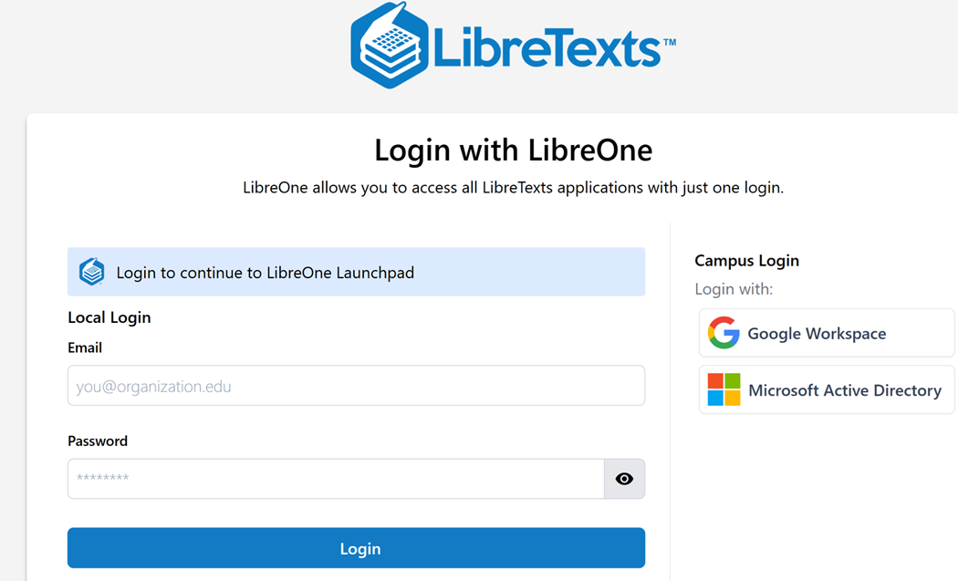
Log into LibreOne
LibreOne link (https://one.libretexts.org/)
Once you have the account, start with “Consult Insight” for training videos and instructions.
Notes:
https://one.libretexts.org/

Slide 14
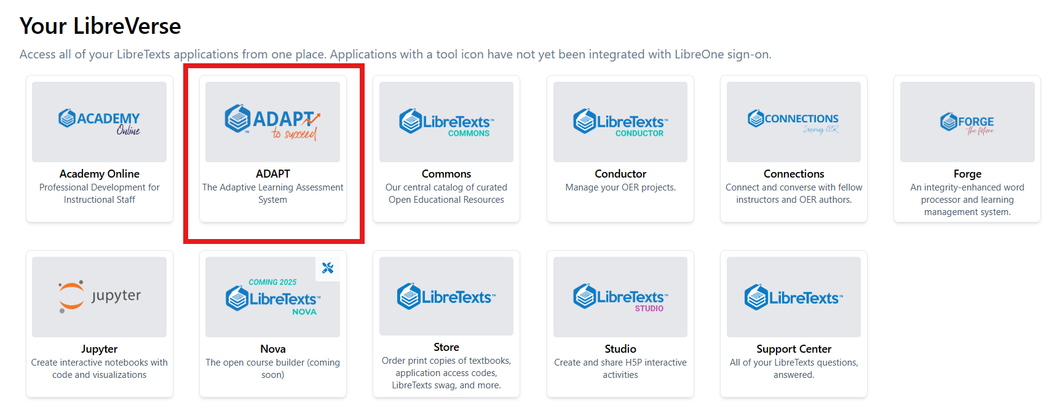
Finding ADAPTT

Slide 15
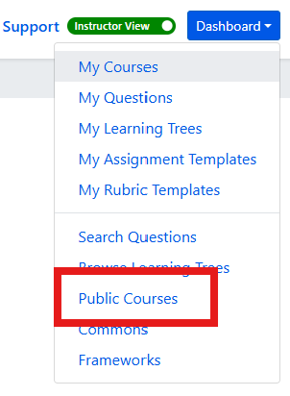
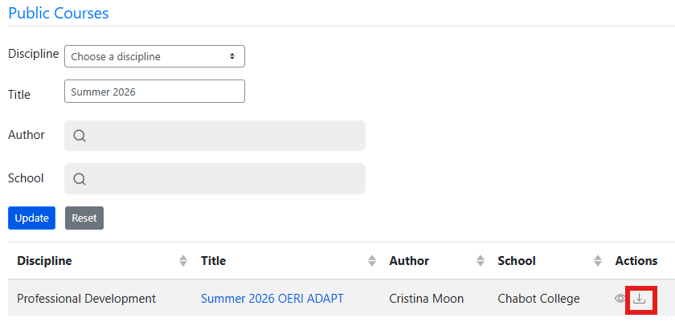
Import OERI ADAPT Demo Course
First, find the Dashboard and select Public Courses.
Next, under Title, type Summer 2026 OERI ADAPT and then select the import (down arrow).

Slide 16
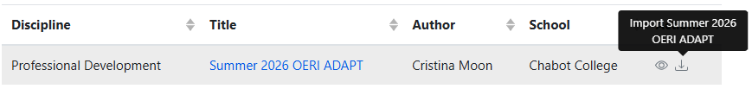
Importing a Public Course - Step-by-Step
Log into LibreTexts.
Navigate to ADAPT.
If you are logged in as an Instructor, your Dashboard will be in the upper right of your screen no matter where in ADAPT you are.
Select “Public Courses.”
Leave the “Discipline” field as it as and then enter “Summer 2026 OERI ADAPT” in the “Title” field.
Select “Update.”
You should now have the Summer 2026 OERI ADAPT Course available for you to import into your courses.
Select the down arrow under actions (on the far right) to import the course.

Slide 17

Time to Play or Breathe
Sloth by Mancia Freddy is licensed CC0 1.0 Public Domain.

Slide 18
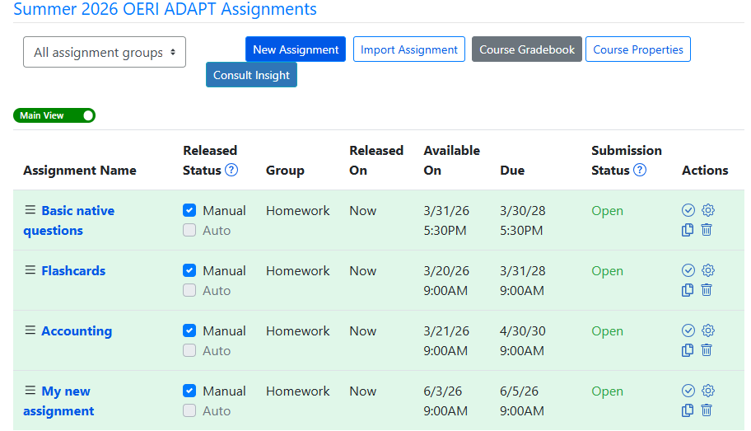
Summer 2026 OERI ADAPT Course Assignments
Notes:
Within the demo course, you will see 4 assignments - each contains examples of the question or activity type specified in its title.

Slide 19
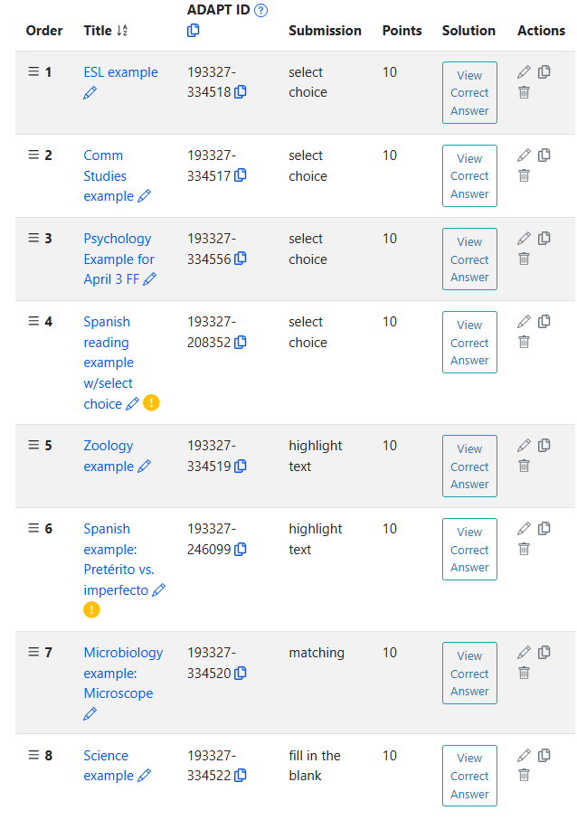
Exploring Basic Native Questions
For today’s webinar, we will work on:
Select choice
Highlight text
Matching
Fill in the blank

Slide 20
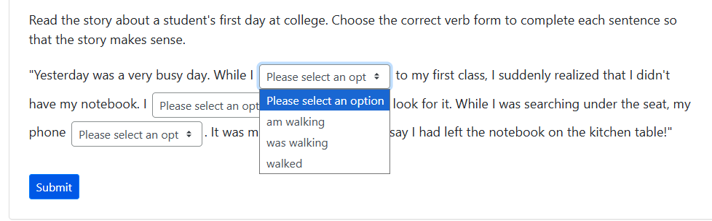
Explore Select Choice Question

Slide 21
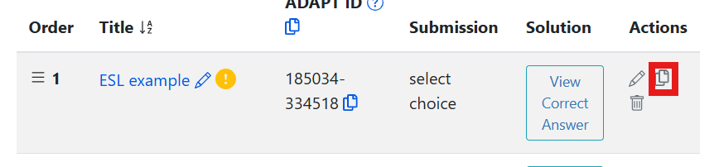
Clone (Copy) an ADAPT Question
Choose the ESL example to clone. Select the clone icon under the Actions heading.
Your cloned question will be at the bottom of the page in your Basic native questions assignment.

Slide 22
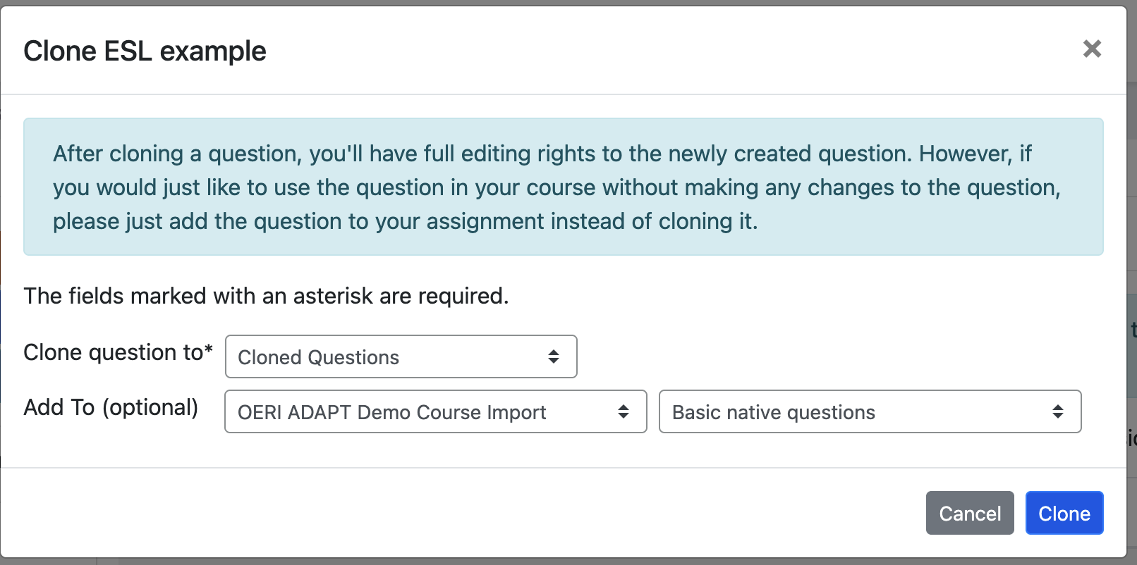
After Cloning

Slide 23
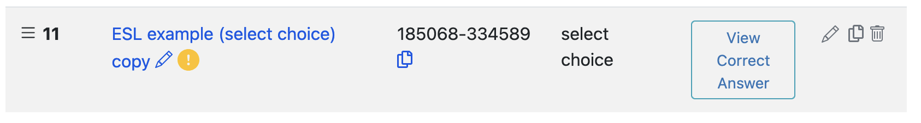
To Access Your Copy, Select Its Title
Modify the title of your cloned question by selecting the pencil icon at the end of the title either before or after accessing all elements of your copy.
Upon accessing your question for editing, you will make edits in just two sections:
  Properties
  Primary Content

Slide 24
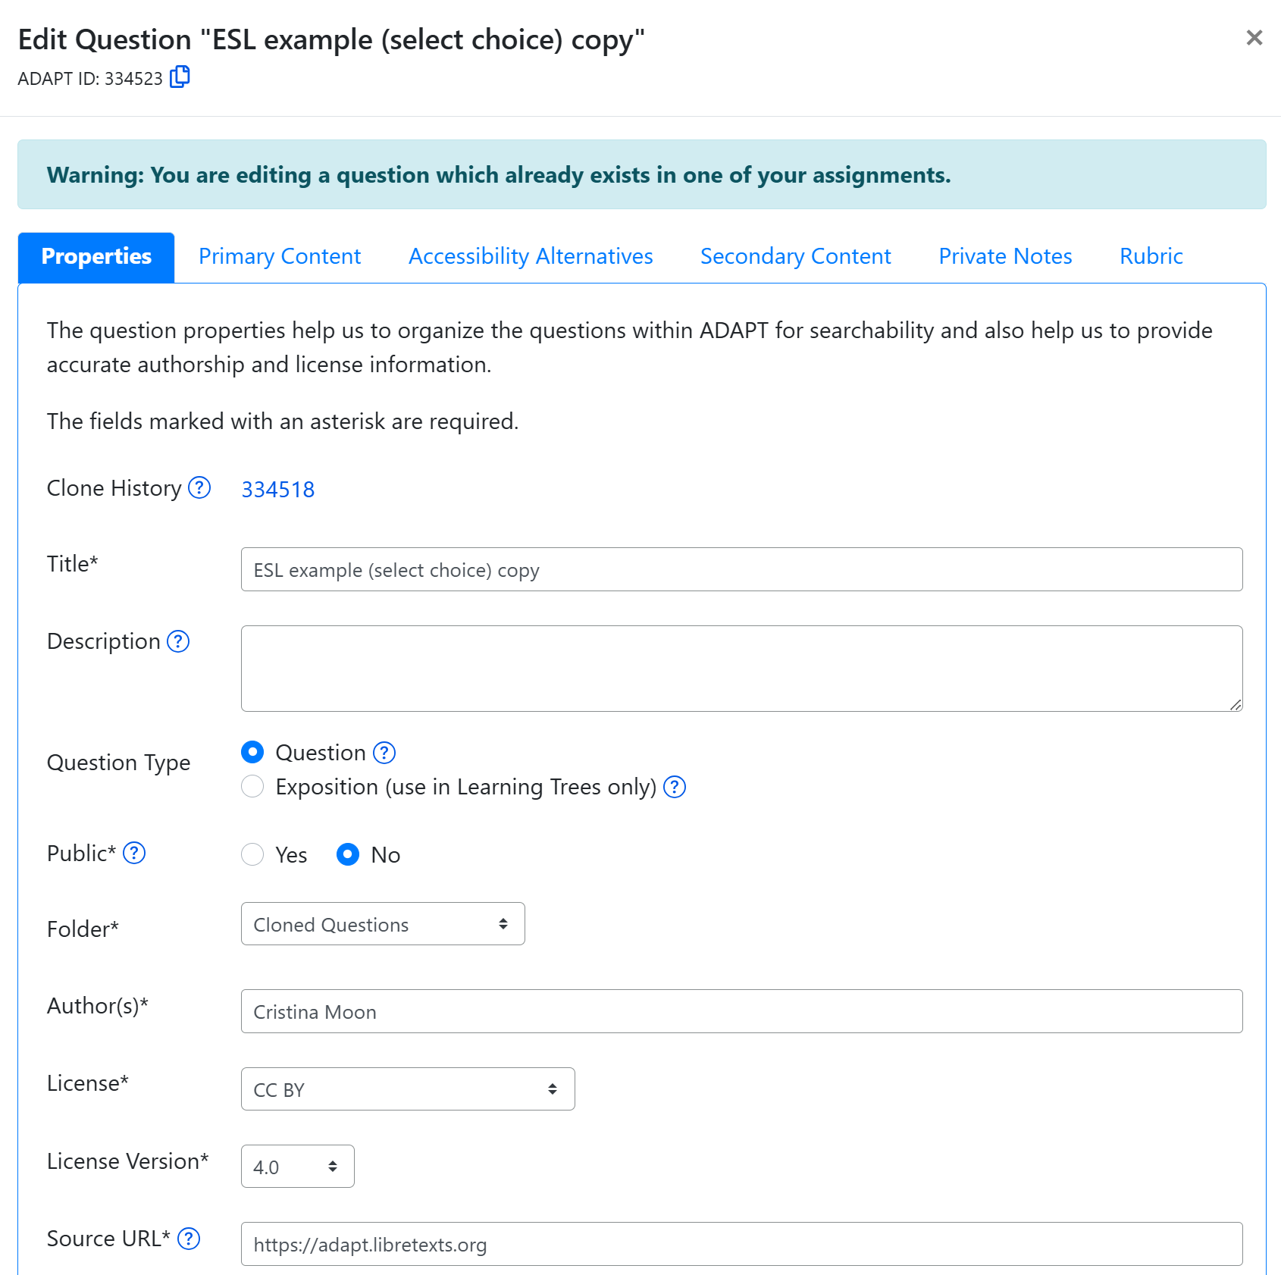
Properties: Edit the Properties of Your Select Choice Question
Under the first tab, Properties:
Change the title.
Add a description, if desired.
Don’t change Question Type.
Public - yes or no.
Automatically goes to Cloned Questions folder - but you can change this.
Change author to yourself.
Modify license if needed.
Notes:
Edit Properties and Primary Content. 1. Change the title. 2. Add a description, if desired. 3. Don’t change Question Type. 4. Public - yes or no. 5. Automatically goes to Cloned Questions folder - but you can change this. 6. Change author to yourself. 7. Modify license if needed.

Slide 25
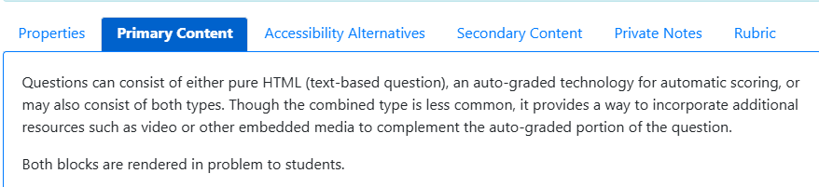
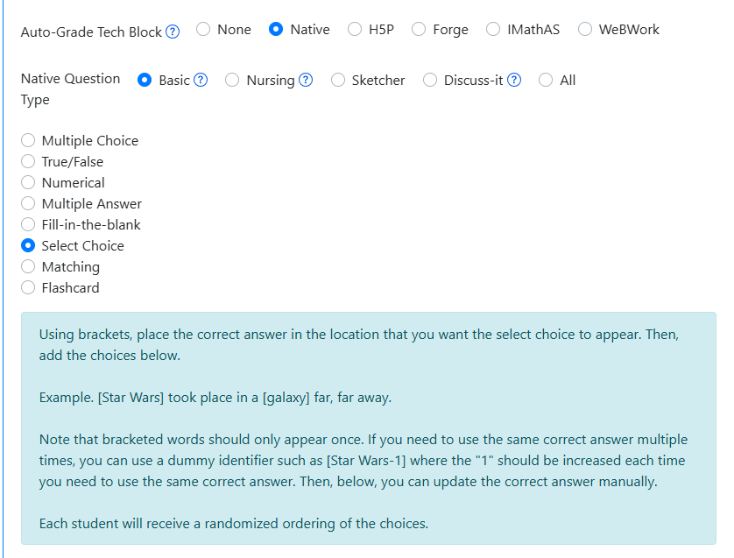
Primary Content: Instructions for Creating a Select Choice Question
Under the Primary Content tab, you can view and edit the question content.
If you are unsure how to create or edit a specific question type, refer to the instructions found in the blue box.
Notes:
Under Primary Content choose Native > Select Choice

Slide 26
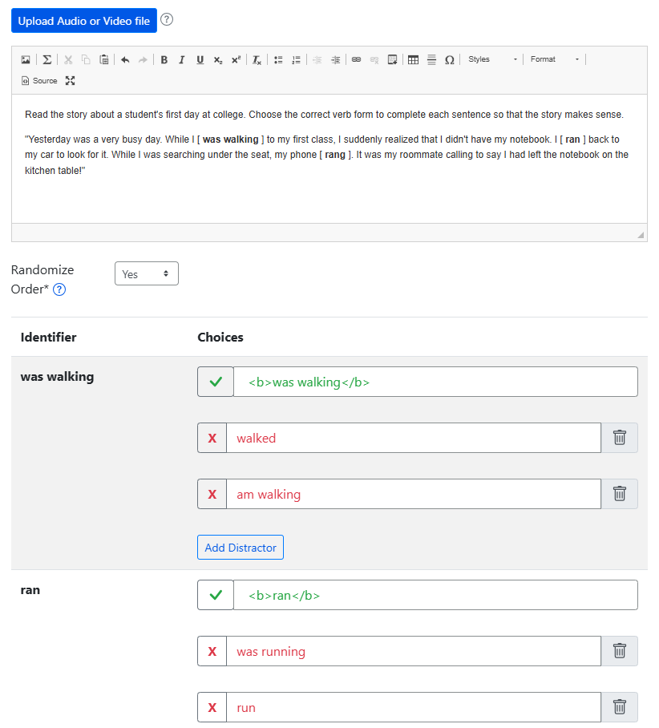
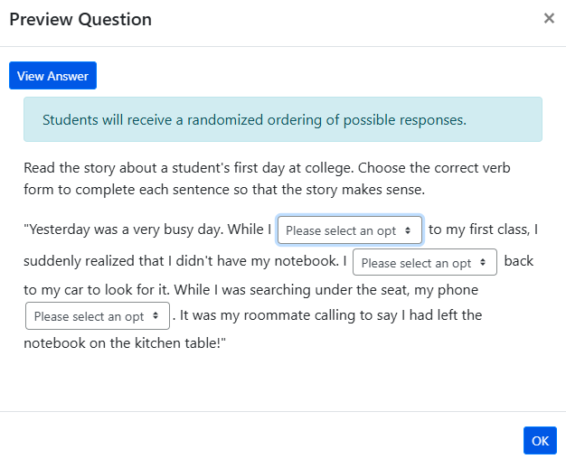
Modify Select Choice Primary Content and Question Preview

Slide 27
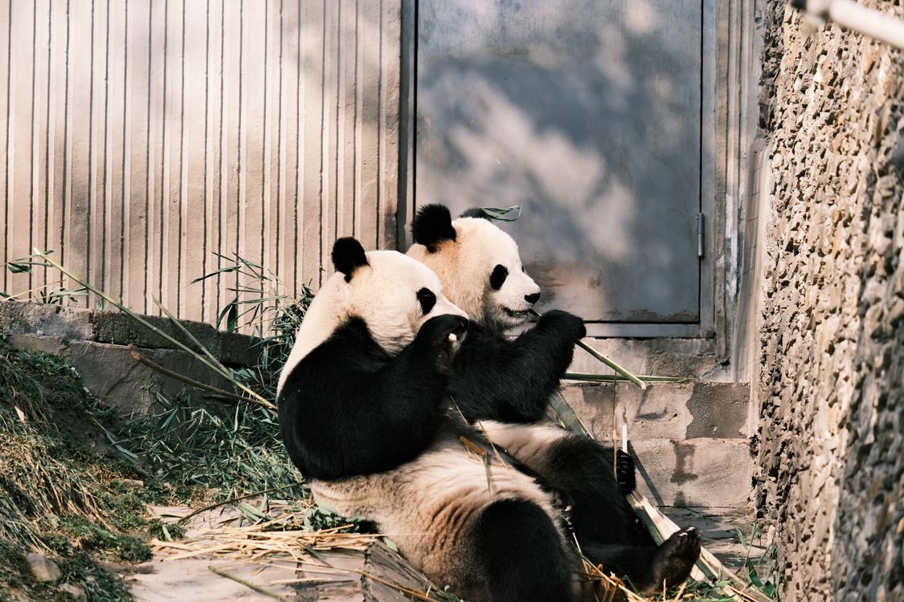
Time to Play or Breathe
Two Pandas by Lily Lili under Pexels license

Slide 28
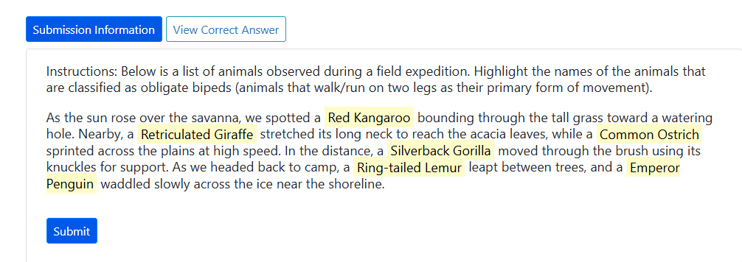
Explore Highlight Text Question

Slide 29
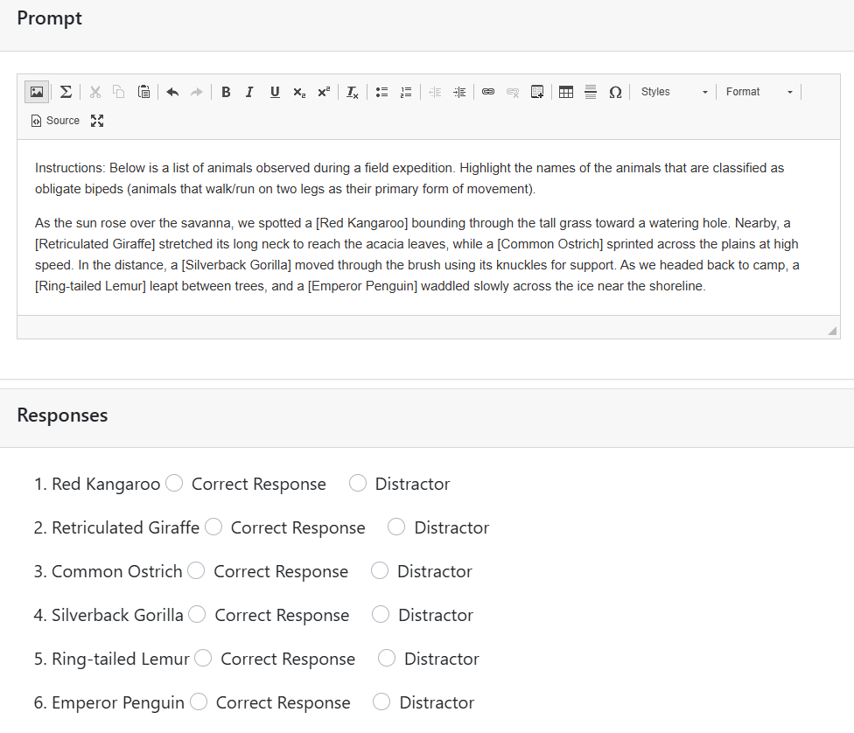
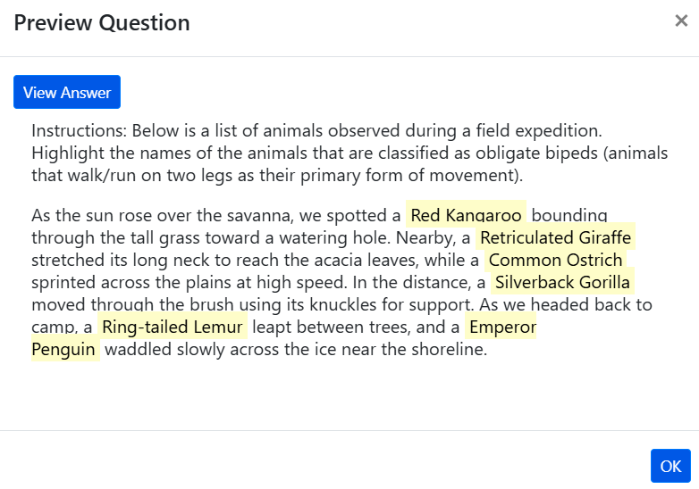
Highlight Text Primary Content and Question Preview

Slide 30
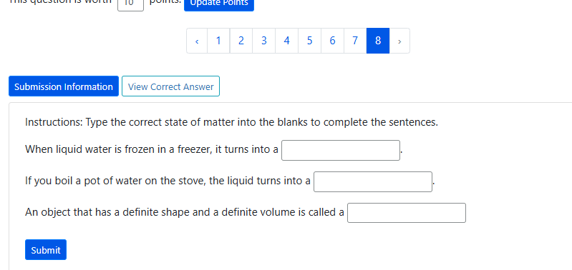
Explore Fill in the blank Question

Slide 31
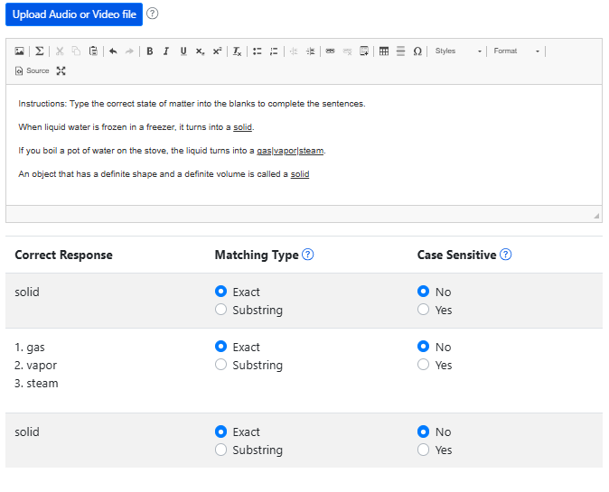
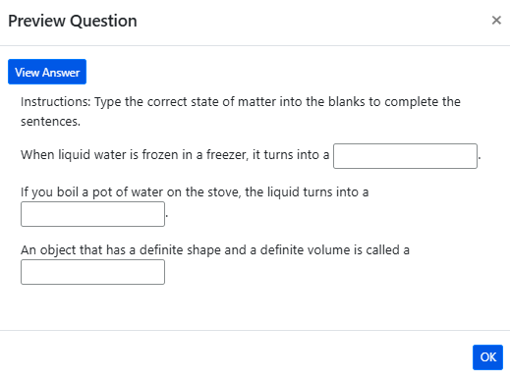
Fill in the blank Primary Content and Question Preview

Slide 32
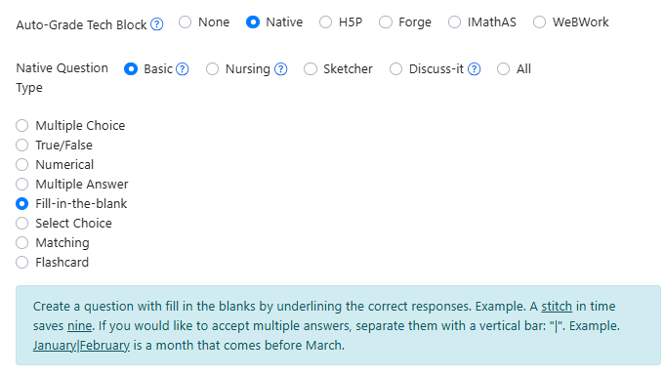
Instructions for Creating a Fill in the blank Question

Slide 33
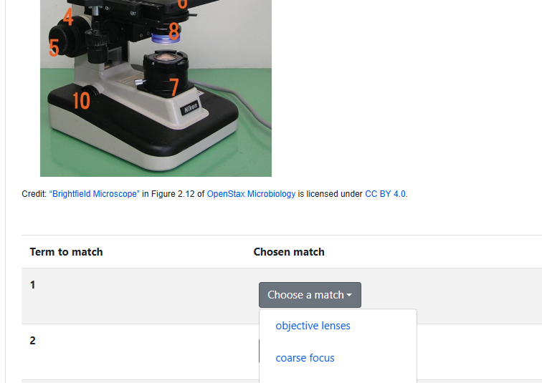
Explore Matching Question

Slide 34
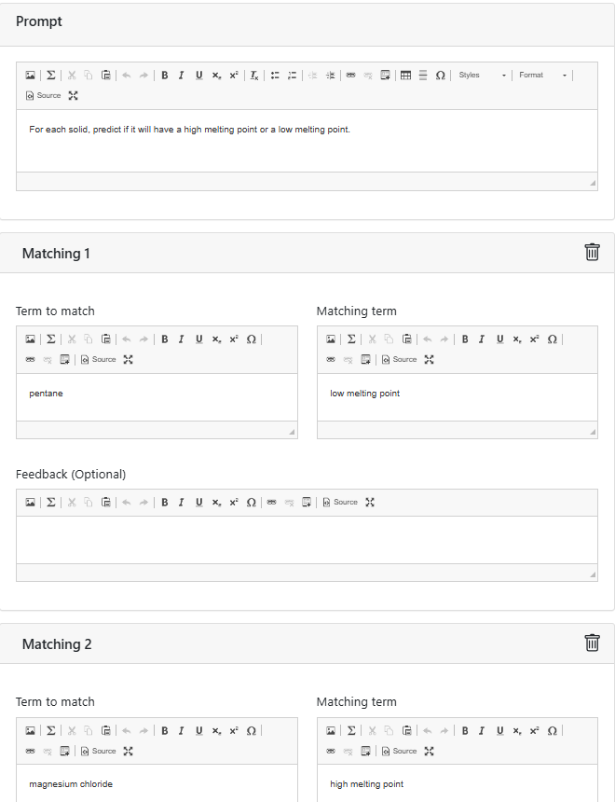
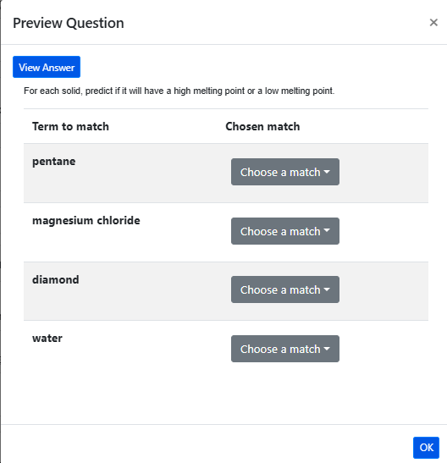
Matching Primary Content and Question Preview

Slide 35
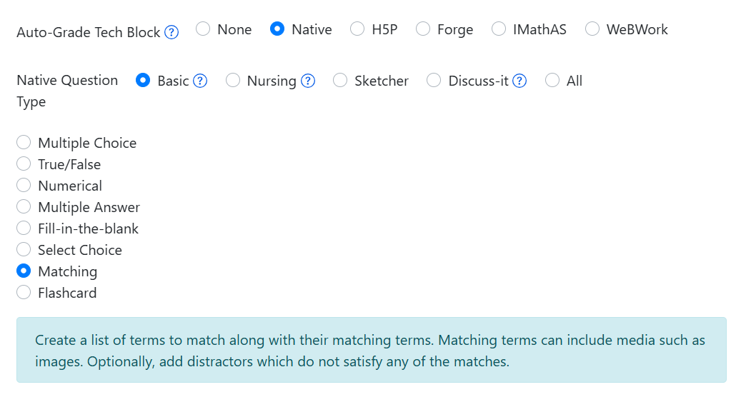
Instructions for Creating a Matching Question

Slide 36

Time to Explore or Breathe
Tortoise is licensed CC0 1.0 Public Domain.

Slide 37
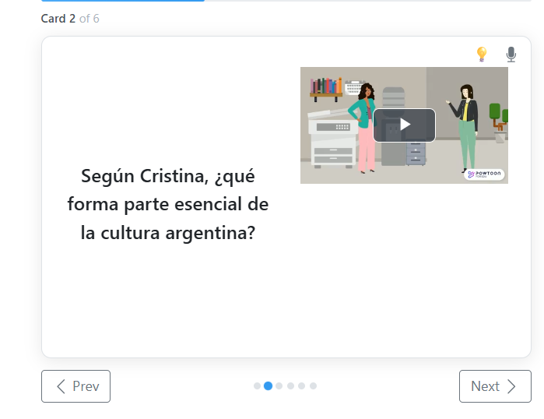
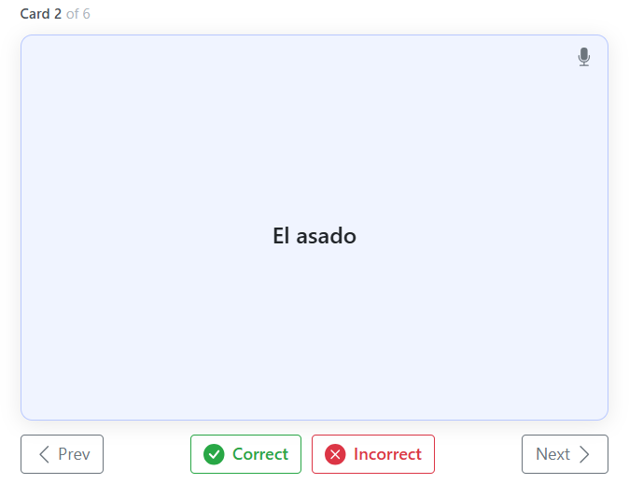
Explore Flashcard Question

Slide 38
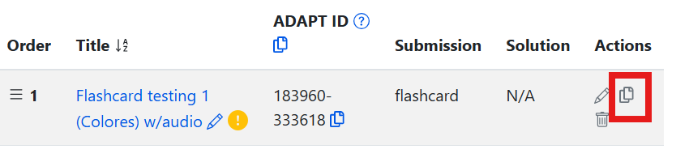
Clone a Flashcard
Return to your imported Summer 2026 OERI ADAPT course.
Navigate to the Flashcards assignment.
Clone the Flashcard of your choice.

Slide 39
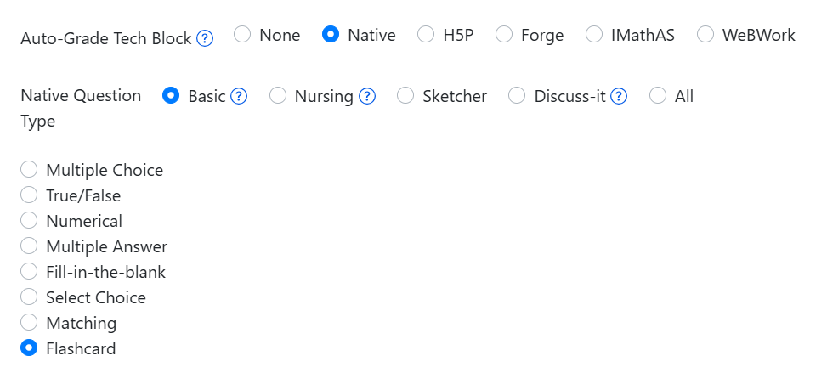
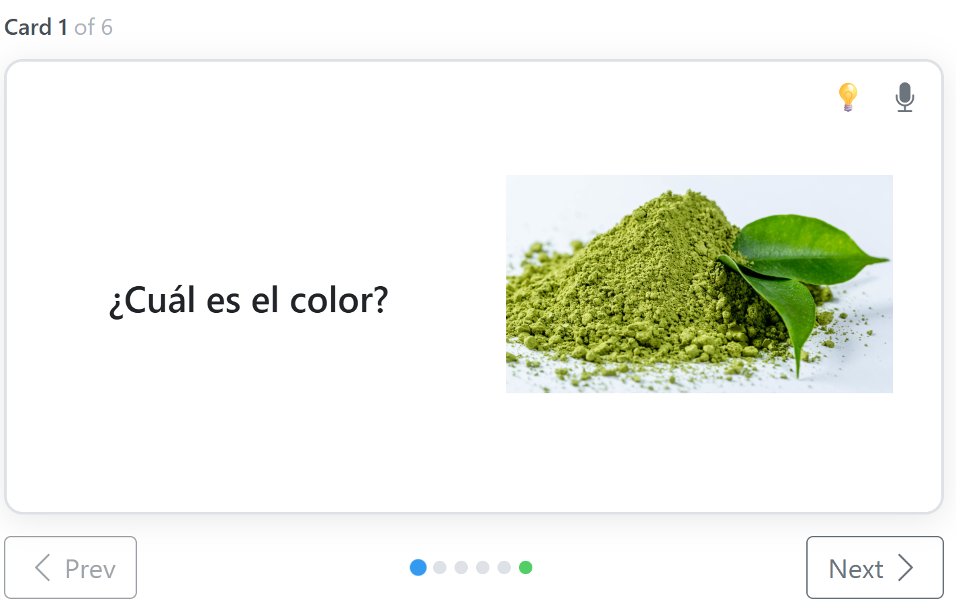
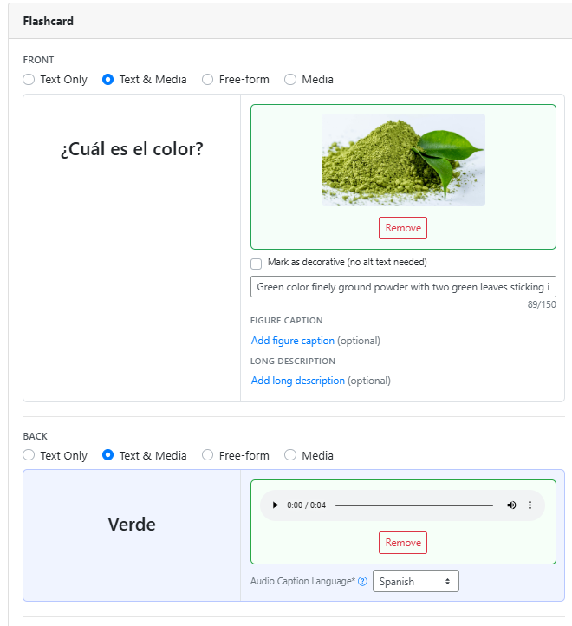
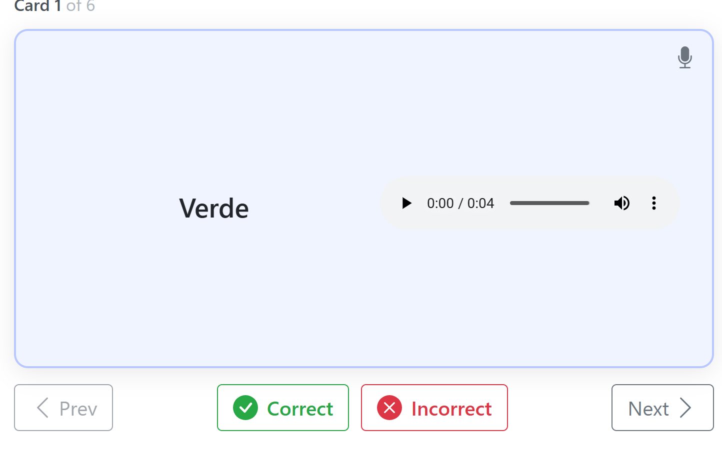
Flashcard Primary Content and Preview
Preview

Slide 40
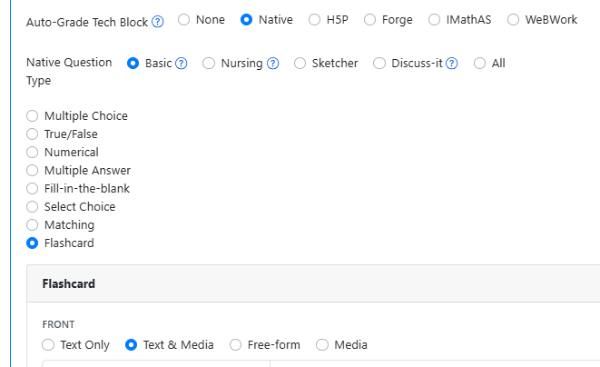
Primary Content: Instructions for Creating a Flashcard

Slide 41
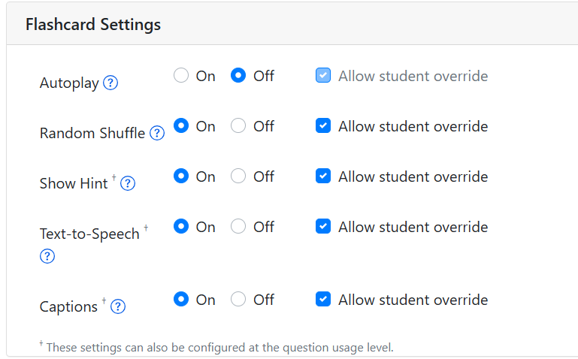
Go to Assignment Properties to find Flashcard Settings
Confirm that all the settings are correct for the Flashcard assignment that you just created.
Check:
autoplay
random shuffle
show hit
text to speech
captions

Slide 42
Editing/Creating a Flashcard Question
Questions can consist of either pure HTML (text-based question), an auto-graded technology for automatic scoring, or may also consist of both types. Though the combined type is less common, it provides a way to incorporate additional resources such as video or other embedded media to complement the auto-graded portion of the question.
  Both blocks are rendered in problem to students.
Front and Back options
  Text only
  Text and media
  Free-form
  Media
Hint (optional)

Slide 43
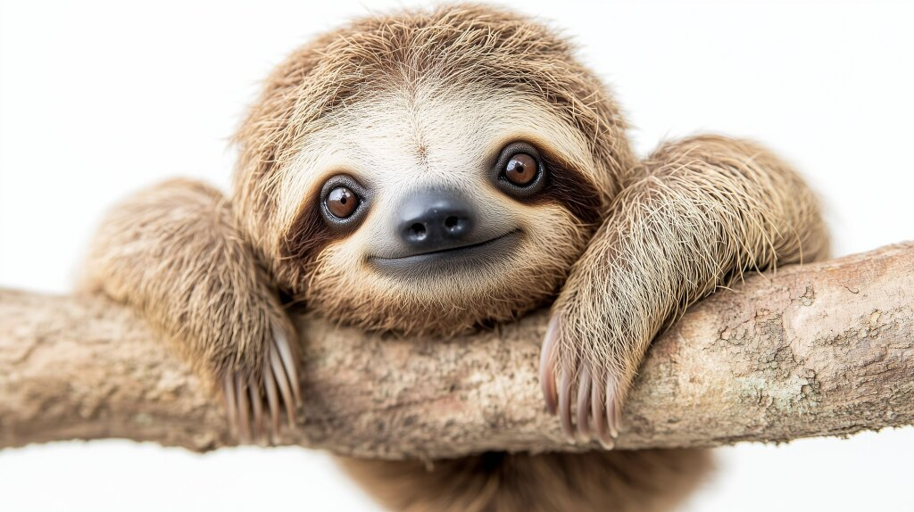
Time to Explore or Breathe
Sloth by Marco Verch is licensed CC BY 2.0

Slide 44
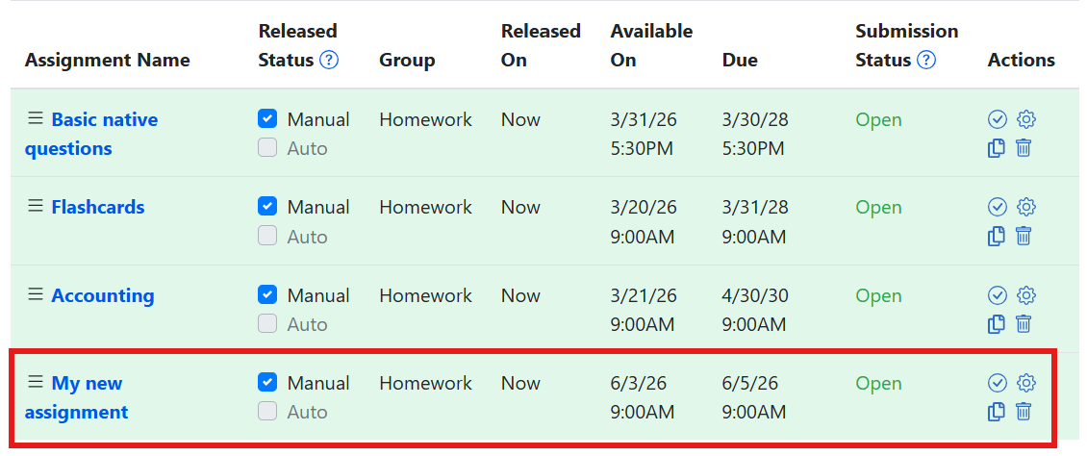
Adding cloned questions to a new assignment
Go back to the Summer 2026 OERI ADAPT course
Select My new assignment

Slide 45
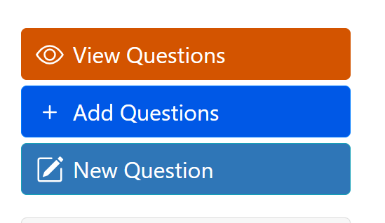
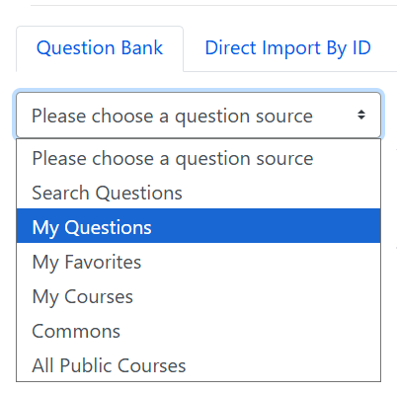
Add Questions to Assignment
Open the course that you imported
Open the assignments
Select Add questions
Under Question Bank, select My Questions
Find the Cloned Questions Folder
Find the questions you want to add

Slide 46
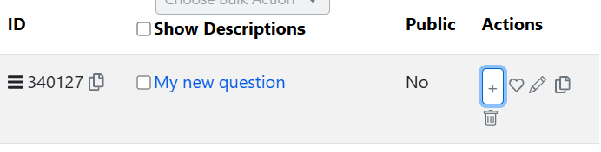
Adding Questions from Folders
To add question to the assignment, select the + sign under Actions.

Slide 47
Things to Remember
You can add any public question to your assignment in ADAPT.
However, only certain question types can be cloned, specifically: ADAPT native questions, WeBWorK questions, Forge questions, and Learning Trees,
Cloning a question creates a copy in your cloned folder that you can freely edit and later add to an assignment.

Slide 48
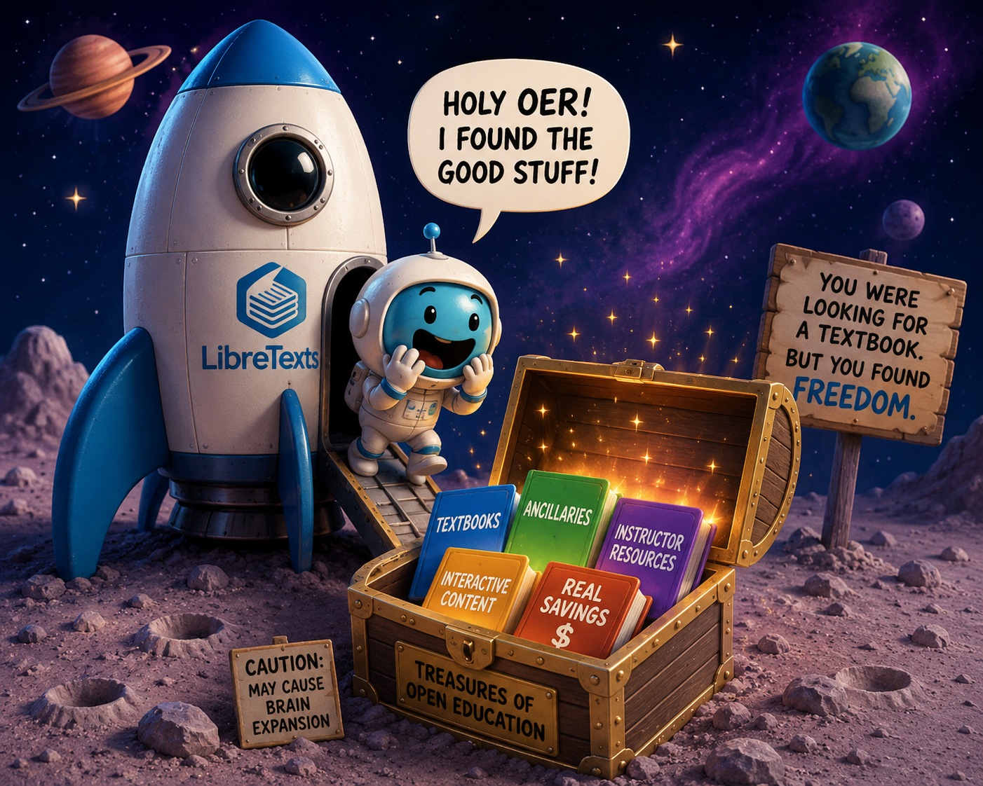
Did you find some good stuff?
LibreTexts Rocket Icon. Adapted for instructional use. Original icon from LibreTexts. CC0 1.0 Public Domain.

Slide 49
Next in the Series and Coming Up
Open Office Hour
Friday, June 5th, 9:00-10:00 am
Friday, June 12th, 2:00-3:00 pm
ADAPT Level 3 | Beyond the Final Draft: Process-Based Assessment with Forge | Tuesday, June 9, 9:00-10:30 am
ADAPT Level 4 | Collaborative Learning: Multimodal Engagement with Discuss-It | Thursday, June 11, 10:00-11:30 am
LibreTexts Level 3 | Quick Start: Edit Pages in LibreTexts | Monday, June 8, 10:00-11:30 am
LibreTexts Level 4 | Designing with Media: Images and Video in LibreTexts | Wednesday, June 10, 10:30-12:00 pm
To register and find the recorded archived of webinars, please visit the ASCCC OERI.

Slide 50

Contact Us
Holiday Hedgehog is licensed CC0 1.0 Public Domain
Cristina Moon –cmoon@chabotcollege.edu
Shagun Kaur – kaurshagun@fhda.edu
OERI Team - oeri@asccc.org

Slide 51

Go Back to the Rocket Ship
LibreTexts Rocket Icon. Adapted for instructional use. Original icon from LibreTexts. CC0 1.0 Public Domain.

