Slide 1
Welcome!
On behalf of the ASCCC OERI, we are pleased to have you here with us for “LibreTexts Remixer Lab: Creating, Curating, Customizing.”
If you are not already muted, please mute yourself upon arrival.
Please note that you are encouraged to use the Zoom “chat” feature for questions and comments.
You’re invited to introduce yourself in the chat – please provide your name, college, discipline/role
This event will be recorded. Archives of all ASCCC OERI events are available at asccc-oeri.org > Webinars and Events

Slide 2
Level 2: LibreTexts Remixer Lab: Creating, Curating, Customizing
June 4th, 20206. 9:00 am – 10:30 am
This work by Shagun Kaur is licensed under a Creative Commons Attribution 4.0 International License.)

Slide 3

Presenters
Shagun Kaur, ASCCC OERI LibreTexts Lead
  Communication Studies, De Anza
Cristina Moon, ASCCC OERI ADAPT lead
  Spanish, Chabot College
Photo by Siora Photography on Unsplash
Notes:
Presenters can be included following the description or the overview. Where images are used, they should include an attribution (Photo by…) and appropriate alternative text should be used (or the image marked decorative).

Slide 4
Webinar Description
In this introductory, hands-on workshop for the LibreTexts Remixer, participants will create a project in Conductor, develop a text, and learn to locate, combine, and reorganize openly-licensed content. The session focuses on practical approaches to curating and customizing course materials within the LibreTexts platform.

Slide 5

Overview
Remix Map
Curating Resources
Conductor Project
Remixing Basics
Notes:
An Overview slide should be included that is an outline of the presentation.

Slide 6
Canvas Course: LibreTexts Basics and Beyond
This course is an adaptation created by Cristina Moon and Michelle Pilati. It is a revision of "Mastering Libretexts" created by Wendy Poling and is shared under a CC-BY-4.0 license
We will be covering Modules 3 today
Register for LibreTexts Basics and Beyond
Note: The ASCCC OERI LibreTexts Basics and Beyond course is also available on Canvas Commons for local use.

Slide 7

Registration for a LibreTexts Account
If you don't already have one, register for a LibreOne account.
Verify your Instructor status to unlock full LibreTexts functionality.

Slide 8


Logging in to your Account
Navigate to LibreTexts.org and click on the “rocket ship” icon
It will prompt you to sign in if you are not already logged in

Slide 9

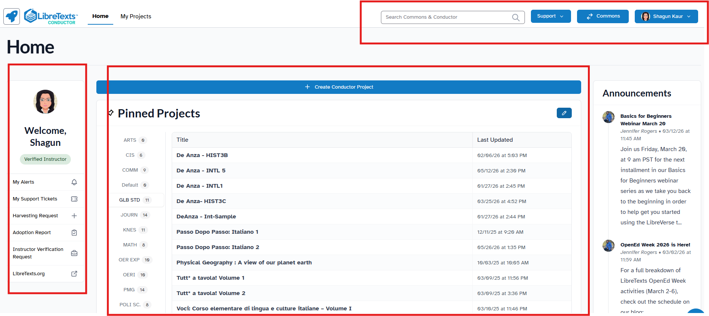


Conductor Dashboard
Navigation & Tools (Top Bar) - Access search, support resources, Commons, and account settings.
Project Workspace (Center) - Create, organize, and manage OER projects, folders, and recently updated content.
Account & Resources (Side Panels) - View instructor tools, requests, alerts, support options, and LibreTexts announcements.

Slide 10
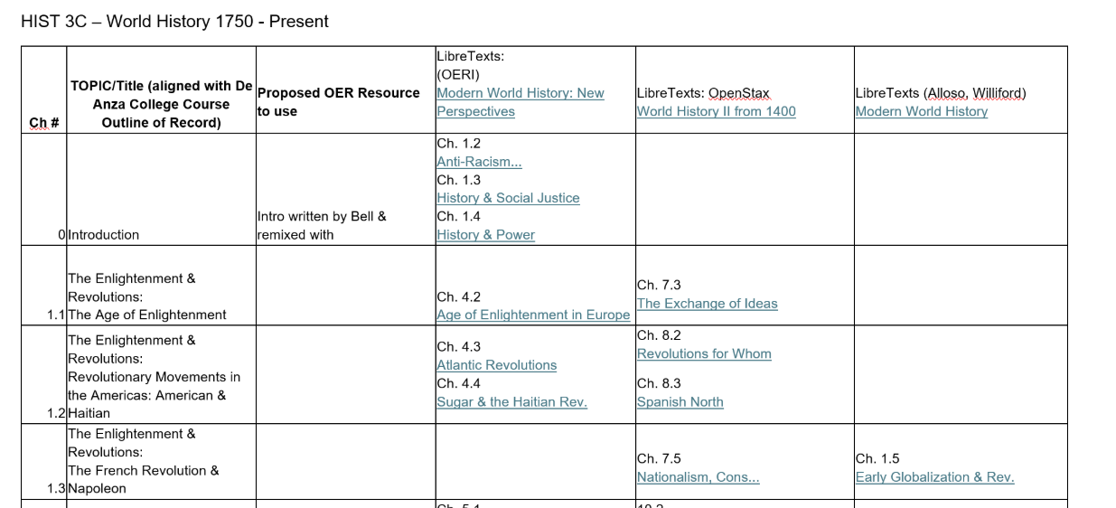
Remixer Maps
A chapter-by-chapter outline of your final resource in the intended order.
Links (URLs) to the LibreTexts content you plan to adopt, adapt, or remix.
Key notes on how selected content will be combined or modified.

Slide 11
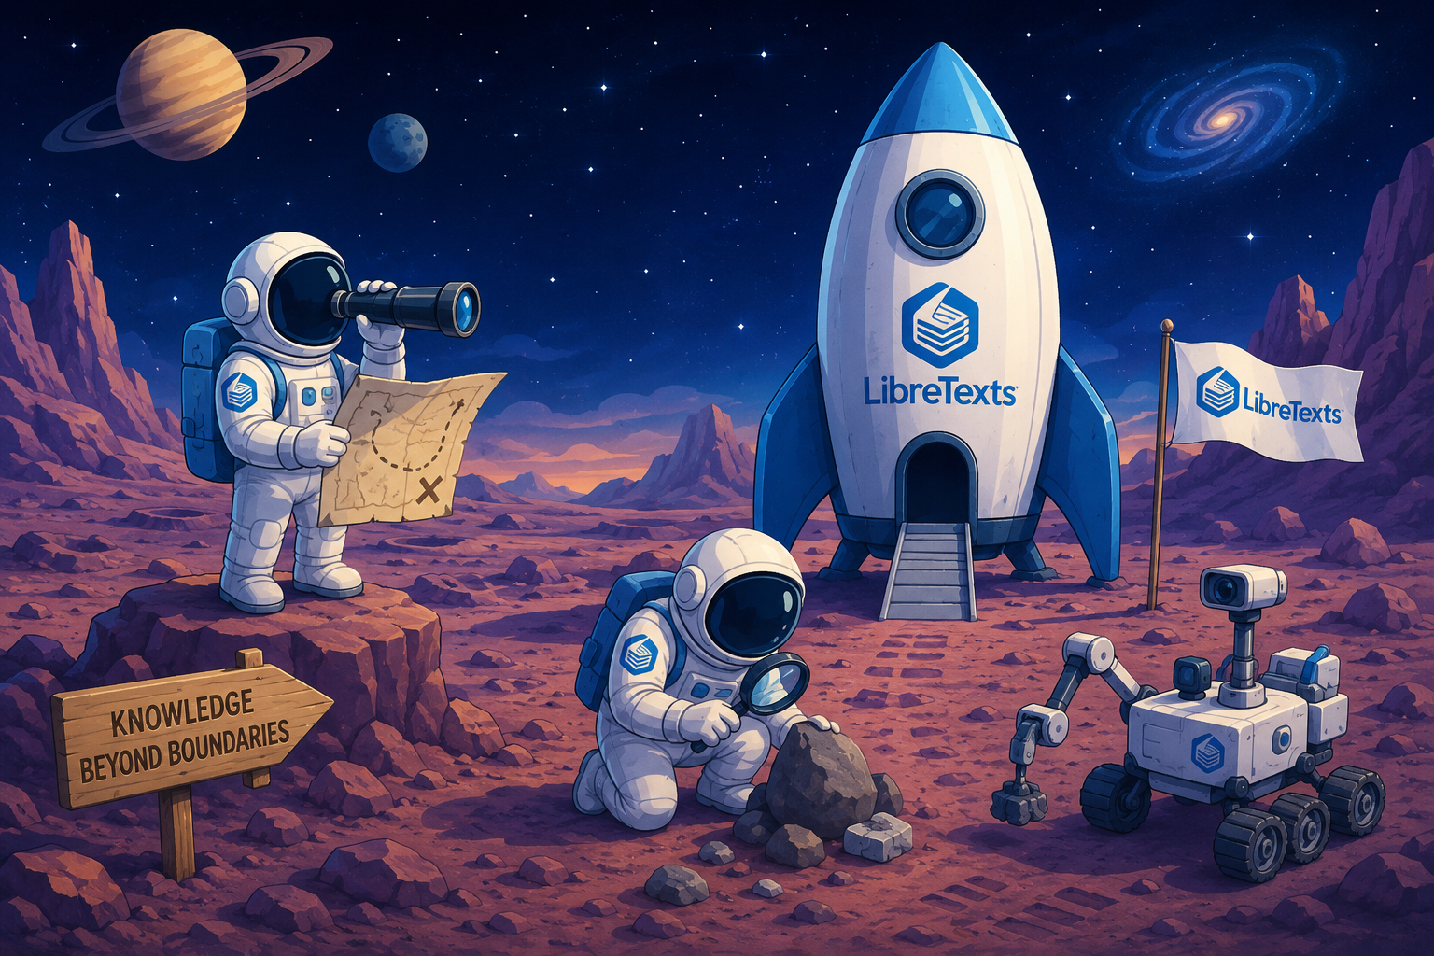
Search in the Commons or Libraries
Identify at least 3-5 sources you would like to incorporate into your textbook.
LibreTexts Rocket Icon. Adapted for instructional use. Original icon from LibreTexts. CC0 1.0 Public Domain.

Slide 12
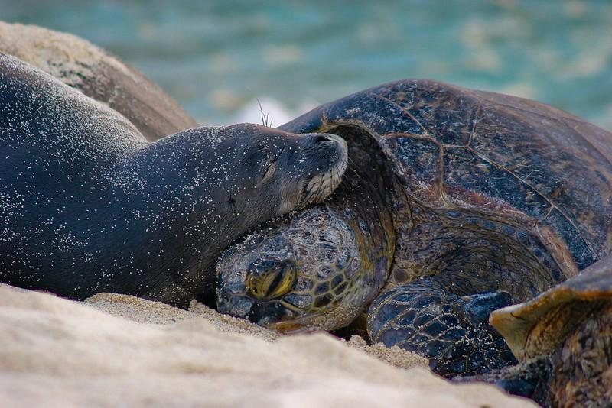
Time to Explore or Breathe
Monk Seal and Turtle by Papahānaumokuākea Marine National Monument is licensed CC BY-NC 2.0

Slide 13

Go Back to the Rocket Ship
LibreTexts Rocket Icon. Adapted for instructional use. Original icon from LibreTexts. CC0 1.0 Public Domain.

Slide 14
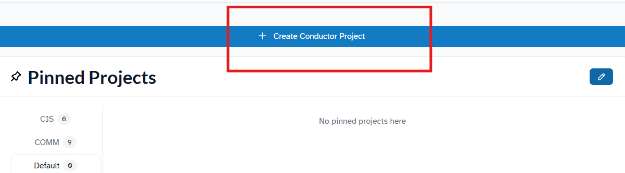
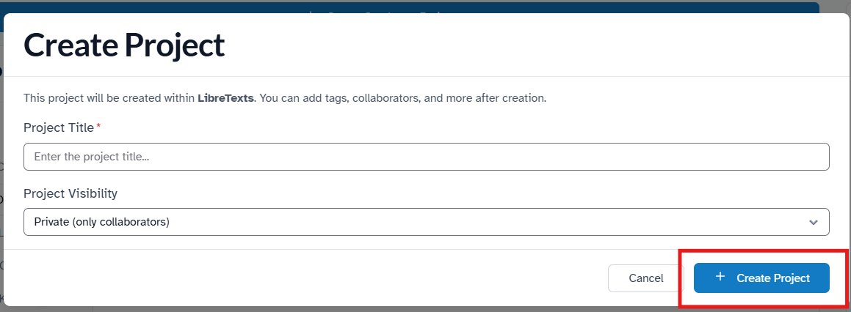
Create a Conductor Project
Select Create Conductor Project, enter a name for your remix, and then select Create Project. Leave the visibility on the default "private" status for now.

Slide 15
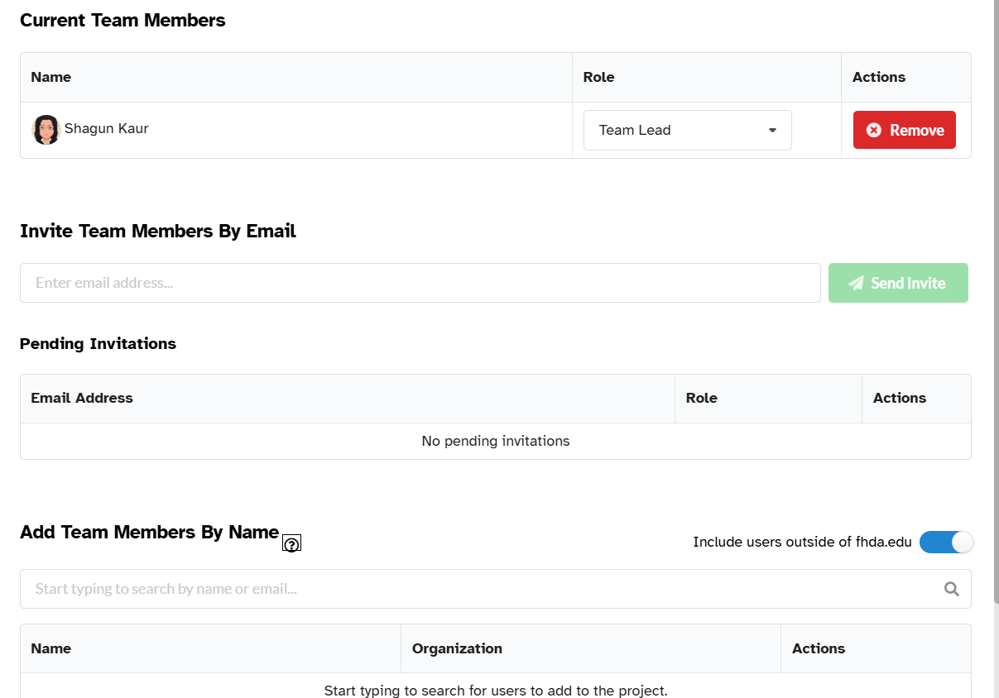
Manage Teams
Use the Team tab to invite collaborators, assign roles, and manage project access throughout the remix process.

Slide 16
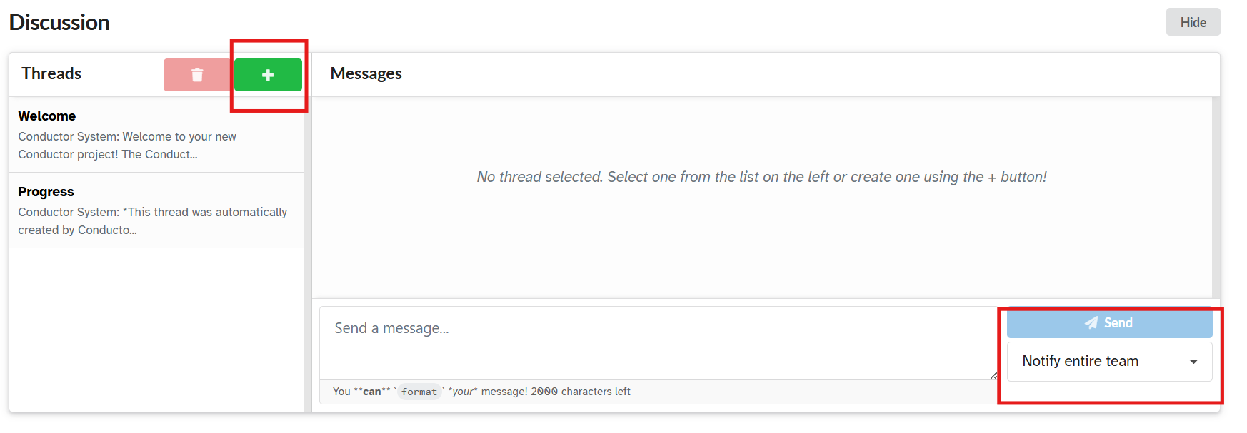
Team Communication
Conductor discussions are organized into threads, allowing project teams to ask questions, share updates, and notify collaborators in a centralized workspace.

Slide 17
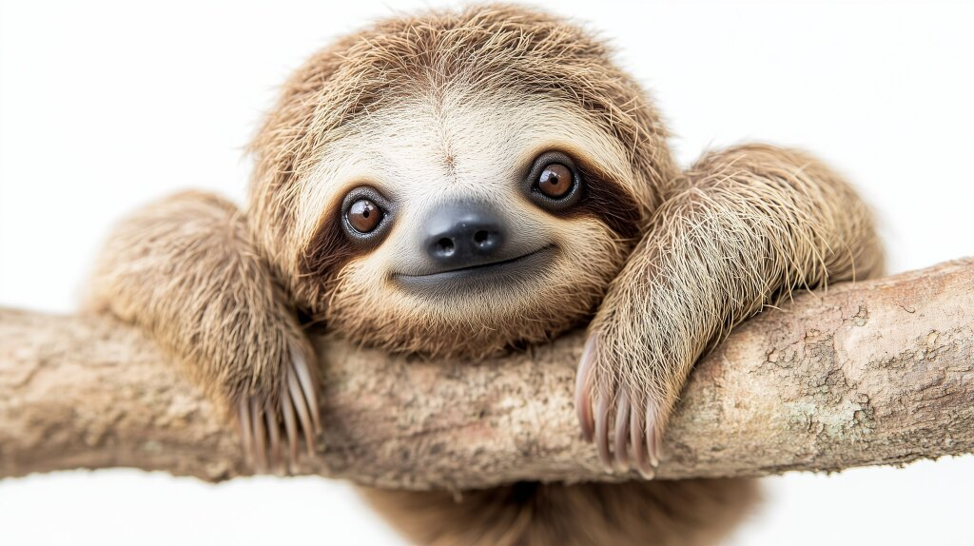
Time to Explore or Breathe
Sloth by Marco Verch is licensed CC BY 2.0

Slide 18
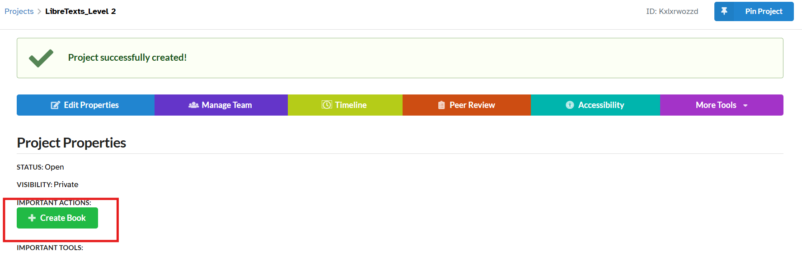
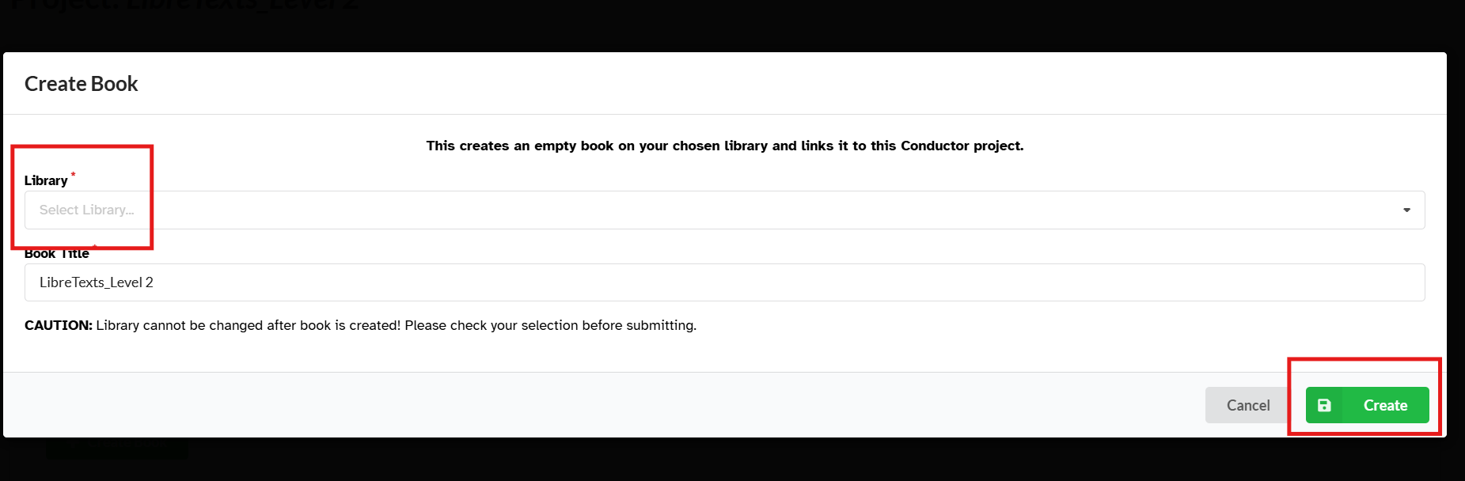
Creating a Book
Click on “Create Book” to make the basic structure of your book.
Select the Library that is the logical choice for your book. Once selected, you cannot change it. Click “Create”

Slide 19
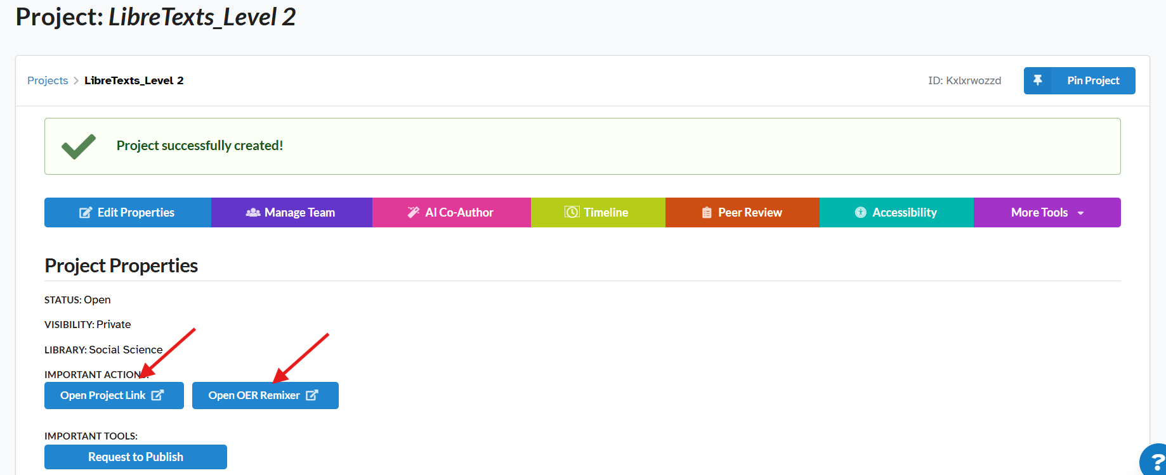
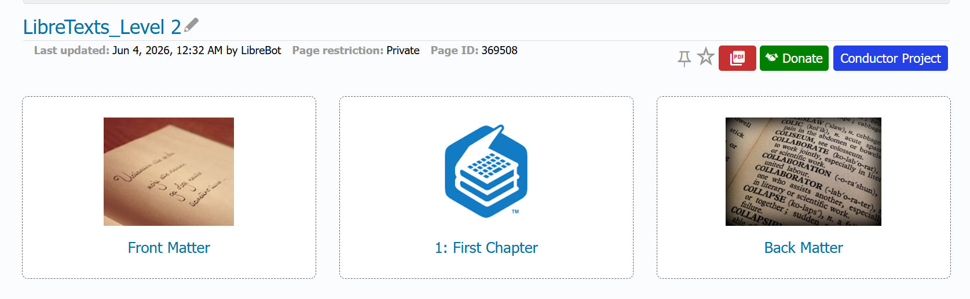
Basic Book Structure
Use the Open Project Link to access your book, and use Open OER Remixer to import, remix, and organize content. A basic book with a “Front” and “Back Matter” and an empty “Chapter” will be created.

Slide 20
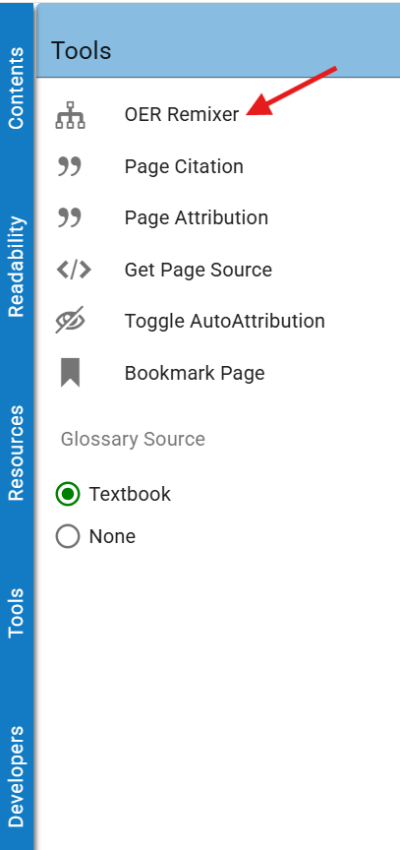
Remixer
Access the OER Remixer from the Tools menu to import existing LibreTexts content and build your custom resource.

Slide 21
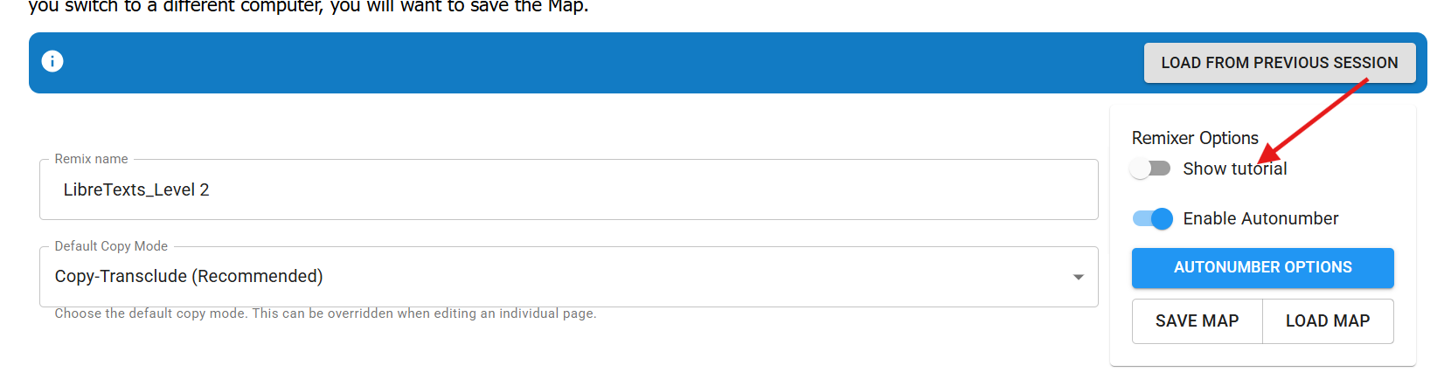
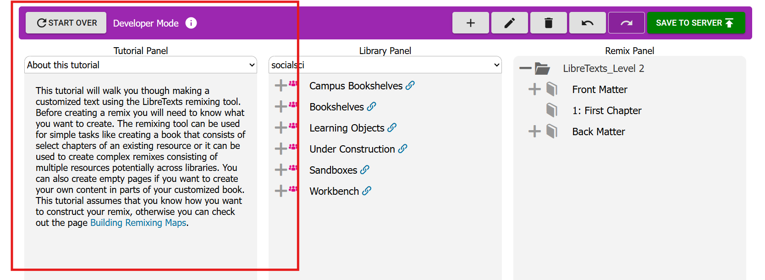
Remixer Tutorial
The OER Remixer workspace lets you browse LibreTexts content, drag chapters into your remix map, and organize your book structure.

Slide 22
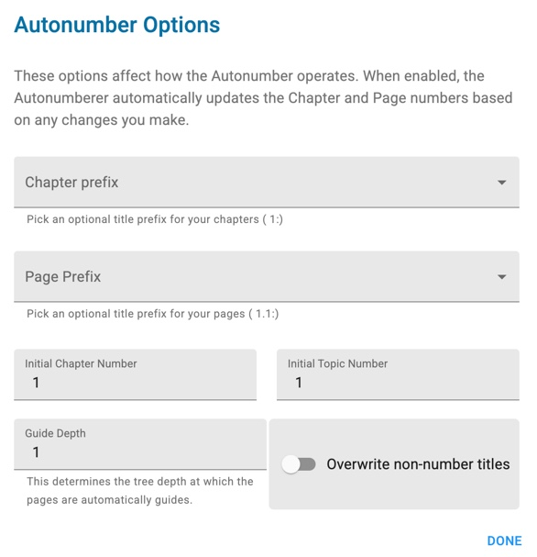
Auto Numbering
Enabled by default and automatically updates chapter and page numbers when content is reordered.
Use Autonumber Options to customize numbering styles and content hierarchy.

Slide 23
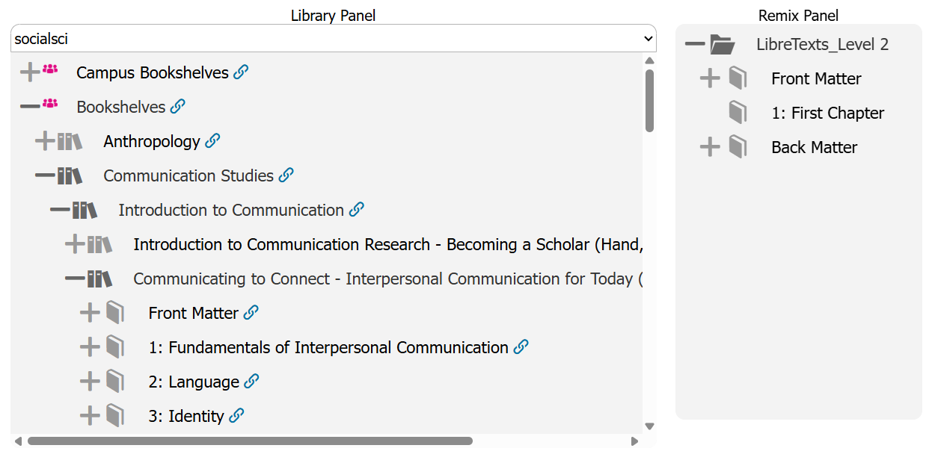
Adding Chapters and Pages
Browse and expand LibreTexts collections in the Library Panel.
Locate chapters, pages, or entire books to reuse.
Add selected content to the Remix Panel to build your resource.
Organize and rearrange content to match your course outline.

Slide 24
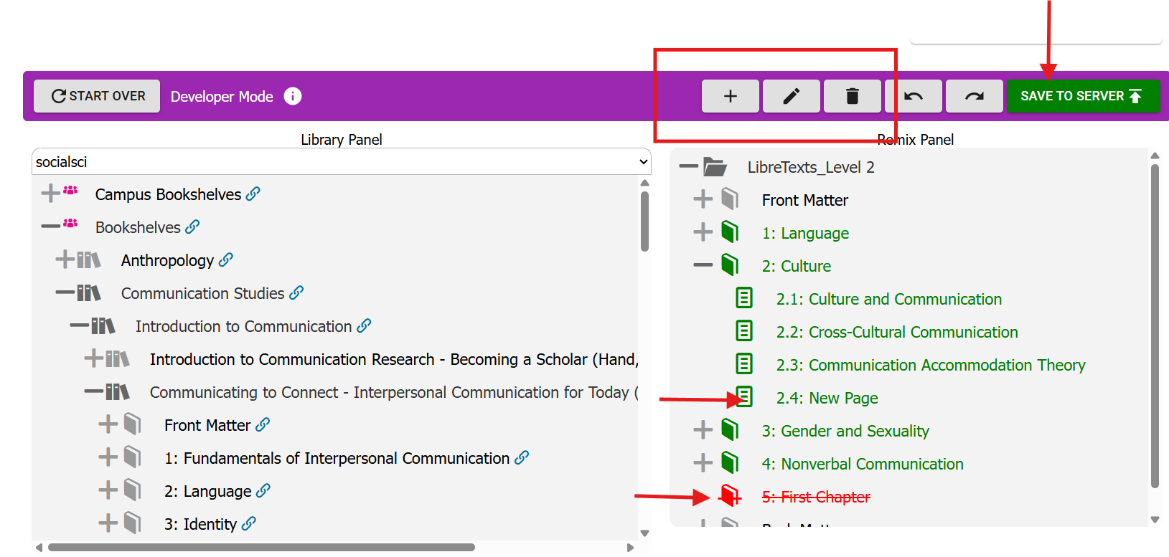
Adding and Deleting Pages
Use + to add new chapters or pages.
Use the pencil icon to rename selected items.
Use the trash can to remove unwanted content.
Click Save to Server [2 times] to save your changes and update the remix map.

Slide 25
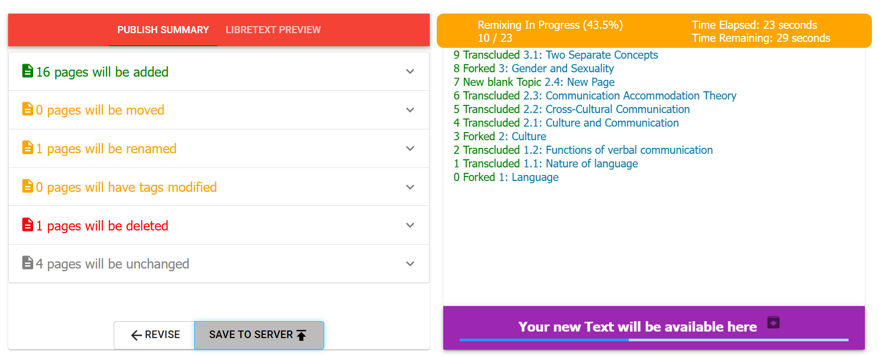
Remixer Operation
Review the Publish Summary to confirm all planned changes.
Verify pages to be added, renamed, moved, or deleted.
Track remix progress as content is copied into your new text.
Click Save to Server to generate and publish the remixed resource.

Slide 26

Time to Explore or Breathe
Tortoise is licensed CC0 1.0 Public Domain.

Slide 27
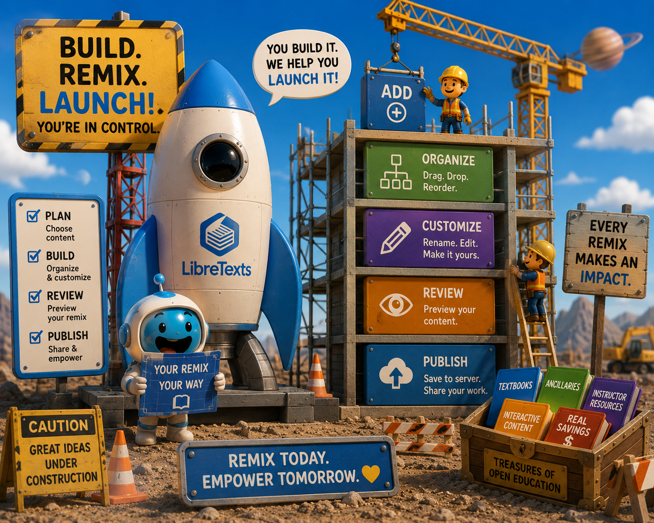
How was the Construction?
LibreTexts Rocket Icon. Adapted for instructional use. Original icon from LibreTexts. CC0 1.0 Public Domain.

Slide 28
Reminders
Save to Server often — your remix map (Table of Contents) is automatically saved to the cloud each time you select Save to Server.
Create a backup — use Save Map to download a copy of your remix map to your computer.
Resume from a backup — use Load Map to upload a previously saved map file.
Continue where you left off — select Load from Previous Session to reopen the version saved in the cloud.
Best practice: Save to the server regularly and keep a local backup of major milestones.

Slide 29
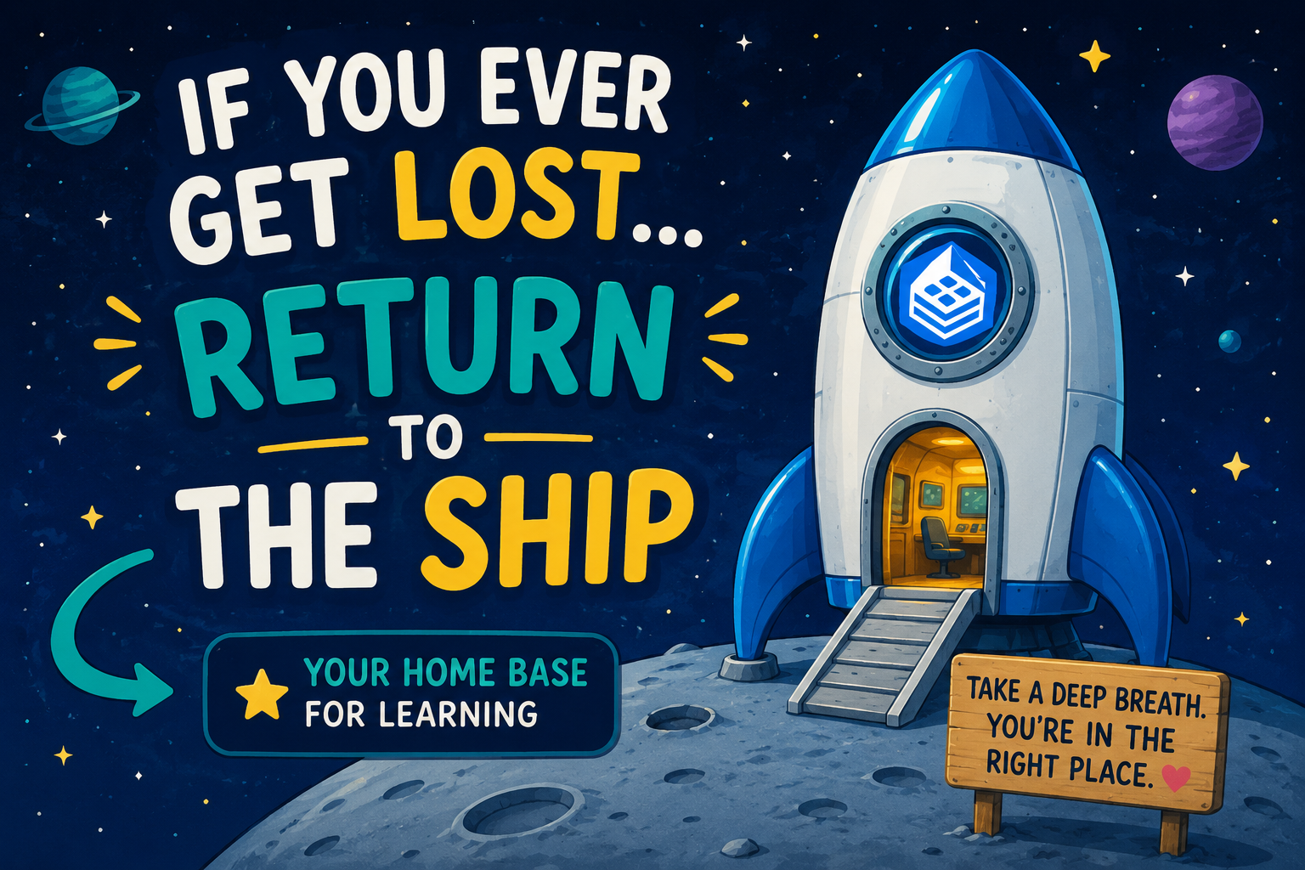
If you get lost: Return to the Ship
LibreTexts Rocket Icon. Adapted for instructional use. Original icon from LibreTexts. CC0 1.0 Public Domain.

Slide 30
Next in the Series and Coming Up
ADAPT Level 2 | Cloning Native Basic Questions | Thursday, June 4, 12:00-1:30 pm
ADAPT Level 3 | Beyond the Final Draft: Process-Based Assessment with Forge | Tuesday, June 9, 9:00-10:30 am
ADAPT Level 4 | Collaborative Learning: Multimodal Engagement with Discuss-It | Thursday, June 11, 10:00-11:30 am
LibreTexts Level 3 | Quick Start: Edit Pages in LibreTexts | Monday, June 8, 10:00-11:30 am
LibreTexts Level 4 | Designing with Media: Images and Video in LibreTexts | Wednesday, June 10, 10:30-12:00 pm
Open Office Hour
Friday, June 5th, 9:00-10:00 am
Friday, June 12th, 2:00-3:00 pm
To register and find the recorded archived of webinars, please visit the ASCCC OERI.

Slide 31
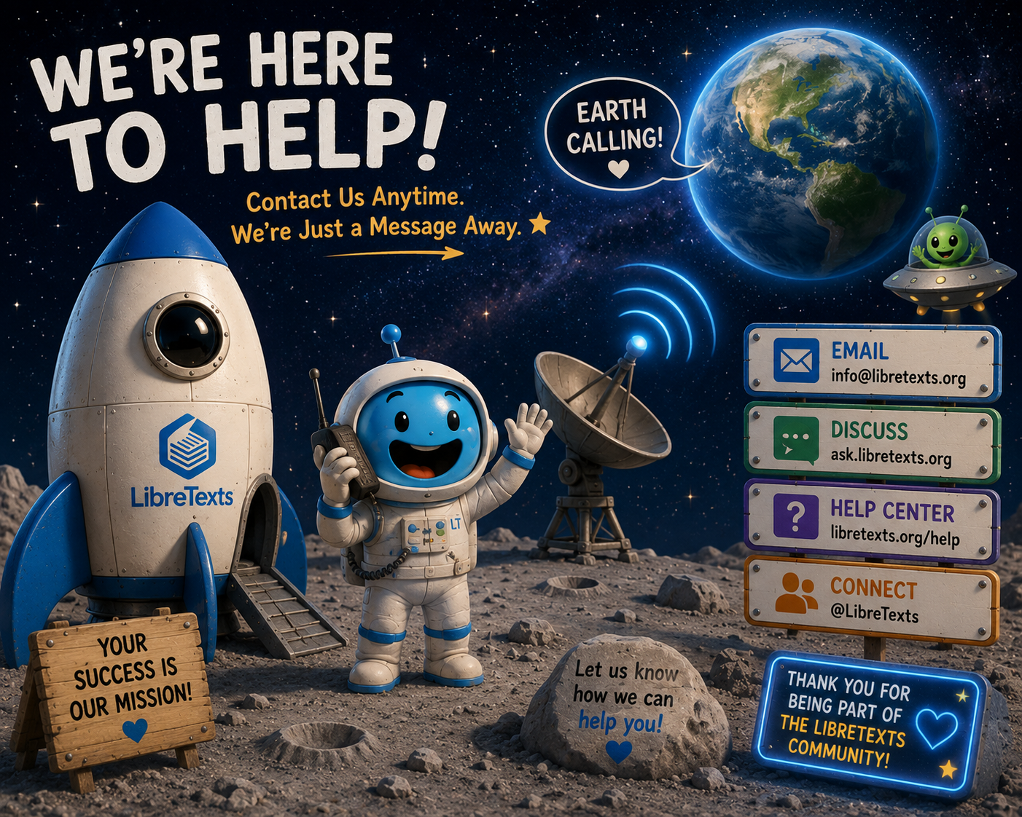
Contact Us
Cristina Moon: cmoon@chabotcollege.edu
Shagun Kaur: kaurshagun@fhda.edu
OERI Team - oeri@asccc.org
LibreTexts Rocket Icon. Adapted for instructional use. Original icon from LibreTexts. CC0 1.0 Public Domain.

