Slide 1
Welcome!
On behalf of the ASCCC OERI, we are pleased to have you here with us for “Beyond the Final Draft: Process-Based Assessment with Forge”
If you are not already muted, please mute yourself upon arrival.
Please note that you are encouraged to use the Zoom “chat” feature for questions and comments.
You’re invited to introduce yourself in the chat – please provide your name, college, discipline/role.
This event will be recorded. Archives of all ASCCC OERI events are available at asccc-oeri.org > Webinars and Events

Slide 2
Level 3: Beyond the Final Draft: Process-Based Assessment with Forge
June 9th, 2026. 9:00 am – 10:30 am
This work is licensed under a Creative Commons Attribution 4.0 International License.)

Slide 3

Presenters
Cristina Moon, ASCCC OERI ADAPT lead
  Spanish, Chabot College
Shagun Kaur, ASCCC OERI LibreTexts Lead
  Communication Studies, De Anza
Photo by Siora Photography on Unsplash
Notes:
Presenters can be included following the description or the overview. Where images are used, they should include an attribution (Photo by…) and appropriate alternative text should be used (or the image marked decorative).

Slide 4
Webinar Description
In this session, participants will explore Forge, a new question type in ADAPT that makes the student writing process visible and verifiable in real time. This integrity-enhanced word processor and collaborative workspace allows faculty to move beyond the final product to see how students draft, revise, and develop their work. By providing actionable insights into the writing journey, The Forge directly addresses the challenges of generative AI and promotes authentic student authorship.

Slide 5

Registration for a LibreTexts Account
If you don't already have one, register for a LibreOne account.
Verify your Instructor status to unlock full LibreTexts functionality.

Slide 6


Logging in to your Account
Navigate to LibreTexts.org and click on the “rocket ship” icon
It will prompt you to sign in if you are not already logged in

Slide 7

Overview
What is Forge?
Forge Features and Tools
Clone Forge ADAPT Demo course
Clone Forge questions
Forge Assignment Settings
Notes:
An Overview slide should be included that is an outline of the presentation.

Slide 8

What is Forge
Powerful question type in Forge that has the clone capability of the ADAPT native questions.
A writing and learning environment build with iteration, reflection, and visible thinking rather than single-use submissions.
Supports drafting, peer edits, and labor-based grading. Delivers detailed, granular writing analytics.
Privacy by design: No student data sold. No external AI database submissions. Self-hosted and GDPR compliance.

Slide 9
Value the Writing Process
Why It Matters
Shifts from product to process
Builds authentic learning and academic integrity
Centers student voice and development over compliance
Across Disciplines
Writing, analysis, and presentations in humanities and social sciences
Data, modeling, and problem-solving in STEM
Visual design, projects, and applied work in career and creative fields
Bottom Line
A platform designed by educators to support how students actually learn to write
Notes:
DL

Slide 10
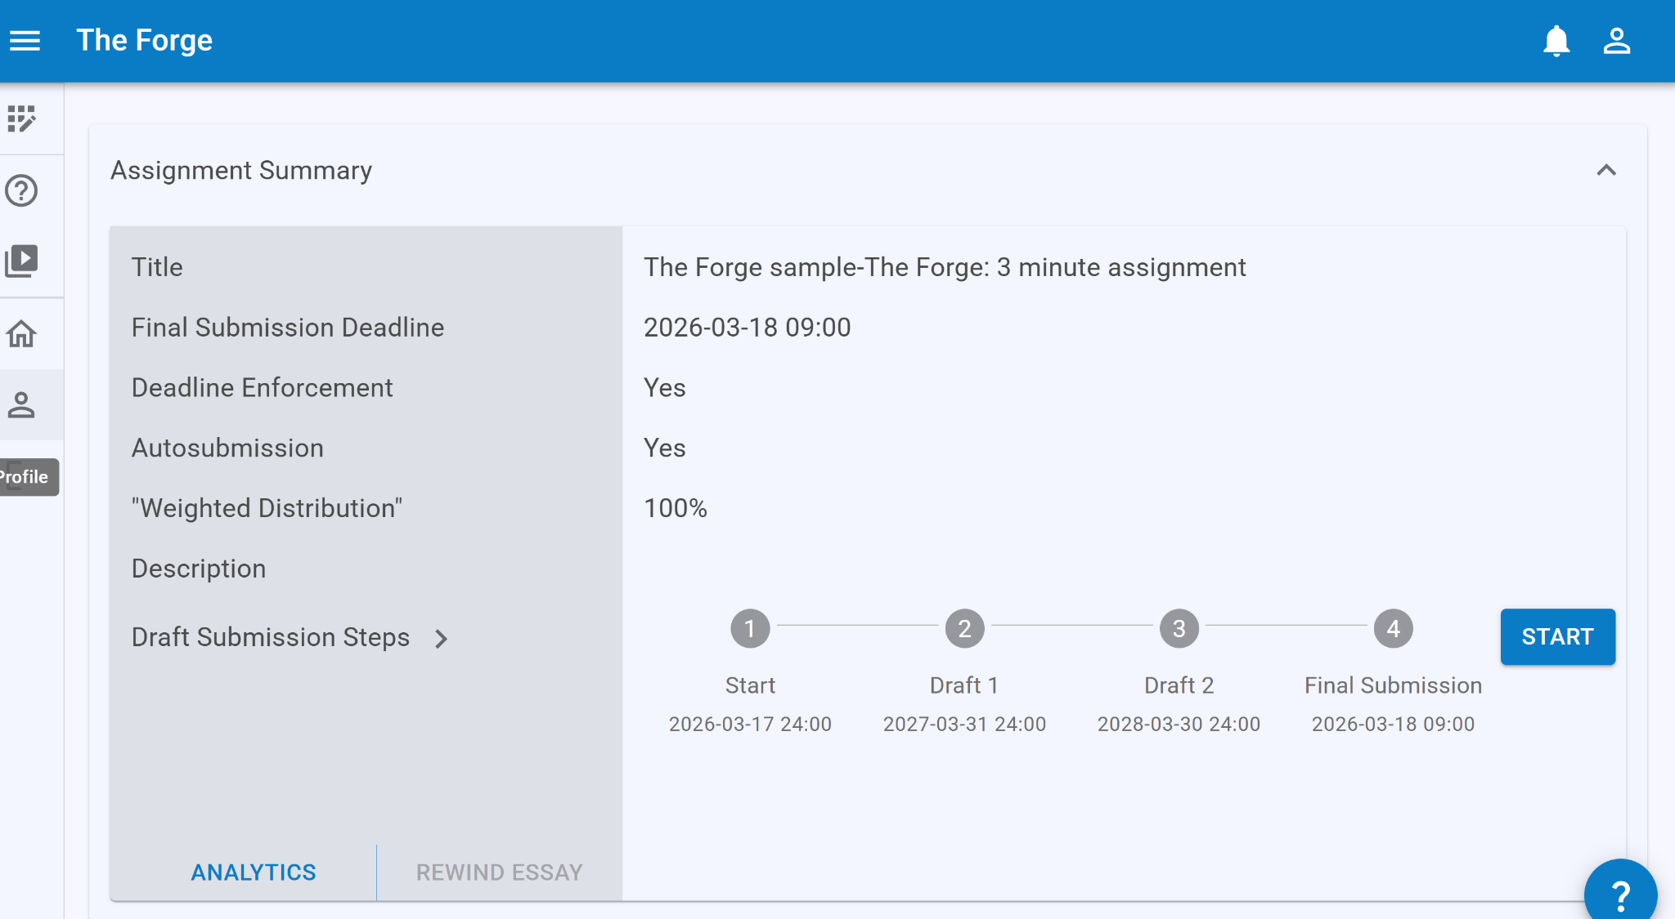
Student View
Student View

Slide 11
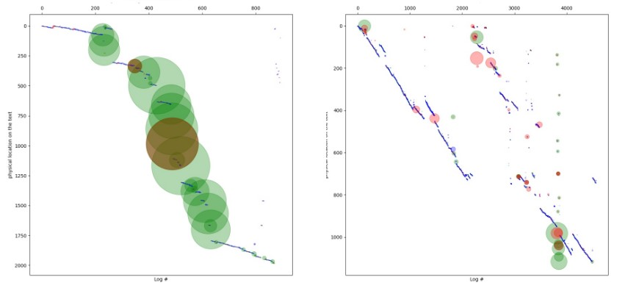
Forge: Long-form writing Analytics & Assessment
Copy/Paste Chunks
Later Editing
Word Count
Time

Slide 12
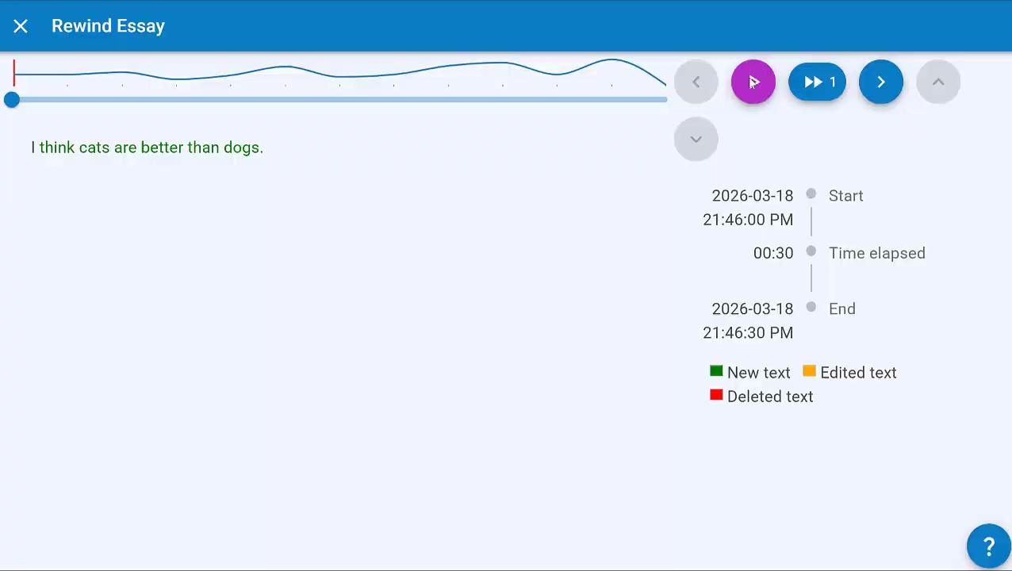
Analytics: “Rewinding” Documents
Analytics: “Rewinding” Documents
Notes:
CM
The Rewind feature provides the instructor with an animation showing how the assignment was written, offering instructors with a finer-scale view of the student’s writing process. If instructors wish to advance the frame, they can click on the forward button. Instructors can click repeatedly on the forward button to move quickly through the animation. By default, the rewind shows the state of the assignment every 30 seconds when the student is writing.

Slide 13
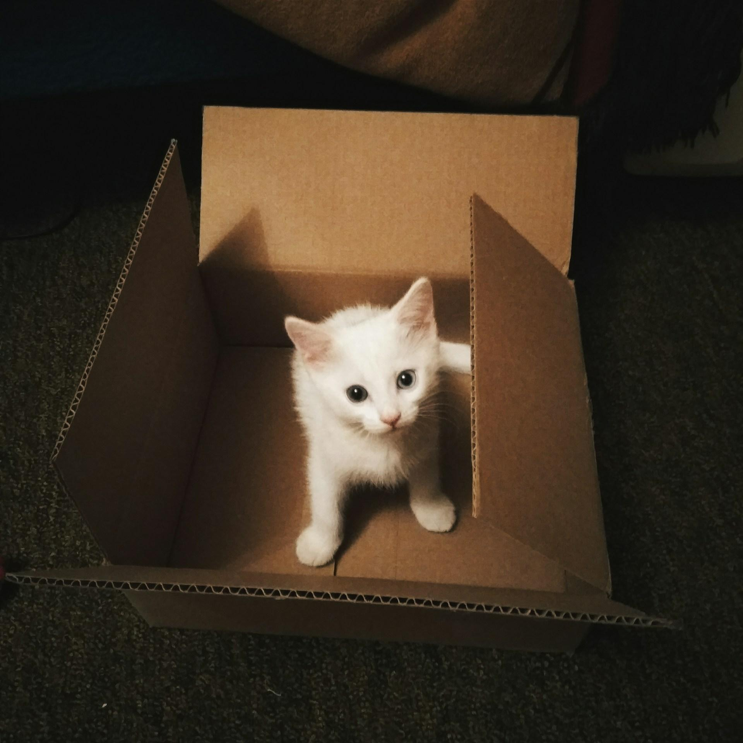
Let’s Unbox Forge
Photo by iam_os on Unsplash

Slide 14
Type of Forge Assignments
Document
Spreadsheet
Presentation
Draw
Image

Slide 15
Exploring Forge - Document
Selecting Document as the main file type will open a word processing file for students to complete their work.
Best suited for written assignments such as essays, reports, lab write-ups, or any task that requires a typed, narrative response.

Slide 16
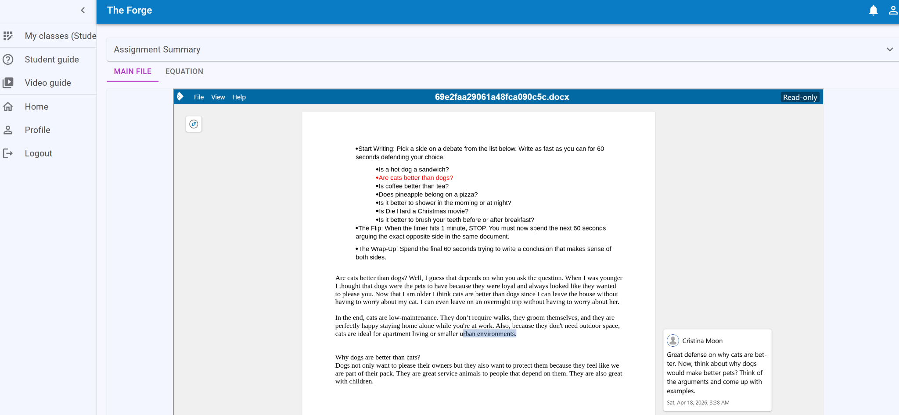
Forge: Document Assignment

Slide 17
Exploring Forge - Spreadsheet
Selecting Spreadsheet as the main file type will open a spreadsheet file for students to complete their work.
Best suited for assignments involving data entry, calculations, budgeting, or any task that requires the organization of numerical information.

Slide 18
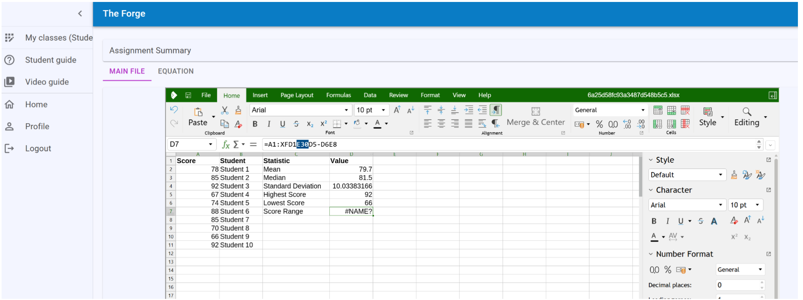
Forge: Spreadsheet Assignment

Slide 19
Exploring Forge - Presentation
Selecting Presentation as the main file type will open a slide deck file for students to complete their work.
Best suited for assignments requiring students to present information visually, such as slideshows, pitches, or multimedia presentations.

Slide 20
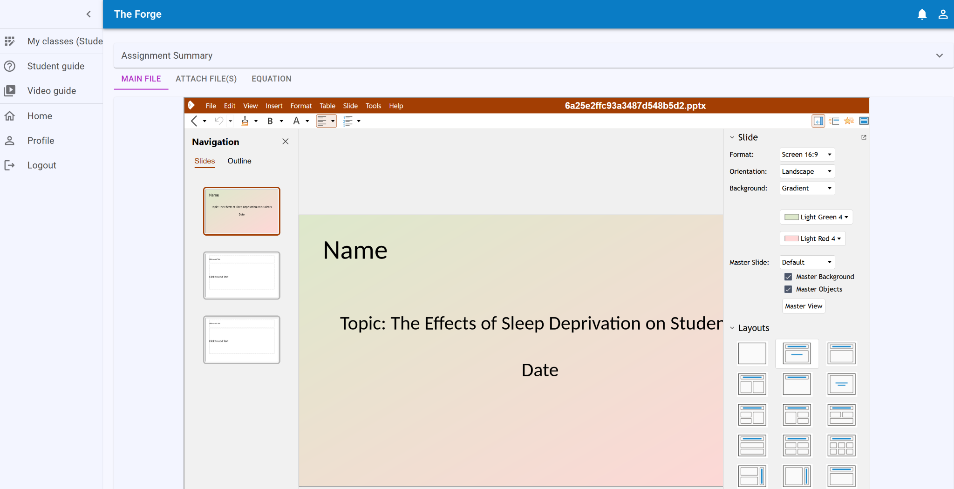
Forge: Presentation Assignment

Slide 21
Exploring Forge - Draw
Selecting Draw as the main file type will open a drawing canvas for students to complete their work.
Best suited for assignments requiring diagrams, sketches, concept maps, or other visual representations.

Slide 22
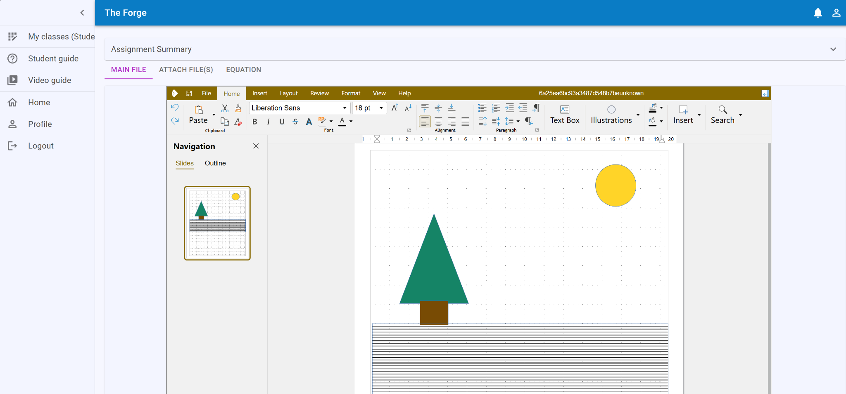
Forge: Draw Assignment for an
Art Fundamentals Class

Slide 23
Exploring Forge - Image
Image is similar to the Draw file type and will allow students to upload an image file.
Best suited for assignments requiring a photograph, scan, or other visual submission.

Slide 24
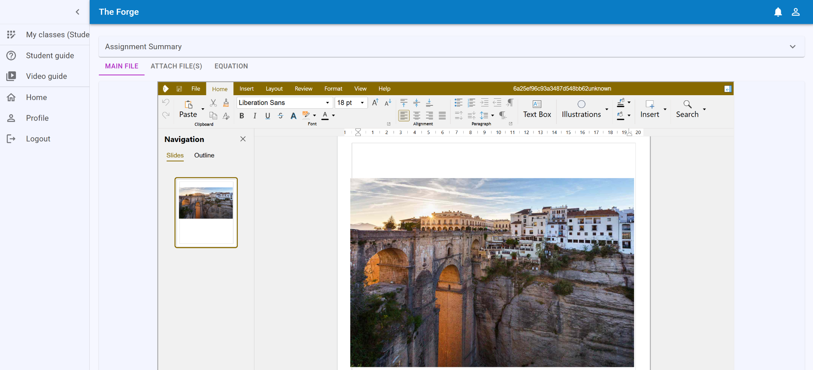
Forge: Image Assignment for a Photography Class

Slide 25

Can you see yourself using
Forge in your classes?
Sloth by Marco Verch is licensed CC BY 2.0

Slide 26
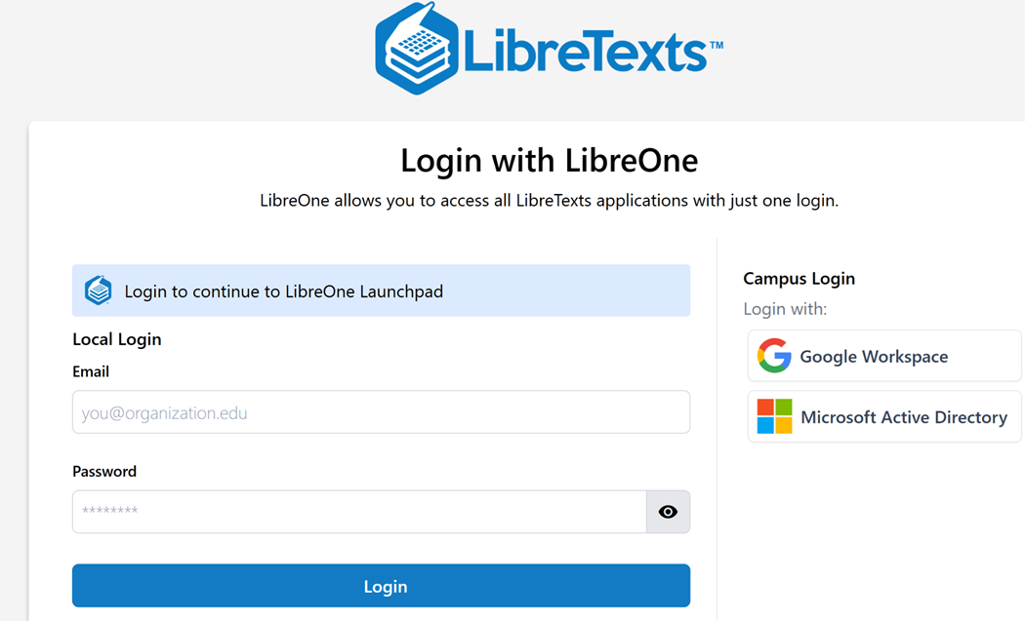
Log into LibreOne
LibreOne link (https://one.libretexts.org/)
Once you have the account, start with “Consult Insight” for training videos and instructions.
Notes:
https://one.libretexts.org/

Slide 27
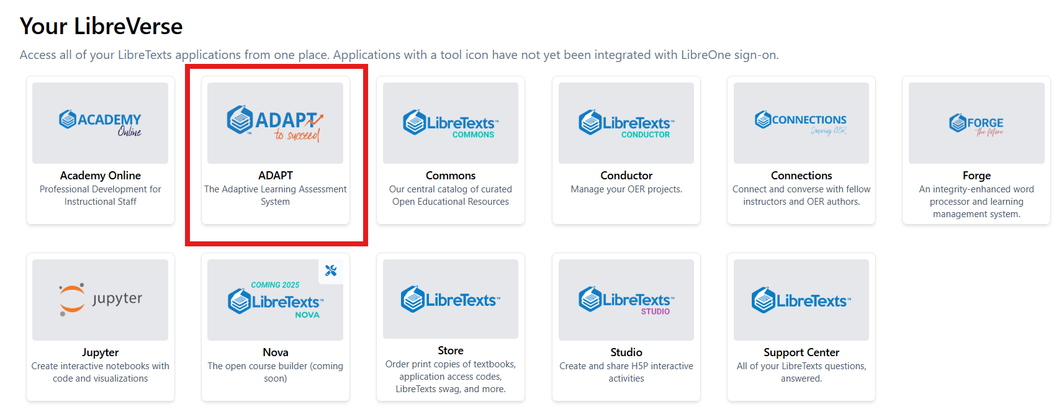
Finding ADAPTT

Slide 28
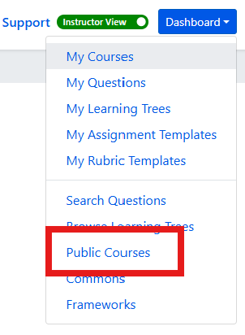
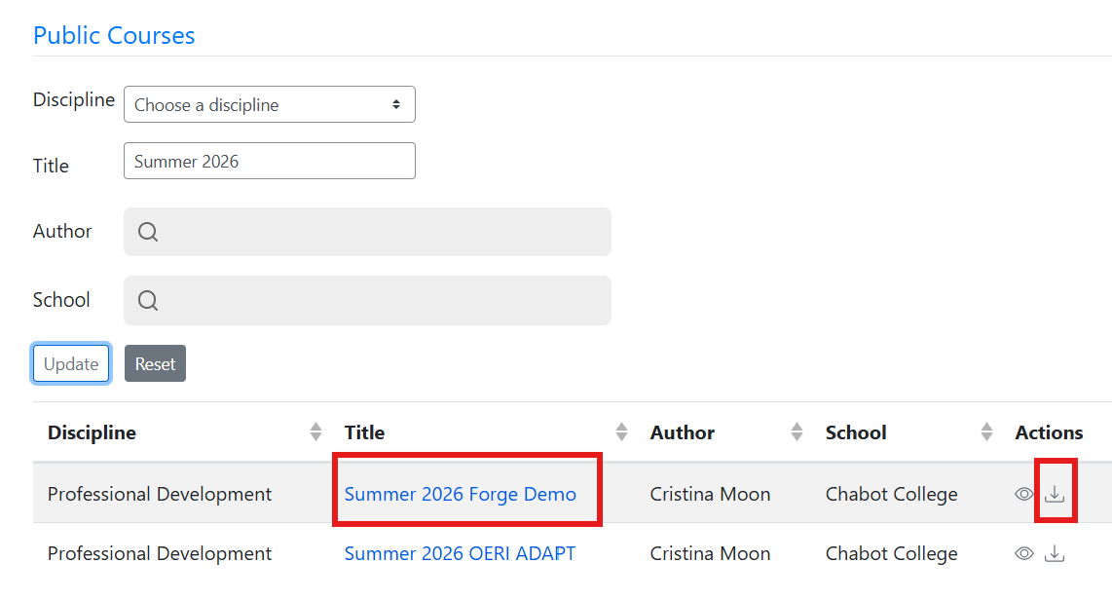
Import OERI ADAPT Demo Course
First, find the Dashboard and select Public Courses.
Next, under Title, type Summer 2026 Forge Demo and then select the import (down arrow).

Slide 29
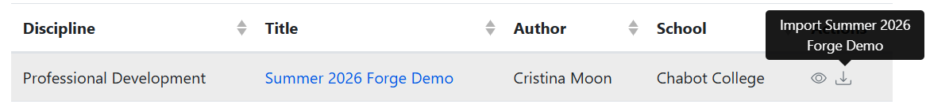
Importing a Public Course - Step-by-Step
Log into LibreTexts.
Navigate to ADAPT.
If you are logged in as an Instructor, your Dashboard will be in the upper right of your screen no matter where in ADAPT you are.
Select “Public Courses.”
Leave the “Discipline” field as it as and then enter “Summer 2026 Forge Demo” in the “Title” field.
Select “Update.”
You should now have the Summer 2026 Forge Demo Course available for you to import into your courses.
Select the down arrow under actions (on the far right) to import the course.

Slide 30

Time to Clone or Breathe
Sloth by Mancia Freddy is licensed CC0 1.0 Public Domain.

Slide 31
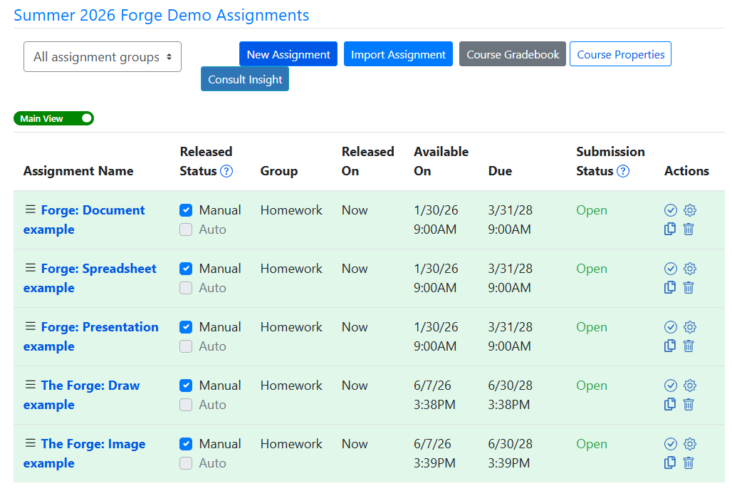
Summer 2026 OERI ADAPT Course Assignments

Slide 32
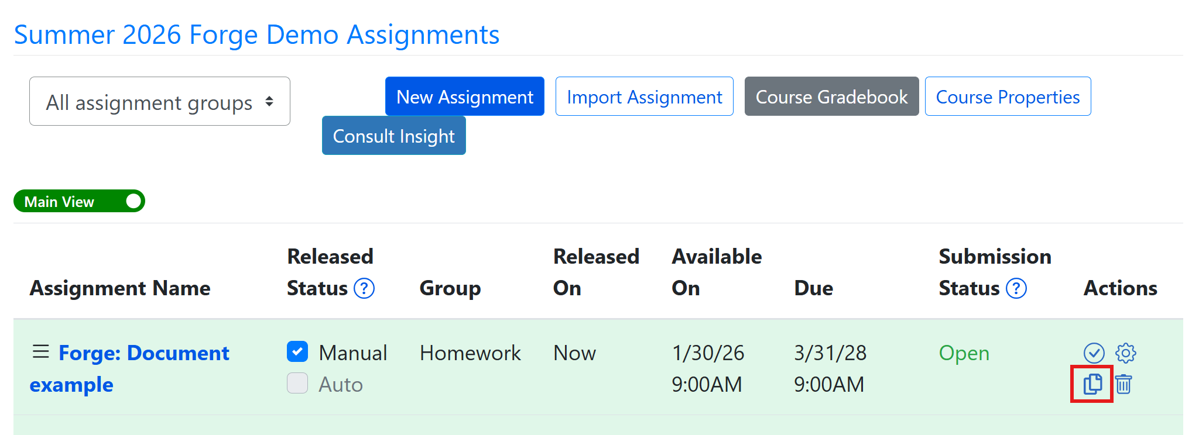
Clone (Copy)
Forge Document Example
Select the clone icon under the Actions heading.

Slide 33
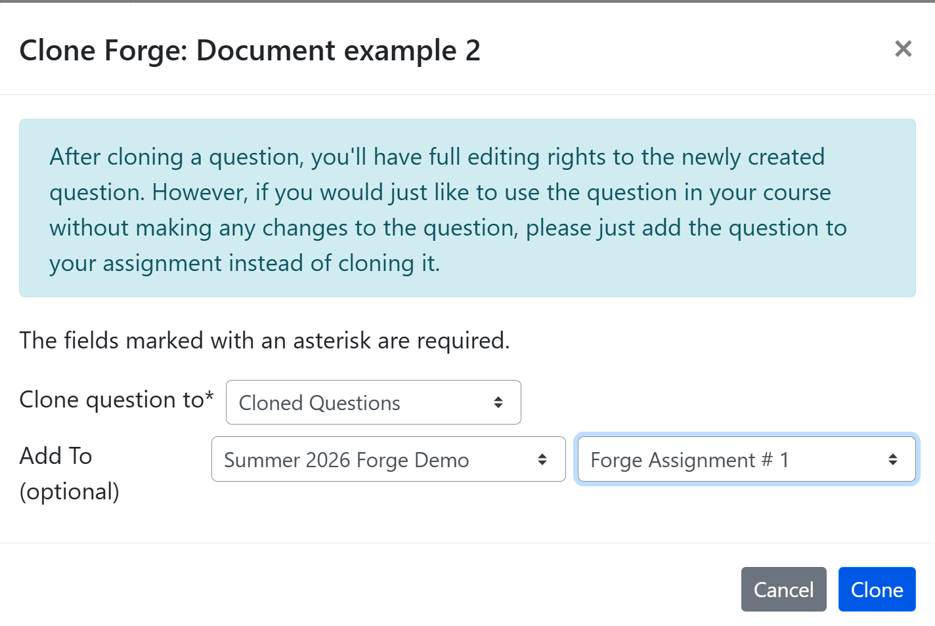
After Cloning

Slide 34
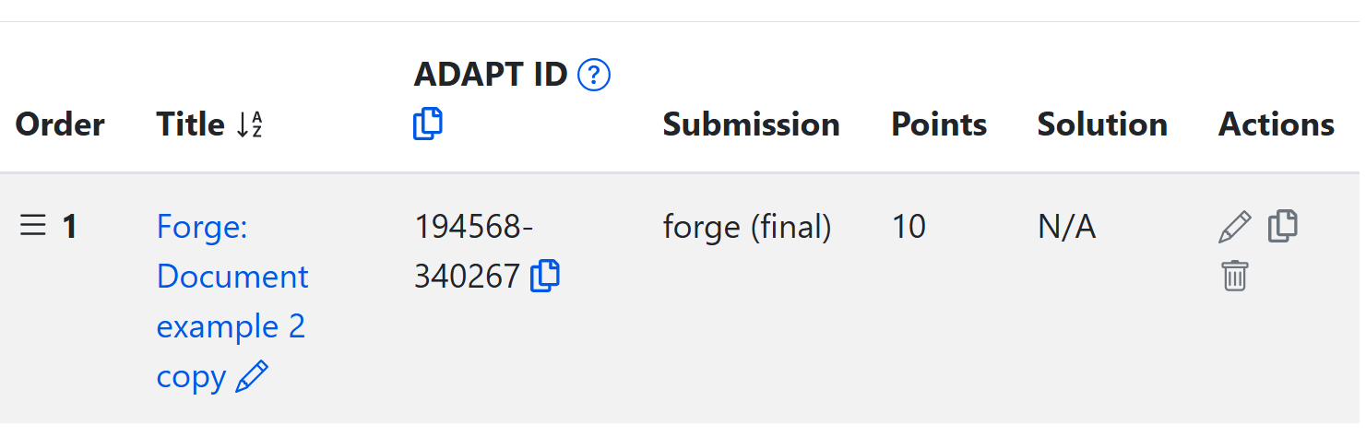
To Access Your Copy, Select Its Title
Modify the title of your cloned question by selecting the pencil icon at the end of the title either before or after accessing all elements of your copy.
Upon accessing your question for editing, you will make edits in just two sections:
  Properties
  Primary Content

Slide 35
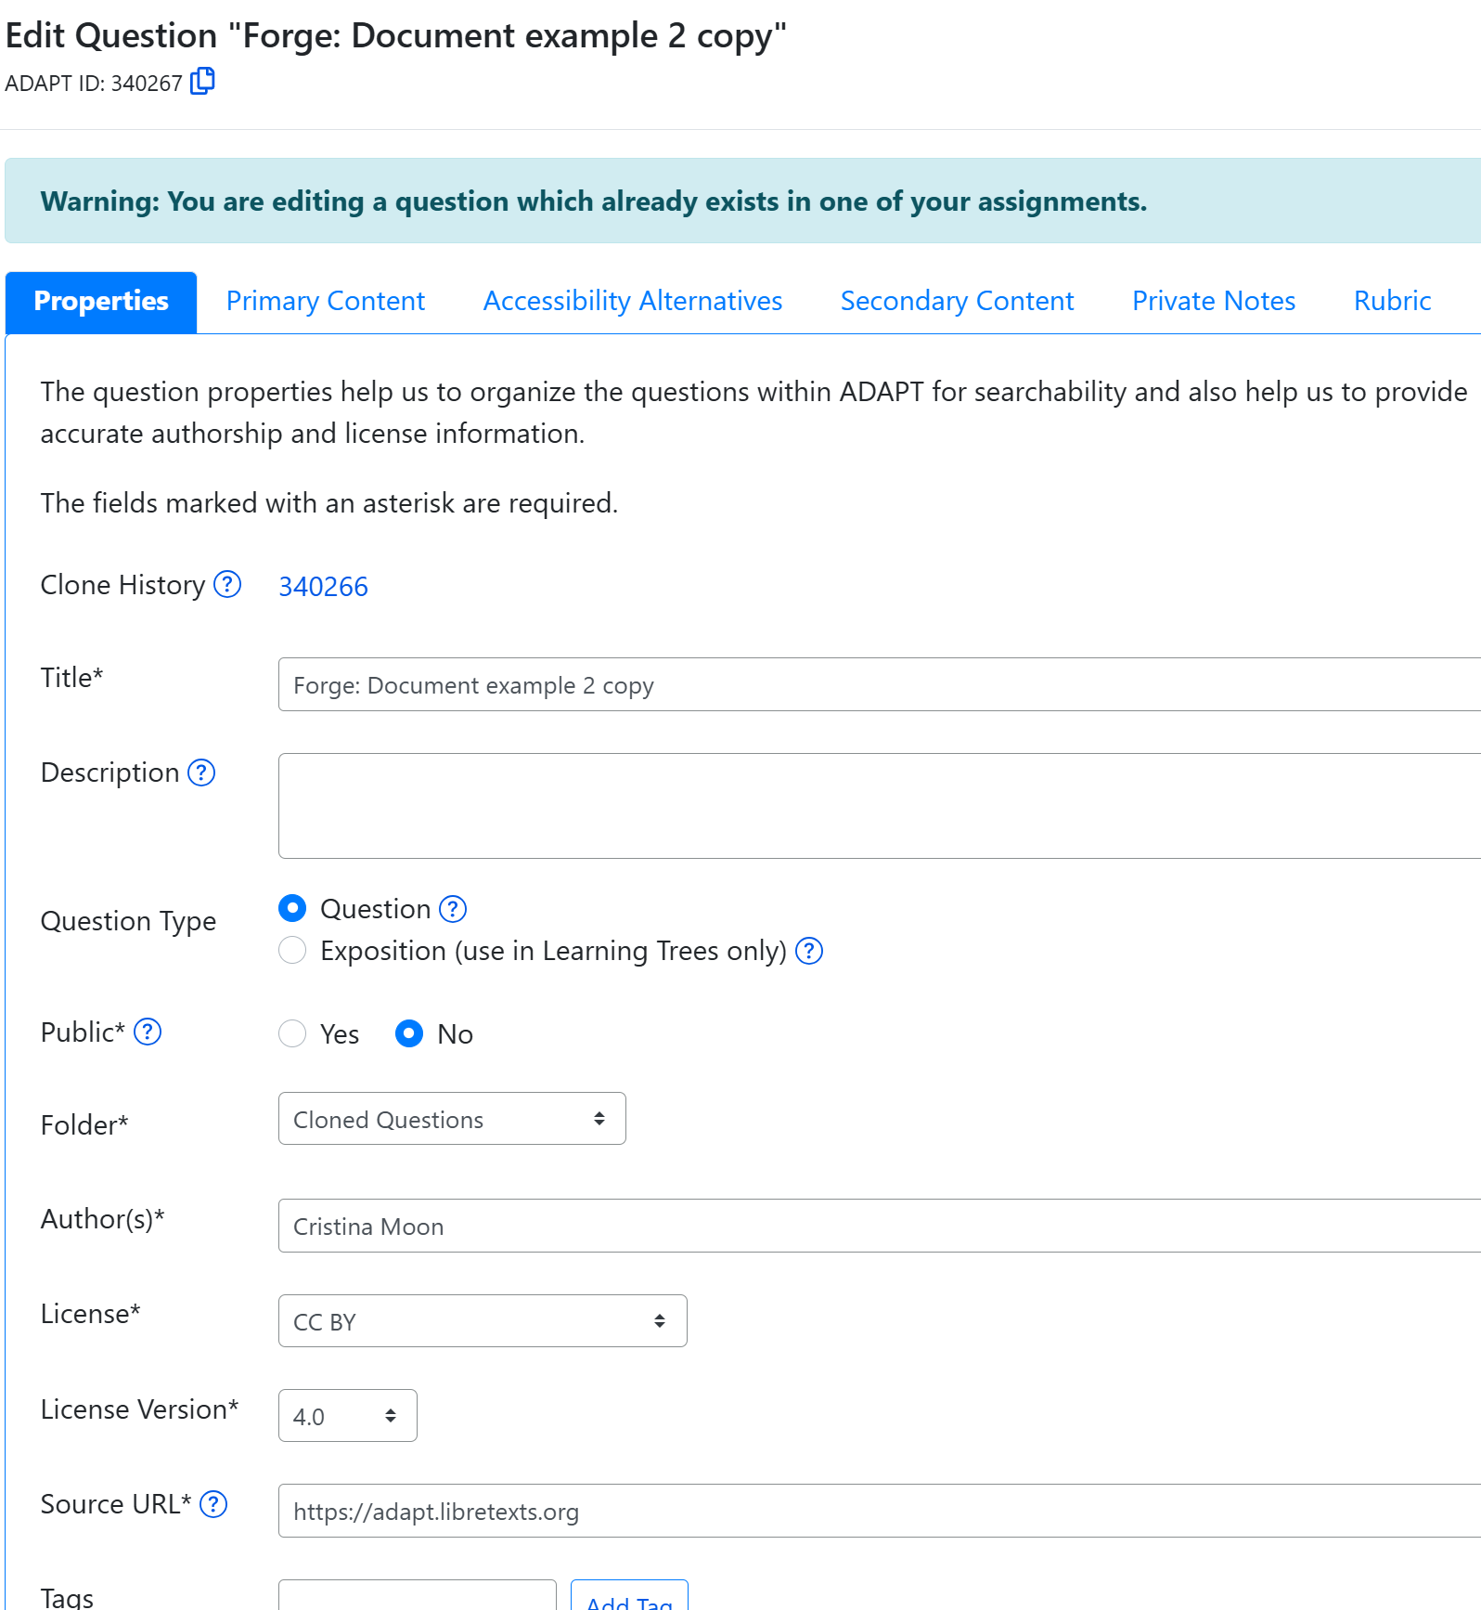
Edit the Properties of Your Cloned Question
Under the first tab, Properties:
Change the title.
Add a description, if desired.
Don’t change Question Type.
Public - yes or no.
Automatically goes to Cloned Questions folder - but you can change this.
Change author to yourself.
Modify license if needed.
Notes:
Edit Properties and Primary Content. 1. Change the title. 2. Add a description, if desired. 3. Don’t change Question Type. 4. Public - yes or no. 5. Automatically goes to Cloned Questions folder - but you can change this. 6. Change author to yourself. 7. Modify license if needed.

Slide 36
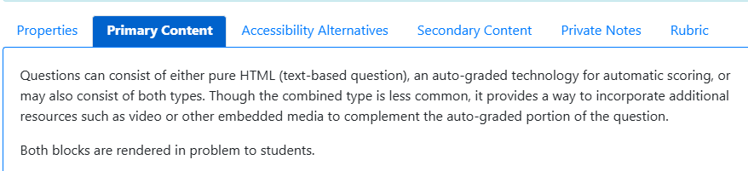
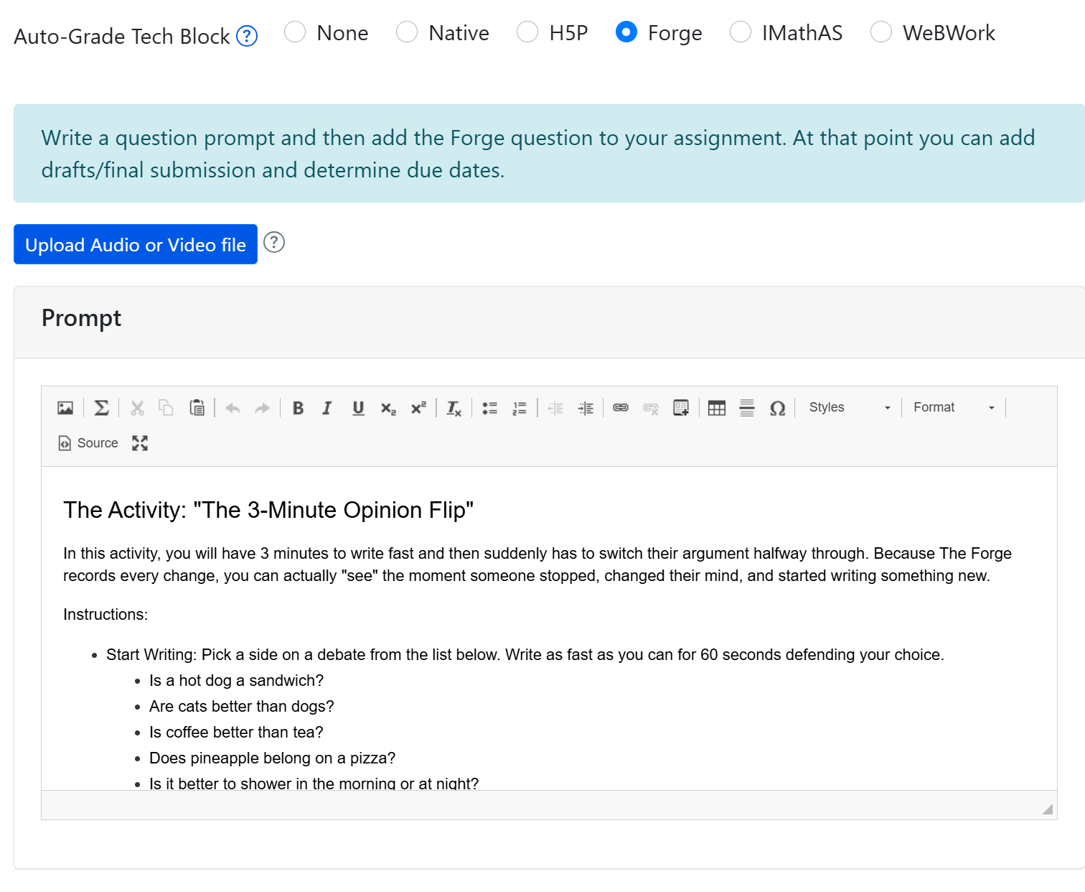
Primary Content
Under the Primary Content tab, you can view and edit the question content.
If you are unsure how to create or edit a specific question type, refer to the instructions found in the blue box.
Now, it’s your turn to try.
Notes:
Under Primary Content choose Native > Select Choice

Slide 37
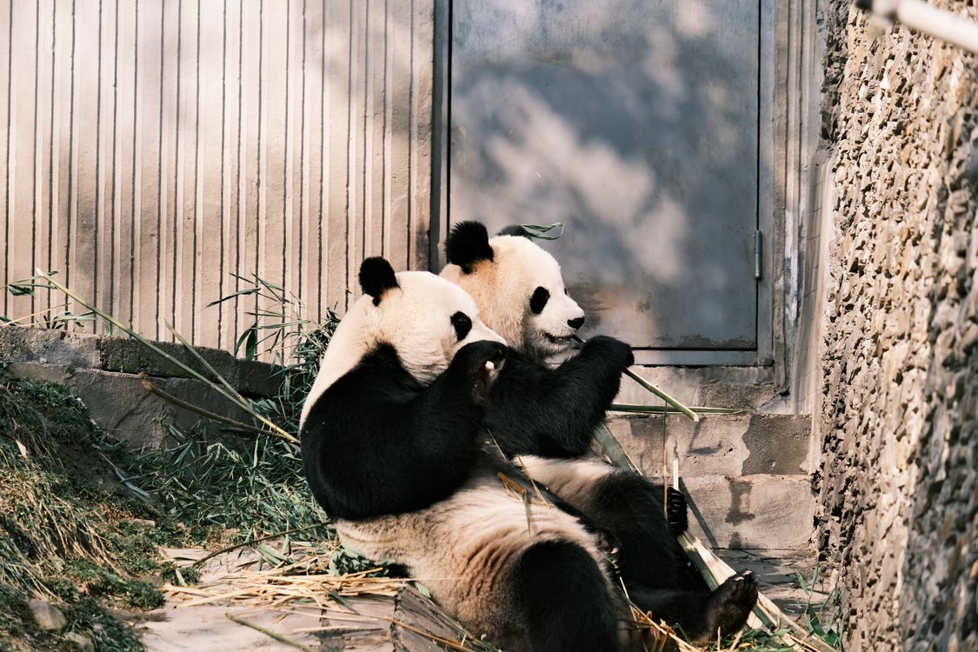
Time to Play
Two Pandas by Lily Lili under Pexels license

Slide 38
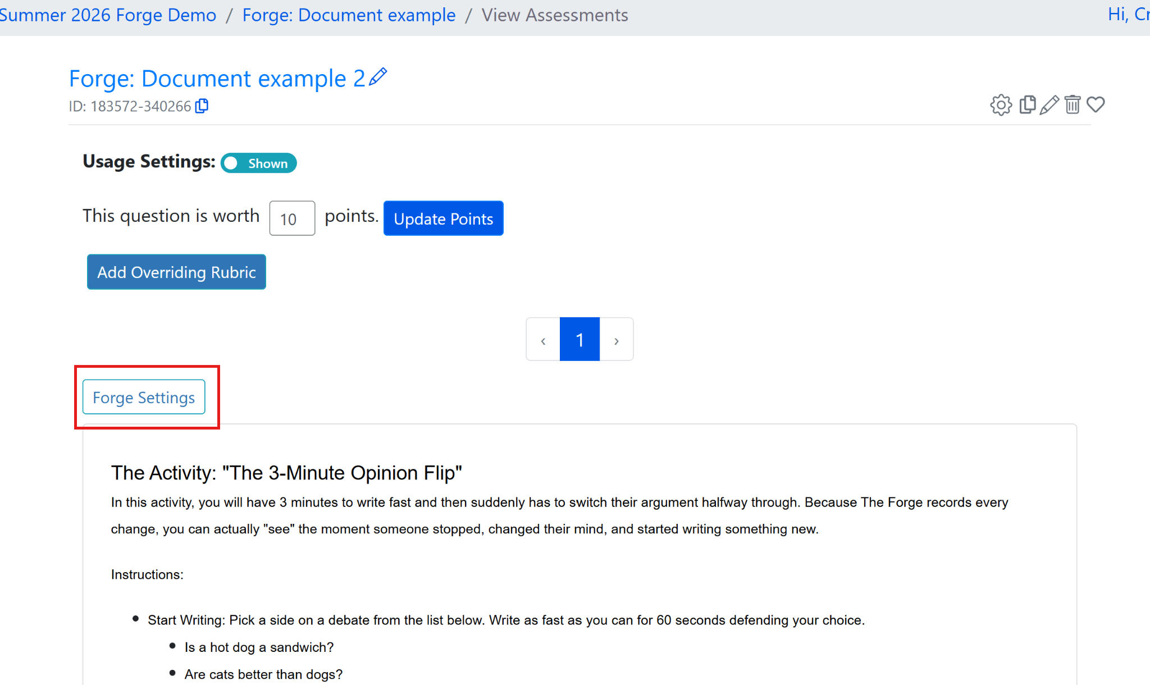
Forge Assignment Settings
After creating or cloning a Forge question, you will see a message indicating that students will not be able to respond until the instructor completes the settings.
Find the Forge Settings on the left corner of the screen.

Slide 39
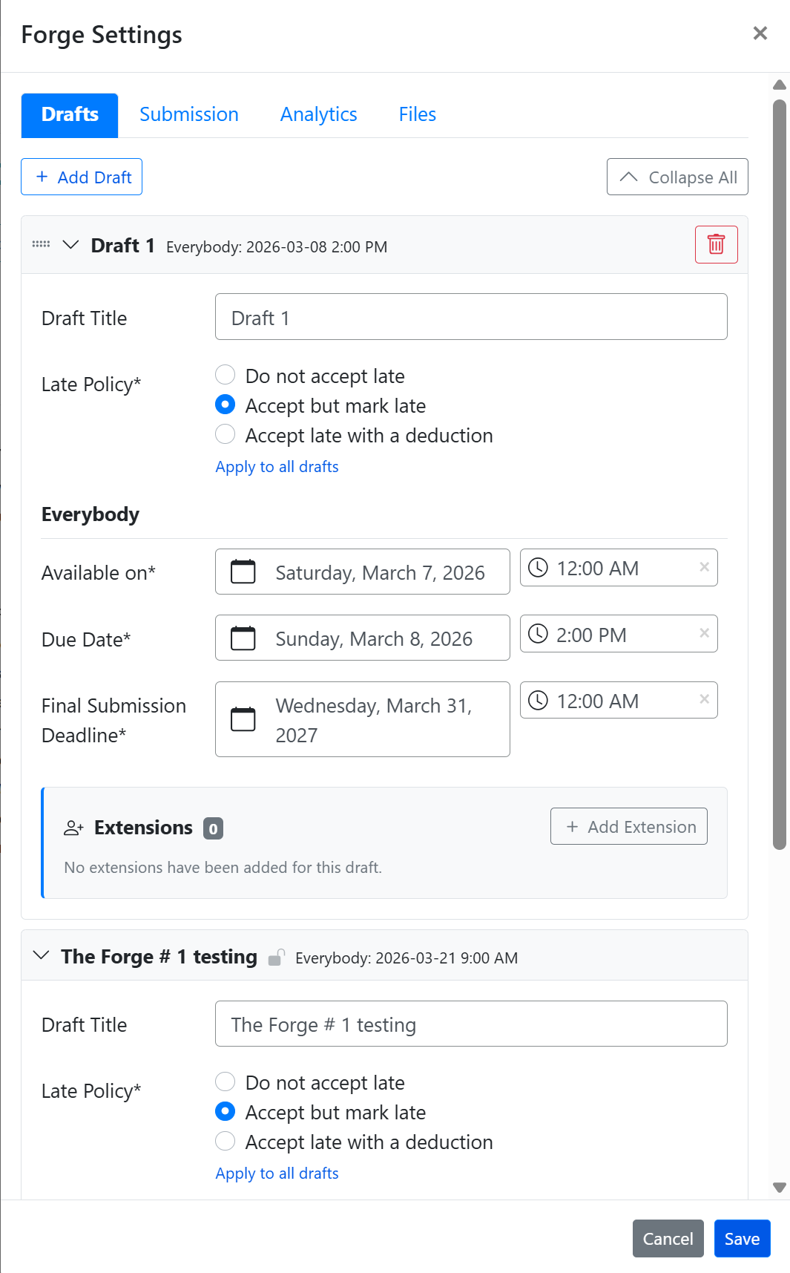
Forge Settings Step 1: Drafts
If you are planning to have drafts, select + Add Draft.
This will open Draft 1.
Complete: title, late policy, and available dates.
If you need to give an extension to a specific student, you can select "+ Add Extension" and find the name of the student

Slide 40
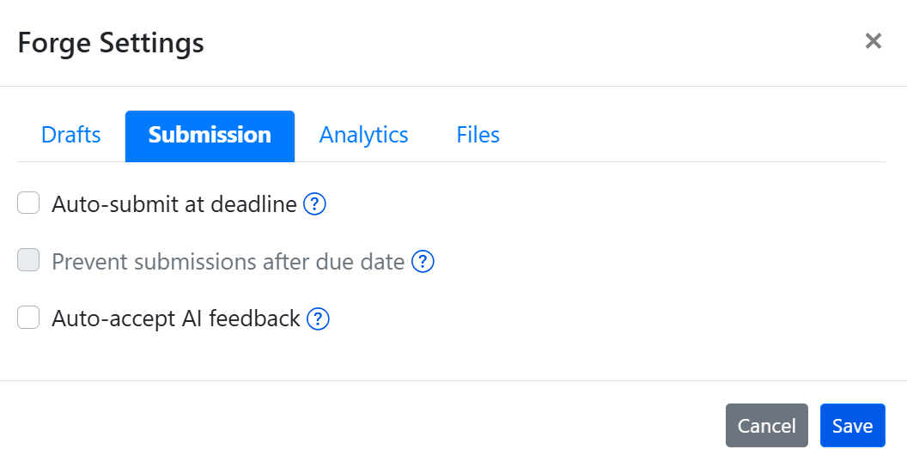
Forge Settings Step 2: Submission
Submission
Auto-submit at deadline -Automatically submits student work when the assignment deadline is reached.
Prevent submissions after due date - Students are unable to submit work after the due date has passed.
Auto-accept AI feedback - Automatically accepts AI-generated feedback without requiring instructor review.
If you are having drafts, it is recommended to select auto-submit at deadline. This will close the draft at the due date and it will automatically push students to the next draft or final version.

Slide 41
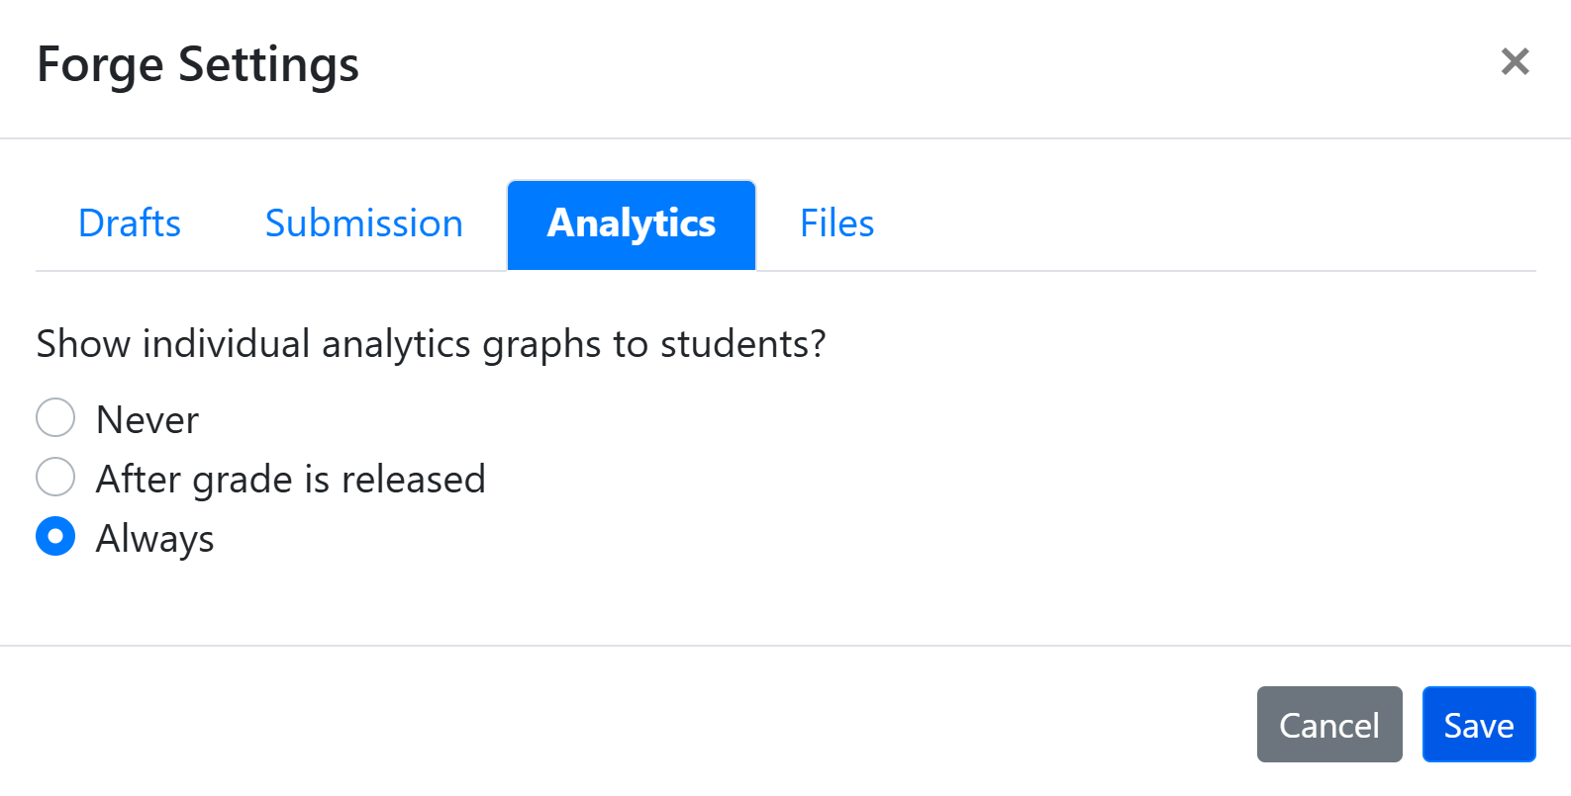
Forge Settings Step 3: Analytics
You will find 3 options for students to see the analytics:
Never
After grade is released
Always
Make your selection and then select Save.

Slide 42
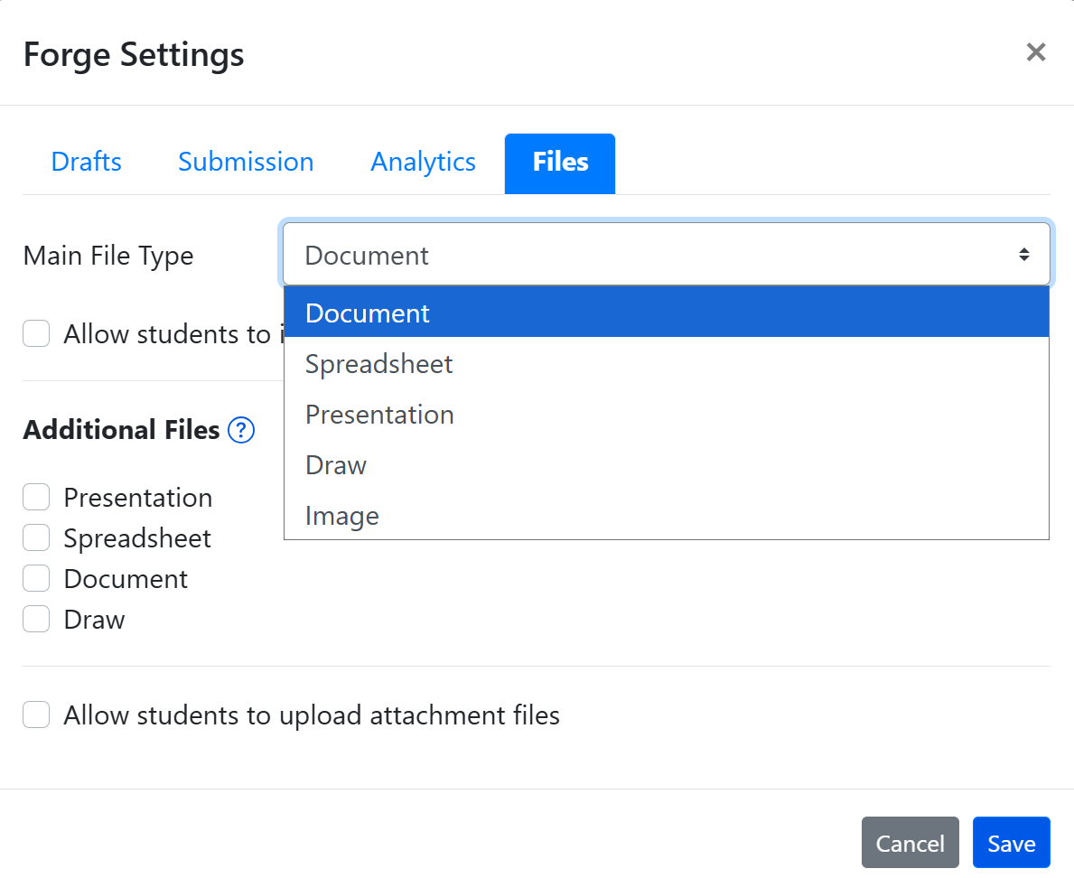
Forge Settings Step 4: Files
Under the Main File Type, you can choose what the main file type will be Document, Spreadsheet, Presentation, Draw, and Image.
In addition, you can allow students to submit different file type documents.
Be sure to save your selection.

Slide 43
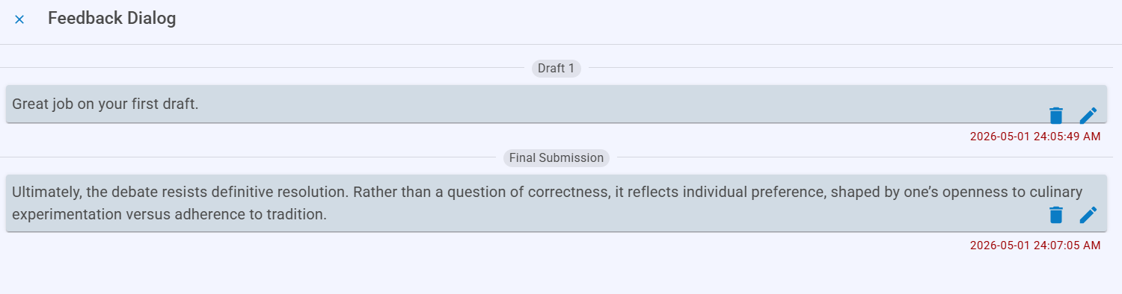
Grading
The Forge assignment will appear as one assignment which means it will appear as a column in the gradebook.
I recommend using Canvas w/rubric to grade.
If you have drafts, then adjust the rubric to include the drafts in each category/criteria.
For comments, you can leave them in Forge (in the document and also as feedback).

Slide 44

Time to Explore or Breathe
Tortoise is licensed CC0 1.0 Public Domain.

Slide 45
Things to Remember
You can add any public question to your assignment in ADAPT.
However, only certain question types can be cloned, specifically: ADAPT native questions, WeBWorK questions, Forge questions, and Learning Trees,
Cloning a question creates a copy in your cloned folder that you can freely edit and later add to an assignment.

Slide 46
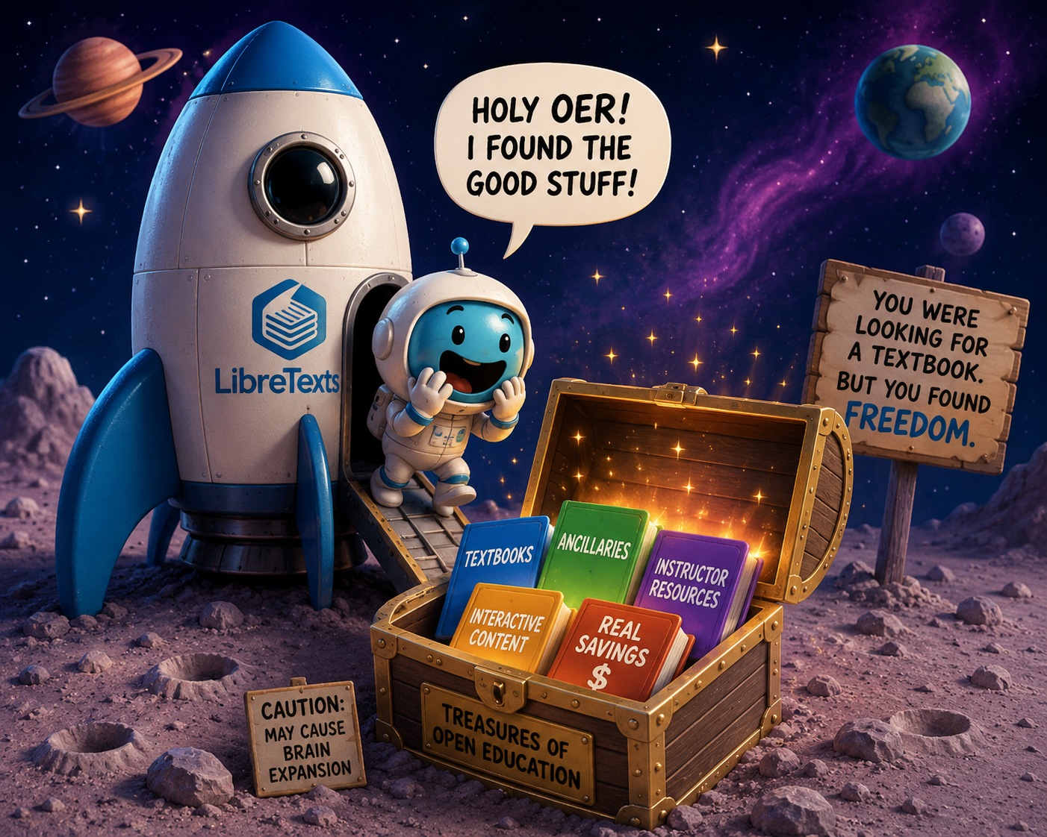
Did you find some good stuff?
LibreTexts Rocket Icon. Adapted for instructional use. Original icon from LibreTexts. CC0 1.0 Public Domain.

Slide 47
Next in the Series and Coming Up
ADAPT Level 4 | Collaborative Learning: Multimodal Engagement with Discuss-It | Thursday, June 11, 10:00-11:30 am
LibreTexts Level 4 | Designing with Media: Images and Video in LibreTexts | Wednesday, June 10, 10:30-12:00 pm
Open Office Hour: Friday, June 12th, 2:00-3:00 pm
To register and find the recorded archived of webinars, please visit the ASCCC OERI.

Slide 48

Contact Us
Holiday Hedgehog is licensed CC0 1.0 Public Domain
Cristina Moon –cmoon@chabotcollege.edu
Shagun Kaur – kaurshagun@fhda.edu
OERI Team - oeri@asccc.org

