Slide 1
Welcome!
On behalf of the ASCCC OERI, we are pleased to have you here with us for “Collaborative Learning: Multimodal Engagement with Discuss-It”.
If you are not already muted, please mute yourself upon arrival.
Please note that you are encouraged to use the Zoom “chat” feature for questions and comments.
You’re invited to introduce yourself in the chat – please provide your name, college, discipline/role.
This event will be recorded. Archives of all ASCCC OERI events are available at asccc-oeri.org > Webinars and Events

Slide 2
Level 4: Collaborative Learning: Multimodal Engagement with Discuss-It
June 11th, 2026. 10:00 am – 11:30 am
This work is licensed under a Creative Commons Attribution 4.0 International License.)

Slide 3

Presenters
Cristina Moon, ASCCC OERI ADAPT lead
  Spanish, Chabot College
Shagun Kaur, ASCCC OERI LibreTexts Lead
  Communication Studies, De Anza
Photo by Siora Photography on Unsplash
Notes:
Presenters can be included following the description or the overview. Where images are used, they should include an attribution (Photo by…) and appropriate alternative text should be used (or the image marked decorative).

Slide 4
Webinar Description
In this final session, participants will explore Discuss-It, a specialized ADAPT question type designed to transform static assignments into dynamic, interactive threaded conversations. This platform allows students to engage with content and each other through multiple modes, including text, audio, and video. You will learn how to set up collaborative spaces that foster peer-to-peer learning and provide a more humanized, authentic way to assess student understanding.

Slide 5
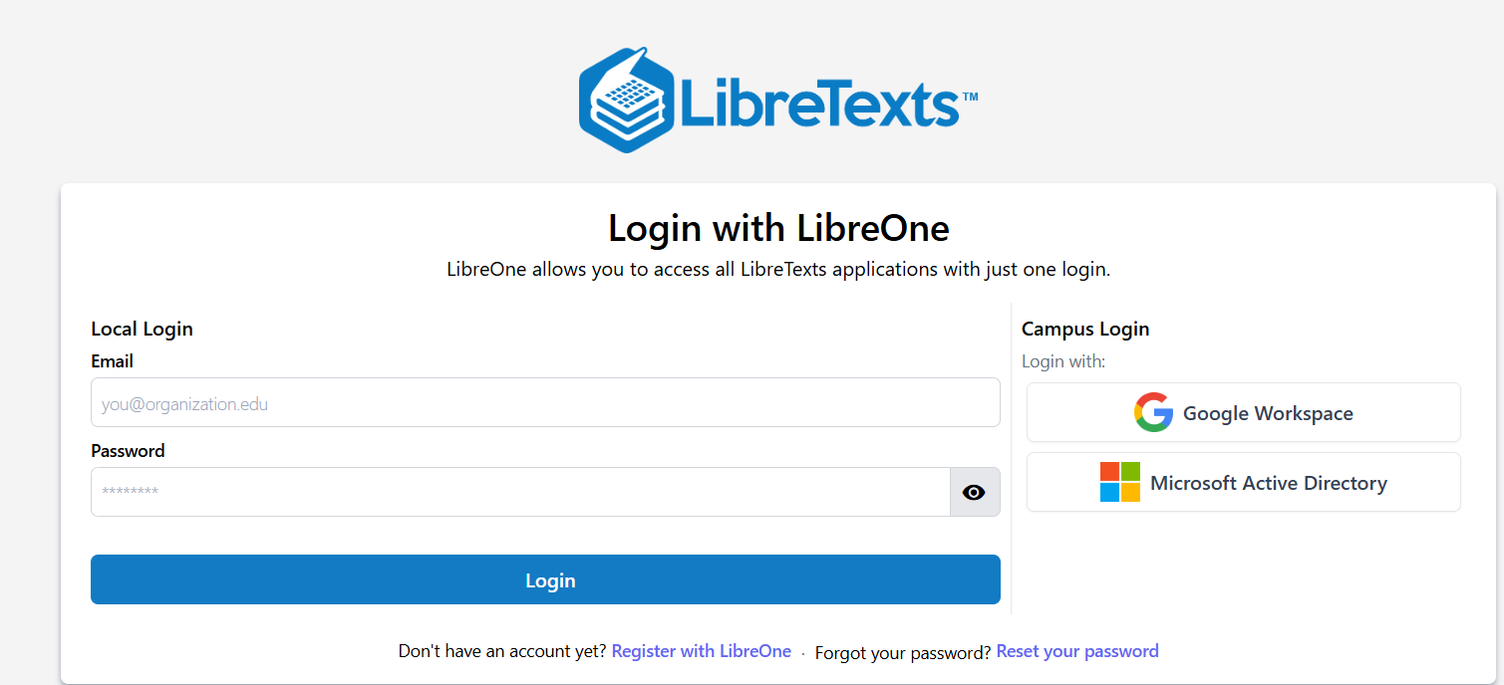
Registration for a LibreTexts Account
If you don't already have one, register for a LibreOne account.
Verify your Instructor status to unlock full LibreTexts functionality.

Slide 6
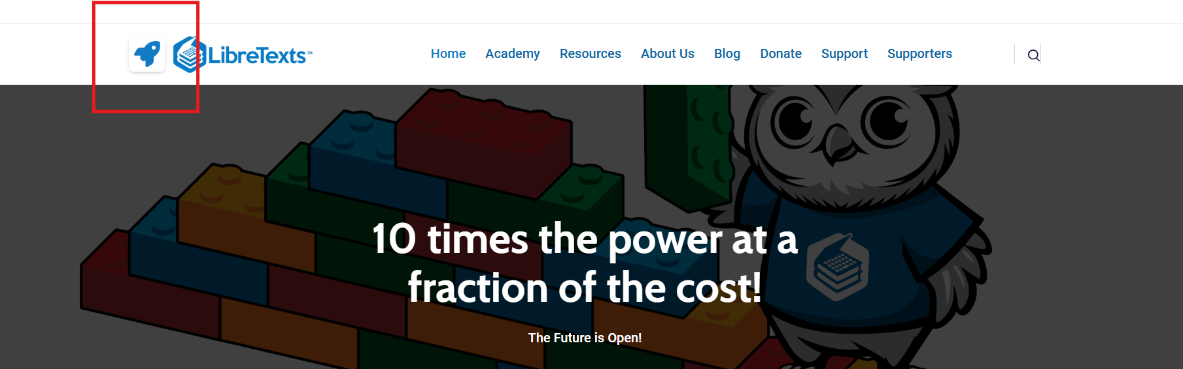
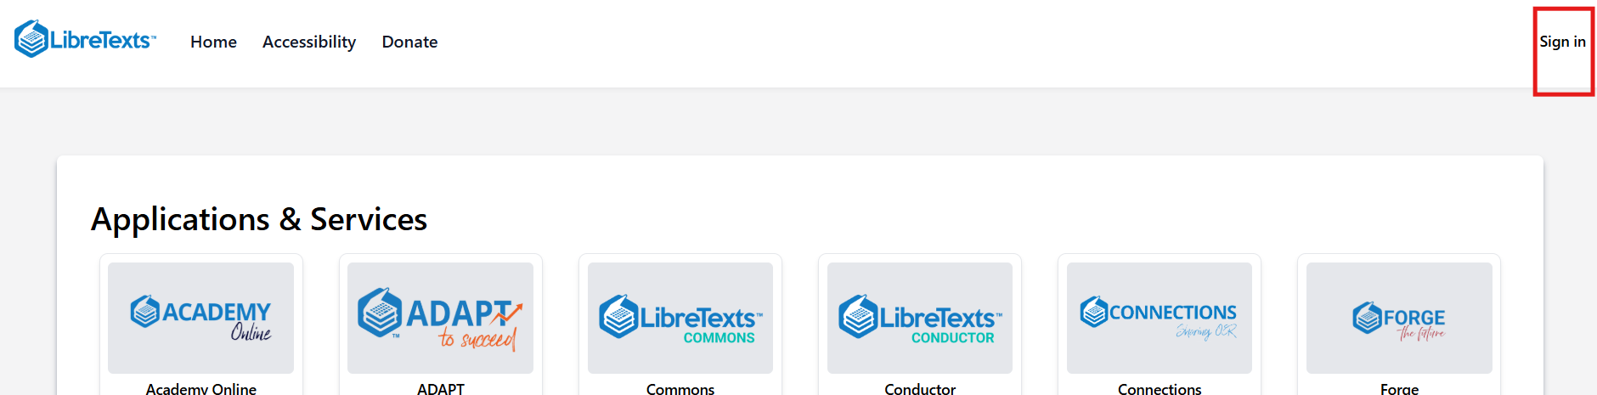
Logging in to your Account
Navigate to LibreTexts.org and click on the “rocket ship” icon
It will prompt you to sign in if you are not already logged in

Slide 7

Overview
What is Discuss-It?
Discuss-It Features
Clone Discuss-It ADAPT Demo course
Clone Discuss-It questions
Discuss-It Assignment Settings
Notes:
An Overview slide should be included that is an outline of the presentation.

Slide 8
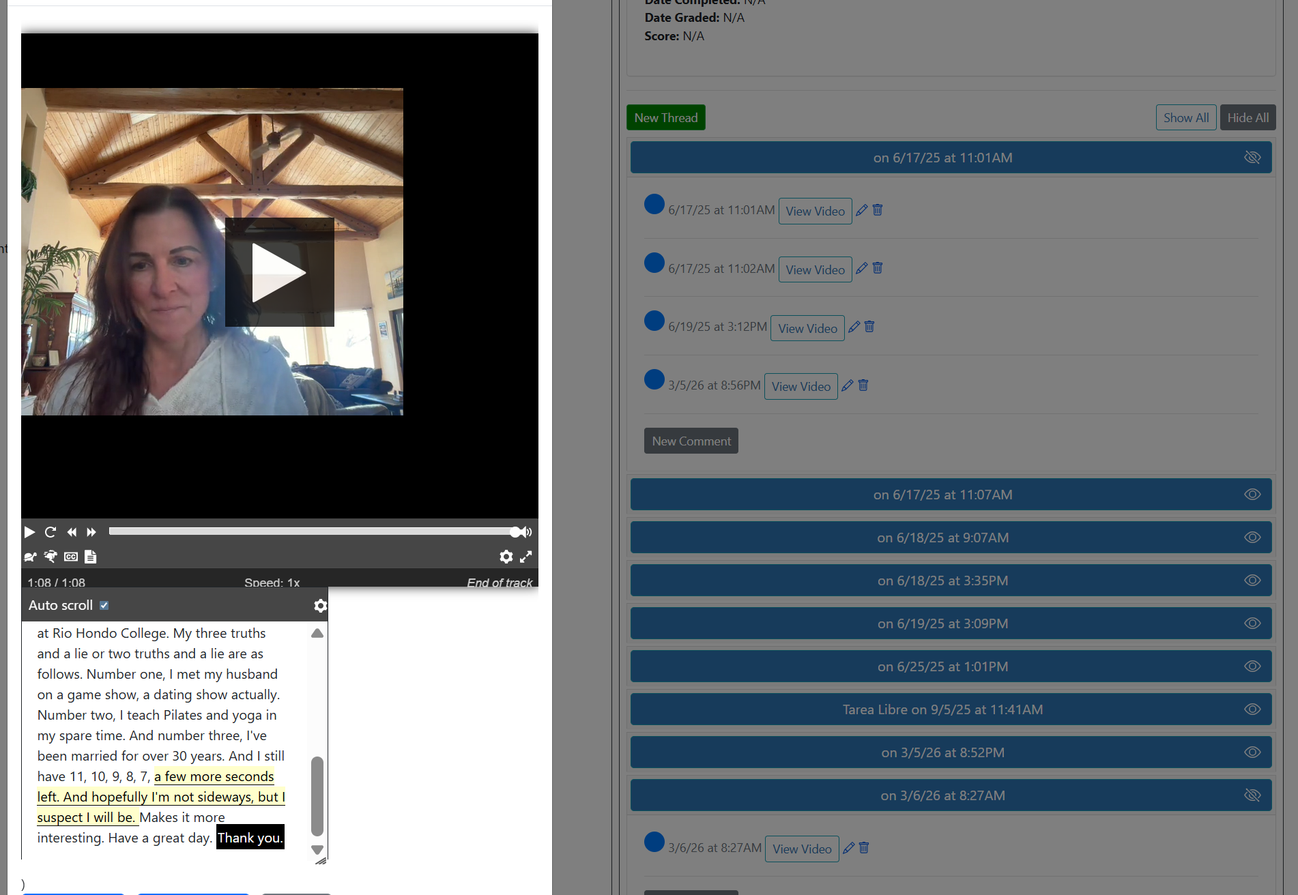
Introducing Discuss-It
Discuss-It is a specialized question type in ADAPT that creates threaded discussions to foster collaboration, critical thinking, and authentic practice — keeping the human element at the center of learning.
Notes:
CM

Slide 9
Discuss-It: Media-Rich Discussions Built for RSI
A discussion tool inside ADAPT that embeds text, audio, and video conversations directly alongside course content such as videos, readings, images, etc.
Why it fits RSI (Regular & Substantive Interaction)
Facilities group discussion using multiple modalities (text, voice, or video) that are logged and timestamped.
Completion criteria + participation tracking support monitoring and proactive outreach
Group assignment makes facilitation realistic in large classes.

Slide 10
Discuss-It Features
Unlike other similar products like Voicethread, Discuss-It is free for CA.
Ability to post video, audio, or text responses (warning if copy/paste occurs).
Auto-Captioning: All audio and video responses are automatically captioned using OpenAI's Whisper speech-to-text technology.
Auto-Transcription: Full transcripts with synchronized time-stamps are generated alongside captions, allowing instructors and students to easily navigate, select, and edit specific moments in the recording for maximum accuracy.
Multi-Language Support: Whisper supports transcription in dozens of languages.
Easy cloning (or copying) of all public questions.
Canvas integration with automatic gradebook syncing.
Rubric for grading.

Slide 11

Let’s take a look at some
Discuss-It examples
tinyurl.com/LTADAPT
Notes:
https://adapt.libretexts.org/students/assignments/94618/init-formative

Slide 12

Can you see yourself using
Discuss-It in your classes?
Photo by panyawat auitpol on Unsplash

Slide 13
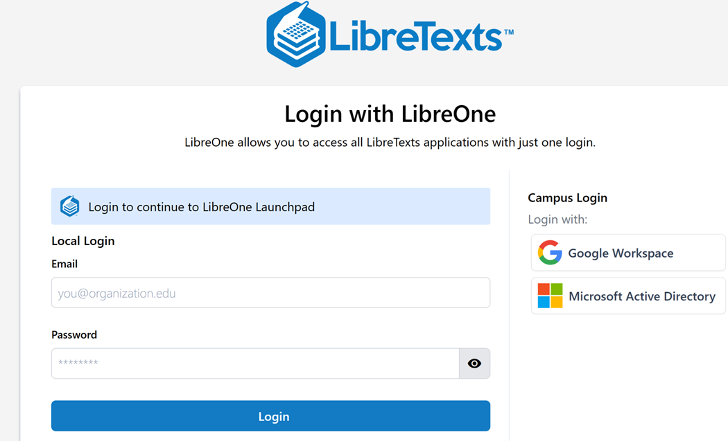
Log into LibreOne
LibreOne link (https://one.libretexts.org/)
Once you have the account, start with “Consult Insight” for training videos and instructions.
Notes:
https://one.libretexts.org/

Slide 14
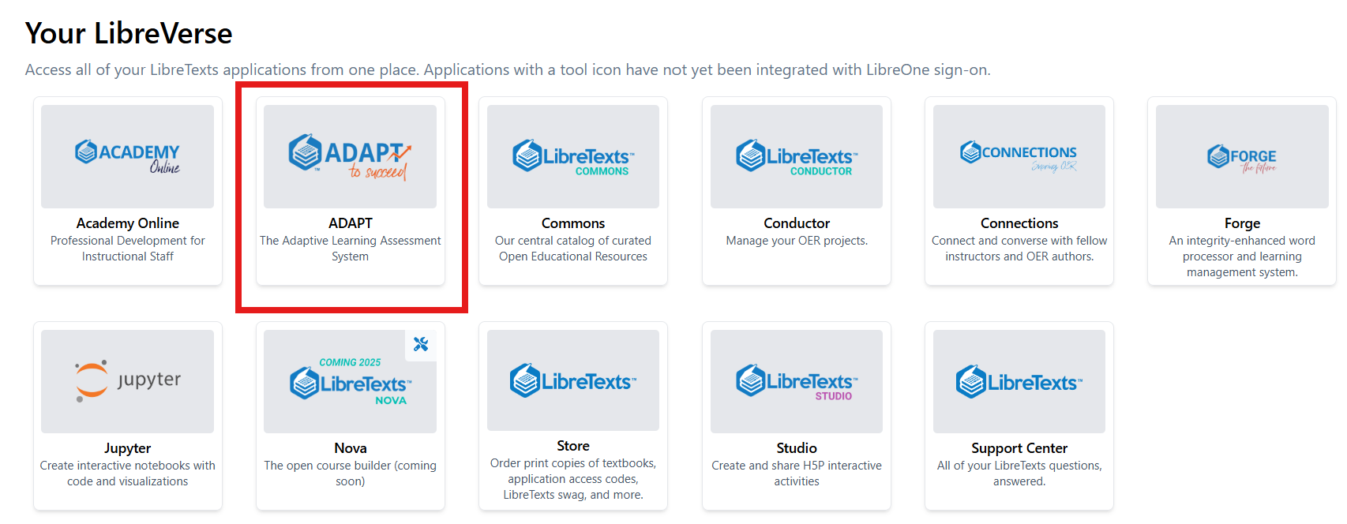
Finding ADAPTT

Slide 15
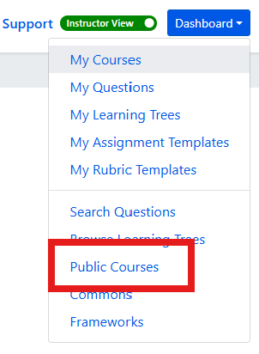
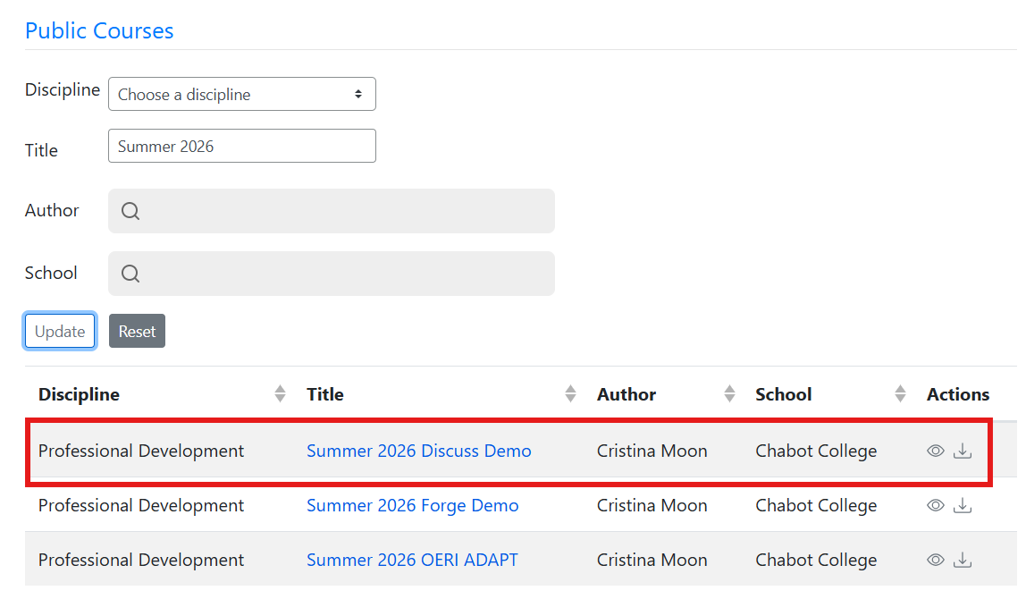
Import OERI ADAPT Demo Course
First, find the Dashboard and select Public Courses.
Next, under Title, type Summer 2026 Discuss-It Demo and then select the import (down arrow).

Slide 16
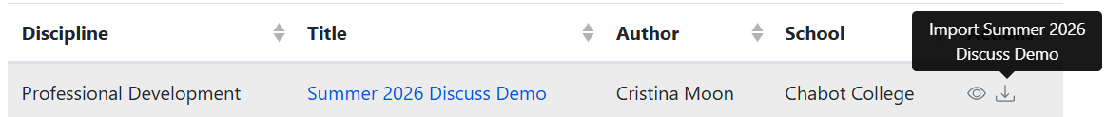
Importing a Public Course - Step-by-Step
Log into LibreTexts.
Navigate to ADAPT.
If you are logged in as an Instructor, your Dashboard will be in the upper right of your screen no matter where in ADAPT you are.
Select “Public Courses.”
Leave the “Discipline” field as it as and then enter “Summer 2026 Discuss-It Demo” in the “Title” field.
Select “Update.”
You should now have the Summer 2026 Discuss-It Demo Course available for you to import into your courses.
Select the down arrow under actions (on the far right) to import the course.

Slide 17

Isn’t Cloning Easy?
Sloth by Mancia Freddy is licensed CC0 1.0 Public Domain.

Slide 18
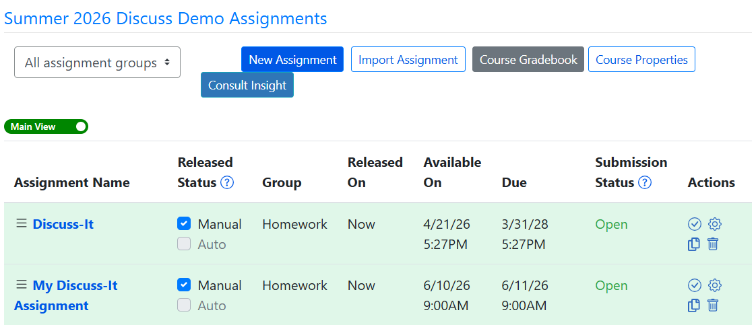
Imported Demo Course

Slide 19
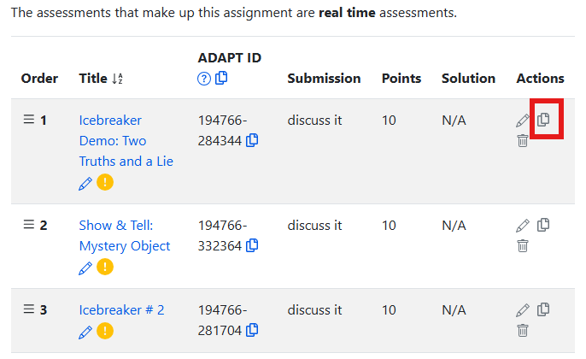
Clone (Copy)
A Discuss-It Example
Select the clone icon that looks a double paper under the Actions heading.

Slide 20
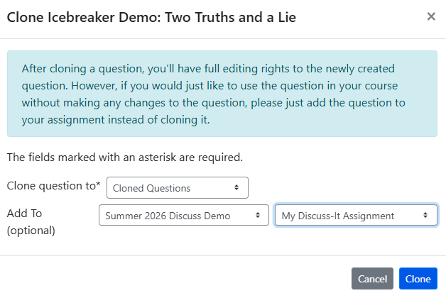
After Cloning

Slide 21
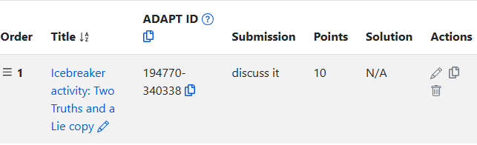
To Access Your Copy, Select Its Title
Modify the title of your cloned question by selecting the pencil icon at the end of the title either before or after accessing all elements of your copy.
Upon accessing your question for editing, you will make edits in just two sections:
  Properties
  Primary Content

Slide 22
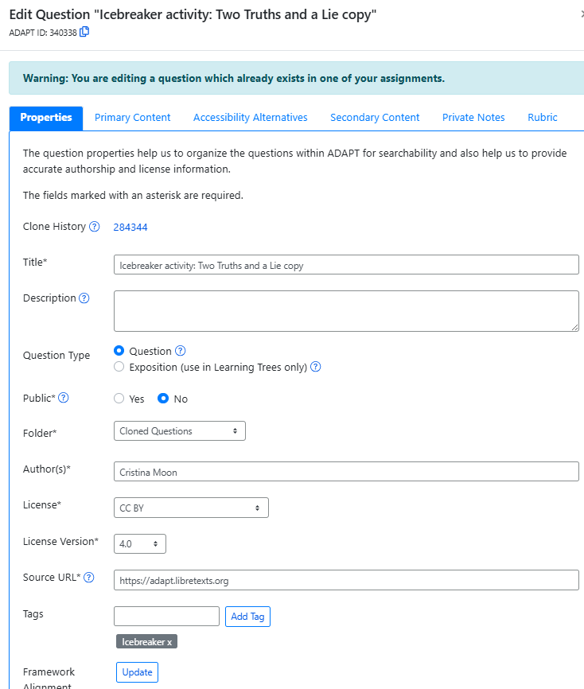
Edit the Properties of Your Cloned Question
Under the first tab, Properties:
Change the title.
Add a description, if desired.
Don’t change Question Type.
Public - yes or no.
Automatically goes to Cloned Questions folder - but you can change this.
Change author to yourself.
Modify license if needed.
Notes:
Edit Properties and Primary Content. 1. Change the title. 2. Add a description, if desired. 3. Don’t change Question Type. 4. Public - yes or no. 5. Automatically goes to Cloned Questions folder - but you can change this. 6. Change author to yourself. 7. Modify license if needed.

Slide 23
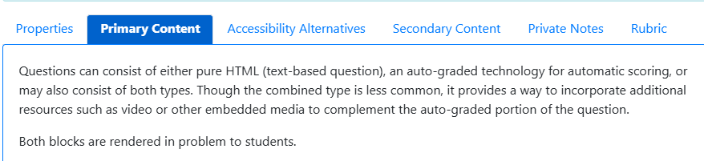
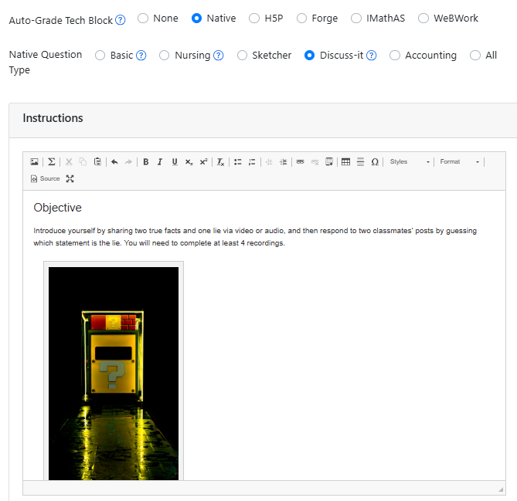
Primary Content
Under the Primary Content tab, you can view and edit the question content.
In Discuss-It, first you will see the Instructions area.
Notes:
Under Primary Content choose Native > Select Choice

Slide 24
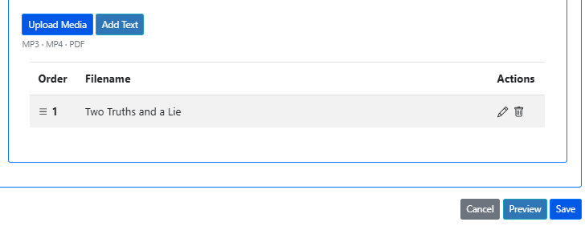
Upload Media and Add Text
Next, select Upload Media to add a video, image, or document. Note that you must include at least one media upload or text box before you can save the question. If you add more than one media item or text box, each one becomes a separate page or slide within the question, allowing you to organize content across multiple pages or create groups.
Select Preview to review your question, and then save.

Slide 25
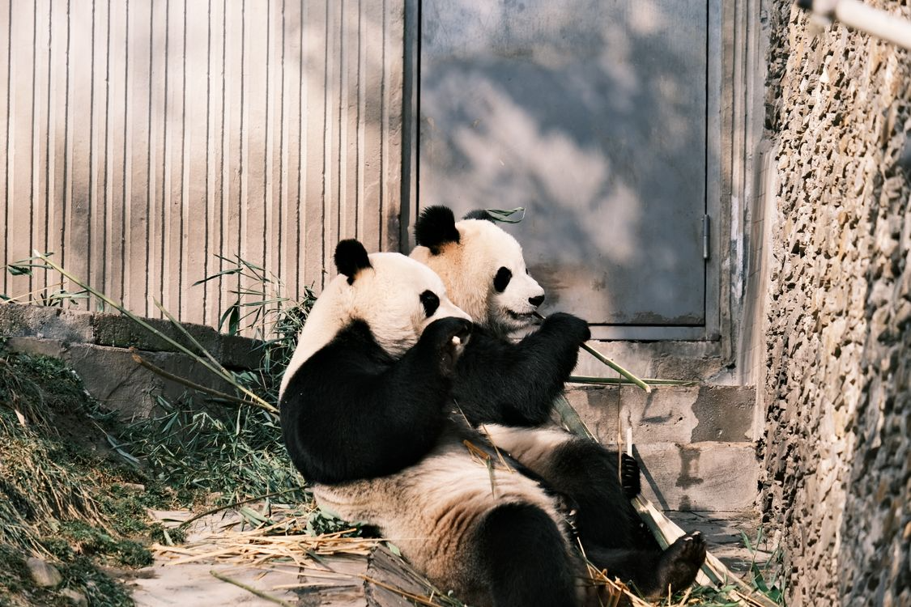
Your Turn to Clone and Edit a Discuss-It Question
Two Pandas by Lily Lili under Pexels license

Slide 26
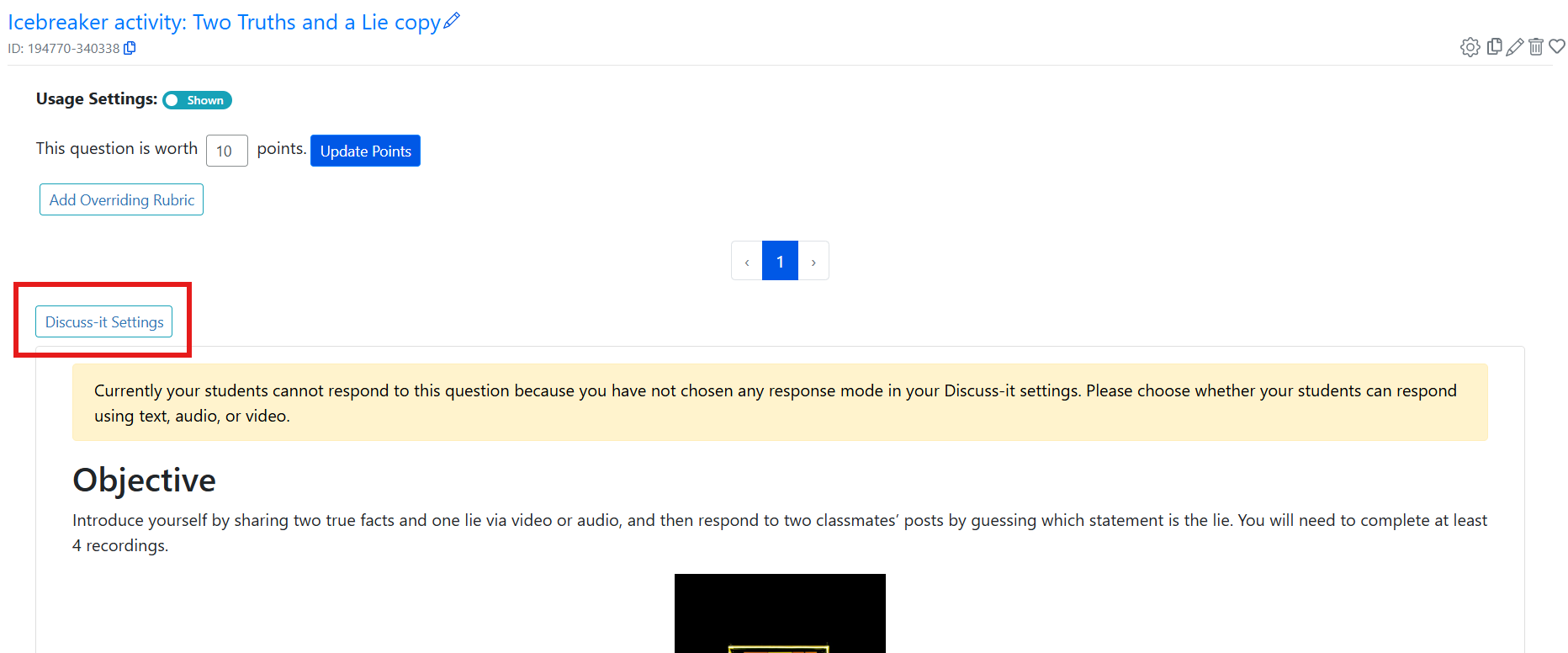
Discuss-It Assignment Settings
Before students can access a Discuss-It question, you must complete the Discuss-It Settings. To find it, go to the question by selecting the title.
Find the Discuss-It Settings on the left corner of the screen.

Slide 27
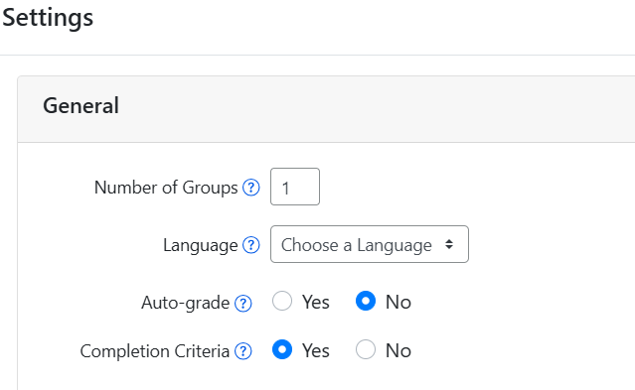
Discuss-It Settings Step 1
Under General, you need to select number of groups, language, auto-grade, and completion criteria:
Number of Groups- If you want students to work in groups, choose how many groups you want. ADAPT will randomly assign students to groups, making discussions easier to manage in large classes.
Language - AI is used to transcribe audio and video. For the best results, select the language spoken in the comments. If more than one language may be used, choose 'Multiple' — but note that accuracy may be lower.
Auto-grade - If you select yes, students automatically receive full credit when they complete the assignment criteria.
Completion Criteria - Select yes if you want students to see the completion requirements, minimum number of words or audio or video length for responses.

Slide 28
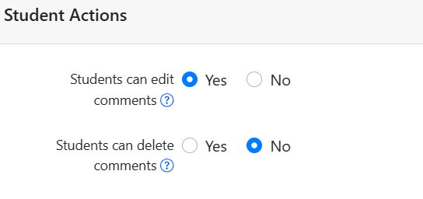
Discuss-It Settings Step 2
Complete the Student Actions section.
We recommend allowing students to edit their comments while restricting the ability to delete them.
Note that if a student deletes their original post, any associated comments will also be removed.

Slide 29
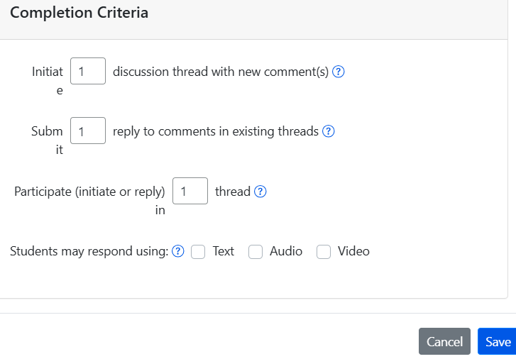
Discuss-It Settings Step 3
Lastly, complete the Completion Criteria by choosing the number of:
Initiate discussion thread with new comment(s)
Submit reply to comments in existing threads
Participate (initiate or reply) thread
Next choose the media format. Choose whether students respond via text only, audio only, video only, or a combination.

Slide 30
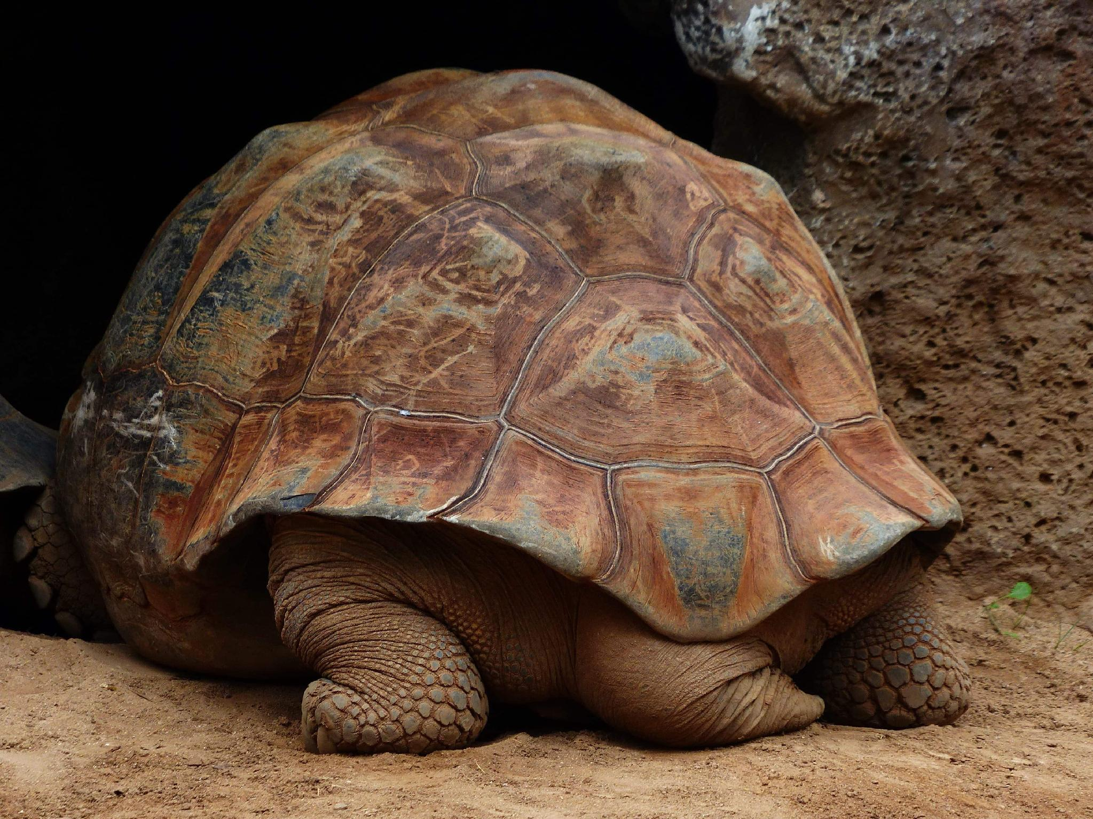
Your Turn to Try
Tortoise is licensed CC0 1.0 Public Domain.

Slide 31
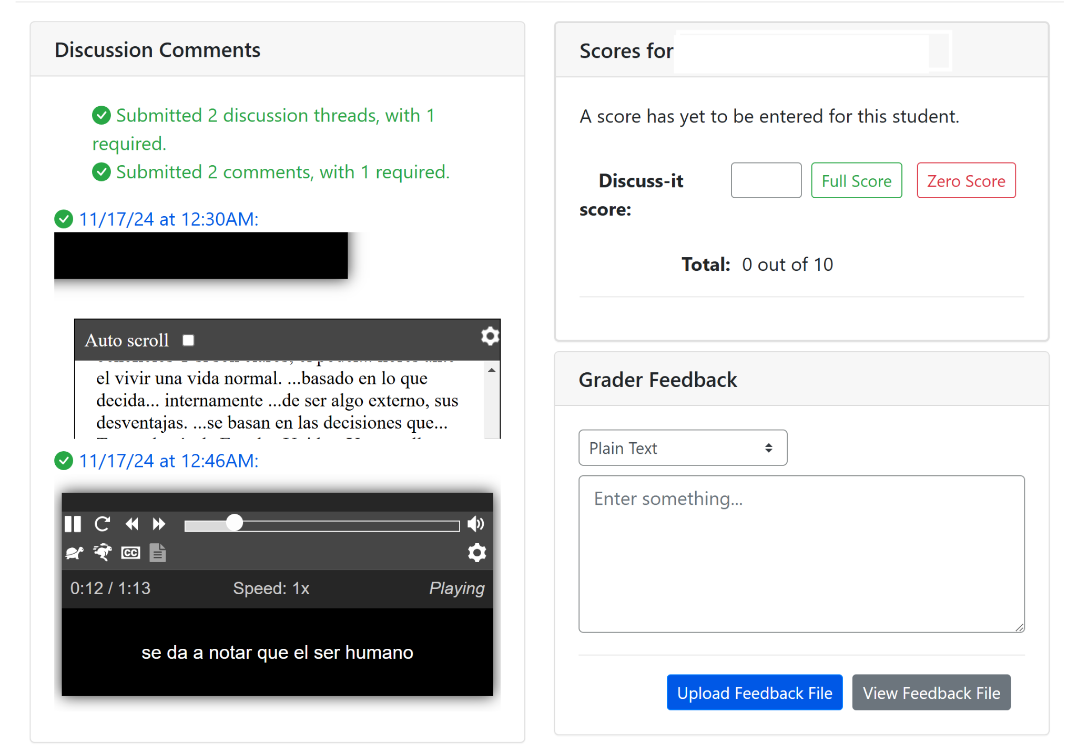
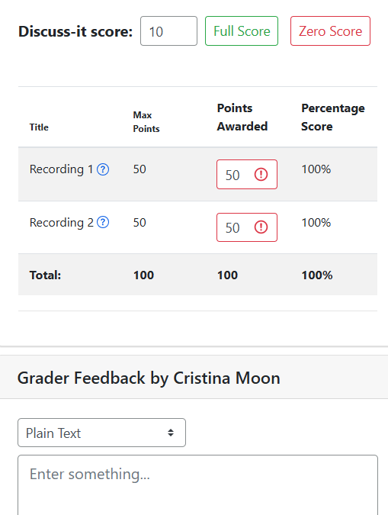
Easy Grading of Discuss-It Questions

Slide 32
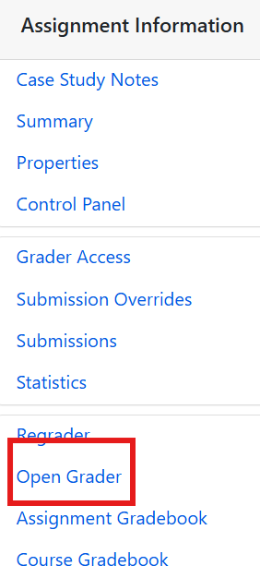
Grading Open-Ended Questions
Find the assignment and select the title of the assignment.
You will see the Assignment Information panel.
Select Open Grader.
Note: all open-ended questions will be graded from the Open Grader.

Slide 33
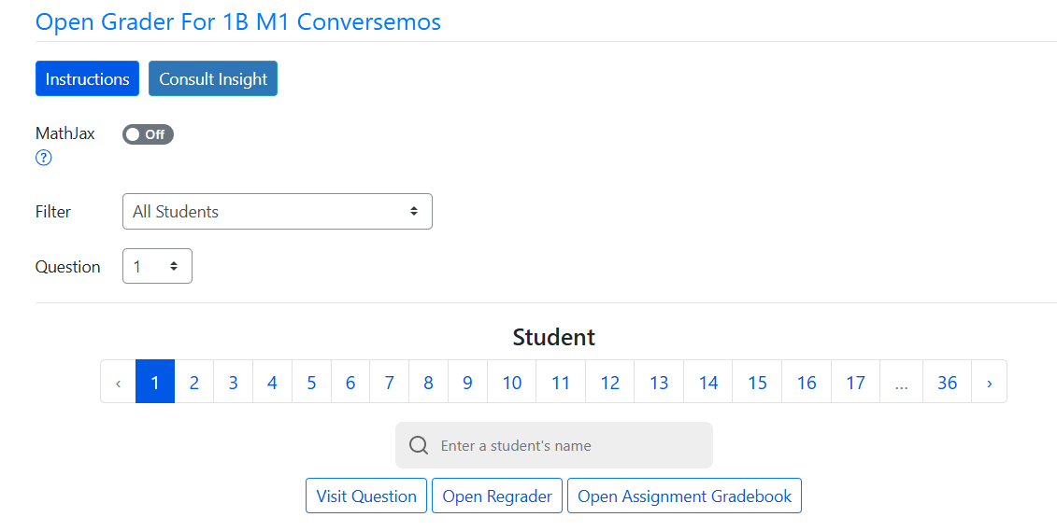
Grading in Open Grader

Slide 34
Things to Remember
You can add any public question to your assignment in ADAPT.
However, only certain question types can be cloned, specifically: ADAPT native questions, WeBWorK questions, Forge questions, and Learning Trees,
Cloning a question creates a copy in your cloned folder that you can freely edit and later add to an assignment.

Slide 35
What did you think of Discuss-It?

Slide 36
Next in the Series and Coming Up
Survey for LibreTexts and ADAPT Webinar Series, Summer 2026
Office hours:
Register for the LibreTexts/ADAPT Office Hours on Friday, June 12, from 2:00 pm – 3:00 pm
Register for the LibreTexts/ADAPT Office Hours on Monday, June 15, from 9:00 am – 10:00 am
Register for the LibreTexts/ADAPT Office Hours on Thursday, June 19, from 9:00 am – 10:00 am
To register and find the recorded archived of webinars, please visit the ASCCC OERI.

Slide 37
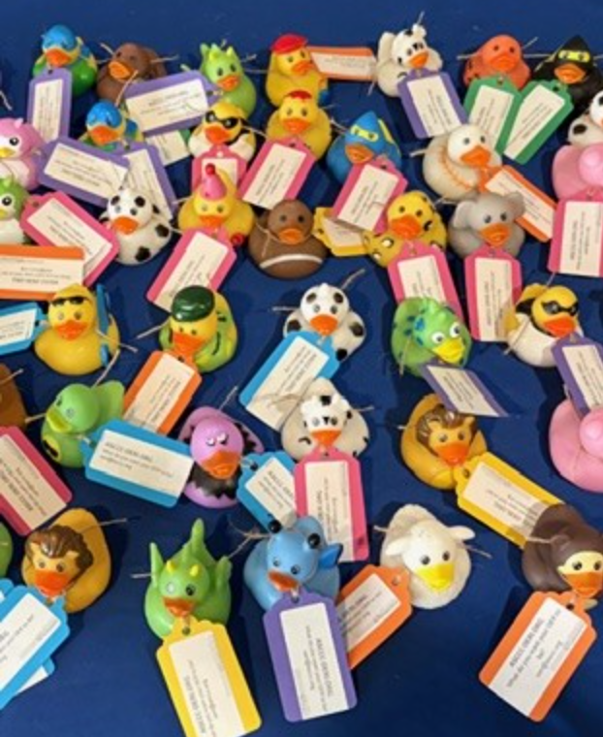
Coming Up in-person Trainings
Tuesday, June 23, 2026, 9am-12pm PE6 -Introduction to LibreTexts and ADAPT at the Online Teaching Conference. Registration. $25
Friday, August 14, 8:30 am – 3:30 pm OERI Regional at Allan Hancock. Registration. $25
Friday, August 28, 8:00 am – 3:00 pm OERI Regional at Cerritos College. Registration. $25
Pending for October
San Diego CCD
Monterey Peninsula College
To register please visit the ASCCC OERI.

Slide 38

Contact Us
Holiday Hedgehog is licensed CC0 1.0 Public Domain
Cristina Moon –cmoon@chabotcollege.edu
Shagun Kaur – kaurshagun@fhda.edu
OERI Team - oeri@asccc.org

