Slide 1
Welcome!
On behalf of the ASCCC OERI, we are pleased to have you here with us for “Level 3: Quick Start: Editing Pages in LibreTexts.”
If you are not already muted, please mute yourself upon arrival.
Please note that you are encouraged to use the Zoom “chat” feature for questions and comments.
You’re invited to introduce yourself in the chat – please provide your name, college, discipline/role
This event will be recorded. Archives of all ASCCC OERI events are available at asccc-oeri.org > Webinars and Events

Slide 2
Level 3: Quick Start: Editing Pages in LibreTexts
June 8th, 2026. 10:00 am – 11:30 am
This work by Shagun Kaur is licensed under a Creative Commons Attribution 4.0 International License.)

Slide 3

Presenters
Shagun Kaur, ASCCC OERI LibreTexts Lead
  Communication Studies, De Anza
Cristina Moon, ASCCC OERI ADAPT lead
  Spanish, Chabot
Photo by Siora Photography on Unsplash
Notes:
Presenters can be included following the description or the overview. Where images are used, they should include an attribution (Photo by…) and appropriate alternative text should be used (or the image marked decorative).

Slide 4
Webinar Description
In this intermediate, hands-on workshop on page editing in LibreTexts, participants will actively revise and format content, apply accessible structure (including headings and links), and use built-in templates (e.g., boxes) to organize material clearly and consistently. Designed for faculty ready to move beyond the basics, this session builds practical skills to enhance usability, accessibility, and overall presentation of course content.

Slide 5

Overview
Editing and formatting content
Using headings to organize pages
Creating accessible links
Adding and customizing content boxes
Improving page readability and accessibility
Notes:
An Overview slide should be included that is an outline of the presentation.

Slide 6
Canvas Course: LibreTexts Basics and Beyond
This course is an adaptation created by Cristina Moon and Michelle Pilati. It is a revision of "Mastering Libretexts" created by Wendy Poling and is shared under a CC-BY-4.0 license
We will be covering Module 4 [4.1,4.2, 4.5] today
Register for LibreTexts Basics and Beyond
Note: The ASCCC OERI LibreTexts Basics and Beyond course is also available on Canvas Commons for local use.

Slide 7

Registration for a LibreTexts Account
If you don't already have one, register for a LibreOne account.
Verify your Instructor status to unlock full LibreTexts functionality.

Slide 8


Logging in to your Account
Navigate to LibreTexts.org and click on the “rocket ship” icon
It will prompt you to sign in if you are not already logged in

Slide 9
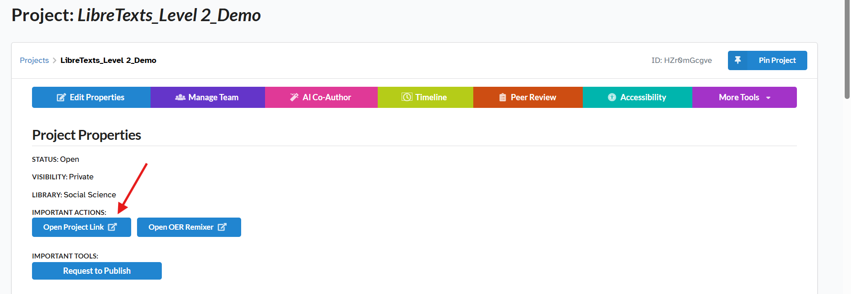
Go to your Conductor Project
Click on “Open Project Link” to access the book you created in the Remixer

Slide 10

Fork before you edit
Pages imported from another book are read-only until you create your own copy.
Forking creates an editable version in your project.
Changes you make will not affect the original page.
Once forked, your page will no longer receive updates from the source.
Want to track future changes? Star the original page to receive update notifications.
Think of forking as making your own working copy before you start editing.

Slide 11
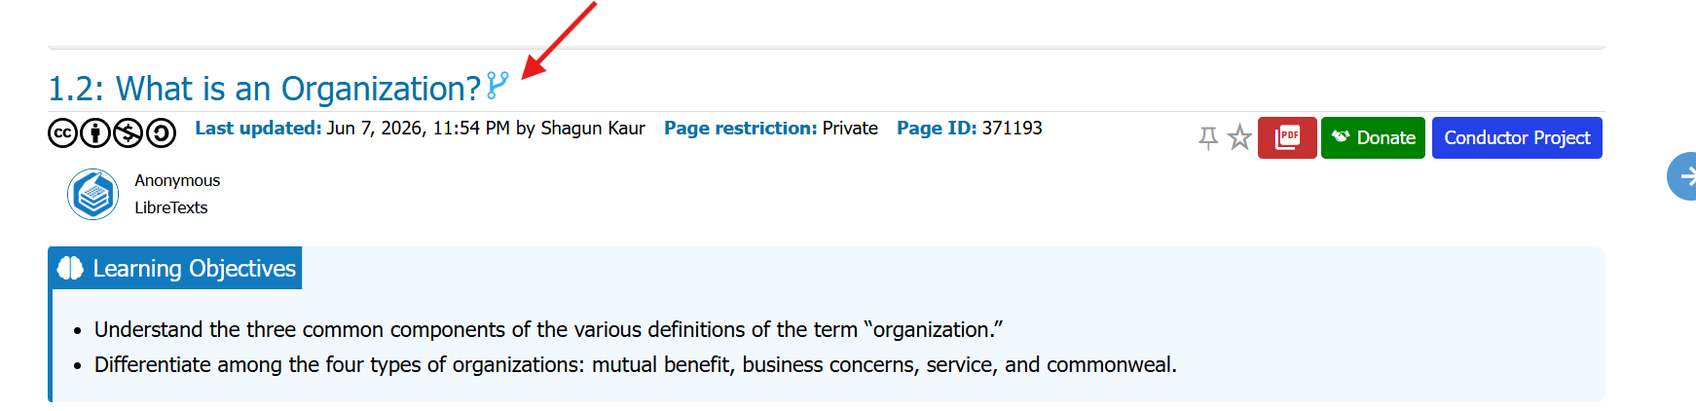
Forking a Page
Select the Fork symbol next to the page title.
Select OK on the two pop-ups that appear.
If the Fork symbol disappears, you are on your own page and can start editing.

Slide 12
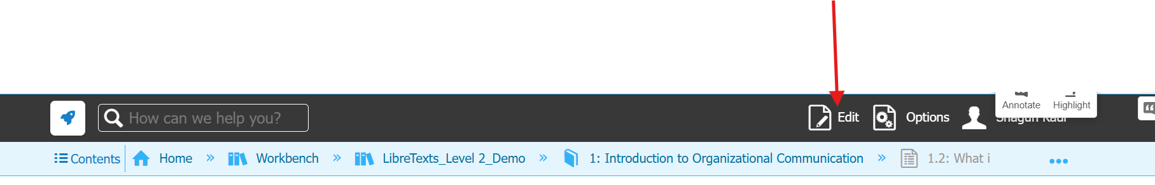
Edit Icons
Clicking on the pencil next to the page title will only change the page title.
Look for the black toolbar at the top of the page.
Select Edit to begin editing a page you own or have forked.
No black toolbar? You are not logged in or do not have editing permissions.
Use the pencil icons throughout the page to quickly edit specific sections.
Black bar = editing access. No black bar = view-only mode.

Slide 13
Page Naming Conventions
Use a consistent page title format to support navigation, remixing, and automatic numbering.
Standard Format:
XX.YY: Page Title
Example: 4.2: Gluconeogenesis
Special Pages
XX.S: Chapter Summary
XX.E: Chapter Exercises
XX.YYA/B: Section Subpages
Remember
Only one colon per title.
Replace additional colons with a dash.
Consistent page titles support navigation, remixing, and automatic numbering of figures, tables, and equations.

Slide 14
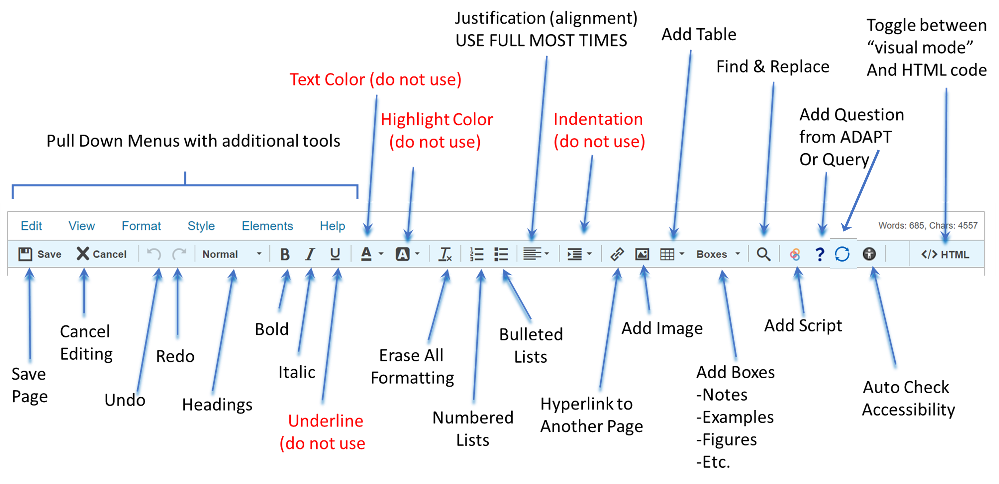
Editing Tool Bar
Notes:
Screenshot of the LibreTexts page editor toolbar with arrows identifying the most commonly used editing tools and highlighting several tools that should not be used for accessibility and consistency reasons.
The toolbar is arranged horizontally beneath the editor menu options (Edit, View, Format, Style, Elements, Help). Blue arrows point to recommended tools, while red labels identify tools that should be avoided.
From left to right, the toolbar includes:
Save button to save changes to the page.
Cancel button to discard changes.
Undo and Redo buttons to reverse or restore edits.
Style dropdown menu (currently showing "Normal") used to apply heading styles and structured formatting.
Bold button for emphasizing text.
Italic button for emphasis.
Underline button, labeled "do not use" because underlined text can be mistaken for hyperlinks.
Text Color tool, labeled "do not use" because color should not be used to convey meaning or importance.
Highlight Color tool, labeled "do not use" because highlighted text may create accessibility and consistency issues.
Remove Formatting button (Tx icon) used to clear unwanted formatting.
Bulleted List button for creating unordered lists.
Numbered List button for creating ordered lists.
Alignment controls for aligning text.
Indentation controls, labeled "do not use", because indentation should not be used to create structure or hierarchy.
Link button for adding hyperlinks.
Image button for inserting images.
Table button for creating tables.
Boxes dropdown menu for inserting LibreTexts content boxes and templates.
Search tool for locating content.
Link management tools for working with hyperlinks.
Accessibility checker icon used to identify accessibility issues.
HTML button located on the far right, allowing users to view and edit the page's HTML source code.
The image emphasizes the tools most frequently used for page editing—saving, formatting with headings, creating lists, adding links, inserting images and tables, using boxes, checking accessibility, and accessing HTML—while discouraging the use of text color, highlighting, underlining, and manual indentation.

Slide 15
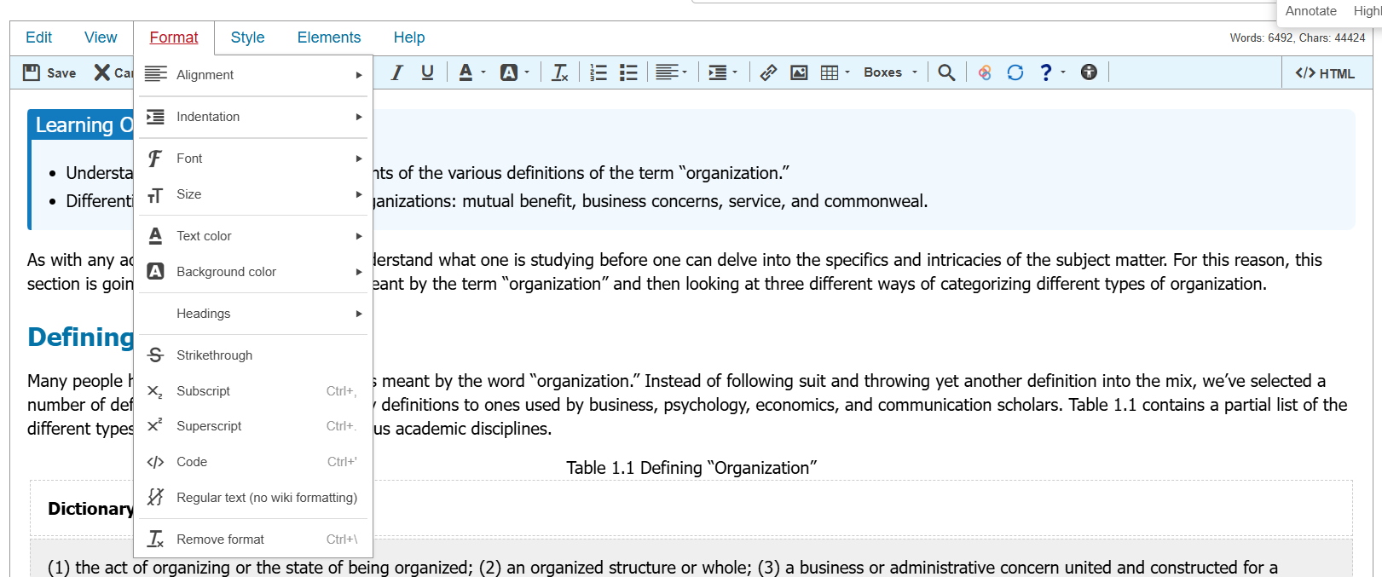
Drop-Down Menus: Edit
Format Menu
Apply headings and text formatting
Use for subscript and superscript
Avoid: underlining, text/highlight colors, indentation, and custom alignment.
Use headings not manual formatting to create structure.

Slide 16
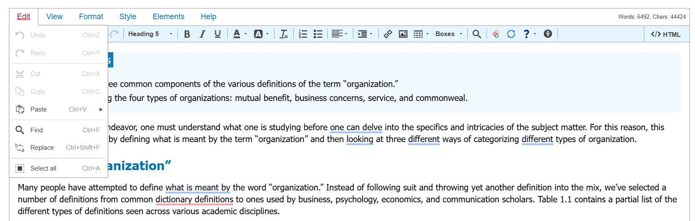
Drop-Down Menus: Format
The Edit menu contains common editing functions:
Undo and Redo changes
Cut, Copy, and Paste content
Find text on a page
Replace text throughout a page
Select all page content
Tip: Find and Replace can save time when updating repeated text, terminology, or links across a page.

Slide 17
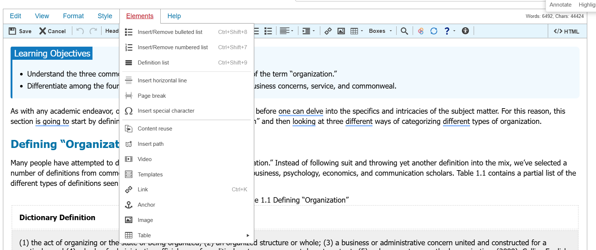
Drop-Down Menus: Elements
Use the Elements menu to add content and page features, including:
Bulleted and numbered lists
Horizontal lines and special characters
Images, videos, and other multimedia
Additional content elements and tools
Think of Elements as your toolbox for adding content to a page.

Slide 18



Editing Symbols
Use LibreTexts tools the way you would use Canvas tools—let the platform create structure for you instead of manually formatting content.
Headings Menu – Create page hierarchy with headings and subheadings for organization and screen reader navigation.
Boxes Menu – Add consistent, accessible elements such as notes, examples, definitions, exercises, objectives, and warnings.
Question Mark Tool – Insert interactive questions and activities using H5P, IMath, or WeBWorK.
Best Practice: Use LibreTexts tools instead of changing font sizes or manually styling content. This improves accessibility and keeps your book consistent.

Slide 19
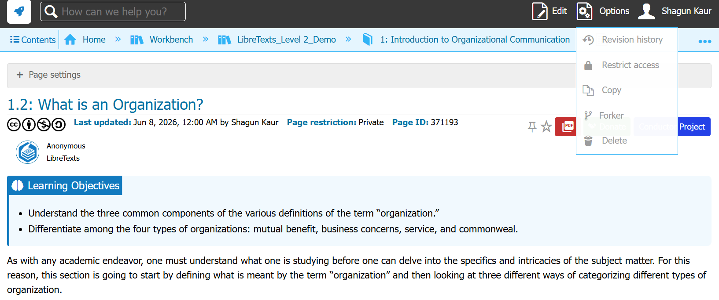
Revision History
Every time you save, LibreTexts creates a new revision that you can review later.
View who made changes and when
See edit summaries and page history
Compare two versions side-by-side
Restore an earlier version if needed
Recover content that was accidentally deleted
Best Practice: Save often and include a brief revision summary. Future-you will thank present-you.

Slide 20
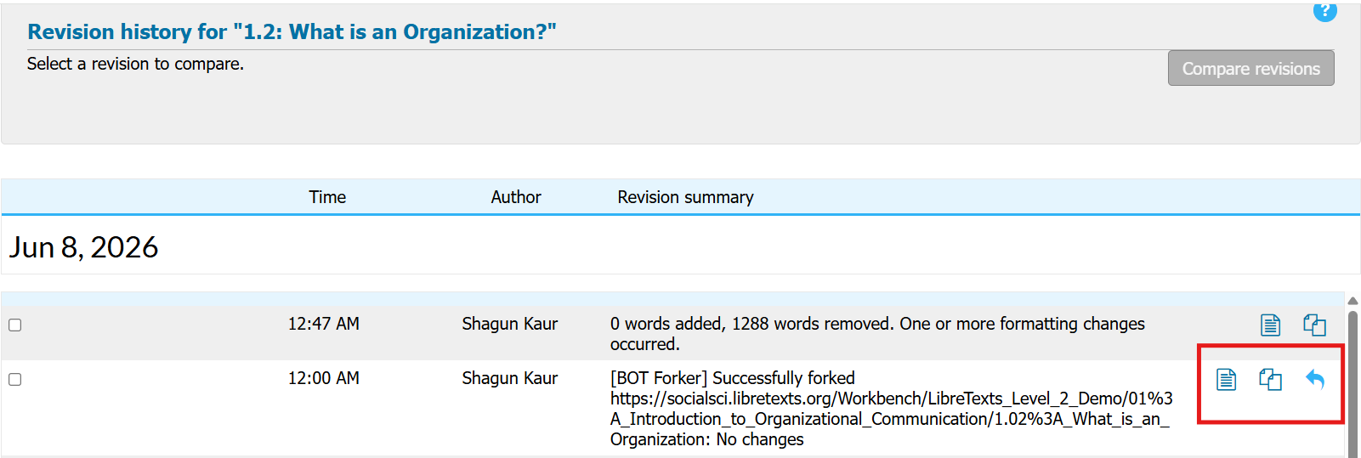
Revision Icons
Highlighted Icons
Document icon: View a specific revision
Compare icon: Compare revisions to see changes
Restore icon: Revert to a previous version if something goes wrong
Why This Matters
Revision History lets you experiment with confidence—you can always go back if an edit doesn't work out.

Slide 21
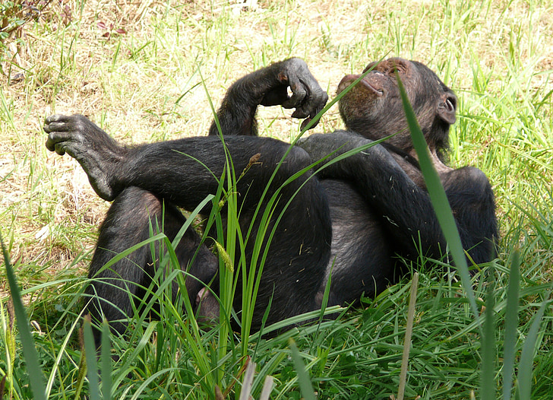
Time to Explore or Breathe
Resting Ape by PickPik is in the Public Domain

Slide 22
Templates: Ready-Made Content Blocks
Templates are prebuilt code snippets that quickly add common page elements and formatting to your content.
Access templates from Elements → Templates
Some templates are also available through the Boxes menu
Templates help maintain consistency across pages
Some are designed for general use, while others support specific content types
The Box Templates create formatted containers for special content such as notes, examples, definitions, exercises, objectives, and warnings
Best Practice: Use templates and boxes instead of manually creating styled content. They are faster, more consistent, and support accessibility.

Slide 23
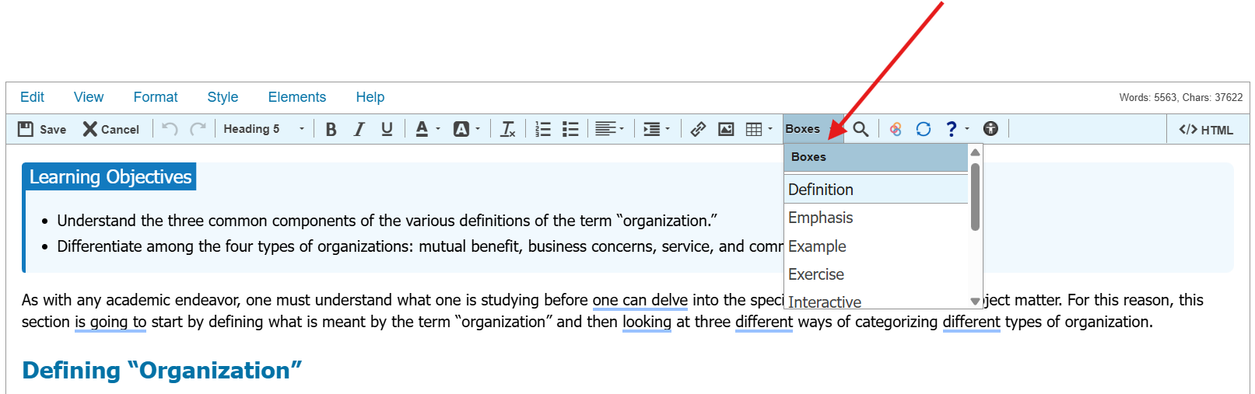
Why use Boxes?
They provide visual organization
Improve accessibility
Help students quickly identify different types of content.
The colors are associated with code in the HTML for screen readers.

Slide 24
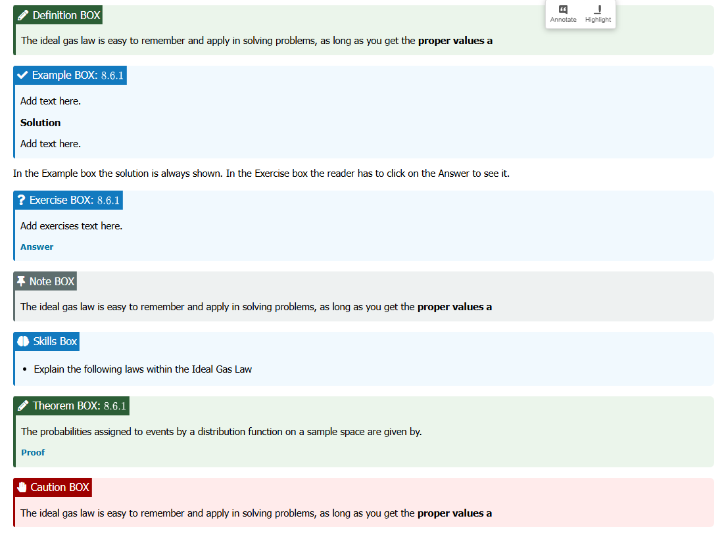
Types of Boxes
Use box templates to highlight important content and create a consistent student experience.
Definition: key terms and concepts
Example: worked examples and demonstrations
Exercise: practice questions and activities
Note: helpful reminders or additional information
Objectives: learning objectives or skill-building tasks
Theorem: formal statements and proofs
Warning: warnings, common mistakes, or important alerts

Slide 25
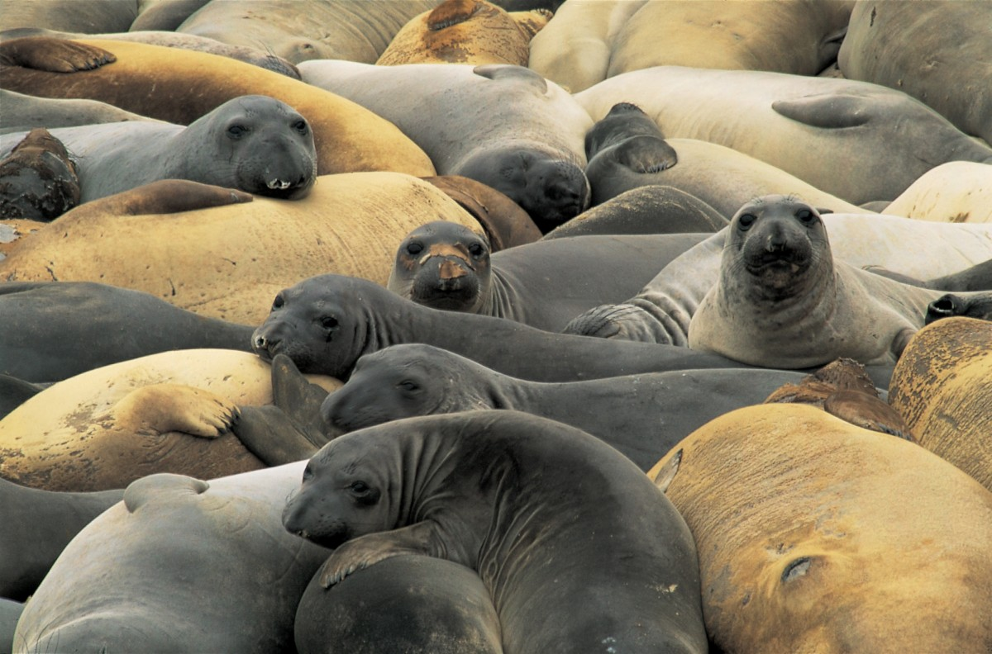
Time to Explore or Breathe
Resting seals is in the Public Domain

Slide 26
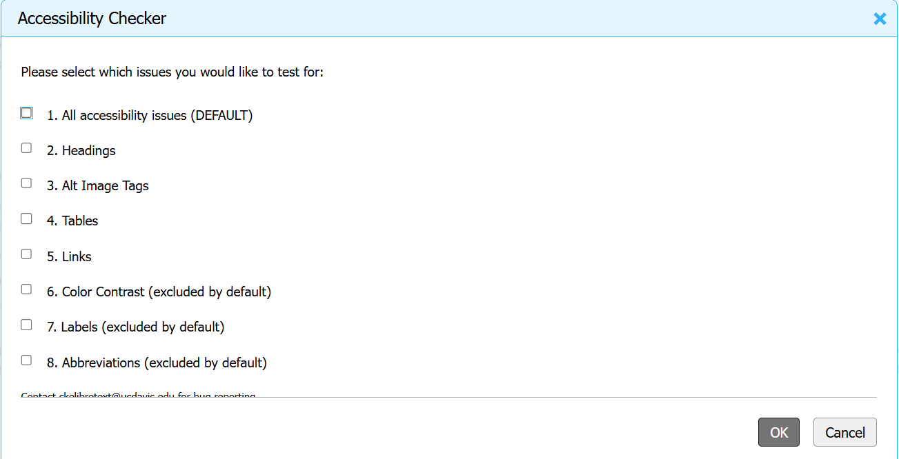
Accessibility Checker in Editor
In the Accessibility Checker pop-up menu, select the issues you would like scanned, then select OK.

Slide 27
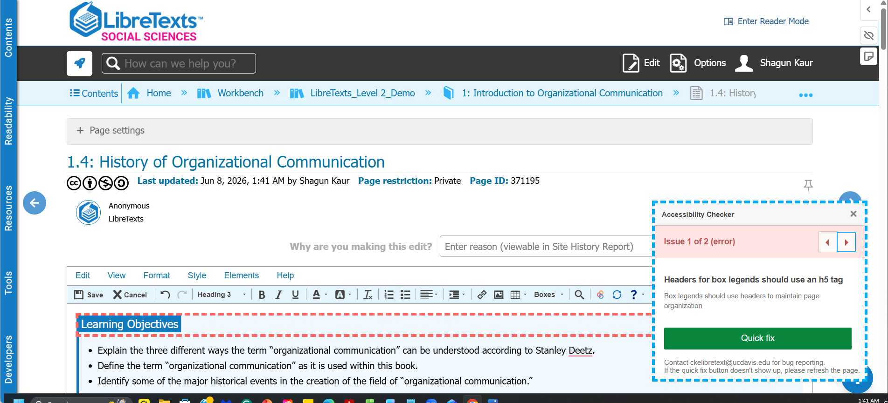
Fixing Accessibility Issues
LibreTexts will highlight each item that needs remediation. Select Quick fix to let LibreTexts fix the issue automatically. The pop-up will cycle to the next item.

Slide 28
Accessibility Requirements Checklist
Content & Structure | Media & Interaction
Keyboard navigation works throughout the page | Videos include captions
Headings are used in order (H2 → H3 → H4) | Audio includes transcripts when needed
Images have meaningful alt text or are marked decorative | Tables include row and column headers
Links are descriptive and clearly labeled | Lists use proper numbered or bulleted formatting
Linked documents are accessible and file types are identified | Instructions do not rely only on color, shape, size, location, or sound
Run the Accessibility Checker and complete a final human review before publishing. Check out the ASCCC OERI Accessibility page and our Accessibility Basic Course

Slide 29

Time to Explore or Breathe
Tortoise is licensed CC0 1.0 Public Domain.

Slide 30
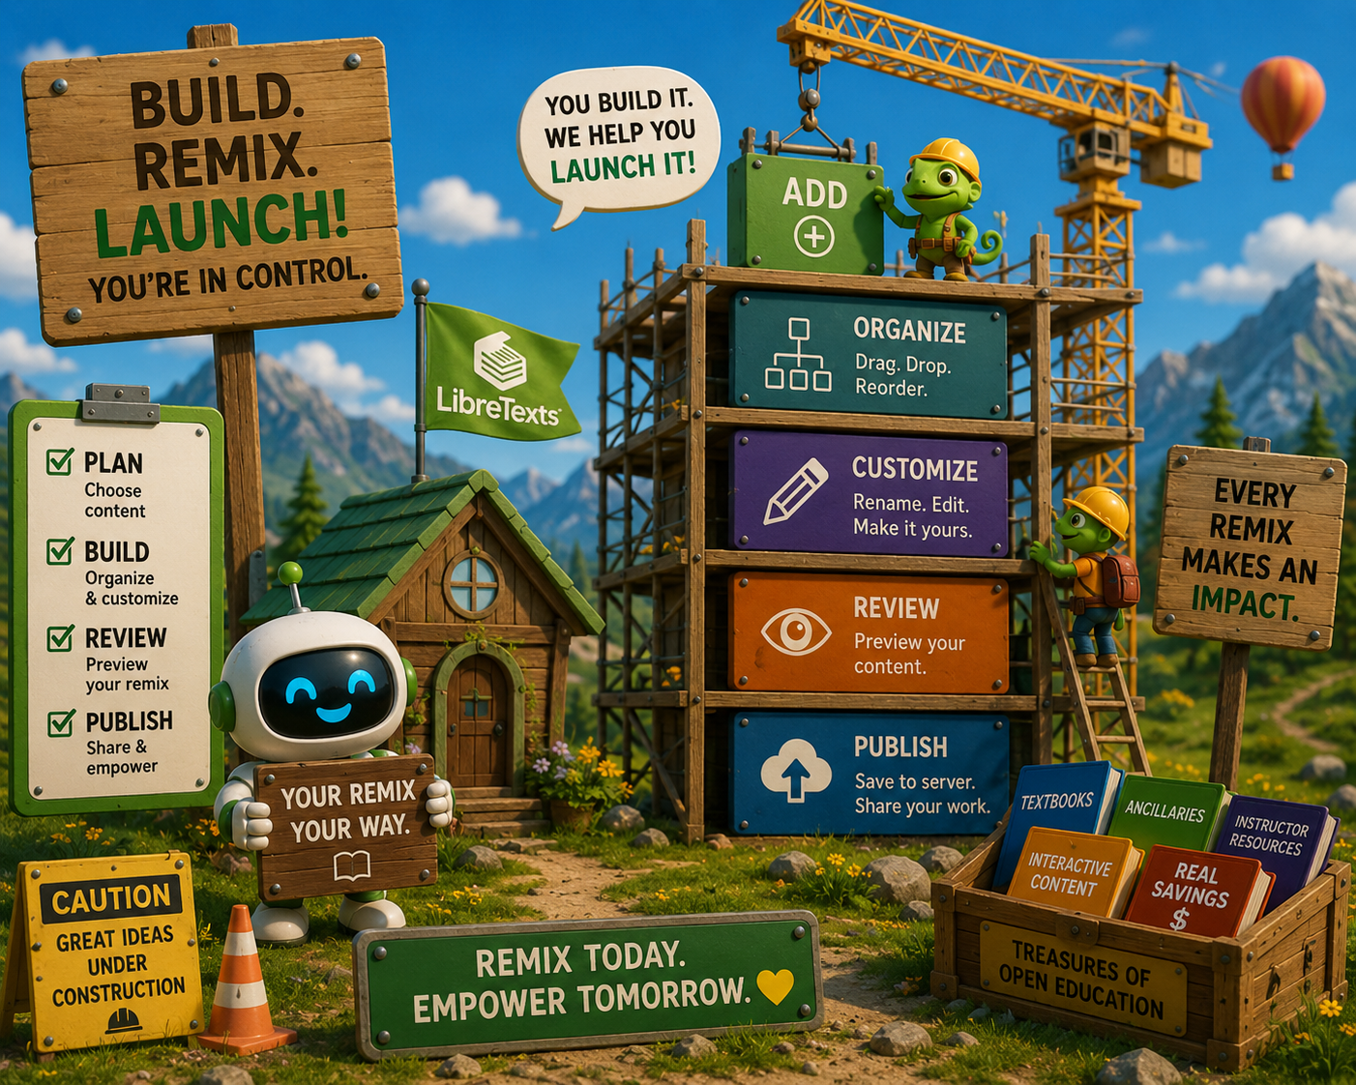
How was the Construction?
LibreTexts Rocket Icon. Adapted for instructional use. Original icon from LibreTexts. CC0 1.0 Public Domain.

Slide 31
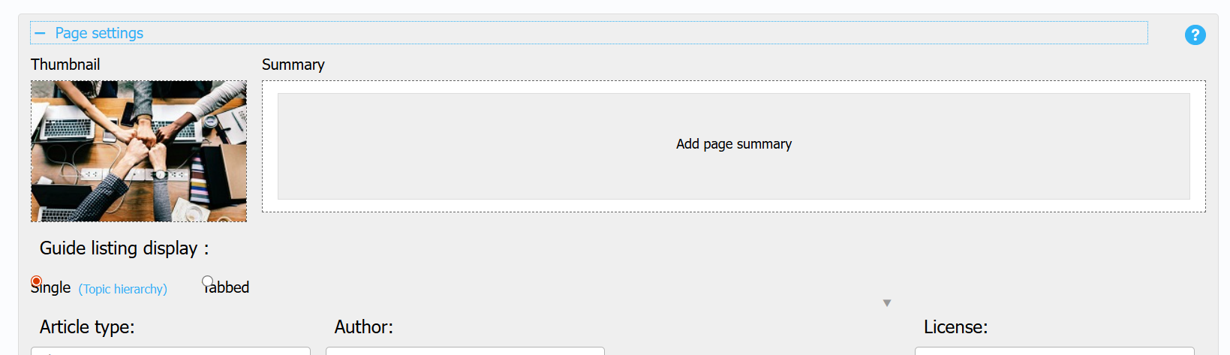
Page Settings
Page Settings control how your page appears across LibreTexts and provide important metadata for readers and remixers.
Thumbnail – Select an image that represents the page in guides and search results.
Summary – Add a brief description to help readers understand the page's purpose.
Guide Display – Choose how pages are organized and displayed within a guide.
Article Type – Identify the type of content (e.g., chapter, topic, activity).
Author & License – Provide attribution and licensing information.
Metadata – Improves discoverability, navigation, and remixing.

Slide 32

Go Back to the Rocket Ship
LibreTexts Rocket Icon. Adapted for instructional use. Original icon from LibreTexts. CC0 1.0 Public Domain.

Slide 33
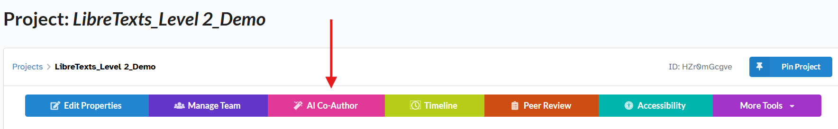
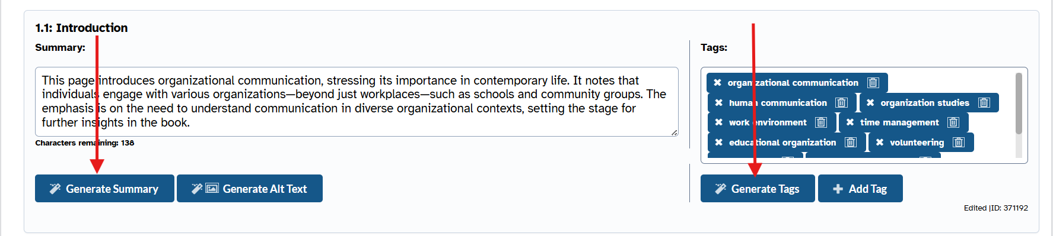
AI Co-Authoring Tools
Save time with AI Co-Author by generating draft summaries, alt text, and tags that you can review and customize for your project.

Slide 34
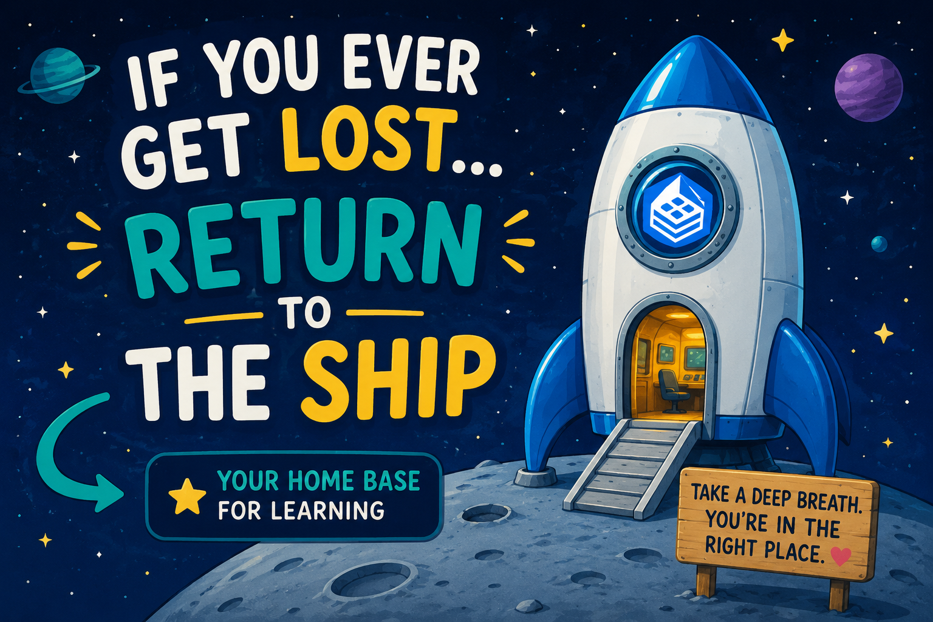
If you get lost: Return to the Ship
LibreTexts Rocket Icon. Adapted for instructional use. Original icon from LibreTexts. CC0 1.0 Public Domain.

Slide 35
Next in the Series and Coming Up
ADAPT Level 3 | Beyond the Final Draft: Process-Based Assessment with Forge | Tuesday, June 9, 9:00-10:30 am
ADAPT Level 4 | Collaborative Learning: Multimodal Engagement with Discuss-It | Thursday, June 11, 10:00-11:30 am
LibreTexts Level 4 | Designing with Media: Images and Video in LibreTexts | Wednesday, June 10, 10:30-12:00 pm
Open Office Hour: Friday, June 12th, 2:00-3:00 pm
To register and find the recorded archived of webinars, please visit the ASCCC OERI.

Slide 36
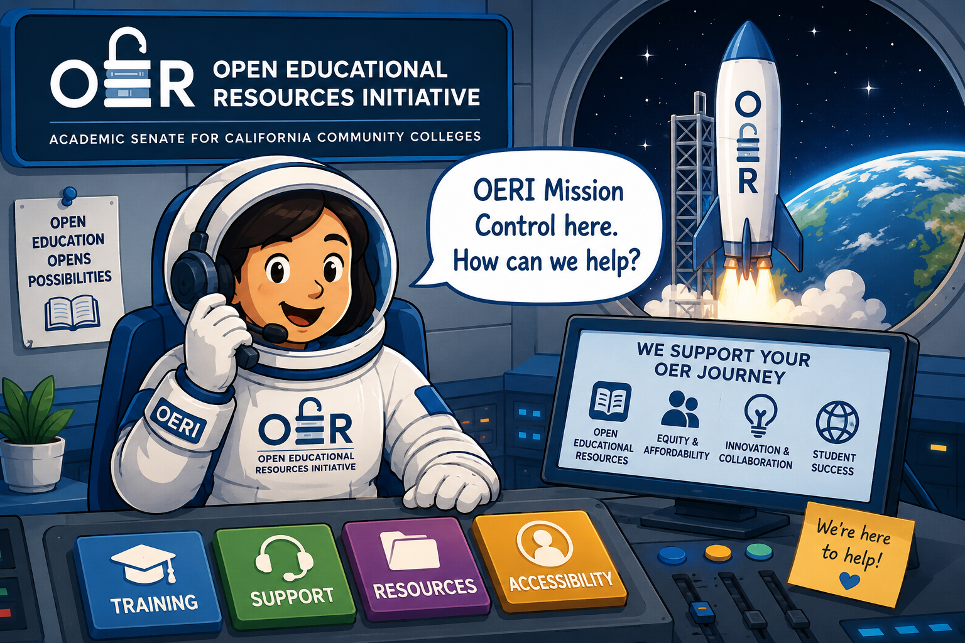
Contact Us
Shagun Kaur: kaurshagun@fhda.edu
Cristina Moon: cmoon@chabotcollege.edu
OERI Team - oeri@asccc.org
OERI Icon. Adapted for instructional use. Original icon from OERI. CC0 1.0 Public Domain.

