Slide 1
Welcome!
On behalf of the ASCCC OERI, we are pleased to have you here with us for “Level 4: Designing with Media: Images and Video in LibreTexts.”
If you are not already muted, please mute yourself upon arrival.
Please note that you are encouraged to use the Zoom “chat” feature for questions and comments.
You’re invited to introduce yourself in the chat – please provide your name, college, discipline/role
This event will be recorded. Archives of all ASCCC OERI events are available at asccc-oeri.org > Webinars and Events

Slide 2
Level 4: Designing with Media: Images and Video in LibreTexts
June 10th, 2026. 10:30 am – 12:00 pm
This work is licensed under a Creative Commons Attribution 4.0 International License.)

Slide 3

Presenters
Shagun Kaur, ASCCC OERI LibreTexts Lead
  Communication Studies, De Anza
Cristina Moon, ASCCC OERI ADAPT lead
  Spanish, Chabot
Photo by Siora Photography on Unsplash
Notes:
Presenters can be included following the description or the overview. Where images are used, they should include an attribution (Photo by…) and appropriate alternative text should be used (or the image marked decorative).

Slide 4
Webinar Description
Learn how to effectively use images and video in LibreTexts to support engagement, diverse learning styles, and accessibility. This session covers best practices for integrating media, writing meaningful captions and alternative text (alt text), and designing content that is both visually engaging and inclusive for all students.

Slide 5

Overview
Adding and embedding media in LibreTexts
Writing meaningful captions and alt text
Common media accessibility pitfalls and best practices
Resources and tools for media accessibility review
Notes:
An Overview slide should be included that is an outline of the presentation.

Slide 6
Canvas Course: LibreTexts Basics and Beyond
This course is an adaptation created by Cristina Moon and Michelle Pilati. It is a revision of "Mastering Libretexts" created by Wendy Poling and is shared under a CC-BY-4.0 license
We will be covering Module 4 [4.3 and 4.4] today
Register for LibreTexts Basics and Beyond
Note: The ASCCC OERI LibreTexts Basics and Beyond course is also available on Canvas Commons for local use.

Slide 7

Registration for a LibreTexts Account
If you don't already have one, register for a LibreOne account.
Verify your Instructor status to unlock full LibreTexts functionality.

Slide 8


Logging in to your Account
Navigate to LibreTexts.org and click on the “rocket ship” icon
It will prompt you to sign in if you are not already logged in

Slide 9
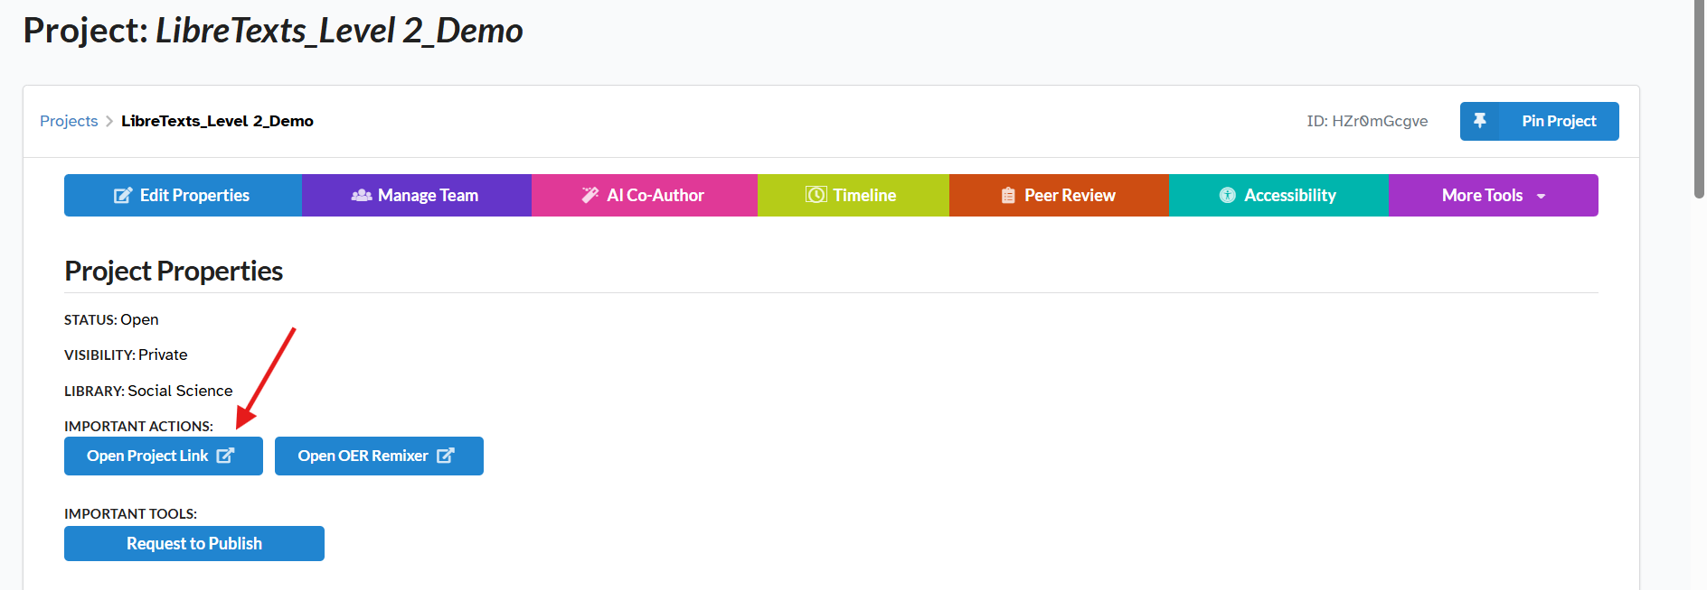
Go to your Conductor Project
Click on “Open Project Link” to access the book you created in the Remixer

Slide 10
Finding Images
Pixabay
Pexels
Unsplash
Freepik
Canva
Open Image Repositories
ASCCC OERI Collection (consider adding to this collection yourself)

Slide 11
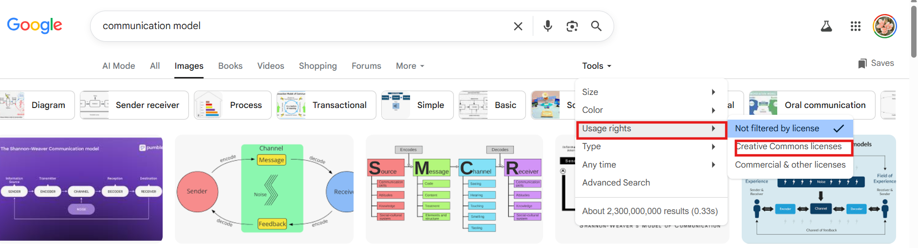
Using a Search Engine
Search for your topic
Select Images.
Open the Tools menu.
Under Usage Rights, choose Creative Commons licenses.
Review the image source and licensing details before use.
Tip: Not all images found through search engines are free to use.

Slide 12
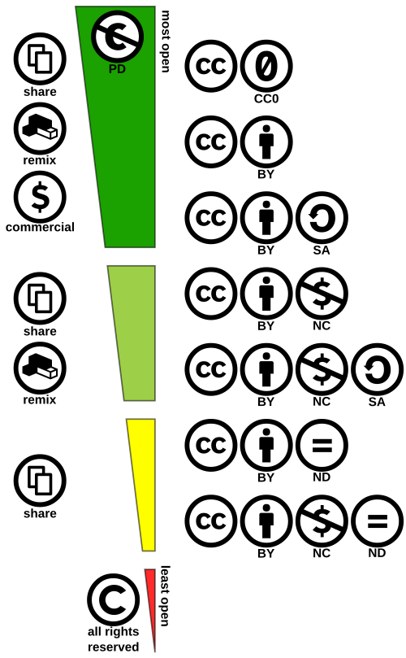
Using Images Responsibly
Before You Download
Verify the image license and permitted uses.
If purchasing royalty-free images, review the terms of use carefully.
Keep a record of attribution and licensing information.
Saving Images
Right-click and save the image.
Use JPEG/JPG format when possible for broad compatibility.
Best Practice: Always confirm you have permission to use an image before adding it to your course materials.
CC Spectrum by Shaddim is licensed CC BY 4.0

Slide 13
Preparing Images for LibreTexts
Optimize Image Files
Use JPEG/JPG whenever possible to reduce file size. PNG files are larger; animated GIFs may create accessibility concerns.
Convert images to JPG using free tools such as Adobe Express
Clean Up Images
Crop images to remove unnecessary white space.
Use free editing tools:
  Microsoft Office Picture Editor or Paint (Windows)
  Lunapic (Windows and Mac)
  Canva (Windows and Mac)
Upload images directly to LibreTexts.
Do not hotlink images from external websites. Hotlinked images may disappear and can create accessibility issues.

Slide 14
AI Generated Images
AI Use Is Permitted. Transparency Is Essential
Disclose when AI tools are used.
Verify AI-generated content, images, and citations.
Authors are responsible for the final work.
Follow local, publisher, and licensing requirements.
LibreTexts Best Practices
Document the AI tool used.
Briefly describe its role.
Review and revise all AI-generated content.
Include an attribution statement when AI contributed significantly.
Bottom Line: Use AI transparently, verify everything, and maintain human oversight.
Resource: Artificial Intelligence (AI) Attribution and Citations for Open Educational Resources (OER) Frequently Asked Questions (FAQ)

Slide 15
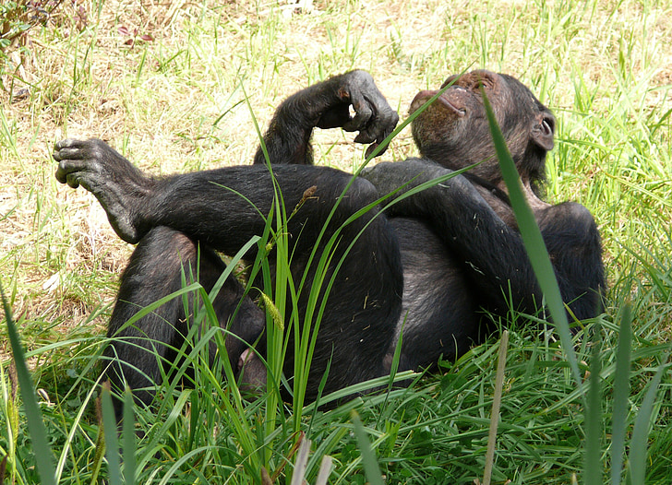
Find 2 Images to load on a Page
Resting Ape by PickPik is in the Public Domain

Slide 16
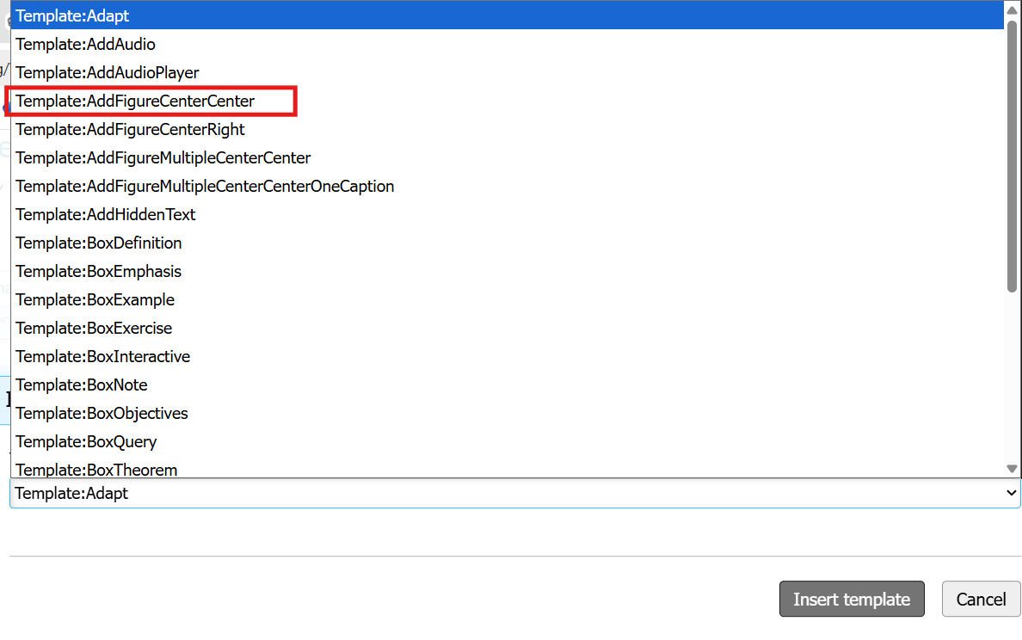
Adding Images
On an editable (forked or new) page, click on the Edit button.
Select Elements from the Tools menu.
Scroll down and select Templates.
Select the AddFigureCenterCenter option that meets your needs.

Slide 17
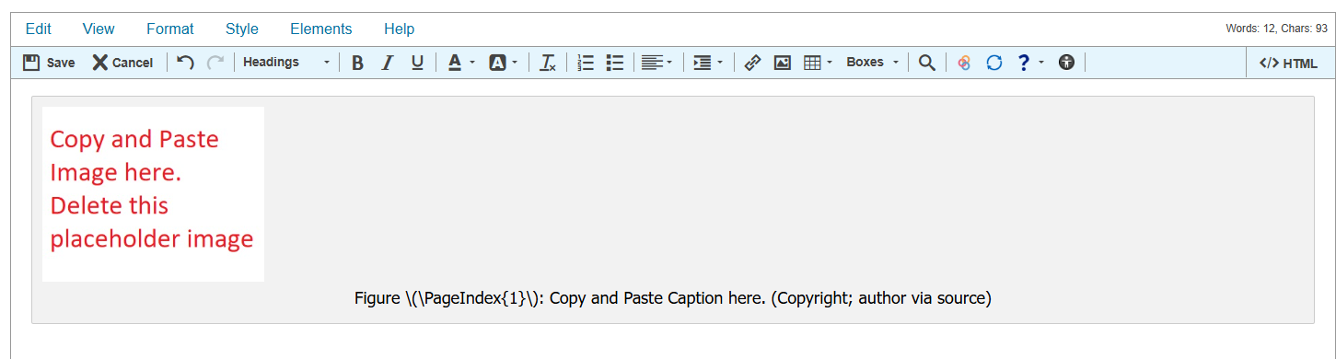
Adding Captions and Attribution
After selecting a template, enter the image, caption, author, source, and licensing information.

Slide 18
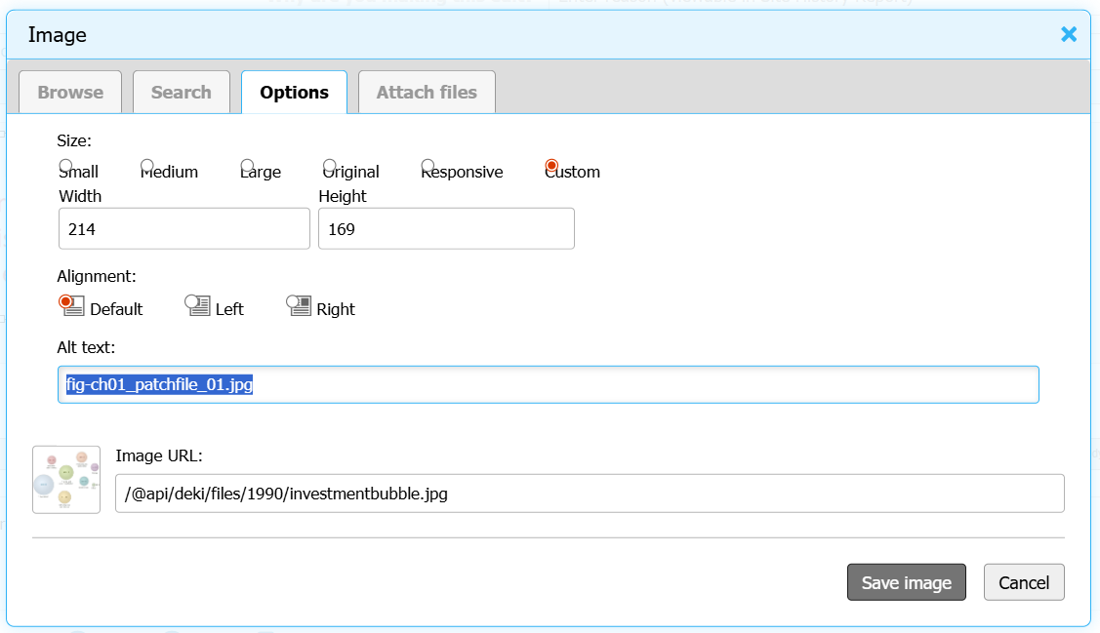
Accessing the Image Menu
In order to add your image, right click or double-click on the provided box to access the Image menu.

Slide 19
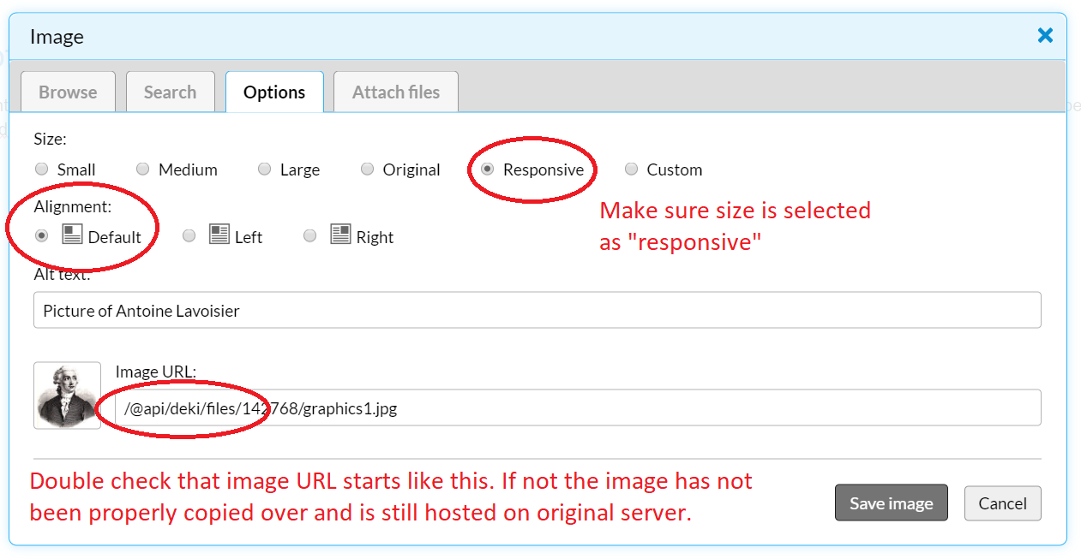
Formatting Figures
To center-justify a figure, click on the right side of the image (not the figure), and you can use the center justification for text off the normal editing toolbar.
To add a caption add a line under the figure formatted as:
Figure \(\PageIndex{i}\): Copy and Paste Caption here. (Copyright; author via source)

Slide 20
Alt Text vs. Captions
Feature | Alt Text | Caption
Purpose | Describes the image for screen reader users. | Provides context or explanation for all readers.
Audience | Users who cannot see the image. | Everyone viewing the page.
Displayed? | No (read by assistive technology). | Yes (appears below the image).
Content | Brief description of the image's essential information. | Explanation, interpretation, attribution, or additional details.
Length | Usually 1–2 sentences (≤120–150 characters for simple images). | As long as needed to support learning.
LibreTexts Location | Entered in the Alt Text field of the Image Options menu. | Added in the figure template beneath the image.
Example | "Communication model showing sender, message, channel, and receiver." | "Figure 2.1. The Shannon-Weaver model illustrates how messages move between sender and receiver through a communication channel."
Alt text describes the image. Captions teach from the image.

Slide 21
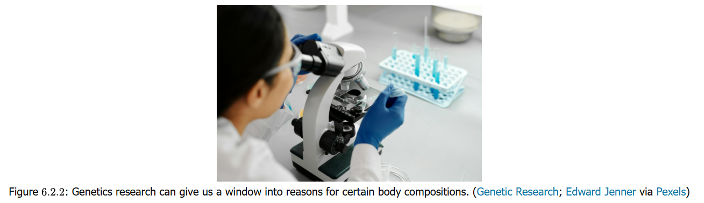
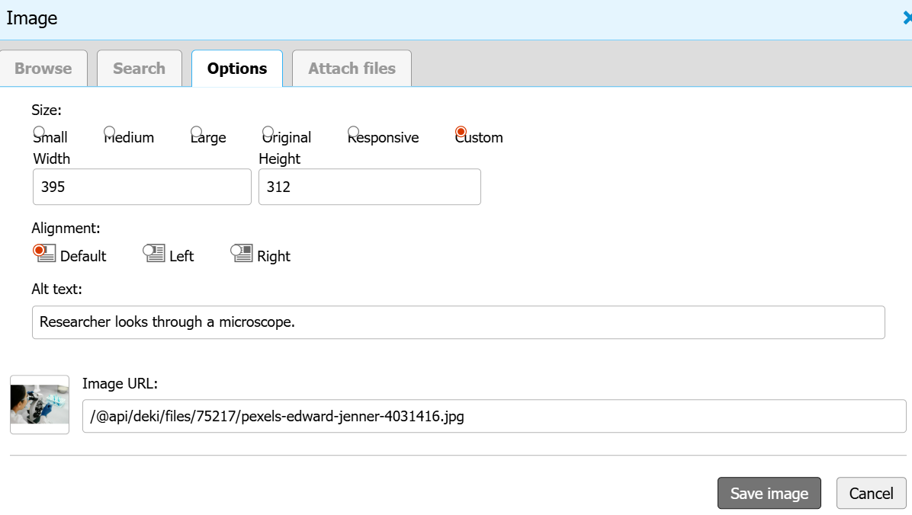
Sample Image: Alt Text vs. Caption
Image taken from Fit Happens by Altman, Johnson, Owiesny is licensed CC BY NC-SA 4.0

Slide 22
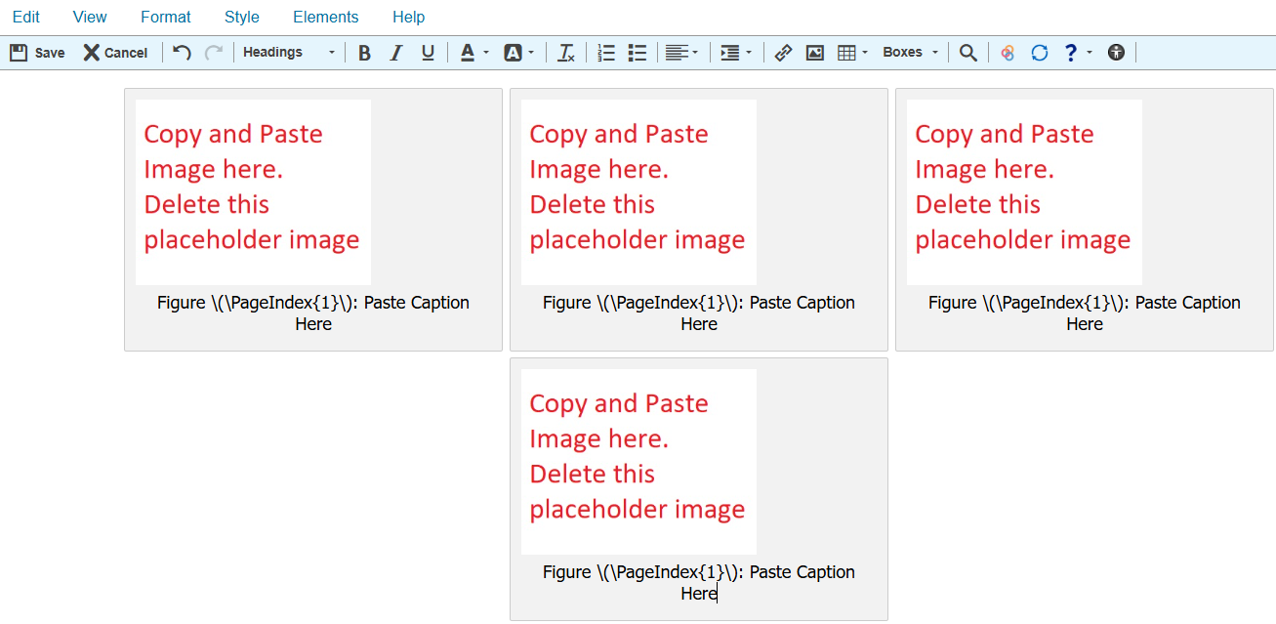
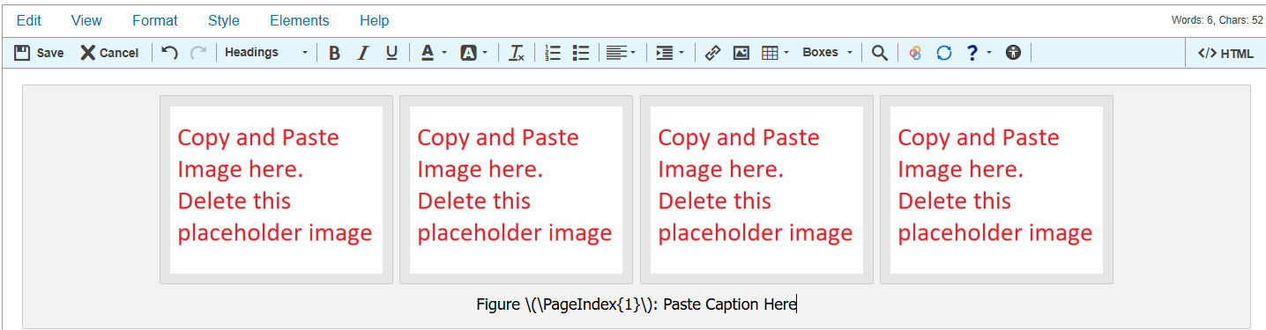
Image Templates
Template: AddFigureMultipleCenterCenter
Template: AddFigureMultipleCenterCenterOneCaption

Slide 23
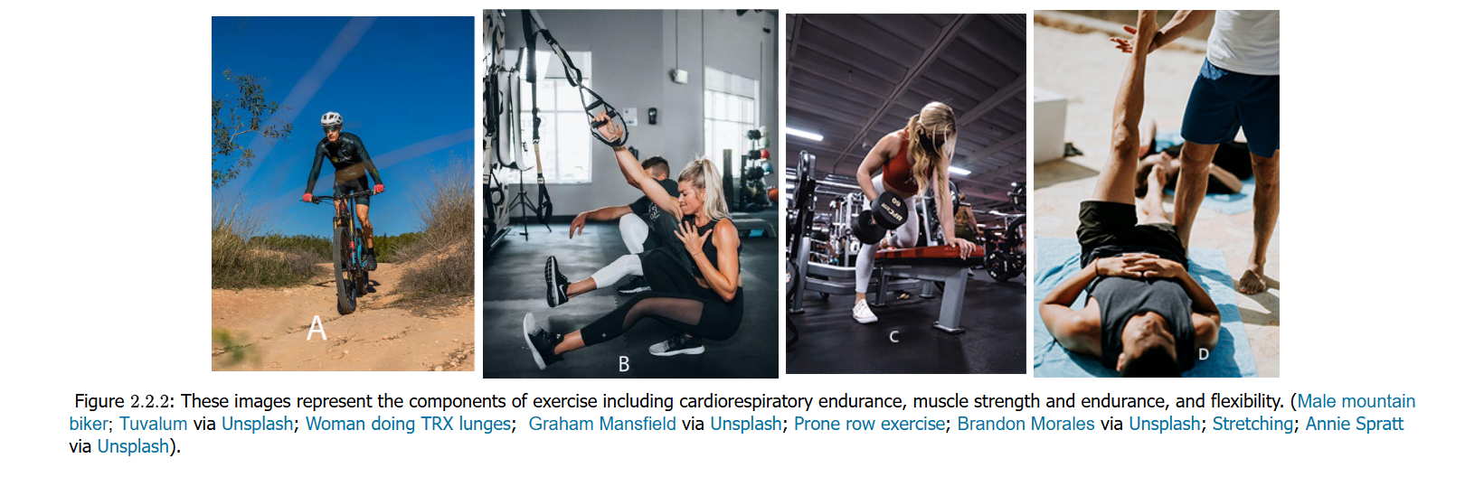
Sample Page: Multiple Images
Image taken from Fit Happens by Altman, Johnson, Owiesny is licensed CC BY NC-SA 4.0

Slide 24
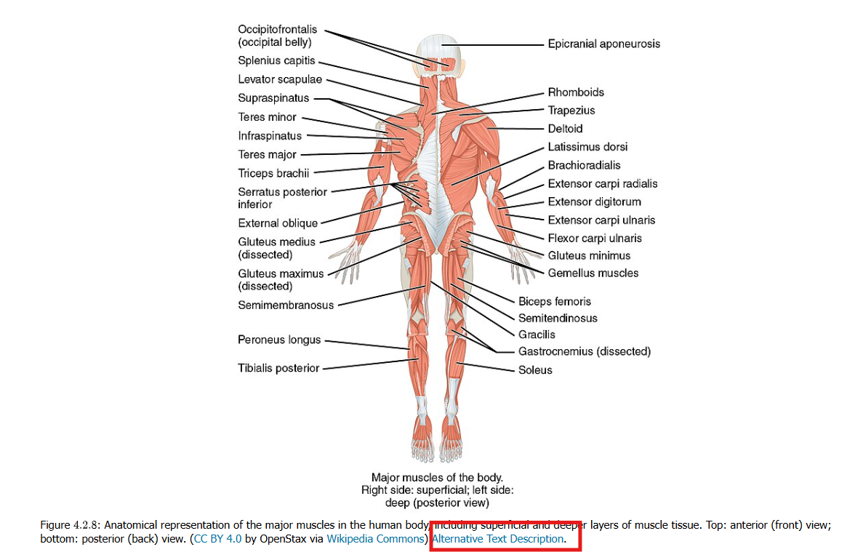
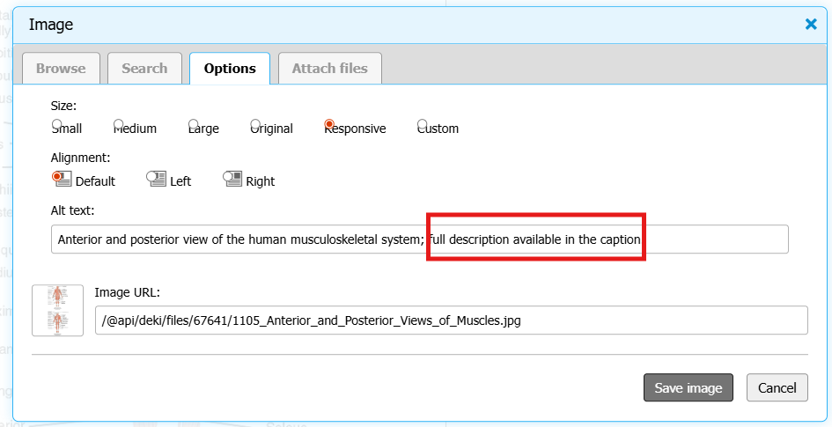
Longer Descriptions and Linking

Slide 25
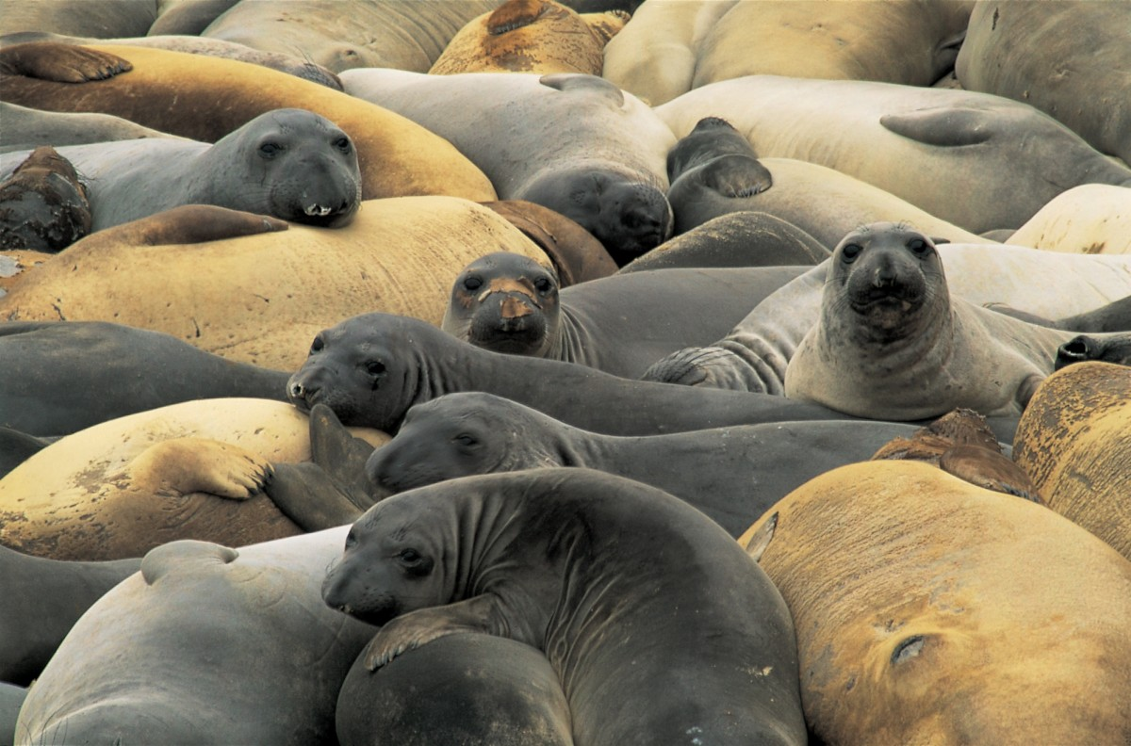
Find a Complex Image
Resting seals is in the Public Domain

Slide 26
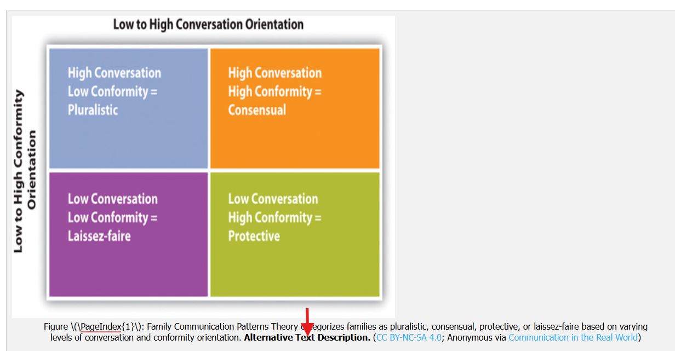
Creating a Label in Caption
Use brief alt text to identify the image and its purpose.
For complex charts, diagrams, maps, or infographics, provide a linked extended description.

Slide 27
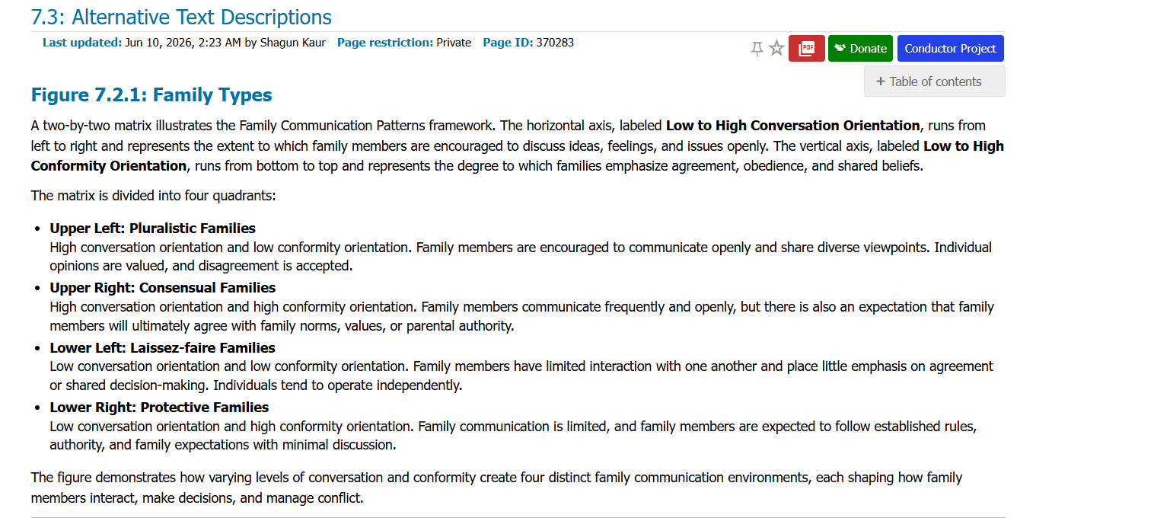
Creating a Longer Description
In LibreTexts, create a separate Alternative Text Descriptions page at the end of the chapter and link to it from the figure caption.

Slide 28
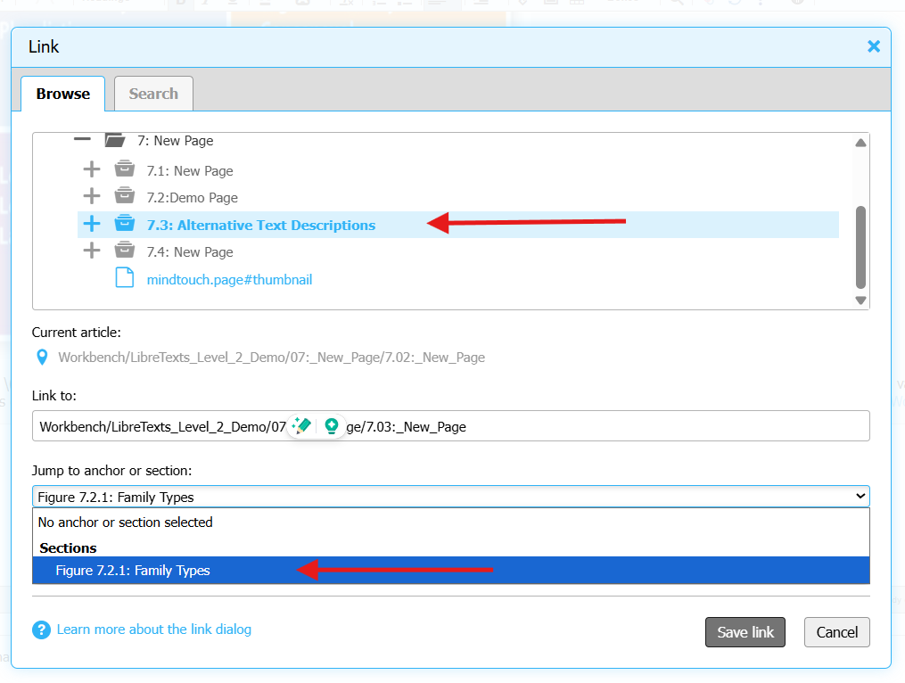
Anchoring
Create an Alternative Text Descriptions page within the chapter, then use the Link tool to connect the figure caption to the appropriate page and anchor. Anchors take readers directly to the specific image description, improving navigation for screen reader users and those accessing complex image descriptions.

Slide 29
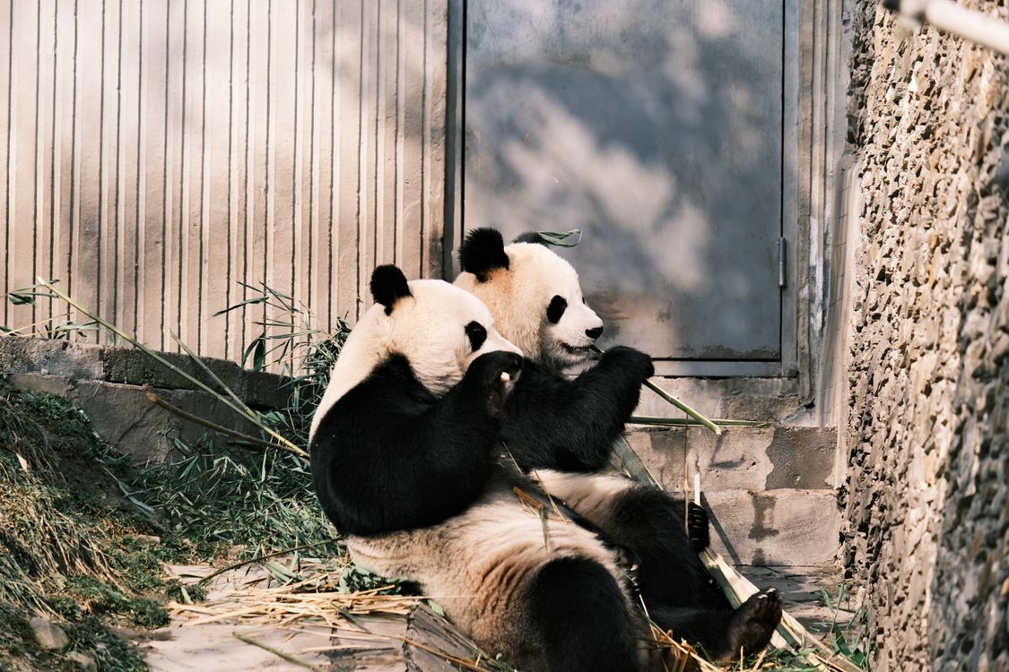
Time to Explore or Breathe
Two Pandas by Lily Lili under Pexels license

Slide 30
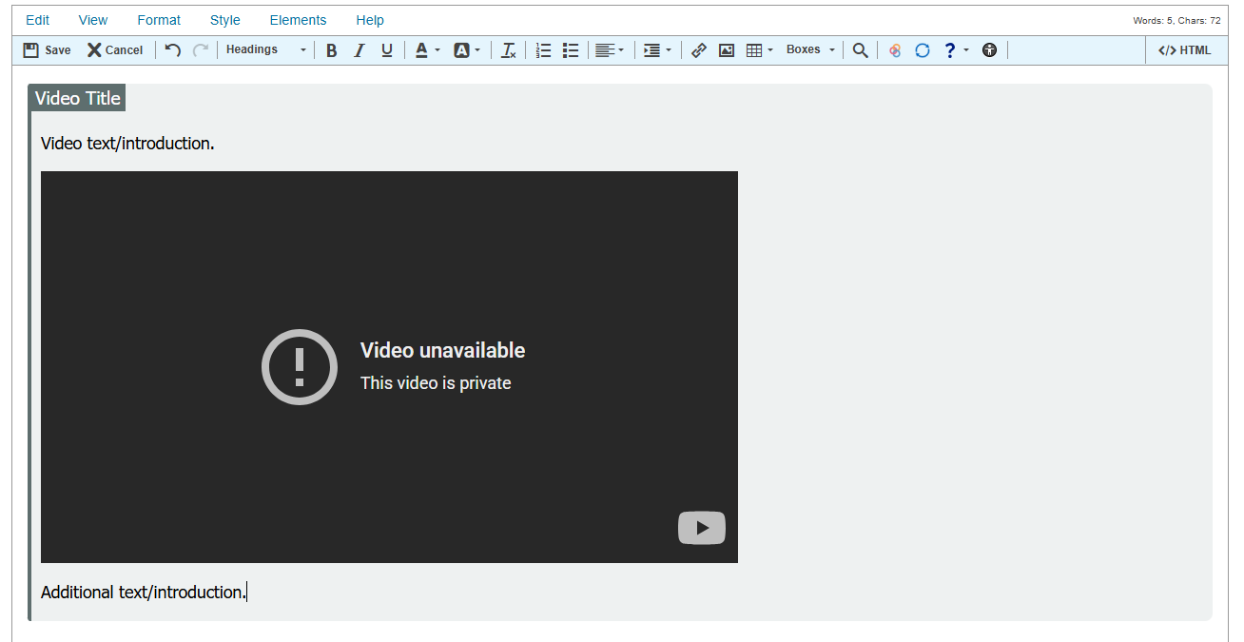
How to Add a Video
From the Elements drop-down menu, select Video Block. A block will be added that provides space for a title, an introduction, the video, and additional text.

Slide 31
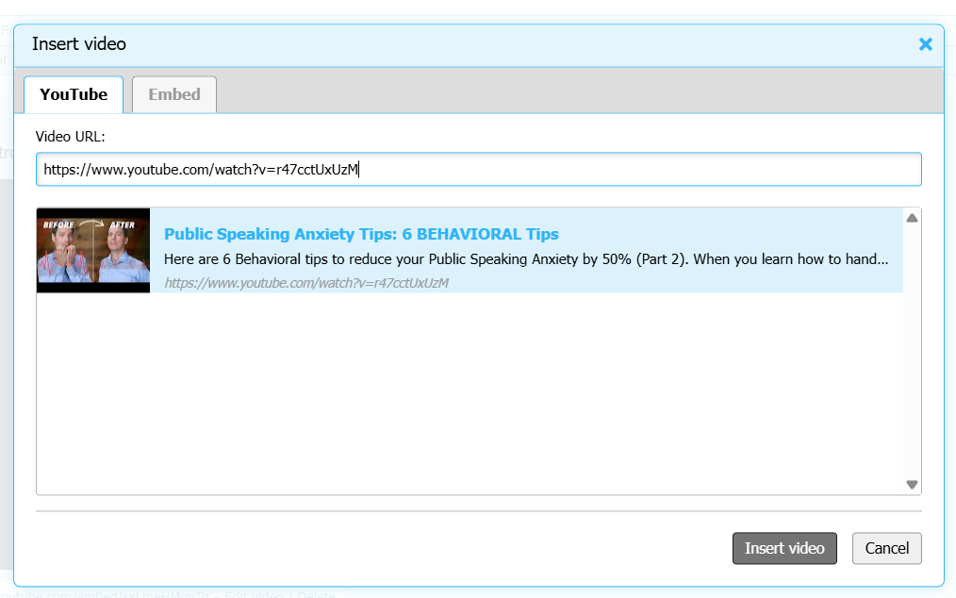
Editing a Video
Click Edit Video to add a YouTube video by URL or search, or use the Embed tab to insert a video using embed code.

Slide 32
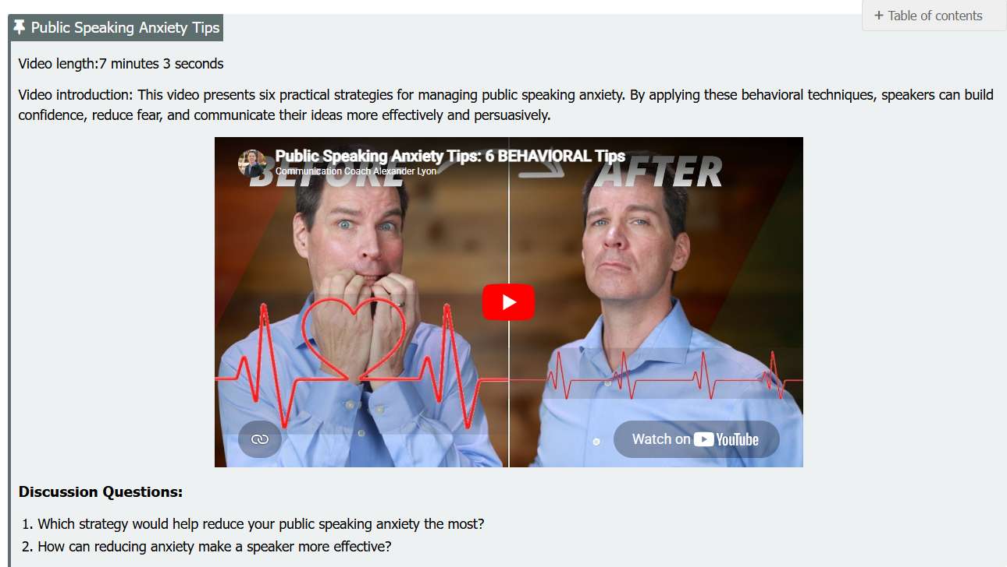
Final Look

Slide 33
Video Accessibility
Not all captions are accessible. Auto-generated or AI-generated captions often contain errors, missing punctuation, and incorrect word recognition. For accessibility compliance, videos should include human-reviewed and edited captions.
How to Check YouTube Captions
  Click the CC button on the video player.
  Watch for the notification in the upper-left corner of the video.
  Confirm whether captions are auto-generated or human-edited.
Use: Human-reviewed captions that accurately reflect spoken content.
Avoid: Videos that rely solely on auto-generated captions.
Why It Matters: Accurate captions support accessibility, improve comprehension, and ensure equal access for all learners

Slide 34
Images, Videos, and UDL
Multiple Means of Representation
Pair images with captions, alt text, and explanations.
Provide video summaries and transcripts.
Use visuals to reinforce key concepts, not replace them.
Offer information in text, audio, and visual formats.
Multiple Means of Engagement
Use relevant images and videos to increase interest and motivation.
Include reflection questions or discussion prompts.
Keep videos concise and focused on learning objectives.
UDL Check
Can students understand the content without the image?
Can students understand the content without the video?
Are multiple ways provided to access the same information?
Don’t just ask, "Can students access this image or video?" Ask, "Can students learn this concept in more than one way?"

Slide 35

Time to Explore or Breathe
Tortoise is licensed CC0 1.0 Public Domain.

Slide 36
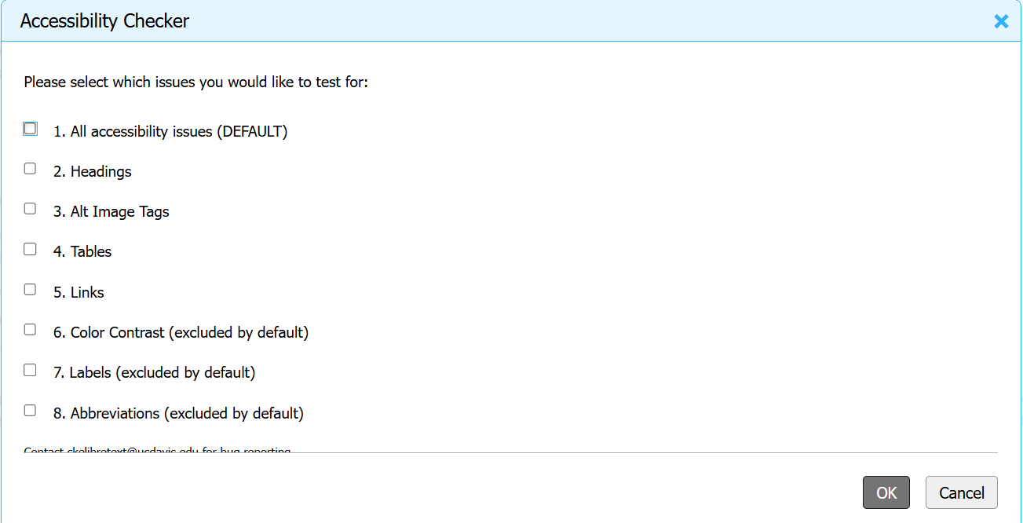
Accessibility Checker in Editor
In the Accessibility Checker pop-up menu, select the issues you would like scanned, then select OK.

Slide 37
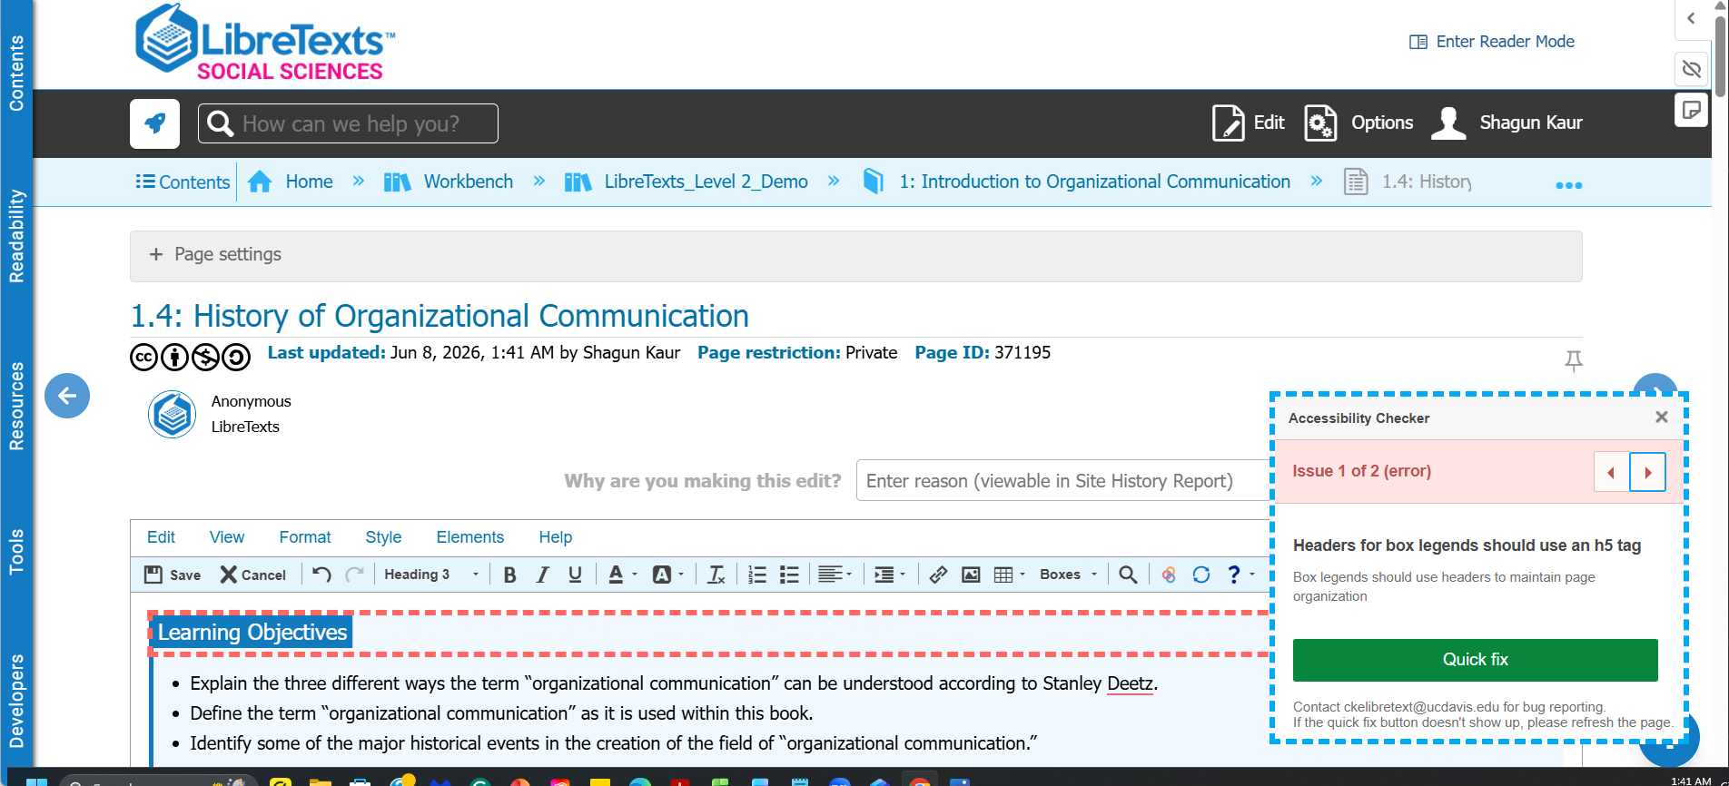
Fixing Accessibility Issues
LibreTexts will highlight each item that needs remediation. Select Quick fix to let LibreTexts fix the issue automatically. The pop-up will cycle to the next item.

Slide 38
Accessibility Requirements Checklist
Content & Structure | Media & Interaction
Keyboard navigation works throughout the page | Videos include captions
Headings are used in order (H2 → H3 → H4) | Audio includes transcripts when needed
Images have meaningful alt text or are marked decorative | Tables include row and column headers
Links are descriptive and clearly labeled | Lists use proper numbered or bulleted formatting
Linked documents are accessible and file types are identified | Instructions do not rely only on color, shape, size, location, or sound
Run the Accessibility Checker and complete a final human review before publishing. Check out the ASCCC OERI Accessibility page and our Accessibility Basic Course

Slide 39
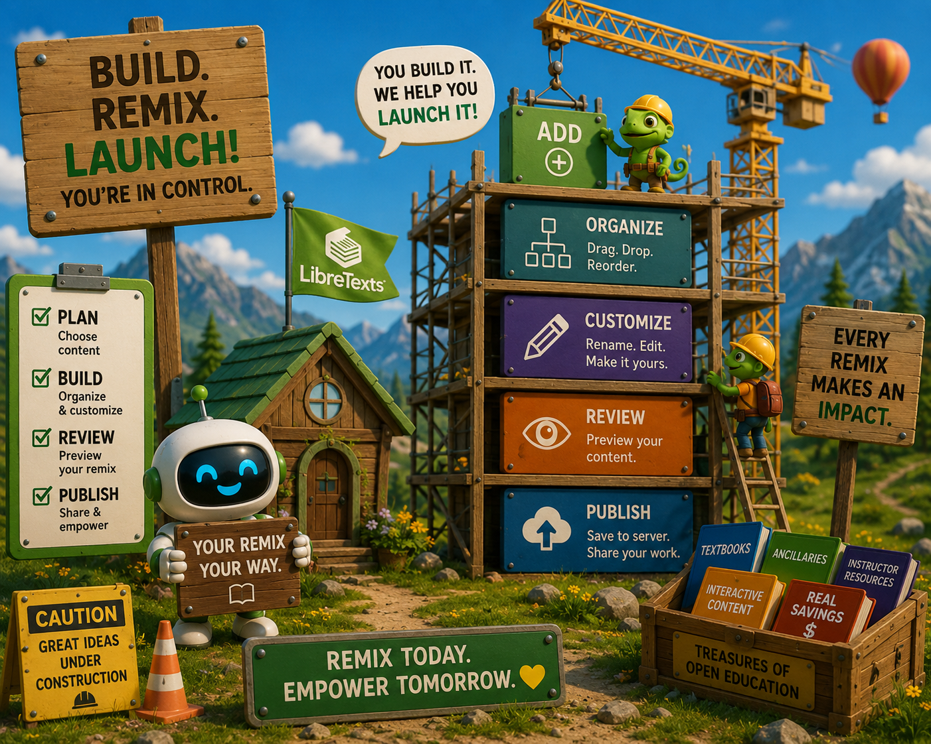
How was the Construction?
LibreTexts Rocket Icon. Adapted for instructional use. Original icon from LibreTexts. CC0 1.0 Public Domain.

Slide 40
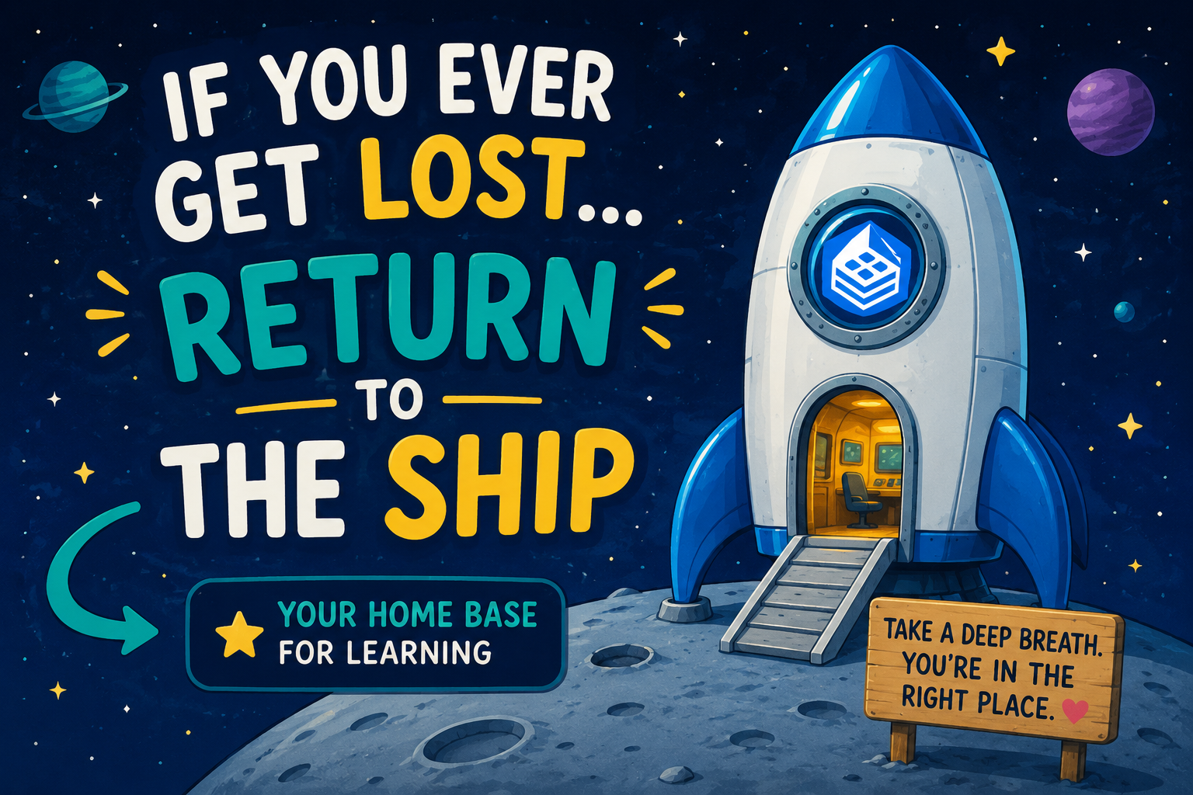
If you get lost: Return to the Ship
LibreTexts Rocket Icon. Adapted for instructional use. Original icon from LibreTexts. CC0 1.0 Public Domain.

Slide 41
Next in the Series and Coming Up
ADAPT Level 4 | Collaborative Learning: Multimodal Engagement with Discuss-It | Thursday, June 11, 10:00-11:30 am
Office hours:
Register for the LibreTexts/ADAPT Office Hours on Friday, June 12, from 2:00 pm – 3:00 pm
Register for the LibreTexts/ADAPT Office Hours on Monday, June 15, from 9:00 am – 10:00 am
Register for the LibreTexts/ADAPT Office Hours on Thursday, June 19, from 9:00 am – 10:00 am
To register and find the recorded archived of webinars, please visit the ASCCC OERI.

Slide 42
Coming Up in-person Trainings
Tuesday, June 23, 2026, 9am-12pm PE6 -Introduction to LibreTexts and ADAPT at the Online Teaching Conference. Registration. $25
If you are interested in registering solely for the Pre-Event Workshops, please email registration@meetingwise.net for the registration link.
Friday, August 14, 8:30 am – 3:30 pm OERI Regional at Allan Hancock. Registration. $25
Friday, August 28, 8:00 am – 3:00 pm OERI Regional at Cerritos College. Registration. $25
Pending for October
San Diego CCD
Monterey Peninsula College
To register please visit the ASCCC OERI.

Slide 43

Contact Us
Shagun Kaur: kaurshagun@fhda.edu
Cristina Moon: cmoon@chabotcollege.edu
OERI Team - oeri@asccc.org
OERI Icon. Adapted for instructional use. Original icon from OERI. CC0 1.0 Public Domain.

