Slide 1
Entrada Libre 2.0
New Spanish Edition OER Showcase
Last updated September 17, 2026
This work is licensed under a Creative Commons Attribution 4.0 International License.
Attribute this slide deck as: “Entrada Libre 2.0 - New Spanish OER Showcase” is licensed under CC BY 4.0.

Slide 2
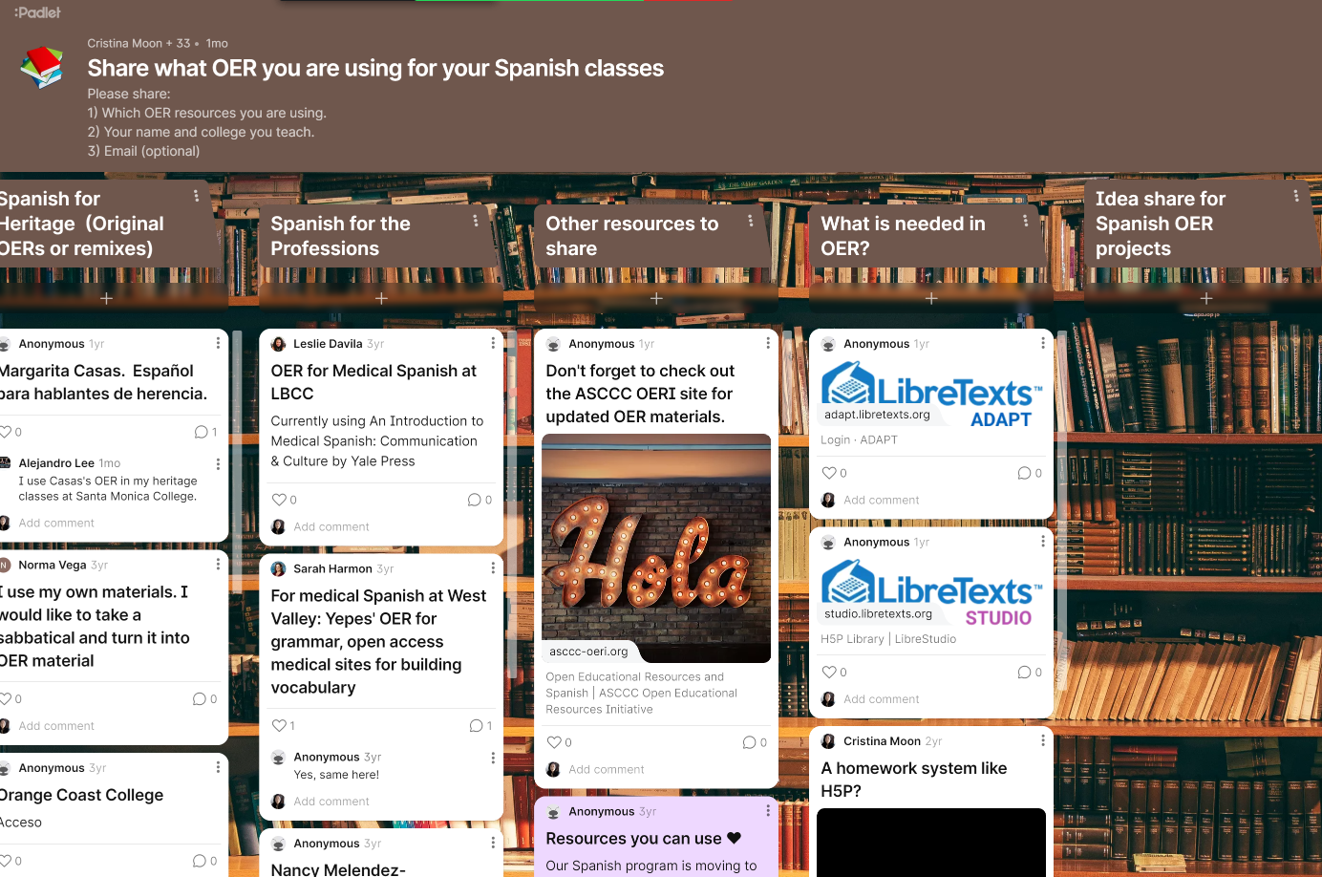
What OER do you use?
Please share with us what OER you are using on this Padlet. ¡Gracias!

Slide 3
Description
The ASCCC OERI is pleased to announce a new OER for intermediate and advanced college-level Spanish. Entrada Libre 2.0 is an intermediate and advanced college-level Spanish OER grammar manual for second language learners and heritage speakers at the community college level. This second edition is fully aligned with Tarea Libre 2 (2024) and University of Kansas’ Acceso. The manual incorporates the ASCCC OERI IDEA Framework and UDL 3.0 principles for culturally responsive, accessible instruction. It includes 8 chapters plus a capstone chapter, “De todo un poco,” each with cultural readings, grammar explanations, and self-graded H5P activities that are available in LibreStudio. Instructors can download the manual or use the LibreTexts OER Remixer to adapt and customize content for their course management system.

Slide 4
Presenters
Hugo Díaz-Rodil, Spanish, Sierra College and American River College
Sarah Harmon, OER/ZTC Program Manager and Linguistics, Cañada College
Alejandro Lee, ASCCC OERI Spanish Lead and Spanish, Santa Monica College
Cristina Moon, ASCCC OERI ADAPT Lead and Spanish and OER/ZTC Coordinator, Chabot College

Slide 5


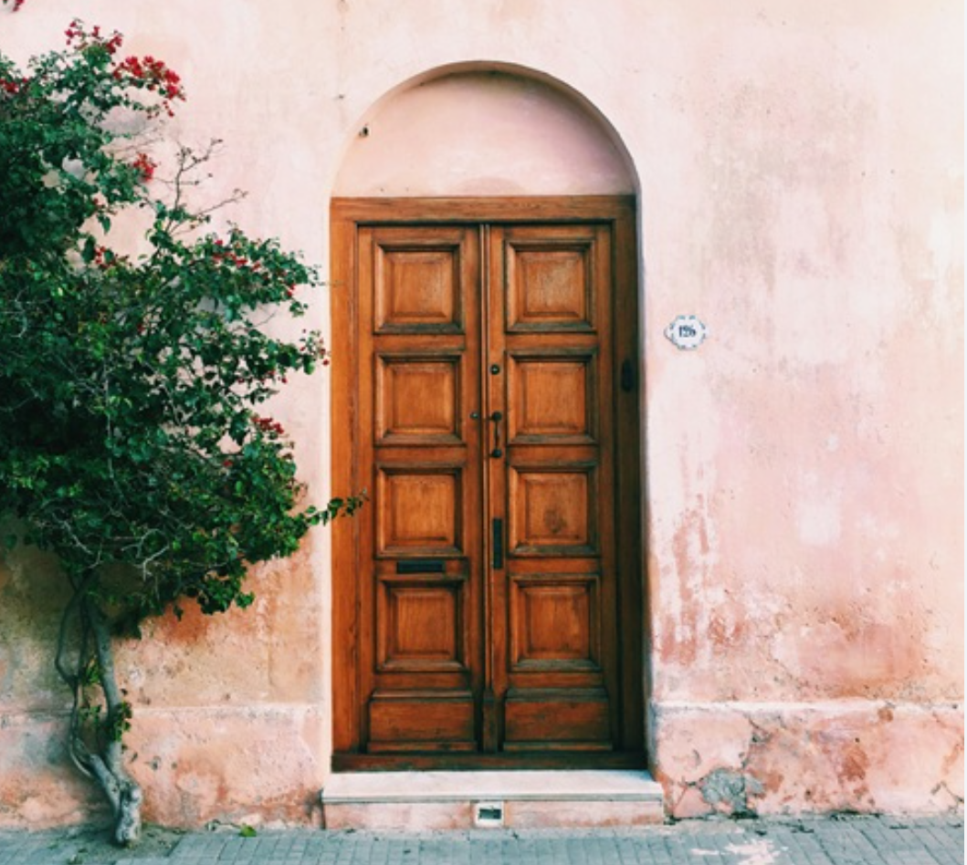



Overview
Entrada Libre 2e
Cristina Moon, Alejandro Lee, Sarah Harmon, and Hugo Díaz Rodil
Book ID: human-229807; Pages: 301
Entrada Libre 2.0 is an intermediate/advanced college-level Spanish OER grammar manual for second language learners and heritage speakers of Spanish at the community college level. Instructors will be able to download the entire manual or use the OER Remixer from LibreTexts to adapt, edit, and customize content and publish it in their LMS.
Seven years in the making
From a 2019 RFP to a second edition
What's new in this edition
Culturally responsive revision + expanded grammar coverage
Our IDEA revision methodology
The AI Crosswalk used to guide every chapter review
Tarea Libre 2
Homework content alignment
Looking Ahead
Continued commitment to open education

Slide 6
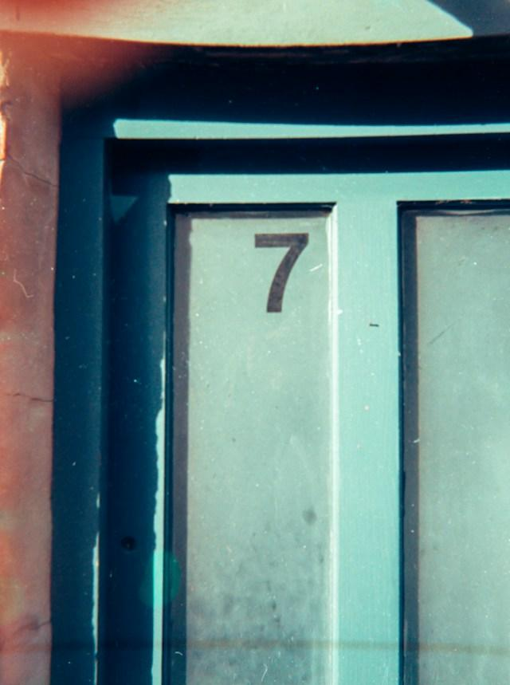
Seven years in the making
Photo by Nik on Unsplash

Slide 7
A New Edition, Seven Years in the Making
2019–2020
2024
2026
Entrada Libre
Tarea Libre 2
Entrada Libre 2.0
Nancy Ballesteros, Alejandro Lee, Nicolás Crisosto, and Cristina Moon
Cristina Moon, Alejandro Lee, Sarah Harmon, and Hugo Díaz-Rodil
Cristina Moon, Alejandro Lee, Sarah Harmon, and Hugo Díaz-Rodil
Developed under the ASCCC OERI's first RFP and published within an accelerated six-month window, it is a foundational OER grammar manual for second-year Spanish, widely adopted and adapted across the discipline.
A homework collection for second-year Spanish courses, it was built in ADAPT using the native questions. It was also the catalyst for the Entrada Libre revision.
Aligned with Tarea Libre 2, Entrada Libre gives students and instructors a more cohesive and integrated learning experience.

Slide 8
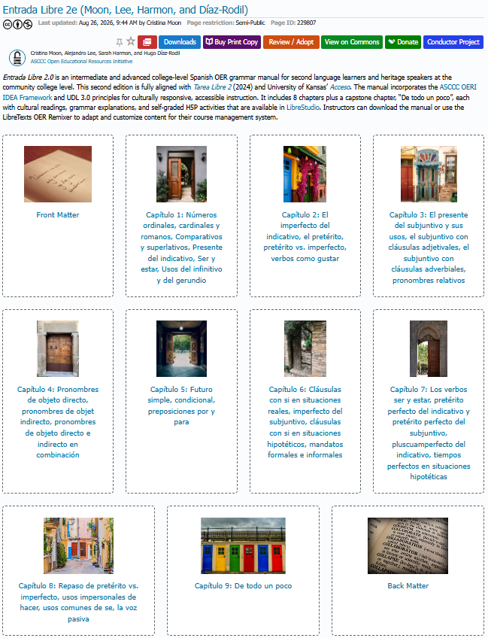
Presenting
Entrada Libre 2.0
(2026)

Slide 9
38 Sections of Content over 9 Chapters
Capítulo 1
  1.1 Números ordinales, cardinales y romanos
  1.2 Comparativos y superlativos
  1.3 Presente del indicativo
  1.4 Ser y estar
  1.5 Usos del infinitivo y del gerundio
Capítulo 2
  2.1 El imperfecto del indicativo
  2.2 El pretérito
  2.3 Pretérito vs. imperfecto
  2.4 Verbos como gustar
Capítulo 3
  3.1 El presente del subjuntivo y sus usos
  3.2 El subjuntivo con cláusulas adjetivales
  3.3 El subjuntivo con cláusulas adverbiales
  3.4 Pronombres relativos
Capítulo 4
  4.1 Pronombres de objeto directo
  4.2 Pronombres de objeto indirecto
  4.3 Pronombres de objeto directo e indirecto en combinación
Capítulo 5
  5.1 Futuro simple
  5.2 Condicional
  5.3 Preposiciones por y para
Capítulo 6
  6.1 Cláusulas con si en situaciones reales
  6.2 Imperfecto del subjuntivo
  6.3 Cláusulas con si en situaciones hipotéticas
  6.4 Mandatos formales e informales
Capítulo 7
  7.1 Los verbos ser y estar
  7.2 Pretérito perfecto del indicativo y del subjuntivo
  7.3 Pluscuamperfecto del indicativo
  7.4 Tiempos perfectos en situaciones hipotéticas
Capítulo 8
  8.1 Repaso de pretérito vs. imperfecto
  8.2 Usos impersonales de hacer
  8.3 Usos comunes de se
  8.4 La voz pasiva
Capítulo 9: De todo un poco
  9.1 Las reglas de acentuación
  9.2 Las reglas de las mayúsculas, minúsculas y puntuación
  9.3 Ortografía de la c, s y z; de la b y v; de la h
  9.4 Más ortografía: la j, g, c, qu, k, ll y y
  9.5 Los cognados falsos
  9.6 Los participios adjetivales
  9.7 Verbos con preposición

Slide 10
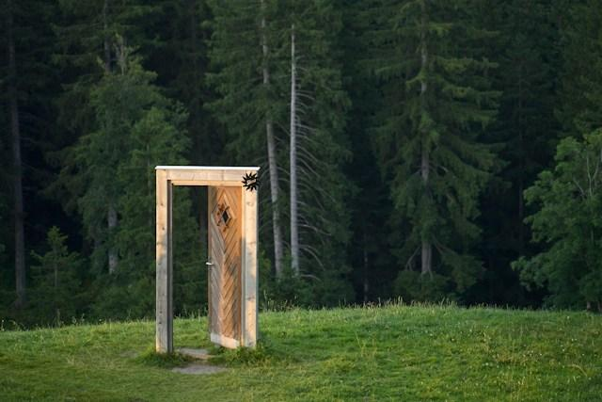
What's new in this edition
Photo by Wolfgang Hasselmann on Unsplash

Slide 11
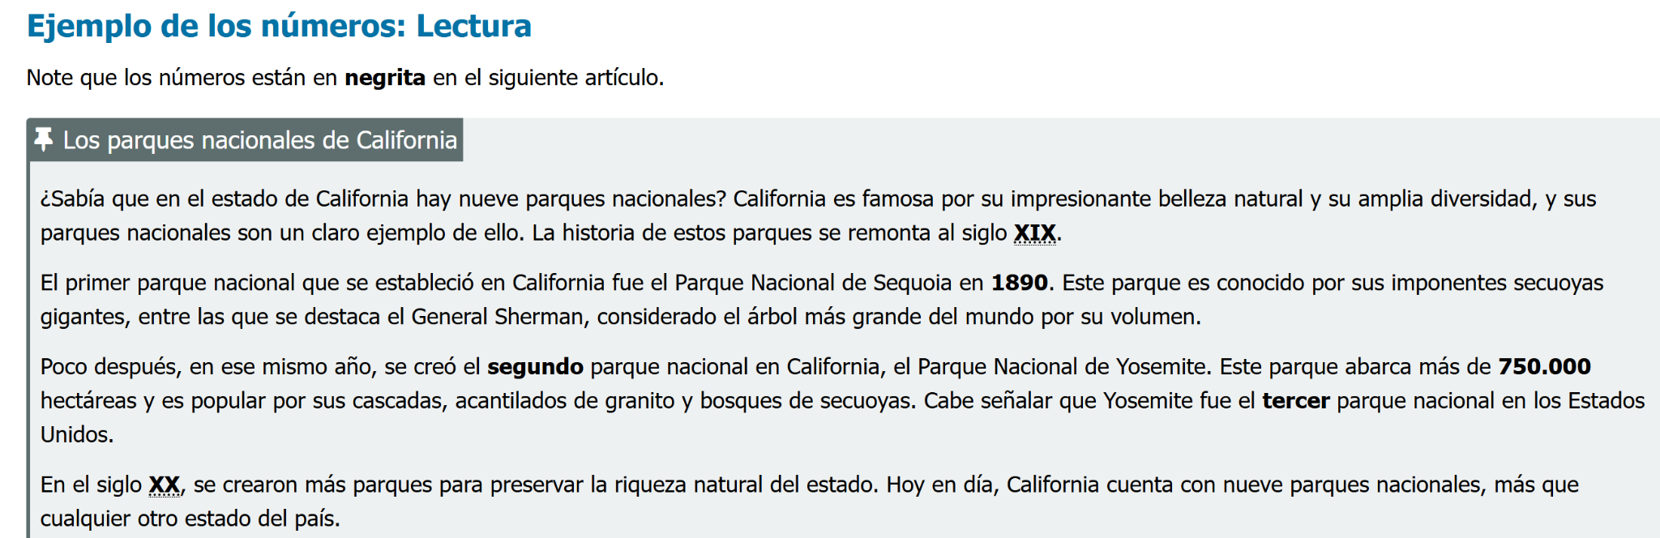
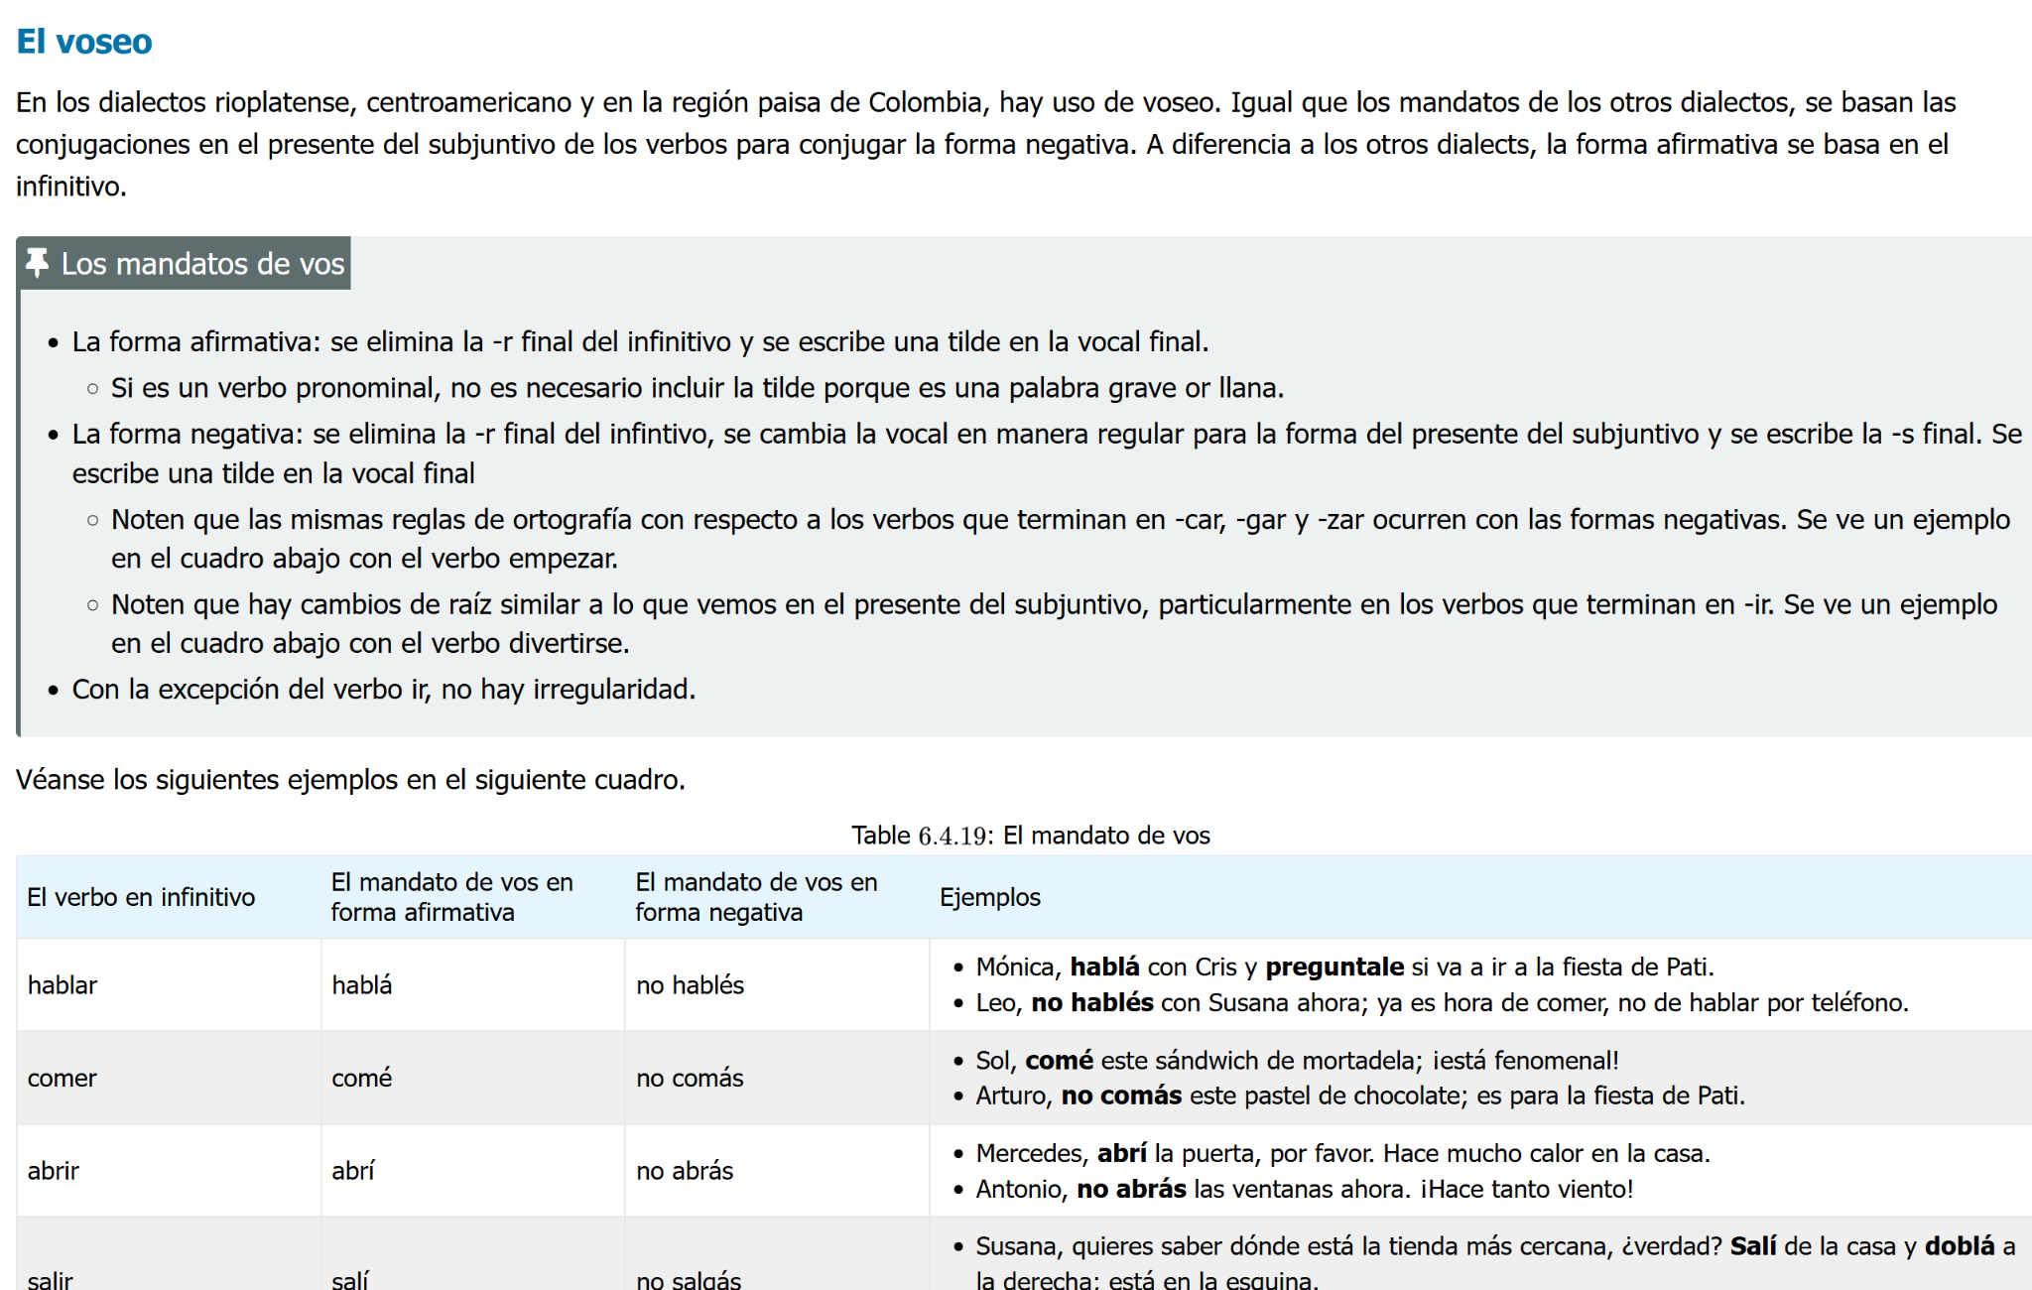
New and Expanded Sections
Ordinal, cardinal, and Roman numbers
Uses of the infinitive and gerund
Relative pronouns
Nosotros commands
Vos and vosotros commands
Impersonal uses of hacer
The passive voice

Slide 12

Two Major Commitments
This second edition reflects a deeper alignment with culturally responsive pedagogy and a substantial expansion of grammar concepts.
A Culturally Responsive Revision
Expanded Grammatical Coverage
Every chapter reviewed through the ASCCC OERI IDEA Framework, accessibility, and UDL reflecting the diverse identities, communities, and learning needs of our students, including heritage learners and first-generation college students.
14 new grammar sections aligned with Tarea Libre 2, plus a new capstone chapter, “De todo un poco.” Existing chapters refreshed with clearer explanations, updated cultural readings and images, and additional H5P activities.

Slide 13
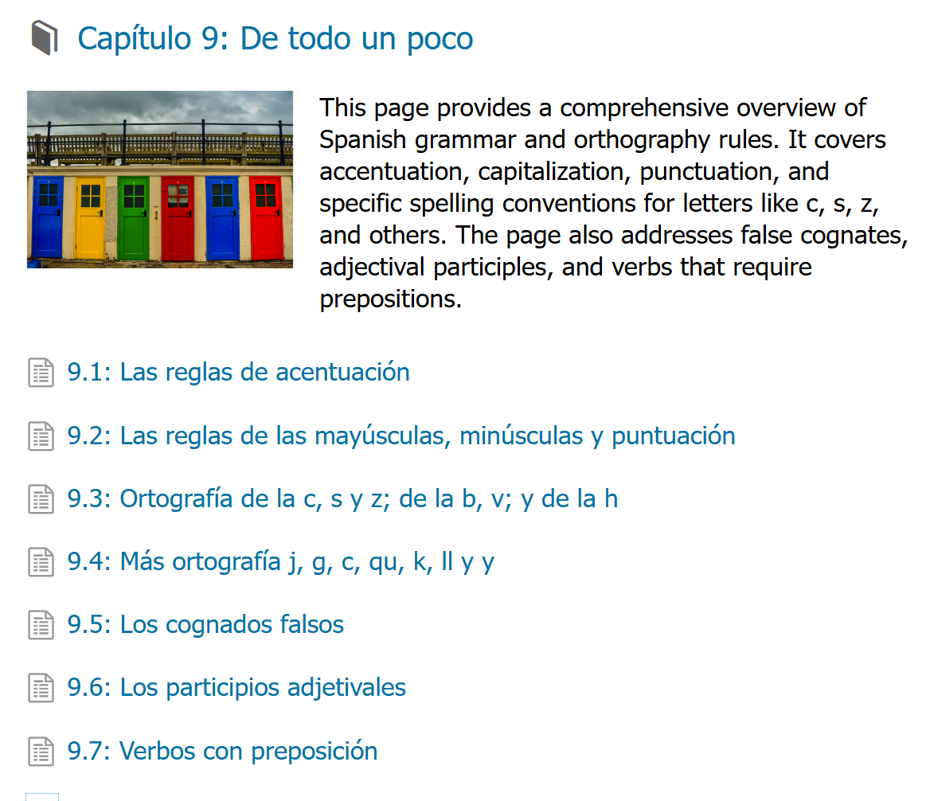
New Capstone Chapter: De todo un poco
Accentuation rules
1
Capitalization and punctuation rules
2
Spelling of c, s, and z; b and v; and h
3
Further spelling: j, g, c, qu, k, ll, y
4
False cognates
5
Adjectival participles
6
Verbs with prepositions
7

Slide 14
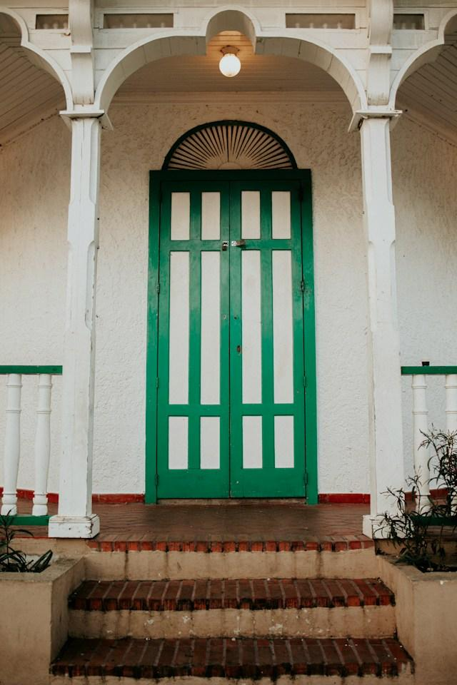
Our IDEA revision methodology
Photo by Ronald Vargas on Unsplash

Slide 15
A Culturally Responsive Revision
ASCCC OERI IDEA Framework (2025)
Inclusion, Diversity, Equity, and Anti-Racism
Every chapter was reviewed and revised through the IDEA Framework lens, integrating Universal Design for Learning (UDL 3.0) principles throughout.

Slide 16
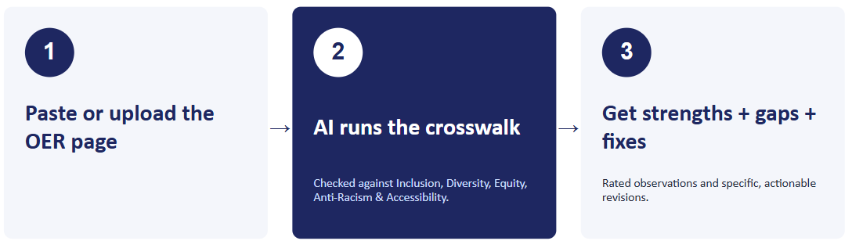
OERI IDEA Framework
AI Crosswalk
IDEA Framework AI Crosswalk Playlab will help faculty complete a ‘crosswalk’ on an OER using gen-AI against the ASCCC OERI IDEA Framework.

Slide 17
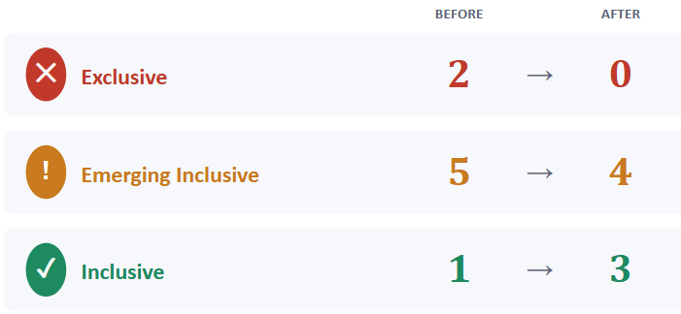
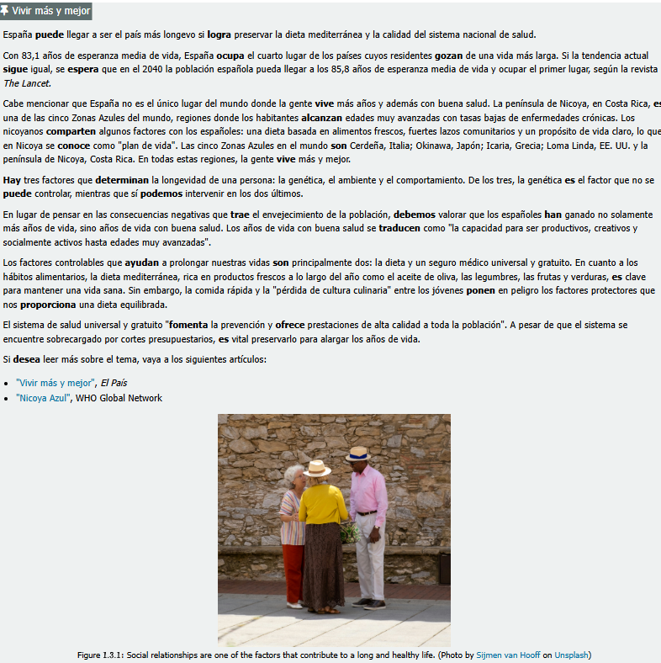
Spanish Example: Entrada Libre 2.0
Capítulo 1.3: Presente del indicativo
Same chapter, re-run through the full 8-element crosswalk after revision.
Results:
7.8 (Diverse Perspectives) moved from Exclusive straight to Inclusive; 7.4 (Diverse Authors & Researchers) moved from Exclusive to Emerging — both driven by one change:
“Spain only” → “Spain + the Nicoya Peninsula, Costa Rica + all five Blue Zones — with the WHO and a named Costa Rican demographer now cited.”

Slide 18
Prioritized Actionable Recommendations
HIGH
Add chapter learning objectives
HIGH
Add chapter summary and key-term glossary
HIGH
Verify image alt text
MEDIUM
Add critical framing for RAE citations
MEDIUM
Expand heritage-speaker dialect affirmation
LOW
Diversify practice-sentence names or identities

Slide 19
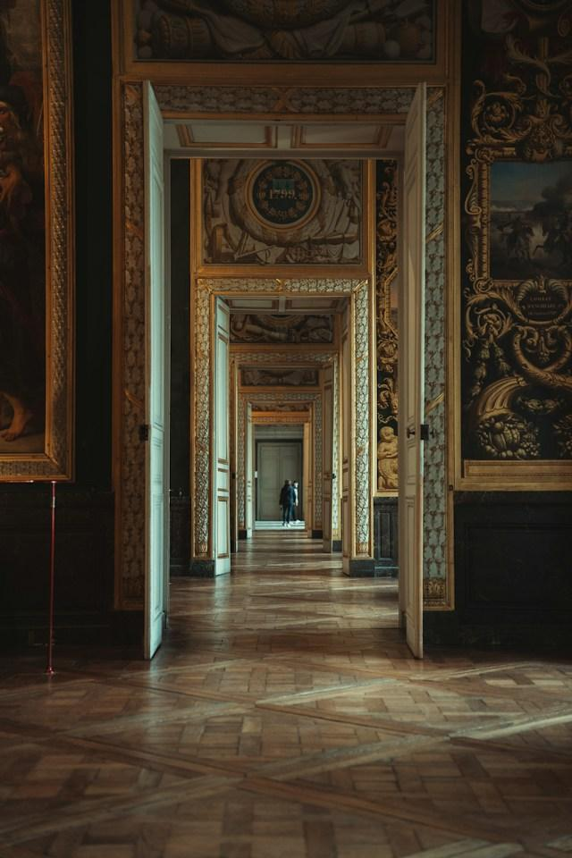
Entrada Libre 2.0 aligns with Tarea Libre 2
Photo by Anna Hunko on Unsplash

Slide 20
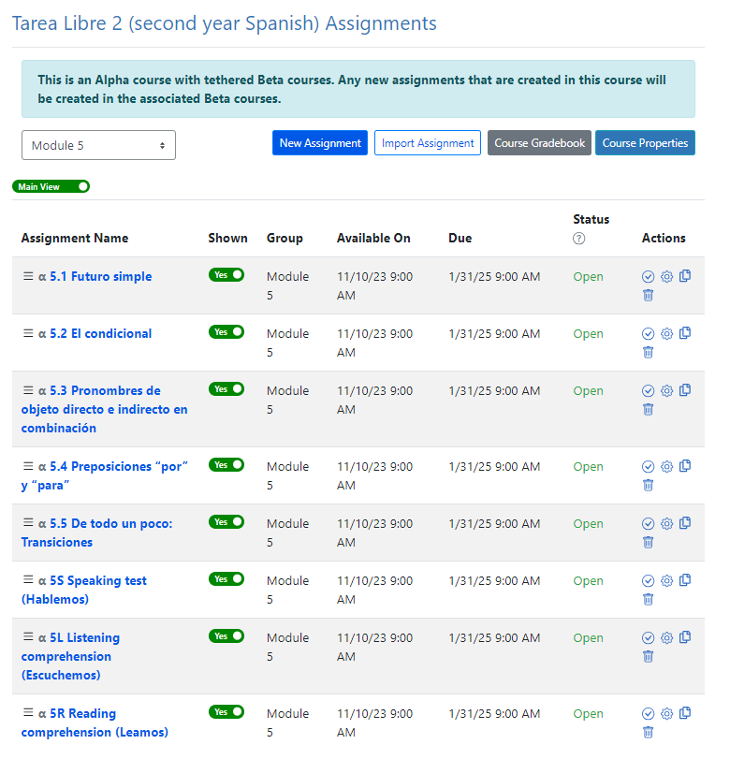
Tarea Libre 2 Modules
Built on California’s C-ID curriculum model for SPAN 200 and SPAN 210
800 activities
8 modules (4 modules per semester) connected to Acceso
4-5 sections per module
5 ‘pasos’ of grammar exercises per section
  Empecemos
  Continuemos
  Practiquemos
  Avancemos
  De todo un poco
3 comprehensive assessments per module
  Hablemos
  Escuchemos
  Leamos

Slide 21
Tarea Libre 2: Scaffolded grammar assignments for formative and summative assessments
1
2
3
4
Empecemos
Continuemos
Practiquemos
Avancemos
Initial application: review of new vocabulary with multiple choice and select-choice questions
Continued application: fill-in-the-blank in short contexts
Expanded application: longer paragraphs, fuller context
Full application in dialogue: fill-in-the-blank in real exchanges

Slide 22
Tarea Libre 2: Four Language Skills
✎
Leamos · Reading
♫
Escuchemos · Listening
17 original and adapted cultural readings with recorded narration and auto-graded comprehension, topics rarely found in commercial texts.
Original videos built for each module, captioned and transcribed in Spanish.
●
Hablemos · Speaking
↔
Conversemos · Discussion
Audio-recorded responses tied to cultural topics and readings, submitted through the ADAPT recording widget.
Threaded audio, video, or text discussions using Discuss-It, can satisfy Regular and Substantive Interaction (RSI) for online courses.

Slide 23
Looking to convert SPAN 200 and 210 to ZTC
Map to your outline
Align chapters and pages to your own SPAN 200 and 210 C-ID
descriptors using the LibreTexts Remixer.
Remix examples from Chabot College:
SPA 2A · Intermediate Spanish: Chabot College’s third-semester remix
SPA 2B · Advanced Spanish: Chabot College’s fourth-semester remix
Link Canvas to homework
Tarea Libre 2 remix connects to Canvas via API with automatic gradebook synchronization.
SPA 2A
SPA 2B
10

Slide 24
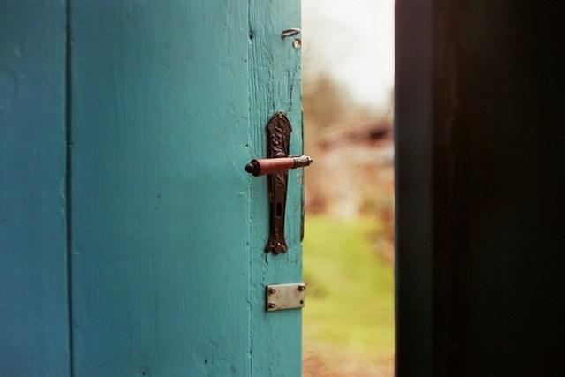
Looking Ahead
Photo by Jan Tinneberg on Unsplash

Slide 25
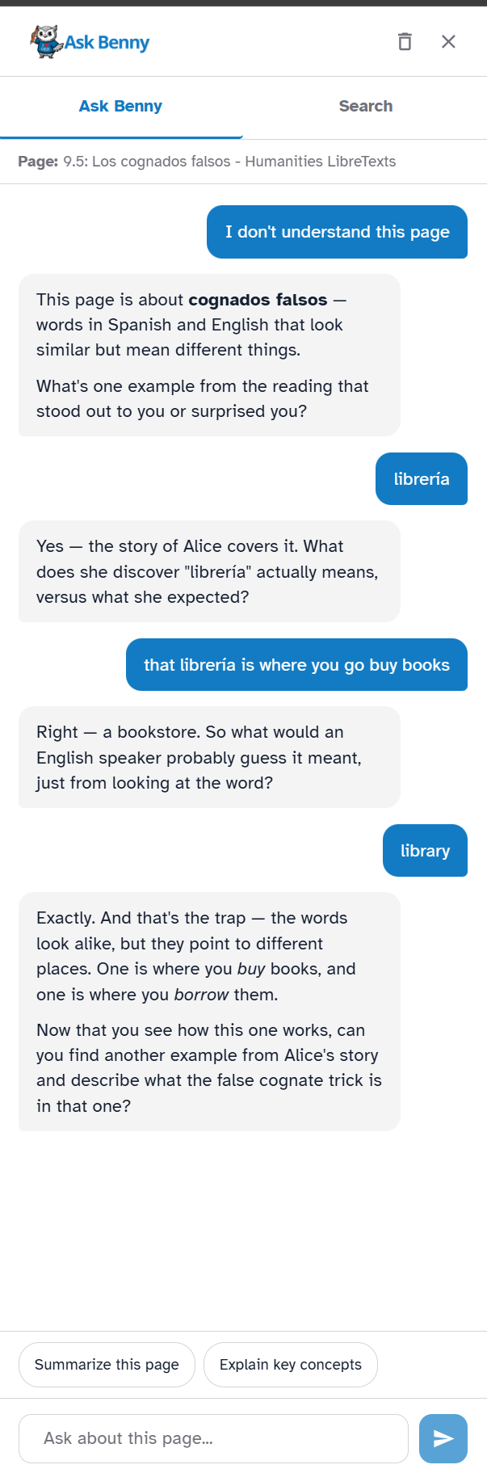
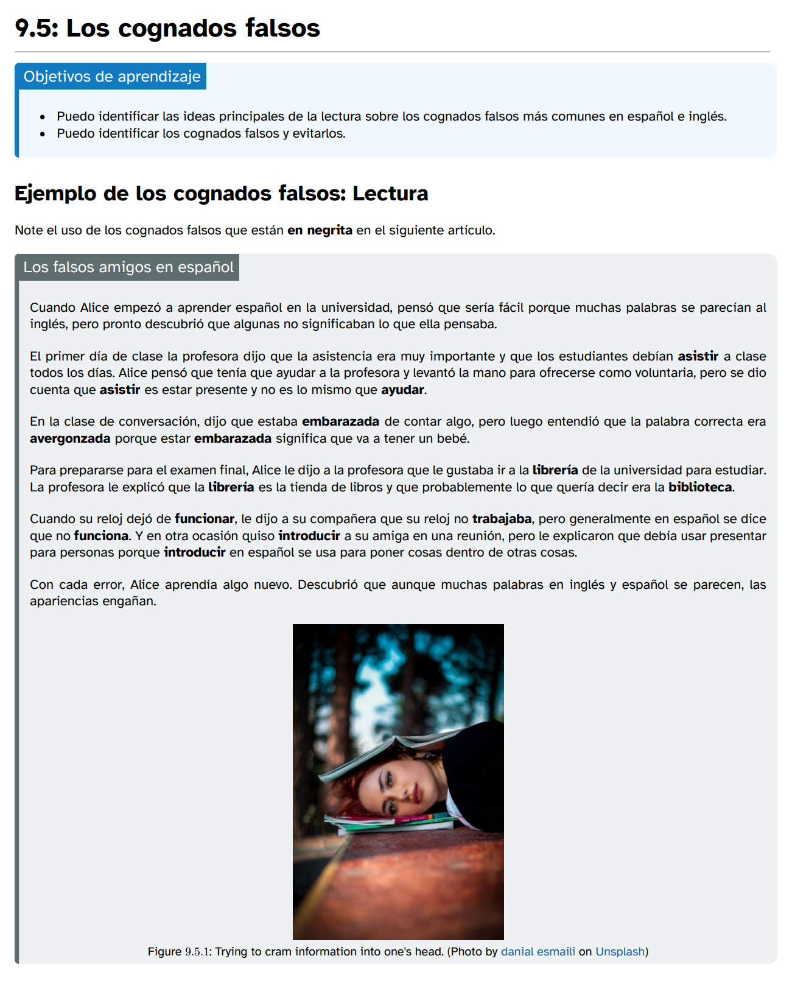
New Interactive Tool: Ask Benny

Slide 26
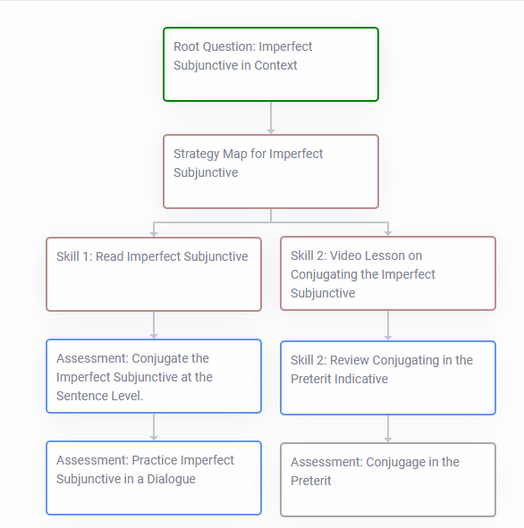

Adaptive Homework with Learning Trees
ADAPT Learning Trees
An adaptive ADAPT question type that branches students down different paths based on how they perform — rather than serving every student the same fixed sequence.
The plan: Turn our four-stage progression (Empecemos, Continuemos, Practiquemos, Avancemos) into a Learning Tree for every grammar topic.
Skip ahead on early mastery: Students who show mastery at Empecemos branch forward straight to Practiquemos or Avancemos instead of repeating what they already know.
Extra support where it's needed: Students who struggle are guided through additional Continuemos practice before the tree advances them to the next stage.
Personalized without extra instructor work: Homework becomes right-sized to each student's level automatically.

Slide 27
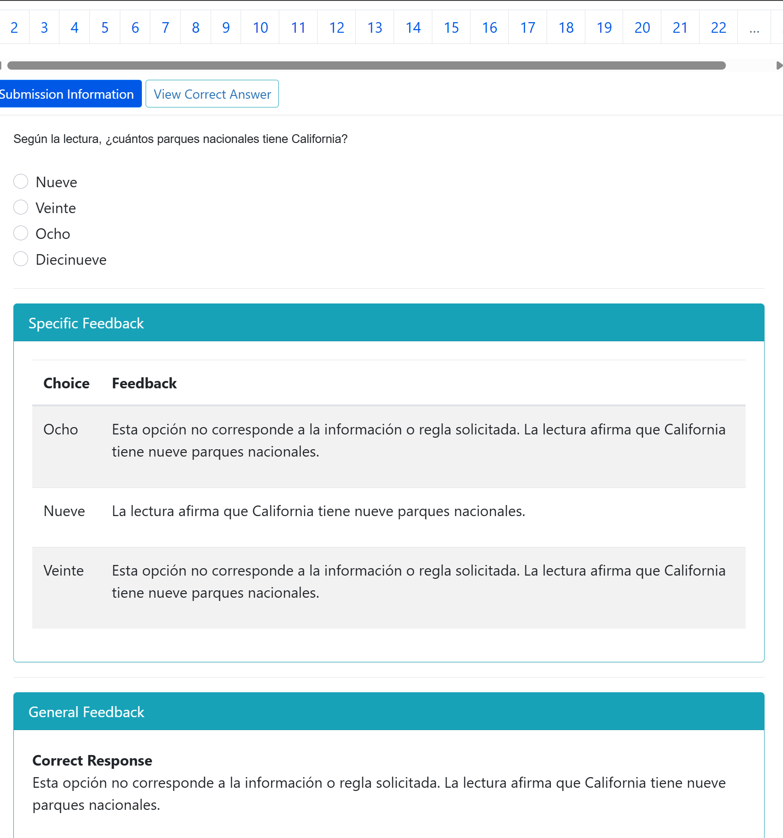
Creating quiz questions and importing into ADAPT
Using an LLM-chat bot (e.g. ChatGPT, Claude, Co-Pilot, Gemini) to create questions on a given chapter or page
Put the questions into Canvas QTI format
  Fill-in-the-blank
  Multiple choice
  Multiple answers
  True/false
Import the Canvas QTI file into ADAPT via Bulk Import
The questions will come up in ADAPT as native questions.

Slide 28
Resources and more

Slide 29
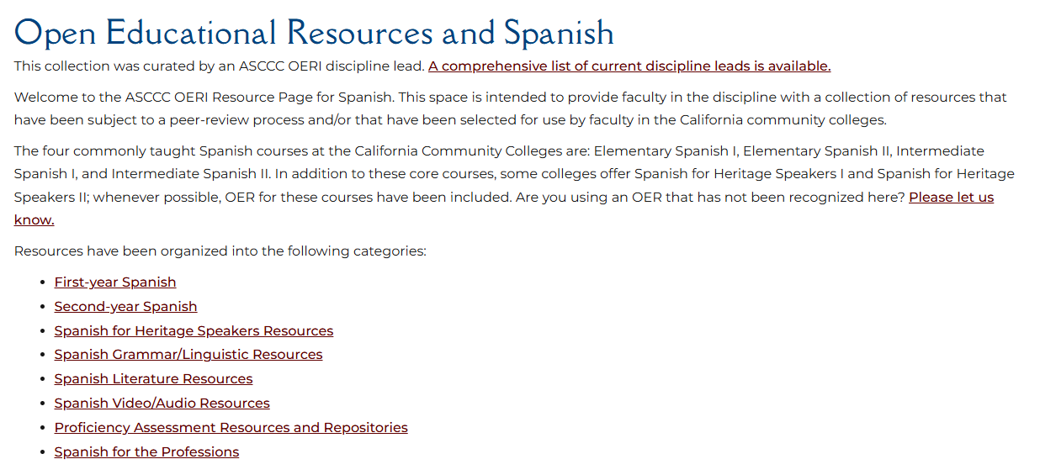
OERI Spanish Discipline Page

Slide 30
Resources and Notes
Apps, Bots, and OER - OERI Curated Collection
OERI Curated Collections
IDEA Framework AI Crosswalk Playlab: This app helps faculty complete a ‘crosswalk’ on an OER using gen-AI against the ASCCC OERI IDEA Framework.
EquityCoach Playlab (Wendy Poling, Chabot College): This app guides faculty in building equity-minded online course content built around ADA, UDL, and humanizing practices.
https://www.playlab.ai/project/cmrz61g7f1idlp60wodroawkj

Slide 31
Recordings of our Summer Series
Remixer Level 1 | LibreTexts Essentials: Navigation & Smart Search.
Remixer Level 2 | LibreTexts Remixer Lab: Create, Curate, Customize.
Remixer Level 3 | Quick Start: Edit Pages in LibreTexts.
Remixer Level 4 | Designing with Media: Images and Video in LibreTexts
ADAPT Level 1 | Navigating ADAPT
ADAPT Level 2 | Cloning Native Basic Questions
ADAPT Level 3 | Beyond the Final Draft: Process-Based Assessment with Forge
ADAPT Level 4 | Collaborative Learning: Multimodal Engagement with Discuss-It
To register for upcoming webinars and find the archived recordings, please visit the ASCCC OERI.

Slide 32
Canvas Course: LibreTexts Basics and Beyond
This course is an adaptation created by Cristina Moon and Michelle Pilati. It is a revision of "Mastering Libretexts" created by Wendy Poling and is shared under a CC-BY-4.0 license
Register for LibreTexts Basics and Beyond
( If you have trouble registering, please contact OERI at oeri@asccc.org )
Note: The ASCCC OERI LibreTexts Basics and Beyond course is also available on Canvas Commons for local use.

Slide 33
Fall 2026 LibreTexts/ADAPT
in-person Training
Friday, October 2, 2026 from 8:00 am – 3:00 pm at San Diego College of Continuing Education – North City Campus
Friday, October 23, 2026 from 8:00 AM – 3:00 PM at Monterey Peninsula College
To register please visit the ASCCC OERI.

Slide 34
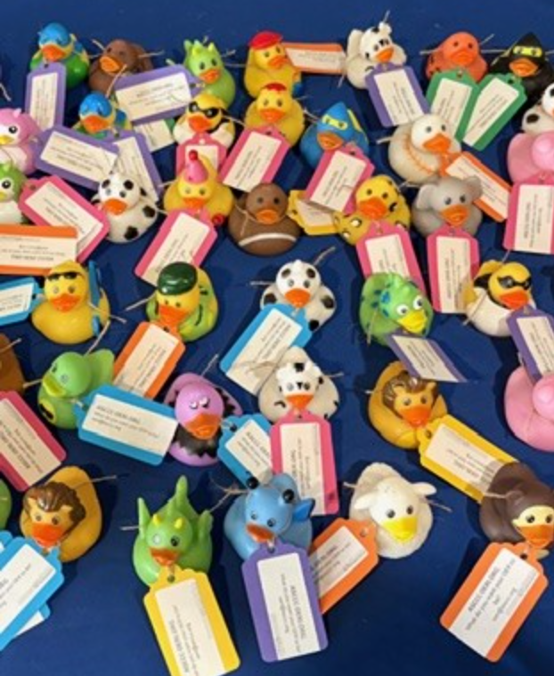
Stay Informed
ASCCC List Servs (one-way)
  https://www.asccc.org/sign-our-newsletters
  tinyurl.com/OERISignUp
  ASCCC OER Initiative; Discipline Listserv
In order to determine faculty interest in OERI work, we are inviting all faculty to demonstrate that interest by completing the ASCCC OERI Application and selecting “Potential OER Development Opportunity” as the role they would like to be considered for on the application.
  tinyurl.com/ApplyOERI

Slide 35
More Information
ASCCC OERI Website (asccc-oeri.org)
Resources
Webinars and Events

Slide 36

Contact Us
Hugo Díaz-Rodil hugodiazrodil@gmail.com
Sarah Harmon harmons@smccd.edu
Alejandro Lee leealejandro@gmail.com
Cristina Moon cmoon@chabotcollege.edu
Holiday Hedgehog is licensed CC0 1.0 Public Domain

