Slide 1
Open Educational Resources
(OER) for Sociology
New Resources and the State of the Discipline
Friday, September 25, 2026 (11am – 12pm)
This work is licensed under a Creative Commons Attribution 4.0 International License.

Slide 2
Welcome!
On behalf of the ASCCC Open Educational Resources Initiative (OERI), welcome to our Fall 2026 Sociology Webinar.
Dr. Sarah Earl-Novell
New Sociology Discipline Lead, ASCCC OERI
Sociology (part-time) and an OER/ZTC Social Science Mentor Chabot College
searl-novell@chabotcollege.edu
Dr. Cristina Moon
  ASCCC OERI ADAPT Lead
  Spanish and OER/ZTC Coordinator
  Chabot College
  cmoon@chabotcollege.edu

Slide 3
Zoom Etiquette and Introductions
Please mute yourself when you’re not speaking
Feel free to use the Zoom chat throughout the webinar for questions, comments, and sharing resources
Say hello in the chat!
Name | College | Role
This webinar will be recorded
Recordings of ASCCC OERI events are available at asccc-oeri.org → Webinars and Events

Slide 4
Goals for Today
Provide an overview of (newly) available sociology OER
Learn what OER you’re currently using
Share OER you’re developing or working on
Identify unmet OER needs and gaps
Highlight useful OERI resources and information

Slide 5
Mapping Sociology in 2026
Colleges have continued to expand their use of OER and Zero Textbook Cost (ZTC) materials.
Fall 2026 marks an important point for ZTC pathways, as many programs funded through the ZTC Degree Program are now expected to be implemented.
New or substantially modified OER developed with ZTC funds are to be shared through COOL4Ed.
As these resources become available, we have a clearer picture of the current OER landscape in sociology—and an opportunity to identify where further development may be needed.

Slide 6
How the OERI Sociology Collection Is Organized
The OERI collection is structured in 2 ways:
(1) C-ID (Course Identification Numbering system), and
(2) The Transfer Model Curriculum (TMC)
The current OERI Sociology Collection
One of my tasks as DL is to review, update, and curate the existing collection.
One stop shop for high quality material
Doesn’t always tally with what’s housed in COOL4ed

Slide 7
Overview of (newly) available sociology OER
What OER do you use?
Which resources are rising to the surface?
In the chat:
College | Course | OER/resource |

Slide 8
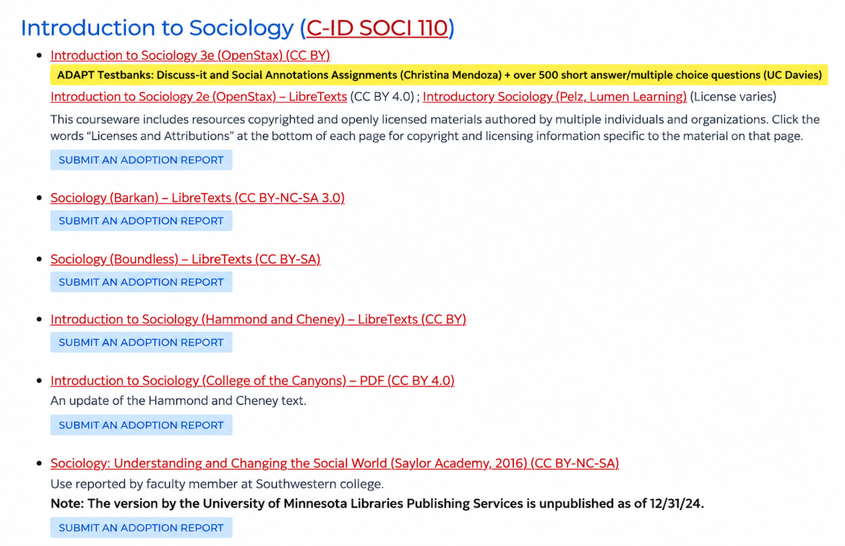
SOCI 110: Introduction to Sociology

Slide 9
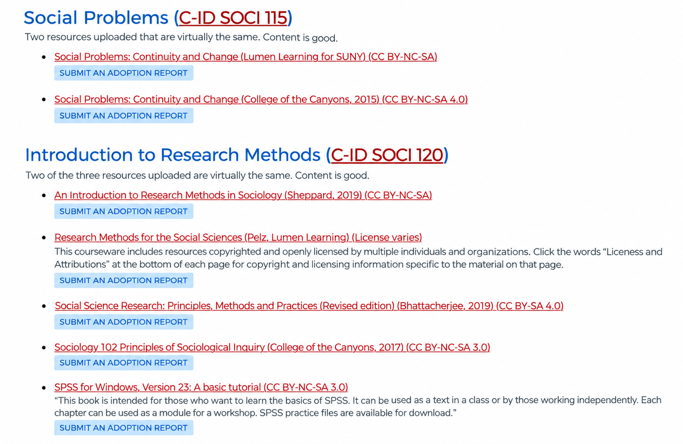
SOCI 115: Social Problems, and
SOCI 120: Introduction to Research Methods

Slide 10
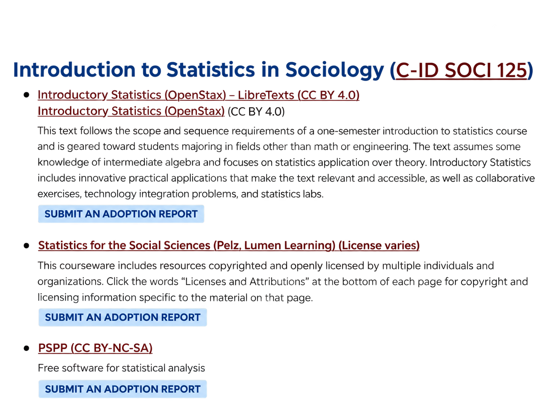
SOCI 125: Introduction to Statistics in Sociology

Slide 11
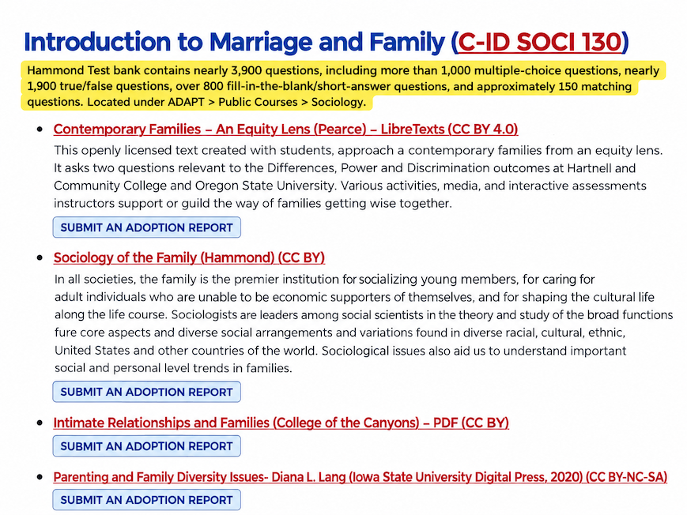
SOCI 130: Introduction to Marriage & Family

Slide 12
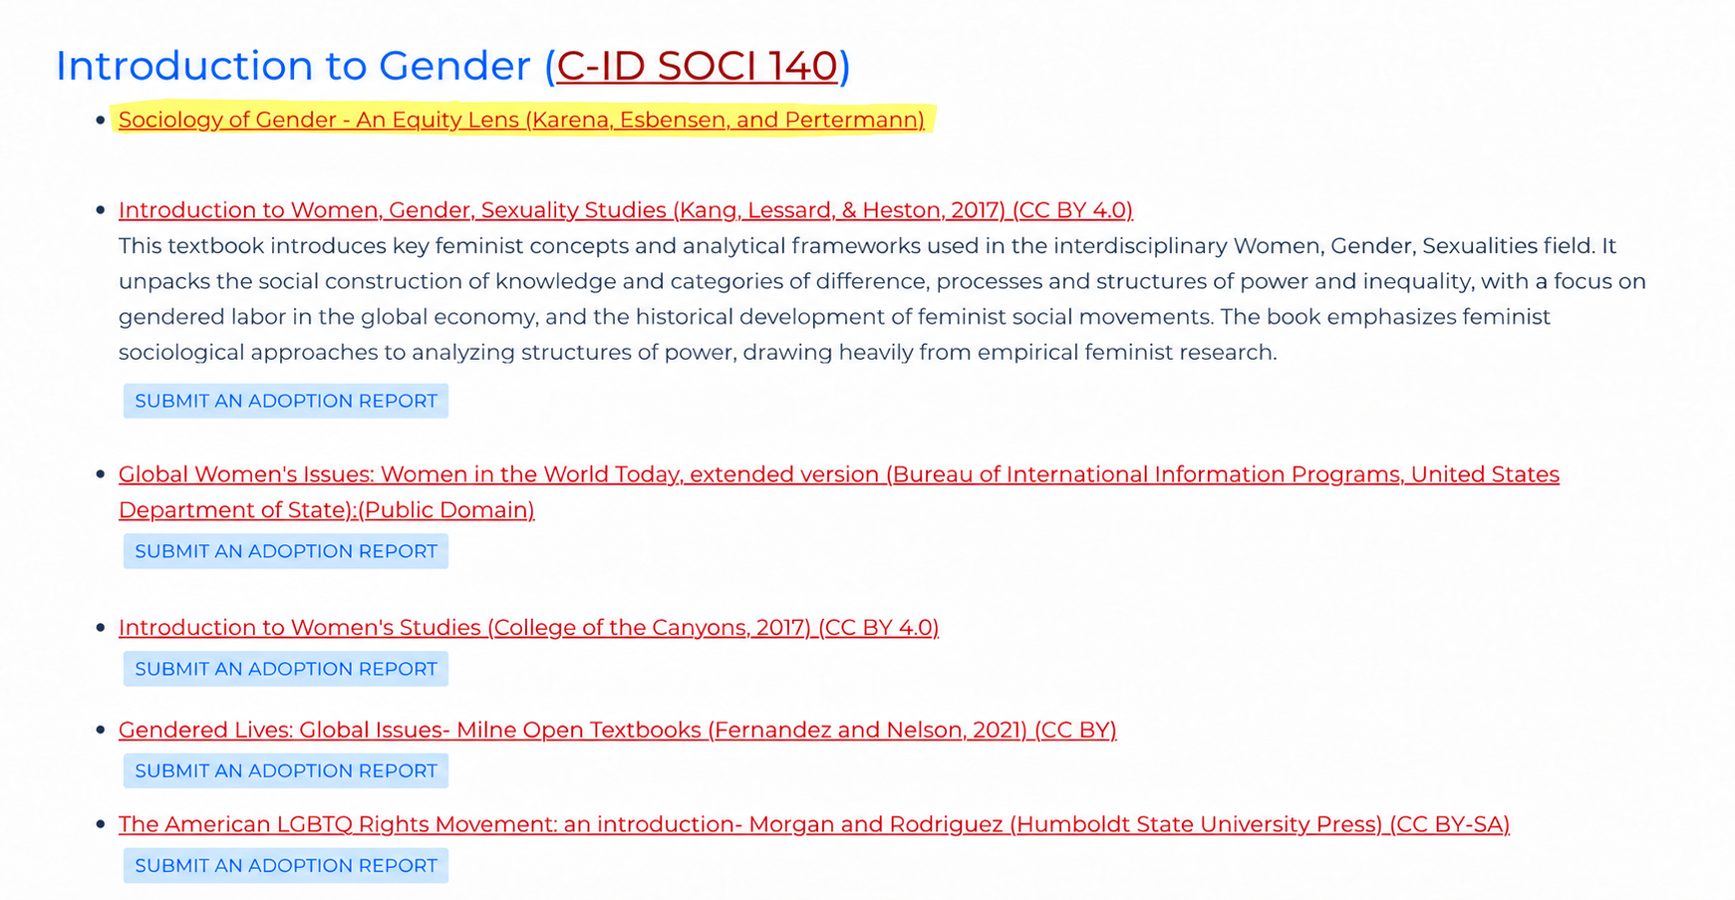
SOCI 140: Introduction to Gender

Slide 13
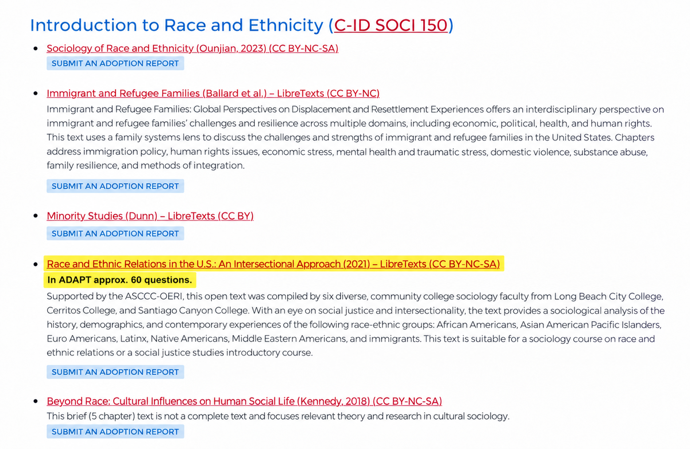
SOCI 150: Introduction to Race and Ethnicity

Slide 14
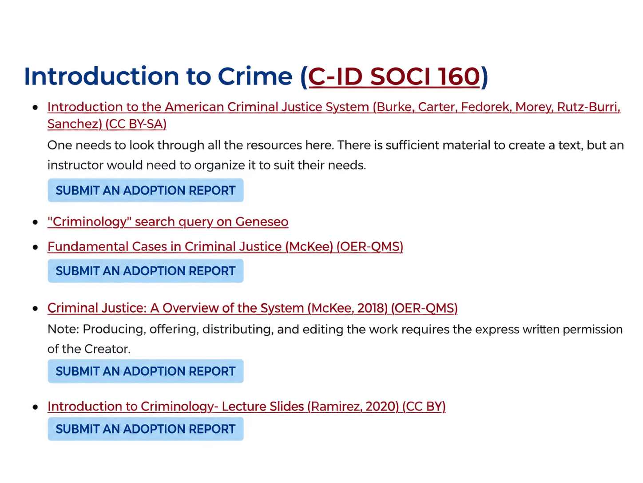
SOCI 160: Introduction to Crime

Slide 15
Help Us Track What Faculty Are Actually Using
Reporting the OER you use is one of the most helpful ways to support this work.
Adoption reports show which resources are being used in practice—not just which materials are available.
To submit an adoption report:
Find the resource in the OERI collection → select Report an OER Adoption → complete the brief form.

Slide 16
Beyond C-ID: Where Are the Gaps?
Additional courses currently represented on the OERI Sociology website:
Intro to Social Psychology • Intro to Social Work • Intro to Human Sexuality • Sociology of Sport
Where might the collection need to grow?
In the chat:
College | Course

Slide 17
Supplemental Sociology Resources
Sociology Vibes - YouTube videos (included in the OERI collection)
Crash Course Sociology - 44 short videos hosted by Nicole Sweeney
American Sociological Association YouTube channel - Sociological Insight interviews
Any additional general resources?

Slide 18
What Are You Creating?
Texts & Remixes
New texts • LibreTexts remixes
Course Infrastructure
Canvas modules • course shells
Ancillaries
Question/test banks • lecture slides • study guides • data activities
Homework and Interactive Tools
ADAPT: Discuss it • Forge • Native Question Types (Fill-in-the-blank, Multiple choice, True/false, Select Choice, Matching)
Other?

Slide 19
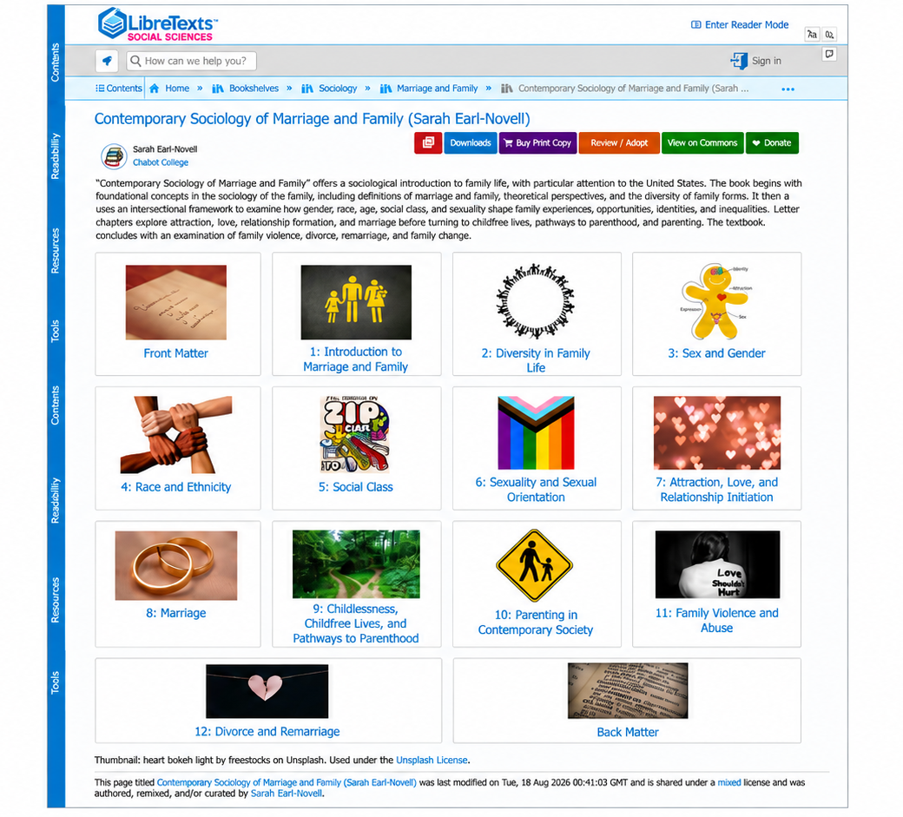
New OER for SOCI 130
Contemporary Sociology of Marriage and Family

Slide 20
Unmet OER Needs and Gaps: Content
Are there courses or topics where you struggle to find strong OER?
Are there resources that need updating or replacing to provide more current, diverse, and inclusive coverage?
Are there courses with only one viable open textbook?

Slide 21
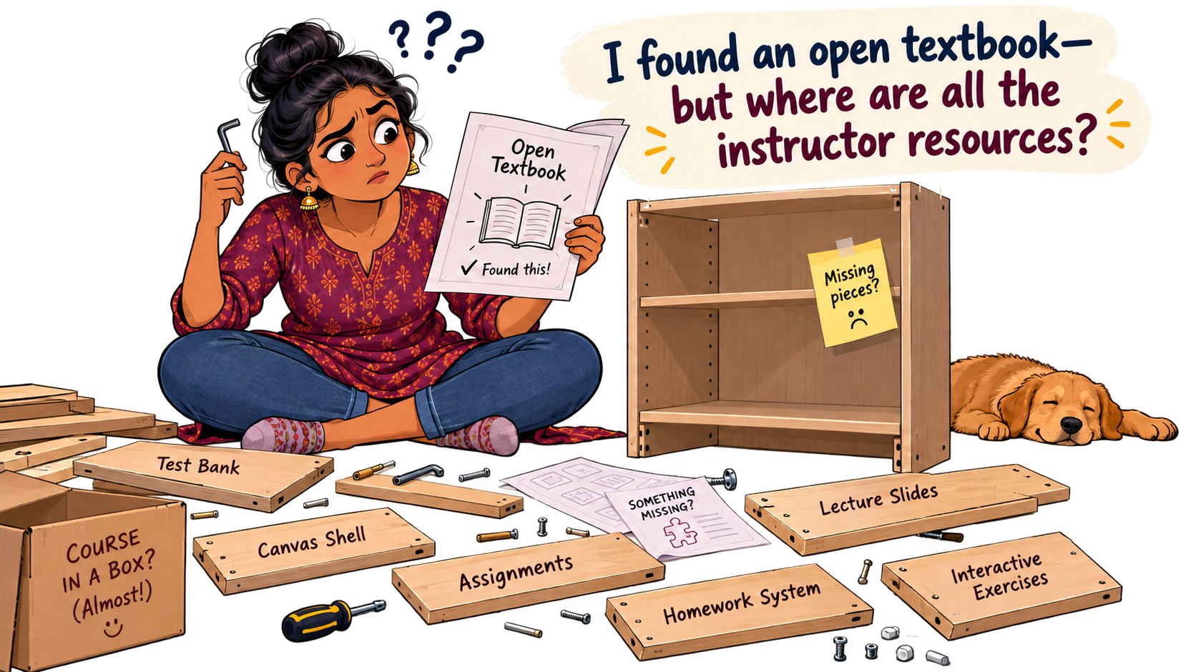
A textbook can feel pretty lonely without the rest of the course…..

Slide 22
Unmet OER Needs and Gaps: Ancillary Resources
What’s missing?
Canvas shells
Lecture slides + study guides
Question/Test banks
Discussion assignments
Data activities
Interactive exercises

Slide 23
Next Steps
Where could faculty collaborate rather than work alone?
Where could OERI support or coordinate this work?
What should our next Sociology OERI webinar focus on?
  Exploring use of AI
  Other?

Slide 24
Canvas Course: LibreTexts Basics and Beyond
This course is an adaptation created by Cristina Moon and Michelle Pilati.
It is a revision of "Mastering Libretexts" created by Wendy Poling and is shared under a CC-BY-4.0 license
Register for LibreTexts Basics and Beyond
( If you have trouble registering, please contact OERI at oeri@asccc.org)
Note: The ASCCC OERI LibreTexts Basics and Beyond course is also available on Canvas Commons for local use.

Slide 25
Canvas Course: LibreTexts ADAPT Basics and Beyond
The OERI is pleased to announce a new course: ASCCC OERI: LibreTexts ADAPT Basics and Beyond.
This self-paced course introduces ADAPT, the homework and assessment platform within LibreTexts, and to serve as a resource for those who have received ADAPT training and are looking for additional support.
As ADAPT is always evolving, this course will also continue to evolve. Every effort was made to provide clear step-by-step guidance to users
Register for ASCCC OERI: LibreTexts ADAPT Basics and Beyond.

Slide 26
OERI Upcoming Webinars
Monday, October 5, 12–1pm
Back to Basics: Open Educational Resources (OER) / Zero Textbook Cost (ZTC) 101. Register
Tuesday, October 13, 1:30–2:30pm
Back to Basics: Finding Open Educational Resources (OER). Register
Wednesday, October 21, 2–3pm
Introduction to Creative Commons Licensing. Register
Wednesday, October 21, 3–4pm
Curation and Advanced Licensing. Register
See ASCCC OERI October 2026 Newsletter for more information.

Slide 27
Recordings of the Summer Series
Level | Title
Remixer Level 1 | LibreTexts Essentials: Navigation & Smart Search.
Remixer Level 2 | LibreTexts Remixer Lab: Create, Curate, Customize.
Remixer Level 3 | Quick Start: Edit Pages in LibreTexts.
Remixer Level 4 | Designing with Media: Images and Video in LibreTexts
Level | Title
ADAPT Level 1 | Navigating ADAPT
ADAPT Level 2 | Cloning Native Basic Questions
ADAPT Level 3 | Beyond the Final Draft: Process-Based Assessment with Forge
ADAPT Level 4 | Collaborative Learning: Multimodal Engagement with Discuss-It

Slide 28
Stay Informed & Get Involved
ASCCC newsletters and listservs; ASCCC OERI discipline listserv
Sign up: asccc.org/sign-our-newsletters
Interested in future OERI development work?
Complete the ASCCC OERI Application and select “Potential OER Development Opportunity” and the role they would like to be considered for on the application.
Sociology OERI survey
A discipline-specific survey will be circulated to gather faculty input on needs, gaps, and priorities.

Slide 29
Fall 2026 LibreTexts/ADAPT
In-Person Training
Friday, October 2, 2026 from 8:00 am – 3:00 pm
San Diego College of Continuing Education – North City Campus
Friday, October 23, 2026 from 8:00 am – 3:00 pm
Monterey Peninsula College
To register please visit the ASCCC OERI.

Slide 30
Contact Us
Dr. Sarah Earl-Novell
Sociology Discipline Lead, ASCCC OERI
searl-novell@chabotcollege.edu
Dr. Cristina Moon
ASCCC OERI ADAPT Lead
cmoon@chabotcollege.edu

Slide 31
Resources
ASCCC OERI Sociology page
https://asccc-oeri.org/open-educational-resources-and-sociology/
COOL4Ed Sociology (C-ID/Course Materials)
https://cool4ed.org/course-materials/50/595
Webinar recording + presentation slides
https://asccc-oeri.org/webinars-and-events/

