Slide 1
Zero Textbook Cost (ZTC) Reporting and COOL4Ed: What You Need to Know
This presentation last modified September 18, 2026.
This work is licensed under a Creative Commons Attribution 4.0 International License.
Attribute this slide deck as: “ZTC and COOL4Ed: What You Need to Know 26F” by ASCCC OERI is licensed under CC BY 4.0.
Notes:
https://cool4ed.org/ztc/courses

Slide 2
Event Description
As the academic year begins, many local ZTC leads are concerned about existing and upcoming deadlines. What does it mean to “implement a pathway” by Fall 2026 or 2027? What reporting must happen by January 29, 2027? What happens if you don’t meet these deadlines? And what, when, and how do you submit OER to COOL4Ed? Join us for an overview of expectations, deadlines, and answers to your questions. Come for the updates, stay for the solutions—and leave knowing what you need to do next.

Slide 3
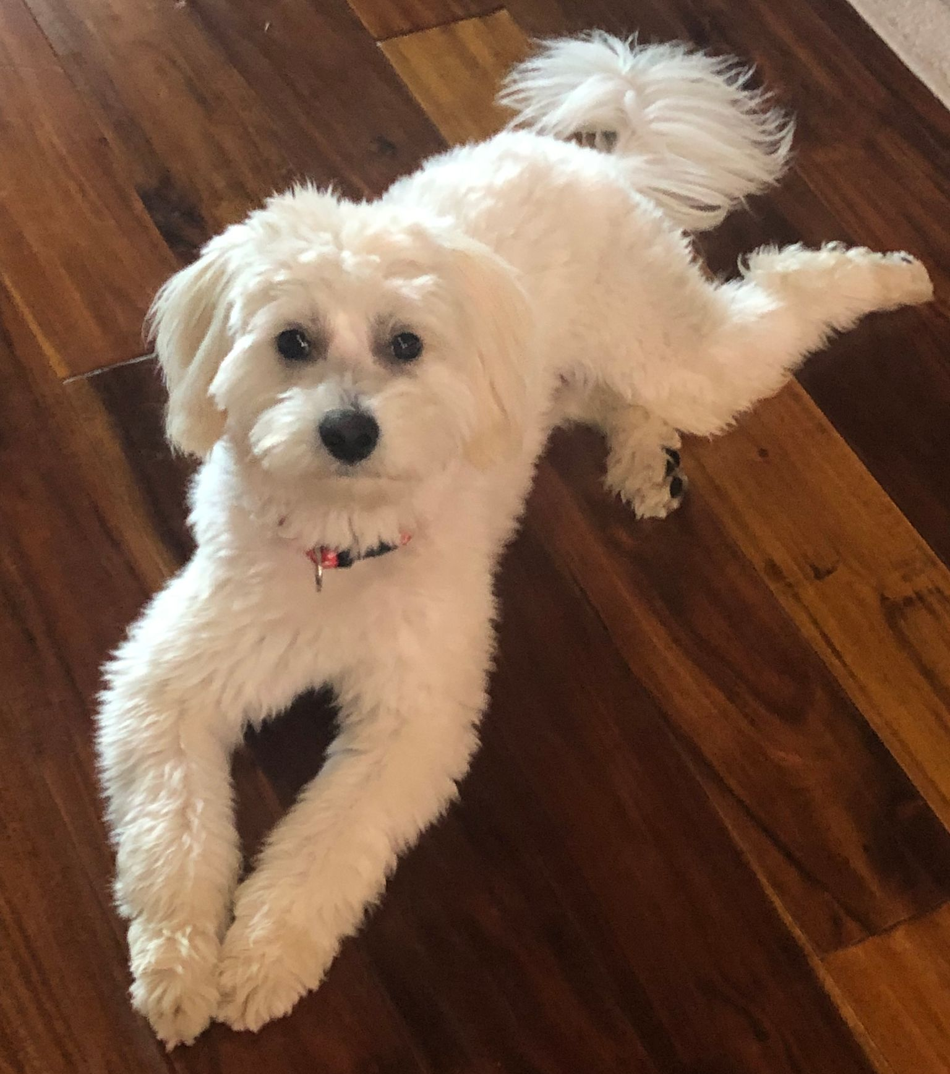
Presenters
Chad Funk, Specialist, Intervention Proposals and Grants
Michelle Pilati, Psychology, Rio Hondo College
  OERI Project Director

Slide 4
Overview
Definitions // What is that?
Deadlines
Fuzzy FAQs
COOL4Ed
The BIG Questions

Slide 5
Definitions
Implementation of a Pathway
Expenditure Report
Spend-Down Plan
Final Report

Slide 6
What does it mean to ”implement a pathway”?
What does it mean to ”implement a pathway”?
“Implementation of a ZTC pathway” means that the first courses in the pathway are available for student enrollment by the required semester, and a student can proceed to complete the full ZTC pathway within two years of full-time enrollment. (Reference – ZTC Program page in the CCCCO website)
  So – Implement a ZTC pathway by Fall 2026 means the student can start the certificate or degree in Fall 2026 and complete within two years (i.e., by Spring 2028)
Notes:
CCCCO Website ZTC Program- https://www.cccco.edu/About-Us/Chancellors-Office/Divisions/Educational-Services-and-Support/burden-free-instructional-materials/zero-textbook-cost-program/

Slide 7
Expenditure Report
The Implementation Grant is a combination of the original Planning Grant and subsequent Implementation Grant ($20K + $180K). All colleges have $200K to report for Implementation Grant.
Accel 1, Accel 2, Impact and OER Expansion Grant(s) totals will vary based upon number of awards received at each institution. ZTC 2025 allocation may be applied to any of these grant phases. The most up-to-date award information is available in the Compendium
Estimations to the end of the 2026 calendar year are allowed for fiscal report. All ZTC phases’ grant funds are to be fully spent or require a spend-down plan.
Notes:
Spend-down plan?

Slide 8
Spend-Down Plan
All funds should be fully expended for Implementation and OER Expansion Grants
Spend-down plans are allowable for Acceleration I, Acceleration II, and Impact grant phases.
Spend-down plans need to outline how remaining funds will be spent with general expense categories and amounts:
  Example:
    Faculty stipends - $25,000
    ZTC Librarian - $50,000
    Accessibility expenses - $10,000
    Marketing to students - $15,000

Slide 9
Final Report
Colleges will be required to first update/verify contacts, then submit and certify that contacts are accurate prior to accessing the ZTC Final Report.
One report will be submitted instead of multiple reports via ZTC grant phase.
Status updates on the report will be comprehensive.
Linked external data sheet will be highly similar to the ZTC 2025 Progress and Expenditure Report format
Space will be provided for special stories, articles or accomplishment that may be included in the ZTC Legislative Report.
Walk through of ZTC Final Report will be provided via the ZTC Final Report Webinar on October 1 at 12pm (noon)

Slide 10
ZTC Deadlines - Past
Fall 2025, Implementation grant program pathways must be implemented and available for student enrollment. (Initial 200K)
December 2025, this is the first progress and expenditure report for the ZTC Acceleration II, ZTC Impact, and ZTC OER Expansion grants in NOVA; this is the second report for the ZTC Implementation Grant and Acceleration Grant expenditure and progress reports in NOVA

Slide 11
ZTC – Deadlines (2026 – 2027)
Fall 2026, ZTC Acceleration, Acceleration II, and OER Expansion grant programs must be implemented and available for student enrollment
January 2027, final ZTC Implementation, Acceleration Grant, Acceleration II, OER Expansion and Impact Grants expenditures and progress reports are due in NOVA; Acceleration, Acceleration II, OER Expansion and Impact Grant funds expenditure deadline.

Slide 12
ZTC – Final Deadline
ZTC programs created exclusively using ZTC 2025 Allocation funds can be implemented up to Fall 2027; however, colleges are to strive to implement all ZTC pathways by Fall 2026.
“Implementation of a ZTC pathway” means that the first courses in the pathway are available for student enrollment by the required semester, and a student can proceed to complete the full ZTC pathway within two years.

Slide 13
Fuzzy FAQs – COOL4Ed
Does the grant require the college to input all courses included in the zero textbook cost degree program pathway into the California Digital Open Source Library? If so, what is the location of the California Digital Open Source Library?
Only open educational resources (OER) created or significantly adapted using ZTC grant funds must have the meta-information inputted into the California Digital Open Source Library course sections located at Cool4Ed.org.
Notes:
.

Slide 14
Fuzzy FAQs – “completed and available”
Can colleges delay implementing a ZTC program pathway that was funded by ZTC program grant funds to after Fall 2026 if more time is needed to complete the development work?
ZTC pathways that were supported by allocation of ZTC program grant funds must be completed and available to students by Fall 2026, per legislative language requirement, with the exception of ZTC pathways that were funded only using ZTC 2025 Allocation funds.

Slide 15
Fuzzy FAQs - Licensing
What licensing requirements apply to OER materials produced using ZTC Degree Grant Program funds?
According to the BOG Procedures and Standing Orders, section 318 (g), “Any published materials produced under an agreement or sub-agreement using public funds must be subject to a Creative Commons Attribution License (CC BY)” (if permissible). But all elements created with ZTC funds must be CC BY.

Slide 16
Why COOL4Ed?
ZTC legislation requires that OER created with ZTC funds be shared via COOL4Ed.
Modifications were made to COOL4Ed to address the needs of the colleges – and to, ideally, make adding to COOL4ED and finding resources easier.

Slide 17

What should be submitted to COOL4Ed?
Notes:
NEW OER.

Slide 18
Submit to COOL4Ed?
Information on resources purchased for student use.
New OER.
Library resources.
Ancillaries for existing OER.
Minor adaptations of existing OER.
Hybrid resources – e.g., library resources + OER

Slide 19
Adoptions and Minor Adaptations
Minor modifications of existing OER should generally not be added to COOL4Ed. If more than 30–50% of the content (by volume or pedagogical impact) is new, restructured, or substantially changed, it is reasonable to consider it a new resource rather than a minor adaptation.
OER that are adapted or remixed with minor changes should be reported to the OERI with an overview of the changes made. Such resources will be made available by the OERI and the OERI will report this information to the CCCCO.
Access the OER Project Update Submission Form
If a bulk upload process is desired and/or you are uncertain as to whether to include your OER in COOL4Ed or via the process referenced here, please contact the OERI for assistance (oeri@asccc.org).
Sharing a modified OER with the OERI will fulfill the reporting requirement for such resources.
Notes:
Submission form link - https://iris24742.softr.app/project-update

Slide 20
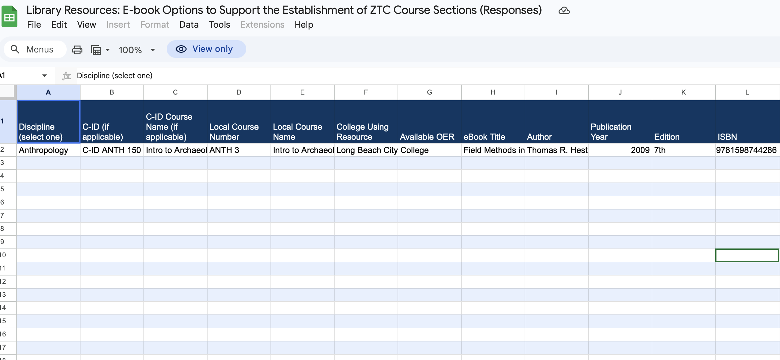
Sharing Library Resources for ZTC
Library Resources: E-book Options to Support the Establishment of ZTC Course Sections (Responses)
Google Form created for submission of library resources.
Notes:
View the form questions (PDF).
Do you have the requested information in a downloadable format? Please email it to oeri@asccc.org instead of submitting this form.
Access responses - https://docs.google.com/spreadsheets/d/1ANPCfT9x87qmXznUAGAAgM6-_sMM-lFRHKeiIzOnl38/edit?usp=sharing
Submit responses - https://docs.google.com/forms/d/e/1FAIpQLSfUjtPxnGbfG0xBEDMxfA6ph-dqosz-YovIErwtnl0dhbXTCQ/viewform?usp=header

Slide 21
Hybrid Resources
What if a faculty member created OER that supplements a library resource?
Is there new OER here – yes.
Is the OER supporting something that could be ZTC – yes.
Important – how do you ensure that the resource is useful for others?

Slide 22
Who’s on the Other End? Making COOL4Ed Submissions Work for the Next Faculty Member
Monday, September 28, 2026 from 10:00 am – 11:00 am
Somewhere out there is a faculty member at another college searching COOL4Ed for exactly what you built. Will they be able to use it? To date, over 110 submissions have been made to the portal, and a review of them reveals how often the answer is no — not because the work is poor, but because the submission does not provide sufficient context for the next person to fully understand what has been provided and how to use it. Join us for a practical look at what makes a ZTC submission genuinely useful and bring your questions.
Register for Who’s on the Other End? Making COOL4Ed Submissions Work

Slide 23
CCC Consortium Commons
Canvas – and Canvas Commons – are not secure environments.
If you submit to the California Community Colleges Consortium Commons – as opposed to the larger Commons, fewer people will have access to your resources.
If you are submitting anything that should not be available to all users, be sure to use this CCC Consortium Commons to limit access.
Notes:
How to available at https://asccc-oeri.org/2026/04/20/cool4ed-the-good-the-bad-and-the-ugly/

Slide 24
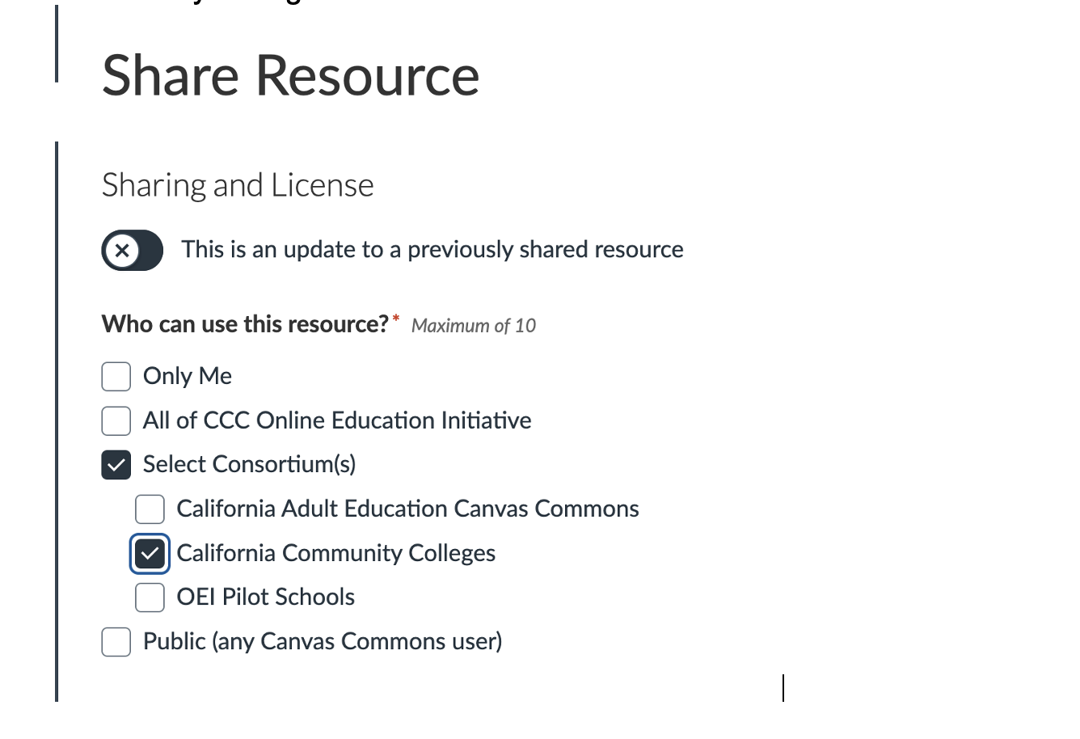
Select Consortium and then California Community Colleges

Slide 25
COOL4Ed Questions
Can colleges share materials to Cool4Ed beyond the reporting deadline? Some projects are still being built with completion dates in December that will then need to be reviewed before uploading to COOL4Ed.
What happens if I should have submitted something to COOL4Ed and I didn’t?

Slide 26
The Big Questions – What if…
…a pathway is not available by the required deadline?
…we simply can’t spend all the money we have?
…we want to fund the creation of a textbook for a course that is not yet part of our curriculum?
…we have had faculty back out and now the promised pathway is not finished – and can’t be?

Slide 27
And…
If we establish our identified pathway(s) and we have funds left over, can we use that money to further our ZTC efforts beyond the identified pathway?
Can our spend-down plan extend beyond the stated deadline?

Slide 28
ZTC Final Report Overview Webinar
tinyurl.com/ZTCFinal
Oct 1, 2026 12:00 PM in Pacific Time (US and Canada)
The ZTC Final Report template is scheduled for release in NOVA on October 2, 2026. All colleges must submit their ZTC Final Report information no later than January 29, 2027. The ZTC Final Report is our last opportunity to collect data from colleges to demonstrate the outcomes and successes of the ZTC Degree Grant Program in the forthcoming legislative report. The Webinar will provide the information and guidance needed to accurately and completely fulfill the ZTC final reporting requirements. Attendees will receive a walk-through of the ZTC Final Report in NOVA, review the external data reporting form, receive guidance on COOL4Ed OER submissions and learn how to report OER adoptions. We encourage OER/ZTC leads, administrators overseeing ZTC efforts, researchers and other contributors to the ZTC Degree Grant Program to attend.
Notes:
https://cccco.zoom.us/webinar/register/WN_rvxjIv7jTM6H4FjV44pw4Q#/registration

Slide 29
ZTC NOVA Reporting Office Hours
tinyurl.com/ZTC-NOVAOH
Friday, October 16 11:30-12:30 pm
Friday, November 6 9:00-10:00 am
Friday, November 13 10:00-11:00 am
Friday, December 4 9:00-10:00 am
Friday, December 11 11:00-12:00 pm
Notes:
https://cccconfer.zoom.us/j/4912833340

Slide 30
And to Contact Us…
How to contact Chad:
  cfunk@cccco.edu
General OERI E-Mail:
oeri@asccc.org

