Slide 1
Welcome!
On behalf of the ASCCC OERI, we are pleased to have you here with us
If you are not already muted, please mute upon arrival.
Please note that you are encouraged to use the Zoom “chat” feature for questions and comments.
You’re invited to introduce yourself in the chat – please provide your name, college, discipline/role
This event will be recorded. Archives of all ASCCC OERI events are available at asccc-oeri.org > Webinars and Events

Slide 2
Open Educational Resources (OER) for Anthropology –
New Resources and the State of the Discipline
OERI-DL Webinar, Thursday 9/10/2026, 12:30-1:30pm
Creative Commons license (This work is licensed under a Creative Commons Attribution 4.0 International License.)

Slide 3
Webinar Overview
As of Fall 2026, most new pathways funded with Zero Textbook Cost (ZTC) Degree Program dollars are required to be implemented and many colleges have added new resources to COOL4Ed as required by the ZTC legislation.
Join us for an overview of newly available anthropology OER, to share what OER you’re working on, and/or to discuss your unmet OER needs.

Slide 4
Presenter
Lara Braff, Ph.D.
  Anthropology Professor and Co-chair of Behavioral Sciences, Grossmont College
  OERI Discipline Lead (DL) for Anthropology and DL Co-coordinator

Slide 5
Outline
State of Anthropology OER
  Resources by TMC
New resources
  ZTC Grant Projects on Cool4Ed
Unmet needs? Forthcoming work?
  Discipline survey

Slide 6
ANTH OER by C-ID and TMC
ASCCC-OERI: OER by C-ID and Transfer Model Curriculum (TMC)
Required Core (C-ID):
  ANTH 120 – Intro to Cultural Anth
  ANTH 110 (C1001) – Intro to Biological Anth
  ANTH 115L (C1001L) – Biological Anth Lab
  ANTH 150 – Intro to Archaeology
List A, B, C
  List A includes ANTH 130 (Linguistic Anth)
  List B can include Anth specialty courses and regional courses
  List C includes Lists A and B; philosophy of science, geology, anatomy, earth science, GIS
Notes:
https://asccc-oeri.org/open-educational-resources-and-anthropology/
https://asccc-oeri.org/oer-and-the-anthropology-transfer-model-curriculum/

Slide 7
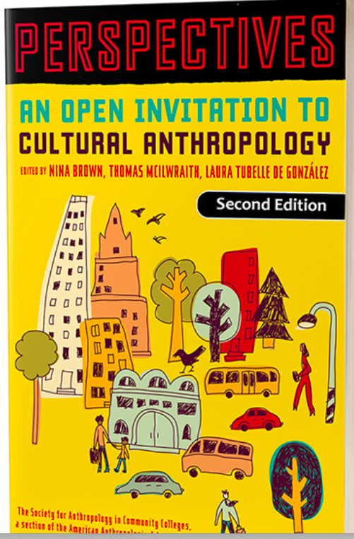
Cultural Anth
(ANTH 120)
Introduction to Anthropology: A Four Field Approach (Edited by Pawlowicz; Brooks; Phaup; and Rector) (CC-BY-NC)
Introduction to Anthropology (Hasty, Lewis, and Snipes, 2022) – OpenStax (CC BY)
Introduction to Anthropology: Holistic and Applied Research on Being Human (Palmiotto, Homsey-Messer, Ford, Poole, Adams, Allard, and Chadwick, 2022) (CC BY-SA)
Cultural Anthropology (Saneda and Field, 2020) – LibreTexts (CC-BY-NC-SA 3.0)
Perspectives: An Open Invitation to Cultural Anthropology, 2nd Edition (Brown, Tubelle de Gonzalez, and McIlwraith – American Anthropological Association, 2020) (CC-BY-NC 4.0)
The Art of Being Human: A Textbook for Cultural Anthropology (Wesch – New Prairie Press, 2018) (CC-BY-NC-SA 4.0)

Slide 8

Biological Anth
(ANTH 110/C1001)
Introduction to Anthropology: A Four Field Approach (Edited by Pawlowicz; Brooks; Phaup; and Rector) (CC-BY-NC)
Explorations: An Open Invitation to Biological Anthropology Second Edition (Shook, Nelson, Braff, and Aguilera – American Anthropological Association, 2023) (CC BY-NC)
Biological Anthropology: A Brief Introduction (Saneda and Field, 2022) (CC-BY-NC-SA)
Introduction to Anthropology (Hasty, Lewis, and Snipes, 2022) – OpenStax (CC BY)
Introduction to Anthropology: Holistic and Applied Research on Being Human (Palmiotto, Homsey-Messer, Ford, Poole, Adams, Allard, and Chadwick, 2022) (CC BY-SA)
Introduction to Physical Anthropology (Schoenberg, 2021) (CC BY-NC)

Slide 9
Biological Anth Lab
(ANTH 115L/ C1001L)
Introduction to Biological Anthropology – Online Lab Course (Neff, 2025) (CC-BY-NC)
Calculations and Palpations (Taylor-Hill, 2025) (CC BY-NC-SA)
Explorations: An Open Invitation to Biological Anthropology – Lab Manual (Shook, Nelson, Braff, and Aguilera – American Anthropological Association, 2021) (CC BY-NC 4.0)
General Biology Labs (Burran and DesRochers, 2015) – LibreTexts (CC-BY-NC-SA 3.0)
Biological Anthropology – Laboratory Activities (Taub, 2010) – LibreTexts (CC BY-NC-SA)

Slide 10
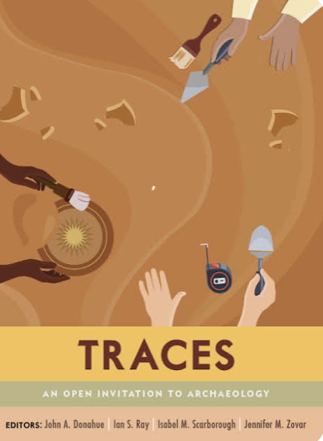
Archaeology OER
Introduction to Anthropology: A Four Field Approach (Edited by Pawlowicz; Brooks; Phaup; and Rector) (CC-BY-NC)
Traces: An Open Invitation to Archaeology (Donahue, Ray, Scarborough, and Zovar – Whatcom Community College, FORTHCOMING) (CC BY)
Archaeology (Ruth, 2023) – LibreTexts (CC BY-NC-SA)
Digging into Archaeology: A Brief OER Introduction to Archaeology with Activities (Paskey and Cisneros, 2020) – LibreTexts (CC BY-NC)
Introduction to Archaeology: A Workbook (Lemke, 2020) – LibreTexts (CC BY-NC-SA)

Slide 11
Other Courses
Linguistic Anthropology:
  Languages and Worldview (Allard-Kropp, 2024) (CC BY-NC-SA 4.0)
  Essentials of Linguistics, 2nd Edition (Anderson et al., 2022) (CC BY-NC-SA 4.0)
Anthroplogy of Magic, Witchcraft, Religion
  Beliefs: Anthropology of Magic, Witchcraft, and Religion

Slide 12
CCCCO ZTC Grants
2021 Budget Act appropriated $115 million in one-time funding to the California Community Colleges for the Zero-Textbook-Cost Degree Grant (ZTC) program
  Develop and implement ZTC degrees, while prioritize Open Educational Resources (OER) as the preferred way to reduce college costs for students
  Three phases of ZTC grant opportunities
Legislation mandated sharing of grant-funded resources on Cool4Ed

Slide 13
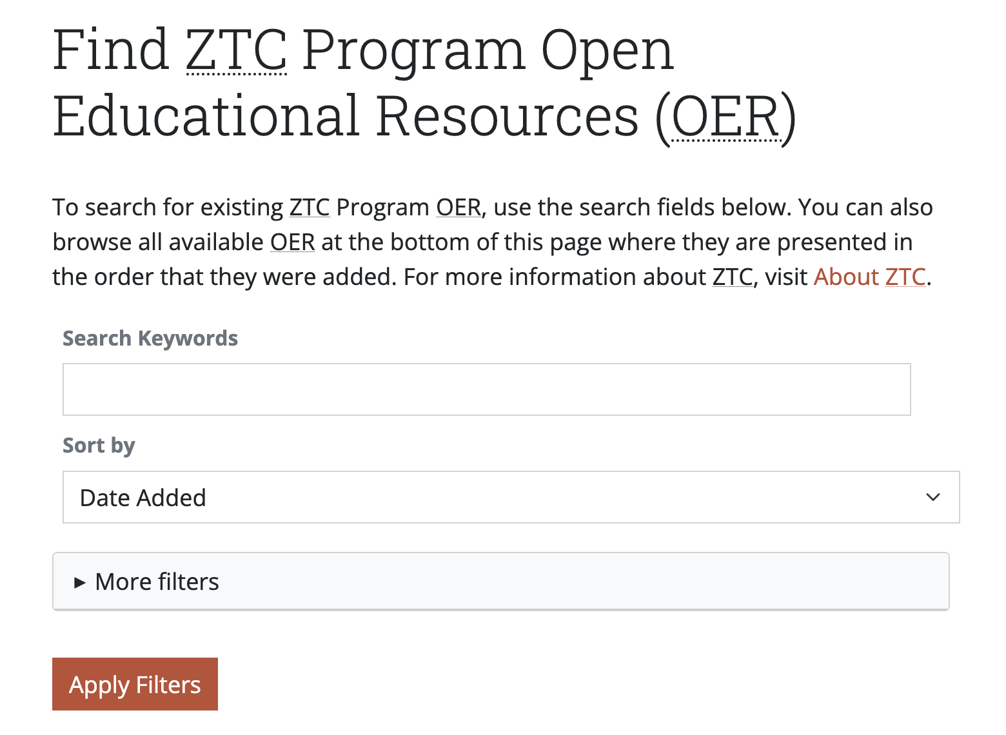
ZTC Grants and Cool4Ed
COOL4Ed was revised to meet needs of the colleges and make adding to COOL4ED and finding resources easier.
Indicate which resources were created with ZTC funds
C-ID and Cal-GETC areas
Limited formats (for accessibility)
License (CC BY) to promote sharing
New ancillaries

Slide 14
Adaptations
Minor modifications of existing OER should not be added to COOL4Ed.
  If more than 30–50% of content (by volume or pedagogical impact) is new, restructured, or substantially changed, it could be considered a new resource rather than minor adaptation.
OER that are adapted or remixed with minor changes should be reported to the OERI, describing the changes. Such resources will be made available by the OERI and reported by the OERI to the CCCCO.
  Sharing a modified OER with the OERI fulfills the reporting requirement

Slide 15
What’s New for ANTH on Cool4Ed?
Five ZTC grant-supported resources
  MiraCosta (3); Orange Coast College (2)
  Canvas Commons courses
Evolution of Human Behavior
Bio Anth Lab
Linguistic Anthropology
Native American Cultures

Slide 16
Evolution of Human Behavior (Drake Rinks)
Canvas Commons; CC-BY, except where noted
  Not all resources are widely available (links to MIRACOSTA LIBRARY) Evolution of Human Behavior (Drake Rinks)
Resource Description: This Evolution of Human Behavior course explores the biological basis and evolutionary value of human behavior. Students explore current research in genetics and epigenetics, neuroanatomy and endocrinology, along with studies of human culture and animal behavior, to understand phenomena such as human emotions, personality, parenting strategies, mating behaviors, and lifetime responses to stress.
The course does not use a single textbook draws from journals, magazines, websites, and media. Each module focuses on a particular topic and contains:
  Lecture Outline
  Reading Discussions
  Media Discussions
  Lecture Quizzes
  Projects (only in some modules)
Notes:
Several readings cannot be accessed: Students at MiraCosta College have access to the following reading through the library's subscription to EBSCO, JSTOR, and GALE.

Slide 17
Biological Anthropology Labs & Discussions
(Rolland and Chan)
Canvas Commons; CC BY 4.0.except where notedBiological Anthropology Labs & Discussions
Resource Description: These Biological Anthropology Laboratory materials are designed to accompany the Biological Anthropology course. This laboratory allows students to garner practical experience with the scientific method, genetic models, simulations of evolutionary processes, primate skeletal anatomy, primate behavior and ecology, human osteology, human variation, and casts and artifacts representing selected stages in human evolution.
Materials include:
  Instructor-Created Lab Activities (Instructions and Student Worksheets)
  Curated Labs from American Anthropology Association's Explorations (CC BY-NC 4.0)
  Online Assignments
  Projects
Notes:
Intended to be modular; instructor to provide lectures and context. Online lab?

Slide 18
Introduction to Linguistic Anthropology (Zeoli)….
Not available?
Resource URL (Canvas Course; CC BY-NC-SA
  https://ecampusontario.pressbooks.pub/essentialsoflinguistics2/
Resource Description: This instructional material brings together open educational resources to introduce students to the foundational concepts of linguistic anthropology. Developed in the spring of 2026, the course material uses Essentials of Linguistics (2nd Edition) via Pressbooks. as its core foundation, supplemented by curated open-access modules from LibreTexts. By utilizing zero-cost materials, this course introduces students to the scientific study of language structure, language acquisition, and the complex ways language intersects with cultural identity, institutional power, and social structures. The primary objective is to cultivate critical thinking regarding communication while providing an equitable, accessible learning experience for all students
Notes:
Accessibility? PPTX lectures

Slide 19
Introduction to Native American Cultures (Zeoli)
Canvas Commons; Mixed license
Resource URL: Introduction to Native American Cultures (Zeoli)
Resource Description: This curated zero-textbook-cost (ZTC) framework offers a comprehensive introduction to the diverse histories, cultures, and contemporary experiences of Native American societies. Moving away from traditional, costly commercial texts, this course relies on peer-reviewed articles from the Orange Coast College Library Databases alongside verified open-source, culturally responsive websites. This approach allows the curriculum to remain highly flexible, current, and deeply engaged with indigenous perspectives, focusing heavily on issues of representation, sovereignty, and social justice.
Notes:
Accessibility? Adoptability?

Slide 20
Gaps? Works in Progress?
What OER gaps remain for ANTH? What are our main needs?
Works in progress?
  Cultural Anthropology OER Reader?
  Other specialty courses?
Discipline Surveys – forthcoming!

