Slide 1


Welcome OER Liaisons!
On behalf of the ASCCC OERI, we are pleased to have you here for one of our term “kick-offs” for new OER Liaisons.
If you are not already muted, please mute yourself upon arrival. As this is set up as a meeting, we will be able to have an actual discussion – but we need all those who are not speaking to be muted.
You are also encouraged to use the “chat” feature.

Slide 2
ASCCC OERI Fall 2026 OER Liaison Kick-Off
Revised August 23, 2026.
This work is licensed under a Creative Commons Attribution 4.0 International License.
Attribute this slide deck as: "ASCCC OERI Fall 2026 OER Liaison Kick-Off" by ASCCC OERI is licensed under CC BY 4.0.

Slide 3

Overview
OER Liaison Basics
Goal-Setting
Updates
OERI and You
Photo by Markus Spiske on Unsplash

Slide 4
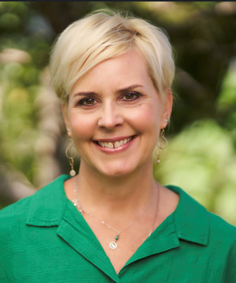
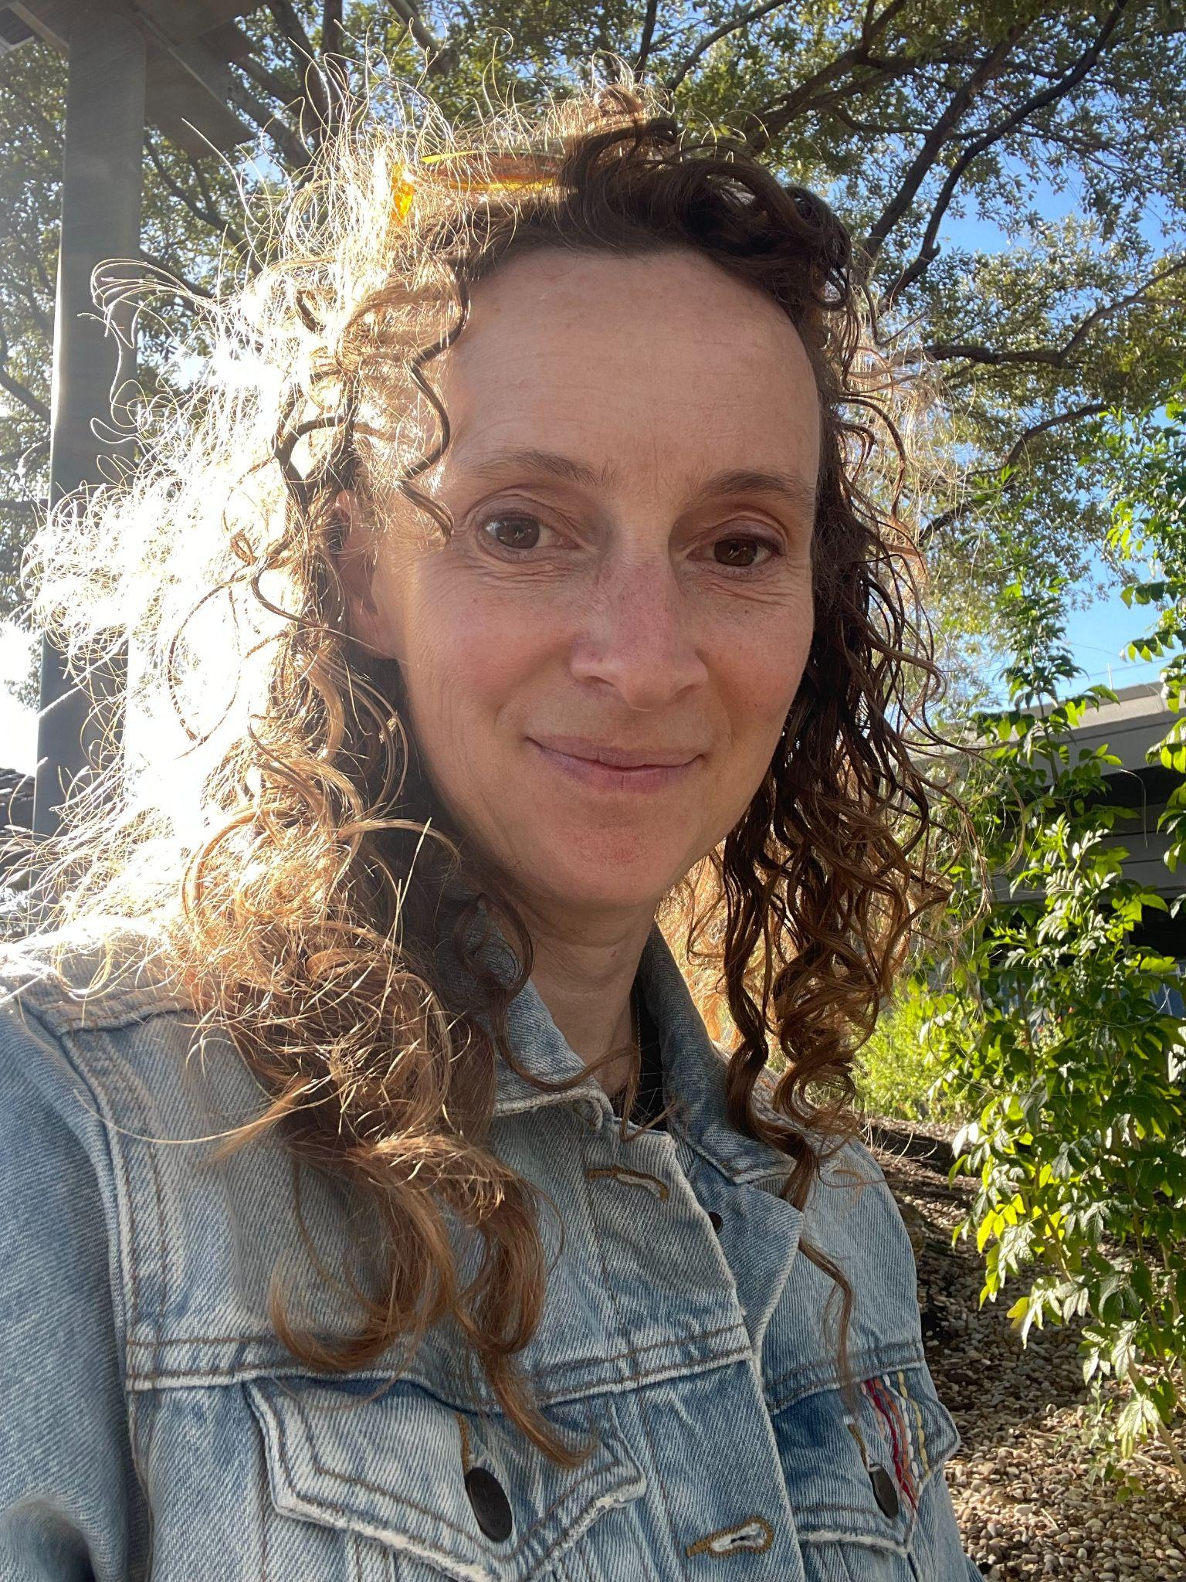


OERI Regional Leads
Andi Adkins Pogue (Area A; New!)
Library, Cosumnes River College
Heather Dodge (Area B; Returning)
Library, Berkeley City College
Kevin Smith (Area C)
Psychology, Rio Hondo College
Rachel Fleming(Area D)
Library, Irvine Valley College

Slide 5
OERI Personnel
Project Director
  Michelle Pilati – Psychology, Rio Hondo
Discipline Lead Coordinators
  Lara Braff - Anthropology, Grossmont
  Julie Bruno - Communication Studies, Sierra
OERI ADAPT Lead
  Cristina Moon - Spanish, Chabot
OERI LibreTexts Lead
  Shagun Kaur - Communication Studies, De Anza
Staff Support
  Amy Liao, OERI Program Specialist

Slide 6
OERI Personnel (Continued)
Accessibility Lead
  Suzanne Wakim – Biology, Butte
Artificial Intelligence Lead
  Elizabeth (Liz) Encarnacion – Communication Studies, Chaffey
Communication Lead
  Julie Bruno – Communication Studies, Sierra
Distance Education Lead
  Amanda Taintor, Instructional Design - Reedley
IDEA Framework Lead
  TBD

Slide 7
Stay Informed
As an OER Liaison, you will be on the OERI and the OER Liaison Newsletters. You may wish to forward the OERI Newsletter to your college community. The OERL Newsletter:
  Contains information intended just for OERLs (and general information)
  Typically distributed before the OERI Newsletter
Discipline Listservs – encourage your colleagues to sign up
Canvas Course
Notes:
OERI Listserv – you’re expected to sign up for it. This will provide you with the general newsletter – which you might choose to forward (as opposed to creating your own message on from the OERL one). You should also consider signing up for your discipline listserv – and you should encourage your faculty to as well.

Slide 8
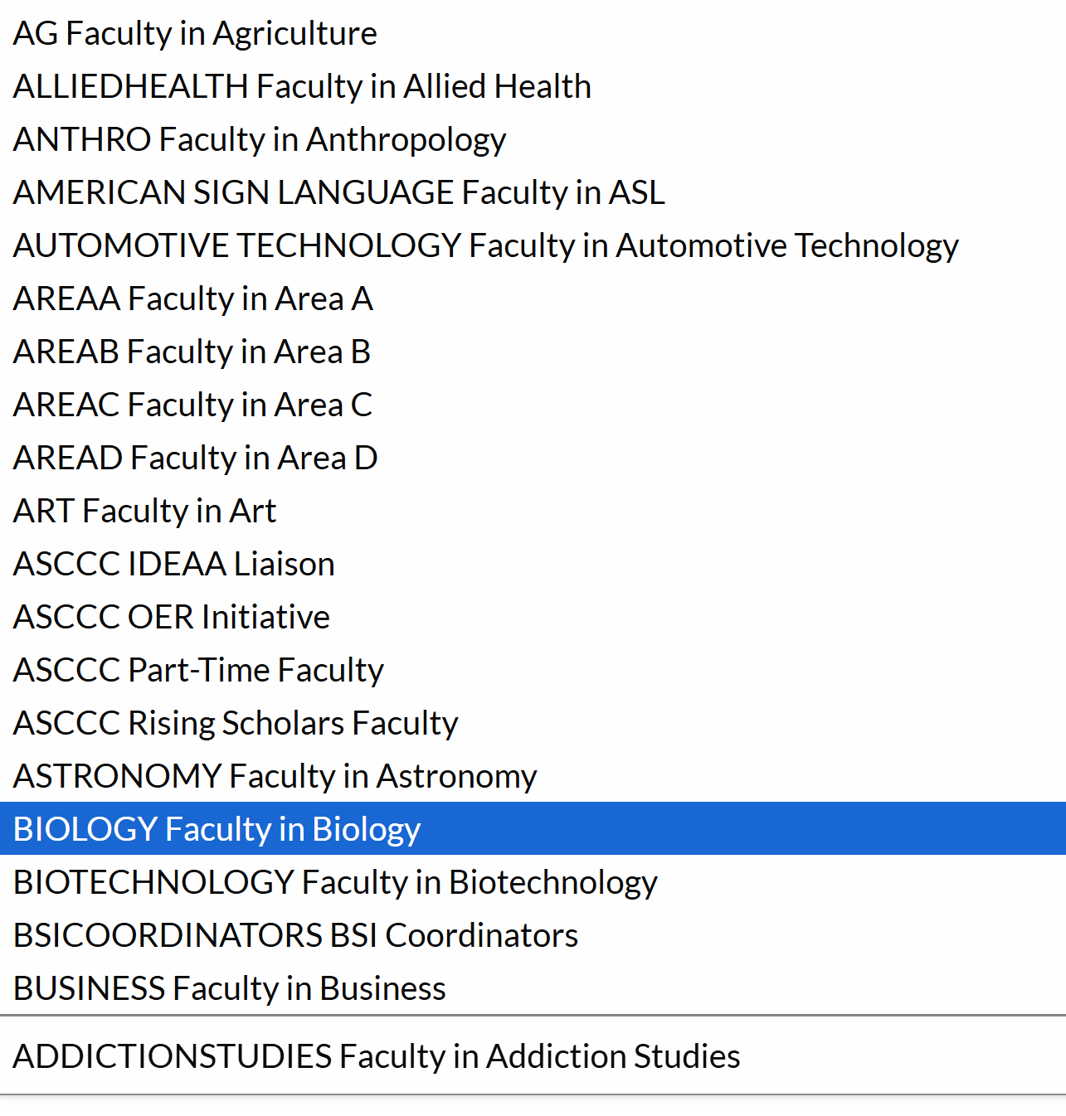
ASCCC.org > Resources
Subscribe to Listservs > https://www.asccc.org/resources
Notes:
Discipline list-servs are used for discipline-specific communications – recruiting Discipline Leads, sharing new resources, matchmaking for projects, etc.

Slide 9
Discipline Listservs
One-way
More important than ever…
  Course Identification Numbering System (C-ID)
  Common Course Numbering (CCN)
  Transfer Model Curriculum (TMC)
  COOL4Ed
  Discipline-specific opportunities
  OERI opportunities and recruitment

Slide 10

Canvas Course
Although we are no longer adding content to the course, we do use it for communication – and we populate its calendar with our events.
Self-enroll at: https://ccconlineed.instructure.com/enroll/7RJL33
"Enrollment" is necessary to receive communications.
Direct access via: tinyurl.com/ASCCC-OpenEd

Slide 11
ASCCC-OERI.org
  Your go-to for everything (we hope)
  Updated regularly
  Archives of webinars and newsletters
  Curated Collections – by discipline, TMC, GE
  OER and ZTC - tinyurl.com/OER4ZTC
    Everything available can be found under “The ZTC Degree Program”
    Scroll to the bottom of the main page for information on existing ZTC pathways

Slide 12
The OERI Website
If you think something should be there, it probably is…
But that does not mean that you can find it.
We will be exploring ways to improve the site.

Slide 13

OERI’s Goal?
Increase the use of open educational resources in lieu of commercial texts by all reasonable means available.
Photo by Markus Winkler on Unsplash

Slide 14
Increase OER Use By…
Increasing awareness
Increasing the availability of high-quality OER
Making the adoption of OER easier
Showcasing and providing professional development related to openly-licensed tools (e.g., Discuss-It) and opportunities created by using OER
Supporting you to help your faculty join us…
Notes:
Opportunities created by using OER - bots, study buddies, use of AI to create ancillaries…

Slide 15
Fall 2026 OERL Expectations
Complete – and document – your Fall 2026 OER Liaison “attendance” activities (column F, J, and K) by Wednesday, December 9. Activities should be tracked throughout the term via the Fall 2026 Liaison Tracking Spreadsheet (tinyurl.com/OERL-2026f)
Communicate with your local senate and faculty regarding the work of the OERI (column L), forwarding the OERI Newsletter broadly and reaching out to specific faculty and departments as warranted (column M).
Document and/or refine your goal(s) by October 16 (column G and H) in consultation with your Regional Lead. Your Regional Lead will contact you with more information
Notes:
We add you to the listserv it you are not on it already.

Slide 16
Expectations (continued)
Attend an OER Liaison Spring 2026 Kick-Off. ✔️
Attend two additional OERI Webinars or OERL Conversations during the term, or host one. Experienced OERLs are strongly encouraged to consider hosting.
Check-in at least twice with an OERI representative to share local needs and issues.

Slide 17

Important
You are our connection to your college.
If you are not able to push communications to your college community as needed, please contact your Regional Lead for assistance.
Photo by Will O on Unsplash

Slide 18

Goal-Setting
Photo by Clay Banks on Unsplash
Notes:
Why we have introduced goal-setting – OERLs are at many levels. Some are new – some have been doing the work for years. This is an opportunity for the OERI to work with OERLs to help them achieve their goals.

Slide 19

Setting Your OERL Goals
Set two new goals
  Goals may be for the semester or the year
Document them in the Fall 2026 tracking spreadsheet
  By October 16 (ideally, you do this even earlier)
Discuss your goals with your regional lead if needed
Image created with Canva under their education license.

Slide 20

Sample Goals
Outreach
  Approach departments hesitant to adopt OER with tailored resources that address their specific concerns or curriculum needs.
Professional Development
  Attend OERI discipline-specific webinars outside your field to discover cross-disciplinary OER opportunities for your college.
Strategic Planning
  Develop a college-specific OER adoption roadmap with measurable milestones for the academic year.
"bullseye" by emiliokuffer is licensed under CC BY-SA 2.0.

Slide 21

Updates
Photo by Jamie Haughton on Unsplash

Slide 22
A New Era for OERI
Same OERI, but collaborating more purposefully with the California Community Colleges Chancellor’s Office (CCCCO) and LibreTexts
Why?
OERI is now funded with ZTC dollars and, consequently, the level of oversight by the CCCCO has increased.
What does this really mean?
Notes:
Add animation - click for each bullet to appear

Slide 23
The OERI will continue to:
Increase use and awareness of OER
Assist faculty in identifying, adopting, adapting and sustaining OER in their courses
Drive, highlight, and scale effective OER practices and models across colleges and regions
Develop and prioritize college and systemwide OER strategies that benefit disproportionately impacted students and reduce course materials cost
Notes:
This is the list of annual deliverables in our contract with the CCCCO. The only thing that is somewhat different is the idea of thinking bigger - helping colleges to do things - as opposed to working exclusively with faculty to effect change.

Slide 24
Measurable Outcomes
Engage in activities to support the CCCCO goal of colleges reaching 70% of all course sections in the system using OER.
Ensure 100% of ADTs that have been in existence for over two years can be completed exclusively using OER.
Ensure all Cal-GETC areas are supported with relevant, utilized OER for the highest-enrollment courses per area.
Ensure 100% of CCN courses that have been in existence for more than two years are supported with relevant, utilized OER.
Employ mechanisms to identify the OER most used at colleges, in high-enrollment subject areas and courses, to determine the highest-impact courses where formal OER reviews and resource development will provide the greatest benefit.
Excluded from the above “100%“ goals are those courses that are simply not able to use OER.
Notes:
Excluded from these 100% goals are those courses that are simply not able to use OER.

Slide 25
Measurable Outcomes (continued)
Identify academic programs and courses that have OER gaps with special attention to courses that are difficult to convert and work towards converting them.
Recruit faculty to create OER texts and ancillaries for identified OER gaps in academic programs and courses for the purpose of removing barriers to OER conversion.
Support integration of LibreTexts as the OER platform for 100% of CCCs by developing hands-on training for OER within the platform, engaging in platform use advocacy and publishing new high-quality materials developments as they become available to the field.
Actively pursue and promote opportunities to integrate artificial intelligence (AI) into OER design and materials to increase accessibility, maintenance, utility and innovation.
Identify, collect, analyze and utilize relevant data points through collaboration with stakeholders including student perspectives of OER and publish in an annual report

Slide 26
Impact to Date?
Revising aspects of the work of the Discipline Leads (DLs)
  The importance of accurate adoption data and identification of needs has increased.
  The CCCCO would like for OERI to publish a complete calendar of events for the term at the start of the term - an impossible ask when working with approximately 40 DLs. A compromise? Scheduling webinars in discipline clusters and striving to schedule them earlier.
  DLs were already going to be tasked with reviewing COOL4Ed submissions.
  Discipline surveys are coming….
Discussions about how we can best support colleges.
And how we can benefit from working with the CCCCO on communications.

Slide 27
COOL4Ed
Critical that those submitting resources to COOL4Ed have end-users in mind - not just compliance.
Library resources don’t belong in COOL4Ed.
Minor modifications don’t belong in COOL4Ed.
Learn more at:
  OERI Friday Forum
    Friday, September 18, 10:30 am – 11:30 am
    ZTC Reporting and COOL4Ed: What You Need to Know
  OERL Webinar
    Monday, September 28, 10:00 am – 11:00 am
    Who's on the Other End? Making COOL4Ed Submissions Work for the Next Faculty Member

Slide 28
EOPS Vouchers
Chancellor’s Office: Allowing EOPS vouchers for “recommended” titles is a local decision
Problem: ZTC courses with a recommended (not required) text can create barriers for EOPS students if they’re only allowed to use vouchers for required materials
OERI is bringing a Fall Plenary resolution to encourage colleges to allow EOPS vouchers for recommended instructional materials

Slide 29

Learning LibreTexts/ADAPT
ASCCC OERI: LibreTexts Basics and Beyond Canvas Course
  Self-paced course is available for local adoption.
ASCCC OERI: ADAPT Basics and Beyond Canvas Course
  Modifications based on pilot are being implemented.
  Self-paced course to be available for local adoption by the end of September.
Interested in hosting an in-person LibreTexts/ADAPT training in Spring 2027? Please let us know ASAP.
Upcoming Regional Meetings - Introduction to Remixing and Open Homework Systems
  October 2 - San Diego
  October 23 - Monterey
Notes:
Why host? Learn about LT and inform its development. Last fall, Cosumnes River College and Rio Hondo hosted the in-person LT/ADAPT training with great success.
Online Teaching Conference pre-conference workshop:
https://onlineteachingconference.org/pre-conference-workshops/

Slide 30
We Need Your Feedback
This is a reminder to facilitators to launch the Zoom poll to gather attendee feedback about this session.

Slide 31

Thanks!
Photo by Thgusstavo Santana from Pexels

