Slide 1
Open Education Resources for Political Science
Friday, September 11, 2026

Slide 2
Welcome and Introductions
Josh Franco, Cuyamaca College, ASCCC OERI POLS Discipline Lead 2026-2027
Charlotte Lee, Berkeley City College
Norma Durian, San Bernardino Valley College
Erin Richards, Cascadia College (WA state)
Helen Chang, CUNY Hostos CC (NYC)
Ryer, Foothill College

Slide 3
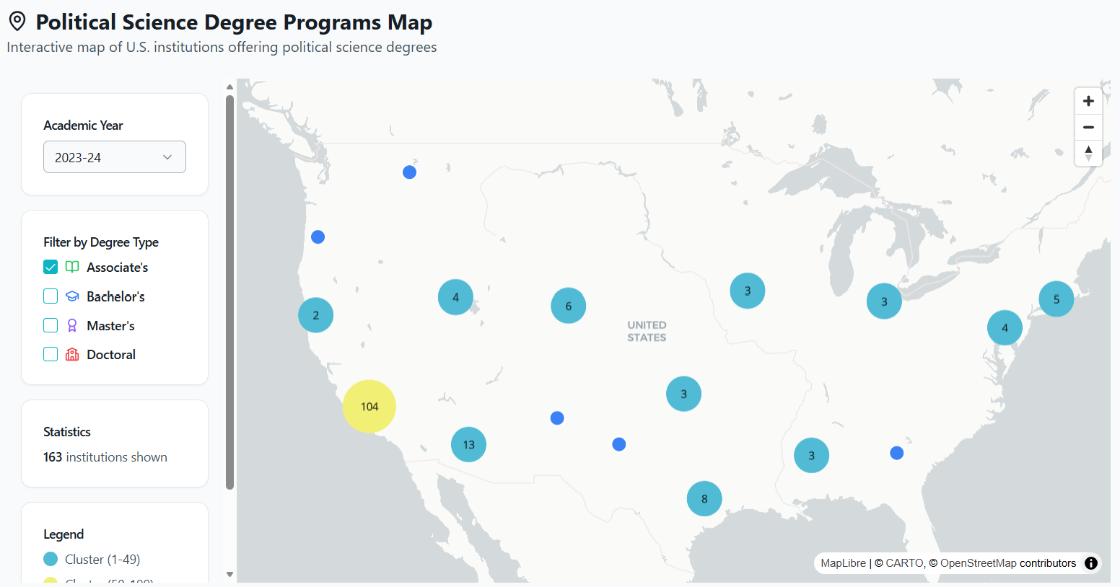
Political Science Degree Programs Map

Slide 4
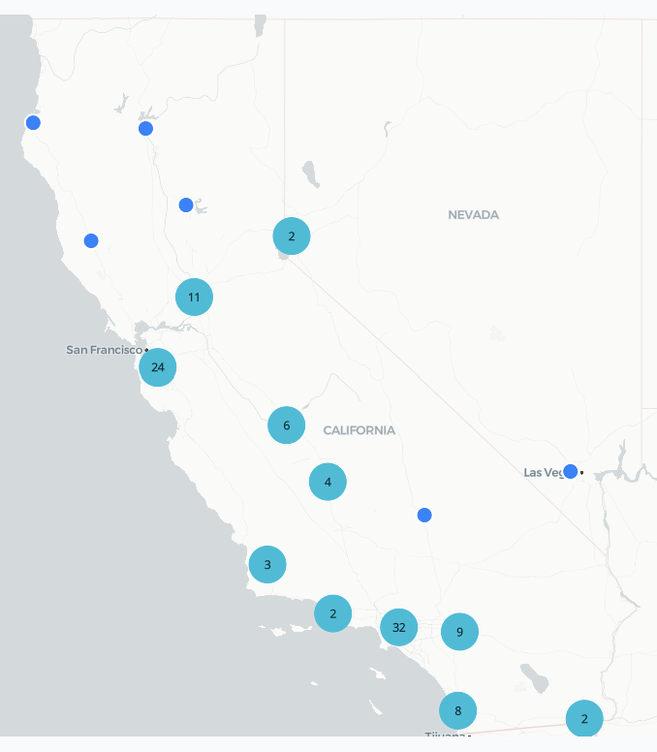
Political Science Degree Programs Map (2)

Slide 5
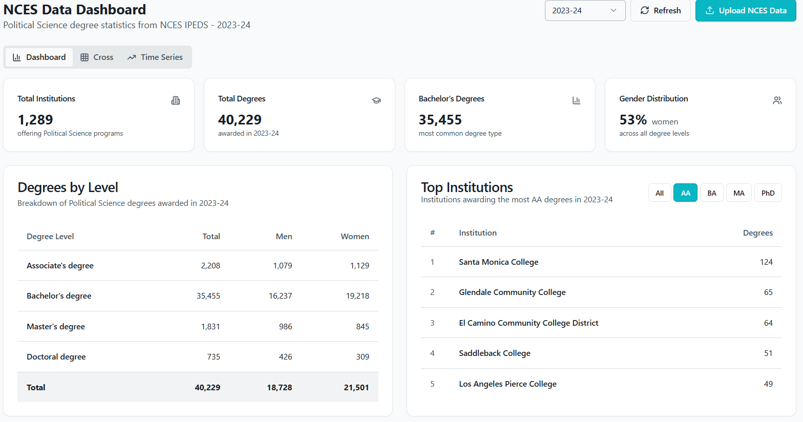
NCES Data Dashboard

Slide 6
C-ID Course Descriptors
POLS 110 Introduction to American Government and Politics
POLS 120 Introduction to Political Theory and Thought
POLS 130 Introduction to Comparative Government and Politics
POLS 140 Introduction to International Relations
POLS 150 Introduction to Political Science
POLS 160 Introduction to Political Science Research Methods
POLS 170 Introduction to the Politics of Race and Gender

Slide 7
POLS 110 Introduction to American Government and Politics
Toward a More Perfect Union: An Introduction to U.S. Government and Politics - Social Sci LibreTexts
American Government 4e (OpenStax)
  American Government 4e Audiobook
Interested in making OER?
  Josh

Slide 8
POLS 120 Introduction to Political Theory and Thought
Political Philosophy Reader by Noah Levin

Slide 9
POLS 130 Introduction to Comparative Government and Politics
Introduction to Comparative Government and Politics (Bozonelos et al.)
A Casebook for Comparative Politics

Slide 10
POLS 140 Introduction to International Relations
(New) Introduction to International Relations edited by Katherine Michel

Slide 11
POLS 150 Introduction to Political Science
Introduction to Political Science by Rom, Hidaka, and Walker (OpenStax)

Slide 12
POLS 160 Introduction to Political Science Research Methods
Introduction to Political Science Research Methods (LibreTexts)POLS 160 Introduction to Political Science Research MethodsIntroduction to Political Science Research Methods, 2nd Ed. | Free OER

Slide 13
POLS 170 Introduction to the Politics of Race and Gender
Ryer et al (Politics of Race, Gender, and Sexuality), coming soon end of 2026

Slide 14
Other POLS courses and OERs
Women in Politics?
Generic state and local government book?
  Introduction to California Government and Politics (Reti)
  Texas Government
  State and Local Government, 3rd Edition by Simon, Steel, and Lovrich
Zero Textbook Cost (ZTC) — No-Tech Political Science Simulations | SimCapitol
Council on Foreign Relations Education – lots of resources, web interactives, and simulation material for Introduction to International Relations classes especially
OER library for political science – maintained by the ASCCC

Slide 15
Ideas
Spreading word about your OER
Pool of OER peer reviewers
Positioning POLS as ASCCC supported sustainability
APSA Educate Board
APSA Educate
“community college” Search – APSA
Open Educational Resources and Political Science - ASCCC Open Educational Resources Initiative

Slide 16
Future Conferences
APSA Teaching and Learning Conference February 5-7, 2027 in Portand, OR
Western Political Science Association Conference March 25-27, 2027 in Denver, CO https://www.wpsanet.org/
APSA Annual Conference September 2-5, 2027 Washington, DC
  https://apsanet.org/events/annual-meeting-exhibition/

