Slide 1
Back to Basics: Open Educational Resources (OER) / Zero Textbook Cost (ZTC) 101
by Heather Dodge CC BY 4.0; October 5, 2026
adapted from Creative Commons, Copyright, and Fair Use – Why do we need OER? by Rachel Arteaga, Shagun Kaur, & Suzanne Wakim; CC BY 4.0
Notes:
Are you new to OER and interested in learning more? This webinar is an introduction to what OER is and the difference between “open" and "free" resources, copyright basics, and the concept of fair use.

Slide 2

Presenters
Presenter: Heather Dodge, ASCCC Regional Lead (Area B)
  Librarian, Berkeley City College
Chat Monitor: Andi Adkins, ASCCC Regional Lead (Area A)
  Librarian, Cosumnes River College
Photo by Siora Photography on Unsplash
Notes:
Presenters can be included following the description or the overview. Where images are used, they should include an attribution (Photo by…) and appropriate alternative text should be used (or the image marked decorative).

Slide 3
Agenda
What we are talking about when we talk about OER and ZTC (and LTC)
Fair Use (and its place in OER)
Copyright
Public Domain
California-specific: ZTC vs. OER
Attribution vs. Citation

Slide 4
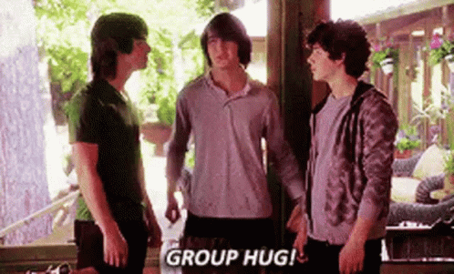
What we talk about when we talk about OER, ZTC, & LTC
Three siblings:
Open Educational Resources (OER)
Zero Cost Textbooks (ZTC)
Low Textbook Cost (LTC)

Slide 5
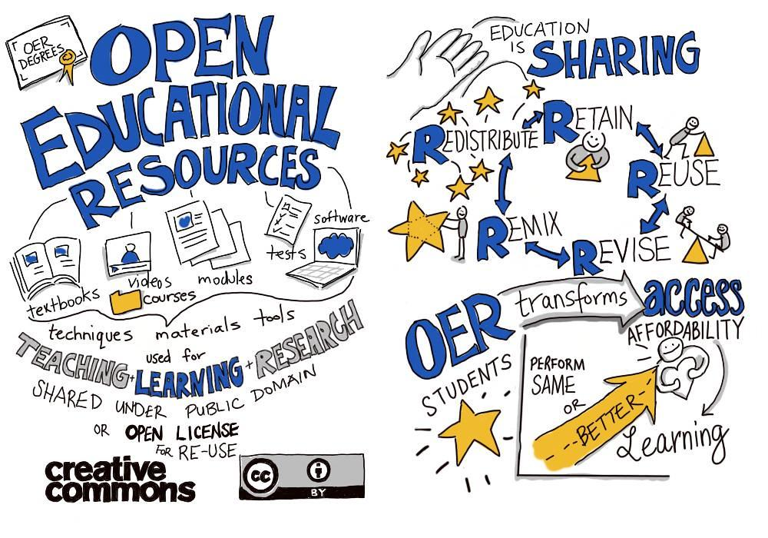
What are Open Educational Resources?
“OER are teaching, learning, and research resources that reside in the public domain or are released under an intellectual property license that permits their free use and repurposing by others”
–Hewlett Foundation
Notes:
Carolyn

Slide 6
The 5R Permissions of OER
Retain - Make and own copies
Reuse - Use in a wide range of ways
Revise - Adapt, modify, improve
Remix - Combine with other sources
Redistribute - Share with others
The framework, freely available under a Creative Commons Attribution 4.0 license (CC BY), was designed by Lumen Learning as the 5Rs
Notes:
About the Licenses: https://creativecommons.org/share-your-work/cclicenses/

Slide 7


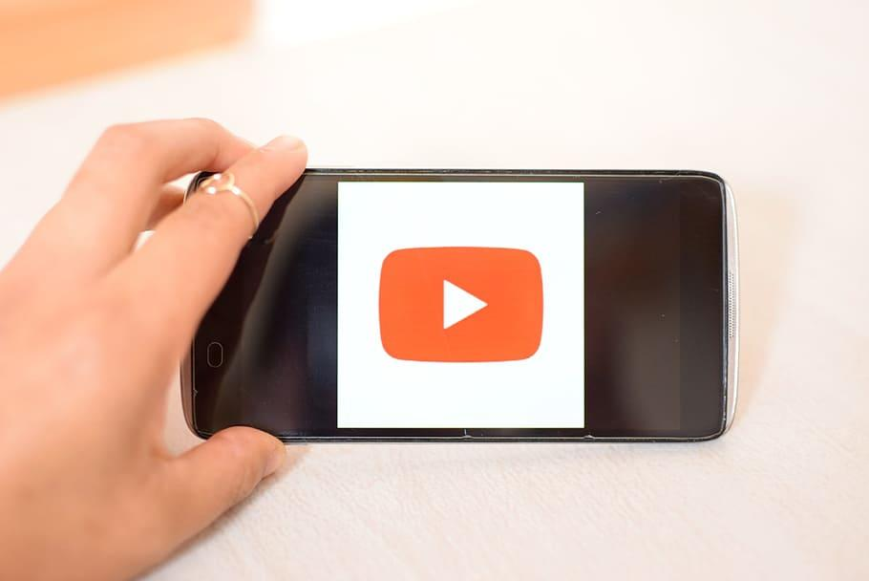

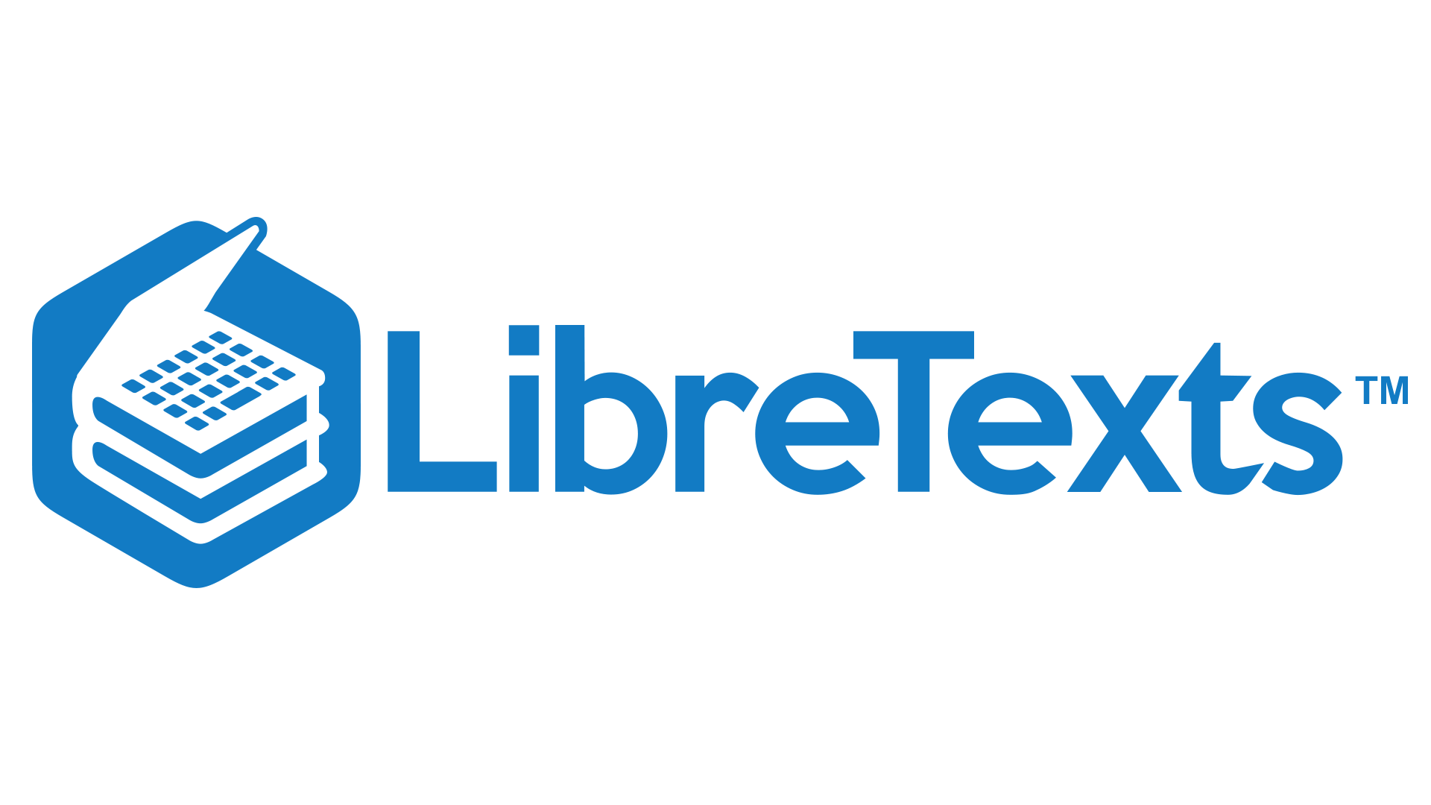
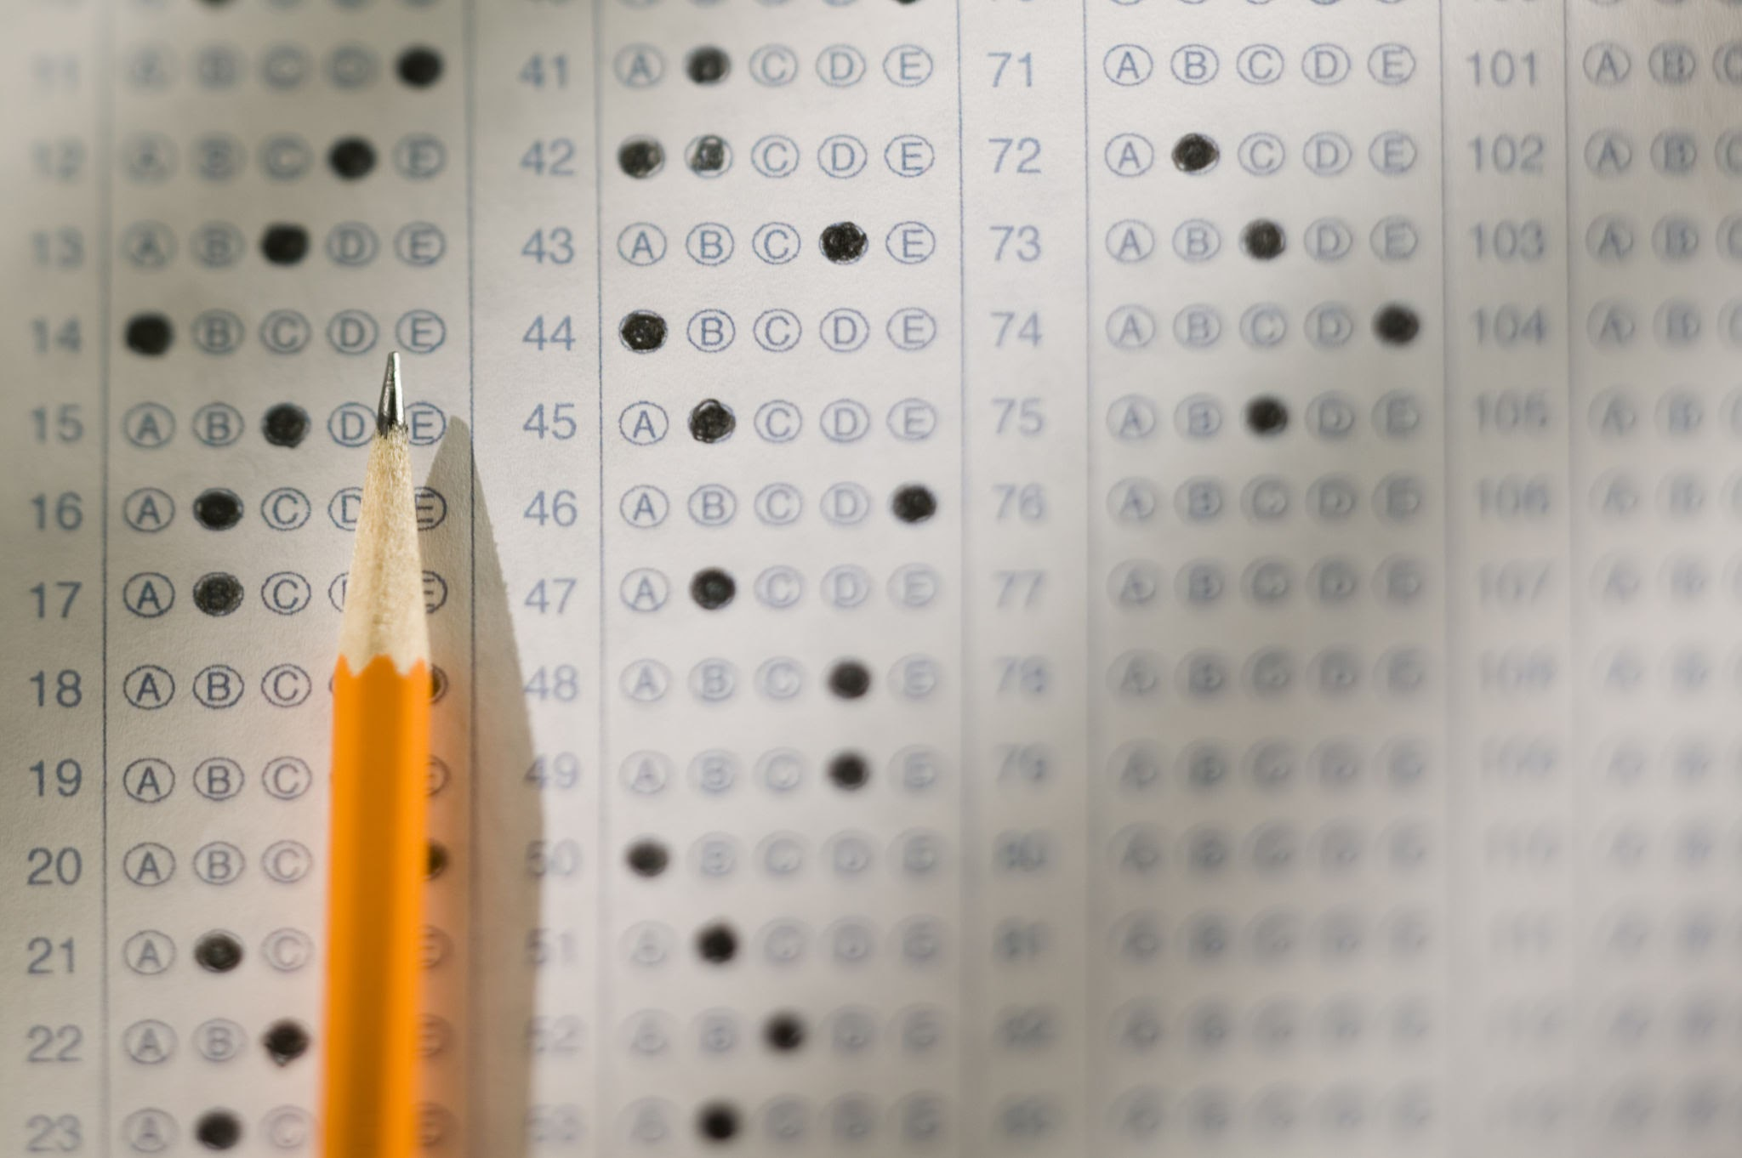
Examples of OER
OER can be….

Slide 8

Creative Commons
Provides free, easy-to-use copyright licenses designed to make a simple and standardized way to give the public permission to share and use creative work.
Licenses work within existing copyright laws but are more “open” - they will tell you which, if any, of the 5R’s apply.
Notes:
Carolyn

Slide 9
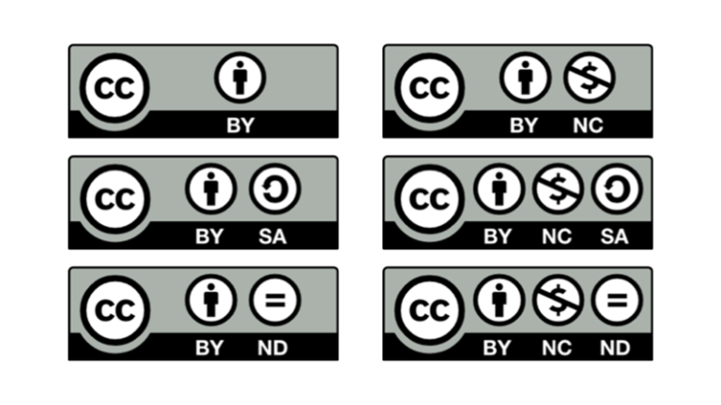
Creative Commons Licenses

Slide 10

What are LTC materials?
Low textbook cost (LTC) course materials cost a total of less than $30 for students. This is *new* as of Summer 2027. (see the CCCCO memo)

Slide 11

What are ZTC materials?
Course related materials that have no direct costs passed on to students, but materials are under copyright or are in the public domain.

Slide 12
California - ZTC v. OER
ZTC ✔️
Not ZTC ❌
Using library resources
Linking out to copyrighted online material
Photocopying pages of a textbook
Importing copyrighted online content into your Canvas shell

Slide 13
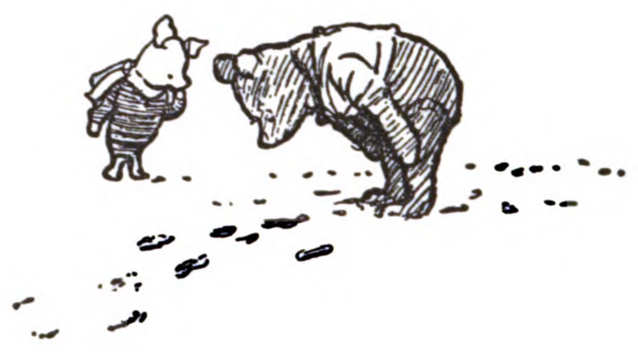


Public Domain
Not subject to copyright protections
Copyright has expired
Dedicated to the public domain (CC0)
Notes:
Winnie the Pooh image source
An comprehensive article on Public Domain: https://fairuse.stanford.edu/overview/public-domain/welcome/

Slide 14
What Is Copyright?
Exclusive set of rights for creators to copy, distribute, perform, adapt or use the work
Someone controls the copyright - creator, organization, employer
Copyright holder grants permission to use work
Copyright law is complicated in ways that cannot be quickly covered.

Slide 15
What Does Copyright Protect?
Copyright protects original and unique works in a tangible medium. For example:
Literary and artistic works
Translations, adaptations, arrangements
Collections of literary and artistic works
Applied art and industrial designs and models
Computer software

Slide 16
What Is NOT Covered by Copyright
Other forms of intellectual property are covered by Trademarks and Patents, others are not considered intellectual property. Examples of what’s not covered by copyright:
Ideas, facts, discoveries, recipes, procedures, processes, systems, methods of operation, concepts, principles

Slide 17
Additional Copyright Information
Copyright is automatic from the moment of creation
In the United States, copyright lasts the length of the author’s life plus 70 years (longer for copyrights held by corporations)
Copyright laws and length vary by country

Slide 18
What is Fair Use?
“Fair use is a legal doctrine that promotes freedom of expression by permitting the unlicensed use of copyright-protected works in certain circumstances. Section 107 of the Copyright Act provides the statutory framework for determining whether something is a fair use and identifies certain types of uses—such as criticism, comment, news reporting, teaching, scholarship, and research—as examples of activities that may qualify as fair use.”
More Information on Fair Use, Copyright.gov
Notes:
Some more resources on Copyright
UMN: Thinking Through Fair Use.​
Stanford University: Measuring Fair Use​
University of Washington: Guidelines for Fair Use in Education​
ALA Fair Use Evaluator

Slide 19
Fair use & OER - Examples
Fair Use ✔️
Not Fair Use ❌
Quoting research studies in the field
Screenshots showing students how to use tools
Short excerpts from different magazines showing differences in grammar
The 10% rule is a MYTH
A chapter from a textbook not used in the class
Short excerpts from National Geographic showing different kinds of maps
Notes:
For information on the TEACH act: https://guides.lib.utexas.edu/copyright/forms

Slide 20
Four Factors of Fair Use
Fair Use is a “framework” that must be looked at for each use. The four factors must be considered in totality and do not offer a definitive or legal answer.
Purpose and character of the use
Nature of the original work
Amount and substantiality of the portion used
Effect of the use on the potential market for or value of the source work

Slide 21
Questions?
ASCCC OERI or oeri@asccc.org

Slide 22
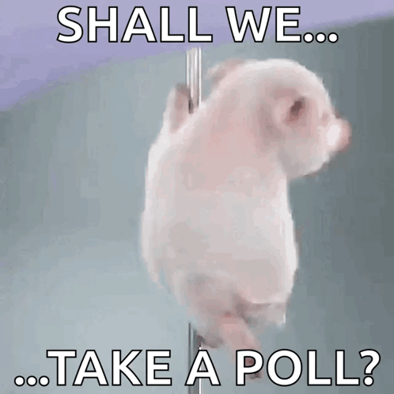
We Need Your Feedback!
TAKE OUR ZOOM POLL BEFORE YOU LEAVE!

