Slide 1
OER for Art History:
Please
feel free to
introduce yourself
in the chat!
New Resources and the State of the Discipline
Tuesday, October 13, 12:00-1:00pm
Cerise Myers, Art & Art History Discipline Lead

Slide 2
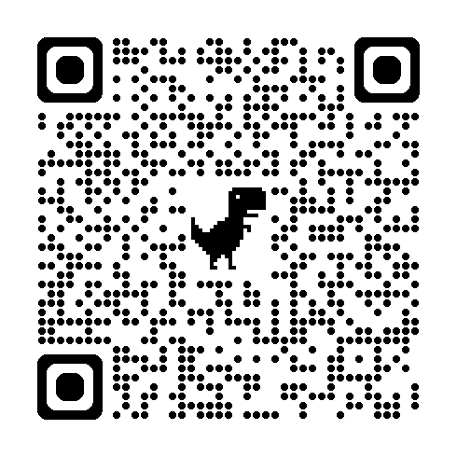
Housekeeping
  Drop questions/comments into the chat, raise your hand, or just speak up!
  Session recording will be available at the ASCCC-OERI website
  Sign up for the Art & Art History OER Google Group

Slide 3
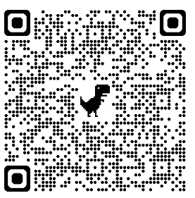
Today
  Background
    ASCCC-OERI
    Cool4Ed
  New resources
  Upcoming survey
  What are you working on? What do we still need?
Today’s slides:

Slide 4

Background
  Academic Senate for California Community Colleges’ Open Educational Resources Initiative (ASCCC-OERI)
  Cool4Ed

Slide 5
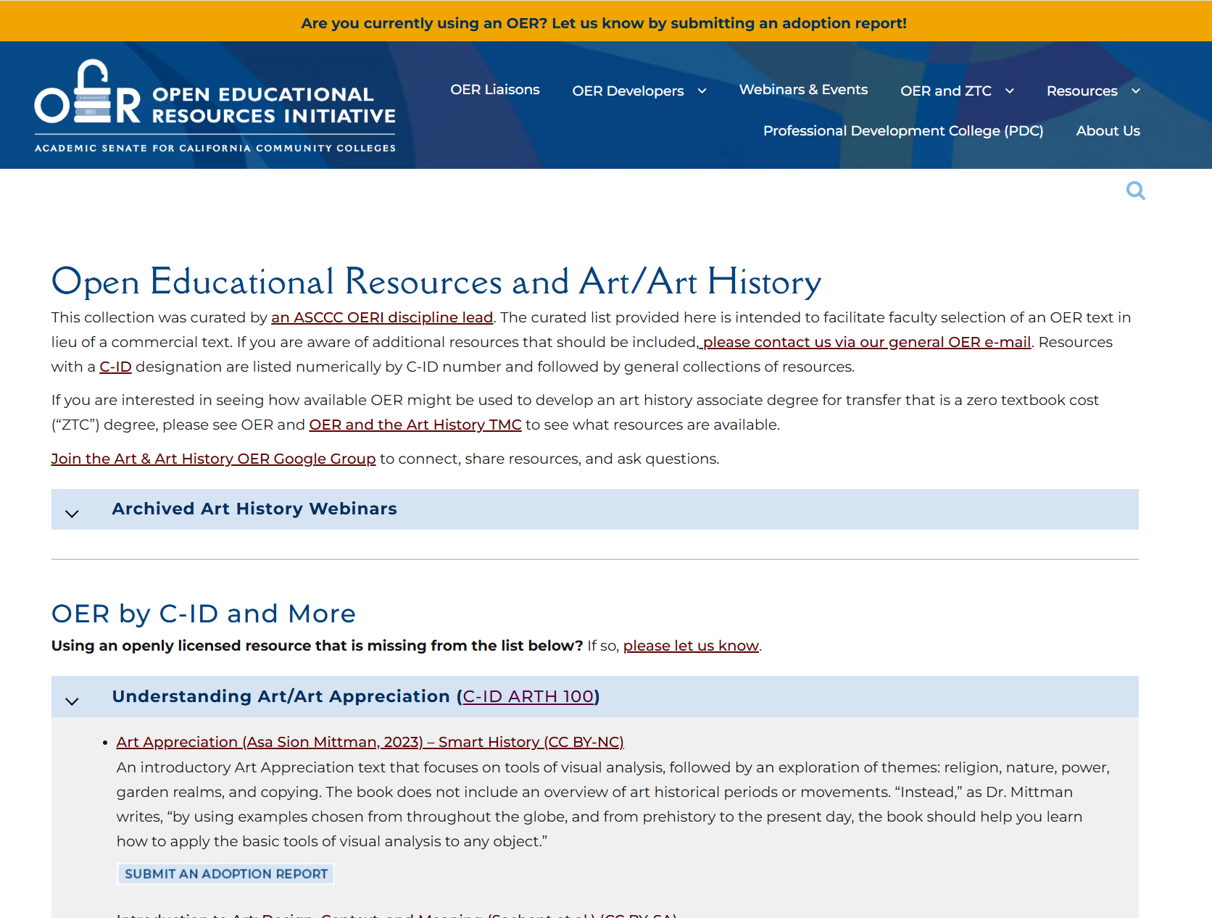
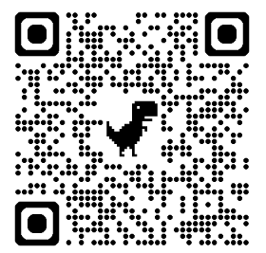
OERI
Curated resource list

Slide 6
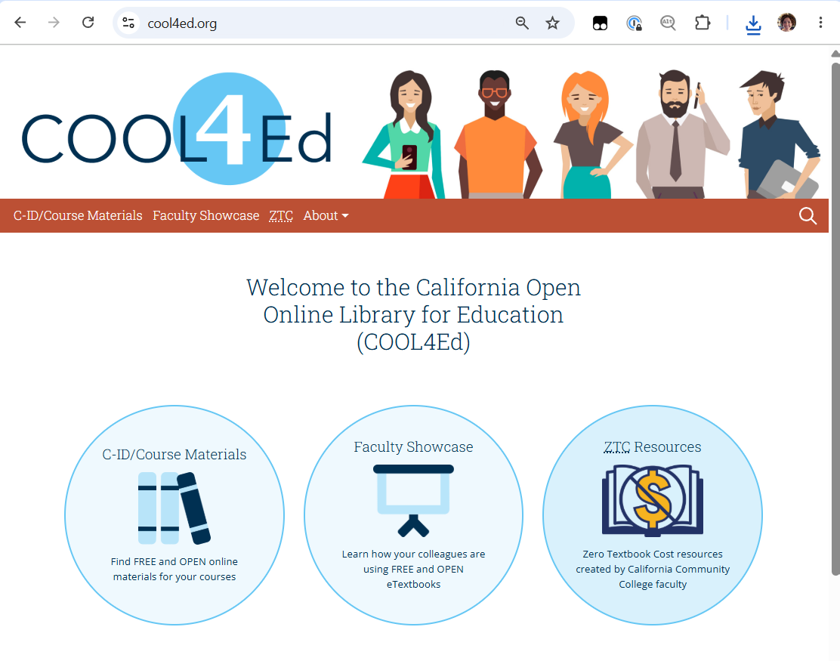
COOL4Ed (1/3)
  COOL4Ed (cool4ed.org)

Slide 7
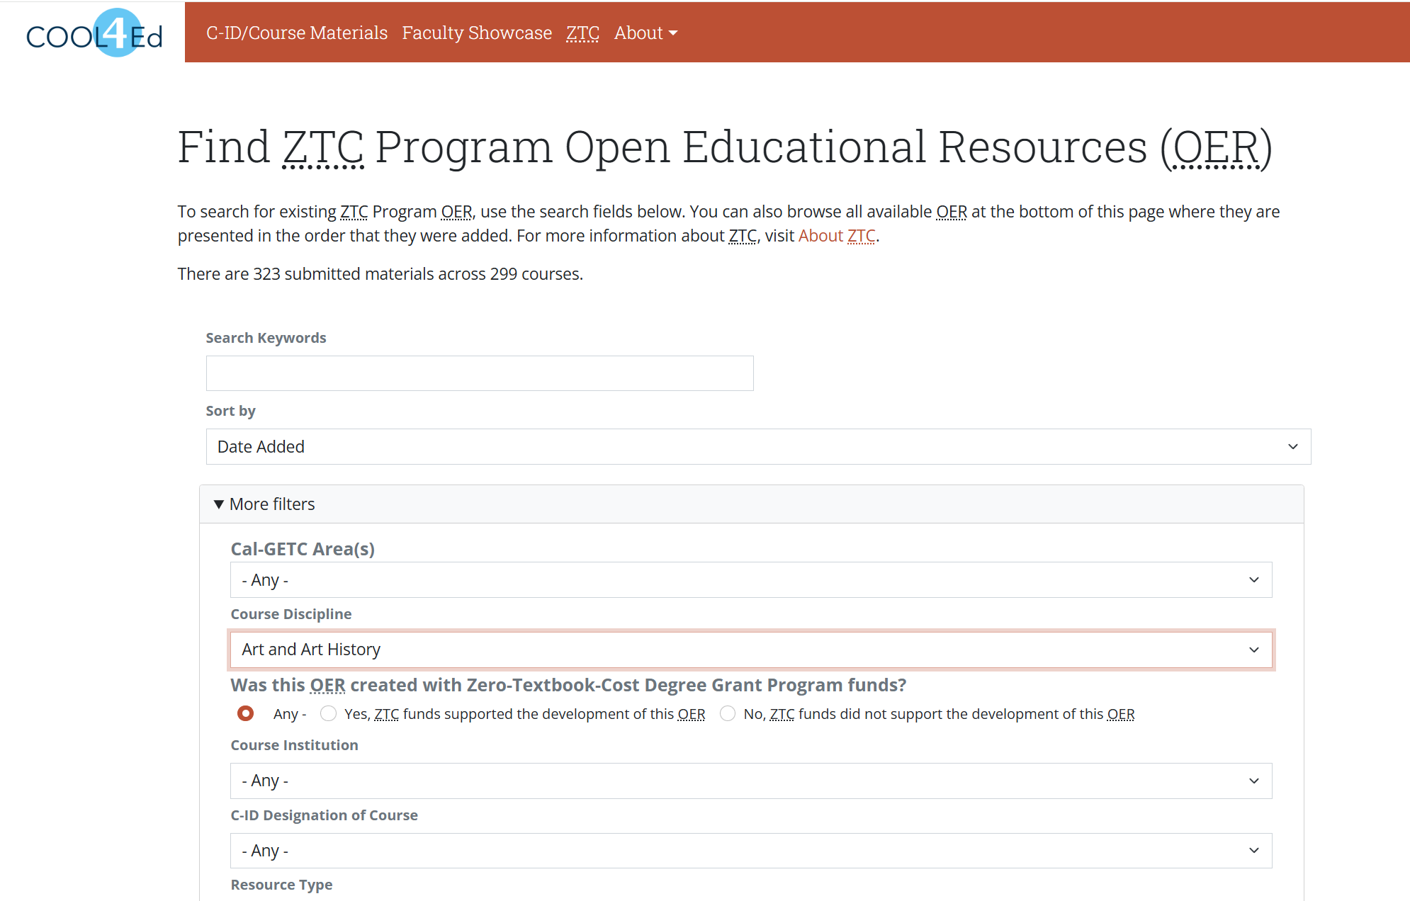
COOL4Ed (2/3)

Slide 8
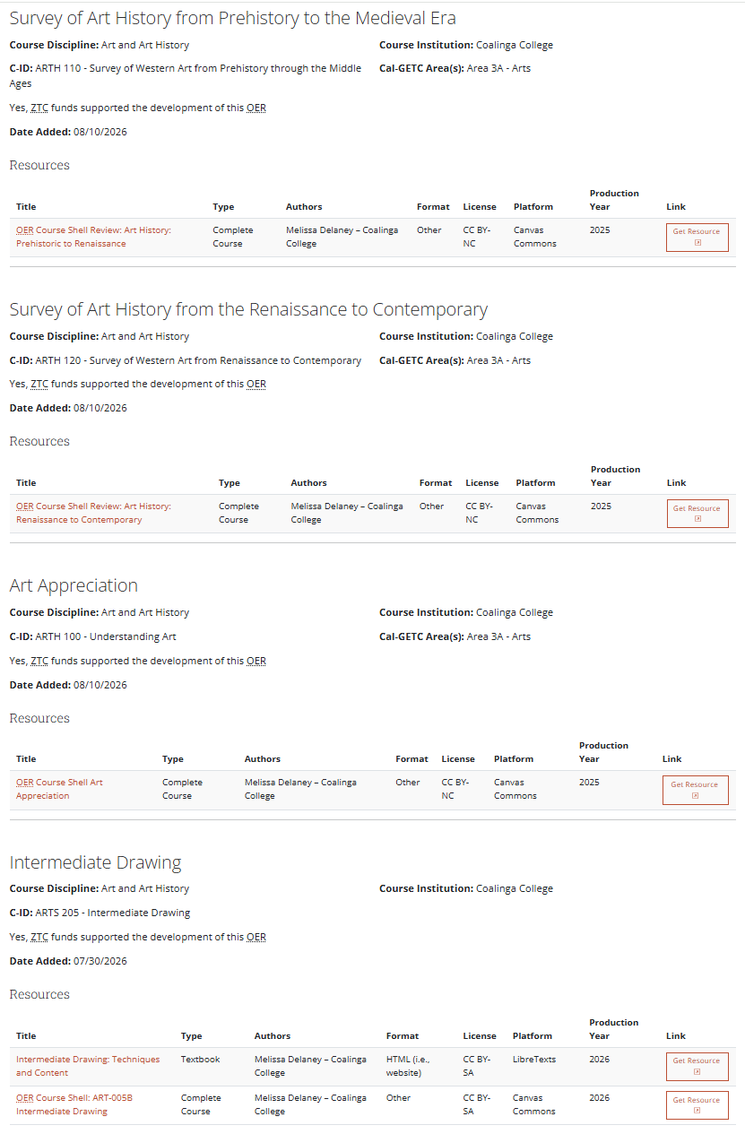
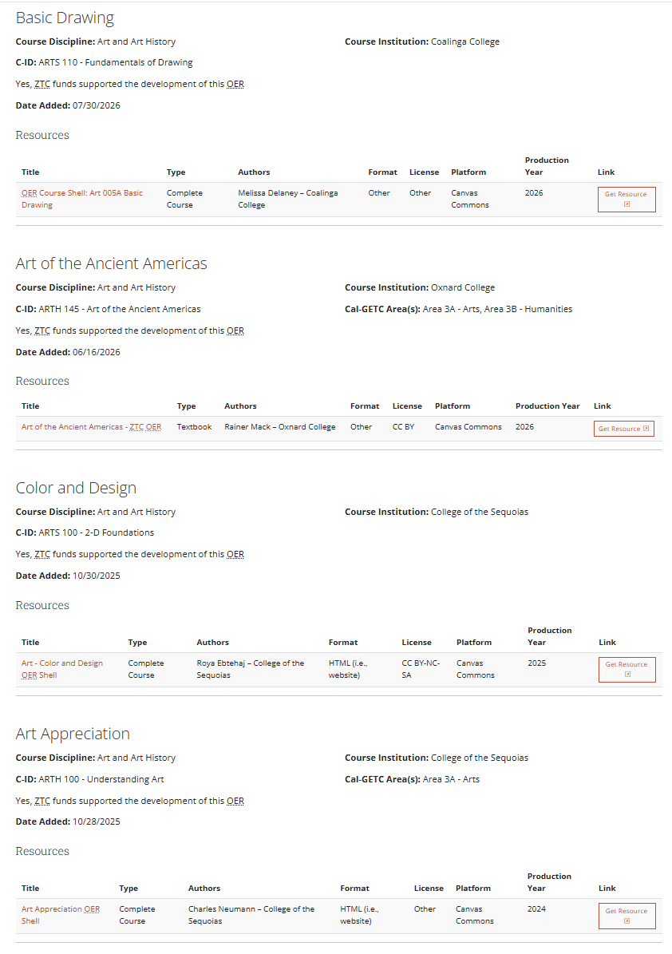
COOL4Ed (3/3)
  Currently, 9 resources (1 duplicate) from 3 colleges
  Survey I, II, Art Appreciation, Basic & Intermediate Drawing, Art of the Americas, Color & Design

Slide 9
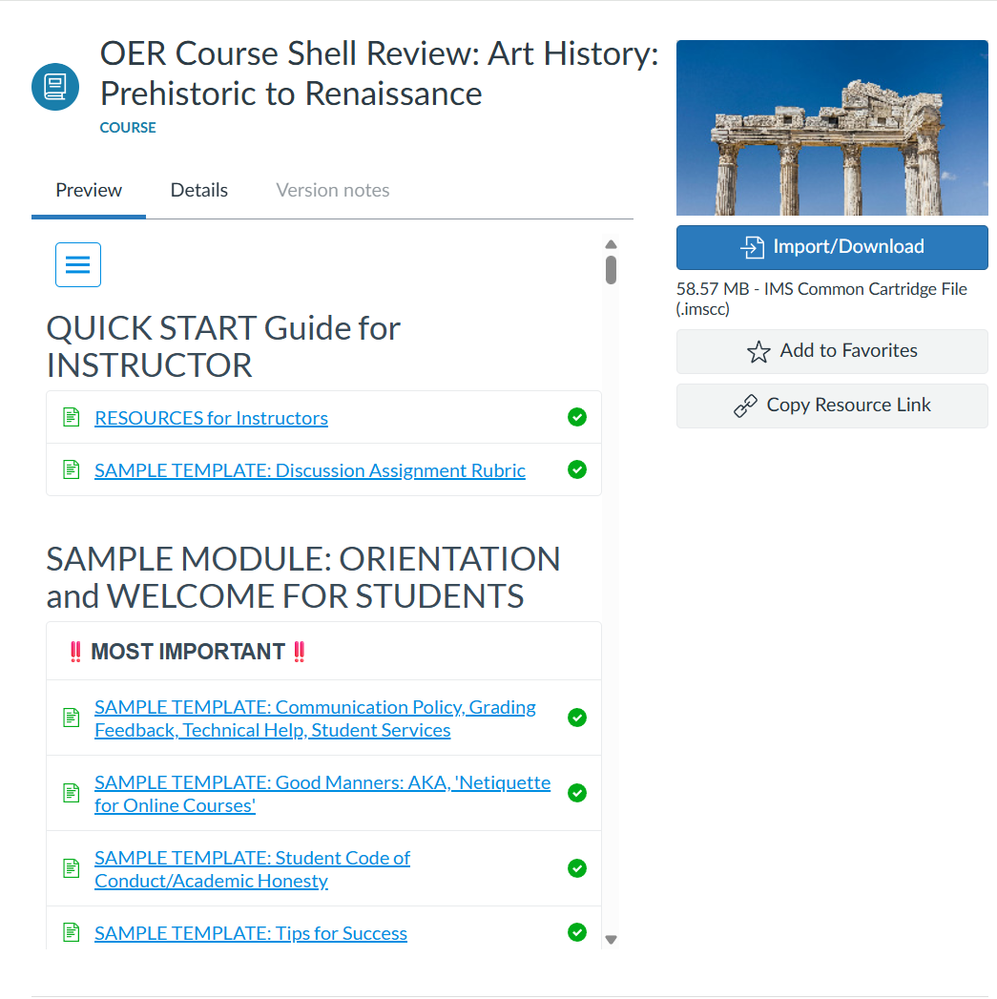
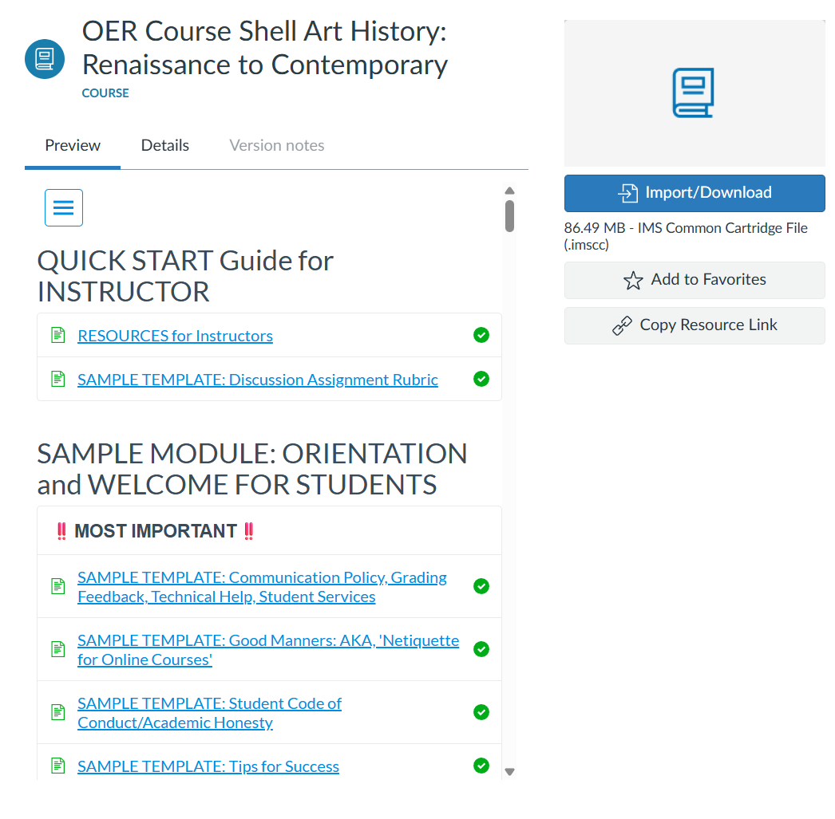
Coalinga Survey I & II Canvas Course Shells
Uses Myers, Caldwell, et al, Introduction to Art History I
Uses Gustlin, Introduction to Art History I

Slide 10
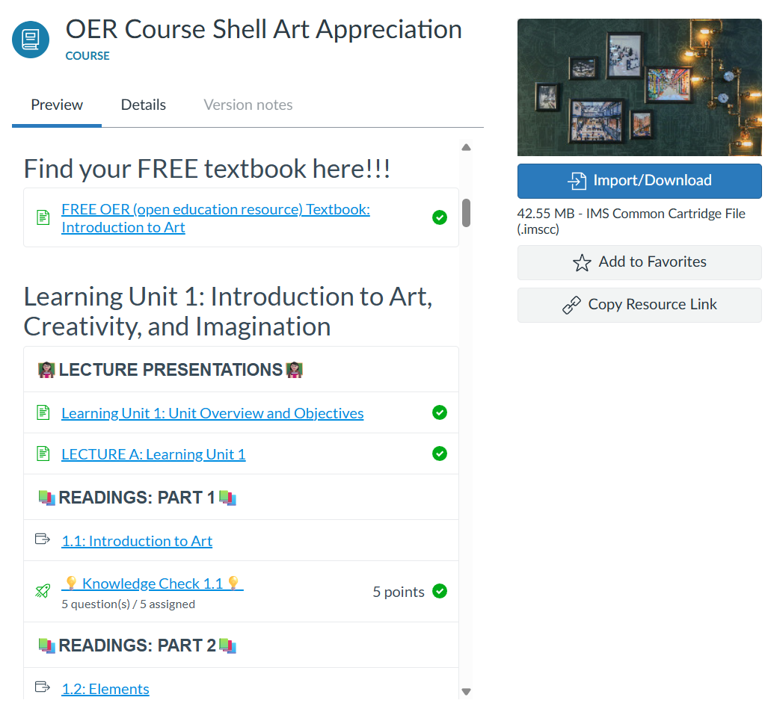
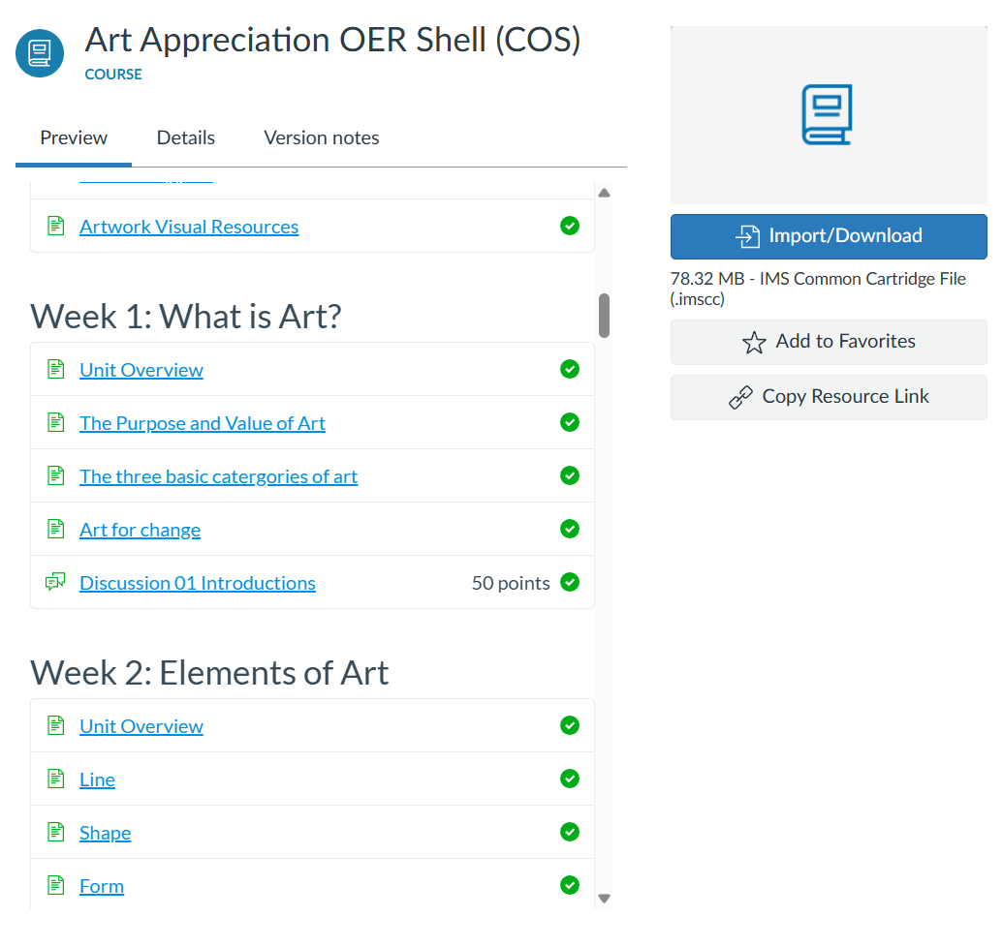
Art Appreciation Canvas Course Shells/Content
Uses Sachant, Blood, & LeMieux, plus “Smarthistory, Khan Academy, PBS, self-made content”
Uses Jones, Introduction to Art

Slide 11
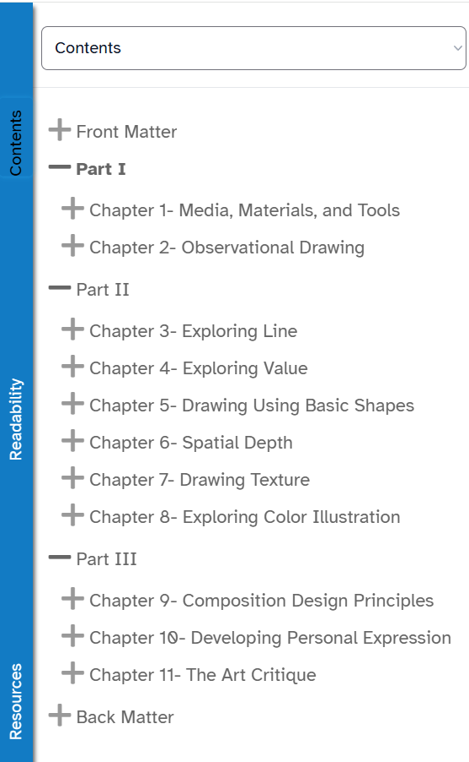
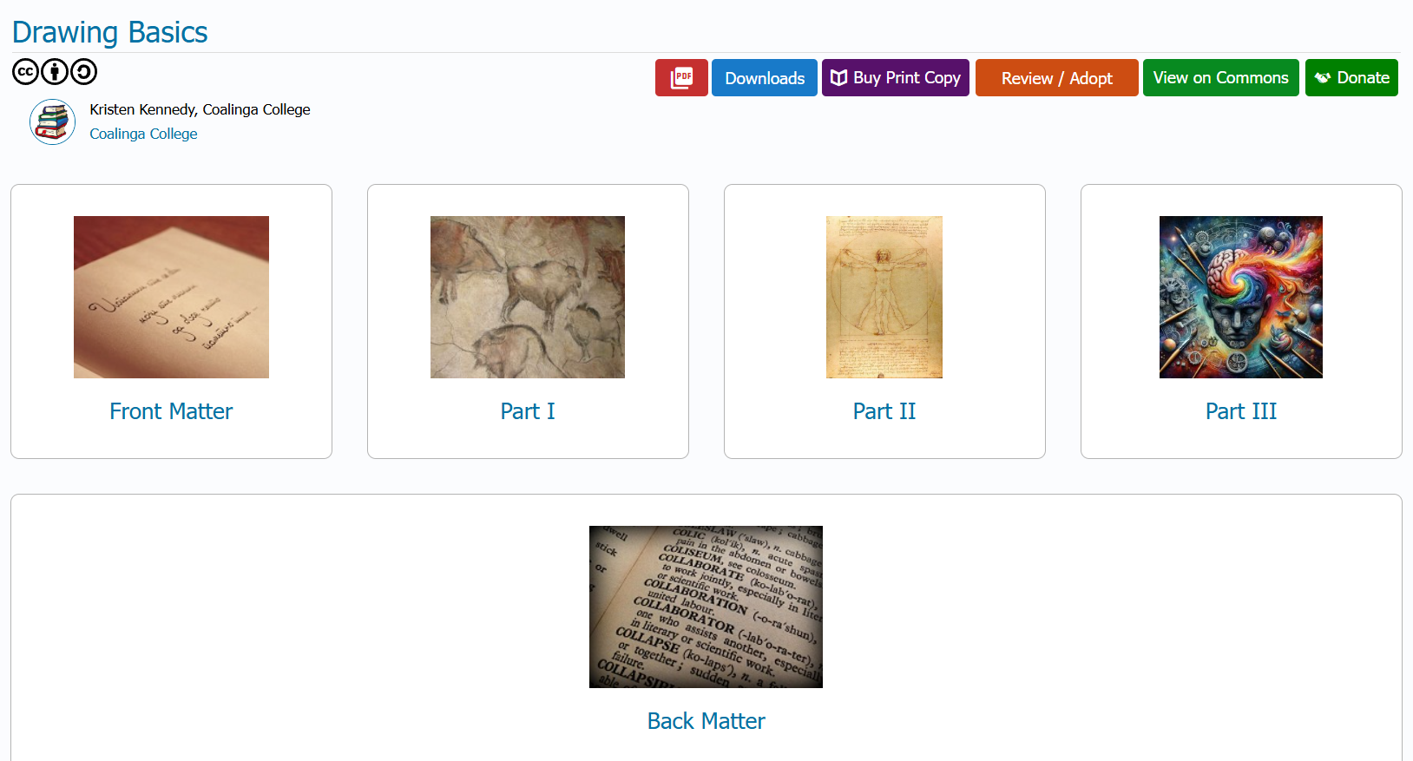
Drawing: Basic & Intermediate (1/2)

Slide 12
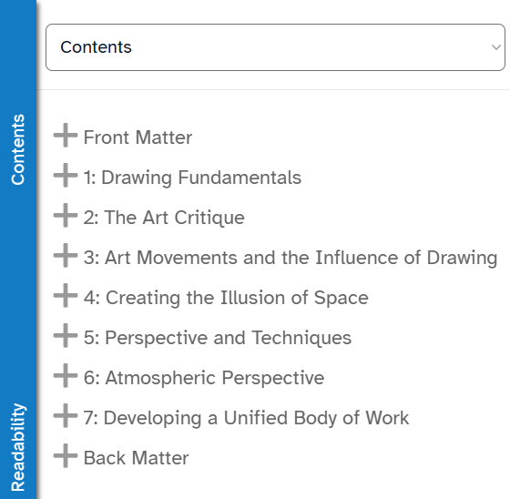
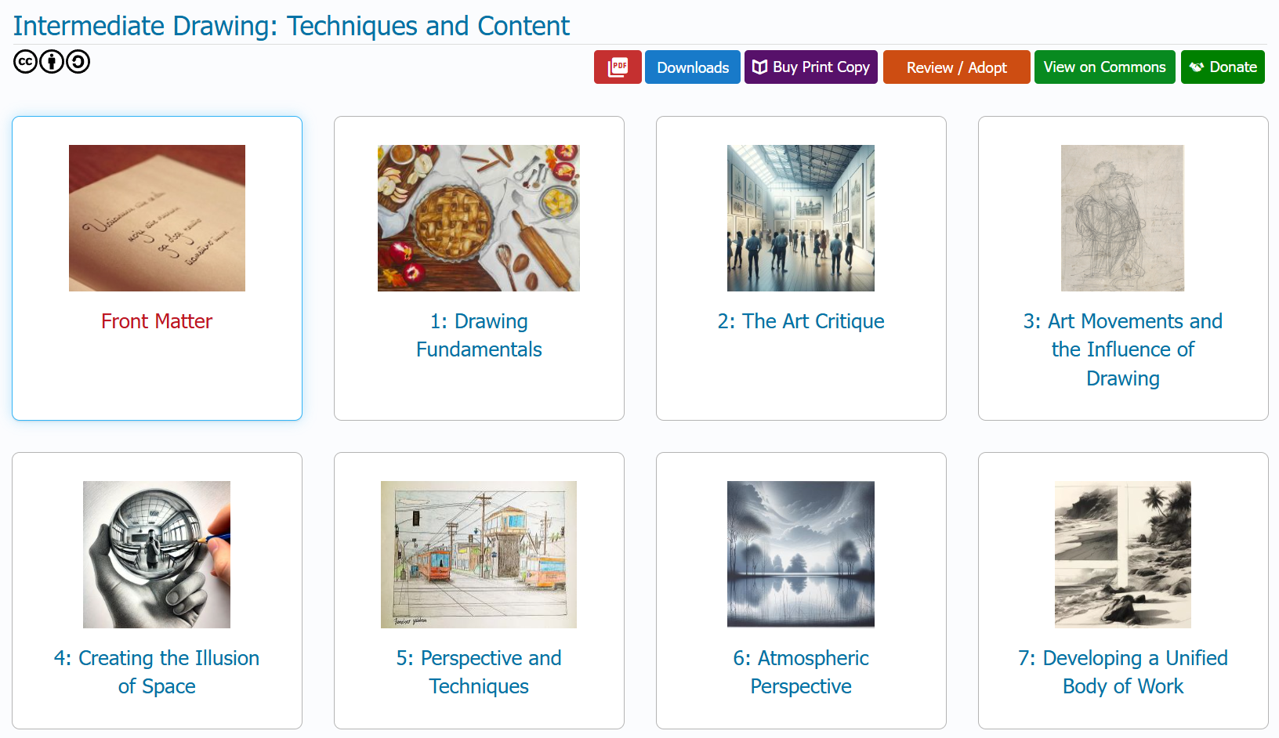
Drawing: Basic & Intermediate (2/2)

Slide 13
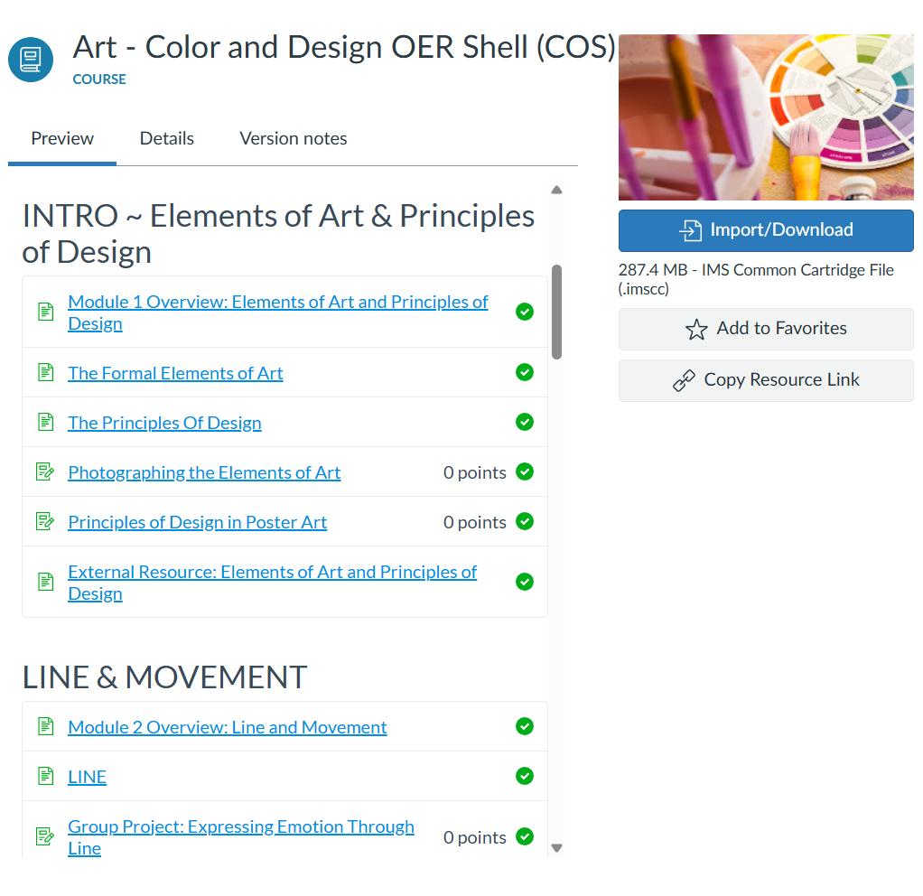
2-D Foundations

Slide 14
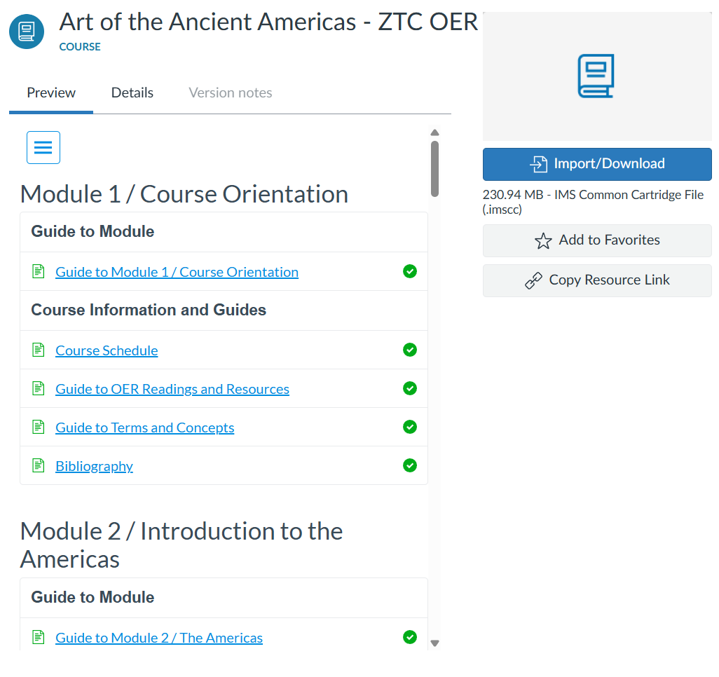
Art of the Ancient Americas
Uses Smarthistory and other resources

Slide 15
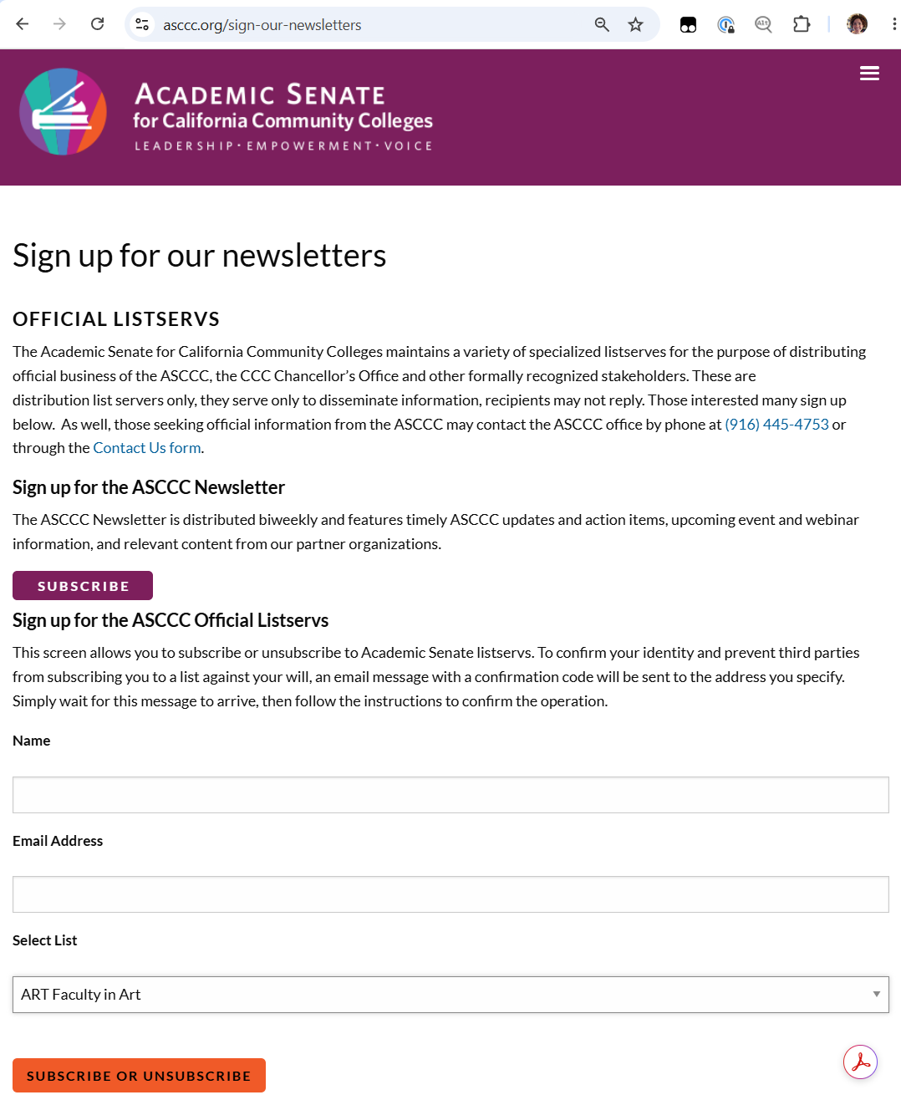
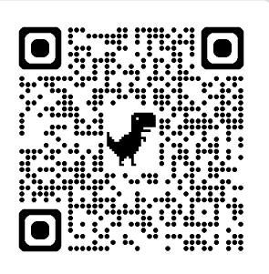
Upcoming Survey (1/2)
  Make sure you’re registered for the discipline listserv! (ART@LISTSERV.CCCNEXT.NET)

Slide 16
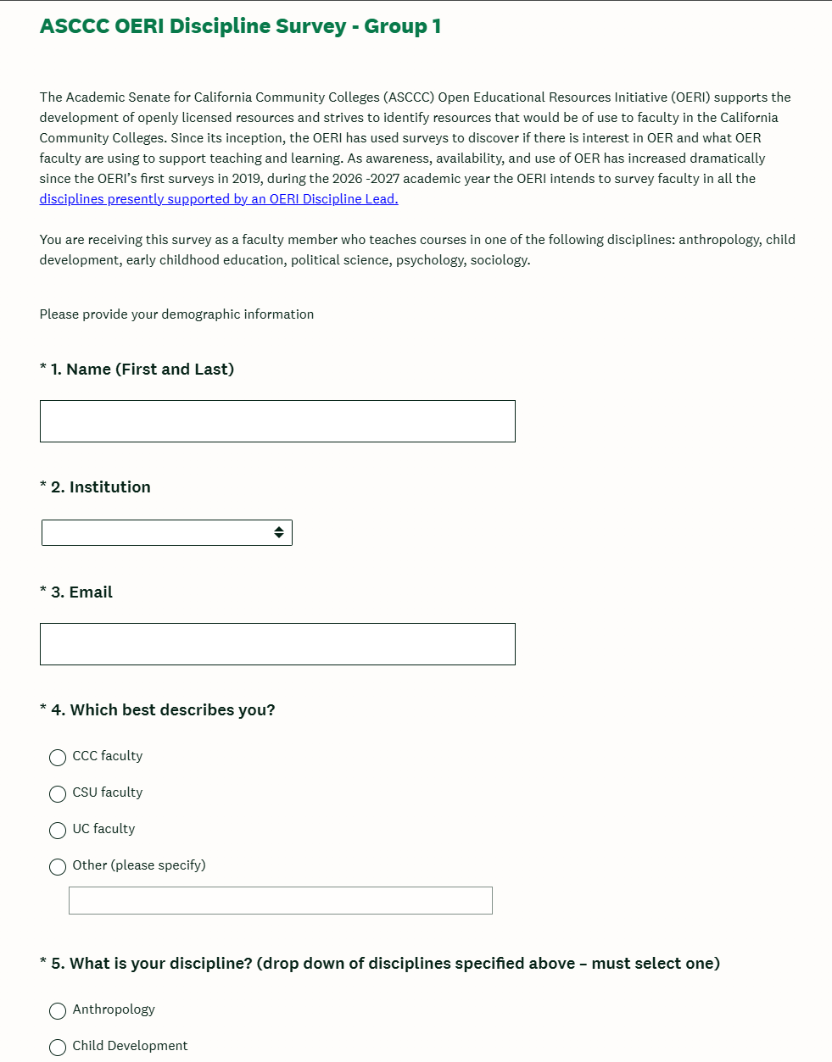
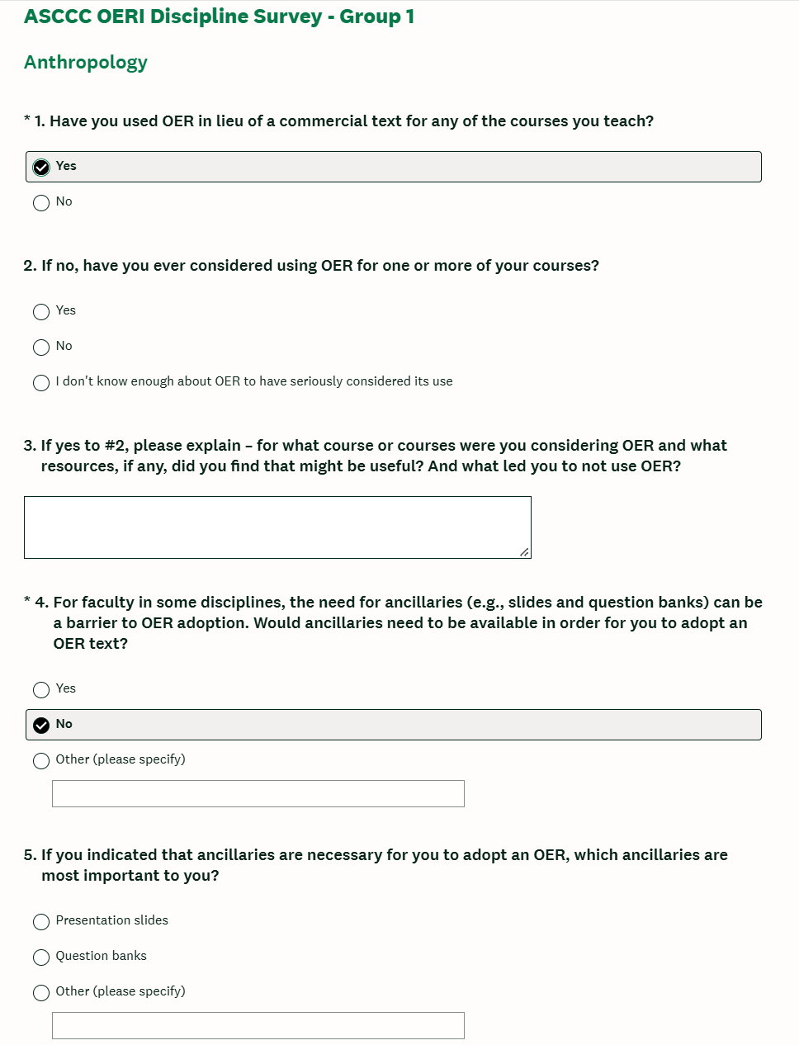
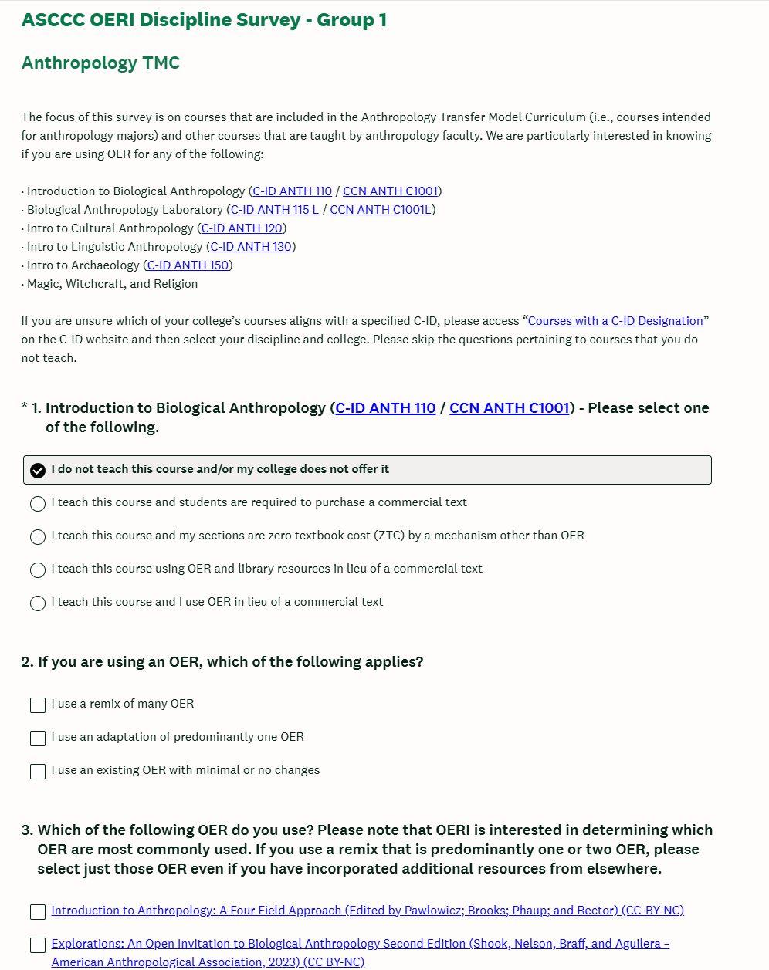
Upcoming Survey (2/2)

Slide 17
Sharing
  What are you working on?
  What do you need?
  Don’t hesitate to reach out to chat more: cerise.myers@imperial.edu

