Slide 1
Introduction to Creative Commons Licenses
Shagun Kaur and Suzanne Wakim
licensed CC BY 4.0; 2024
Notes:
Understanding Creative Commons licensing is critical when working with open educational resources (OER). In this interactive webinar we’ll explore the nuances of the various Creative Commons licenses for when a resource is used, adapted, or created.

Slide 2
Agenda
Discuss CC licenses
Practice identifying license rights
Demonstrate attribution

Slide 3
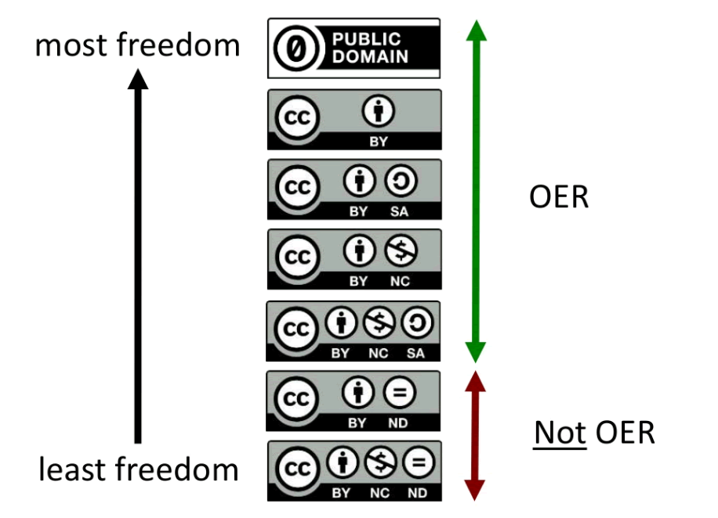

Creative Commons Licenses
(and public domain)
All right reserved copyright

Slide 4

CC 0
No rights reserved
  creator is opting out of copyright and database protection, and the exclusive rights automatically granted to creators
No attribution required (but good idea)
View License Deed | View Legal Code
Notes:
License descriptions adapted from Review of Licenses by Rachel Arteaga CC BY 4.0
CC0 empowers yet another choice altogether – the choice to opt out of copyright and database protection, and the exclusive rights automatically granted to creators – the “no rights reserved” alternative to our licenses.
Unlike the Public Domain Mark, CC0 should not be used to mark works already free of known copyright and database restrictions and in the public domain throughout the world. However, it can be used to waive copyright and database rights to the extent you may have these rights in your work under the laws of at least one jurisdiction, even if your work is free of restrictions in others. Doing so clarifies the status of your work unambiguously worldwide and facilitates reuse.

Slide 5

CC BY
“Attribution”
Credit creator
Distribute, adapt, remix, build upon the work
Commercial use permitted
Most accommodating CC license
Recommended for maximum dissemination and use of licensed materials
View License Deed | View Legal Code
Notes:
License descriptions adapted from Review of Licenses by Rachel Arteaga CC BY 4.0

Slide 6

CC BY-NC
“Attribution, Non-Commercial
Credit creator
Distribute, adapt, remix, build upon the work
Non-commercial use only
View License Deed | View Legal Code
Notes:
Discuss bookstore & NC

Slide 7

CC BY-SA
“Attribution, Share Alike”
Credit creator
Distribute, adapt, remix, build upon the work
Must license new creations under the identical terms
Commercial use permitted
New works will carry the same license, so any derivatives will also allow commercial use
View License Deed | View Legal Code
Notes:
All license images adapted from About the Licenses, by Creative Commons, CC-BY 4.0 International license

Slide 8

CC BY-NC-SA
Credit creator
Distribute, adapt, remix, build upon the work
Non-commercial use only
License new creations under the identical terms
New works will carry the same license, so any derivatives cannot allow commercial use
View License Deed | View Legal Code

Slide 9

CC BY-ND
“Attribution, No Derivatives”
Credit creator
Allows redistribution
Can only be used in its unadapted state
Not truly open
View License Deed | View Legal Code

Slide 10

CC BY-NC-ND
“Attribution, Non-Commercial, No Derivatives”
Credit Creator
Allows redistribution
Can only be used in its unadapted state
Non-commercial use only
Most restrictive license; not truly open
View License Deed | View Legal Code

Slide 11
Review
License | Attribution Required? | Adapt & Modify? | Commercial Use? | Change License?
CC0*
CC BY
CC BY-SA
CC BY-NC
CC BY-NC-SA
CC BY-ND
CC BY-NC-ND
* CC0 is a public domain dedication rather than a license
text-only version of this table

Slide 12
Review: CC0
License | Attribution Required? | Adapt & Modify? | Commercial Use? | Change License?
CC0* | N* | Y | Y | Y*
CC BY
CC BY-SA
CC BY-NC
CC BY-NC-SA
CC BY-ND
CC BY-NC-ND

Slide 13
Review: CC BY
License | Attribution Required? | Adapt & Modify? | Commercial Use? | Change License?
CC0* | N | Y | Y | Y*
CC BY | Y | Y | Y | Y
CC BY-SA
CC BY-NC
CC BY-NC-SA
CC BY-ND
CC BY-NC-ND

Slide 14
Review: CC BY-SA
License | Attribution Required? | Adapt & Modify? | Commercial Use? | Change License?
CC0* | N | Y | Y | Y*
CC BY | Y | Y | Y | Y
CC BY-SA | Y | Y | Y | N
CC BY-NC
CC BY-NC-SA
CC BY-ND
CC BY-NC-ND

Slide 15
Review: CC BY-NC
License | Attribution Required? | Adapt & Modify? | Commercial Use? | Change License?
CC0* | N | Y | Y | Y*
CC BY | Y | Y | Y | Y
CC BY-SA | Y | Y | Y | N
CC BY-NC | Y | Y | N | Y*
CC BY-NC-SA
CC BY-ND
CC BY-NC-ND

Slide 16
Review: CC BY-NC-SA
License | Attribution Required? | Adapt & Modify? | Commercial Use? | Change License?
CC0* | N | Y | Y | Y*
CC BY | Y | Y | Y | Y
CC BY-SA | Y | Y | Y | N
CC BY-NC | Y | Y | N | Y*
CC BY-NC-SA | Y | Y | N | N
CC BY-ND
CC BY-NC-ND

Slide 17
Review: CC BY-ND
License | Attribution Required? | Adapt & Modify? | Commercial Use? | Change License?
CC0* | N | Y | Y | Y*
CC BY | Y | Y | Y | Y
CC BY-SA | Y | Y | Y | N
CC BY-NC | Y | Y | N | Y*
CC BY-NC-SA | Y | Y | N | N
CC BY-ND | Y | N | Y | N/A
CC BY-NC-ND

Slide 18
Review: CC BY-NC-ND
License | Attribution Required? | Adapt & Modify? | Commercial Use? | Change License?
CC0* | N | Y | Y | Y*
CC BY | Y | Y | Y | Y
CC BY-SA | Y | Y | Y | N
CC BY-NC | Y | Y | N | Y*
CC BY-NC-SA | Y | Y | N | N
CC BY-ND | Y | N | Y | N/A
CC BY-NC-ND | Y | N | N | N/A

Slide 19
Questions?
ASCCC OERI

Slide 20

T A S L
CC Blue Heart by Creative Commons Corporation; licenced under CC BY 4.0
Title: CC Blue Heart
Link to Location: https://commons.wikimedia.org/wiki/File:CC_blue_heart.png
Author: Creative Commons Corporation
Author Page: https://stateof.creativecommons.org/
License: CC BY 4.0
Link to license: https://creativecommons.org/licenses/by/4.0/deed.en
Notes:
https://wiki.creativecommons.org/wiki/Recommended_practices_for_attribution
Author link if you can
Different Platforms have different formatting requirements
Our style guide - uniformity and clarity for downstream work

Slide 21
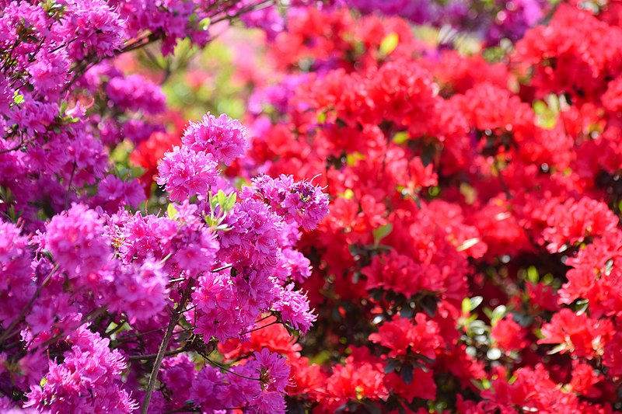
Practice 1
Notes:
https://commons.wikimedia.org/wiki/File:Ashikaga_Flower_Park,_Tochigi_Prefecture;_May_2019_(02).jpg

Slide 22
Practice 1 - Answer
Ashikaga Flower Park by 雷太 licensed CC BY 2.0
Notes:
cut/paste author

Slide 23
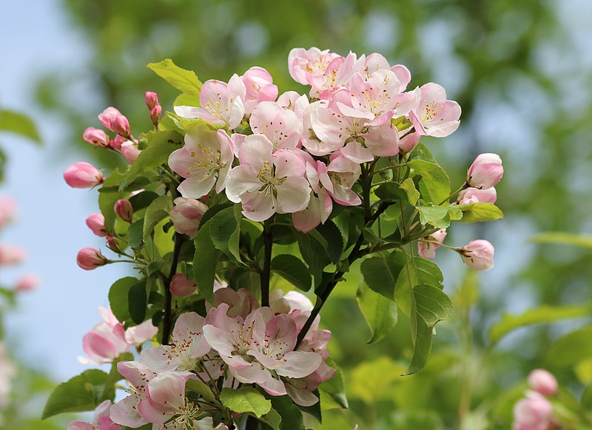
Practice 2
Notes:
https://commons.wikimedia.org/wiki/File:Apple-tree_blossoms_2017_G3.jpg

Slide 24
Practice 2 - Answer
Apple Tree Blossoms by George Chernilevsky; released into the Public Domain
Notes:
Even if public domain, still follow TASL

Slide 25
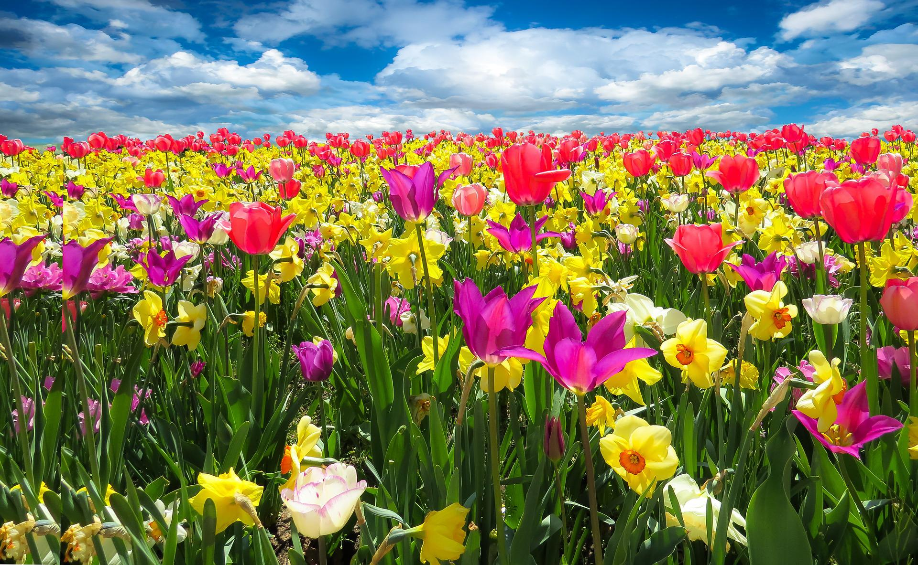
Practice 3 -
Notes:
https://pixabay.com/photos/tulips-daffodils-flowers-field-1197602/

Slide 26
Practice 3 - Answer
Field of Tulips by Blende12 via Pixabay License
Notes:
No real title, so do your best
Not a CC license

Slide 27
Practice 4
Ashikaga Flower Park by 雷太 licensed CC BY 2.0
Notes:
Link to Image in Slide 27, Practice 3: https://pixabay.com/photos/tulips-daffodils-flowers-field-1197602/

Slide 28
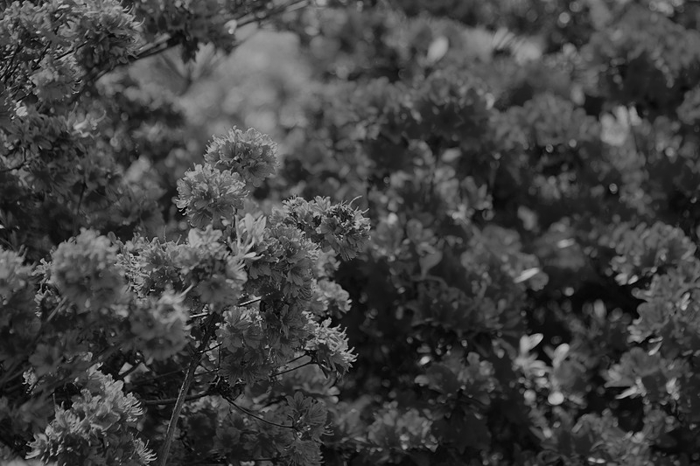
Practice 4 - Adapting
Notes:
Discuss what is and isn’t an adaptation (briefly); will discuss combining works in session #5
adapting is making a creative change
just adding a border (for example) isn’t adaptation
https://commons.wikimedia.org/wiki/File:Ashikaga_Flower_Park,_Tochigi_Prefecture;_May_2019_(02).jpg

Slide 29
Practice 4 – Adapting (2)
Mysterious flowers by Suzanne Wakim licensed CC BY 4.0 adapted from Ashikaga Flower Park by 雷太 licensed CC BY 2.0
Notes:
add your link if you want people to use it

Slide 30
We Need Your Feedback!
This is a reminder to facilitators to please launch the Zoom poll to gather attendee feedback about this session.

Slide 31
Questions?
ASCCC OERI

