Slide 1
Open Educational Resources (OER) Curation and Advanced Licensing
Shagun Kaur and Suzanne Wakim
licensed CC BY 4.0; 2024
Notes:
How do you remix and attribute content with different licenses? How are collections and remixes different and why does it matter? This interactive session is intended for those who are familiar with the Creative Commons licenses and would like to expand their understanding. Bring your questions and licensing challenges.

Slide 2
Topics
What licenses can you use when:
Adapting a single work
Remixing multiple works
Creating collections

Slide 3
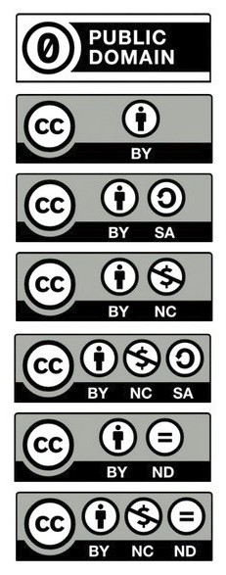
Review
CC Licenses and
Public Domain Dedication

Slide 4

T A S L
CC Blue Heart by Creative Commons Corporation; licenced under CC BY 4.0
Title: CC Blue Heart
Link to Location: https://commons.wikimedia.org/wiki/File:CC_blue_heart.png
Author: Creative Commons Corporation
Author Page: https://stateof.creativecommons.org/
License: CC BY 4.0
Link to license: https://creativecommons.org/licenses/by/4.0/deed.en

Slide 5

Revising a Single Work
Global Open Educational Resources Logo
by Jonathasmello licensed CC BY 3.0

Slide 6

Original is CC BY
OER Recolored by Suzanne Wakim; licensed ??? is an adaptation of Global Open Educational Resources Logo by Jonathasmello licensed CC BY 3.0
Notes:
All but public domain

Slide 7
What if: Original is CC BY-SA
Notes:
CC BY-SA

Slide 8
What if: Original is CC BY-NC
Notes:
Yes: anything with NC element
Other technically allowed but not a good idea

Slide 9
What if: Original is CC BY-NC-SA
Notes:
CC BY-NC-SA

Slide 10
What if: Original is CC BY-ND
Notes:
Trick question (can’t adapt and share)

Slide 11

Remixing multiple works
Global Open Educational Resources Logo by Jonathasmello
licensed CC BY 3.0
OER Logo; Public Domain

Slide 12
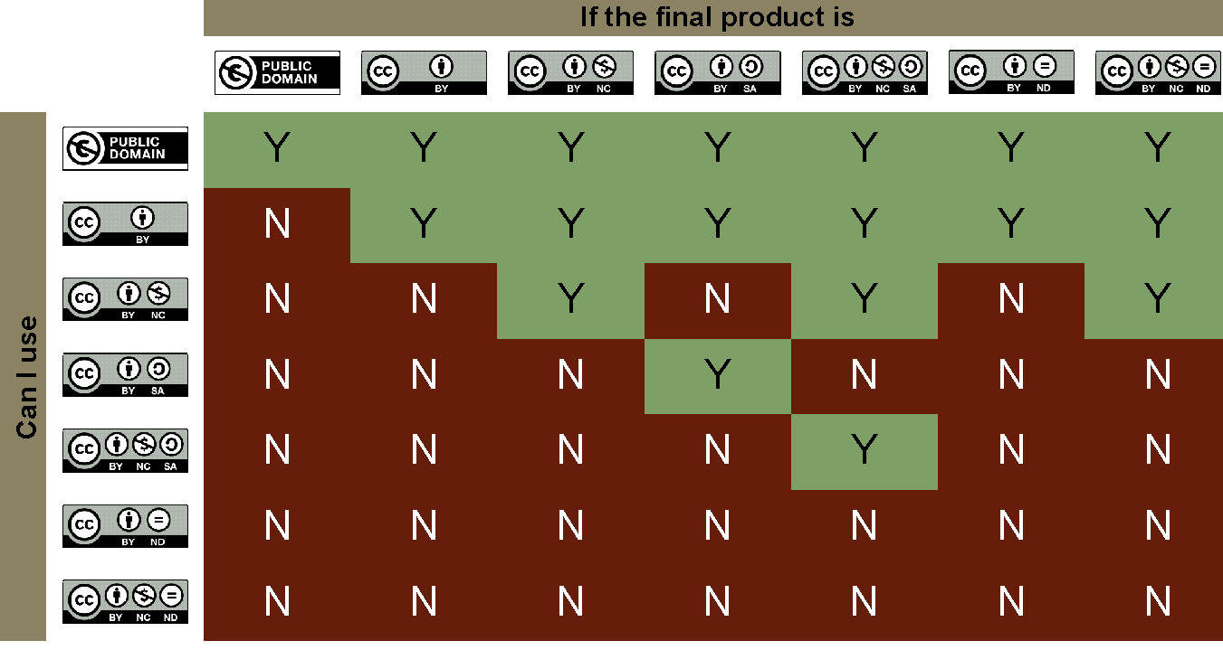
Combining Licenses Chart
Text-only version
Please note that there are nuances which are not represented here.
This table is based on a final product that remixes content into an integrated (blended) final product rather than into an anthology of separate works.
Notes:
Last page of toolkit has the chart
Explain the two comments at the bottom - fully remixed (that’s why ND is all “no”)
Pause for questions

Slide 13
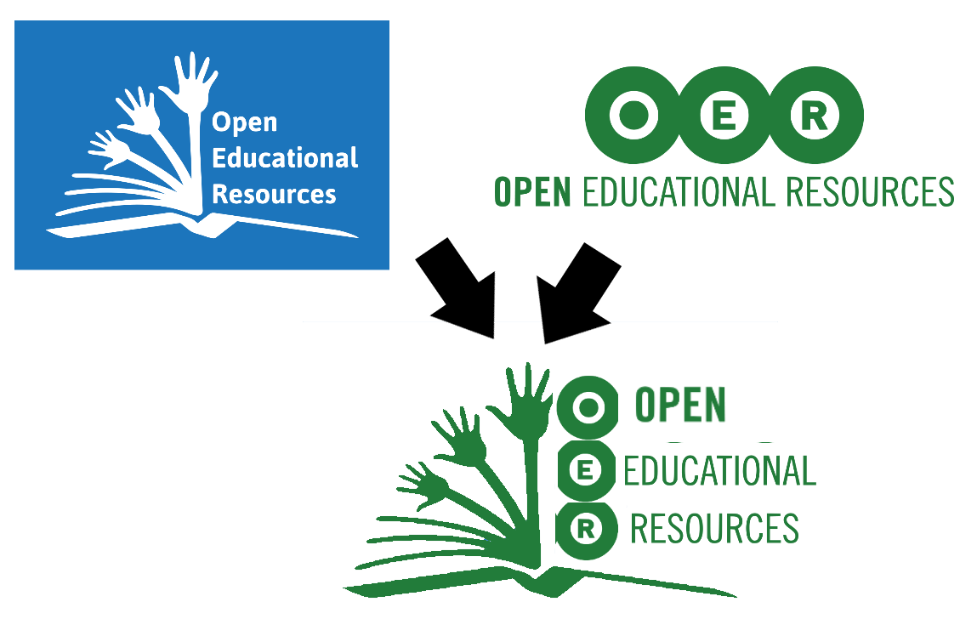
Remixing:
CC BY with Public Domain
Green OER Book by Suzanne Wakim; licensed ??? is an adaptation of:
Global Open Educational Resources Logo by Jonathasmello licensed CC BY 3.0
OER Logo; Public Domain
Notes:
any except public domain

Slide 14
What if the licenses were:
CC BY with CC BY-SA
Notes:
CC BY-SA

Slide 15
What if the licenses were:
CC BY with CC BY-NC
Notes:
Yes: anything with NC element
Other technically allowed but not a good idea

Slide 16
What if the licenses were:
CC BY-NC with CC BY-NC-SA
Notes:
CC BY-NC-SA

Slide 17
What if the licenses were:
CC BY-SA with CC BY-NC-SA
Notes:
trick question - can’t be combined

Slide 18
What if the licenses were:
CC BY-SA with CC BY-NC
Notes:
trick question - can’t be combined

Slide 19
What if the licenses were:
CC BY with CC BY-ND
Notes:
trick question again-can’t be combined

Slide 20
More works = More Complicated
Public Domain
CC BY
CC BY-SA
CC BY-NC-SA
Public Domain
CC BY
CC BY-SA
CC BY-NC-SA
CC BY-NC
Notes:
neither of these is possible

Slide 21
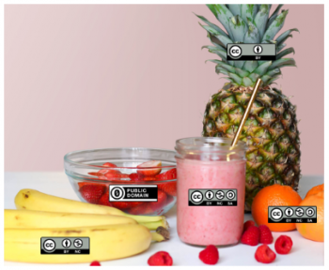
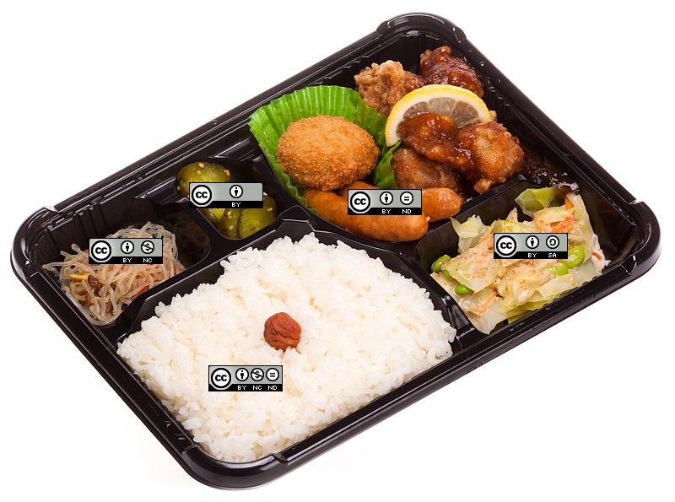
ND - You Can Create Collections NOT Adaptations
Adaptation = Smoothie
Collection = Bento Box
“CC Smoothie” by Nate Angell. CC BY. Derivative of “Strawberry Smoothie On Glass Jar” by Element5 in the public domain, and various Creative Commons license buttons by Creative Commons used under CC BY.
CC Bento box by Suzanne Wakim licensed CC-BY-SA (Links to an external site.). Derivate of "Shop-made bento box (Links to an external site.)" by Laitr Keiows (Links to an external site.)licensed CC-BY-SA (Links to an external site.) via Wikimedia Commons

Slide 22
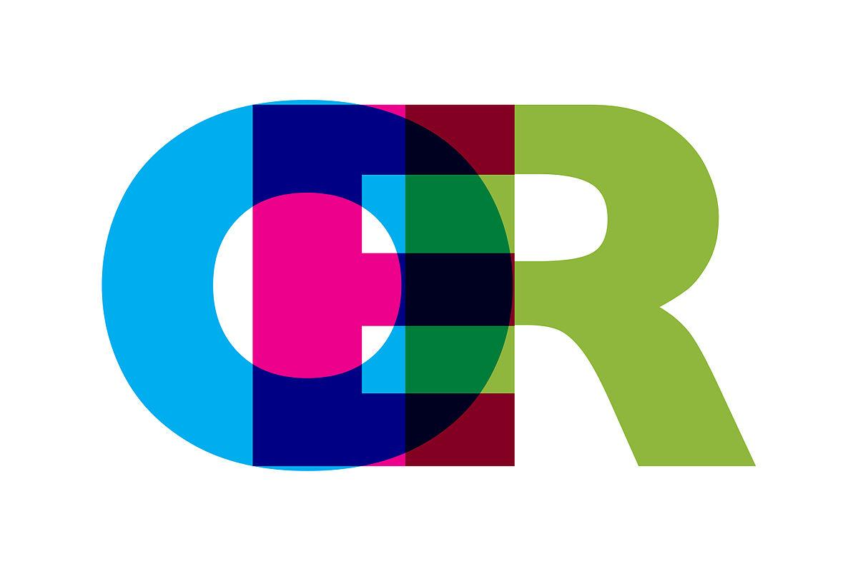
Collections
Global Open Educational Resources Logo by Jonathasmello licensed CC BY 3.0
OER Logo; Public Domain
OER Logo by Grafik: Markus Büsges, leomaria licensed CC BY-SA 3.0

Slide 23
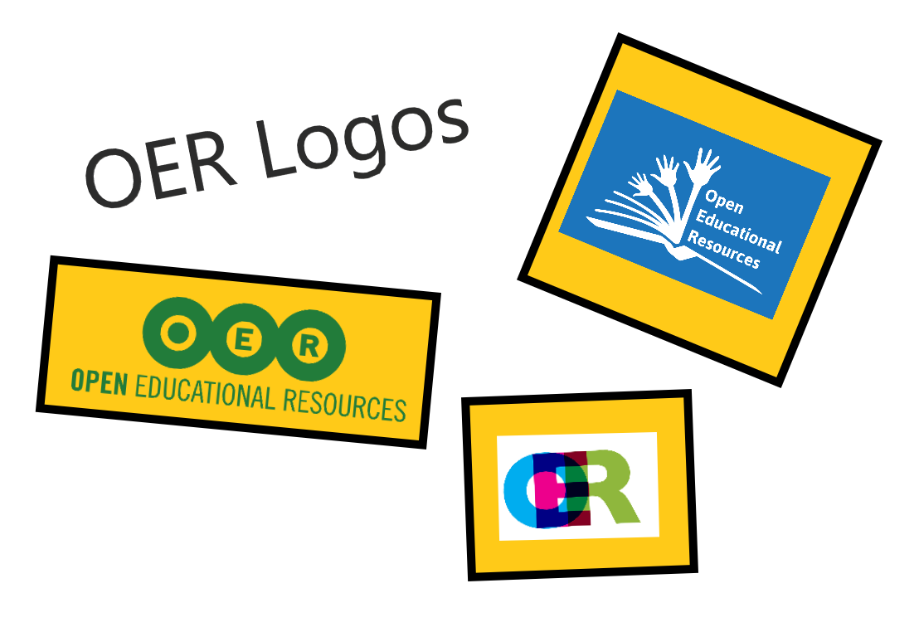
My Collection
Notes:
Explain difference between collection & remix

Slide 24
Collection:
Public Domain, CC BY, CC BY-SA
OER Logos Collection by Suzanne Wakim; licensed ??? contains:
Global Open Educational Resources Logo by Jonathasmello licensed CC BY 3.0
OER Logo; Public Domain
OER Logo by Grafik: Markus Büsges, leomaria licensed CC BY-SA 3.0
Notes:
Any other than public domain (“SA” element not relevant as I’m not adapting)

Slide 25
What if:
One of the works in CC BY-ND?
Notes:
This if fine b/c I’m not adapting

Slide 26
What if:
One of the works in CC BY-NC?
Notes:
As before, best to use something with NC

Slide 27
We Need Your Feedback!
This is a reminder to facilitators to please launch the Zoom poll to gather attendee feedback about this session.

Slide 28
Questions?
ASCCC OERI

