Slide 1
Welcome!
On behalf of the ASCCC OERI, we are pleased to have you here with us for “When Students Want Print: Delivering OER Through TouchNet Marketplace”
If you are not already muted, please mute yourself upon arrival.
Please note that you are encouraged to use the Zoom “chat” feature for questions and comments.
You’re invited to introduce yourself in the chat – please provide your name, college, discipline/role
This event will be recorded. Archives of all ASCCC OERI events are available at asccc-oeri.org > Webinars and Events
Notes:
[Before 2:00] Leave this slide up as people join. Amanda: welcome attendees, read the housekeeping points, and invite introductions in the chat. Remind the tech host to start the recording.

Slide 2
When Students Want Print: Delivering OER Through TouchNet Marketplace
ASCCC OERI Webinar; Monday, October 5, 2026, 2:00 p.m.
This work is licensed under a Creative Commons Attribution 4.0 International License.
Notes:
[2:00] Amanda: introduce the session title. The license line is part of the ASCCC OERI template (CC BY 4.0).

Slide 3
Description
Open educational resources save students money, but they can create a practical problem that colleges don’t always plan for: What happens when a student wants a printed copy? Faculty may be faced with requests they can’t fulfill, and business offices may be asked to handle transactions without an established process. In this session, the Reedley College Business Office manager and an ESL faculty member explain how Reedley College solved this problem using Marketplace, both the setup phase (building the storefront, pricing, handling funds and fulfillment) and the classroom aspect (preparing materials, walking students through ordering, and what it’s meant for access in an ESL context). We’ll cover what worked, what we’d do differently, and the questions worth asking before your college implements an OER printing solution.
Notes:
[2:01] Amanda: briefly summarize the purpose of the session rather than reading the full description.

Slide 4
Presenters
Amanda Taintor
Instructional Designer
Reedley College
Facilitator
Ralph Marrufo
Business Office Manager
Reedley College
Setting up the storefront
Rebecca Alhaider
ESL Instructor
Reedley College
Using it in the classroom
Notes:
[2:02] Each presenter introduces themselves in about 30 seconds: role at Reedley College and how they got involved in the print project. Replace the circles with headshots and add alt text for each photo.

Slide 5
Overview
Time | Topic | Presenter
2:00 | Welcome and the print problem | Amanda
2:08 | Part 1: Building the storefront | Ralph
2:20 | Q&A | All
2:25 | Part 2: In the classroom | Rebecca
2:37 | Q&A | All
2:42 | Lessons learned and questions to ask | All
2:47 | Resources and feedback | Amanda
Notes:
[2:03] Amanda: walk through the agenda. Point out the two Q&A breaks and encourage attendees to drop questions in the chat at any time; you'll collect them for each break.

Slide 6



Free online, but some students want print
Students
Faculty
Business office
Ask for a printed copy of an OER they can read and annotate on paper.
Receive print requests they have no way to fulfill.
Is asked to handle transactions without an established process.
Notes:
[2:04] Amanda: frame the problem. OER removes the cost barrier, but a printed copy still matters to some students, and without a process the request lands on faculty or the business office with nowhere to go. Transition: 'Before we hear how Reedley solved this, let's see where your college is.'

Slide 7

Poll: How do you handle OER print requests?
A. Bookstore or vendor print-on-demand
B. Campus print shop, with an established process
C. Informal arrangements, case by case
Waterfall answers... WAIT FOR CUE
D. Students print on their own
E. Not sure / we don’t have a process yet
Notes:
[2:06] Facilitator: launch Zoom poll 1 (set it up in advance with options A–E). Give about 60 seconds, then share results. Use the results to tell Ralph and Rebecca what to emphasize, for example if most attendees have no process yet.

Slide 8
Part 1: Building the storefront
Ralph Marrufo, Business Office Manager
Notes:
[2:08] Amanda hands off to Ralph. Ralph: start with the request that got this started — what landed in the business office, and why an existing process didn't fit.

Slide 9





How an order moves through the system
1
2
3
4
5
Faculty provide a print-ready file
Book is listed in the Marketplace store
Student orders and pays online
Campus print shop prints the order
Delivered in class or shipped
Notes:
[2:09] Ralph: give the big picture before the details. Steps 1 and 2 are a best guess at the workflow; please confirm or edit. Confirmed so far: the store runs on TouchNet Marketplace, the campus print shop prints, and orders are delivered in class or shipped.

Slide 10
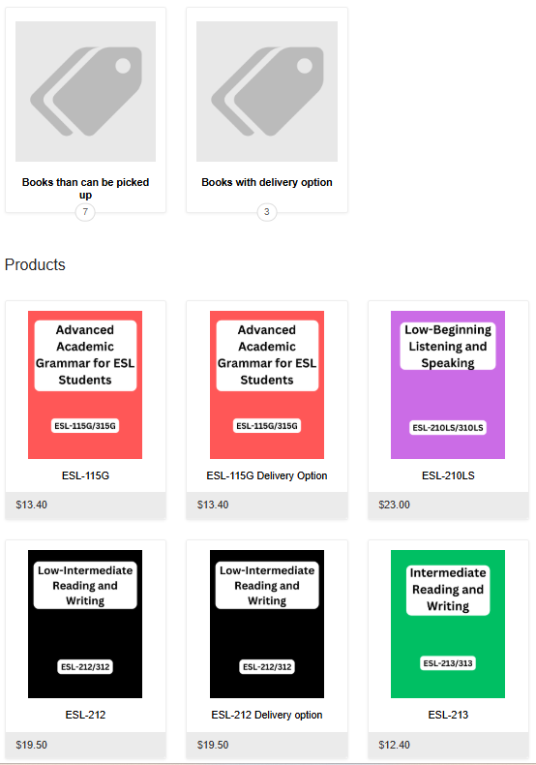

Setting up the store
Why TouchNet Marketplace? Was it already in use at the college or district?
Who had to be involved or approve it (district, IT, print shop, bookstore)?
How long did setup take, from first conversation to first order?
What does a product listing include, and what does the student see?
Notes:
[2:11] Ralph: about 3–4 minutes. Cover how the storefront was built and who was involved. If possible, replace the box on the right with a screenshot of the Reedley store (and add alt text).

Slide 11
Pricing and handling funds
$14.80
How is the price set (for example, covering print costs only)?
Where do the funds go, and how is the print shop paid?
Who reconciles orders and handles refunds or problems?
What did you have to set up on the accounting side?
Price of a printed OER copy
$86
Comparable commercial textbook
Notes:
[2:14] Ralph: about 3–4 minutes. Replace the two amounts on the right with real figures (or delete the cards if a comparison isn't helpful).

Slide 12
Fulfillment: printing and delivery
How does the print shop learn about a new order?
What is the typical turnaround time?
How do in-class delivery and shipping work? Who pays for shipping?
How do you handle the rush at the start of a term?
Delivered in class
Printed copies are brought to the student’s class.
Shipped
Copies can be shipped to students who need them.
Notes:
[2:17] Ralph: about 3 minutes. Then hand back to Amanda for Q&A at 2:20.

Slide 13
Q&A: Questions?
Add your questions in the chat or unmute
Notes:
[2:20–2:25] Amanda: read questions from the chat. Backup questions if the chat is quiet: (1) What would a college need to have in place before contacting TouchNet? (2) Were there any policy or audit concerns about selling printed materials?

Slide 14
Part 2: In the classroom
Rebecca Alhaider, ESL Instructor
Notes:
[2:25] Amanda hands off to Rebecca. Rebecca: start with the first time a student asked you for a printed copy and what you did before Marketplace existed.

Slide 15

Preparing the materials
Which ESL course(s) and OER text(s) are offered in print?
What did it take to get the file print-ready (formatting, page count, cover)?
How do you work with the print shop and business office each term?
What would you tell a faculty member preparing their first print file?
Notes:
[2:26] Rebecca: about 4 minutes. A photo of the printed book helps attendees picture the result; add alt text if you include one.

Slide 16
Walking students through ordering
Ordering steps for students
When and how do you introduce the print option to students?
What do students find confusing, and how do you help?
How do students without a card or reliable internet access order?
What do you share in Canvas or in class to support ordering?
1
View materials information on Canvas
2
Complete the Marketplace purchase
3
Receive the textbook in-person or by mail
Notes:
[2:30] Rebecca: about 4 minutes. Fill in the four steps on the right with how students actually order (for example: find the link, select the book, choose delivery, pay). A screenshot of the order page could replace the steps.

Slide 17

What print access means for ESL students
Why do some of your ESL students prefer a printed copy?
What changed in your class once a print option existed?
Did it affect how students engage with or use the text?
What would you want other faculty to know about access?
"It's easier to bookmark information in a printed book than to keep track of Canvas pages."
— [ESL-13, Fall 2025]
Notes:
[2:34] Rebecca: about 3 minutes; this is the heart of the classroom section. If you have a student quote (with permission), add it to the card. Then hand back to Amanda for Q&A at 2:37.

Slide 18
Q&A: Questions for Rebecca?
Add your questions in the chat or unmute
Notes:
[2:37–2:42] Amanda: read questions from the chat. Backup questions: (1) How much class time does the ordering walkthrough take? (2) Do students who choose print still use the digital version?

Slide 19


What worked, and what we’d do differently
What worked
What we’d do differently
Business office
Classroom
Business office
Classroom
Notes:
[2:42] Amanda: facilitate a short conversation (about 3 minutes). Ask each speaker for one thing that worked and one thing they'd change. Fill in the points beforehand if possible, or remove the placeholders and keep the slide as a discussion prompt.

Slide 20
Questions to ask before you implement
Setup and operations
Students and faculty
Does your college or district already have TouchNet Marketplace or another online store?
Who will own the store and update listings each term?
Can your print shop handle the rush at the start of a term?
How will prices be set, and where will revenue go?
Do the OER licenses allow printing and selling copies at cost?
How will students without a card or online access pay?
Will students pick up, get delivery in class, or need shipping?
How will faculty and students learn the option exists?
Notes:
[2:45] Amanda: invite Ralph and Rebecca to add the one question they wish they had asked first. Additional questions if time allows: Does an optional, paid print copy affect how your college marks ZTC or low-cost courses? Does your district have rules about who can sell items to students? Is there a backup if the store or print shop is unavailable?

Slide 21





Resources and Notes
Reedley College Marketplace store
TouchNet representative
Presenter contacts
Rebecca Al Haider: rebecca.alhaider@reedleycollege.edu
ASCCC OERI webinar archives
asccc-oeri.org > Webinars and Events
Questions for the OERI
oeri@asccc.org
Notes:
[2:47] Amanda: point attendees to these resources. Before the session, replace the three placeholders and make the links clickable. Template reminder: check that font sizes are consistent across slides.

Slide 22
We Need Your Feedback!
Please take a moment to answer the Zoom poll before you leave. Thank you for joining us!
Notes:
[2:48] This is a reminder to facilitators to please launch the Zoom poll to gather attendee feedback about this session. Thank the presenters and attendees, and remind everyone the recording will be posted at asccc-oeri.org.

